Slide 1
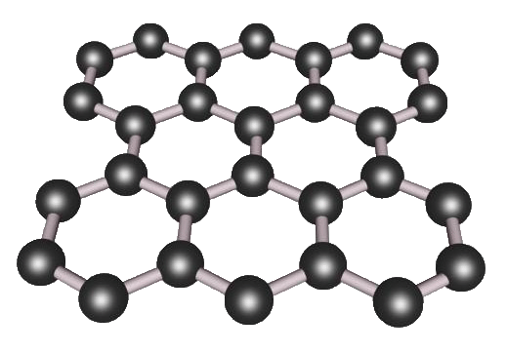
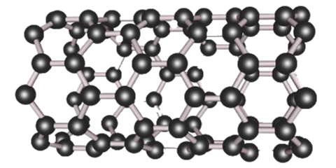
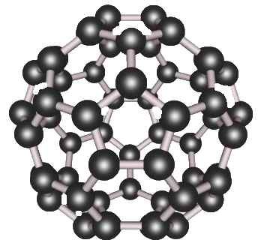
What IS Nanoscience?
When people talk about Nanoscience, many start by describing things
Physicists and Material Scientists point to things like new nanocarbon materials:
They effuse about nanocarbon’s strength and electrical properties
Graphene
Carbon Nanotube
C60 Buckminster Fullerene
A Hands-on Introduction to Nanoscience: WeCanFigureThisOut.org/NANO/Nano_home.htm

Slide 2
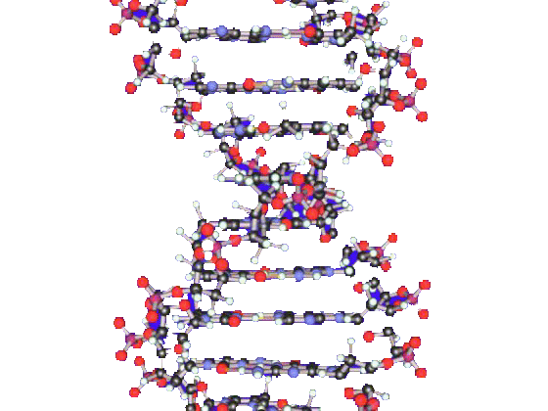
Biologists counter that nanocarbon is a recent discovery
THEY’VE been studying DNA and RNA for much longer
(And are already using it to transform our world)
A Hands-on Introduction to Nanoscience: WeCanFigureThisOut.org/NANO/Nano_home.htm

Slide 3
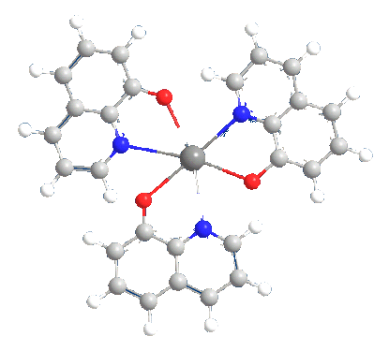
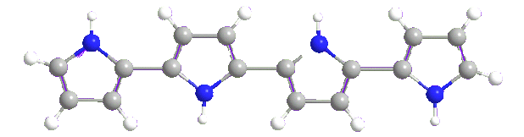
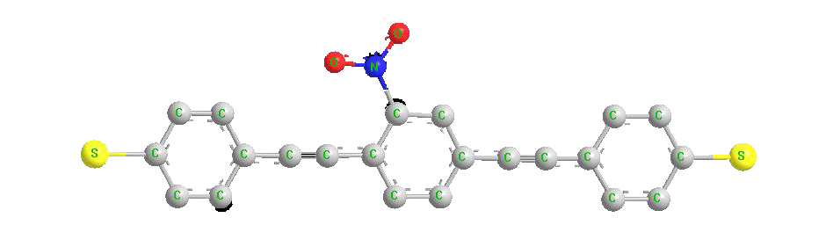
And Chemists note THEY’VE synthesized molecules for over a century
<= First OLED material: tris 8-hydroxyquinoline aluminum
(OLED = organic light emitting diode)
Commercial OLED material: Polypyrrole
Most heavily investigated molecular electronic switch: Nitro oligo phenylene ethynylene
A Hands-on Introduction to Nanoscience: WeCanFigureThisOut.org/NANO/Nano_home.htm

Slide 4
All of these things ARE very small
Indeed, they are all about the size of a nanometer:
Nano = 10⁻⁹ = 1/ 1,000,000,000 = 1 / Billion
A nanometer is about the size of ten atoms in a row
This leads to ONE commonly used definition of nanoscience:
Nanoscience is study of nanometer size things (?)
Why the question mark? Because what is so special about a nanometer?
A micrometer is ALSO awfully small:
Micro = 10⁻⁶ - 1/1,000,000 = 1 / Million
A micrometer (or "micron") is ~ size of light's wavelength
A Hands-on Introduction to Nanoscience: WeCanFigureThisOut.org/NANO/Nano_home.htm

Slide 5
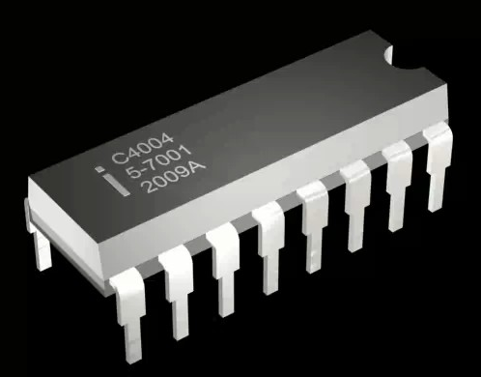
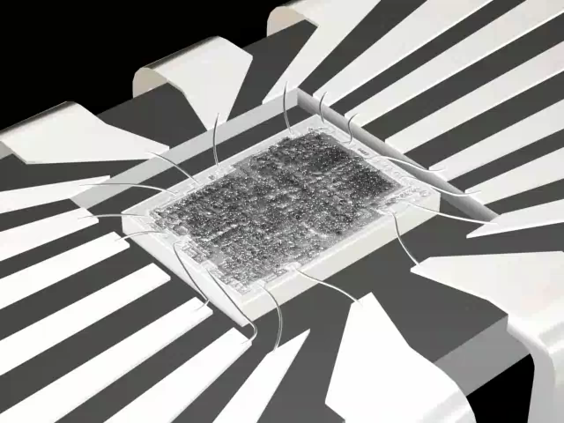
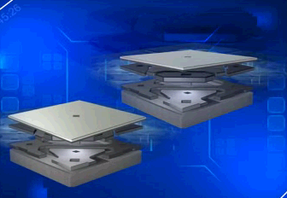
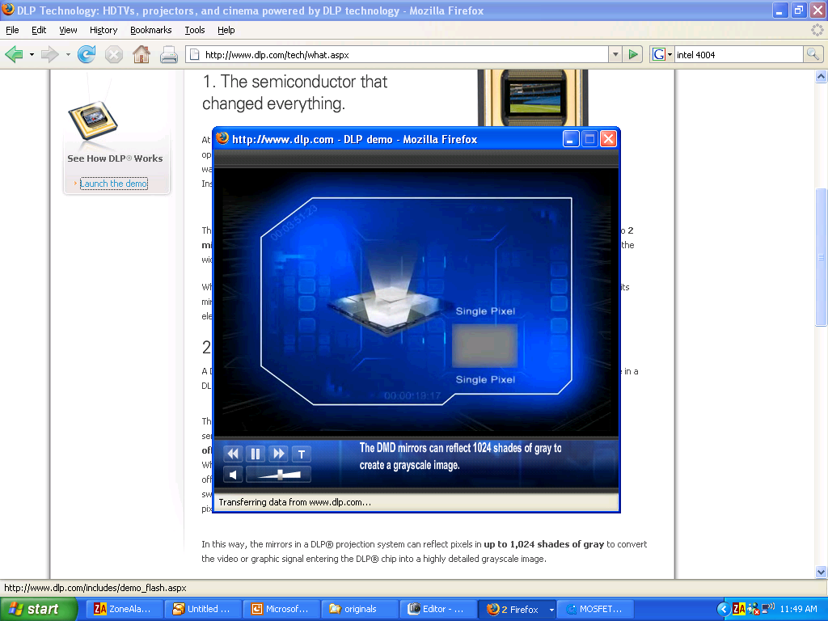
And microtechnology has been rolling along for half a century!
Microelectronics = Integrated circuits, PC's, iPods, iPhones . . .
Intel 4004: The original "computer on a chip" - 1971 (Source: UVA Virtual Lab)
Also = MEMS (Micro-electro-mechanical-systems):
Air bag accelerometers, micro-mirror TVs & projectors . . .
(Source: Texas Instruments DLP demo - www.dlp.com/tech/what.aspx)
A Hands-on Introduction to Nanoscience: WeCanFigureThisOut.org/NANO/Nano_home.htm

Slide 6
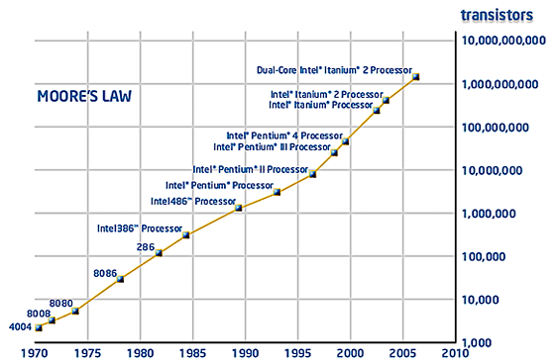
Indeed, microtechnology has gotten smaller EVERY year
MOORE'S LAW:
  The (then almost whimsical) 1965 observation by Intel co-founder Gordon Moore that the transistor count for integrated circuits seemed to be doubling every 18-24 months
He was really sticking his neck out: IC's had only been invented 7 years before!
(by Moore, his Fairchild/Intel colleagues, and Texas Instrument's Jack Kilby)
But his "law" has since been followed for forty five years:
(Source: www.intel.com/technology/mooreslaw/index.htm)
A Hands-on Introduction to Nanoscience: WeCanFigureThisOut.org/NANO/Nano_home.htm

Slide 7
So is Nanoscience/technology really new & unique?
Micro is also VERY small
Micro has been around for a long time
Micro has steadily shrunk to the point that it is now almost NANO anyway !
Leading to a LOT of confusion about the distinction between Micro & Nano
Even among scientists!!
And likelihood that Nanotechnology will be built UPON Microtechnology
Either by using certain Microfabrication techniques
Or, literally, by being assembled ATOP Microstructures
A Hands-on Introduction to Nanoscience: WeCanFigureThisOut.org/NANO/Nano_home.htm

Slide 8
Meaning that the NANO "revolution" is just a lot of hype?
Just about making things incrementally smaller?
Just about a simple shift in the most convenient unit of measure?
No, as a Nano scientist/teacher, I DO see something very unique about Nano:
Nano is about boundaries where BEHAVIOR radically changes:
When the BEHAVIOR OF THE OBJECTS SUDDENLY CHANGES
Or when OUR BEHAVIOR MUST CHANGE to make those things
A Hands-on Introduction to Nanoscience: WeCanFigureThisOut.org/NANO/Nano_home.htm

Slide 9
Boundary #1:
ELECTRON WAVES Separate NanoSCIENCE from MicroSCIENCE
The discovery that electrons = waves led to QUANTUM MECHANICS
A weird, new, counter intuitive, non-Newtonian way of looking at the nano world
With a particular impact upon our understanding of electrons: Electrons => Waves
How do you figure out an electron’s wavelength?
l_{electron} = h / p “De Broglie’s Relationship”
(λ = electron wavelength, h = Planck’s Constant, p = electron’s momentum)
This relationship was based on series of experiments late 1800’s / early 1900’s
To put the size of an electron’s wavelength in perspective:

Slide 10
Size of Things (orange = man-made things)
Millimeters Microns Nanometers
Ball of a ball point pen 0.5
Thickness of paper 0.1 100
Human hair 0.02 - 0.2 20 – 200
Talcum Powder 40
Fiberglass fibers 10
Carbon fiber 5
Human red blood cell 4 – 6
E-coli bacterium 1
Size of a modern transistor 0.25 250
Size of Smallpox virus 0.2 – 0.3 200 – 300
Electron wavelength: ~10 nm or less
Diameter of Carbon Nanotube 3
Diameter of DNA spiral 2
Diameter of C60 Buckyball 0.7
Diameter of Benzene ring 0.28
Size of one Atom ~0.1
A Hands-on Introduction to Nanoscience: WeCanFigureThisOut.org/NANO/Nano_home.htm

Slide 11
Below that line = Nanoscience!
It’s NOT just about the metric units we prefer to use when measuring things
Things above that line are still often measured using nanometers
It IS about the SCIENCE (QM) => Electrons are mushy clouds of size ~ λ_{De Broglie}
Above that line, clouds seem small: Electrons ~ hard B-B like dots
Below that line, mushy cloudiness of electrons becomes very important
Controls electrical, optical, mechanical and other properties
Controls bonding and nanostructure
The Behavior Changes! Microscience ≠ Nanoscience
A Hands-on Introduction to Nanoscience: WeCanFigureThisOut.org/NANO/Nano_home.htm

Slide 12
Or putting it into more human terms
Above that boundary:
Things still behave as Sir Isaac Newton would expect
It is still the world WE commonly experience
Even though we DO need microscopes to see its smaller things
And even if those smaller things seem unduly influenced by:
Water tension, static charge . . . (things we largely ignore)
Below that boundary:
The rules of Quantum Mechanics => Mushy electron waves take over
And our (Newtonian) instincts and assumptions are frequently dead wrong!
A Hands-on Introduction to Nanoscience: WeCanFigureThisOut.org/NANO/Nano_home.htm

Slide 13
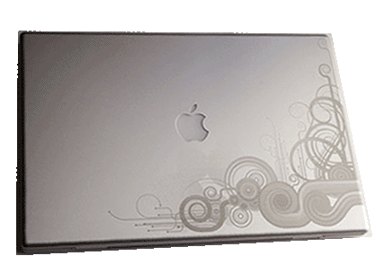
Boundary #2:
LIGHT WAVES Separate NanoTECHNOLOGY form MicroTECHNOLOGY
Technology = The things we make and how we make them
As opposed to the underlying science dictating how they act
Where does light’s wavelength enter into technology?
Micro technology is based on the use of light
How? Light is used for PHOTOENGRAVING:
Use of light images to pattern metal parts =>
Micro projection of light images = Way we make the billions of transistors in the integrated circuits of our PCs, iPods . . .
(a.k.a. “Microfabrication”)
A Hands-on Introduction to Nanoscience: WeCanFigureThisOut.org/NANO/Nano_home.htm

Slide 14
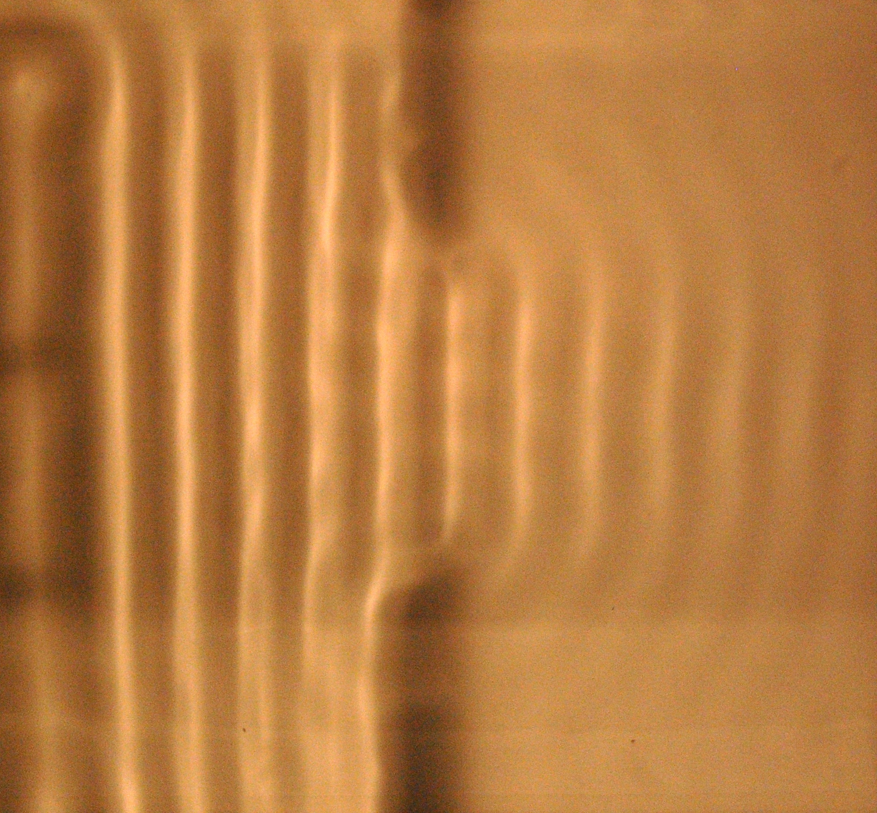
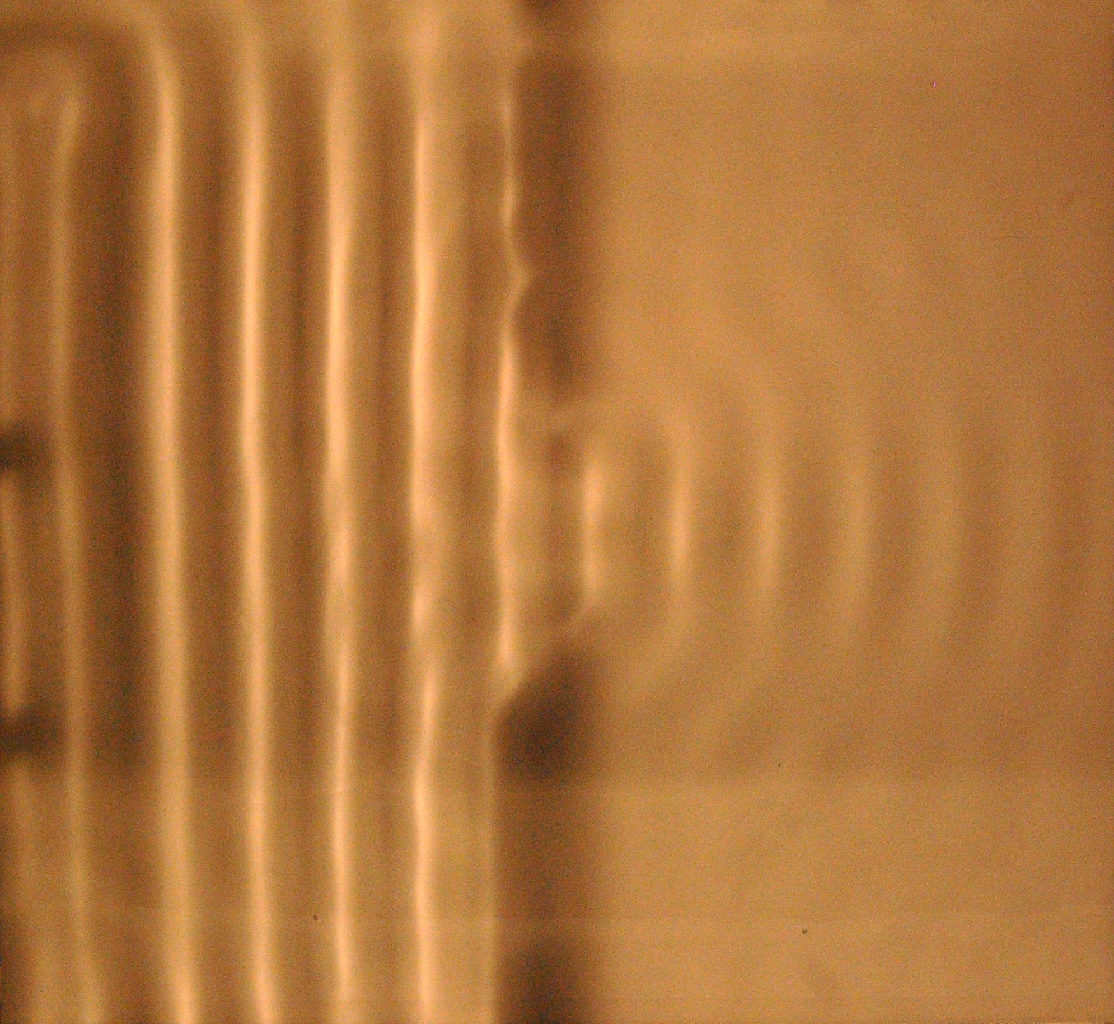
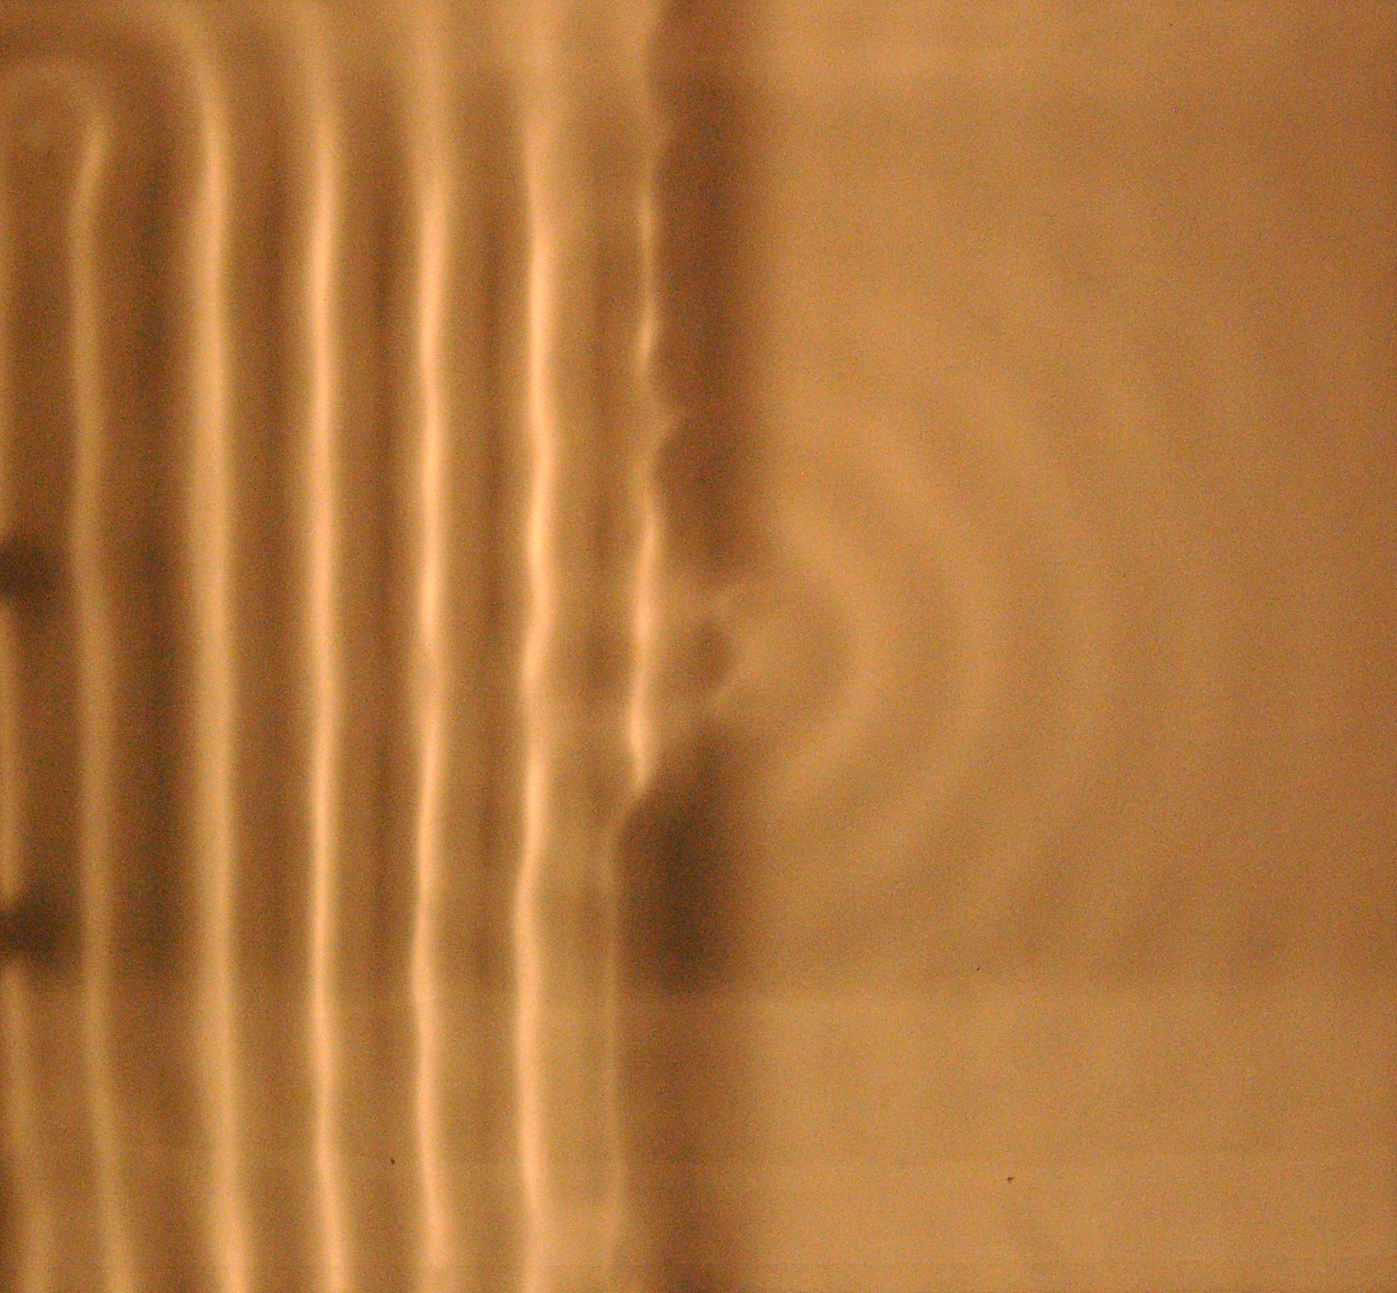
But HOW does Light Wavelength affect Technology?
Micro-photoengraving (photolithography) confines projected light to small beams
Can “confine” by focusing light with a lens
Can “confine” by passing light through holes / shadow masks
But you cannot confine a wave into a beam narrower than its wavelength
Shadow images of water waves, from left, passing thru gap in barrier
Explore fully in lecture 2 - For now, point is can’t photo-process below wavelength
OK, but what is light’s wavelength?
A Hands-on Introduction to Nanoscience: WeCanFigureThisOut.org/NANO/Nano_home.htm

Slide 15

Size of Things (orange = man-made things)
Millimeters Microns Nanometers
Ball of a ball point pen 0.5
Thickness of paper 0.1 100
Human hair 0.02 - 0.2 20 – 200
Talcum Powder 40
Fiberglass fibers 10
Carbon fiber 5
Human red blood cell 4 – 6
E-coli bacterium 1 1000
Size of a modern transistor (fabricated using UV light) 0.25 250
Size of Smallpox virus 0.2 – 0.3 200 – 3
Electron wavelength: Upper upper limit ~ 10 nm
Diameter of Carbon Nanotube 3
Diameter of DNA spiral 2
Diameter of C60 Buckyball 0.7
Diameter of Benzene ring 0.28
Size of one Atom ~0.1
Visible Light Wavelength: 0.40 – 0.75 microns 400 – 750 nm

Slide 16
At new (upper) visible/UV light boundary and above:
We can still use light-based “Microfabrication” techniques
And even though they were developed for electronics,
they are now also applied to making all sorts of micro things!
Below that new boundary:
NO longer able to use Microfabrication – OUR behavior must change!
Replacement is called “Nanofabrication” or “Nanotechnology”
Dirty little secret: We are still rather poor at Nanofabrication/Nanotechnology
We can do it in very small quantities, at very great expense
But we haven't figured out how to do it well enough to = technology
(I'll return to this point later)
A Hands-on Introduction to Nanoscience: WeCanFigureThisOut.org/NANO/Nano_home.htm

Slide 17
To recap:
There are big changes in OBJECT BEHAVIOR below ~ 10 nanometers:
Newton is out the window. Quantum Mechanics is in.
Hard sensible objects are replaced by squishy electron waves / clouds
Intuition, based on our life experience => fundamentally flawed
And to make things < 100 nanometers WE MUST BEHAVE differently:
Light will not focus this small
Light image based fabrication ceases to work
Need something new (“Nanotechnology”) - Still being defined!!!
A Hands-on Introduction to Nanoscience: WeCanFigureThisOut.org/NANO/Nano_home.htm

Slide 18
Further extending definitions of NANO:
BIOMEDICINE: Organisms create critical barriers to penetration
- Skin
- Blood – Brain barrier
- Cell Membranes
Barriers are breached as objects shrink from microns to nanometers
=> Radical impact on organisms
These changes in BEHAVIOR can also be taken as onset of NANO:
Boundary #3: Radically increased penetration of organisms
A Hands-on Introduction to Nanoscience: WeCanFigureThisOut.org/NANO/Nano_home.htm

Slide 19
Extending definitions of NANO (cont'd):
CIVIL ENGINEERING / ENVIRONMENTAL SCIENCE: Dispersion
Normal dust particles rapidly fall out of the air
But as shrink to nanometers, winds carry them around the world!
Larger pollutants can be trapped in waste sites by clay basins
But nanometer pollutants may escape to flow into ground water
These changes in BEHAVIOR can also be taken as onset of NANO
Boundary #4: Radically increased environmental dispersion . . .
A Hands-on Introduction to Nanoscience: WeCanFigureThisOut.org/NANO/Nano_home.htm

Slide 20
So in THIS nano class:
We will NOT focus narrowly on only certain types of objects
We will NOT get hung up on just one unit of measurement
We will instead search for radical changes in behavior:
Behavior of the objects themselves
Behavior of the objects interacting with organisms & ecosystems
The changes in our behavior required for their fabrication
(Why this class is subtitled "We're not in Kansas Anymore!)
A Hands-on Introduction to Nanoscience: WeCanFigureThisOut.org/NANO/Nano_home.htm

Slide 21
Also want to explore how nano might become practical
Light-based processing will NOT work
Other present day techniques are HOPELESSLY slow and/or expensive
So attractive alternative is SELF-ASSEMBLY
Setting things up so that Mother Nature does the fine scale work
But to ferret out where Mother Nature may give us a hand, must span:
Physics, Chemistry, Biology, Materials Science . . .
So I will also put major effort into providing insights into those fields
i.e., "Opening Doors" into those subjects for you
A Hands-on Introduction to Nanoscience: WeCanFigureThisOut.org/NANO/Nano_home.htm

Slide 22
Specifics about how the class will go?
A recurring theme is wavelength, so:
Class 2) We will start by studying waves
Of ALL types - including nice friendly water waves and light waves:
Class 3) We'll then tackle our squirreliest topic: Electron waves & quantum mechanics
  But we'll do this mostly based on what we learned about water waves + some history of why scientists became convinced electrons were truly wavelike
A Hands-on Introduction to Nanoscience: WeCanFigureThisOut.org/NANO/Nano_home.htm

Slide 23
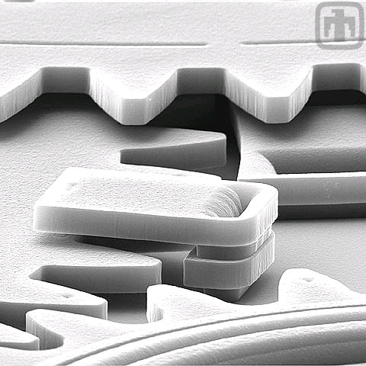
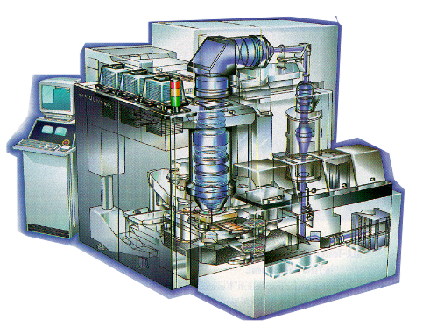
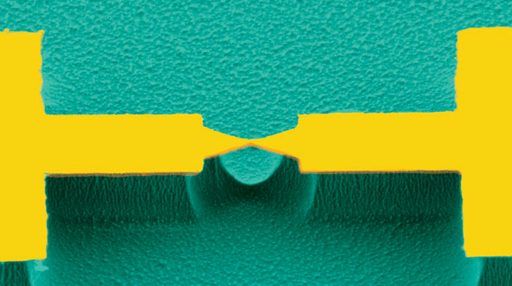
We’ll then talk about technology
Class 4) We’ll learn a bit about microfabrication & microelectronics
But the lesson will be why, despite MOORE'S LAW, these cannot be extrapolated to nano sizes
Class 5) With that knowledge, we’ll distinguish nano science from nano technology
<= Technology
Science =>
There is a LOT of good Nanoscience, but not yet much in the way of viable Nanotechnology!
RF
A Hands-on Introduction to Nanoscience: WeCanFigureThisOut.org/NANO/Nano_home.htm

Slide 24
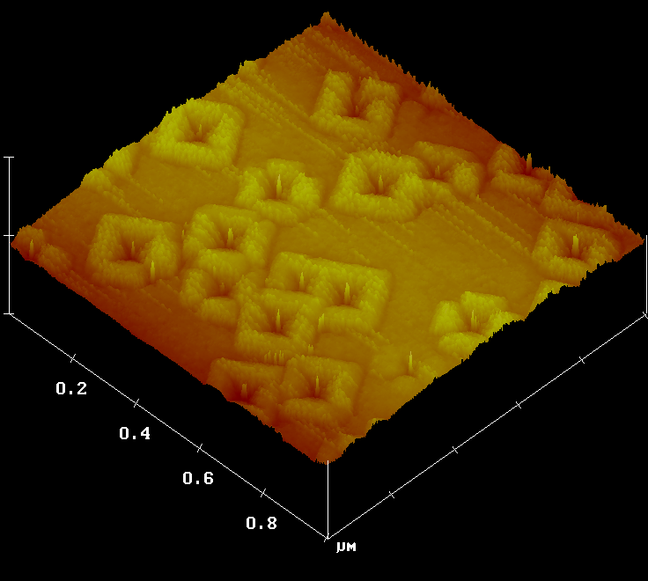
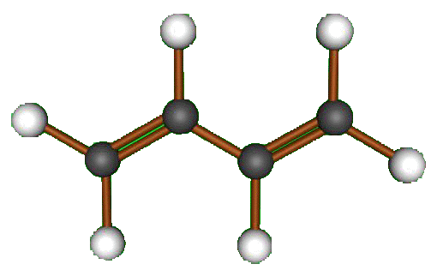
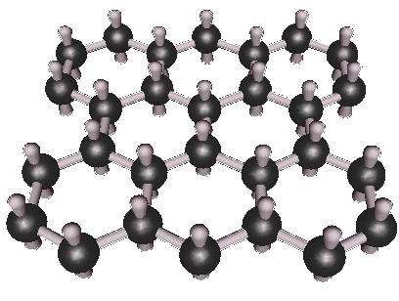
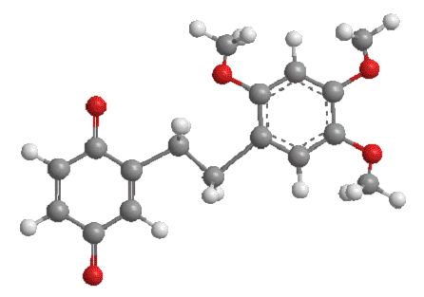
We'll then discuss Microfabrication's likely replacement: Nanoscale Self-Assembly
Class 6) Early forms of self-assembly that man tamed (such as crystal growth)
Leading us to the master of self-assembly: Mother Nature
Or what a billion years of random experimentation produced, including:
Class 7) Self-assembly of organic molecules
A Hands-on Introduction to Nanoscience: WeCanFigureThisOut.org/NANO/Nano_home.htm

Slide 25
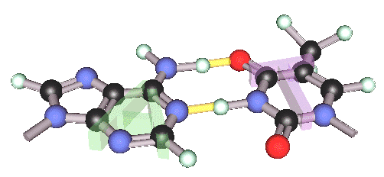
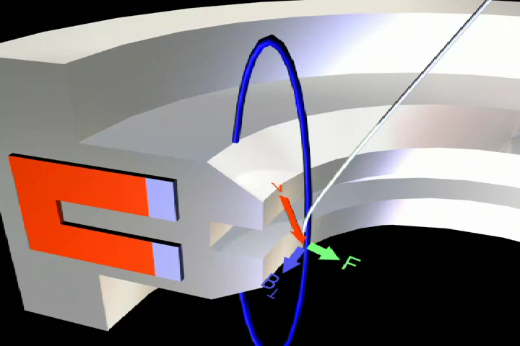
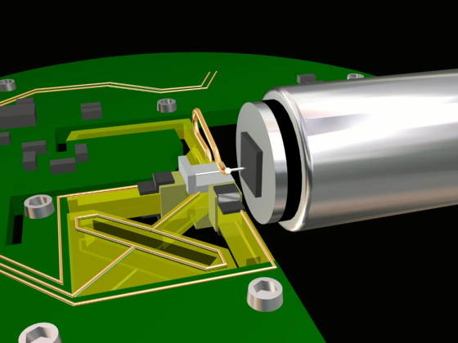
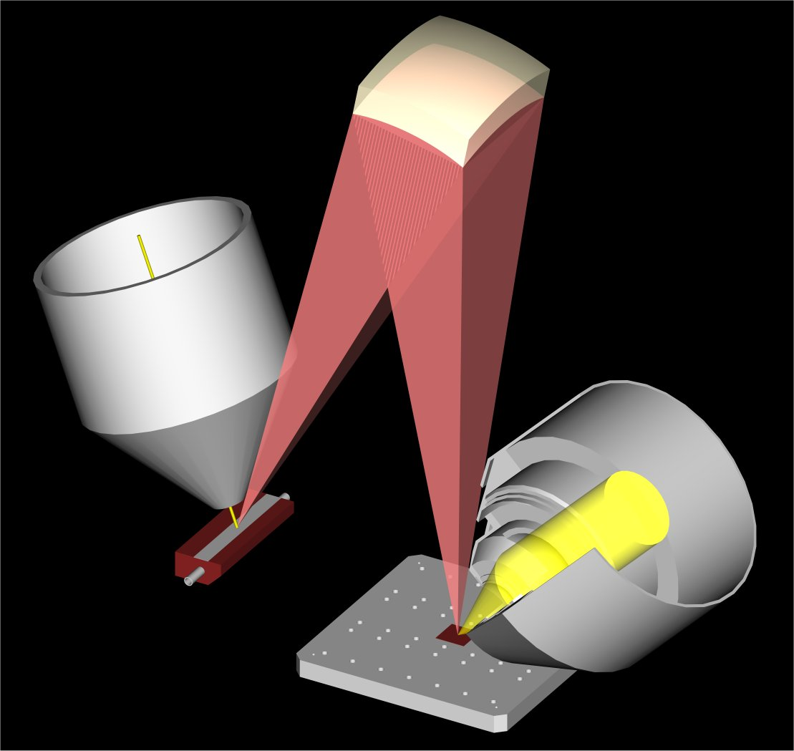
Taking us to the ultimate known form of Self-Assembly: DNA
Class 8) The incredible processes of DNA programmed assembly of proteins
Class 9) Leading to a discussion of how we actually "see" and measure at the nanoscale
A Hands-on Introduction to Nanoscience: WeCanFigureThisOut.org/NANO/Nano_home.htm

Slide 26
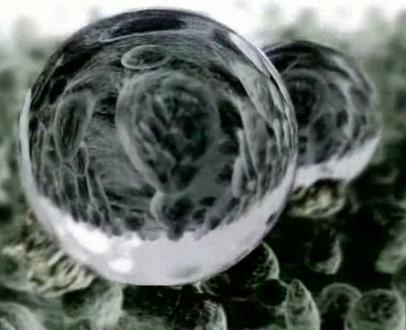
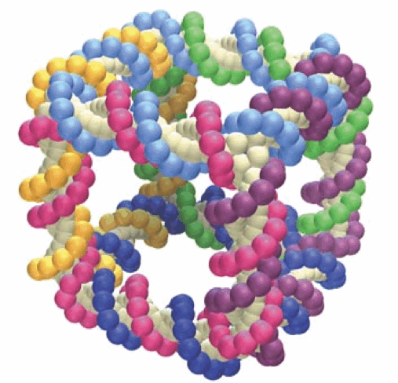
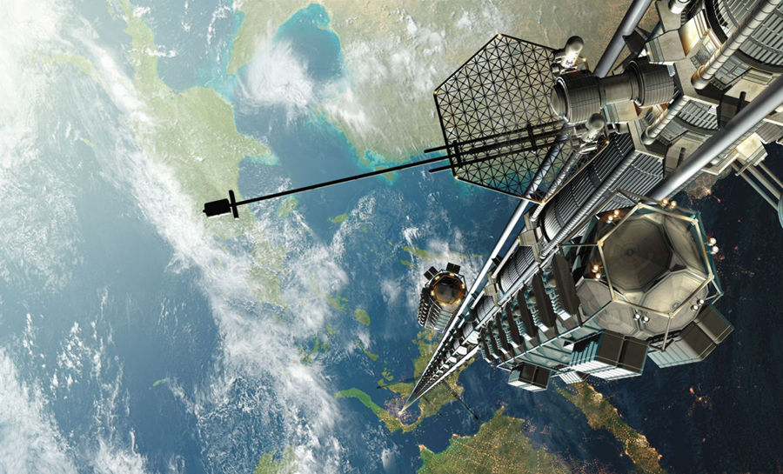
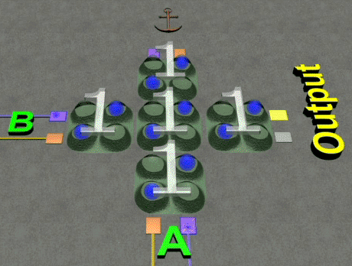
To the "Bleeding Edge:" Where nanoscience might be taking us:
Class 10) Emerging nano-mechanical technologies
Class 11) Emerging nano-energy technologies
Class 12) Emerging nano-electronic technologies
V_{g}
V_{ds}

Slide 27
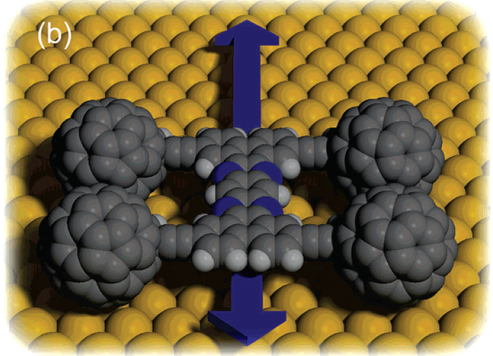

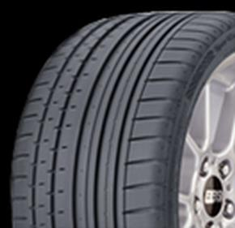
Then back down to earth for some reality checks:
Class 13) Nano molecular machines: Nanobots in our future?
Class 14) Legitimate fears and challenges of nanoscience & nanotechnology
A Hands-on Introduction to Nanoscience: WeCanFigureThisOut.org/NANO/Nano_home.htm

Slide 28
Labs?
- Waves ("slinky" and "snakey" springs) – to sharpen your observation of waves
- Water Waves – to show why light-based processing is limited,
  why sunblocks use nanoparticles, AND why quantum mechanics is quantized
- Integrated Circuit Microfabrication Cleanroom Demonstration/Tour
- Scanning Electron Microscope
- Self-Assembly (of magnetized atom analogs)
- Using AFM to examine the structure of state-of-the-art integrated circuits
- An introduction to the scanning tunneling microscope
- Using STM to see individual atoms on the surface of graphite
- Super hydrophobic surfaces
- Charlottesville CSI (DNA Fingerprinting)
A Hands-on Introduction to Nanoscience: WeCanFigureThisOut.org/NANO/Nano_home.htm

Slide 29
Homework?
- Weekly personal analyses of nano news reports
- Do-it-yourself models of graphene, nanotubes and Buckyballs
- Do-it-yourself models of DNA
- Study of "UVA Virtual Lab" virtual reality recreations of our
Scanning electron microscope
Scanning tunneling microscope
Atomic force microscope
- Chapters from “textbook”
- Other readings
A Hands-on Introduction to Nanoscience: WeCanFigureThisOut.org/NANO/Nano_home.htm

Slide 30
Credits / Acknowledgements
Funding for this class was obtained from the National Science Foundation (under their Nanoscience Undergraduate Education program).
This set of notes was authored by John C. Bean who also created all figures not explicitly credited above (with the exception of lecture preview figures which are credited in their home set of lecture notes).
Copyright John C. Bean
(However, permission is granted for use by individual instructors in non-profit academic institutions)
A Hands-on Introduction to Nanoscience: WeCanFigureThisOut.org/NANO/Nano_home.htm

