Slide 1
Wind Power – Part I
John C. Bean
Outline
Wind's variation with locale, time & altitude
Wind's energy and power
Implications for all wind turbine designs / Implications for wind farm location & layout
Aero 101: DRAG (exploited in Savonius vertical axis wind turbine - VAWT)
LIFT (exploited in Danish horizontal axis wind turbine - HAWT & Darrieus VAWT)
How their use of lift & drag explain and limit performance of these turbines
Aero 201: Bernoulli's Equation / Betz's Limit of Lift + Drag turbines / Limit on pure Drag Turbines
The Danish Experience: Anyone can make a working wind turbine, problem's KEEPING it working!
Aerospace failures vs. the farm machinery company now supplying the world with turbines:
Shared & verified performance data driving use of robust & standardized components
The hard-luck lessons about failsafe turbine over-speed protection
Leading to the Danish turbine's current supremacy and ongoing trends in its deployment
(Written / Revised: August 2022)

Slide 2
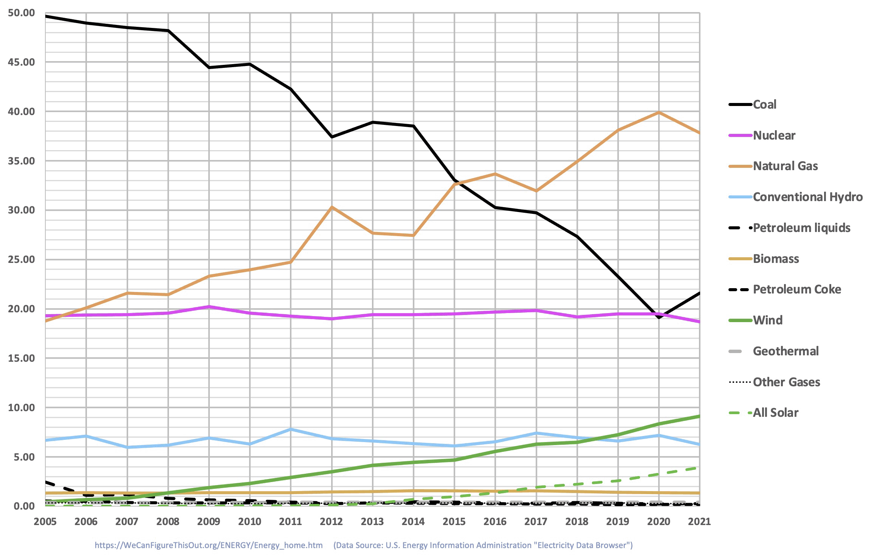
Wind Power
Wind is now the #3 low-greenhouse-gas source of U.S. power (at 9.1%) ¹
It's behind nuclear (18.6%) & hydro (6.3%), but still well ahead of solar (3.9%)
The government now identifies it as one of the three cheapest forms of U.S. power ²
With certain natural gas plants & geothermal plants sharing that distinction
Industry sources instead identify it as the single cheapest form of U.S. power ²
The result: Over half of newly built U.S. power generation capacity is due to wind ³
1) From my web note set: U.S. Energy Production and Consumption (pptx / pdf / key)
2) From my web note set: Power Plant Economics: Analysis Techniques & Data (pptx / pdf / key)
3) U.S. Federal Energy Regulatory Commission: Office of Energy Projects – Energy Infrastructure Update – May 2018

Slide 3
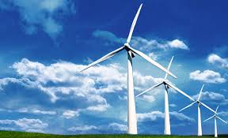
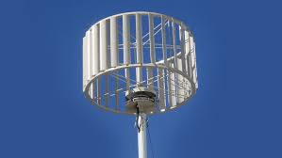
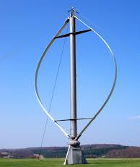
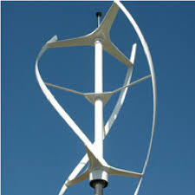
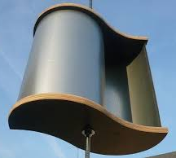
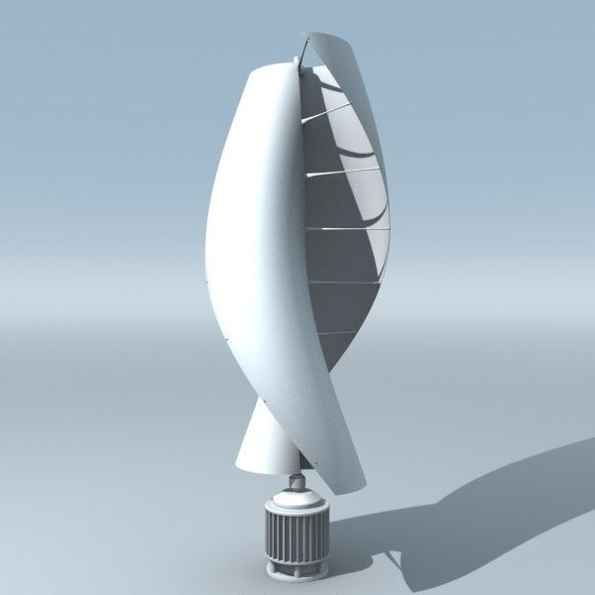

And there seem to be so very many choices of wind turbine:
"Danish"
Simple Darrieus
Eggbeater Darrieus
Spiral Darrieus
Simple Savonius
Spiral Savonius
(Classic)
Photo credits,,clockwise from top left:
http://www.christopherteh.com/blog/2010/11/wind-energy/
https://www.researchgate.net/figure/Quiet-Revolution-twisted-Darrieus-wind-turbine_fig1_252509085
https://en.wind-turbine-models.com/turbines/93-dornier-darrieus-55
http://www.power.news/2017-08-15-vertical-axis-wind-turbines-harvest-turbulent-wind-more-efficiently.html
https://mechaniclove.com/wind-turbine-types/main-qimg-94635f1f0ea3aa06995be51f04c4e43a-c/
https://www.pinterest.com/mcdegen/cm_urban-scene/
https://www.decoupagedesignsusa.com/dutch-windmill-decoupage-napkin/

Slide 4
But wind power is not without controversy, including:
Heated arguments about Wind Power's impact upon flying creatures
And about its impact on human neighbors
Including noise, radio/TV interference, disruption of natural vistas, yielding:
NIMBY = Not in MY backyard (!!#@$!)
Further, there is huge disagreement about the best way to implement Wind Power:
The public and press are fascinated by unique & compact turbine designs
Such as the non-Danish turbines pictured on the preceding page
But Danish turbines now provide virtually all worldwide Wind Power
Further, the industry is obsessed with ever bigger (more intrusive) versions!
Finally, answers seem buried in aerodynamic theory so opaque and obscure that
aerodynamicists seldom even TRY to explain it to anyone but aerodynamicists!
An Introduction to Sustainable Energy Systems: WeCanFigureThisOut.org/ENERGY/Energy_home.htm

Slide 5


Making this note set one of my most difficult to research & write
Which rather surprised me, given that it started out looking so easy
Especially given all of our relevant personal experience with things such as
Childhood pinwheels: And paper airplanes:
But in the spirit of WeCanFigureThisOut.Org, I believe I have now figured it out
And in this note set I'm eager to share with you what I have learned
Starting at the very beginning with what I have learned about:
Left: http://living.thebump.com/craft-paper-pinwheel-young-children-15846.html
Right: http://www.pbs.org/parents/education/science/activities/first-second-grade/everyday-science/

Slide 6
WIND
An Introduction to Sustainable Energy Systems: WeCanFigureThisOut.org/ENERGY/Energy_home.htm

Slide 7
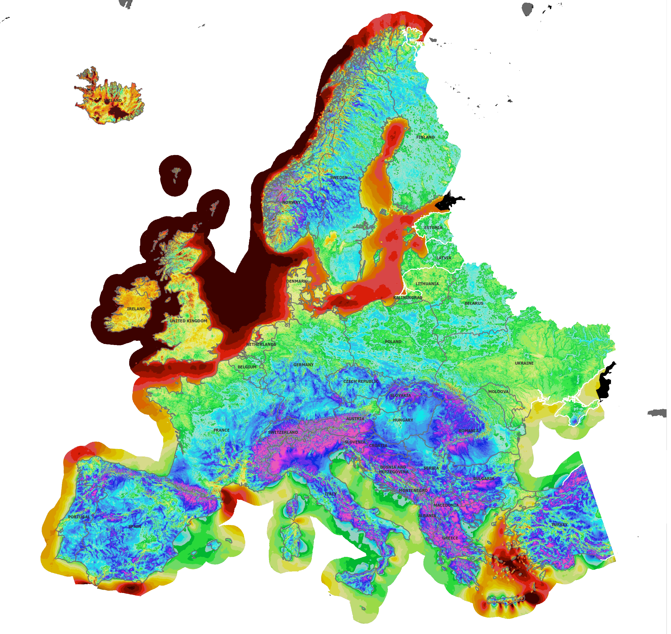
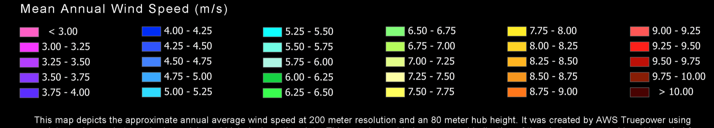
Yearly averaged wind speeds for Europe (at 80 meters):
The implications for wind power?
BAD = High mountains (wind blocked/lifted)
FAIR = Low hills
POOR = Low altitude plains (e.g. the Veneto)
BEST = Offshore
Especially at northern latitudes!
(FYI: 1 m/s ~ 2 ¼ mph)
Map & its key were extracted from: https://aws-dewi.ul.com/assets/Wind-Resource-Map-EUROPE-11x17.pdf

Slide 8
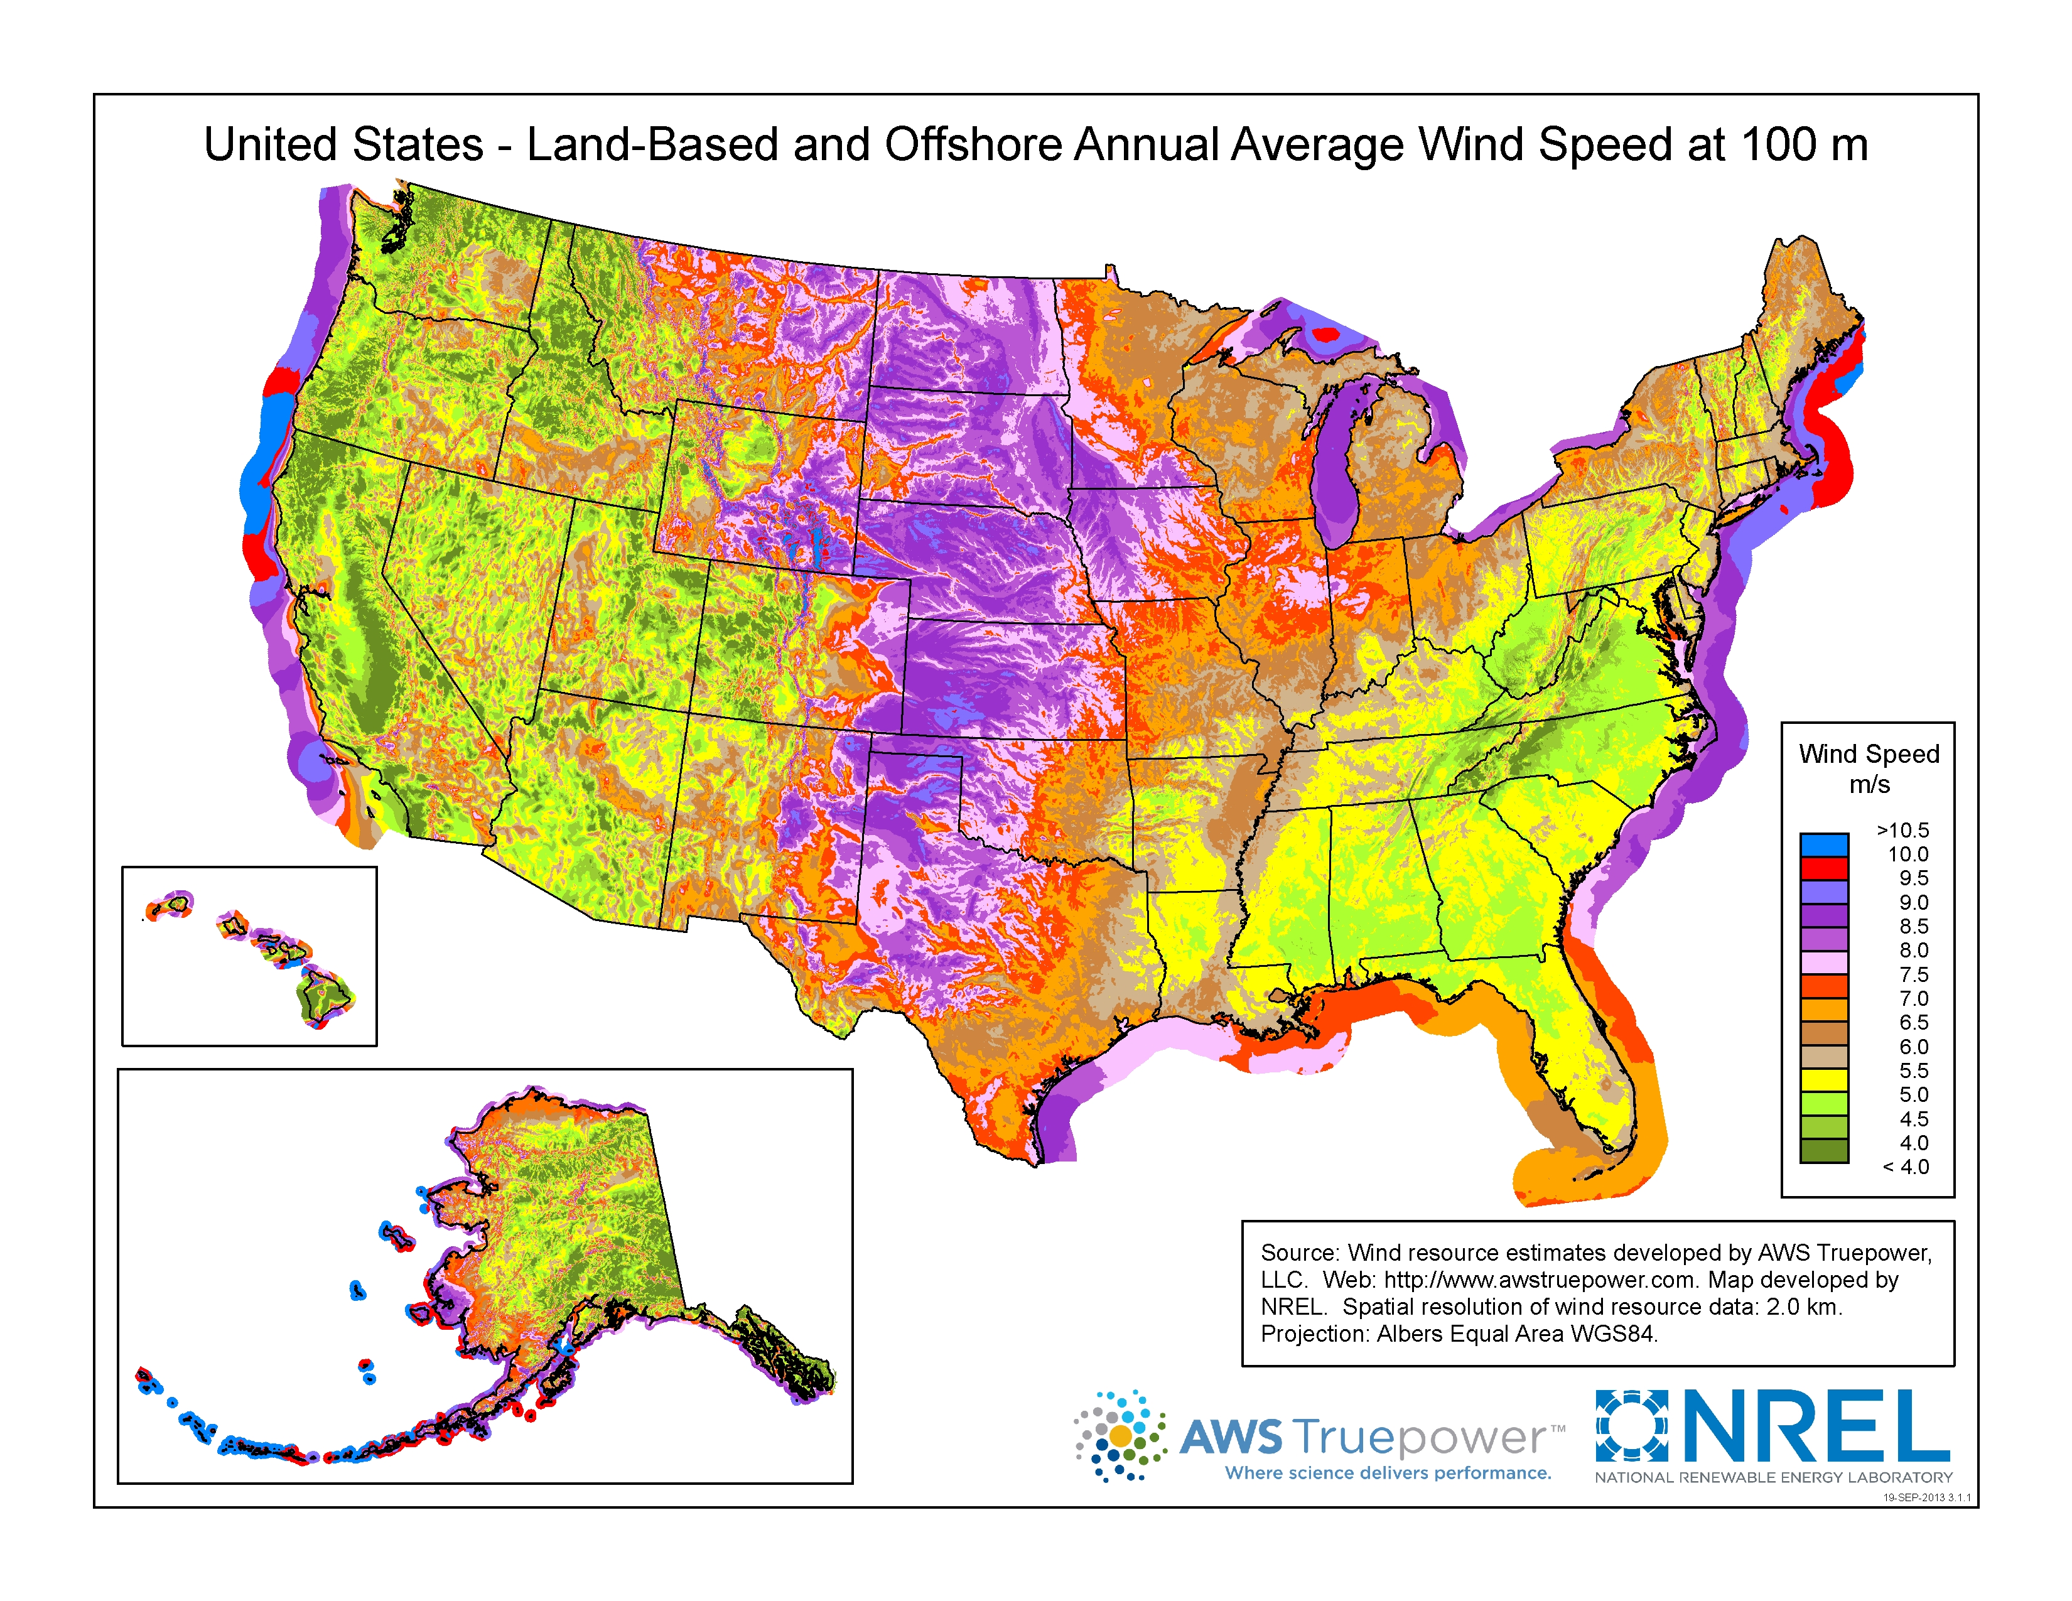
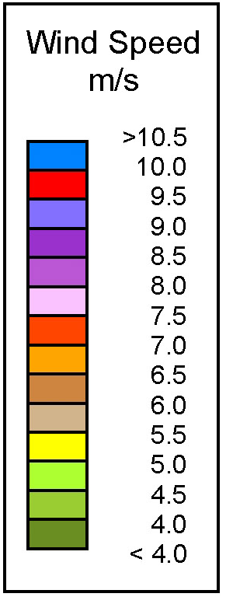
Yearly averaged wind speeds for U.S. (at 100 meters)
Similar implications: Northern offshore = Best Low hills = Fair Mtns / Low plains = Poor
New implications: Abundant HIGH central plains = Very good
www.nrel.gov/gis/wind.html

Slide 9
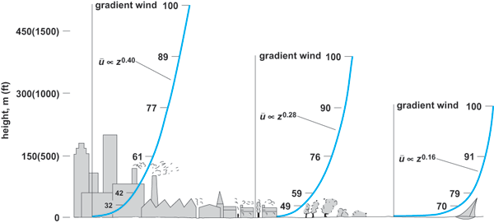
But why did those maps carefully note the height above ground?
Because wind speed increases rapidly with height
Due to things near the ground impeding air flow (plants, trees, buildings . . .)
(Ask any ant: While rain's a big concern, ground level wind is no problem!)
GET ABOVE THE GROUND CLUTTER!
http://rockets2sprockets.com/issue-cross-winds-wind-tunnels/
This variation, known as WIND SHEAR, can be modeled as:
Wind speed α (height) ^{n} with n ~ ¼ to ½

Slide 10
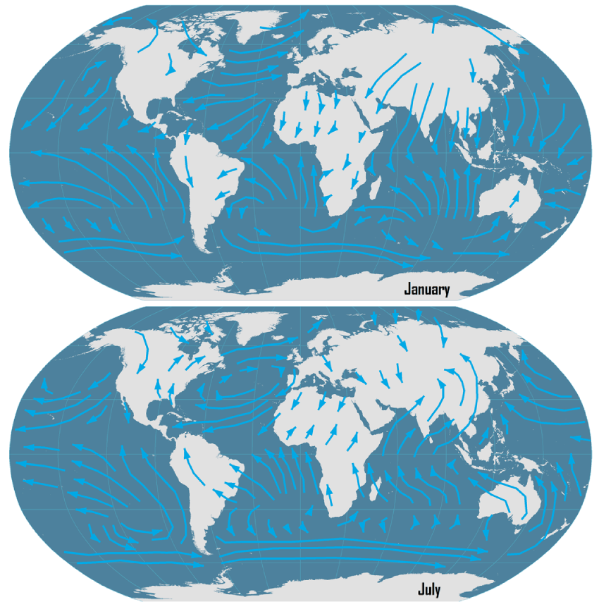
WHEN do we get the strongest winds?
You've probably noticed seasonal variations in wind direction
Illustrated here are typical shifts in worldwide January vs. July wind direction:
https://transportgeography.org/?page_id=386

Slide 11
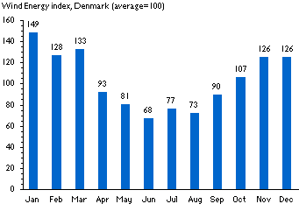
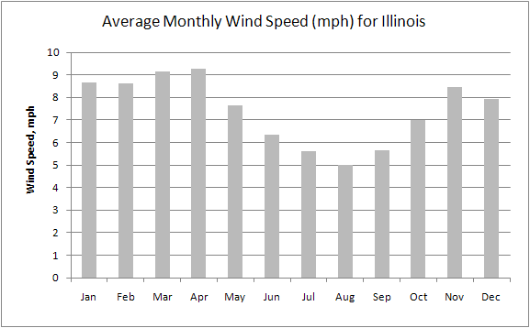
Wind speed also follows an ANNUAL CYCLE
WindPower.Org generated this plot of Danish winds falling over summer months,
a trend they identified as typical for "temperate" areas of the world: ¹
Consistent with that claim, I found this plot of annual U.S. (Illinois) wind speeds: ²
1) https://transportgeography.org/?page_id=386 2) https://www.isws.illinois.edu/statecli/wind/wind.htm

Slide 12
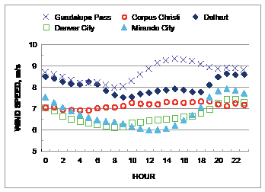
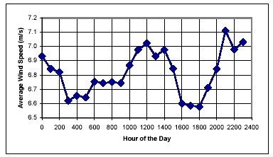
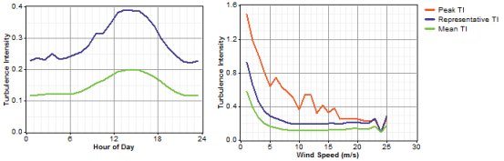
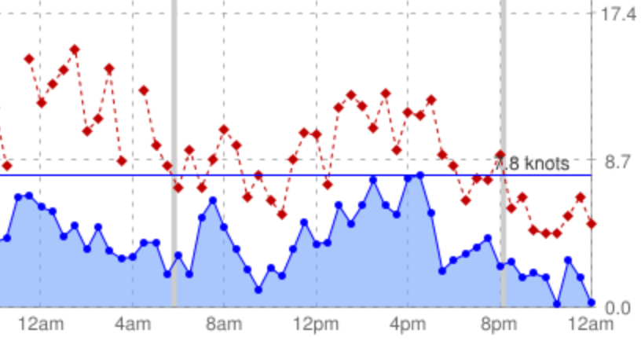
Wind speed is also subject to strong DAILY CYCLES:
With that speed peaking in the late afternoon in many (but not all!) locales
TEXAS: www.seco.cpa.state.tx.us/publications/renewenergy/windenergy.php
ONTARIO CANADA: www.omafra.gov.on.ca/english/engineer/facts/03-047.htm
NETHERLANDS: www.ekopower.nl/wind-energy-monitoring-data-logger-data-processing.htm
WISCONSIN: www.windpowerweather.com/history?date=last2days

Slide 13
But what POWER do such winds offer?
Turbine generator (with whirly things)
Chunk of "air flow"
Area of flow
intercepted
Velocity v
Energy Density
½ ρ v²
The kinetic energy per volume of wind = ½ (M / volume) v² = ½ ρ v²
But wind volumes arrive at the turbine at a rate proportional to the wind's velocity
So the power delivered = (½ ρ v²) v Area_{intercepted} = ½ ρ v³ Area_{intercepted} OR:
Power of Wind Flow / Area _{intercepted} = ½ ρ v³
That v³ dependence has far reaching consequences!

Slide 14
But first, what exactly IS a wind turbine's Area_{intercepted} ?
The wind is being intercepted BY the turbine's blades
Suggesting that interception area = Net blade area
More precisely: The net area presented to the wind = The turbine's silhouette
Conventional "Danish" Horizontal Axis Turbine "Darrieus" Vertical Axis Turbine
But many (if not most) modern turbines have very, very slender blades
Suggesting that their "intercepted wind areas" might be disturbingly small,
which would radically decrease the wind power harvested by such turbines!
An Introduction to Sustainable Energy Systems: WeCanFigureThisOut.org/ENERGY/Energy_home.htm

Slide 15
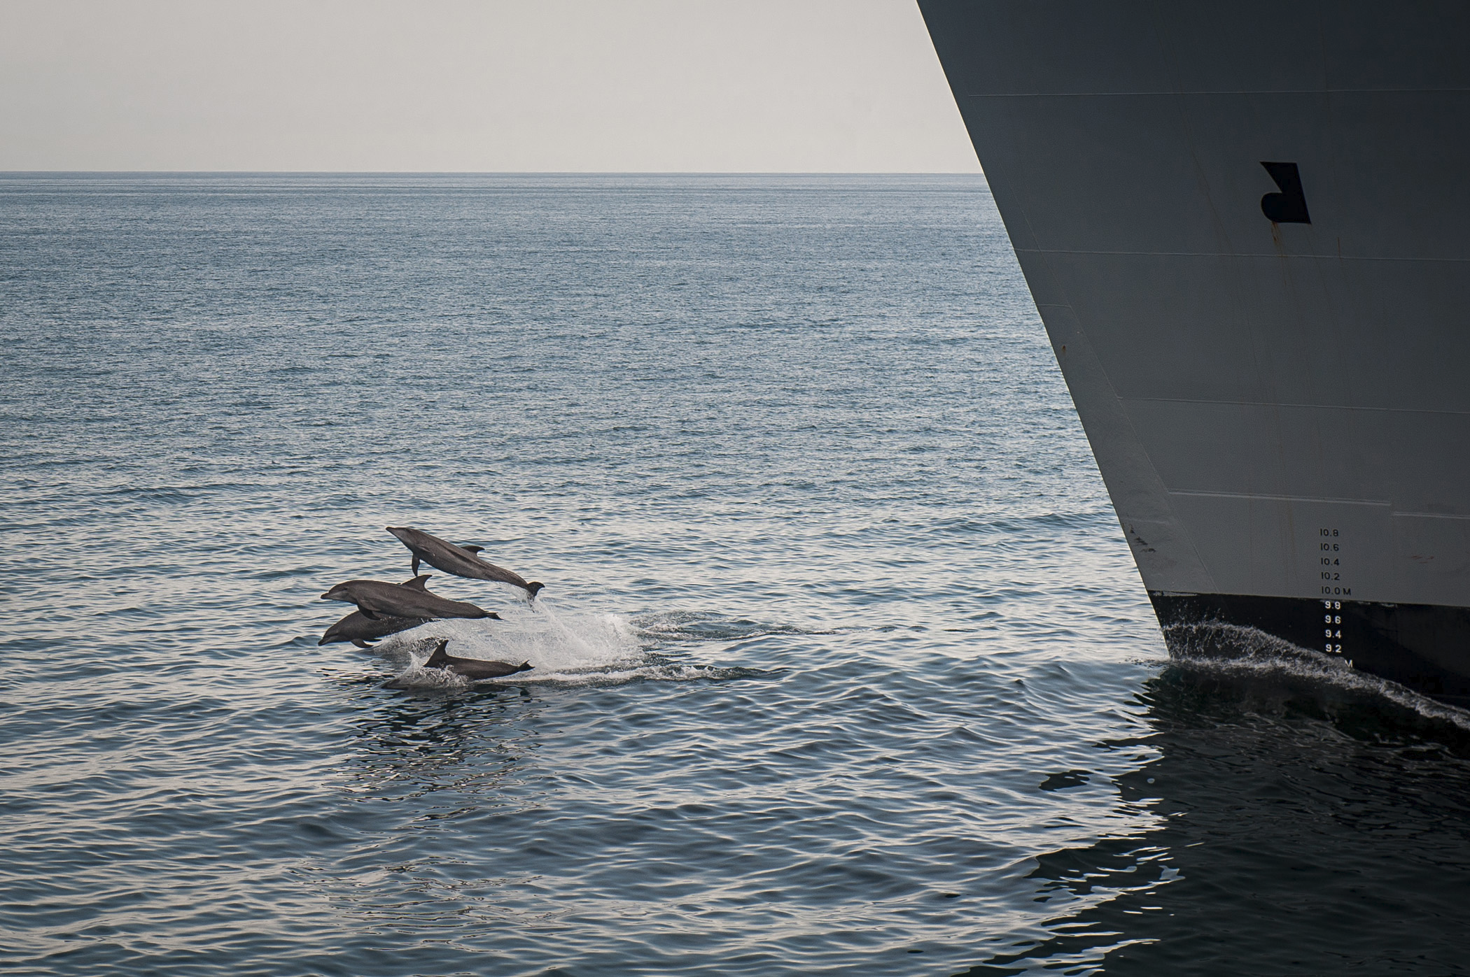
But as ships have "bow waves," so do the blades of wind turbines
https://www.popsci.com/navy-agrees-to-limit-activities-in-california-and-hawaii-to-save-whales
And, as demonstrated by these happily surfing dolphins
these pressure waves spread surprisingly far forward and to the sides
The air flow affected by a turbine blade
is thus significantly wider than that blade's physical width
THEN: If the blades turn fast enough, wind caught up in one blade's "bow wave"
cannot pass completely through that bow wave
before it's caught in the bow wave of the next blade sweeping by

Slide 16
To the wind, turbines thus appear almost as big as their swept area
That is: Map out the 3D volume swept out by the rotating turbine
Then take its full 2D cross section as viewed by the wind
The result: Instead of these these blade silhouette cross sections:
Conventional "Danish" Horizontal Axis Turbine "Darrieus" Vertical Axis Turbine
The wind flow Area_{intercepted} for these turbines is more like this:
And these much larger areas determine their ability to harvest wind power

Slide 17
"Far reaching consequences" of wind's velocity cubed power dependence
Power of Wind Flow / Area _{intercepted} = ½ ρ v³

Slide 18
That wind power is due to the air's movement
To remove all of that power FROM the wind,
and transfer it to our turbine,
we would have to STOP that wind
But if our turbine completely stopped the air flow, no more wind could then reach it!
So as a compromise, what if our turbine just slowed the wind by ½?
That sounds like it would allow us to extract only ½ of the wind's power, right?
NO! Thanks to that v³, we might extract close to 7/8's of the wind's power:
Entering wind: P_{in} = ½ ρ v_{in}³ A Exiting wind: P_{out} = ½ ρ (v_{in}/2)³ A
P_{extracted} = P_{in} – P_{out} = ½ ρ v_{in}³ (1-1/8) A = 7/8 P_{in}
That's good news. The bad news is that we'd still slow flow down by 50%
Suggesting that we might be forced to use just ONE ROW of turbines
Because a 2nd row (behind the 1st row) would get so much slower wind!

Slide 19
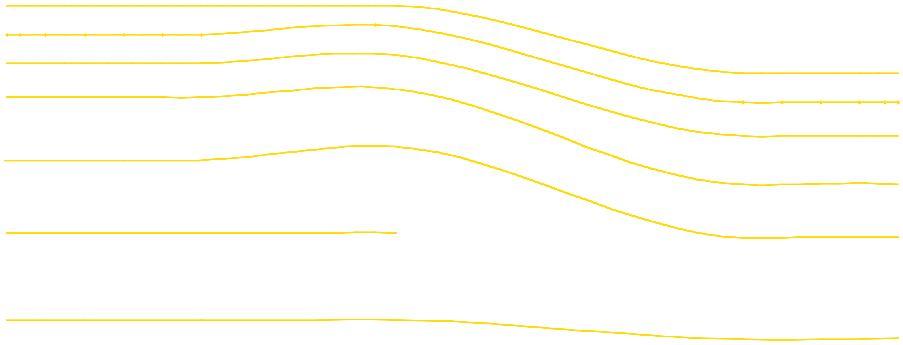
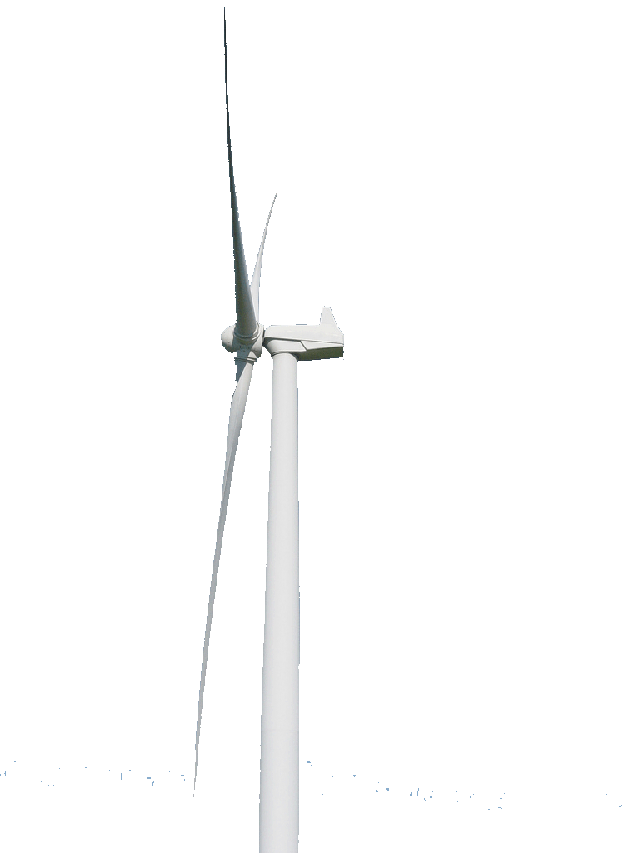
But we are now saved by those higher speed winds ABOVE the turbine
And there is a whole lot of higher speed wind above it!
The turbine affects airflow across its ~ full rotational area
Air flowing through the turbine area is radically slowed
Which lowers air pressure behind the turbine
Which sucks faster-flowing air down from above:
Elevated
Pressure
Reduced Pressure
To the turbine's SIDES there is a similar backfill by faster-higher-altitude airflow

Slide 20
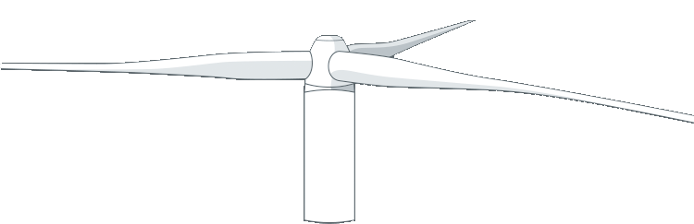
Drawn-in higher-altitude wind can thus regenerate lower-altitude wind
At least if it is given enough time (=> space behind & beside the turbine) to do so
To allow for that regeneration time/space:
Wind farms generally separate their turbines by ~ five blade diameters
5D
D
An Introduction to Sustainable Energy Systems: WeCanFigureThisOut.org/ENERGY/Energy_home.htm

Slide 21
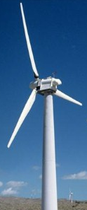
But how big should D (turbine diameter) & 5D (turbine spacing) be?
Based on the v³ dependence, mild increases in speed yield major increases in power
And the easiest way to access speedier winds, is to just build a taller tower
A taller tower ALSO accommodates a larger turbine => larger Area_{intercepted}
MAKE THINGS AS LARGE AS POSSIBLE! => Huge, widely spaced turbines:
GET ABOVE THE GROUND CLUTTER!
Yes!
No!

Slide 22



And where should these tall/huge widely spaced turbines be built?
Based again upon wind power's v³ dependence:
Slightly higher wind speed => Hugely higher wind power
Which, combined with Wind Resource maps such as this:
Suggests this ranking of possible wind farm locations:
BEST: Off northern coasts
GOOD: On high plains
POOR: In mountains & low plains

Slide 23
And, of course, we should look for locations with steady winds
NOT NECESSARILY!
From: Power / Area_{intercepted} = ½ ρ v³ Using a density for air: ρ_{air} = 1.2 g / liter
We'd calculate these wind powers:
Wind Speed Wind Power
2 m/s (4.4 mph) 4.8 watts / m² x A_{intercepted}
4 m/s (8.8 mph) 38.4 watts / m² x A_{intercepted}
8 m/s (17.6 mph) 307 watts / m² x A_{intercepted}
16 m/s (35.2 mph) 2457 watts / m² x Aintercepted
Note the HUGE differences in power!
Then consider two hypothetical locales, both with average wind speed of 8 m/s:
At the 1st locale wind speed is constant throughout the day at 8 m/s
But at the 2nd locale: 0 wind for 8 hrs, 8 m/s for next 8 hrs, 16 m/s for final 8 hrs

Slide 24
Compare the accumulated wind power (= Energy) for both locales
(Using formula from above for two cases with SAME average wind speed of 8 m/s)
LOCALE 1: Constant daily wind speed of 8 m/s:
Wind speed over day: Wind power over day:
LOCALE 2: Variable wind speed averaging (over day) 8 m/s:
Wind speed over day: Wind power over day:
8 m/s
Average Power = ½ ρ 512 A
½ ρ 8³ A
16 m/s
½ ρ 16³ A
8 m/s
Average Power = ½ ρ 1536 A
½ ρ 8³ A
½ ρ 0³ A

Slide 25
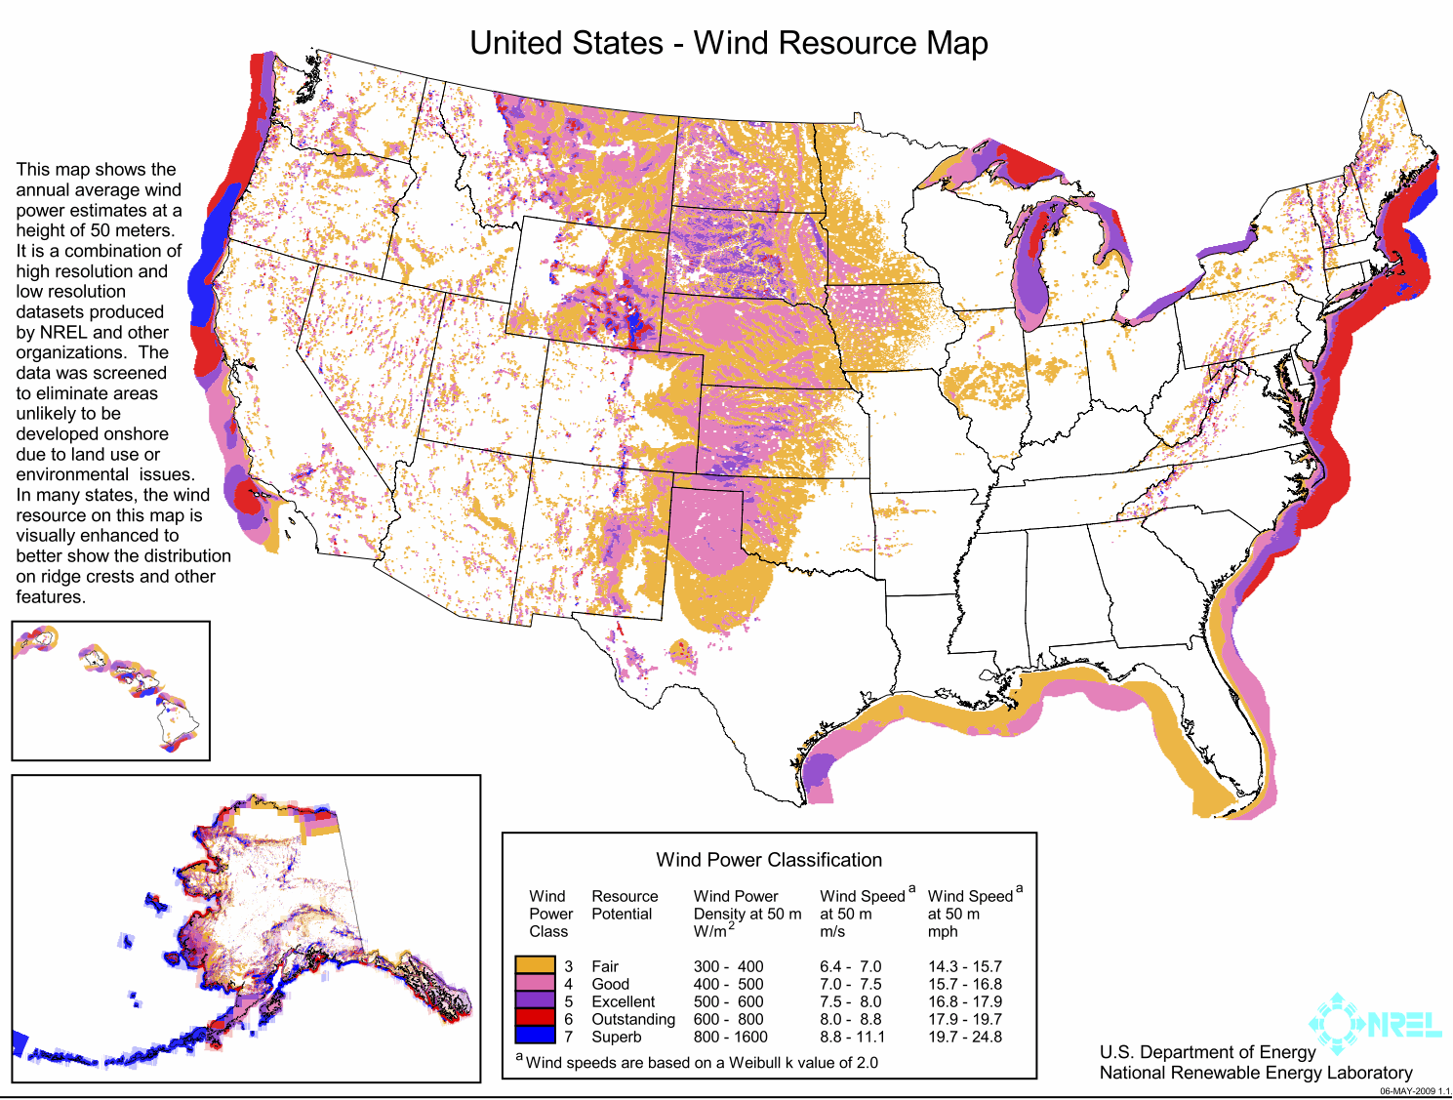
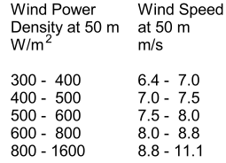
But is my simplified variable wind scenario realistic?
My model suggests that intermittent wind might TRIPLE daily wind power
307 watts / m² (for steady 8 m/s) => 921 watts / m² = (0 + 307 + 2457) / 3
What does REAL DATA for REALISTICALLY VARIABLE WIND LOCATIONS give?
Based on real data + modeling, an earlier edition of NREL's U.S. map ¹
translated wind speed into wind power as follows:
For 8 m/s average wind speed locations, NREL cited powers of 600 watts / m²
Thus, according to NREL, real variable winds ~ DOUBLE daily wind power
Suggesting real winds are high for ~ ¼ of day (vs. my assumed 1/3 of day)
1) https://wecanfigurethisout.org/ENERGY/Web_notes/Wind/Wind%20-%20Supporting%20-%20Files/Wind%20Resourses%20US%20-%20NREL%20-%202009.jpg

Slide 26
Looking back upon what we just learned about wind:
You (or certainly I) might have thought that an ideal wind farm should consist of:
Lot's of compact closely-spaced turbines
located atop nearby ridgelines or packed into nearby plains,
at least if those ridgelines & plains offered strong steady winds
But then a little science taught us that wind power increases as its speed ^{cubed}
That, plus mapping of real-life winds by locale, time and height,
taught us that ideal wind farms should instead consist of:
Huge well separated turbines
located off our northern coasts
or across our high western/midwestern plains
which offer high peak (but not necessarily steady) winds

Slide 27
AERODYNAMICS 101
An Introduction to Sustainable Energy Systems: WeCanFigureThisOut.org/ENERGY/Energy_home.htm

Slide 28
How can we best capture the wind's energy?
Which types of turbine will do the best job?
"Danish"
Simple Darrieus
Eggbeater Darrieus
Spiral Darrieus
Simple Savonius
Spiral Savonius
Photo credits,,See earlier version of this slide, above

Slide 29
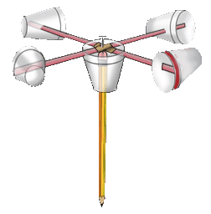
Answers are to be found in the field of Aerodynamics
Which Wikipedia defines as:
The study of the motion of air, particularly its interaction with a solid object
Aerodynamics is built around two concepts, drag and lift
Different wind turbine designs exploit both, but to differing degrees
Drag, and drag-based wind turbines are the easiest to understand
Consider a really simple drag-based wind turbine:
The DIY styrofoam cup anemometer Its simplified top view
Left figure adapted from: https://c03.apogee.net/contentplayer/?coursetype=kids&utilityid=pseg&id=16244

Slide 30
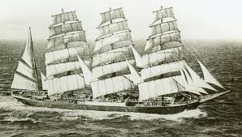
Wind turns this anemometer based on unbalanced drag:
Drag (resistance to air flow) pushes ALL of the cups ⬇
Drag on the upper and lower cups generates no torque
Drag on the left cup generates strong CCW torque
Drag on the right cup generates weak CW torque
The combined effect? This anemometer spins CCW
How fast do the individual cups end up moving?
With really good bearings and really well designed cups,
their speed might approach (but not exceed) that of the wind
Drag similarly propels classic "windjammers" downwind,
but friction limits them to far less than wind speed
Air Flow
Picture: https://www.seacloud.com/en/yachts/sea-cloud-ii/sailing/

Slide 31
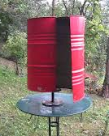
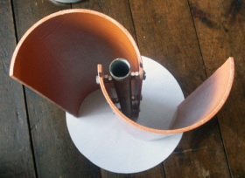
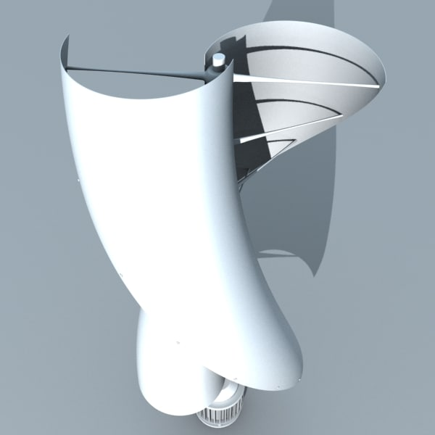
The classic "Savonius" wind turbine is just a rearranged drag anemometer:
Left: Movie showing operation of Savonius turbine made from split metal drum (link)
Center: Top view revealing the close resemblance to a 2 cup anemometer
Right: Commercial spiral version of a Savonius turbine:
Spiral ensures that some part of one cup is ALWAYS directly facing the wind
Which smoothes out the torque produced as this turbine rotates
Left: https://www.youtube.com/watch?v=HFerHBNS9BE
Center: http://verticalaxiswindturbines.blogspot.com/2010/10/how-efficient-are-vertical-axis-wind.html
Right: https://www.turbosquid.com/3d-models/3ds-max-helical-savonius-wind-turbine/804711

Slide 32
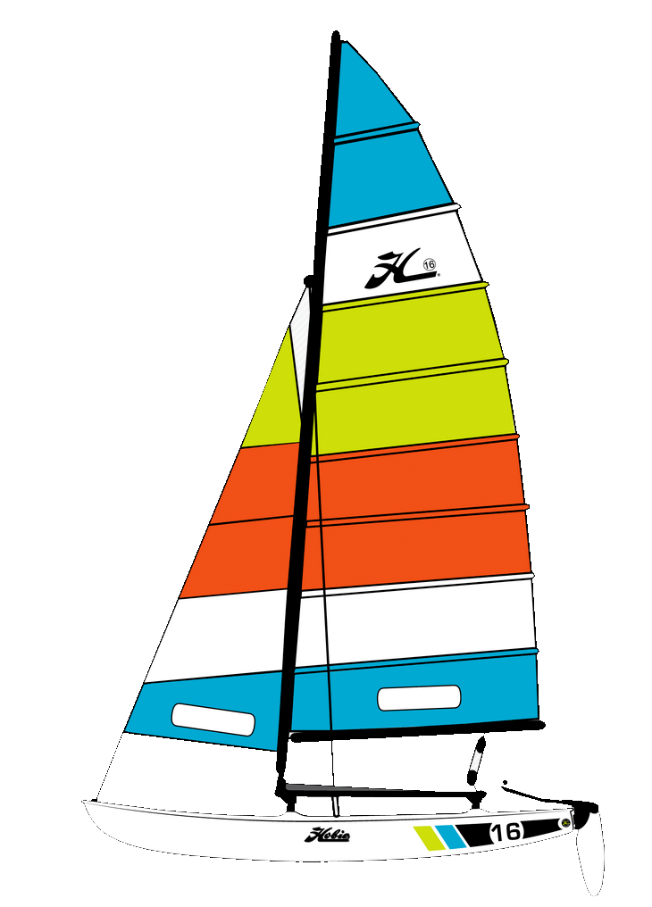
But based on drag, Savonius turbine speed is fundamentally limited:
Like our styrofoam cup anemometer, its fastest point (the outer edge of its rotor)
can at best be dragged along at the wind's full speed
Which introduces a key "figure of merit" for wind turbines, their:
TIP SPEED RATIO (TSR) = Speed of rotor tip / Speed of Wind
For ANY turbine based solely upon DRAG, Tip Speed Ratio is ≤ 1
Our windjammer is a sort of wind turbine (just being dragged along by the wind):
Encumbered by a lot of water resistance, that windjammer's TSR is << 1
But for a streamlined modern sailboat, TSR should be significantly larger
TSR << 1
TSR ~ ?
Left: https://www.seacloud.com/en/yachts/sea-cloud-ii/sailing/ Right: https://www.hobie.com/sail/hobie-16/

Slide 33
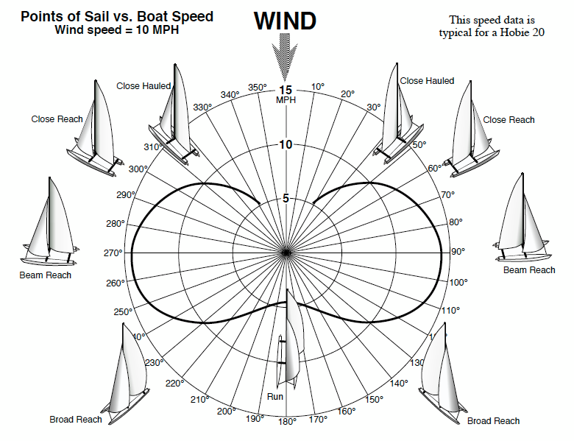
This is a plot of a modern Hobie Cat sailboat's speed vs. sailing direction:
Moving down a 10 mph wind it achieves 4.5 mph: TSR = 4.5 mph / 10 mph = 0.45
But look what happens when it (& other modern sailboats) turn away from the wind
THEY GO FASTER THAN THE WIND: TSR = 1.4 at right angles!!
= 10 mph
12
14
4.5
10
Figure = My enhanced version of: https://hobiecat16.wordpress.com/2010/09/23/points-of-sail-vs-boat-speed/

Slide 34

What the heck is going on? We've added aerodynamic lift
Air flowing into an "airfoil" (e.g., an aircraft wing, a sailboat sail, or a turbine blade)
must change its direction of movement => a change in its momentum
but to alter an airflow's momentum, it must experience a force
Newton's "action = reaction" demands a balancing force on the airfoil
That force on the airfoil is conventionally broken down into two components:
- A component parallel to the direction of the air flow = Drag
- A component perpendicular to the direction of the airflow = Lift
But the tilt of the airfoil relative to the air flow can be changed
The misalignment between the two is called Angle-of-attack
Lift
Air flow
Drag
Airfoil
(edge view)

Slide 35
As the angle-of-attack changes, so do lift and drag
But they change in different ways:
As the angle-of-attack increases from 0 to 90 degrees:
- Lift initially increases, but then falls dramatically
- Drag just increases (as the airfoil presents an increasing obstacle to air flow)
Angle of attack: 0° ~ 20° ~ 45° 90°
Which explains the sailboat's strange behavior - IF we remember that boat hulls
allow easy motion forward (and backward), but sharply limit motion sideways
We just have to figure out components of the sail's lift & drag along the hull axis:

Slide 36
How lift can propel sailboats (and wind turbines) faster than drag:
Even as the sailboat turns away from the wind
Where necessary, divide lift or drag into vector components:
One parallel to the boat's width
One parallel to it's length (=> dashed force driving the sail boat forward)
For wind flowing down the page =
Downwind: Crosswind: Upwind:
Moderate drag induced speed Fast lift induced speed Moderate lift induced speed
FORCE
One component
of FORCE
Other component of FORCE

Slide 37
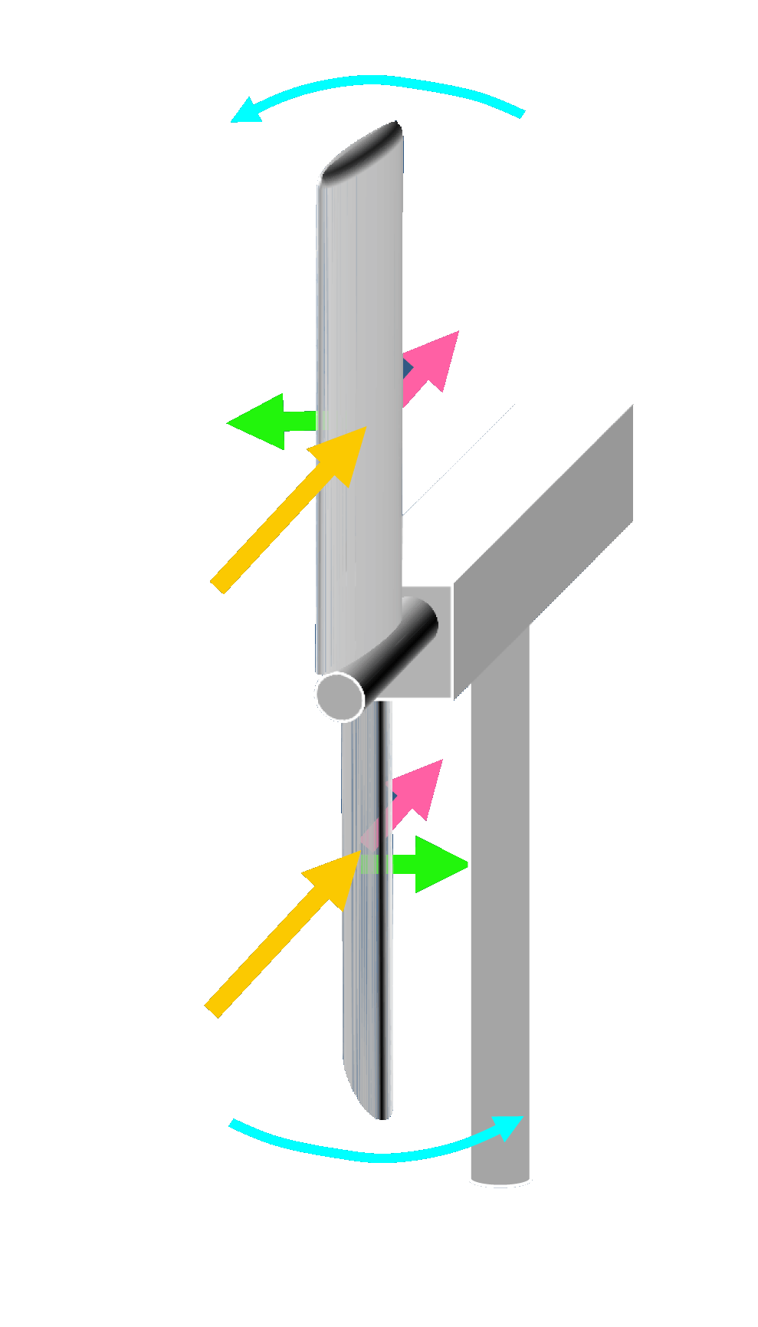
Aerodynamic lift can similarly explain a wind turbine's rotation:
You just have to think of the blades as sailboats sailing crosswind:
Lift drives each blade sideways,
The upper blade to the left
The lower blade to the right
Which, together, rotate this turbine CCW
Drag pushes back on both blades
but it does not strongly affect the turbine's rotation,
because that rotation is in a perpendicular plane)
An Introduction to Sustainable Energy Systems: WeCanFigureThisOut.org/ENERGY/Energy_home.htm

Slide 38
That explains slowly moving sailboats and slowly rotating Danish turbines

Slide 39
But when boats or blades speed up it gets more complicated:
Remember: Tip Speed Ratio (TSR) = Tip (or boat) Speed / Wind Speed
As shown above, TSR for modern crosswind sailing sailboats can be ~ 1.5
For modern "Danish" turbines TSR is even larger, typically ~ 5
Sailboat and turbine tip speeds thus often exceed wind speed!
We then need to deal with "Apparent wind"
Apparent wind = Wind as perceived by the sailboat or turbine blade
When boats or blades speed up, Apparent wind shifts away from True wind:
Wind speed = 0: For sailboat or blade speed equal to Wind speed:
True
Wind
Apparent Wind
True
Wind
Blade (or boat) velocity
Apparent Wind
- Blade (or boat) velocity

Slide 40
It is the apparent wind that determines the lift and drag on an object
Which means that we really need to take a closer look at lift and drag, including:
How they change with the direction of the apparent wind
How they change with magnitude of the apparent wind
And we need to re-examine my earlier diagram of airfoil lift and drag
Which alleged that:
Drag just increased with airfoil tilt, all the way to 90°
But lift first increased, but then declined
In re-examining lift I encountered something that may surprise you
(it certainly surprised me!)

Slide 41
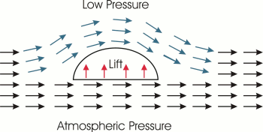
The common textbook & encyclopedia explanation of lift is WRONG!
That explanation (below) focuses on the airflow over asymmetric ("humped") airfoils:
- The airfoil divides the airflow into two parts, one above and one below the airfoil
- For smooth / non-turbulent (laminar) airflow, the path above is longer
- Molecules that started side-by-side, must meet back up again after the airfoil
- Thus, molecules following the longer upper path must move faster than those below
- Then, invoke the obscure & wildly non-intuitive Bernoulli's Equation:
Air_Pressure + ½ ρ v² + ρ g h = Constant
(ρ = air density, v = air speed, g earth's surface gravity, h = height)
RESULT: Because v is faster above the airfoil, pressure must be lower => Lift
http://large.stanford.edu/courses/2007/ph210/glownia2/

Slide 42
Failings of that explanation:
As noted (long ago!) in papers written by aerodynamicists in "The Physics Teacher,"
one by a retired career NASA engineer / project leader ¹
one by a retired aero professor from the best known U.S. aero university: ²
1) Separated molecules do NOT have to meet up at the tail of the airfoil
And, in fact, flow above the airfoil is often faster than predicted by Bernoulli
2) Bernoulli's Equation is not a physical law = it's not the CAUSE of things
It just reports what happens in certain special situations (i.e., it's an EFFECT)
3) It describes "dry water" = Idealized incompressible zero viscosity fluids ³
4) As applied (above) to airfoils it actually violates Newton's 3rd Law:
"Reaction" (airfoil lift) invokes no "Action" (downward force upon the airflow)
5) AND THE WHOPPER: Airplane's can fly with flat and/or symmetric wings
1) "Bernoulli and Newton in Fluid Mechanics" - Norman F. Smith, The Physics Teacher 10, pp. 451-455 (1972)
2) "An Aerodynamicist’s View of Lift, Bernoulli, and Newton" – Charles N. Eastlake, The Physics Teacher 40, p. 166-173,(2002)
3) The Feynman Lectures on Physics, Volume III, Chapter 40 (1964)

Slide 43
Intuition (and Newton) instead provide a simpler explanation:
Step 1:
Consider the behavior of a bouncing ping pong ball:
A ping pong ball is shot at an inclined object
It is deflected downward
The ball's momentum has been changed
so the ball experienced a force (= an action)
Newton insists that object had to experience a balancing force (a reaction)
The part of that reaction parallel to the ball's incoming motion = Drag
The part perpendicular to the ball's incoming motion = Lift
Object's "Reaction"
Lift
Drag
Ball's "Action"

Slide 44
Step 2: Vary the angles-of-attack (by varying the object's tilt):
Angle-of-attack: ~ 20° ~ 40° ~ 60°
Then generate plots of how the Lift and Drag components of the reaction changed:
Lift
Angle-of-attack
Drag
Angle-of-attack
0°
20°
40°
60°
90°

Slide 45
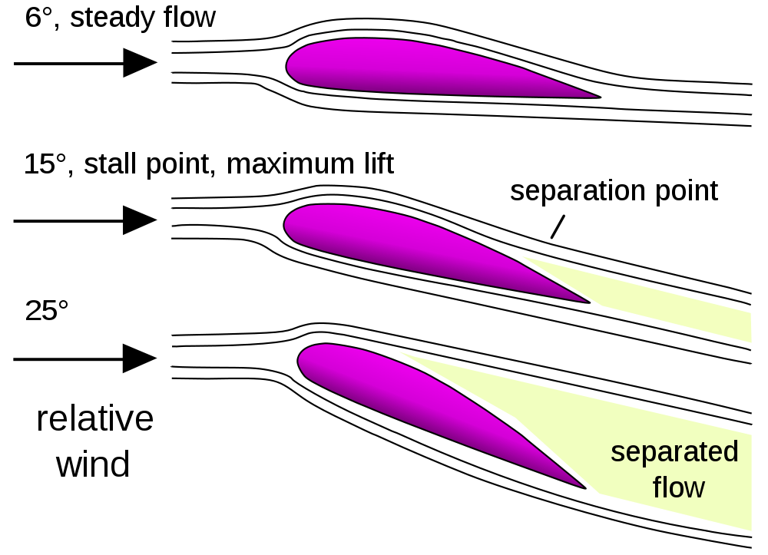
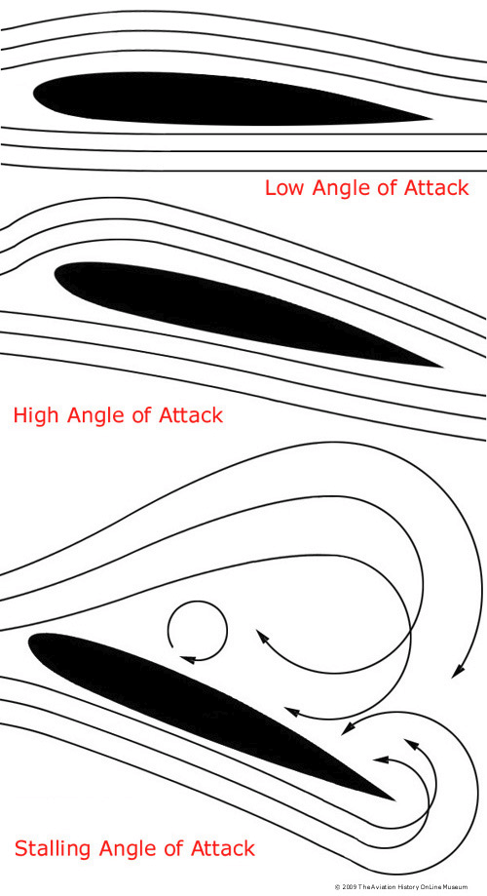
Step 3: Correct for the differences between ping pong balls and air:
Like ping pong balls, air molecules DO bounce off things, transferring momentum
But they also do a lot of bouncing off of one another
Momentum is thus rapidly shared and redistributed among them
Yielding the sort of merged / cooperative behavior typical of a gas (or liquid)
When mildly deflected, these "fluids" flow in smooth stable "streamlines"
But when strongly deflected, flow becomes unstable and confused
Turbulent airflow transfers far less momentum to the object
Turbulent airflow
in greater detail:
Left: BGoogle Images link Right: http://www.spacesafetymagazine.com/aerospace-engineering/spacecraft-design/what-is-a-stall/

Slide 46
Turbulent flow:
For what sort of deflections (angles-of-attack) does turbulent flow set in?
Slowly moving wings induce turbulence for angles-of-attack greater than ~ 10°
Rapidly moving wings induce turbulence for angles-of-attack greater than ~ 20°
How does turbulent air flow change Lift and Drag?
For Lift, the effect is a catastrophic collapse (called stall): ¹⁻³
For Drag, the effect is much harder to pin down:
Because airplanes fall out of the sky once stall sets in
aerodynamicists don't spend much time studying those angles-of-attack!
But the "wings" of ALL vertical axis wind turbines (VAWTs)
circle through ALL possible angles-of-attack
Lift
Stall
Angle-of-attack
10 - 20°
1) https://en.wikipedia.org/wiki/Angle_of_attack 2) https://en.m.wikipedia.org/wiki/Stall_(fluid_mechanics)
3) http://www.spacesafetymagazine.com/aerospace-engineering/spacecraft-design/what-is-a-stall/

Slide 47
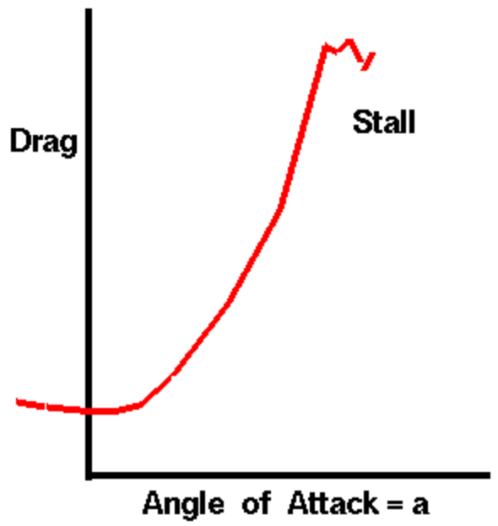
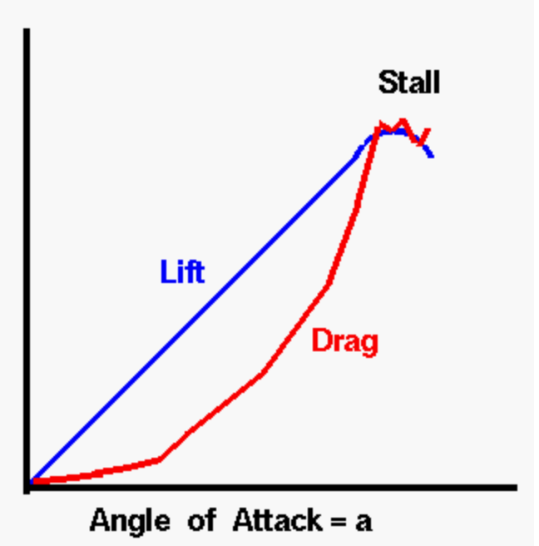
I thus dug more deeply into drag under turbulent flow / stall:
A lot of sources effectively ignored stall's effect upon drag,
just plotting its smooth increase all the way up to 90° angle-of-attack
But I ultimately discovered two NASA websites with plots suggesting that,
at least immediately above stall, drag saturates: ^{1,2}
Extrapolating NASA's result, I'll thus modify my earlier Drag plot as follows:
Drag
Stall
Angle-of-attack
10 - 20°
Left: https://www.grc.nasa.gov/www/k-12/airplane/inclind.html RIGHT: https://www.grc.nasa.gov/WWW/K-12/airplane/kiteincl.html

Slide 48
Which brings us to these revised estimates of Lift and Drag:
Lift
Stall
Angle-of-attack
10 - 20°
Drag
Stall
Angle-of-attack
10 - 20°
With which we can now more fully explain the operation
and optimization of various types of wind turbine
An Introduction to Sustainable Energy Systems: WeCanFigureThisOut.org/ENERGY/Energy_home.htm

Slide 49
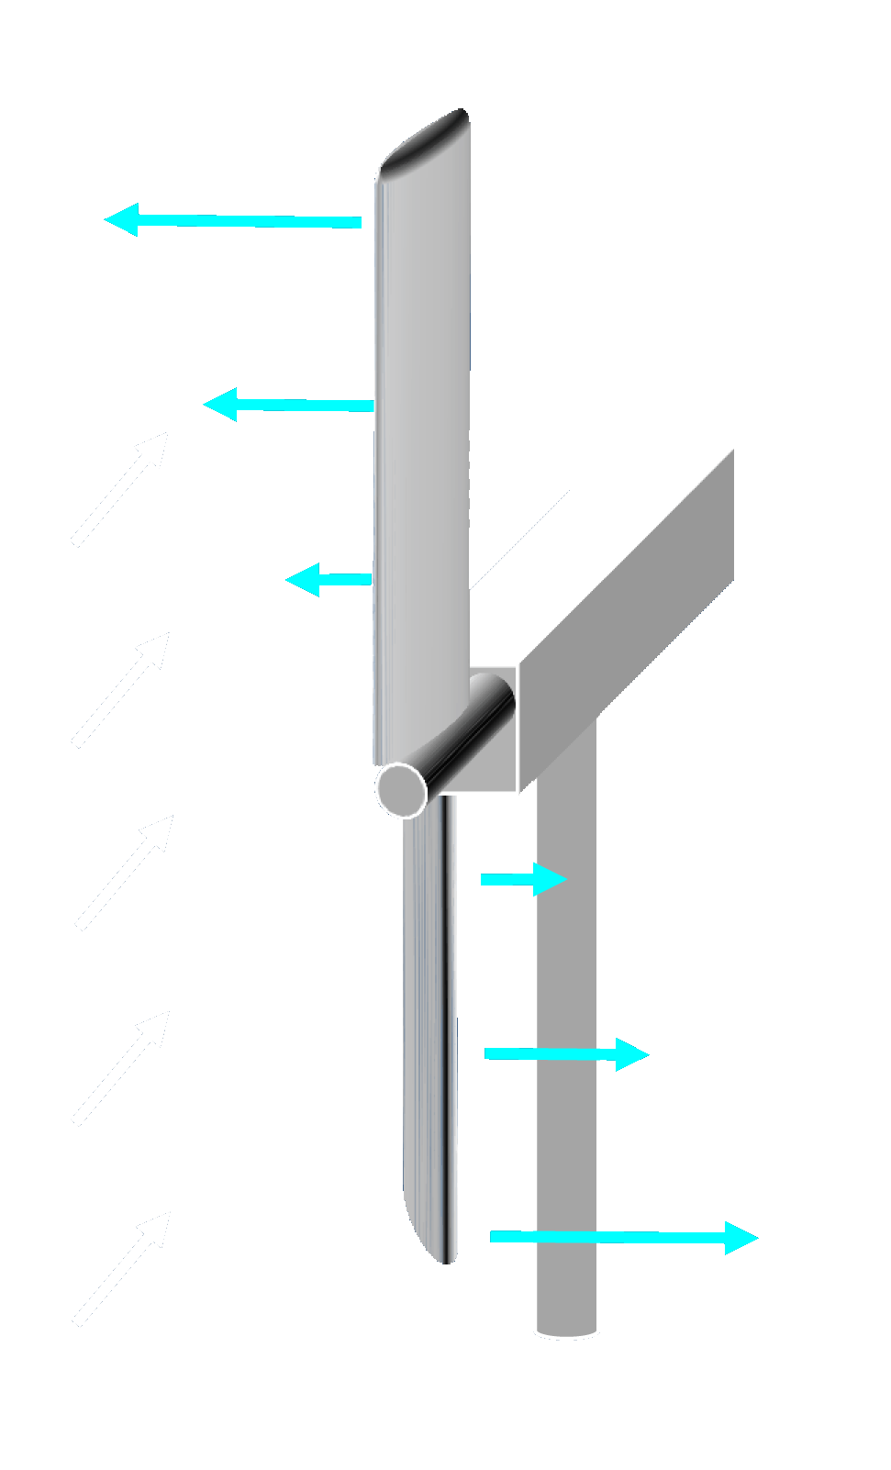
Applying these to an already-rotating Danish wind turbine:
Here, depicting it operating at a Tip Speed Ratio of ~ 2
True Wind & Blade Velocity:
Apparent Wind
(viewed in perspective):
Apparent Wind
(viewed from above):

Slide 50
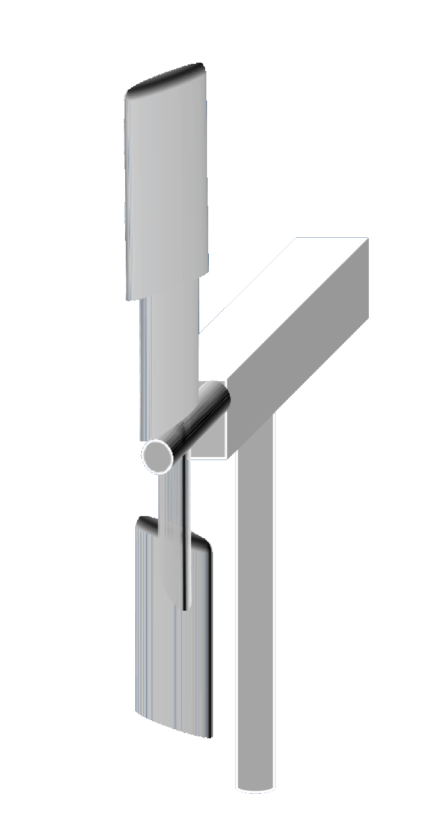
Moving out toward the tips of the turbine blade:
1) The magnitude of the apparent wind increases
2) The direction of the apparent wind swings into the plane of blade rotation
To capitalize upon this, while avoiding stall, the blades should be twisted:
Apparent wind + blade cross-sections from above
(if both blades were in fact twisted smoothly):
Note how this blade twist ensures
that the airfoil is always tilted
slightly upward from apparent wind
yielding good lift
(by avoiding stall angles-of-attack)

Slide 51
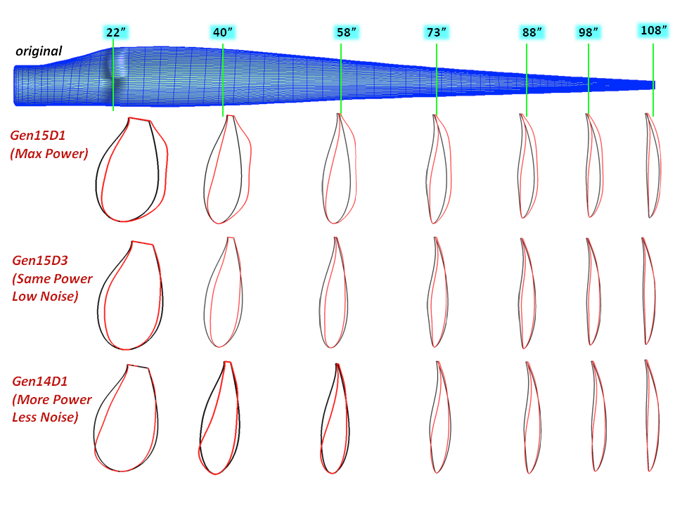
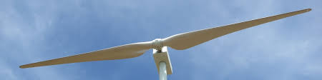
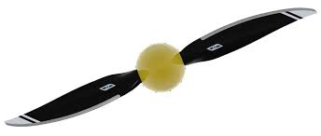
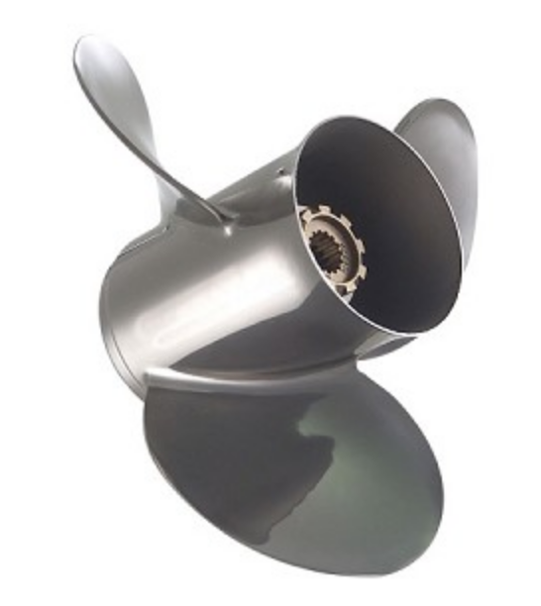
Cross-sections of a computer-optimized twisted turbine blade:
Blade
"Root"
Blade
Tip
Photo of a turbine with two such blades:
Aircraft and boat propellers twisted for same reasons:
Top: https://crunch.craft-tech.com/applications/design-optimization/wind-turbine-blade/
Middle: https://www.windflow.co.nz/turbines/why-two-blades
Bottom left: https://whirlwindpropellers.com/windtunnel/ground-adjustable-aircraft-propellers/
Bottom right: https://www.boatownersworld.com/quicksilver-silverado-vengeance-stainless-steel-boat-propeller.html

Slide 52
Important factoid: Stall can save wind turbines:
Storms have torn wind turbines to pieces
The problem is not so much that blade bending => breaking (induced by drag)
It is instead excess winds rotating the turbine so fast that centripetal force
on individual blades rips them right out of the turbine's hub
But the Lift turning the turbine is driven by Apparent Wind
Which is vector difference of: True wind – Blade velocity:
As a storm drives True wind higher, it can increasingly dominate the Apparent wind,
shifting Apparent wind direction, increasing Angle-of-attack on turbine blades
which can then push those blades past their peak Lift and into stall:
Lift
Angle-of-attack
10 - 20°

Slide 53
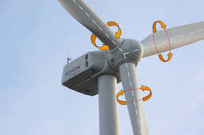
That stall provides a degree of "passive" over-speed protection
"Passive" in the sense that it doesn't require sensors and alarms to set it off
But to keep turbines pointing into the wind, commercial turbines already have sensors
In extreme winds, they can set off stronger active over-speed protection:
FIRST: Blades can be rotated about their axes (i.e., changing their pitch)
to zero out wind's Angle-of-attack, slashing blade lift (called feathering)
SECOND: The whole head of the turbine (its nacelle) can be rotated 90°
so that wind strikes it from the side, radically slowing or stopping rotation
(While also minimizing total wind drag upon the complete structure)
Photo: http://eng-electric.blogspot.com/2016/11/power-control-of-wind-turbines.html

Slide 54
Simple drag thus explains Savonius turbines
While a combination of drag + lift explains Danish turbines
But what about the Darrieus turbines that so intrigue inventors & the press?
Simple Darrieus
Eggbeater Darrieus
Spiral Darrieus
An Introduction to Sustainable Energy Systems: WeCanFigureThisOut.org/ENERGY/Energy_home.htm

Slide 55
Take a closer look at the Simple Darrieus turbine design
From this picture, you might suspect that it twists its blades as it turns
which could produce the blade cross-sections shown below right,
which DOES create strong drag on one side, light on the other => Rotation
But how would you get the blades to twist?
You could add motors on each blade (likely impractical / certainly expensive)
Or you might devise some clever way of linking the blades together
such that they cause each other to pivot as the whole assembly rotates
That HAS been tried, but based solely on drag, it is then not a true Darrieus turbine
It's more like a distant cousin of the drag-based Savonius turbine

Slide 56
A true Darrieus turbine exploits Lift
And a Simple Darrieus turbine is quite simple, with just one rigid rotating assembly:
Is its rotation then induced by some subtlety in its blade cross-sections?
No, simple flat plates will work (e.g., a rolled up set of wood-slat venetian blinds)
But how then does wind cause a Darrieus turbine to rotate?
In fact: WIND WON'T START A DARRIEUS TURBINE ROTATING
But if it's ALREADY rotating, wind WILL SPEED UP THAT ROTATION
The latter is something aerodynamicists only ever explain to fellow aerodynamicists
But after a lot of study, I believe I can now explain it to you using diagrams:
?

Slide 57
We need to estimate lift & drag all around the full Darrieus circle:
Producing Apparent wind diagrams as input to lift & drag Angle-of-attack Diagrams
Fortunately, for a Simple Darrieus turbine we need only consider one horizontal plane
Because its winds flow only within horizontal planes,
producing forces entirely within those same horizontal planes,
(making all horizontal planes effectively equivalent)
Further, analysis of wind striking a non-rotating Simple Darrieus turbine is "trivial"
because symmetry tells us that everything happening on one side of the turbine
is balanced (and thus canceled) by what's happening on the other side:
Drag
Stall
Lift
Stall
10 - 20°
Angle-of-attack
10 - 20°
Angle-of-attack
An Introduction to Sustainable Energy Systems: WeCanFigureThisOut.org/ENERGY/Energy_home.htm

Slide 58
NON-ROTATING Darrieus turbine: Winds and where blades stall
With no rotation: Apparent Wind = Real Wind
But then, for most of the blades, Angles-of-attack are >> 20°,
inducing massive turbulence, putting those blades in full aerodynamic stall:
Passing thru these sectors, blades stall

Slide 59
NON-ROTATING Darrieus turbine: Blade lift & stall forces
Using those apparent wind angles-of-attack as input
to the lift and drag diagrams two slides above (which accounted for stall),
the lift and drag vectors for individual blade can be estimated as:

Slide 60
NON-ROTATING Darrieus turbine: Cumulative effect of those forces
There is COMPLETE top to bottom symmetry:
EVERY force in the top half is precisely mirrored in the bottom half
Torques thus precisely cancel => The turbine will NOT start rotating

Slide 61
Repeating that analysis for an ALREADY-ROTATING Darrieus turbine:
Which is much harder because now not only does Apparent Wind ≠ Real Wind,
but Apparent Wind changes both direction AND magnitude around the circle
Let's say the turbine is now rotating with Blade Speed = True Wind Speed (TSR =1)
Meaning they have the same magnitude, but not necessarily the same direction
True Wind = Blade velocity =
Then, moving around the circle, True Wind – Blade velocity => Apparent Wind
At one point on that circle things will look like this:
Diving right in:

Slide 62
ALREADY-ROTATING Darrieus turbine: Winds
Key: True Wind Rotation (solid) Rotational Wind (dashed) Apparent Wind

Slide 63
ALREADY-ROTATING Darrieus turbine: Where the blades stall
Note that symmetry has been been lost: Top half no longer mirrors bottom half!
Passing thru these sectors, blades stall

Slide 64
ALREADY-ROTATING Darrieus turbine: Blade lift & drag forces
Based on the turbulence / stall-corrected lift and drag diagrams:

Slide 65
ALREADY-ROTATING Darrieus turbine: Cumulative effect of those forces
Strongest forces occur when blades pass thru non-stalled top of diagram
Net torque (rotational force) = CCW = Direction of turbine's initial rotation!
Wind thus causes an ALREADY-ROTATING Darrieus turbine to SPEED UP

Slide 66
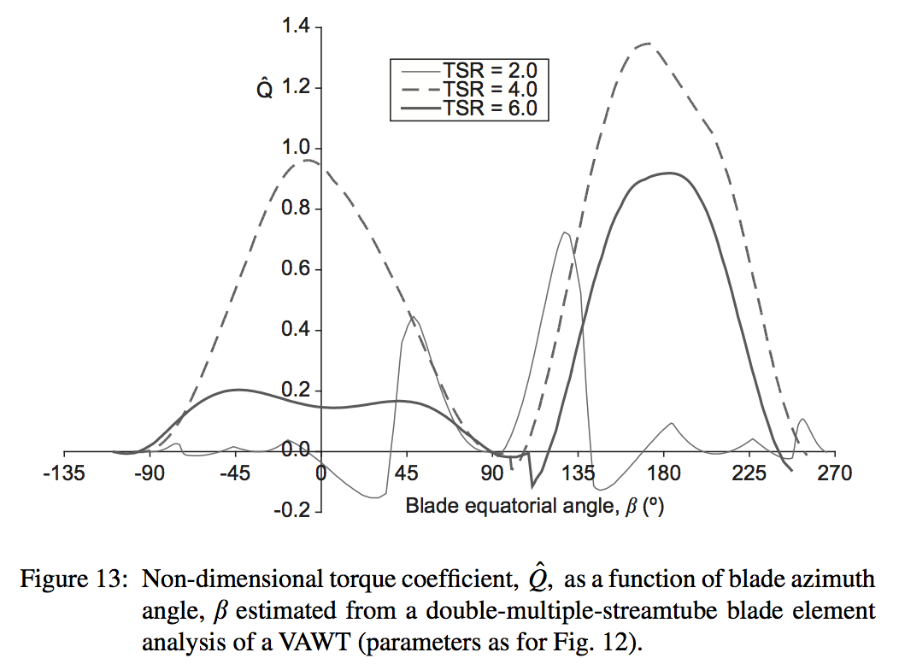
Are you still skeptical? (I probably would be)
Those plots were awfully complex and subtle (and very easy to get wrong)
I thus dug up aerodynamically-rigorous computer simulations of Darrieus turbines,
which calculated precise lift & drag for their rotating blades,
which were then used to plot torque as a blade rotates around the circle:
For slow rotation (TSR = 2):
Plot is almost left/right symmetric
=> Weak net torque
For fast rotation (TSR = 6):
Plot is very left/right non-symmetric
=> Strong net torque
Figure: Development and Analysis of Vertical-axis Wind Turbines, Chapter 8, Paul Cooper, School of Mechanical, Materials and Mechatronic Engineering, University of Wollongong, NSW, Australia (link)
SEE ALSO: Other VAWT aerodynamic theory papers given on this note set's Resources Webpage

Slide 67
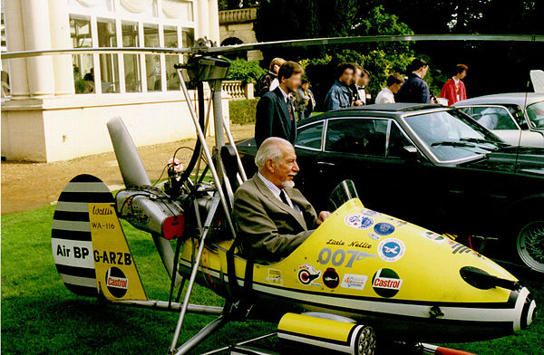
I REALLY wanted to figure out why Darrieus turbines spin
Because it would then explain something that's mystified me for decades:
How the heck / Why the heck Autogyros fly!
An Autogyro is a go-cart with the not-so-secret ambition of becoming a helicopter
They are often homebuilt, consisting of crude three-wheel open chasses,
on which a seat and motorized pusher propeller are mounted
But then, above that seat, on a wobbly / tiltable mount,
a ridiculously UNPOWERED larger propeller is added:
"Little Nellie"
in the 1967 James Bond film:
You only Live Twice
Photo: https://en.wikipedia.org/wiki/Wallis_WA-116_Agile

Slide 68
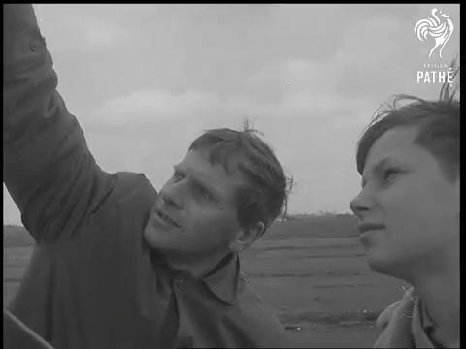
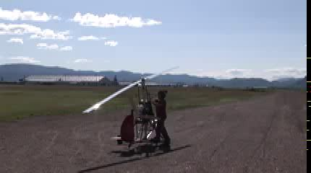
When you power up an Autogyro's (Gyrocopter's) pusher prop:
You can drive around on the ground like a normal go cart,
with the floppy upper prop doing nothing other than endangering passersby
But if you FIRST stand up in your seat, and push the upper prop into slow rotation,
something miraculous occurs: (although it occurs more slowly here):
YouTube link
YouTube link
(Cached copies of these videos are also linked from this note set's Resources Webpage)

Slide 69



But is the rotor just turning due to airflow from below & ahead?
Which would inhibit that airflow (like a Danish wind turbine) acting a bit like a wing,
thereby providing lift if driven forward fast enough by the pusher prop
The videos show that both rotors were hand-started CCW (per the added arrows)
And looking very carefully at these photos from those videos you can see that
each rotor blade is inclined as in the diagram shown at the right:
An Introduction to Sustainable Energy Systems: WeCanFigureThisOut.org/ENERGY/Energy_home.htm

Slide 70

Tilts + rotational direction are NOT consistent with airflow from below:
CW Rotation responding to air flow
entering from below:
Which only retards that upward airflow
CCW Rotation induced by a Darrieus-like
airflow mechanism:
Which yields helicopter-like downward thrust
I suspect the rotor spun up so slowly in 2nd video BECUASE the pilot mistakenly tilted it such that:
The (left) retardation-producing effect (=> CW rotation) was strengthened to the point
that it almost overwhelmed the (right) thrust-producing effect (=> CCW rotation)

Slide 71
What then (finally) is the best type of wind turbine?
That battle seems to shape up as:
Monster Danish turbines (the overwhelming wind industry favorite)
Versus
An assortment of vertical axis wind turbine (the inventor, press & public favorite)
With that inventor/press/public preference based on
VAWTs' diminutive size + eye-pleasing appearance

Slide 72
VAWTs might work if more blades and/or wider blades made up for size
After all, the Danish turbine's three narrow blades seem to miss most of the wind!
But as I discussed far above:
Turbine blades have a "bow wave" making them act much larger than they are
Turbine rotation then makes it ~ impossible for air to pass without interaction
A turbine's effective area is thus closer to a wind's eye view of the turbine's
total swept area than to the sum of individual blade areas:
An Introduction to Sustainable Energy Systems: WeCanFigureThisOut.org/ENERGY/Energy_home.htm

Slide 73
Which puts today's VAWTs at a huge disadvantage
Because today, Danish turbines are SO MUCH BIGGER than almost all VAWTs
Which means that even if whole fields or
whole building rooftops were covered by VAWTs,
at their current diminutive but eye-pleasing sizes,
they would together intercept so much less wind,
and, nearer to the ground, so much slower wind
Which means that fields or rooftops packed with small / eye-pleasing VAWTs
would have to be VASTLY MORE EFFICIENT at harvesting
the much smaller amount of wind that they DO intercept
Which IS INDEED suggested in many (if not most) press articles about VAWTs!

Slide 74
But ARE today's VAWTs vastly more efficient than Danish turbines?
NO! But might future improved VAWT designs change the answer to YES?
Our best clues from more advanced aerodynamic theory
Which I will cover in this note set's next section: Aerodynamics 201
But even if VAWTs fail to achieve vastly higher efficiencies than Danish turbines,
there would still be the possibility of making VAWTs as large as Danish turbines
But Danish turbines can be ~ 150 meters in diameter, 100 meters above the ground
Imagining such a huge and tall VAWT, the incredible challenges seem obvious!
100-150 meters

Slide 75

But could a medium sized but many-bladed VAWT still win out?
More blades inevitably require more material and produce more rotating mass
More rotating mass then requires a stronger and heavier supporting structure
All of which increase the cost of building and/or maintaining such a turbine
And there is a strong AERODYNAMIC ARGUMENT against too many blades:
More blades boost the overall drag trying to slow a turbine's rotation
Which leads aerodynamicists to actually suggest the use of: ¹⁻³
One blade (alone!) – in combination with a counterweight:
OR
A large number of very narrow - and thus low drag - blades
(which, unfortunately, would be weak & susceptible to breakage)
Photo: https://www.videoblocks.com/video/static-shot-of-a-single-blade-wind-turbine-on-a-windy-day-soh1f9wjliujtg2bn
1) http://drømstørre.dk/wp-content/wind/miller/windpower%20web/en/tour/design/concepts.htm
2) https://www.windpowermonthly.com/article/1083653/three-blades-really-better-two
3) http://explorecuriocite.org/Explorer/ArticleId/193/why-dont-wind-turbines-have-more-than-3-blades-193.aspx

Slide 76

For Danish turbines the optimum is actually thought to be three blades: ¹
Because the wind speed increases rapidly with height,
a blade is pushed back most strongly at the top of its rotation
But for two blades, as one blade tops its rotation
the other is at the bottom, passing in front of the pylon
Not only is wind slower at that lower height
but it is particularly slow in front of the pylon's obstruction
Maximum push back at top + Minimum push back at bottom =>
An abrupt imbalance that tries to jerk a blade pair out of vertical
Which can then generate a pulse of noise
and requires stronger/bulkier mechanical design
Such top-to-bottom synchronization is avoided with 3 blades:
1) Danish Wind Industry Association:
http://drømstørre.dk/wp-content/wind/miller/windpower%20web/en/tour/design/concepts.htm

Slide 77
But VAWTs seem to have two BIG strengths . . . and one BIG weakness:
The strengths come from the vertical rotation axis of VAWTs:
Complex and heavy electrical generators can be housed on the ground
Where they can can be accessed and maintained very easily
Vs. climbing up to a Danish turbine's nacelle ~ 100 meters above the ground
Turbines rotate in a full compass circle thus having no front (or back)
So they can accept, even minute by minute, wind coming from ANY direction
Vs. the Danish turbine's need for sensor and motor-driven nacelle rotation
The apparent weakness is that wind can't get at least a Darrieus VAWT started
But a little Grid power sent to its generator, then acting as a motor, does the job
The real weakness comes from their 2nd strength: VAWTs can't turn out of the wind
How then do you keep a storm from destroying a VAWT?
An Introduction to Sustainable Energy Systems: WeCanFigureThisOut.org/ENERGY/Energy_home.htm

Slide 78
Danish turbines have two ways of protecting themselves from excessive wind:
The nacelle (and thus the turbine) can rotate perpendicular to the wind
The turbine then has minimal cross section and thus minimal wind interaction
Vs. a VAWT that - via its basic design - is always full face to the wind
The Danish turbine's other (actually its first) defense is to feather its blades
Rotating blades to align their airfoils ~ parallel to the wind:
Similar feathering is possible for Simple Darrieus Turbines
It can be done by mounting each blade on off-center pivots and
then adding torsion springs sized to allow each blade to pivot in high wind
This is exactly how blades were feathered on some early Danish turbines!

Slide 79

But wind-driven feathering is not possible in other Darrieus variants
Further, where steady blade rotation of a Danish turbine tries to stretch its blades,
The same rotation of a Darrieus turbine tries to bow its blades outward
But that rotation has a cyclic variation of angle-of-attack and thus of lift & drag,
so bowing due to aerodynamic forces is also cyclic, with that flexing
setting up resonances that can weaken or even destroy Darrieus turbines
Large Darrieus turbines are thus known for short operational lifetimes
This, the 96 meter tall "Eole Cap Chat" Quebec CA turbine
managed to stay in operation for only six short years
It survives to this day only because (now locked in place)
locals continue to maintain it as a tourist attraction
Eole Cap Chat photo: http://www.odec.ca/projects/2011/likek2/windturbines.html

Slide 80
How might future VAWTs be improved?
Starting with Savonius turbines:
Recall that they spin based solely on a side-to-side imbalance of drag forces
They'd work better if that imbalance were increased by blocking half their wind:
Archaeologists have found evidence that this HAS been tried:
An Introduction to Sustainable Energy Systems: WeCanFigureThisOut.org/ENERGY/Energy_home.htm

Slide 81

Artist's depiction of Persian "Panemone" Savonius turbine – Pre 1000 AD: ¹
One assumes this ancient turbine was used
only for pumping water or grinding grain
1) https://en.wikipedia.org/wiki/Panemone_windmill
Figure: "Wind Technology: Historical Drive Trains, Conversion Devices, Configurations, Design"
http://www.wind-works.org/cms/fileadmin/user_upload/Files/presentations/Wind-101/Wind_101-half-6_Technology_01.pdf
However, using only drag, Savonius turbines can at best reach wind speed (TSR ≤ 1)
Making them the "windjammers" of wind power:
But higher blade speed => Higher turbine kinetic energy => HIGHER POWER OUT
Purely drag turbines are thus doomed to very low conversion efficiencies
Savonius turbines achieve conversion efficiencies of 7, 9, 11% ²⁻⁴
2) https://aip.scitation.org/doi/pdf/10.1063/1.5024100
3) https://ac.els-cdn.com/S111001681200049X/1-s2.0-S111001681200049X-main.pdf?_tid=e63cb153-20c9-4c08-871d-e58db583d95e&acdnat=1535037457_2f9e50aa620f3e80abedede5fa1f1fb6
4) http://www.engr.mun.ca/~blaines/Docs/Final%20Report-April-09.pdf

Slide 82
Danish and Darrieus turbines instead exploit both drag and lift:
Making them more like modern Hobie Cat sailboats:
Danish turbines typically operate at TSR ~ 5, and can reach TSR ~ 10
While aerodynamicists model Darrieus turbines achieving TSR = 2-8 ¹
What power conversion efficiencies (power coefficients, C_{P}) do they achieve?
Danish turbines are usually cited as achieving ~ 50% conversion efficiency
Darrieus turbines are usually cited as "now having lower efficiency"
From sources spanning real-life data, wind tunnel tests & computer simulations,
but avoiding sources with obvious biases or vested interests, I found:
Danish turbines achieve efficiencies of 45-50, 48, 50% ²⁻⁴
Darrieus turbines achieve efficiencies of 20, 35-40, 40% ⁵⁻⁷
1) As shown above at the end of my explanation of how Darrieus turbines work (~16 slides back)
2) https://en.wikipedia.org/wiki/Betz%27s_law 3) https://www.researchgate.net/publication/289639250/download
4) http://css.umich.edu/factsheets/wind-energy-factsheet 5) http://iopscience.iop.org/article/10.1088/1742-6596/923/1/012036/pdf
6) http://iopscience.iop.org/article/10.1088/1742-6596/753/6/062009/pdf
7) https://prod.sandia.gov/techlib-noauth/access-control.cgi/1980/800179.pdf

Slide 83
Those numbers already torpedo the "fields of tiny VAWTs" scenario:
Based on conservation of energy, power conversion efficiency can only rise to 100%
With Danish turbines already achieving ~ 50% efficiency
No future VAWT could possibly do better than doubling that efficiency
Which means that even with almost magically efficient future VAWTs
their effective sizes would have to total at least half that of a Danish turbine
in order to compete with that Danish turbine's output power
Thus, instead of this choice: The choice would be:

Slide 84
What are the chances of any turbine approaching 100% efficiency?
VAWTs already exist in so many different variations
that predicting the cleverness of future inventors is clearly impossible
We must therefore look to nature to define an upper limit,
which here means Newton's laws as manifested in advanced aerodynamics
To explain that natural limit, I will now need to:
Explain how Bernoulli's Equation is derived, and then use it to derive:
Betz's Law providing a theoretical limit on lift + drag turbine efficiency
Then derive the companion theoretical limit on pure drag turbine efficiency
Yes, it is about to get quite technical, but even if you fear it will get too technical,
I urge you to scan the next section's text explanations & figures
And at least review its two conclusion slides before reading on to:
MY SUBSEQUENT SECTION ABOUT WHICH TURBINES SURVIVE IN THE REAL WORLD

Slide 85
AERODYNAMICS 201:
Bernoulli's Equation describing air flows
The Betz theoretical limit on lift/drag turbines
The corresponding theoretical limit on pure drag turbines
An Introduction to Sustainable Energy Systems: WeCanFigureThisOut.org/ENERGY/Energy_home.htm

Slide 86
Bernoulli's Equation relating pressure & velocity:
Bernoulli's equation models the flow of "fluids" including both liquids & gases
Those flows can be exceedingly complex phenomena
Which led Bernoulli to employ a pair of approximations,
and to restrict his analysis to a special situation
The 1st approximation is that the fluid's viscosity is ignored
That is a reasonable approximation for low pressure gases,
a so-so approximation for medium pressure gases (such as our air),
and a lousy approximation for at least rapidly moving liquids
The restriction is that the fluid must be is in steady, non-turbulent flow
Its molecules then move along constant smooth paths, called streamlines
Which is equivalent to saying that their flow is laminar
An Introduction to Sustainable Energy Systems: WeCanFigureThisOut.org/ENERGY/Energy_home.htm

Slide 87
Zero viscosity laminar flow is depicted in this diagram:
The yellow lines are some of the streamlines along which the molecules flow
We will track molecules entering through the left oval area
And exiting through the right oval area
And then calculate how things change between those two places
With the "things" tracked including these (given in both words and symbols):
Flow In:
Pressure = Pressure_{in}
Mass per volume = ρ_{in}
Area = A_{in}
Velocity = v_{in}
Mass Flow = MF_{in}
Power = P_{in}
Flow Out:
Pressure = Pressure_{out}
Mass per volume = ρ_{out}
Area = A_{out}
Velocity = v_{out}
Mass Flow = MF_{out}
Power = P_{out}

Slide 88
Properties of that flow – here assumed to be air (keeping diagram handy):
ENERGY PER AIR MASS = Kinetic Energy + Potential Energy
Kinetic energy per gas mass = ½ v²
Gravitational potential energy per mass = g x height thus:
Energy per air mass = ½ v² + g h (1)
MASS FLOW and CONSERVATION OF MASS
In steady flow, air mass neither accumulates or diminishes at any point
MASS FLOW = (mass/volume) (area) (velocity) = ρ A v = Constant Thus:
Mass Flow_{in} = Mass Flow_{out} OR: ρ_{in} A_{in} v_{in} = ρ_{out} A_{out} v_{out} (2)
Pressure = Pres_{n}
Mass per volume = ρ_{in}
Area = A_{in}
Velocity = v_{in}
Mass Flow = MF_{in}
Power = Power_{in}
Pressure = Pres_{out}
Mass per volume = ρ_{out}
Area = A_{out}
Velocity = v_{out}
Mass Flow = MF_{out}
Power = Power_{out}

Slide 89
That air flow can do work (e.g., by powering a wind turbine)
That work can be calculated from the change in the AIR FLOW's POWER
Air Flow Power = Pressure x Area x Air velocity thru that area:
Thus: Air Flow Power_{in} = Pressure_{in} A_{in} v_{in}
And: Air Flow Power_{out} = Pressure_{out} A_{out} v_{out}
The work done by that air flow is then:
Δ Power = Pressure_{in} A_{in} v_{in} - Pressure_{out} A_{out} v_{out} (3)
Pressure = Pres_{n}
Mass per volume = ρ_{in}
Area = A_{in}
Velocity = v_{in}
Mass Flow = MF_{in}
Power = Power_{in}
Pressure = Pres_{out}
Mass per volume = ρ_{out}
Area = A_{out}
Velocity = v_{out}
Mass Flow = MF_{out}
Power = Power_{out}

Slide 90
But that power had to come out of the air molecules' energy
Net molecular power flow = (Mass Flow) x (Energy per air mass)
Inserting mass flow (2) and energy density (1) from two pages back
Power_{in} = ρ_{in} A_{in} v_{in} (1/2 v_{in}² + g h_{in})
Power_{out} = ρ_{in} A_{in} v_{in} (1/2 v_{out}² + g h_{out})
The difference between power flow out and power flow in is then:
Δ Power = ρ_{in} A_{in} v_{in} (1/2 v_{out}² + g h_{out}) - ρ_{in} A_{in} v_{in} (1/2 v_{in}² + g h_{in}) (4)
Setting that equal to work done by that air flow (equation 3):
Pres_{in} A_{iin} v_{in}- Pres_{out} A_{out} v_{out} = ρ_{in} A_{in} v_{in} (1/2 v_{out}² + g h_{out}) - ρ_{in} A_{in} v_{in} (1/2 v_{in}² + g h_{in})
Dividing through by the constant Mass Flow = ρ_{in} A_{in} v_{in} = ρ_{in} A_{in} v_{in}
(Pressure_{in} / ρ_{in}) - (Pressure_{out} / ρ_{out}) = (1/2 v_{out}² + g h_{out}) - (1/2 v_{in}² + g h_{in})
(5)

Slide 91
That equation is then further simplified by making a 2nd approximation:
It is assumed that the density of the "fluid" never changes significantly
That's a very good assumption for liquids such as "incompressible" water:
Even though its pressure increases one atmosphere per 10 meters of depth,
deep, deep water is only slightly denser than near-surface water
But high school's "Ideal Gas Law" (PV = nRT) taught us that gases CAN compress
However: Air flowing slowly by an obstruction may not compress . . . much
Because it then has time to instead detour around that obstruction
But how "slow" is slow?
Sonic booms occur when air can no longer flow out of a jet's way,
And air has no choice but to pile up (compress) in front of that jet
A Rule of Thumb: Air compression is minor at velocities << Speed of sound

Slide 92
Negligible viscosity + Negligible compression = "Dry Water"
Which, as weird and implausible as it sounds, IS the basis for simple aerodynamics
For such "dry water" the fluid density is ~ constant: ρ_{in} = ρ_{out} = ρ
Then, if the change in flow height is small (h_{in} ~ h_{out} = h), equation (5) becomes:
Pressure_{out} / ρ + ½ v_{out}² = Pressure_{in} / ρ + ½ v_{in}²
But the "in" and "out" areas (the ovals) were arbitrarily positioned,
and could be located anywhere along the air flow streamlines IMPLYING:
Anywhere along a streamline, (Pressure_{in} / ρ + ½ v_{in}² ) must be the same:
For a non-viscous
incompressible fluid
in laminar flow
(along streamlines):
Pressure / density + ½ velocity² = A constant
Bernoulli's Equation
For a low-viscosity almost incompressible fluid, this should be approximately correct

Slide 93

One of the Bernoulli Equation's strange predictions:
Driving along freeway, have you ever been surprised by a big truck overtaking you?
Appearing suddenly out of your blind spot, it's lurking size can startle you
But have you then imagined that the truck was sucking you toward it?
Bernoulli's Equation says that it was not your imagination:
Passing your vehicles, the airflow had to speed up, particularly between them
With the highest speed between the vehicles
Bernoulli's Equation:
Pressure / ρ + ½ velocity² = constant
Says that there the air pressure IS lowest
(A passing truck does indeed suck!)
Figure: https://phys.libretexts.org/TextBooks_and_TextMaps/University_Physics/Book%3A_University_Physics_(OpenStax)/Map%3A_University_Physics_I_-_Mechanics%2C_Sound%2C_Oscillations%2C_and_Waves_(OpenStax)/14%3A_Fluid_Mechanics/14.6%3A_Bernoulli%E2%80%99s_Equation

Slide 94

The Betz Limit on wind turbine efficiency (C_{p}):
v_{at_turbine}
v_{in}
v_{out}
Figure: My rework of WindPower.Org's: http://ele.aut.ac.ir/~wind/en/stat/betzpro.htm
Pressure_{in}
Pressure_{out}
This diagram illustrates air flow passing by a wind turbine
As we now know, air compresses little when travelling at subsonic speeds
But given that mass flow = (density = ρ) (Area of cross-section) (velocity):
With ρ ~ constant, as the air's velocity decreases passing the turbine,
flow cross section must increase to maintain mass flow across the diagram
Only then can: ρ A_{in} v_{in} = ρ A_{turbine} v_{at_turbine}= ρ A_{out} v_{out}

Slide 95
Calculations would now be easy if we knew values AT the turbine
Newton pretty much supplies the answers:
The force on the turbine equals its area x the air pressure difference front to back:
Force = A_{turbine} ΔPressure ~ A_{turbine} (Pressure_{in} – Pressure_{out}) (1)
That force must also equal the rate at which the air is losing momentum,
which equals its mass flow x its change in velocity:
Force = dMomentum / dt = (Mass Flow) (v_{out} – v_{in})
= ρ (Air Flow) (v_{in} – v_{out}) = ρ A_{turbine} v_{at_turbine} (v_{in} – v_{out}) (2)
The power transferred from the air flow into the turbine would then be
that force multiplied by how fast air arrives at the turbine:
Power_{turbine} = Force x v_{at_turbine} (3)
An Introduction to Sustainable Energy Systems: WeCanFigureThisOut.org/ENERGY/Energy_home.htm

Slide 96
We now use Bernoulli's Equation to pin down velocity AT the turbine:
Bernoulli's Equation says along streamlines (Pressure / ρ + ½ v²⁾ is constant, thus:
Pressure_{in} + ρ v_{in} ² / 2 = Pressure_{out} + ρ v_{out} ² / 2 Reworking:
Pressure_{in} - Pressure_{out} = ρ v_{out} ² / 2 - ρ v_{in} ² / 2
Substituting that into the first force equation (1):
A_{at_turbine} (ρ v_{out} ² / 2 - ρ v_{in} ² / 2 ) = (A_{turbine} v_{at_turbine} ρ ) (v_{out} – v_{in})
After some cancellations and rearrangement, that becomes:
v_{out} ² - v_{in} ² = 2 v_{turbine} (v_{out} – v_{in}) But D² - E² = (D-E)(D+E), Yielding:
v_{at_turbine} = (v_{out} + v_{in}) / 2 (4)
You would have guessed that v_{at_turbine} must be between v_{out} and v_{in}
But without Bernoulli there is no reason to assume it is their exact average
(As IS slyly assumed on many, many wind power information websites!)

Slide 97
Putting it all together to get a turbine power limit:
Solving the preceding v_{at_turbine} equation for v_{out}: v_{out} = 2 v_{at_turbine} – v_{in}
Using this to eliminate v_{out} from second force equation (2)
Force = ρ A_{turbine} v_{at_turbine} (v_{in} – v_{out}) => 2 ρ A_{turbine} v_{at_turbine} (v_{in} – v_{at_turbine})
Substituting that force into the power equation (3)
Power_{turbine} = Force x v_{at_turbine} = 2 ρ A_{turbine} v_{at_turbine}² (v_{in} – v_{at_turbine})
= 2 ρ Aturbine (vturbine²vin - vturbine³) (5)
Solving for the power maximum with respect to possible values of v_{at_turbine}:
d Power_{turbine} / d v_{at_trubine} = 0 = 2 ρA_{turbine} (2 v_{at_turbine} v_{in} – 3 v_{at_turbine}²)
The maximum thus occurs when v_{at_turbine} = (2/3) v_{in}
Substituting that optimum v_{at_turbine} back into the power equation (5)
Power_{turbine_max} = 2ρA_{turbine}((4/9)v_{in}³ – (8/27)v_{in}³) = (8/27) ρA_{turbine}v_{in}³ (6)

Slide 98
Comparing that to the wind's total power:
As derived at the opening of this note set:
The kinetic energy per volume of wind = ½ (M / volume) v² = ½ ρ v²
But wind volumes arrive at the turbine at a rate proportional to the wind's velocity
So the wind's total power = ½ ρ A_{turbine} v_{in}³
Dividing that into the maximum turbine power that we just calculated:
Turbine generator (with whirly things)
Chunk of "air flow"
Area of flow
intercepted
Energy Density
½ ρ v²
Velocity v
Max Turbine Efficiency (C_{P_max}) = [ (8/27) ρ A_{turbine} v_{in}³ ] / [½ ρ A _{turbine} v_{in} ³ ]
= 16 / 27 => 59.3% = THE BETZ LIMIT
Max wind kinetic energy to turbine blade kinetic energy conversion efficiency

Slide 99
Limit on purely drag wind turbine efficiency (C_{p}):
The derivation of this (un-named) limit resembles the Betz derivation:
According to Newton, Force = Rate of momentum transfer
The momentum per volume of an air flow = ρ v_{air}
The volume of flow passing through a surface per time = A_{surface} v_{air}
If the air's full momentum were transferred to that surface, force on it would be
Force = ρ A_{surface} v_{air} ²
In real situations only some fraction of that momentum is transferred, thus
Force = (C_{D} / 2) ρ A_{surface} v_{air} ²
This equation defines what is called the Drag Coefficient, C_{D}
Why stick in an additional 2? I suspect so that many C_{D}'s end up being ~ 1
An Introduction to Sustainable Energy Systems: WeCanFigureThisOut.org/ENERGY/Energy_home.htm

Slide 100

Values of the drag coefficient for common shapes:
Now imagine one such object (a turbine blade) being dragged by an air flow
The air flow's velocity is: v_{air}
It drags the object along at a velocity of: v_{object}
The object experiences an Apparent wind of (v_{air} - v_{object})
Making the drag force on the object:
Force = (C_{D} / 2) ρ A_{surface} (v_{air} – v_{object}) ²
Referring back to Newton, the work done by a force is:
Work = Force x (distance object is moved by that force)
= Energy transferred to object
Power to the object is the time derivative of energy, thus:
Power = Force x d/dt (distance object travels) = Force x v_{object}
= (CD / 2) ρ Asurface (vair – vobject) ² vobject (1)
https://en.wikipedia.org/wiki/Drag_coefficient

Slide 101
For what object velocity will power transfer be maximized?
It will be a maximum when: d / d v_{object} (Power) = 0 Thus:
0 = d / d v_{object} (C_{D} / 2) ρ A_{surface} (v_{air} – v_{object}) ² v_{object}
= (CD / 2) ρ Asurface [ - 2 (vair – vobject) vobject + (vair – vobject) ² ]
= (C_{D} / 2) ρ A_{surface} [ 3 v_{object} ² – 4 V_{air} V_{object} + v_{air} ² ]
Requiring: 3 v_{object} ² – 4 V_{air} V_{object} + v_{air} ² = 0 With solution: v_{object} = v_{air} / 3
Inserting this optimum object speed back into the power equation (1):
Power_{max} = (C_{D} / 2) ρ A_{surface} (v_{air} – v_{air} /3 ) ² (v_{air} / 3)
= (4/27 C_{D} ) x (1/2) ρ A_{surface}v_{air} ³ = (4/27 C_{D}) x Air's Power Thus:
Max drag turbine efficiency (C_{P_max}) = (4/27) C_{D}
For typical objects with drag coefficients near 1, C_{P_max} is ~ 4 / 27 = 14.8 %
An Introduction to Sustainable Energy Systems: WeCanFigureThisOut.org/ENERGY/Energy_home.htm

Slide 102
Conclusions from Aerodynamics 201:
Maximum theoretical power coefficients (transfer of kinetic energy, air to turbine):
Betz Limit for lift + drag turbines = 16 / 27 = 59.3 %
Limit for pure drag turbines ~ 4 / 27 = 14.8 %
Versus real-life and/or computer simulated power coefficients that I reported earlier:
Danish (lift + drag) turbines: 44-50, 48, 50% ¹⁻³
Darrieus (lift + drag) turbines: 20, 35-40, 40% ⁴⁻⁶
Savonius (pure drag) turbines: 7, 9, 11% 7-9
1) https://en.wikipedia.org/wiki/Betz%27s_law
2) https://www.researchgate.net/publication/289639250/download
3) http://css.umich.edu/factsheets/wind-energy-factsheet
4) http://iopscience.iop.org/article/10.1088/1742-6596/923/1/012036/pdf
5) http://iopscience.iop.org/article/10.1088/1742-6596/753/6/062009/pdf
6) https://prod.sandia.gov/techlib-noauth/access-control.cgi/1980/800179.pdf
7) https://aip.scitation.org/doi/pdf/10.1063/1.5024100
8) https://ac.els-cdn.com/S111001681200049X/1-s2.0-S111001681200049X-main.pdf?_tid=e63cb153-20c9-4c08-871d-e58db583d95e&acdnat=1535037457_2f9e50aa620f3e80abedede5fa1f1fb6
9) http://www.engr.mun.ca/~blaines/Docs/Final%20Report-April-09.pdf

Slide 103
Conclusions from Aerodynamics 201 (cont'd):
Today's Danish turbines are at ~ 5/6 ^{th} of their theoretical limit
Today's Darrieus turbines are at ~ 2/3 ^{rds} of their theoretical limit
But even if they reached that full limit (while Danish turbines were stagnant)
To produce power equal to a Danish turbine, their size would have to be
~ 5/6 ^{th} that of a comparably powerful Danish turbine
The Darrieus vs. Danish wind turbine size choice would (at best!) then be:
vs.
Today's Savonius turbines are almost at their much lower theoretical limit
An Introduction to Sustainable Energy Systems: WeCanFigureThisOut.org/ENERGY/Energy_home.htm

Slide 104


VAWT Data Corruption:
Above are theory & data indicating Savonius Turbines are limited to ~15% efficiency
But I then noted plots all over the Internet displaying a 30% efficiency peak
Most cited absolutely no data source, as in the example at left below: ¹
Then I spotted the "same" figure in a VAWT review I had used (shown above right) ²
But look more closely at which curve it labels as the Savonius data!
(Modern Danish turbines are best described by the "High-speed two-or three bladed turbine" curves)
1) http://www.icrepq.com/icrepq%2715/389-15-damota.pdf2) https://www.researchgate.net/publication/
2) https://www.researchgate.net/publication/319678764_Review_Paper_Overview_of_the_Vertical_Axis_Wind_Turbines

Slide 105
Anyone can make a working wind turbine
The real problem is KEEPING it working!
An Introduction to Sustainable Energy Systems: WeCanFigureThisOut.org/ENERGY/Energy_home.htm

Slide 106
"Anyone can make a working wind turbine
The real problem is KEEPING it working!"
That is the overriding message of Paul Gipe's book about wind energy's origins:
Wind Energy for the Rest of Us ¹
The quote is my restatement of what has been called the Danish Experience
Which was the school-of-hard-knocks collision of laboratory aerodynamics
with the cold, wet, and often catastrophically windy reality of trying to
get an actual turbine to produce affordable power for 20+ years
It's thus an essential addendum to my previous sections on aerodynamics!
1) Wind Energy for the Rest of Us, Paul Gipe, Windowrks.org (2016)

Slide 107
The very rough road to present day wind power:
As told by Gipe, wind power's development has been anything but smooth
He describes it as consisting of two big misadventures + one final success
With the latter ultimately attributed to penny-pinching Danish farmers
whose purchases led a small local farm machinery company
to grow into today's largest worldwide producer of wind turbines
The first misadventure was of government/corporate alliances in the U.S. & Germany
Which were stimulated by the middle east oil embargos of the 1970's & 1980's
In the U.S., the players were NASA and the Department of Energy teamed with
corporate giants such as Boeing, General Electric and Westinghouse,
along with utility companies such as California's Pacific Gas & Electric (PG&E)
An Introduction to Sustainable Energy Systems: WeCanFigureThisOut.org/ENERGY/Energy_home.htm

Slide 108

The rationale behind such collaborations was clear:
These agencies were our governmental bastions of aeronautics & power expertise
These corporations mirrored that expertise, adding
manufacturing, sales & operational experience
This collaboration built BIG wind turbines
Having sizes modern commercial wind power
has only recently matched - decades later!
This is Boeing's 1987 "Mod-5b"
with its 98 meter diameter rotor
Photo: http://www.windsofchange.dk/WOC-usastat.php

Slide 109

Those aerodynamic test-beds produced valuable lessons:
Unfortunately, the paramount lesson was that they were very unreliable
For instance, one of the more successful project prototypes (the "Mod 2")
operated for a total of only 8658 hours (equivalent to ~ one year),
it was available for operation only 37% of the time,
and after being dynamited to the ground it was sold for scrap by PG&E
Excerpting some of Gipe's data from this NASA / DOE / industry collaboration:
Excerpted from: Table 4-1, p. 54, Wind Energy for the Rest of Us, Paul Gipe, Windowrks.org (2016)

Slide 110
Why did these turbines have such short operational lifetimes?
Real world wear and tear (especially in high winds) was the direct culprit
But Gipe attributes the ultimate fault to these company's aviation culture:
In commercial aviation, airplanes spend a LOT of time out of service
on the ground being maintained, inspected and upgraded
Planes can thus spend less than half of their time actually flying passengers
With such a maintenance-intensive and downtime-accepting culture
aerospace companies designed comparably maintenance hungry wind turbines
Those turbines had downtimes often exceeding 60% ("Mod 2" above)
And, outside in severe weather and thus hard to maintain, had brief lifetimes
The bottom line: NASA & DOE terminated these R&D programs and
none of the companies pursued further commercial development
An Introduction to Sustainable Energy Systems: WeCanFigureThisOut.org/ENERGY/Energy_home.htm

Slide 111

The second misadventure: "The California Wind Rush" ¹
This was another byproduct of the middle east oil embargos,
when the state of California added its own green energy tax rebates
to similar tax rebates being offered by the federal government
California also first assessed its statewide wind resources,
identifying three mountain passes as prime locations:
Altamont, Tehachapi & San Gorgonio Passes ²
The state's Public Utilities Commission then encouraged
California power companies to foster green energy
They were then discovered to be colluding against it ¹
So the PUC then ordered those companies
to begin adding their own generous incentives
1) Page 68-72, Wind Energy for the Rest of Us, Paul Gipe, Windowrks.org (2016)
2) https://en.wikipedia.org/wiki/Wind_power_in_California
FIGURE: http://zebu.uoregon.edu/2001/ph162/wreg.html

Slide 112








This led to a predictably California-style entrepreneurial stampede: ¹
Where instead of a few huge old companies developing a few huge turbines,
a whole array of small new companies developed a whole array of small turbines:
Blue Max
DAF
Enertech
Carter
ESI
Storm Master
U.S. Wind
Kenetech
1) Here I speak as someone who spent the first third of my life – and received all of my formal education - in California
Photos from Paul Gipe's "Winds of Change" listing of early U.S. turbines: http://www.windsofchange.dk/WOC-usaturb.php

Slide 113
Many of these "California" turbines shared common characteristics: ¹
Compared to turbines then being developed in Denmark,
the "California" turbines were not only smaller but also much more lightly built
But despite their smaller & lighter construction
many actually used higher Tip Speed Ratios (i.e., higher blade speeds)
which subjected those lighter structures to larger mechanical stresses
Further, to take advantage of notoriously ephemeral government tax rebates,
these turbines were often developed very quickly, with very little testing
And because those subsidies rewarded units with higher stated power capacities,
there was a severe temptation to strongly overstate those capacities
THE RESULT? Once again many turbines fell well short of expectations
in terms of both real power produced AND operational lifetimes
1) Page 68-72, Wind Energy for the Rest of Us, Paul Gipe, Windowrks.org (2016)

Slide 114
Bringing us to the effort that has defined modern Wind Power:
Which took place largely on the weather-beaten farms of Denmark
There, wind has traditionally been used to pump water & grind grain:
But then, in the same post-middle-east-oil-embargo time frame,
local tinkerers, inventors & academics began work on modernizing that tradition
Consistent with that tradition, their would-be customers were not
government agencies or public utilities, but farmers on isolated farms
But rather than having "deep pockets," farmers are notoriously (and proudly) cheap
And already risking their economic survival with the planting of each year's crops,
they weren't going to increase risk by investing in unproven new technology
The key word in that last sentence was "unproven"
An Introduction to Sustainable Energy Systems: WeCanFigureThisOut.org/ENERGY/Energy_home.htm

Slide 115
Danish farmer's insisted on proof!
Thus, while Denmark had an "entrepreneurial stampede" resembling California's,
entrepreneur's claims were not so eagerly accepted,
nor was disappointing early turbine performance so easily tolerated
Farmers instead pushed back, insisting on standardized up front testing,
with the results then being openly disseminated,
along with information on operational lifetimes & equipment failures
via the newly formed Danish Wind Turbine Owner's Association
This compelled (often painful) disclosure forced inventors & entrepreneurs:
To address failures such as those encountered with new custom blade designs,
often replacing custom parts with standardized designs then shared,
and further refined, across Denmark's emerging Wind Power industry
And to provide much improved wind turbine over-speed protection measures

Slide 116
But the farmer's skepticism then produced one final ironic twist:
Farmer's were used to buying equipment from local farm equipment manufacturers,
which, to survive, had carefully developed and protected their reputations
for selling exceptionally cost-effective & reliable equipment
As testing & disclosure drove entrepreneurs toward the "Danish" wind turbine design,
what should then be more natural than for farm equipment manufacturers
to begin manufacturing, distributing and maintaining that design?
A local farm equipment company named Vestas took up that challenge
And shortening the long story¹ of the "Danish Wind Turbine's" full development:
Vestas is now WORLD'S LARGEST producer of commercial wind turbines
1) Page 58-68 and 75-81, Wind Energy for the Rest of Us, Paul Gipe, Windowrks.org (2016)

Slide 117
Trends in Commercial Wind Power
An Introduction to Sustainable Energy Systems: WeCanFigureThisOut.org/ENERGY/Energy_home.htm

Slide 118
Wind Power is Changing
That is a point often underappreciated outside the wind power industry
E.G., in Wind Power II (pptx / pdf / key) I'll review influential studies on Wind Power's:
Economics (i.e., its LCOE = Levelized Cost of Energy)
Its Energy Returned on Invested energy (EROI)
Its toll upon birds and bats
Those studies, done by serious economists, ecologists and social scientists,
tend to base conclusions on averages of all existing Wind Power installations
But existing installations span many, many technology generations
And I will show how re-analyzing those data in terms of technology generation
has sometimes led me to some very different conclusions
(some more favorable, at least one less favorable)
An Introduction to Sustainable Energy Systems: WeCanFigureThisOut.org/ENERGY/Energy_home.htm

Slide 119
So where have we been, and where are we going with Wind Power?
The recent past has been Danish, the foreseeable future will be Danish
Understanding why has been perhaps my major goal in writing this note set
In technical/textbook literature "turbine" is now synonymous with "Danish turbine:"
A 3-bladed turbine, mounted on a wind-facing, tower-mounted, rotatable nacelle
Evolution of that design is now almost entirely driven by these earlier figures
With their messages about reaching higher: And increasing turbine area:
GET ABOVE THE GROUND CLUTTER!
An Introduction to Sustainable Energy Systems: WeCanFigureThisOut.org/ENERGY/Energy_home.htm

Slide 120

Turbines have thus been getting steadily bigger:
A U.S. National Renewable Energy Labs (NREL) plot of early U.S. turbines ¹
1) https://www.nrel.gov/docs/fy08osti/43374.pdf

Slide 121

And bigger:
A U.S. National Renewable Energy Labs (NREL) plot of more recent turbines ¹
1) p. 5: https://www.nrel.gov/docs/fy14osti/61063.pdf

Slide 122

Assembly of these huge turbines is a "monumental" challenge:
Here: Installation of the nacelle on a Siemens 6 MW turbine,
with the blades of its 154 meter diameter rotor waiting on the ground
https://www.siemens.com/press/en/presspicture/?press=/en/presspicture/2014/windpower-renewables/pn201403.php

Slide 123

As is just getting components TO the assembly site:
Figure: p. 81, Wind Vision Report – US DOE: https://www.energy.gov/eere/wind/wind-vision

Slide 124

The growing dominance of these larger turbines is shown here:
In this Greentech Media figure showing how previously "BIG" 2 MW turbines ¹
are now being displaced by at least 4 MW turbines ¹
(which are now being displaced by 6 MW turbines ¹)
1) Such "nameplate" power ratings ≠ Average power from such a turbine!
They're the highest power that turbine could ever produce = It's CAPACITY
https://www.greentechmedia.com/articles/read/an-illustrated-guide-to-the-growing-size-of-wind-turbines#gs.MmESzMk

Slide 125

But physical growth has driven Wind Power prices steadily downward
As correlated here in the left axis plot of wind's "levelized" cost of energy (LCOE):
Figure: p 63. Wind Vision Report – US DOE: https://www.energy.gov/eere/wind/wind-vision

Slide 126

Much larger turbines are already in the design stages:
Including GE's 12 MW wind turbine "expected to ship in 2020" ¹
853 feet => 260 meters in height (with a 220 meter diameter rotor)
1) https://www.vox.com/energy-and-environment/2018/3/8/17084158/wind-turbine-power-energy-blades

Slide 127

And even larger turbines are being contemplated:
From Scientific American's 2017 article:
"World’s Largest Wind Turbine Would Be Taller Than the Empire State Building
Massive, flexible blades would bend with storm winds like the palm trees that inspired them"
1) https://www.scientificamerican.com/article/world-rsquo-s-largest-wind-turbine-would-be-taller-than-the-empire-state-building/

Slide 128
Those figures raise obvious questions about:
Integrating Wind Power into our Economy
Integrating Wind Power into our Grid
Integrating Wind Power into our Lives
Integrating Wind Power into our Biosphere
These and other broader challenges and possible impacts
will be explored in my second web note set about Wind Power
There I will also explore the technology & impacts of Offshore Wind Power:
Wind Power II (pptx / pdf / key)
An Introduction to Sustainable Energy Systems: WeCanFigureThisOut.org/ENERGY/Energy_home.htm

Slide 129
Credits / Acknowledgements
Some materials used in this class were developed under a National Science Foundation "Research Initiation Grant in Engineering Education" (RIGEE).
Other materials, including the WeCanFigureThisOut.org "Virtual Lab" science education website, were developed under even earlier NSF "Course, Curriculum and Laboratory Improvement" (CCLI) and "Nanoscience Undergraduate Education" (NUE) awards.
This set of notes was authored by John C. Bean who also created all figures not explicitly credited above.
Copyright John C. Bean
(However, permission is granted for use by individual instructors in non-profit academic institutions)
An Introduction to Sustainable Energy Systems: WeCanFigureThisOut.org/ENERGY/Energy_home.htm

