Slide 1
Power Plant Land & Water Requirements
John C. Bean
Outline
How much power does a "typical" plant generate? How many plants does the U.S. need?
Calculation of power plant land use for all of the different technologies
With design goals based on current U.S. power consumption:
1000 power plants of 1 GW power production capacity
Leading to table of net land use if each technology produced ALL of U.S. power
Calculation of power plant water use for all of the different technologies
Water for 100% use of biofuel power is likely ~ ALL available fresh water
With portion returned to rivers often polluted by agricultural chemicals
Water for 100% steam-driven power plants ~ 2X Mississippi River
But almost all of that water is returned to rivers "polluted" only by warming
Minimal water consumption for solar PV, some solar thermal, wind and OCGT natural gas
(Written / Revised: August 2020)

Slide 2
Power Plant Land & Water Requirements
Power plants are all really power conversion plants
Converting energy from one form into another
Meaning that they all require fuel of some sort
Even if it is something as simple as wind or sunshine
But beyond fuels, a large fraction of power plants also depend upon water
Not just those based on water, such as hydroelectric, tidal, or tidal flow plants
But any plant producing electricity via steam turbines, which includes:
Coal, CC natural gas, nuclear, geothermal & many solar thermal plants
And while every power plant obviously requires some land/space,
renewable power plants often require HUGE tracts of land (or ocean)
Today we'll calculate the latter often surprisingly large land & water requirements

Slide 3
How big should an ideal power plant be?
In planning a manufacturing plant, you'd normally focus upon averages:
"I need average production X to meet (hoped for) average demand"
But what if you made a gift item sold mostly at Christmas?
You'd then stockpile your product, saving it for those Xmas sales
Because, rather than enlarge your factory to cope with Xmas demand
It would almost certainly be cheaper to add a warehouse
But what if your product was a foodstuff with a finite shelf-life?
First, you'd probably do everything possible to extend its shelf life
Then you'd do an economic analysis of of possible factory expansion
Perhaps deciding to just forgo some holiday sales
Accepting the resulting customer disappointment

Slide 4
But as I've noted before: Electricity's shelf-life is milli-seconds!
That miniscule shelf-life stems from the fact that:
Electricity is not a THING, it's a process (of charge flow)
And you can't just stop and store a flow (because it's then not a flow!)
You MIGHT store a little excess plus charge here, and excess minus charge there
Which could later re-arrange themselves into a flow
But, electric forces make this difficult to do on a large scale
You MIGHT use any excess electricity to now do some work
For instance, pumping water up a hill into a "pumped hydro" reservoir
Recovering most of that energy later
But these, and other storage alternatives, are still difficult and expensive

Slide 5
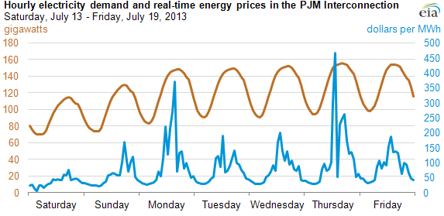
And electricity's Christmas sales and January slump come once a day!
EIA data on hour-by-hour power consumption at one Grid "node" (location)
Customers are going to be awfully unhappy if you don't meet "Christmas demand"
Further, in many areas, those customers may be co-owners of your company
Elsewhere, via "public utility commissions," they regulate your profit margins
Besides, with the grid, "fall short" and your entire production probably crashes
So your plant MUST be large enough to cope with daily "Christmas Season"
Demand Cycles:
www.eia.gov/todayinenergy/detail.cfm?id=12711
Cost Cycles:

Slide 6
How big are today's power plants, and how many are there?
The EIA says that the US now has 6997 power plants of at least 1 MW capacity ⁽¹⁾
And that the total US energy production in 2012 was 4,047,765 GW-h ⁽²⁾
Which divided by 8760 hours/year => US average power = 462 GW
Leading to my easier to remember: US average power ~ ½ Tera-Watt
If you divide THAT by the 6997 power plants, average power/plant/time = 66 MW
But that is power production (= average) and NOT power capacity (= peak)
Further, that number is distorted by inclusion of many older smaller power plants
REALITY = A much smaller number of LARGER plants produce MOST of our energy
1) www.eia.gov/tools/faqs/faq.cfm?id=65&t=2 2) www.eia.gov/electricity/annual/html/epa_03_01_a.html

Slide 7
Capacities of TYPICAL U.S. power plants:
Per the Congressional Research Service study of REAL operating plants (2008)¹:
FOSSIL FUEL POWER PLANTS: ~ 500 MW per plant
NUCLEAR PLANTS: ~ 1500-3000 MW per plant
SOLAR THERMAL: ≤ 250 MW per plant
WIND: ≤ 200 MW per plant
GEOTHERMAL: ≤ 150 MW per plant
SOLAR PHOTOVOLTAIC: ≤ 75 MW per plant
NOTE (!): Not only are most renewable power plants MUCH, MUCH smaller
But, data above cites the then largest example of each new technology
With MOST plants of that type being much smaller (hence "≤" signs!)
1) http://fas.org/sgp/crs/misc/RL34746.pdf

Slide 8
But the 1st two types produce the vast majority of our power:
TYPE: TYPICAL SIZE SHARE OF U.S. POWER ⁽¹⁾
Fossil Fuel Power Plants ~ 500 MW per plant 67%
Nuclear Plants: ~ 1500-3000 MW per plant 19%
It is from this and the preceding slide that I derived my oft repeated:
"Typical U.S. power plant capacities: 200-2000 MW"
"Average US Power Plant ~ 600 MW"
Comparing those numbers with data on preceding slide, one would conclude:
1) http://www.eia.gov/tools/faqs/faq.cfm?id=427&t=3
For more detailed information see my U.S. Power Production & Consumption (pptx / pdf / key) note set

Slide 9
To be major contributors, renewable plants must grow > 3-10 X
In fact, a good design goal for all power plants would be a capacity of ~ 1 GW
You COULD build smaller plants, but you'd need a LOT more of them
And then interconnection and operational costs might bite you
So let's use that as our 1st design goal:
Capacity of a typical power plant ~ 1 GW
But I also want figure out TOTAL U.S. requirements
From above, time averaged U.S. power generation was 462 GW (~ ½ TW)
But this averages high evening loads with much lower overnight loads
An Introduction to Sustainable Energy Systems: WeCanFigureThisOut.org/ENERGY/Energy_home.htm

Slide 10
Returning to those daily / weekly power cycles:
www.eia.gov/todayinenergy/detail.cfm?id=12711
Peak power consumption looks to be about 1.5 X the average consumption
Remember that our power plants must be designed for the peak not average
Then add in power plant downtimes for repair and/or refueling
=> Capacity had better be ~ 2 X times the average consumption
Which provides our 2nd design goal:
U.S. Power Capacity ~ 1 Tera-Watt => One thousand 1 GW plants

Slide 11
Part I: Power Plant Land Requirements:
Conventional (coal, gas, oil) plants are not that large – say 2-5 hectares
"hectare" = (100 m)(100 m) = 0.01 km² ~ 2.5 acres
Current capacity ~ 500 MW = ½ our design goal, so rounding upward:
1 GW fossil fuel plant ~ 0.1 km²
Nuclear plants tend to be larger based on security and used fuel storage needs
Our local "Lake Anna" nuclear plant is probably a worst case on space
It includes a ~ 1400 hectare "waste heat treatment" plant
Which makes use of a ~ 3800 hectare manmade lake
Not counting the lake's area, its two reactors occupy 4.35 km²
Those reactors have a power capacity of 1.89 GW, yielding:
1 GW nuclear plant ~ 2 km²

Slide 12
What about renewable energy power plants?
Most of these are ultimately driven by solar energy:
Directly as in solar photovoltaic and solar thermal
Or quasi directly as in plant or algae photosynthesis
Or by solar heat producing convection-driven winds (or waves)
Or by solar evaporation of sea water collecting as rain in reservoirs
But the sun delivers, at the very best, only 1 kW / m² to the earth's surface
Tidal power is also very dilute, and geothermal even weaker
So plants tapping into dilute renewable energy sources must be much larger
Further, they'd better be optimally located
And/OR optimally directed
An Introduction to Sustainable Energy Systems: WeCanFigureThisOut.org/ENERGY/Energy_home.htm

Slide 13
Starting with solar photovoltaic plants:
For max power, solar cells SHOULD always be aimed DIRECTLY at the sun
Requiring East to West daily tilting AND North to South seasonal tilting
Necessary motors and drives for tilting (one or two axes) add cost
Yielding options (in Northern hemisphere) of:
1) Fixed cells (tilted slightly South to best catch average noon sun) - OK
2) Motorized East-West daily tilt (with fixed Southern tilt) - BETTER
3) Motorized East-West daily AND North-South seasonal tilts - BEST
Option 1 is the most popular, but let's goose solar upward by using option 2:
Go to NREL (National Renewable Energy Lab) webpage on U.S. insolation
Select options of: - Average annual insolation
- East to west tracking (tilting) solar cells

Slide 14
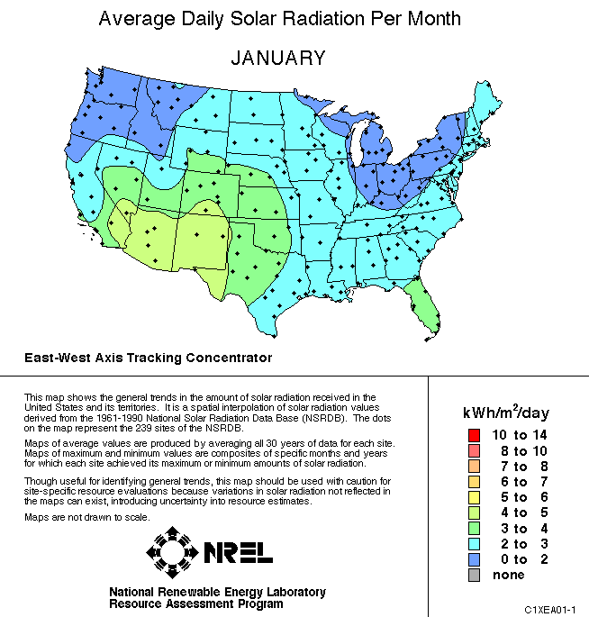
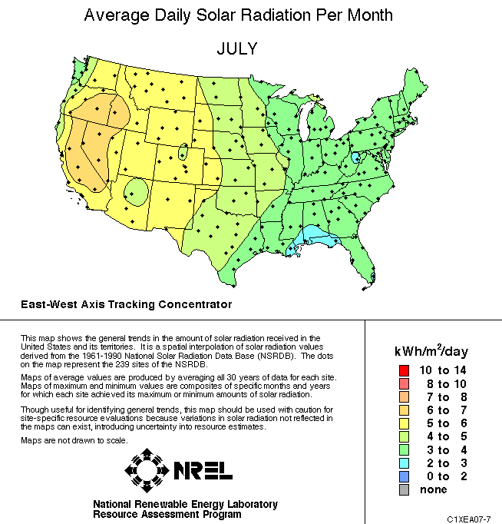
Which then pops up these maps (for different months)
U.S. National Renewable Energy Lab map (by year, month, min, max or average):
http://rredc.nrel.gov/solar/old_data/nsrdb/1961-1990/redbook/atlas/
Conclusion? Build solar plants in the high deserts of the Southwest
(and we'll come back to the exact numbers in just a second)

Slide 15
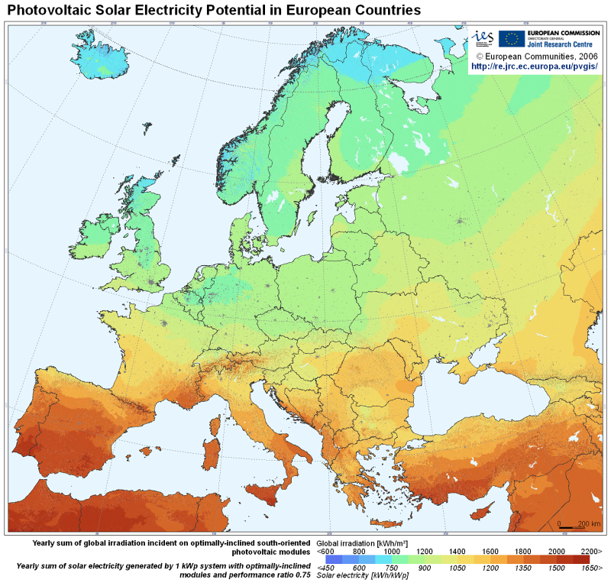
What about Europe?
I did not spot maps with comparable (important!) tilt selection options
From European Joint Research Centre (http://re.jrc.ec.europa.eu/pvgis/countries/countries-europe.htm):
Conclusion?
Look to the Mediterranean
Or to North Africa?

Slide 16
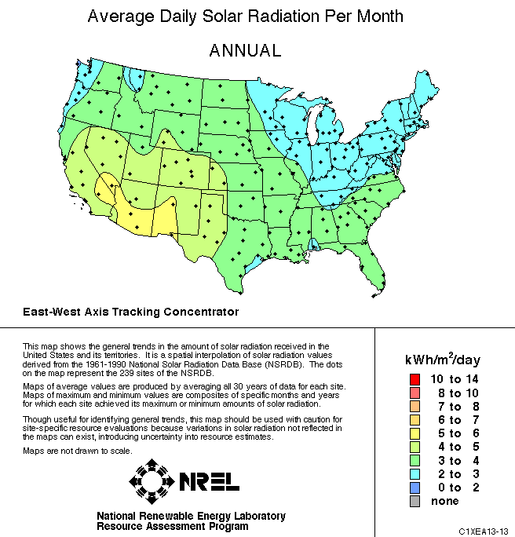
Back to an ANNUALY AVERAGED NREL U.S. insolation map
Let's build our solar plant right here!
Map gives, for Central Virginia:
3 kW-h/m²/day average solar "insolation"
= 3 kW/m² x (h/day)
= 3 kW/m2 x (1/24)
= 125 W / m²
Earlier in class we learned that common Si crystalline solar cells are ~20% efficient:
If they occupied 100% of ground area:
http://rredc.nrel.gov/solar/old_data/nsrdb/1961-1990/redbook/atlas/
Average energy harvested in central Virginia = 25 W / m²
An Introduction to Sustainable Energy Systems: WeCanFigureThisOut.org/ENERGY/Energy_home.htm

Slide 17
Working toward our goal for a competitive renewable plant:
That design goal specified a power production capacity of = 1 GW
Dividing that target by solar power per area:
Land = 1 GW /(25 W / m²) = 40 million m²
= 40 km² (in VA) ~ 4 mi x 4 mi !!
And we still have to figure out how to
store daytime energy for evening use!
To heck with Virginia, let's build in Arizona!
Where we'd need half the land = 20 km² (AZ)
1 GW crystalline Si solar photovoltaic plant ~ 20 – 40 km²

Slide 18
What about using alternative solar PV technologies?
PV plants using cheaper materials? From Today's Solar PV (pptx / pdf / key) notes:
Polycrystal Si cells are ~ 4/5 as efficient => 5/4 the land (25-50 km²)
Amorphous Si cells are ~ ½ as efficient => twice the land (40-80 km²)
Organic cells are ~ ¼ as efficient => four times the land (80-160 km²)
And what about concentrated Solar thermal? (tower + heliostat mirrors)
Might that be much more efficient than PV's paltry 20% ?
From a textbook I've come to respect ("Energy and the Environment" – Fay & Golomb)
Average solar thermal power production (p. 186): "11.6-49 W/m²" =>
1 GW solar thermal plant ~ 20 – 86 km²
But for what type of solar thermal plant, and at what quality of location?

Slide 19
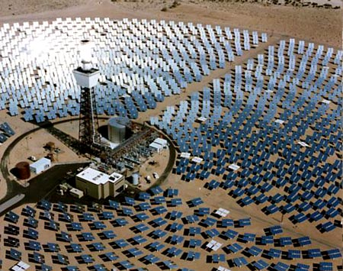
Trying to further pin down numbers for solar thermal:
Solar Thermal is another "Carnot Engine" (as explained in Exotics lecture):
=> Max energy conversion efficiency (%) = (1 – T_{low} / T _{high}) x 100
Assume it uses oil, boiled in tower at 400°C, then air-cooled to 100°C
Maximum efficiency (%) ~ (1-373 °K/673 °K) ~ 45%
=> ~ 40% in real life
It receives same sunlight per area as solar photovoltaics
But moving mirrors seem to occupy only ~ ¼ of area:
Thus efficiency drops to 10% = ½ that of Xtal Si PV
So 1 GW Solar Thermal plant might be 2X size of Xtal Si solar or ~ 40-80 km
Can we find any confirming data? What about California's big new plant?
http://blog.zintro.com/clean-tech-alt-energy/page/2/

Slide 20
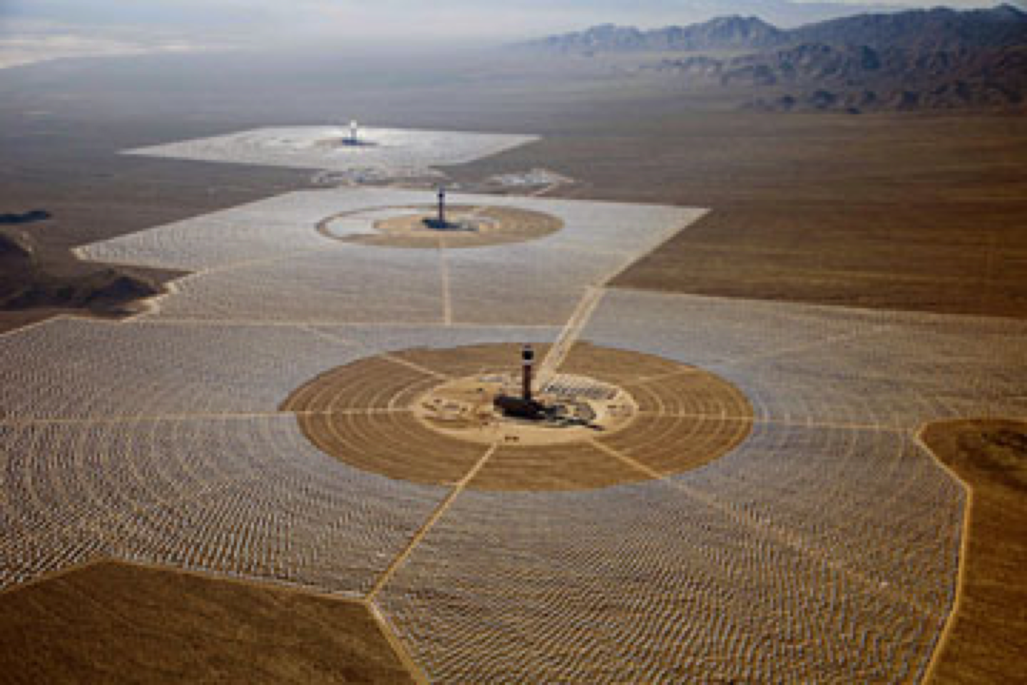
From earlier Solar Energy lecture:
California's recently completed "Ivanpah" Mojave Desert farm:
NREL⁽¹⁾: "Annual Generation (planned) = 1,079,232 MW-h / 3500 acres"
3500 Acres => 1400 hectares => 14 km²
P_{average_out} / km² = (1079232 MW-h/ 8760 h) / 14 km² = 8.8 MW / km²
So to produce 1 GW in this Arizona-like insolation, would need area of:
Area (in dessert CA or AZ) for 1 GW = 1 GW / (8.8 MW / km²) = 113 km²
Poorer number could because Ivanpah uses water and not oil as working fluid!
"Tower of Power" Time Magazine June 24, 3013
1) http://www.nrel.gov/csp/solarpaces/project_detail.cfm/projectID=62

Slide 21
Summary of numbers for 1 GW Solar Thermal plant area:
1) From Fay & Golomb's Energy and the Environment textbook:
1 GW solar thermal plant = 20 to 86 km²
2) From Carnot Cycle using oil as working fluid + photo of mirror ground coverage:
1 GW solar thermal plant = 40 - 80 km²
3) From that NREL information on Ivanpah plant using water as working fluid:
1 GW solar thermal plant = 113 km² in CA
Which would then translate into 226 km² in VA
In calculations to follow, let's use Ivanpah-like numbers, good site vs. any old site:
1 GW solar thermal plant = 100 – 200 km²
An Introduction to Sustainable Energy Systems: WeCanFigureThisOut.org/ENERGY/Energy_home.htm

Slide 22
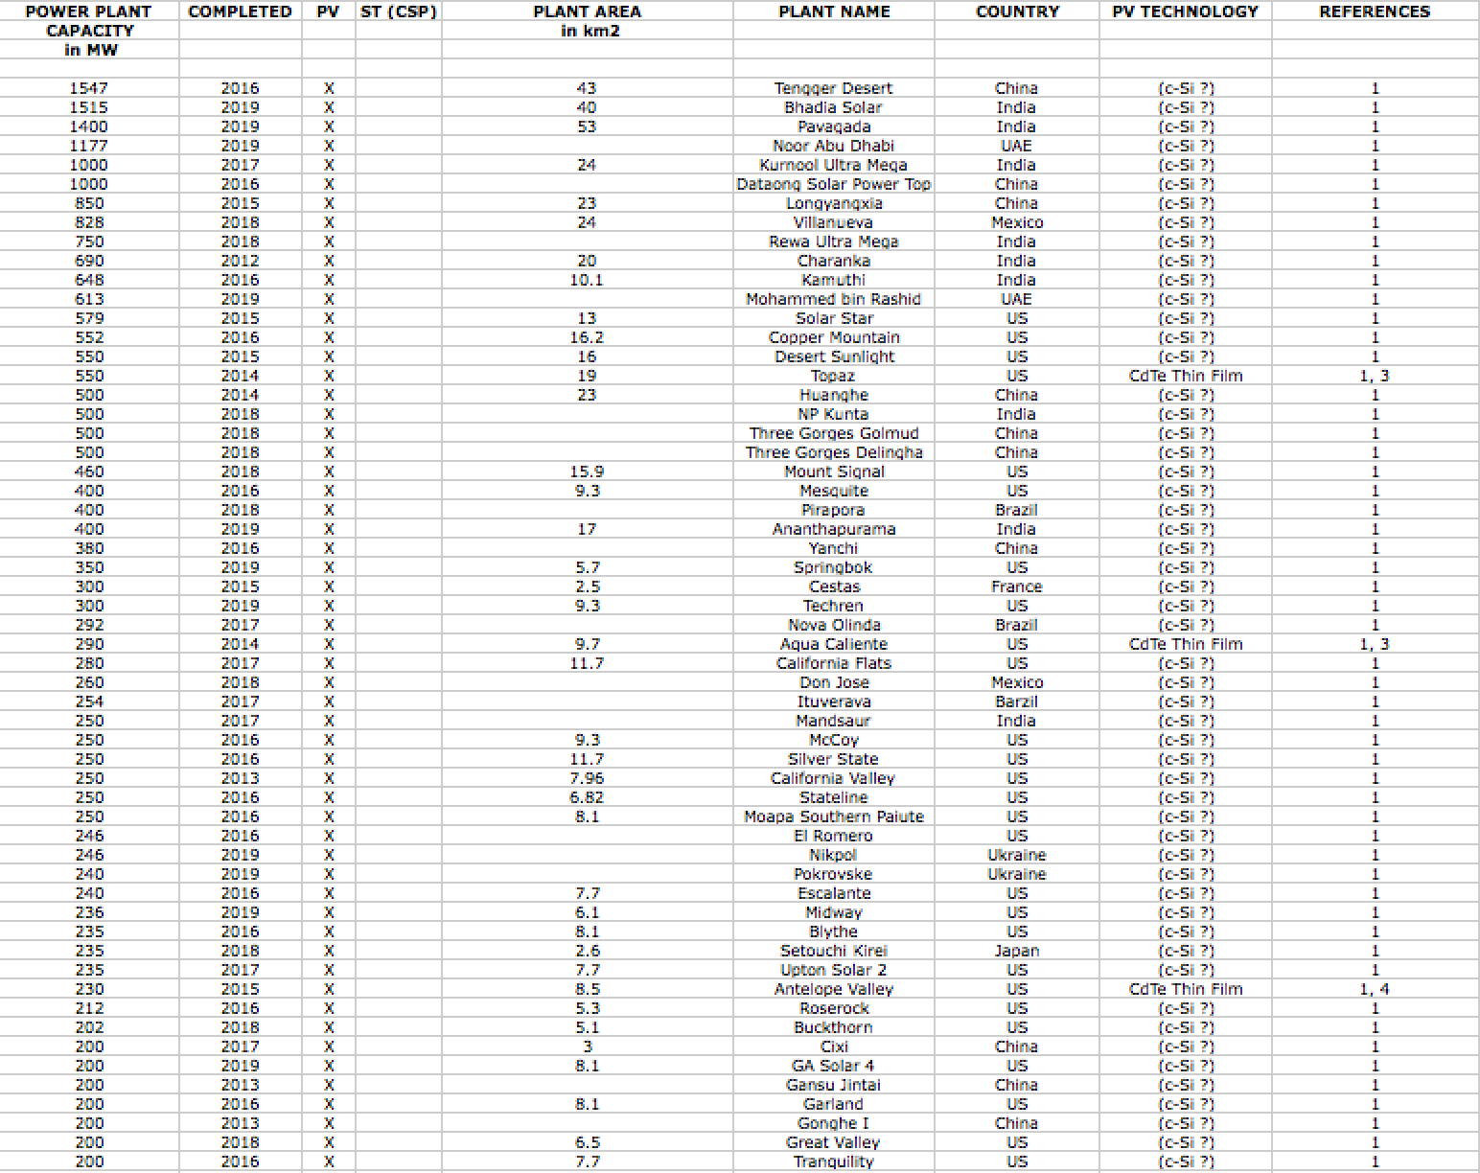
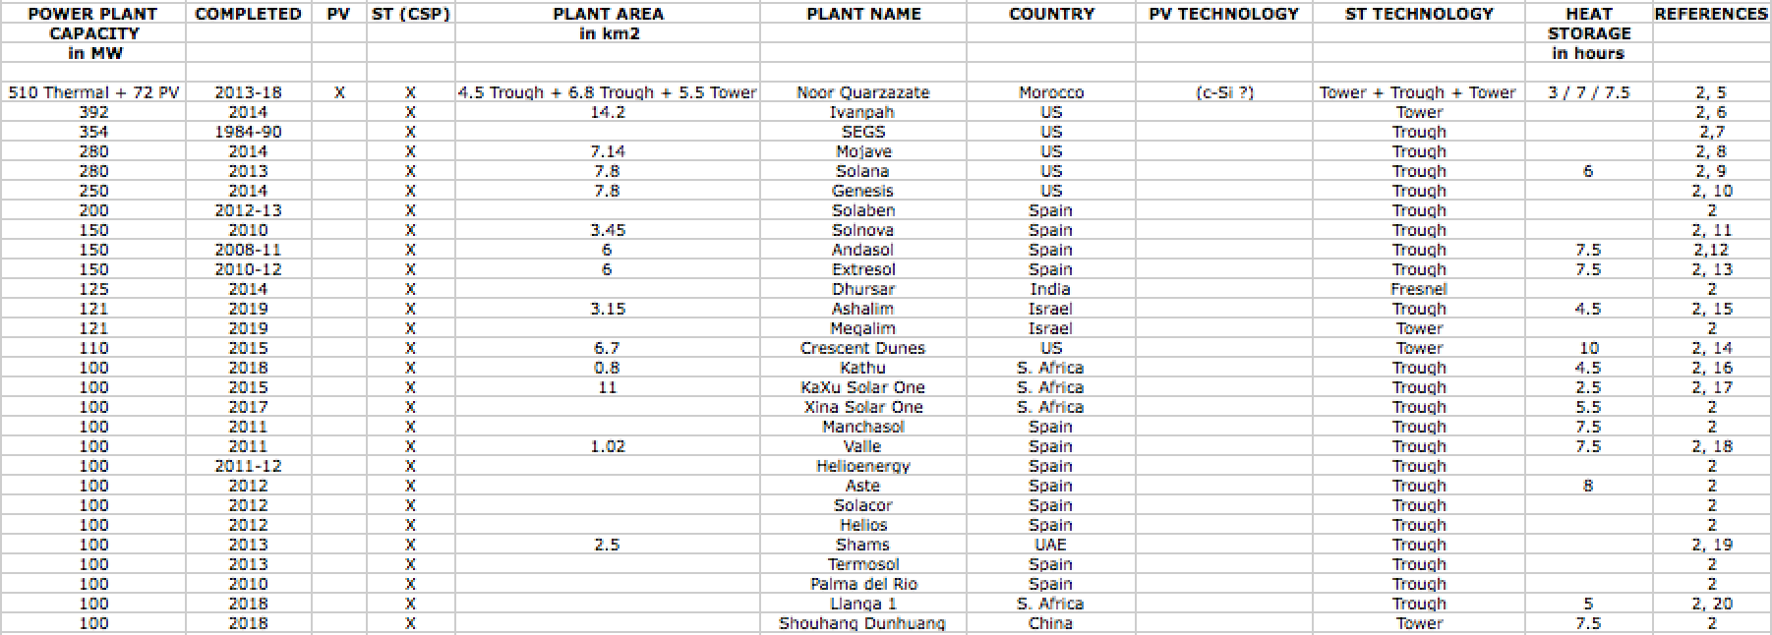
ADDED SUMMER OF 2020:
There are finally significant numbers of large Solar PV & Solar Thermal Plants
And for my note set on Utility Scale Solar Power Plants (pptx, pdf, key)
I gathered all the information I could find about them
compiling these long spreadsheet tables:
Utility Scale Solar PV Plants: Utility Scale Solar Thermal Plants:
NOTE: For almost all of the Solar PV plants
in the table on the left, the PV cells used
were single crystal silicon PV cells

Slide 23
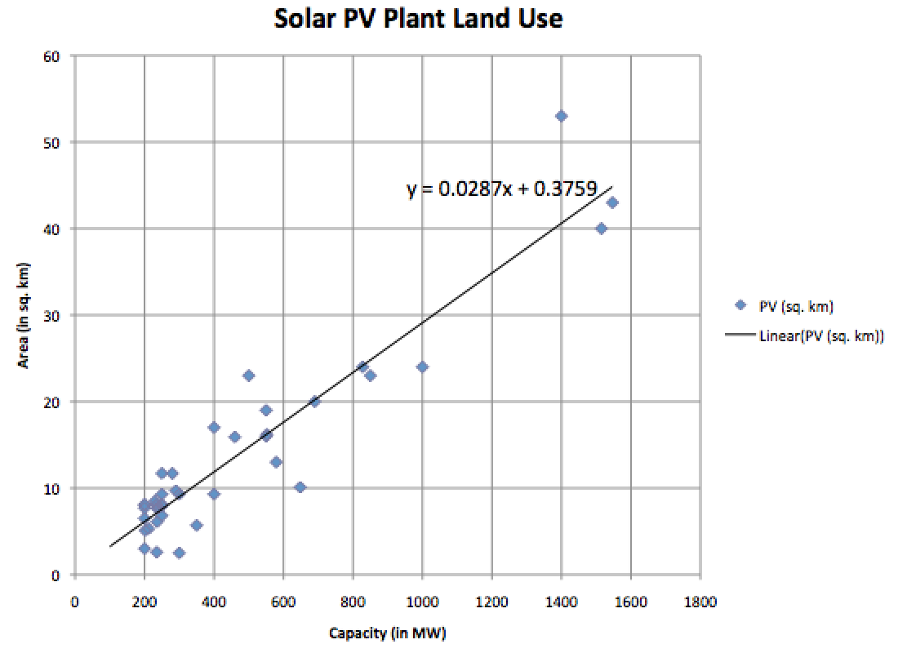
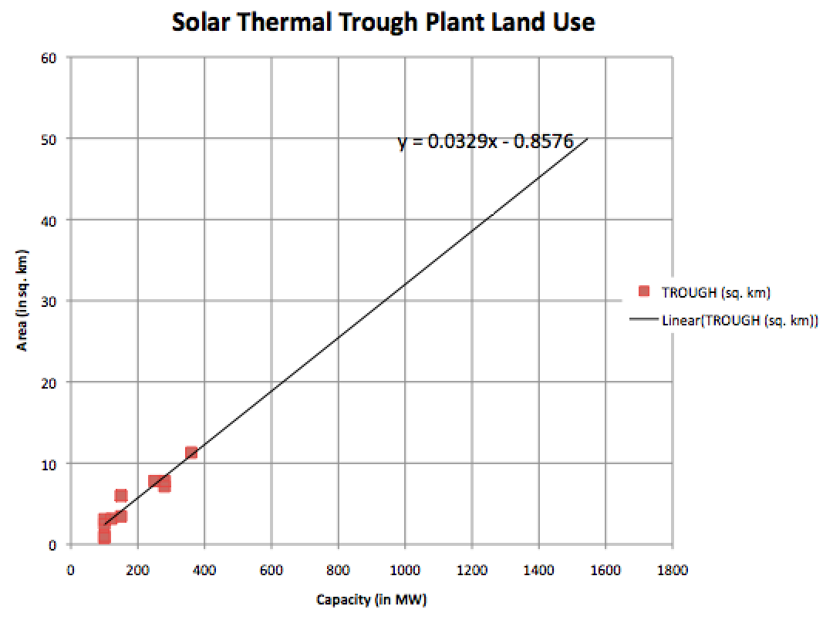
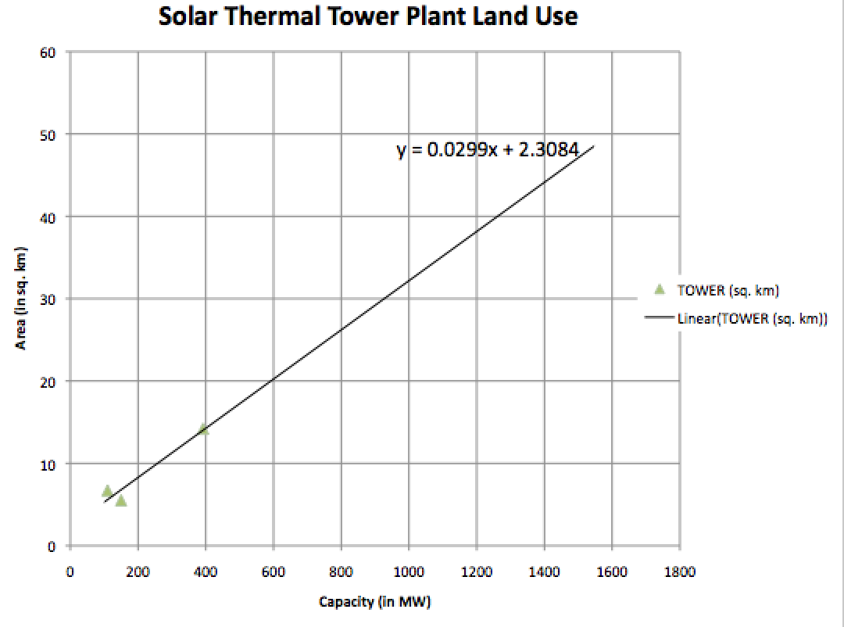
But most sources still omitted information about solar plant area
And instead gave the cumulative areas of the solar cells or solar collectors alone
But in the end, I was able to find enough reliable information to make these
statistically significant Plant Power Output vs. Plant Area correlations:
An Introduction to Sustainable Energy Systems: WeCanFigureThisOut.org/ENERGY/Energy_home.htm

Slide 24
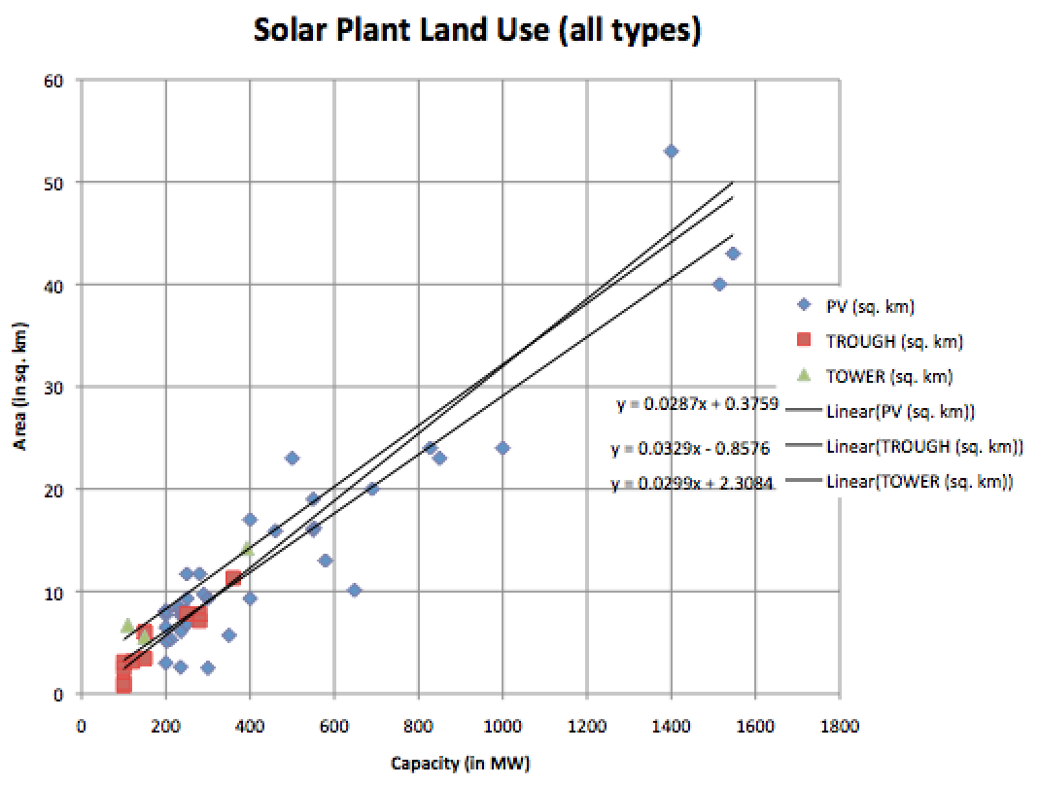
The Solar PV and Solar Thermal correlations were surprisingly similar:
Silicon Solar PV:
0.029 km² / MW => 34 W / m²
Thermal Troughs:
0.033 km² / MW => 30 W / m²
Thermal Towers:
0.030 km² / MW => 33 W / m²
And thus for all 2020 commercial Solar Plants: Land use ~ 0.03 km² / MW
meaning that for our targeted goal of a 1 GW plant:
1 GW Commercial Solar Plant Area = ~ 30 km²

Slide 25
Which supplants my earlier predictions about 1 GW Solar Plant Sizes:
Based on textbook / single plant data:
Crystalline Silicon Solar PV ~ 20-40 km²
Poly Si PV (5/4 of Xtal Si) ~ 25-50 km²
Amorphous Si PV (2X Xtal Si) ~ 40-80 km²
Organic PV (4X Xtal Si) ~ 80-160 km²
Solar Thermal Tower ~ 100-200 km²
Based on existing 2020 plant data:
Crystalline Silicon Solar PV ~ 30 km²
Poly Si PV (5/4 of Xtal Si) ~ 37.5 km²
Amorphous Si PV (2X Xtal Si) ~ 60 km²
Organic PV (4X Xtal Si) ~ 120 km²
Solar Thermal Trough or Tower ~ 30 km²

Slide 26
What about biofuels?
Biofuels are a form of Solar Energy ¹
Because their ultimate source of energy IS the sun
But while photovoltaic solar cells have conversion efficiencies of:
20-25% for widely commercialized cells
50% for complex research "tandem" solar cells
Or 1-10% for (potentially) much cheaper emerging types
Plant photosynthesis has a solar energy conversion efficiency of ~ 1% ²
Algae (including saltwater tolerant species) can achieve ~ 10%
These are the fundamental (unbeatable) chemical conversion efficiencies
And thus not something that better / more mature engineering will improve
1) For a general discussion see my Biomass & Biofuels (pptx / pdf / key) note set
2) From Vanek et al.: Energy Systems Engineering – Evaluation and Implementation (p. 453)

Slide 27
Which allows for a technology-independent land use estimate:
Crystal PV solar cells with ~ 20% conversion efficiencies:
To produce 1 GW require 20-40 km2
Scaling from this, based on an intrinsic 10% photosynthetic conversion efficiency,
To produce 1 GW algae based biofuels should require at least 40-80 km²
Based on an intrinsic 1% photosynthetic conversion efficiency,
To produce 1 GW plant based biofuels should require at least 400-800 km²
Comparing to actual data from Fay & Golomb's Energy and the Environment (p. 168):
Time averaged P_{output} ~ "0.42 W/m²" (discussing agricultural crops)
To get 1 GW => 2.4 x 10⁹ m² => 2400 km²
Yielding a fair consensus on biofuels: Theoretical limit vs. measured values ~ 3:1

Slide 28
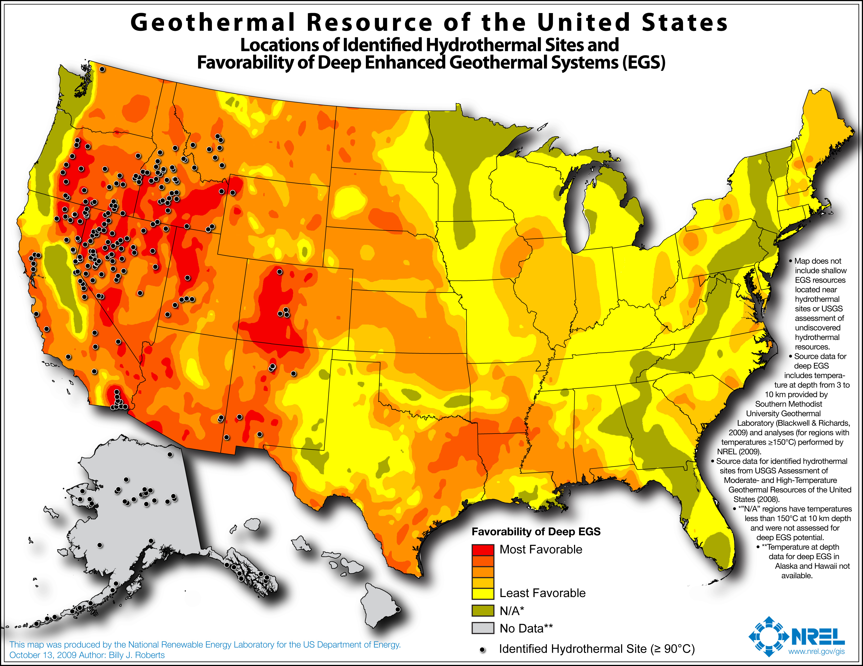
What about technologies that CAN SHARE the land?
Geothermal - NREL Geothermal map from Exotic Power Sources lecture:
http://www.nrel.gov/gis/images/geothermal_resource2009-final.jpg
Which steers us toward West/Northwest and suggests other "favorable" locations
But does NOT give any hard heat flux numbers!
An Introduction to Sustainable Energy Systems: WeCanFigureThisOut.org/ENERGY/Energy_home.htm

Slide 29
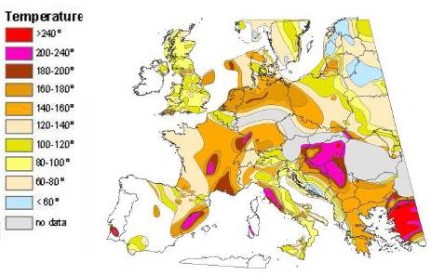
Comparable incomplete geothermal data for Europe:
European Commission:
http://ec.europa.eu/research/energy/eu/research/geothermal/background/index_en.htm
An Introduction to Sustainable Energy Systems: WeCanFigureThisOut.org/ENERGY/Energy_home.htm

Slide 30
So to estimate Geothermal requirements: Back to single numbers:
From my earlier Exotic Power Technologies (pptx / pdf / key) note set:
Thermodynamics' Carnot cycle gives maximum "heat engine" efficiency of
Max efficiency (%) = (1 – T_{low} / T _{high}) x 100
For geothermal heat engines, T_{low} ~ earth surface temperature ~ 300°K
And T_{high} might be 200°C higher, e.g. 500°K giving theoretical limit of
Max geothermal efficiency ~ (1- 300 / 500) x 100 ~ 40%
Wikipedia specs average thermal flux as 65 mW / m² land (vs. 110 ocean bottom)
USGS gives about the same at ~ 50 mW / m²
An Introduction to Sustainable Energy Systems: WeCanFigureThisOut.org/ENERGY/Energy_home.htm

Slide 31
From those numbers:
1) With 40% capture of 50-65 mW / m²:
P_{geothermal} = 20-26 mW / m² = 20-26 x 10⁶ mW / km² = 20-26 kW / km²
Area of 1 GW plant => 1 GW / (20-26 kW / km2) = 38500-50000 km²
1 GW geothermal plant ~ 38,000-50,000 km²
2) But "Sustainable Energy – Without the Hot Air" (p. 99)¹ gives: 25 – 150 mW / m²
Which would expand range to:
1 GW geothermal plant ~ 6,666-40,000 km²
Low 6,666 km² area number suggests McKay included enhanced locations
E.G., Yellowstone which has ~ 50X higher heat (peaking ~ 2000X higher!)
So assuming enhanced (but not extraordinary) locations, I'll use McKay's:
1 GW geothermal plant ~ 6,666-40,000 km²

Slide 32
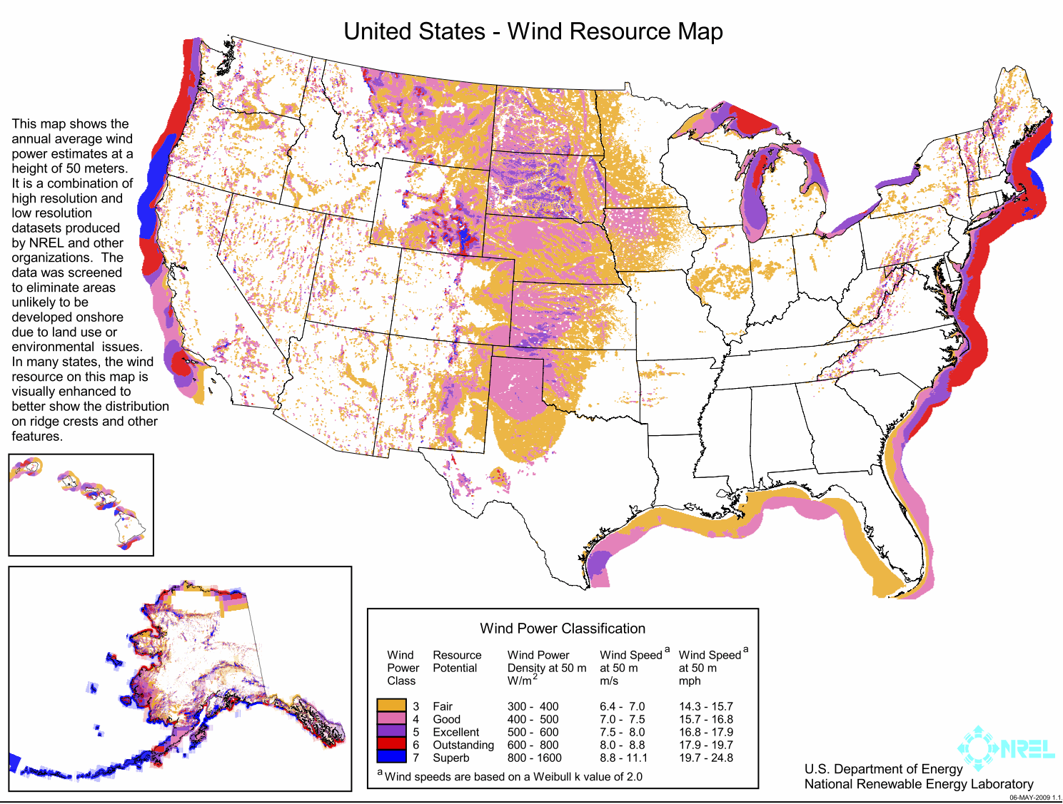
Moving on to second land-sharing power source: Wind
Back to maps – here a much more useful NREL map (with hard numbers!):
Conclusions: Northern coast = Best Abundant HIGH plains = Very good
Low hills = Fair Tall Mountains / Low plains = Poor
TALL mountains block, or divert winds upward beyond turbine's easy reach!
Offshore is great but costs escalate on more quickly deepening western coasts
www.nrel.gov/gis/wind.html

Slide 33
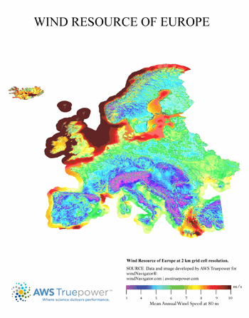
Or comparable data for Europe:
Conclusions are very similar:
High mountains = Bad (block/lift wind)
Low hills = Fair
Low altitude plains = Poor (e.g. Veneto Italy)
Offshore = Best
Especially at northern latitudes
But water cannot be too deep!
~ Excluding mountainous coasts
An Introduction to Sustainable Energy Systems: WeCanFigureThisOut.org/ENERGY/Energy_home.htm

Slide 34
But conversion of average wind speed to power extracted / area requires:
Answering wind farm design questions of:
- How far should turbines be spaced from one another?
- How big should individual turbines be?
Recalling results from my earlier Wind Power (pptx / pdf / key) note set:
1) As turbine slows wind, back-pressure causes air to divert around it
2) Wind speed increases sharply as you rise above ground level
Because the ground, its grass, bushes and trees retard air movement
3) Wind power passing by a turbine increases as wind speed cubed (v_{wind}³)
Because the air's kinetic energy (per volume) goes as v_{wind}²
And the volume of air passing by the turbine goes as v_{wind}
An Introduction to Sustainable Energy Systems: WeCanFigureThisOut.org/ENERGY/Energy_home.htm

Slide 35
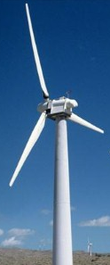
Which led to our rules about turbine spacing and size:
Turbines should be separated by ~ 5 times their blade diameter ¹
Implying, turbines per plant area = 1 / (5 x turbine-blade-diameter)²
With turbines should be as tall/big as possible to capture higher speed upper winds:
1) "Sustainable Energy – Without the Hot Air" – McKay, page 265

Slide 36
Conversion of map's wind speed => Wind farm power output
As derived in my earlier lecture (and "Sustainable Energy without the Hot Air"):
P_{wind} (thru area A) = ½ (air density) x (air velocity)³ A = ½ rho v³ A
where air density rho (ρ) will be taken as 1.2 kg / m³
Solving this, for instance, with a wind speed of 8 m / s:
P_{wind} (at 8 m/s wind passing thru area A) = 307 (W / m² ) x Area
However, as I discovered by analyzing NREL data (but the book "Hot Air" did not!):
The v_{wind}³ dependence of power upon wind speed
means that you shouldn't use average wind speeds
Because, for same average speed, variable winds give more energy!
An Introduction to Sustainable Energy Systems: WeCanFigureThisOut.org/ENERGY/Energy_home.htm

Slide 37
Which I demonstrated via this case comparison:
Using formula from above, for two cases with SAME average wind speed of 8 m/s:
CASE 1: Constant daily wind speed of 8 m/s:
Wind speed over day: Wind power over day:
CASE 2 : Variable wind speed averaging (over day) 8 m/s:
Wind speed over day: Wind power over day:
8 m/s
Average Power = ½ ρ 512 A
½ ρ 8³ A
16 m/s
½ ρ 16³ A
8 m/s
Average Power = ½ ρ 1536 A
½ ρ 8³ A
½ ρ 0³ A

Slide 38
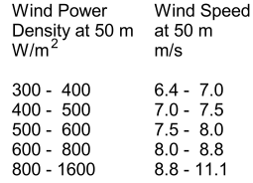
Comparison with NREL map suggested real life enhancement of 2X:
Formula: Constant wind speed of 8 m/s => P_{wind} = 307 W/m² x A
My model: Variable wind with 8 m/s average => P_{wind} = 921 W/m² x A
NREL data: With real life wind, 8 m/s average => P_{wind} = 600 W/m² x A
So we can use P_{wind} formula (~ doubling its results to account for variable winds)
OR, where sources like NREL give variable wind power densities, just use that data!

Slide 39
Enlarging the NREL U.S. map so that we can read off numbers:
Location: Ave. Wind @50m (m/s) Ave. Wind Power Density @50m (W/m²)
Onshore Central Virginia << 6 << 300
Onshore Great Plains ~ 7 ~ 400
Offshore Virginia ~ 8 ~ 700
Offshore N. CA / S. OR ~ 10 ~ 1200

Slide 40
Starting calculation with a single wind turbine:
"Betz Law" said theoretical max wind turbine power conversion efficiency = 59.3%
So let's assume that for our real world-turbines, ε_{turbine} = 50%
For 50 m diameter wind turbine, wind area intercepted = 1963 m²
P_{50m turbine} = (50% efficiency) (turbine blade area) (wind power per area)
= 982 m² x (wind power per area)
Filling in wind power per area from preceding slides, get P_{50m turbine} =
    Location: Using wind speed Using wind
in formula: power density data:
Onshore Central Virginia << 127 kW << 295 kW
Onshore Great Plains 201 kW 392 kW
Offshore Virginia 301 kW 687 kW
Offshore N. CA / S. OR 587 kW 1178 kW

Slide 41
Then using spacing rule to build a full wind farm:
Power / plant area = Power per turbine / turbine footprint (with optimum spacings)
P_{per plant land area}= P_{50m turbine} / (5 x turbine-blade-diameter)²
= P_{50m turbine} / (62,500 m²) = 16 P_{50m turbine} / km²
Plugging in P_{50m turbine} data from preceding slide, get P_{per plant land area} =
  Location: Using wind speed Using wind
in formula: power density data:
Onshore Central Virginia << 2 MW / km² << 4.7 MW / km²
Onshore Great Plains 3.2 MW / km² 6.3 MW / km²
Offshore Virginia 4.8 MW / km2 10.9 MW / km2
Offshore N. CA / S. OR 9.36 MW / km2 18.7 MW / km2
An Introduction to Sustainable Energy Systems: WeCanFigureThisOut.org/ENERGY/Energy_home.htm

Slide 42
And dividing this into our 1 GW power capacity goal:
We get 1 GW wind farm land areas of:
Location: Using wind speed Using wind
in formula: power density data:
Onshore Central Virginia >> 500 km² >> 213 km²
Onshore Great Plains 312 km² 159 km²
Offshore Virginia 208 km² 92 km²
Offshore N. CA / S. OR 106 km² 54 km²
Recalling that formula did not account for enhancement due to variable winds
And that power should thus be doubled (halving the land requirement)
Both methods give almost identical results = That of table's final column
Hence my highlighting of that column's data
An Introduction to Sustainable Energy Systems: WeCanFigureThisOut.org/ENERGY/Energy_home.htm

Slide 43
Grand summary of estimated 1 GW power plant sizes:
Plant Technology: Good / Best Site: Random Site:
Fossil Fuel ~ 0.1 km² ~ 0.1 km²
Nuclear ~ 2 km² ~ 2 km²
Crystal Si PV solar ~ 30 km² ~ 60 km²
Solar Thermal ~ 30 km² ~ 60 km²
Poly Si PV solar ~ 37.5 km² ~ 75 km²
Offshore Wind ~ 55 km² ~ 90 km²
Amorphous Si PV solar ~ 60 km² ~ 120 km²
Organic PV solar ~ 120 km² ~ 240 km²
Onshore Wind ~ 160 km² >> 200 km²
Biofuel (algae) ~ 200 km² ~ 200 km²
Biofuel (plants) ~ 2000 km² ~ 2000 km²
Geothermal ~ 6000 km² ~ 40,000 km²

Slide 44
For full U.S. power (1000 such plants on "good/best" sites):
Technology: Good Sites: Equivalent to area of: % of US:
Fossil Fuel 100 km² ½ of Washington DC 0.001%
Nuclear 2,000 km² ½ of Rhode Island 0.02%
Crystal Si PV solar 30,000 km² Maine 0.3%
Solar Thermal 30,000 km² 0.3%
Poly Si PV solar 37,000 km² 0.37%
Offshore Wind 55,000 km 0.55%
Amorphous Si PV solar 60,000 km² Georgia 0.6%
Organic PV solar 120,000 km² 1.2%
Onshore Wind 160,000 km 1.7%
Biofuel (algae) 200,000 km² 2%
Biofuel (plants) 2,000,000 km² TX+CA+MT+NM+AZ 20%
Geothermal 6,000,000 km² AL+TX+CA+MT+NM+ 61%
AZ+NV+CO+OR+WY+
MI+MN+UT+ID+KS

Slide 45
Power Plant Land Requirement Bottom Lines:
Because renewable energy sources are very dilute (i.e., average power / area),
in order to deliver a good fractions of US power requirements,
their cumulative land areas range from smaller state to most states
And this was for "good to best locations" for each type of plant
I suspect practical limit will not exceed onshore wind's cumulative 100,000 km²
And only then because wind can SHARE land with other uses
From an aggressive land use perspective, viable renewables appear to be:
Wind or Solar Photovoltaics
From a less aggressive land use perspective, viable renewables appear to be:
Offshore Wind or Crystal/Polycrystal Silicon Solar Photovoltaics
Both of which are more plausible when supported (at least for now) by:
Quasi-renewable Nuclear

Slide 46
Part II: Power Plant Water Requirements:
Biofuel water consumption: Much of the above crop area would be irrigated
Actual water use would depend upon crop, soil and weather conditions
Making crop by crop calculations very complicated
But from Biomass and Biofuel (pptx / pdf / key) notes, water use would be huge
A Georgia Tech study even concluded (to the researchers' surprise) that:
1st world dependence on biofuels would require ALL of world's fresh water ^{1, 2}
Further, water released from corn biofuel farms is polluted by agricultural chemicals
And then there is the preceding damning computation of biofuel land requirements
Which all combine to make exact water use computations effectively moot
(But links to the above articles are given on this note set's Resources Webpage)
1) Biofuel's Water Problem, IEEE Spectrum, June 2010 2) Organic But Not Green IEEE Spectrum, November 2009

Slide 47
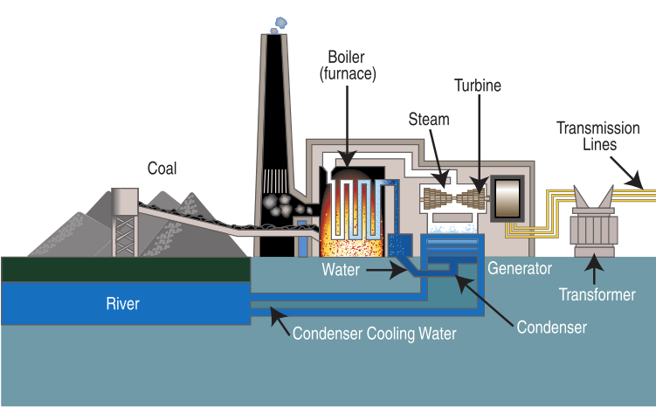
Water consumption of more conventional power plants?
Hydropower water consumption: I've already mentioned the GREAT DROUGHT
Which is jeopardizing hydropower in the Southwest
Possibly even crippling hydroelectric plants such as the Hoover Dam
Steam driven power plant water consumption:
= All fossil fuel plants (except OCGT natural gas), nuclear, some solar thermal
The issue here is the water used to cool and recondense that steam:
Boiler
River/lake
Condenser
http://en.wikipedia.org/wiki/Fossil-fuel_power_station

Slide 48
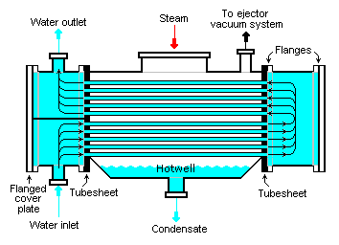
Steam condensation occurs in water-cooled "condensers"
Which allow two loops (or volumes) of water to come into close contact
One carrying steam that has just exited the turbine generator
One with "cooling water" (from river / lake. . . then returning to same)
Heat from the much hotter steam migrates to the much cooler cooling water
The steam condenses, the cooling water gets warmer
http://en.wikipedia.org/wiki/Surface_condenser
An Introduction to Sustainable Energy Systems: WeCanFigureThisOut.org/ENERGY/Energy_home.htm

Slide 49
Warming of that cooling water has consequences:
For smaller lakes and rivers, water temperature rise can be very important:
Harming wildlife, or perturbing the ecosystem
For example by fostering alga growth => Oxygen depletion => Fish die offs
How might one calculate the cooling water's temperature change?
Power _{Steam => Cooling Water} = (Steam mass / time) (H₂O heat of vaporization)
Which should cause that cooling water's temperature to rise by:
ΔT = Power _{Steam => Cooling Water} / [(Cooling H₂O mass per time) (H₂O specific heat)]
Combining those equations:
(Steam mass per time) (H₂O heat of vaporization)
(Cooling H₂O mass per time) (H₂O specific heat)
ΔT =

Slide 50
Looking up relevant physical constants for water:
Water's heat (or "enthalpy") of vaporization = 2260 k Joules / kg
Water's specific heat (or heat capacity") = 4.179 Joules / g / °C
Inserting those values into equation above:
ΔT = 540 °C x (Steam mass per time)/(Cooling water mass per time) (1)
Use more cooling water => Get smaller ΔT rise
But steam mass per time DRIVES the turbine generator, thus I'd expect:
Electrical power generated should be proportional to steam flow
And I could indeed dig that proportionality out of a textbook:
An Introduction to Sustainable Energy Systems: WeCanFigureThisOut.org/ENERGY/Energy_home.htm

Slide 51
Incorporating steam to electrical conversion efficiency:
From Rubin's Introduction to Engineering & the Environment (p. 190-191):
(Electrical energy output of turbine) / (Heat energy added to steam) ~ 42%
But heat added to steam = heat of vaporization = 2260 k Joules / kg Thus:
0.42 = (Electrical Output of turbine) / (2260 k W-s / kg steam)
Rearranging that:
(kgs of steam / sec) = 0.42 (Electrical Output of turbine) / (2260 kW)
= (1.86 x 10⁻⁴ / kW) (Electrical Output of turbine) (2)
Combining equations (1) & (2) to get warming of cooling water per power output
ΔT (Cooling water kg / s) / (540 °C) = (1.86 x 10⁻⁴ / kW) (Electrical Output) =>
ΔT = (0.1 °C / kW) (Electrical Power Output) / (Cooling water kg / s)

Slide 52
Cooling water load for our target 1 GW power plant:
Inserting 1 GW (= 10⁶ kW) for “Electrical Output” in the above equation:
ΔT = 10⁵ °C / (Cooling water kg / s)
If we could accept a 3°C (~ 5°F) cooling water temperature increase then:
Cooling water (kg / s) = 33,000 => 33 kilo-liter / sec
Converting this to an annual water use number, 1 GW plant needs:
~ 120 mega liters / hr => 10¹² liters / yr = 250 billion gallons / yr
With that volume inversely proportional to allowed temperature rise
If one such water-cooled technology provided total US power (~1000 x 1 GW):
Cooling water (for total U.S. power ) ~ 10 ¹⁵ liters / yr = 250 trillion gal / yr
~ Twice the Mississippi River's total flow (if water not reused)

Slide 53
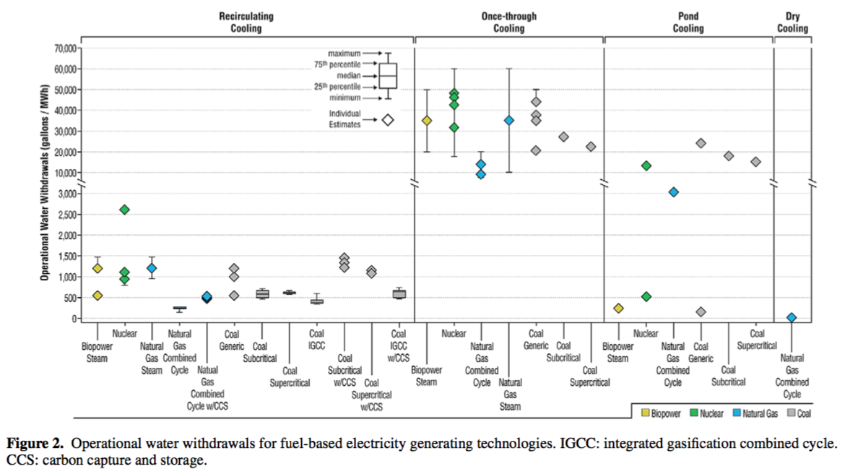
Confirmation of that seemingly huge steam plant water consumption?
From one analysis published in journal Environmental Research Letters:¹
Hourly water consumption per power produced ~ 50,000 gal/hr/MW
=> 50 M-gal/hr/GW => 200 mega-liters/hr/GW = 1.6 X my 3°C number!
1) J. Macknick et al.: http://iopscience.iop.org/1748-9326/7/4/045802/pdf/1748-9326_7_4_045802.pdf

Slide 54
Finally, likely water requirements for solar and wind:
Wind power: No operating water requirement
Solar PV: No operating water requirement
However, for both of the above. lifecycle analysis would include some water use:
As used in mining and refining building materials such as Al and Si
But likely still small compared to steam power plant water use numbers
Solar Thermal:
If water is boiled into must-be-condensed-steam => steam plant water numbers!
But if boiling oils are instead used, one might eliminate water use
Because hotter oil vapor can be effectively cooled/condensed by ambient air
An Introduction to Sustainable Energy Systems: WeCanFigureThisOut.org/ENERGY/Energy_home.htm

Slide 55
Power Plant Water Requirement Bottom Lines:
FOR STATUS QUO: Use power from H₂O steam generation & condensation:
Coal, natural gas combined cycle, nuclear, biomass, much solar thermal
=> Mississippi-scale water consumption
But remember: Most of that cooling water is reusable
At least after environment has cooled it down (e.g. down river)
FOR REDUCED WATER CONSUMPTION: Use ~ water-free technologies
= Gas turbines, wind, solar photovoltaics, some solar thermal (those using oils)
FOR RADICAL INCREASE IN WATER CONSUMPTION: Use water as prime input
= Biofuels
An Introduction to Sustainable Energy Systems: WeCanFigureThisOut.org/ENERGY/Energy_home.htm

Slide 56
Credits / Acknowledgements
Some materials used in this class were developed under a National Science Foundation "Research Initiation Grant in Engineering Education" (RIGEE).
Other materials, including the WeCanFigureThisOut.org "Virtual Lab" science education website, were developed under even earlier NSF "Course, Curriculum and Laboratory Improvement" (CCLI) and "Nanoscience Undergraduate Education" (NUE) awards.
This set of notes was authored by John C. Bean who also created all figures not explicitly credited above.
Copyright John C. Bean
(However, permission is granted for use by individual instructors in non-profit academic institutions)
An Introduction to Sustainable Energy Systems: WeCanFigureThisOut.org/ENERGY/Energy_home.htm

