Slide 1
Power Plant Economics: Analysis Techniques & Data
John C. Bean
Outline
Analysis Techniques:
Time value of money + Uniform payment series + Present value
Worked example of a power plant's lifetime financing
Application in computing a breakeven Levelized Cost of Energy: LCOE
Energy Information Agency data on LCOE: 2011 - 2018
Analysis of EIA data peculiarities and trends
Examining the EIA assumption of across-the-board 30 year power plant lifetime
LCOE data from Lazard and Bloomberg
Comparison of data from all sources
Resulting conclusions about present day renewable energy economics
Appendix tables of "U/P", "P/U", "F/P" and "P/F" function values
(Written / Revised: March 2021)

Slide 2
Power Plant Economics: Analysis Techniques & Data
In his book, David MacKay chose to ignore the economics of power systems
He wanted to teach about fundamental energy issues and challenges
And feared that economics was a quagmire the reader might never escape
I have followed a similar strategy in my focus upon the science of power systems
But I cannot now walk away without discussing dollars and cents
Yes, energy costs are changing all of the time!
Yes, real (fully inclusive) costs can be hugely controversial!
But, in a capitalist system, costs will determine the future of our energy systems
Unless we now choose to alter that future via public policy
In which case we'd better understand the real costs of those interventions
An Introduction to Sustainable Energy Systems: WeCanFigureThisOut.org/ENERGY/Energy_home.htm

Slide 3
Figuring out the purchase price of a power plant:
It should be simple to find the cost of a power plant of type X and capacity Y
At least it should be simple for well established technologies
Such as coal, gas, hydro, or nuclear power plants
After all, we've already built hundreds or even thousands of these!
Further, these were mostly built by public and/or government-regulated companies
So that data, at least, should be readily available, right? WRONG!
Regulated or not, these companies keep their costs analyses very private!
And this is just the initial purchase price of the power plant!
To which labor, fuel and operating costs still need to be added
An Introduction to Sustainable Energy Systems: WeCanFigureThisOut.org/ENERGY/Energy_home.htm

Slide 4
Complete comparative data are generated in certain reports
Most of which are published by governmental agencies
These agencies should be nominally unbiased about competing technologies
Possibly offset by their naiveté about certain new technologies
A point I will return to late in this lecture
And, now, they've become the target of political intervention & censorship
Their reports state costs in strange ways, using strange terms such as
Net Present Value OR Overnight Capital Cost OR O&M Cost
OR, most importantly, whole categories of Levelized Cost
To make sense of these terms and data, we need to learn a bit of . . .
An Introduction to Sustainable Energy Systems: WeCanFigureThisOut.org/ENERGY/Energy_home.htm

Slide 5
"Engineering Economics"
Concept #1 - The Time Value of Money:
Which encapsulates the investor's view of what his/her money is really worth
Present value = P = How much money that investor has right now
Future value = F = What investor expects that money to be worth in the future
Which will be greater, because investor expects money to earn interest
To be paid by whomever he/she loans/invests that money to/with
F = P + cumulative interest earnings up to that future date
If annual interest rate is i, the future value of that money will become:
Future value at end of year 1 = P (1 + i)
Future value at end of year 2 = [P (1 + i)](1+i)
Future value at end year n: F(at n) = P(1+i)^{n} (1)

Slide 6
Engineering Economics continued:
Concept #2 - Uniform Series Payment:
Which addresses the repayment of a loan, or income from a loan/investment
Common way distributing repayments is by uniform amount repaid each interval
Where interval may be once a year, or once a month
Which is exactly what you do with a home mortgage or auto loan
We will work out this series by computing payments, interval by interval
Accounting for investor's expectation of interest income
That income is usually expressed as an annual percentage interest rate ("APR")
Whereas payment intervals are usually months
in which case interest per month can be taken as = APR / 12
An Introduction to Sustainable Energy Systems: WeCanFigureThisOut.org/ENERGY/Energy_home.htm

Slide 7
Working out a uniform series of payments:
Assume a payment of U each payment interval (on a loan/investment of P):
Working out entries for the END of each payment interval:
Interval: Owed: Paid: Then owed (= Owed – Paid)
1 P (1+i) U P (1+i) – U
2 [P(1+i) – U] (1+i) U [P(1+i) – U] (1+i) - U
3 {P(1+i) – U](1+i) – U} (1+i) U {P(1+i) – U](1+i) – U} (1+i) - U
n P(1+i)^{n} – U Σ _{j=0} ^{to n} (1+i)^{j}
Now say that U is chosen such that loan is to be paid off at that n^{th} payment:
So "Then owed" must then be zero => P(1+i)^{n} = U Σ _{j=0} ^{to n} (1+i)^{j}
Which, after some clever algebra, gives: U = P { i / [1 – (1+i)^{-n}] } (2)

Slide 8
Playing a bit with these two relationships:
First relationship converted present value (of money) into its value at a future date
Future value (after n time intervals) = Present Value (1+i)^{n} OR:
F/P (i, n) = (1+i)^{n} where "F/P" is the name of the conversion function
Reverse conversion function is then P/F (i, n)= (1+i)^{-n}
Second relationship took present value (of loan) and converted to series of payments
Uniform Payments (over n time intervals) = Loan { i / [1 – (1+i)^{-n}] } OR:
U/P (i, n) = i / [1 – (1+i)^{-n}] where "U/P" is name of conversion function
Reverse conversion function is then P/U (i, n) = [1 – (1+i)^{-n}] / i
Expressing these as conversion functions can do two things:
Help you remember/see what a given calculation is really doing AND
Save computing because they're in textbooks (and at end of this lecture)!

Slide 9
Let's now apply this to compute a Levelized Cost:
Over power plant lifetime, there will be series of expenses => Cash Flow Diagram
To figure out the price charged for power, we need to know "Levelized Cost" per year
Computation requires two steps, each answering a question:
1) "How much money would I need up front to eventually meet those expenses?"
2) "If you loaned me that money now, what would I need to pay back each year?"
Year
Decomissioning Cost
Annual Costs (fuel, labor, maintenance . . .)
Capital Cost
An Introduction to Sustainable Energy Systems: WeCanFigureThisOut.org/ENERGY/Energy_home.htm

Slide 10
Choosing some values for our power plant calculation:
Our hypothetical power plant, to be financed with a 10% annual interest loan:
Capital cost: 1000 M$
Operating lifetime: 10 years
Annual costs (inaccurately lumped together): 10 M$
Decommissioning cost 100 M$
Inaccurately assuming plant is built overnight and decommissioned in 1.0 years:
0
1
2
3
4
5
6
7
8
9
10
11
Year
Annual Operating Costs = 10 M$
Decommissioning Cost = 100 M$
Capital Cost = 1000 M$

Slide 11
Step 1) Money needed up front = Present Values of all costs:
0
1
2
3
4
5
6
7
8
9
10
11
Year
Annual Operating Costs = 10 M$
Decomissioning Cost = 100 M$
Capital Cost = 1000 M$
a) Present Value of Capital Cost: P_{capital} = 1000 M$
No conversion is necessary! Because it's a cost right now, at time = 0
b) Present Value of Decomissioning Cost comes from its Future Value:
Conversion function is P/F (10%, 11 yrs) = 1 / (1+0.10)¹¹ = 0.3504 =>
P_{decomissioning} = 100 M$ x P/F (10%, 11 yrs) = 35.04 M$

Slide 12
Plus Present Value of all those annual costs:
0
1
2
3
4
5
6
7
8
9
10
11
Year
Annual Operating Costs = 10 M$
Decommissioning Cost = 100 M$
Capital Cost = 1000 M$
c) Present Value of Annual Operating Costs:
String of payments ~ Uniform Payment Series with U = 10 M$
Convert this to the Present Value (of the corresponding loan/investment) with:
P/U (i=10% = 0.1, n=10 yrs) = [1 – (1+0.1)⁻¹⁰] / 0.01
From textbook (or my tables at end of this lecture) P/U (10 yrs, 10%) = 6.1446,
P_{operating costs} = 10 M$ x P/U (10%, 10 yrs) = 61.446 M$

Slide 13
Completed "Net Present Value" calculation:
0
1
2
3
4
5
6
7
8
9
10
11
Year
Annual Operating Costs = 10 M$
Decommissioning Cost = 100 M$
Capital Cost = 1000 M$
Net Present Value of the above total cash flow = Sum of present values:
NPV = P_{capital cost} + P_{operating costs} + P_{decommissioning costs}
= 1000 M$ + 10 M$ P/U (10%, 10yrs) + 100 M$ P/F (10%, 11 yrs)
= 1000 M$ + 10 M$ (6.1446) + 100 M$ (0.3504)
= 1000 M$ + 61.44 M$ + 35.04 M$ = 1096.48 M$
Compare this to simple sum of costs (which ignores the "time value of money"):
Simple Sum of Costs = 1000 M$ + 10 x 10 M$ + 100 M$ = 1200 M$

Slide 14
Step 2) Annual cost of loan to cover that up front cost
0
1
2
3
4
5
6
7
8
9
10
11
Year
Loan payments?
Up front cost = NPV = 1096.48 M$
Uniform Payment Series of payments you'd now have to pay for n years:
U = P { i / [1 – (1+i)^{-n}] } => NPV x U/P (n, i)
For a 10 year loan at the same 10% interest rate:
U = 1096.48 M$ x U/P (10%, 10 yrs) = 1096.48 M$ x (0.1627)
= 178.39 M$ / year (totaling 1783 million over the life of the mortgage)
THIS is money you have to recoup through your annual power sales
Divided by plant's annual energy output => LEVELIZED COST OF ENERGY

Slide 15
Schematic of entire Levelized Cost of Energy (LCOE) calculation:
Start with Cash Flow:
Convert all costs to Present Values, adding to get Net Present Value
Convert NPV to corresponding Uniform Series Payment => Levelized Cost
NPV = 1096.48 M$
(=value of loan you need up front)
LCOE = 178.39 M$
(=annual loan payment / annual energy produced)
NPV = 1096.48 M$

Slide 16
Hold it, why not just pay annual costs from annual income?
1) Get a loan to cover ONLY THE CAPITAL COST of plant (10 year / 1000 M$ loan):
Payment, each year, on that loan:
U_{capital} = U/P (10 year, 10%) x 1000 M$ = (0.1627) x 1000 M$ = 162.7 M$
2) Plus, each year, put away part of annual income to cover decommissioning cost:
U_{decommissioning} = U/P (10 year, 10%) x 100 M$ = (0.1627) x 100 M$ = 16.27 M$
3) Plus, each year, pay your operating costs (in real time) of 10 M$
Giving you a total annual cost of: 162.7 + 16.27 + 10 M$ = 193.97 / year
Versus previous LCOE financing scheme of 178.39 M$ / year
Strange backward / forward LCOE financing scheme DOES make sense!

Slide 17
Where can we find levelized costs of energy?
From the U.S. Energy Information Administration ("EIA") which issues:
A yearly: Annual Energy Outlook
With sub-report: Levelized Cost of New Generation Resources
The latter sub-reports are particularly relevant to this lecture
I've found (and downloaded) these sub-reports for 2011 to present
They support the "Outlook" by estimating costs of power plants initiated today
Which, given licensing and construction times, take years to build
So this year's report is for new power plants coming on line 5 years from now
And, as focus of these reports is on economics (and not on technology),
all costs given are LEVELIZED COSTS,
using the same methodologies that we covered above

Slide 18
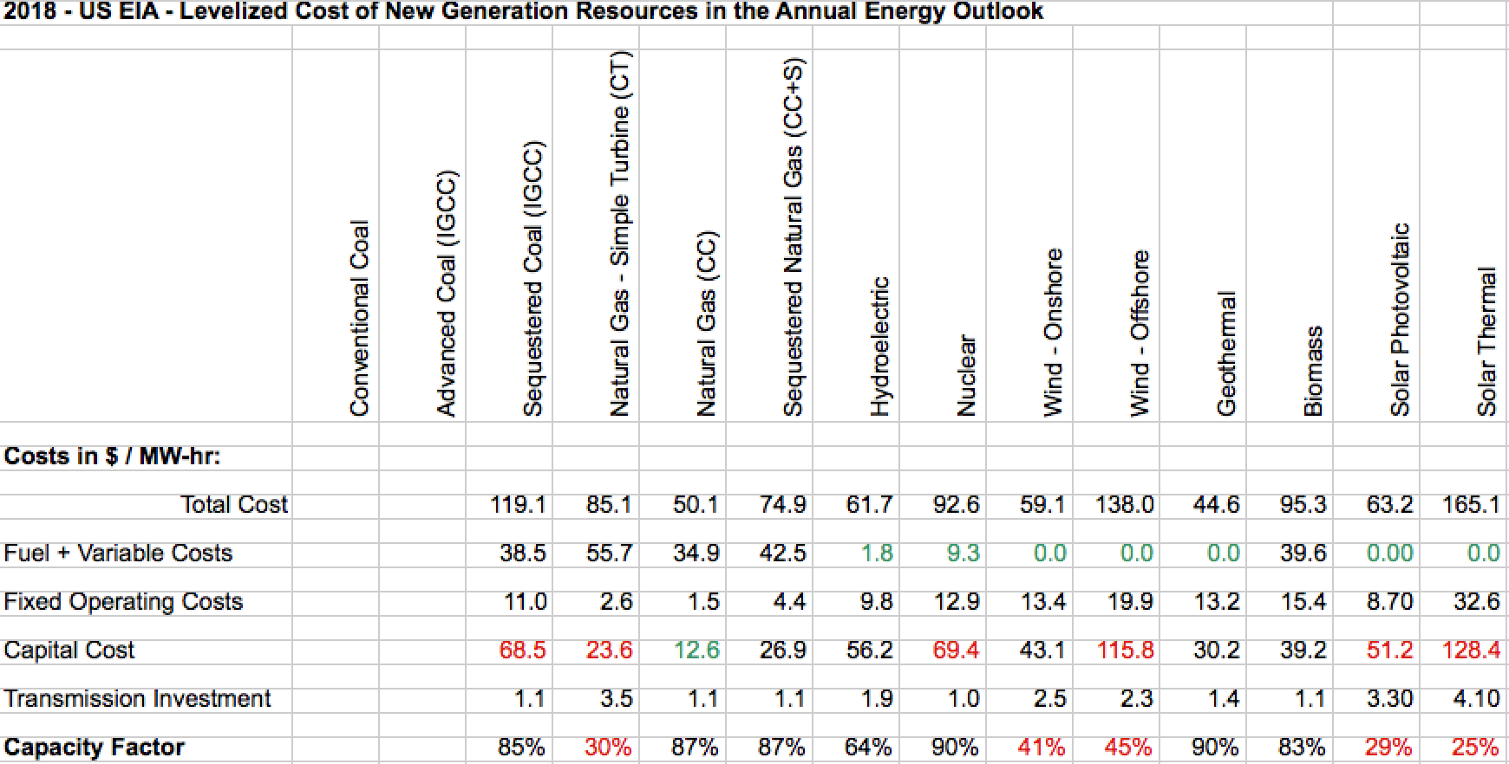
The 2018 EIA breakdown of levelized costs for different power plants:
By fuel/variable costs, fixed operating costs, capital costs, transmission investment
RED = Notably poor values GREEN = Notably good values
Tables = My Excel transcription from specified EIA report – Reports are available on my Resources Webpage

Slide 19
Analyzing contributors to EIA total levelized cost, line by line:
Fuel & Variable Operating Costs (costs varying with the plant's output):
"Renewables" have zero to low fuel + variable costs because nature provides the fuel
EXCEPT for BIOMASS which does rack up substantial total fuel cost
Because farmers aren't dumb, they're going to charge for their garbage!

Slide 20
Fixed operating costs:
Fixed Operating Costs:
Solar Thermal has unusually high fixed operating costs
Likely due to the complexity of servicing and maintaining
1000's of steerable mirrors ("heliostats") + boiler + turbine + generator

Slide 21
Transmission investment and Capacity factors:
Transmission Investment ~ Cost of wiring generators together within a "farm"
Capacity Factor = Actual plant output / Maximum possible output:
Low for "simple" gas turbines (OCGT) because they're used for only peak evening power
Low for solar and wind because these are strong for only a fraction of the day
Lowish for hydro because reservoirs are increasingly vulnerable to droughts?

Slide 22
And the BIG one: Capital cost
Capital Cost = THE MAJOR COST for almost every single technology
Exception = Combined Cycle natural gas turbines ¹
Combined Cycle => More power out per fuel => Decreased cost per power output
Solar thermal's capital cost appears very high (but more about this later)
1) For a more complete explanation, see my Fossil Fuels (pptx / pdf / key) note set

Slide 23
OK, but aren't costs of renewables falling?
Let me first just give you all of the data (2011-2018)
then I'll come back and look for trends
An Introduction to Sustainable Energy Systems: WeCanFigureThisOut.org/ENERGY/Energy_home.htm

Slide 24
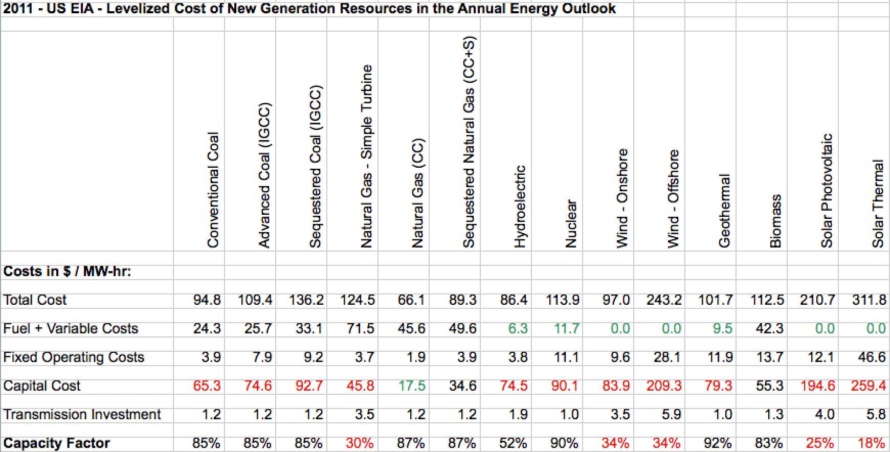
2011 EIA report on Levelized Cost of New Generation Resources
Which predicts costs of power plants coming on line in 2016:
An Introduction to Sustainable Energy Systems: WeCanFigureThisOut.org/ENERGY/Energy_home.htm

Slide 25
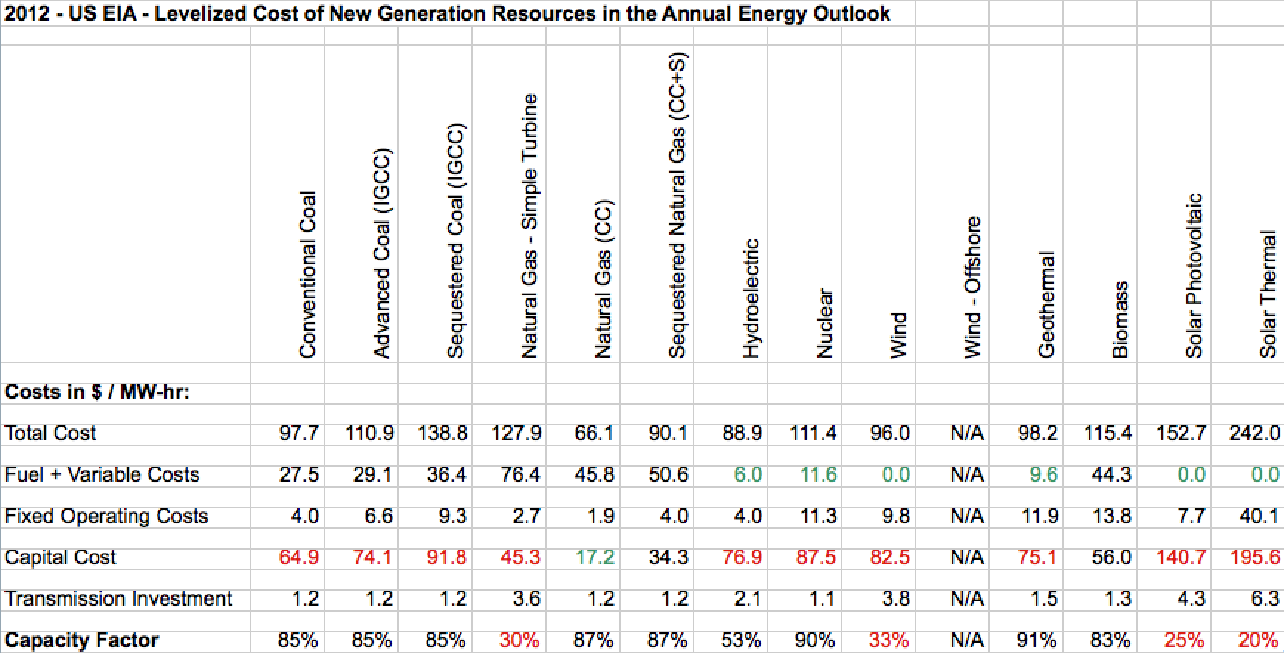
2012 EIA report on Levelized Cost of New Generation Resources
Which predicts costs of power plants coming on line in 2017:
An Introduction to Sustainable Energy Systems: WeCanFigureThisOut.org/ENERGY/Energy_home.htm

Slide 26

2013 EIA report on Levelized Cost of New Generation Resources
Which predicts costs of power plants coming on line in 2018:
An Introduction to Sustainable Energy Systems: WeCanFigureThisOut.org/ENERGY/Energy_home.htm

Slide 27
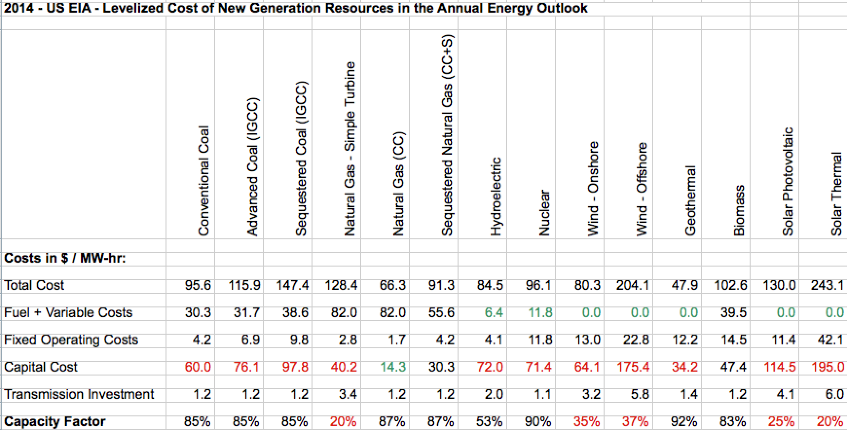
2014 EIA report on Levelized Cost of New Generation Resources
Which predicts costs of power plants coming on line in 2019:
An Introduction to Sustainable Energy Systems: WeCanFigureThisOut.org/ENERGY/Energy_home.htm

Slide 28
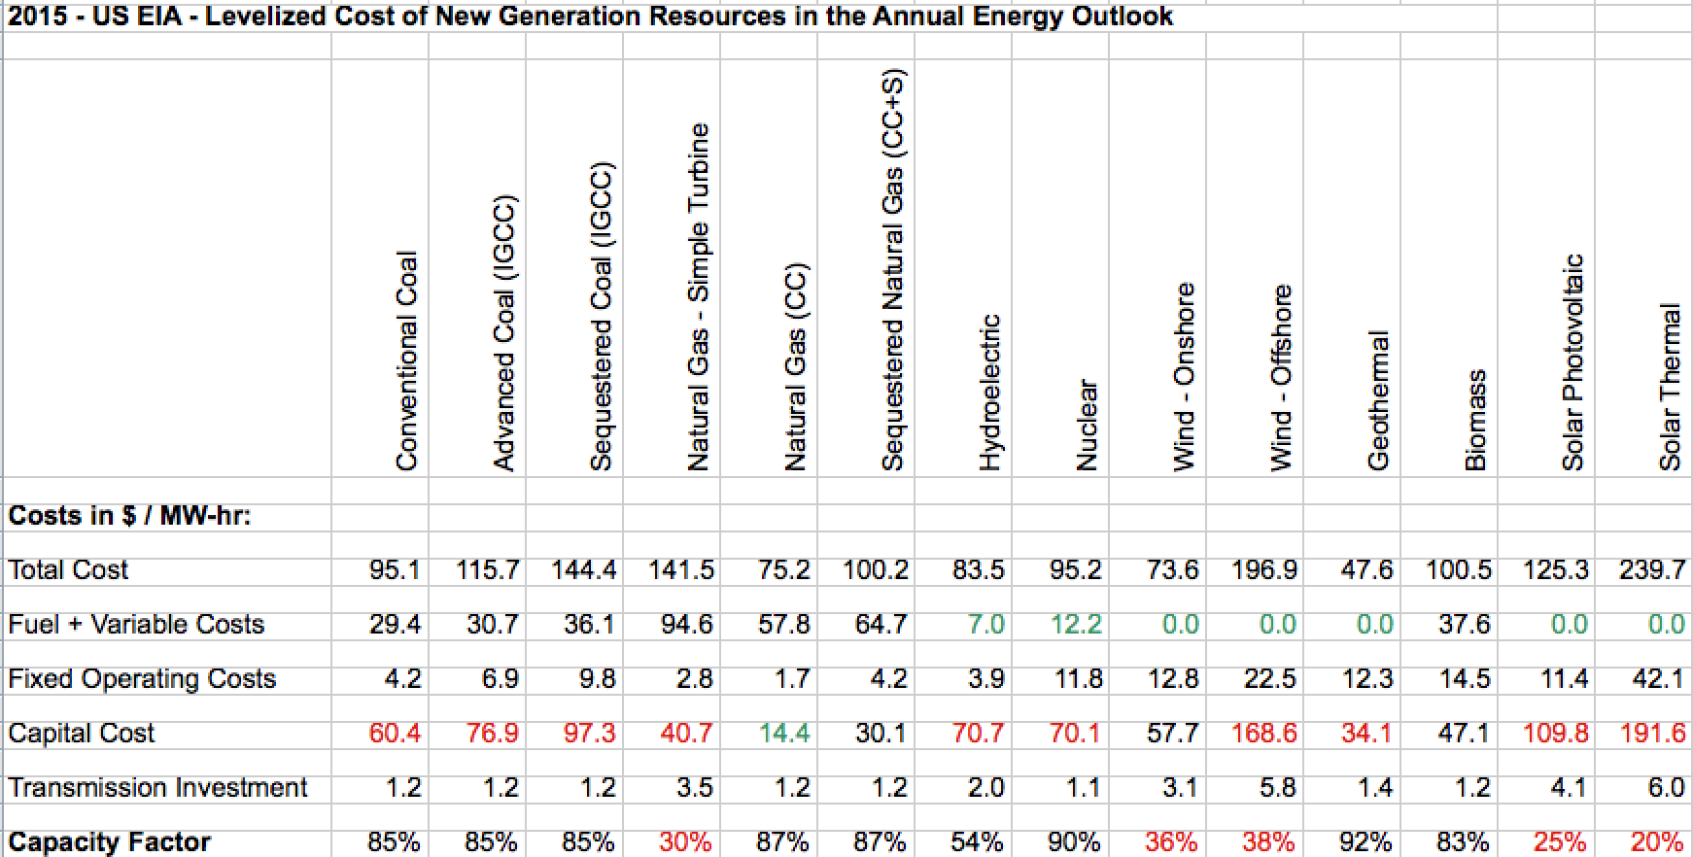
2015 EIA report on Levelized Cost of New Generation Resources
Which predicts costs of power plants coming on line in 2020:
An Introduction to Sustainable Energy Systems: WeCanFigureThisOut.org/ENERGY/Energy_home.htm

Slide 29
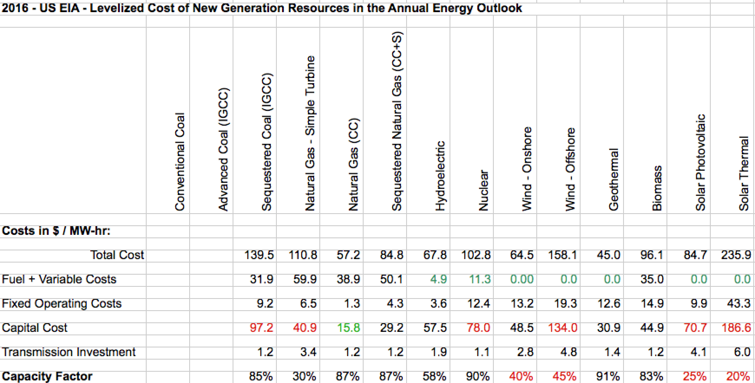
2016 EIA report on Levelized Cost of New Generation Resources
Which predicts costs of power plants coming on line in 2021:
An Introduction to Sustainable Energy Systems: WeCanFigureThisOut.org/ENERGY/Energy_home.htm

Slide 30
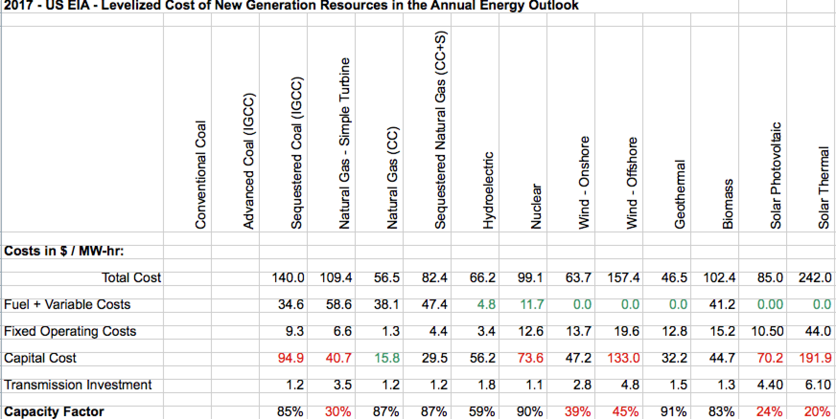
2017 EIA report on Levelized Cost of New Generation Resources
Which predicts costs of power plants coming on line in 2022:
An Introduction to Sustainable Energy Systems: WeCanFigureThisOut.org/ENERGY/Energy_home.htm

Slide 31
2018 EIA report on Levelized Cost of New Generation Resources
Which predicts costs of power plants coming on line in 2023:
An Introduction to Sustainable Energy Systems: WeCanFigureThisOut.org/ENERGY/Energy_home.htm

Slide 32
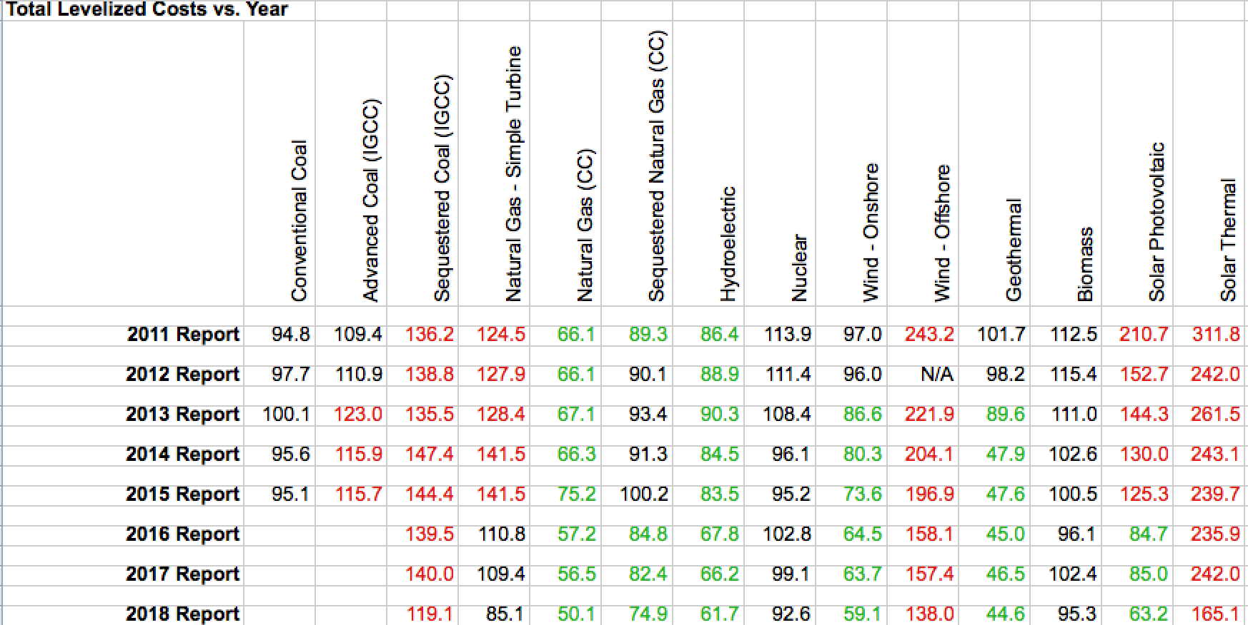
Now COMPARING those seven years of EIA LCOE reports:
First some quirky observations (bearing on the accuracy of EIA reports):
The EIA seems to be having trouble assessing offshore wind power:
Even dropping it completely from their 2012 report
Likely explanation?
Absence of U.S. offshore wind farms + their rapid technological evolution

Slide 33
EIA also seems to be having trouble with hydroelectric & geothermal:
Cost of very mature hydroelectric power plants plunging in just two years?
Cost of geothermal power plunging in just one year?
Yes, geothermal is a young and still maturing technology
But cost falling by almost 50% in one year?
Shortcomings in EIA assessment techniques seem more plausible!

Slide 34
And why are coal data missing from the last two reports?
Easy (but depressing) explanation: EIA projects cost for NEW power plants
In 2016 the U.S. banned new coal plants lacking CO₂ sequestration
Leading EIA to drop them from their report
(Surviving 3rd column is for coal plants with partial CO₂ sequestration)
With "WAR ON COAL" ended, can we now expect their resurrection?

Slide 35
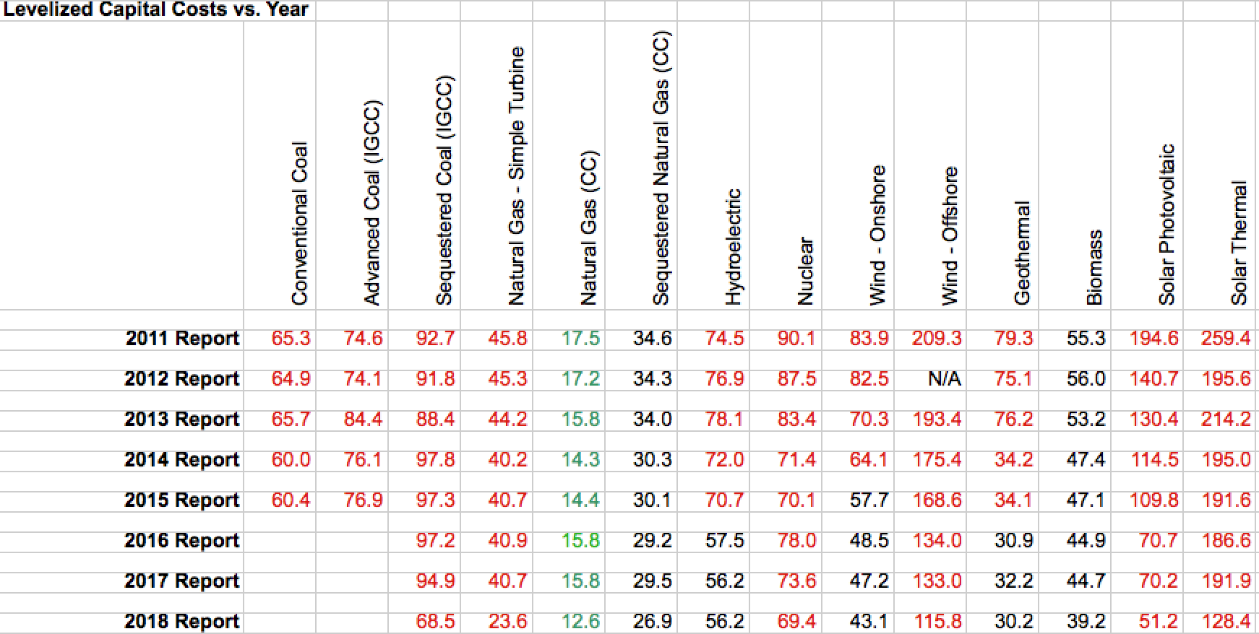
Finally comparing levelized capital costs for all technologies
Capital costs for cleaner but still carbon-emitting natural gas plants have fallen
As have costs for non-carbon-emitting hydro, nuclear, wind, geothermal & solar
Decreases have been particularly strong, or sustained, or plausible for:
Onshore wind and Solar PV

Slide 36
OR comparing levelized total costs for all technologies
Total cost trends closely resemble those of capital costs alone
Reflecting the prominence of capital cost in determining final energy prices
The big bottom line conclusion (based on green labeled < 90 numbers)?
All but two lowest cost technologies (natural gas) are now renewables!
With total costs well below that of even resurrected "conventional (dirty) coal"

Slide 37
Something (else) that bothered me about EIA reports:
EIA never mentions what TYPE of solar PV plant they are evaluating
I assumed it would be single crystal silicon solar cells
Which concerned me because high energy UV sunlight can degrade PV's
Single crystal Si is the toughest stuff with lifetime of at least 20 years
Polycrystalline Si is a bit less tough and might last ~ 15 years
Really cheap organic material cells may only last few months / years
But levelized costing assumes financing of projects over their whole lifespan
So EIA analysis SHOULD have taken power plant lifetimes into account
I dug and dug, and the ONLY place EIA mentioned lifetime was in a tax section
Where they used a 30 year lifetime for ALL types of power plants
An Introduction to Sustainable Energy Systems: WeCanFigureThisOut.org/ENERGY/Energy_home.htm

Slide 38
I couldn't believe EIA ignored technology lifetimes!
So I wrote Prof. Edward S. Rubin (of Carnegie Melon)
Author of respected "Introduction to Engineering and the Environment"
He confirmed that EIA reports assume 30 year lifetimes for everything
DESPITE the likely shorter (and technology specific) lifetimes of solar PV
DESPITE the fact that nuclear plants are regularly licensed for 40 years of operation
And many are now being re-licensed for 1-2 decades of more use
DESPITE the fact that commonly assumed lifetime of hydroelectric dams is 100 years
And Hoover Dam is actually showing few signs of ANY aging at 75
So I decided to try and correct the EIA data by taking likely lifetimes into account
An Introduction to Sustainable Energy Systems: WeCanFigureThisOut.org/ENERGY/Energy_home.htm

Slide 39
Combining EIA data with earlier tutorial on levelized costs:
For almost all power generation technologies:
Levelized CAPITAL cost = 2/3 – 7/8 of TOTAL levelized annual power cost
(With notable exception of natural gas using cheap jet engine turbines)
But levelized annual capital cost = (up front capital cost) x U/P (i interest, n years)
Where, U/P (n, i) = i / [1 – (1+i)^{-n}]
And although EIA used n = 30 years for ALL different types of power plants
As a technologist, I am telling you they should have used values more like:
n ~ 100 years for hydro
n ~ 40-60 years for nuclear
n ~ 30 years for coal and possibly gas, wind, geothermal and solar thermal
n ~ 20 years for silicon single crystal solar PV
n ~ 10 (or less) "emerging" PV technologies such as organic PV

Slide 40
So to correct EIA data for likely power plant lifetimes:
EIA's levelized capital costs need to be adjusted by factor of:
U/P (actual plant lifetime, i) / U/P (30 year lifetime, i)
And given the heavy contribution of capital cost to total cost
Correction almost as large should be applied to total cost of most plants
I need to know EIA's assumed interest rate, which I didn't spot in EIA reports
But elsewhere I found data on overnight capital cost of some plants
= capital + labor + materials cost to build a power plant
This present value (P) x U/P (i=?, 30 yrs) should => EIA's levelized capital cost
Found I could fit EIA conversion to levelized capital cost with i = 10-15%
10-15% interest sounds very high, but this is a relatively risky investment:
If goes bust (and they do!) no one may be willing to buy that power plant!

Slide 41
Calculating my proposed correction to EIA data:
Correction factor (using my fitting value of i ~ 12.5%):
U/P (actual plant lifetime, 12.5%) / U/P (EIA's 30 year lifetime, 12.5%)
= {i / [1 – (1+i)^{-actual lifetime} ]} / {[i / [1 – (1+i)⁻³⁰]}
= [1 – (1.125)⁻³⁰ ] / [1 – (1.125)^{-actual lifetime} ]
For which I get these values:
Actual lifetime (years): 10 20 30 40 60 100
Correction factor: 1.402 1.072 1 0.979 0.9716 0.9709
Emerging PV is 40% higher, Si PV 7% higher, nuclear/hydro 3% lower
Why, if 20 year Si PV lasts half as long as 40 year nuclear, is difference only 10%?
Won't I have to buy TWO PV plants to match ONE nuclear plant?
And thus have to double my charges for PV power to break even?

Slide 42
It would mean that IF your investors expected zero interest:
Your mortgage/bond payments cover two things:
- Repayment of the loan (P)
- Interest on the remaining loan balance
Tiny interest rate / short loan: Almost all of payment => paying down loan
And the remaining balance on that loan drops ~ linearly with time
Finite interest rate / long loan: Almost all of payment => interest on loan
And, initially, the remaining balance on the loan drops hardly at all!
The latter is the origin of the homeowners lament that:
"I don't really own my home, I just rent it from my bank!"
An Introduction to Sustainable Energy Systems: WeCanFigureThisOut.org/ENERGY/Energy_home.htm

Slide 43
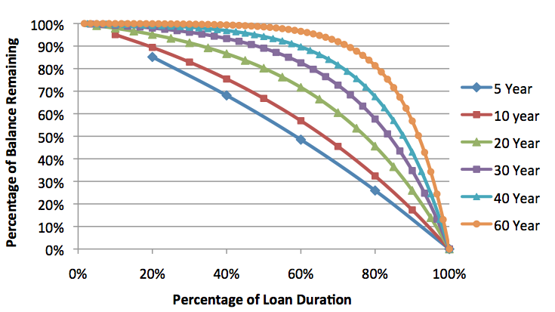
As revealed by plot of balance remaining on various loans:
Balance remaining on a loan is:
Balance (i, n = number of loan intervals, m = this loan interval)
= Loan {1 – [(1+i)^{n} – (1+i)^{m}]/[(1+i)^{n} - 1]}
My Excel plot of Balance on Loan vs. m/n (= percentage of the loan's lifetime)
For loans of
labeled duration
With interest
Rates of i = 15%
Homeowners are right: With long loans initial payments are ~ all interest!

Slide 44

Calculating the advantage of getting power plants to last longer:
Three different power plant technologies with same capital cost & power output
But Tech10 lasts 10 years, Tech20 last 20 years, Tech40 lasts 40 years
For 40 years of power I'll need 4 Tech10 plants, 2 Tech20 plants or 1 Tech40 plant
Assume I'll finance each of these with loans lasting plant lifetime, at 12.5% interest
Total cost = (# of loans) x (# payments per loan) x (payment amount)
Giving, for the three different alternatives supplying 40 years of power:
Tech10 Total cost = (4 loans) (10 payments) [ P x U/P(12.5%, 10 yrs)]
Tech20 Total cost = (2 loans) (20 payments) [P x U/P(12.5%, 20 yrs)]
Tech40 Total cost = (1 loan) (40 payments) [P x U/P(12.5%, 40 yrs)]
vs.
vs.

Slide 45
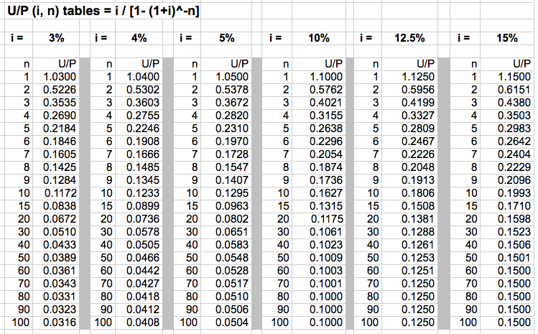
Pulling up U/P uniform payment table
With data highlighted for our 10, 20 or 40 year long 12.5% interest loans
Source: My Excel spreadsheets – as included at the end of this lecture note set

Slide 46
Inserting those ratios of payments/loan amount (U/P):
Tech10 total cost = P x 4 x 10 x U/P(12.5%, 10 yrs) = 40 P x (0.1806) = 7.224 P
Tech20 total cost = P x 2 x 20 x U/P(12.5%, 20 yrs) = 40 P x (0.1381) = 5.524 P
Tech40 total cost = P x 1 x 40 x U/P(12.5%, 40 yrs) = 40 P x (0.1261) = 5.044 P
Assuming "overnight construction cost" is identical for all of these plants (=> P):
Non-surprise: Cost of 4 short-lived Tech10 plants is a lot more!
7.224 / 5.044 = 1.43: Four Tech10's cost 43% more than one Tech40
Surprise: Cost of 2 Tech20 plants ~ Cost of 1 Tech40 plant
5.524 / 5.044 = 1.09: Four Tech10's cost 9% more than one Tech40
THIS is why EIA economists didn't worry about plant lifetimes!
Once lifetimes get up to 20 years, capital costs get buried under "cost of money"
With ALMOST ALL of each payment covering that expense!

Slide 47
But plant lifetimes are not quite irrelevant:
Lifetime WILL STILL BE AN ISSUE for shorter-lived technologies
For instance, for emerging non-silicon thin-film & organic photovoltaics
with possible lifetimes of 10 years or less,
=> 50% or greater increase in resulting levelized cost of power
Long lifetime plant decisions are also affected by "cost of money"
Say your plant will run efficiently for 30 years
But could run (with more fuel and maintenance) for another 10 years
Would it make more sense to finance and operate it for 30 or 40 years?
The answer could well be "30 years"
Because at 30 years ~ same loan payment could buy a new plant
Which would then require less fuel and maintenance

Slide 48
So EIA really didn't mess up!
I overestimated effect of plant lifetimes because:
I didn't account for "Engineering Economics" / "cost of money"
But the preceding analysis raises another question:
Why not just finance a 40 year nuclear plant with a 20 year mortgage?
Your cumulative loan payment costs would be almost halved
For the same cumulative 40 years of power production!
But for first 20 years you'd have loan payments => higher costs / lower profits
This would likely clobber your early stock price & dividend payments
which, taking the "time value of money" into account,
would erode the lifetime investment value of your power plant
An Introduction to Sustainable Energy Systems: WeCanFigureThisOut.org/ENERGY/Energy_home.htm

Slide 49
Back to LCOE data:
Many energy industry insiders question the EIA's accuracy
Just as I, above, raised doubts about the EIA's analysis of:
Offshore vs. Onshore Wind, Hydroelectricity and Geothermal
Energy industry insiders prefer data from a commercial energy consulting firm:
Lazard's Levelized Cost of Energy Analysis ¹
Lazard has posted a public summary of their 2017 Version 11.0 Report
It's a 22 page edited version of their full report (for which they charge clients)
It presents decidedly more complex and nuanced data than that of the EIA
But that presentation can be cryptic (at least to we energy outsiders)
For details you've just got to pay for the full report!
(But I personally thank Lazard for the public service provided by their summaries!)
1) Lazard Summaries of their V8 (2014), V10 (2016), V11(2017) reports are on the Resources Webpage

Slide 50
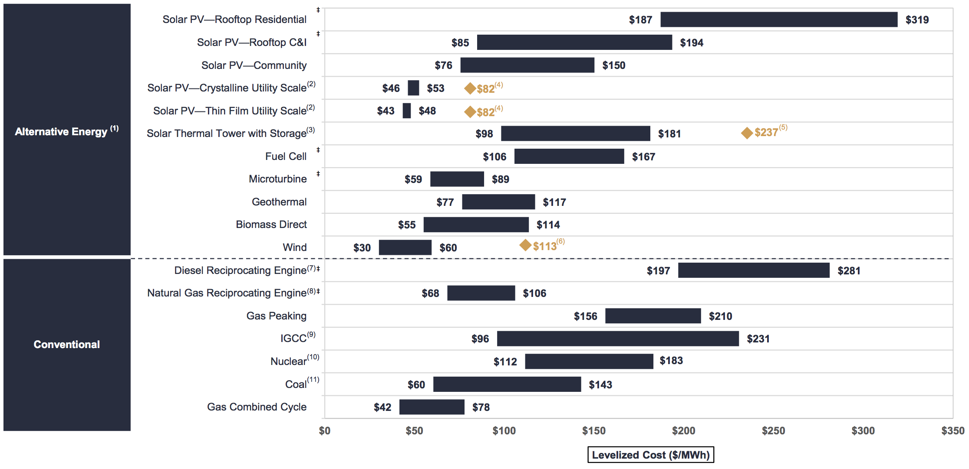
Lazard 2016: Unsubsidized levelized costs of energy:
The bands represent typical data spreads for each technology
But diamonds are for often very important special cases
With each of those special cases then explained in a must-read set of:

Slide 51
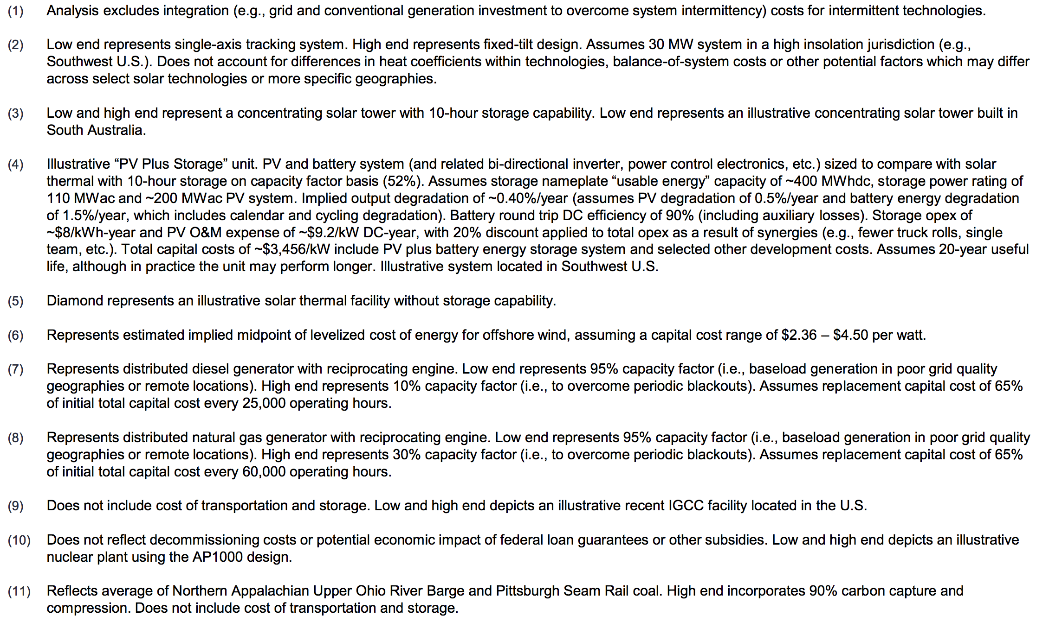
Footnotes:

Slide 52
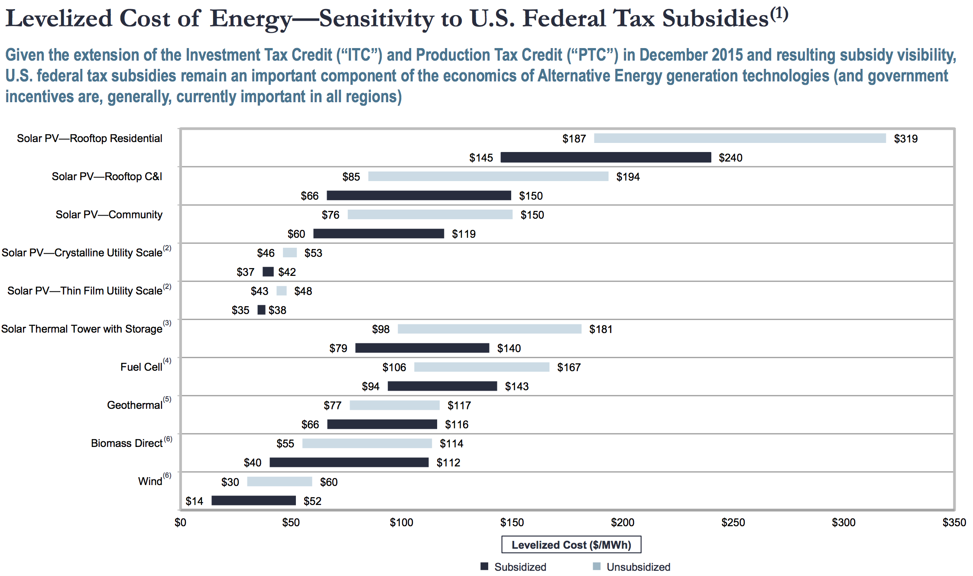
The effect of the U.S. Investment Tax Credit is then shown by:
Note the key at the bottom: ■ = Unsubsidized ■ = Subsidized

Slide 53
Things that jump out at me: The effect of scale upon Solar PV:
Solar Photovoltaic costs PLUMMET with the size of their installation:
Personal solar is at least 2X AS EXPENSIVE as community scale solar!
And 4X to 6X AS EXPENSIVE as utility scale solar farms!
Residential Rooftop PV: 187-319 $/MW-h
Community PV: 76-150 $/MW-h
Utility Scale Crystal PV: 46-53 $/MW-h
Utility Scale Thin Film PV: 43-48 $/MW-h
An Introduction to Sustainable Energy Systems: WeCanFigureThisOut.org/ENERGY/Energy_home.htm

Slide 54
Things that jump out at me: Solar w/o Storage versus with it
Lazard's Solar Thermal w/o Energy Storage (diamond) = 237 $/MW-h
Their Solar Thermal WITH built-in Storage = 98–182 $/MW-h
Cost of energy storage = 56 – 139 $/MW-h ~ cost of energy generation!
In 2017, the EIA gave their (only) solar thermal number as 242 $/MW-h
But in 2018, EIA's solar thermal number plummeted to 165 $/MW-h
Suggesting EIA's has started assuming solar thermal WITH storage
(though I could no confirmation of that in their 2018 report)
Isn't solar thermal WITH storage still much more expensive than solar PV?
An Introduction to Sustainable Energy Systems: WeCanFigureThisOut.org/ENERGY/Energy_home.htm

Slide 55
Solar w/o Storage versus with it (cont'd)
Solar Thermal WITH built-in Storage = 119–182 $/MW-h
vs.
Utility Scale Solar PV = 43-53 $/MW-h
That's an apple to orange comparison because to become a major Grid power supplier
Solar PV plants will have to add ways of storing their power until evening/night
Which, Lazard predicts => Solar PV with Storage (diamonds) = 82 $/MW-h
That's getting close to Solar Thermal with Storage = 119–182 $/MW-h
And as a still very young technology, Solar Thermal may yet close that gap!
An Introduction to Sustainable Energy Systems: WeCanFigureThisOut.org/ENERGY/Energy_home.htm

Slide 56
Things that jump out at me: Cost of wind
Lazard's absolutely lowest cost is for Onshore Wind = 30-60 $/MW-h
And not too far from being competitive is Offshore Wind = 113 $/MW-h
But the biggest thing that jumps out at me is top vs. bottom of the table:
Renewable vs. Non-renewable ranges are now fully comparable!
With wind beating all, and utility solar PV challenged by only CCGT gas
Range of renewable 2017 costs
Range of fossil fuel + Nuclear (- diesel) costs

Slide 57
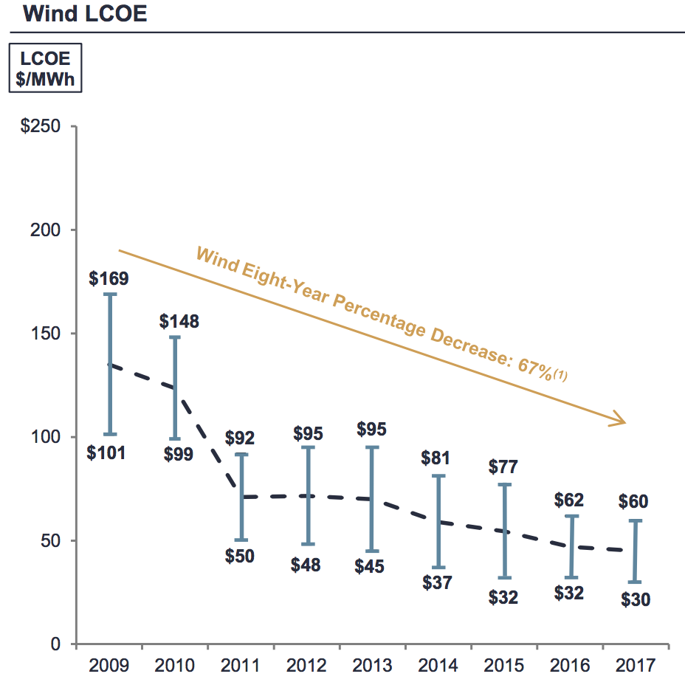
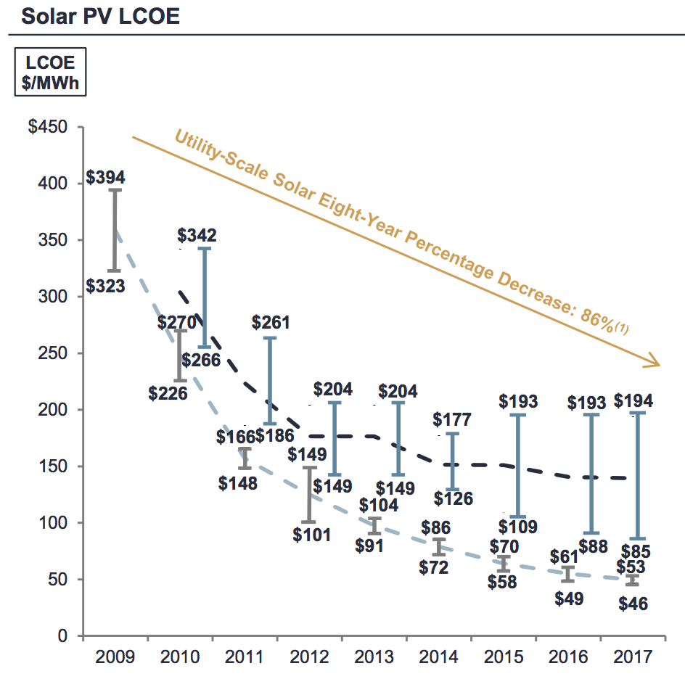
Compound this with Lazard's optimistic take on Renewable trends:
An Introduction to Sustainable Energy Systems: WeCanFigureThisOut.org/ENERGY/Energy_home.htm

Slide 58
But might this still undervalue renewables?
After all, Lazard's business is that of supplying information to the energy industry
Such large & old industries are rarely known for their embrace of innovation
(Here I speak as a 20+ year former employee of the Bell System)
Could their conservatism have rubbed off on Lazard?
Bloomberg & The World Energy Council are advocates for sustainable energy
In 2013 they released their own study of renewable LCOE's ¹
Their LCOE's were in excellent agreement with Lazard's 2014 report
Both citing renewable LCOE's generally lower than EIA estimates
Bloomberg did release an updated LCOE report in 2017
But, unfortunately, I cannot now update my comparisons because:
Unlike Lazard, Bloomberg no longer publically discloses their data!
1) Publically available 2013 and 2017 Bloomberg documents are also available on my Resources Webpage

Slide 59
LCOE's: EIA 2018 vs. Lazard 2017
EIA Lazard
Sequestered IGCC Coal 119.1 143 ¹
Natural Gas CC (CCGT) 50.1 42-78
Natural Gas Peaking (OCGT) 85.1 156-210
Hydroelectric 61.7
Nuclear 92.6 112-183
Biomass - no subsidy (subsidized) 95.3 55-114 (40-112)
Geothermal - no subsidy (subsidized) 44.6 (41.6) 77-117 (64-116)
Wind Onshore- no subsidy (subsidized) 59.1 (48) 30-60 (14-52)
Wind Offshore - no subsidy (subsidized) 138.0 (117.1) 113
Solar PV 63.2 (49.9)
Si crystalline PV – utility - no subsidy (subsidized) 46-53 (37-42)
Thin Film PV – utility - no subsidy (subsidized) 43-48 (35-48)
Solar Thermal w/o Storage - no subsidy (subsidized) 237
Solar Thermal w/ Storage - no subsidy (subsidized) 165.1? (126.6)? 98-181 (79-140)
1) Lazard gives sequestered IGCC coal as being at the top of their bar = 143 (footnote 11)

Slide 60
Highlights of that EIA 2018 to Lazard 2017 comparison:
Notable Points of Disagreement:
Lazard LCOE for natural gas peaking (OCGT) is substantially higher
Lazard LCOE for geothermal is substantially higher
Lazard LCOE for onshore wind has a range extending much lower
Lazard LCOE for offshore wind is substantially lower
Lazard LCOEs for utility scale solar PV are substantially lower
Suggesting that EIA's solar PV number is biased toward residential PV
Notable Point of Complete Agreement:
The cost of sequestered coal is completely non-competitive
Highlighting areas of agreement & disagreement:

Slide 61
Strong Agreement vs. Strong Disagreement
EIA Lazard
Sequestered IGCC Coal 119.1 143 ¹
Natural Gas CC (CCGT) 50.1 42-78
Natural Gas Peaking (OCGT) 85.1 156-210
Hydroelectric 61.7
Nuclear 92.6 112-183
Biomass - no subsidy (subsidized) 95.3 55-114 (40-112)
Geothermal - no subsidy (subsidized) 44.6 (41.6) 77-117 (64-116)
Wind Onshore- no subsidy (subsidized) 59.1 (48) 30-60 (14-52)
Wind Offshore - no subsidy (subsidized) 138.0 (117.1) 113
Solar PV 63.2 (49.9)
Si crystalline PV – utility - no subsidy (subsidized) 46-53 (37-42)
Thin Film PV – utility - no subsidy (subsidized) 43-48 (35-48)
Solar Thermal w/o Storage - no subsidy (subsidized) 237
Solar Thermal w/ Storage - no subsidy (subsidized) 165.1? (126.6)? 98-181 (79-140)
1) Lazard gives sequestered IGCC coal as being at the top of their bar = 143 (footnote 11)

Slide 62
If Lazard's right, why aren't we seeing massive U.S. wind & solar investment?
Well it turns out that we ARE now investing massively in onshore wind
More than in any other current technology!
And, with the possibility of sighting offshore wind out-of-sight:
We are finally beginning to build offshore wind farms
But it looks like the EIA and we citizens have been too focused upon our rooftops
Rooftop solar PV is just not competitive with most energy alternatives
This will worsen as renewables grow to the point that we need storage
Instead, community and utility scale solar PV now make a lot more sense
Finally, with its natural ability to integrate energy storage
We should keep a close watch upon developments in solar thermal power

Slide 63
Credits / Acknowledgements
Some materials used in this class were developed under a National Science Foundation "Research Initiation Grant in Engineering Education" (RIGEE).
Other materials, including the WeCanFigureThisOut.org "Virtual Lab" science education website, were developed under even earlier NSF "Course, Curriculum and Laboratory Improvement" (CCLI) and "Nanoscience Undergraduate Education" (NUE) awards.
This set of notes was authored by John C. Bean who also created all figures not explicitly credited above.
Copyright John C. Bean
(However, permission is granted for use by individual instructors in non-profit academic institutions)
Note: Tables of U/P, P/U, F/P and P/F follow this slide
An Introduction to Sustainable Energy Systems: WeCanFigureThisOut.org/ENERGY/Energy_home.htm

Slide 64

My tables of U/P (i, n):
From my Excel spreadsheet (checked against Rubin's textbook tables):
An Introduction to Sustainable Energy Systems: WeCanFigureThisOut.org/ENERGY/Energy_home.htm

Slide 65
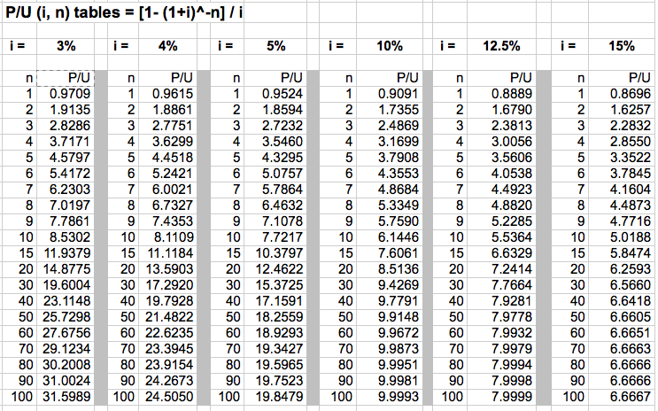
My tables of P/U (i, n):
From my Excel spreadsheet (checked against Rubin's textbook tables):
An Introduction to Sustainable Energy Systems: WeCanFigureThisOut.org/ENERGY/Energy_home.htm

Slide 66
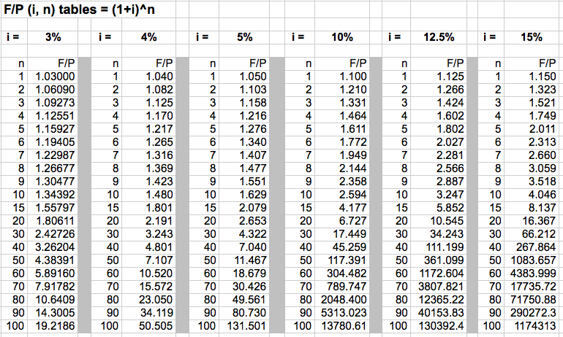
My tables of F/P (i, n):
From my Excel spreadsheet (checked against Rubin's textbook tables):
An Introduction to Sustainable Energy Systems: WeCanFigureThisOut.org/ENERGY/Energy_home.htm

Slide 67
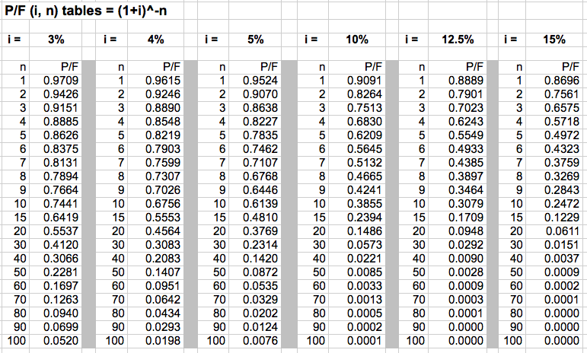
My tables of P/F (i, n):
From my Excel spreadsheet (checked against Rubin's textbook tables):
An Introduction to Sustainable Energy Systems: WeCanFigureThisOut.org/ENERGY/Energy_home.htm

