Slide 1
Lifetime Energy Output vs. Lifetime Energy Investment: EROI
John C. Bean
Outline
The shortcomings of a purely economic assessment of energy technologies
Energy Payback Time vs. full lifetime energy cycle assessment
Definition and classic papers on Energy Return on (Energy) Invested: EROI
My re-examination of EROI data based on newer/additional data + technological insights
Electrical Power Plant EROI's (in order of supposedly decreasing EROI):
Hydro / Wind / Coal / Natural Gas / Solar / Nuclear
My dramatic revision of Wind and Nuclear EROIs based on their technology evolution
Fuel EROI's: Coal, Oil & Gas, Tar Sands, Oil Shale, Biofuels
The murky world of biofuel EROI assessment,
where sound carbon footprint arguments can strongly color EROI evaluation
Final comparison of classic EROI values with my reassessed EROI numbers
(Written / Revised: October 2017)

Slide 2
Lifetime Energy Output vs. Lifetime Energy Investment: EROI
This group of note sets compares energy technologies in different ways
Starting with their land, water, and raw material requirements
And ending with an analysis of their present day economics
Some would say that economics should have the last word
Because Adam Smith's "invisible hand" will identify the most effective solutions
But as applied to energy, simple economics can overlook important facts such as:
1) Stable energy supply is just too damned important to a country!
Which inevitably leads to that government's massive market intervention
For instance, in the U.S. we now heatedly debate energy subsidies & tax breaks
Which we tend to associate with solar and wind energy
Despite fossil-fuel subsidies & tax breaks being much older & much larger

Slide 3
And massive subsidization is the worldwide NORM:
A 2015 International Monetary Fund report concluded that across the world:
Fossil fuels receive a $5.3 trillion annual subsidy = 6.5% of global GDP ¹
And this is hardly something new - Look back over the last century's world history:
German and Japanese WWII invasions were heavily motivated by fuel access
As were near continuous European & U.S. interventions in the Middle East
SIMPLE economics often further overlooks what economists themselves label:
2) "The Social Cost of Carbon" & "Negative Externalities"
Which is the idea that the market cost of energy does ≠ Its true cost
E.G., fossil fuel prices don't cover their true health & environmental costs
And that many impacted individuals have no say in those economic transactions
Both of which I explore in my note set: Where Do We Go From Here? (pptx / pdf / key)
1) IMF 2015: https://www.imf.org/external/pubs/ft/wp/2015/wp15105.pdf

Slide 4
And then there is the problem that:
3) Economics is largely about NOW (this quarter's profit or loss!)
Where sustainability is instead primarily about TOMORROW
But how can one anticipate tomorrow? One tool is Life Cycle Analysis (LCA)
Which, applied to energy, involves trying to evaluate a technology's impact:
BEFORE it comes into operation:
Including the impact of its raw materials, parts, construction . . . PLUS:
WHILE it is in operation:
Including the impact of its energy product, fuel, wastes, labor . . . PLUS:
AFTER is has ceased operation:
Including costs of "decommissioning," waste reclamation & storage . . .
An Introduction to Sustainable Energy Systems: WeCanFigureThisOut.org/ENERGY/Energy_home.htm

Slide 5
In other words:
A Life Cycle Analysis attempts to evaluate the complete impact
that an action taken today will have upon a future world
Such a full and accurate evaluation will be extraordinarily complex
Leading researchers to sub-divide LCA into different categories
For energy, two of the most heavily researched categories are:
Life Cycle Analysis of Greenhouse Gas Emissions
Which I'll explore in my later note set on:
Greenhouse Effect, Carbon Footprint & Sequestration (pptx / pdf / key)
Life Cycle Analysis of Energy Input & Output
Which is the topic of this note set
An Introduction to Sustainable Energy Systems: WeCanFigureThisOut.org/ENERGY/Energy_home.htm

Slide 6
Research on Energy Life Cycle Analysis is surprisingly young
Most examples I've found appeared well after the year 2000
And until about 2010, energy was mostly just part of much larger LCA analyses
Which typically evaluated dozens of parameters (differing from study to study)
The focus seemed to turn to energy only when doubts were raised by solar energy
Specifically, about solar's ability to ever produce more energy than it required
(As previewed in Today's Photovoltaic Solar Cells (pptx / pdf / key) notes)
The response was to define the parameter: Energy Payback Time (EPBT)
= The time an energy technology must operate in order to
produce an amount of energy equivalent to all of the energy
expended in its manufacture, operation and decommissioning
An Introduction to Sustainable Energy Systems: WeCanFigureThisOut.org/ENERGY/Energy_home.htm

Slide 7
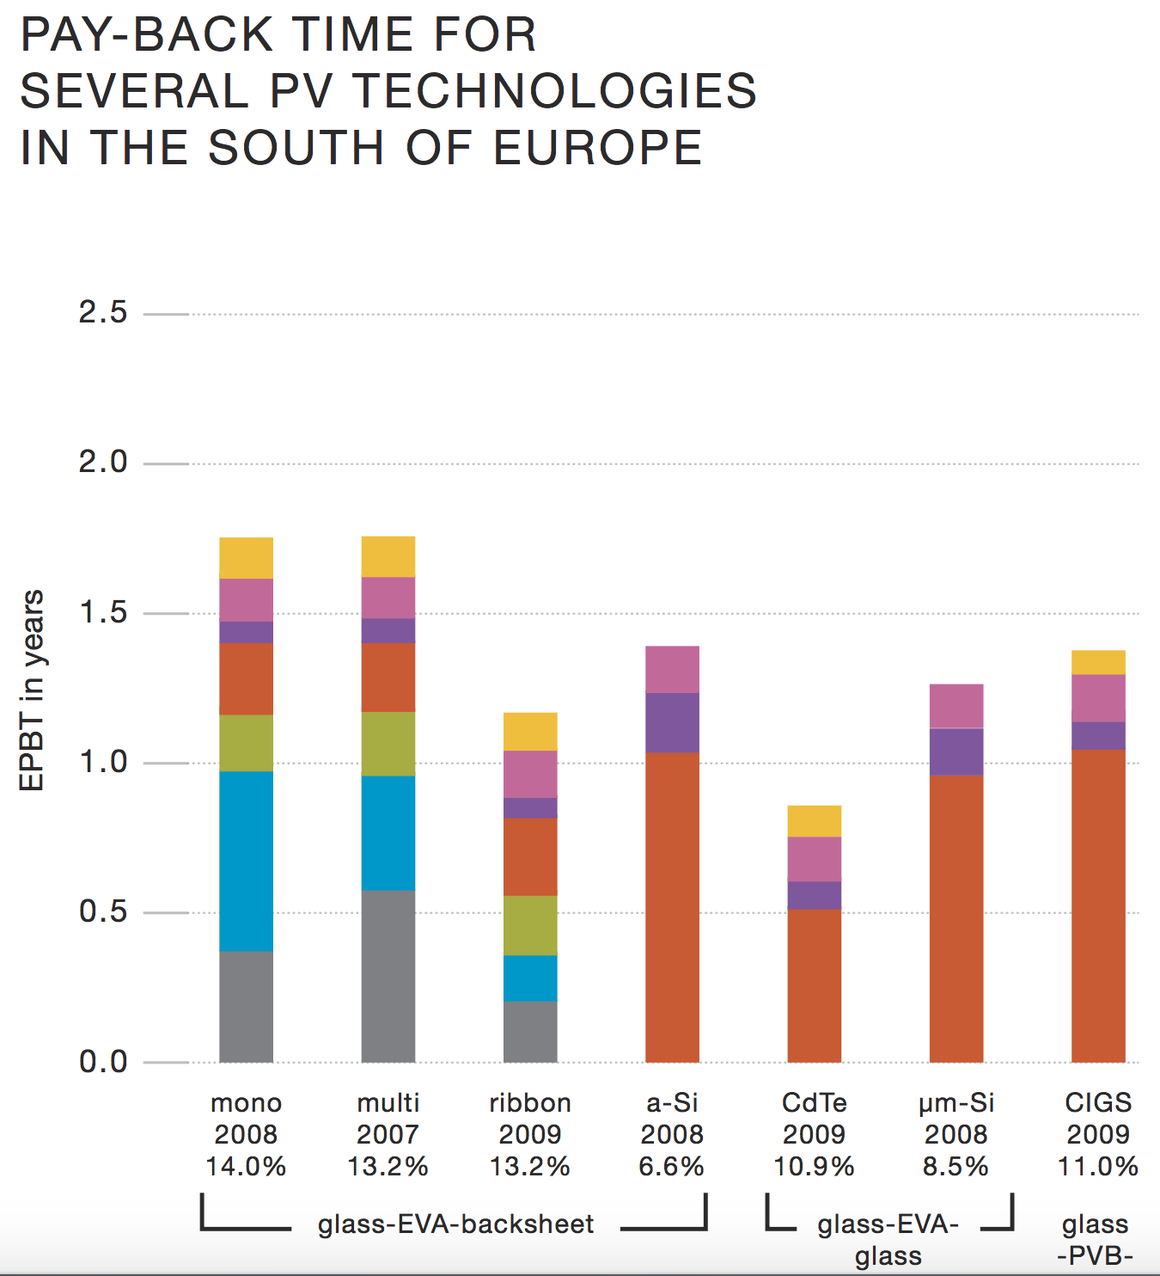
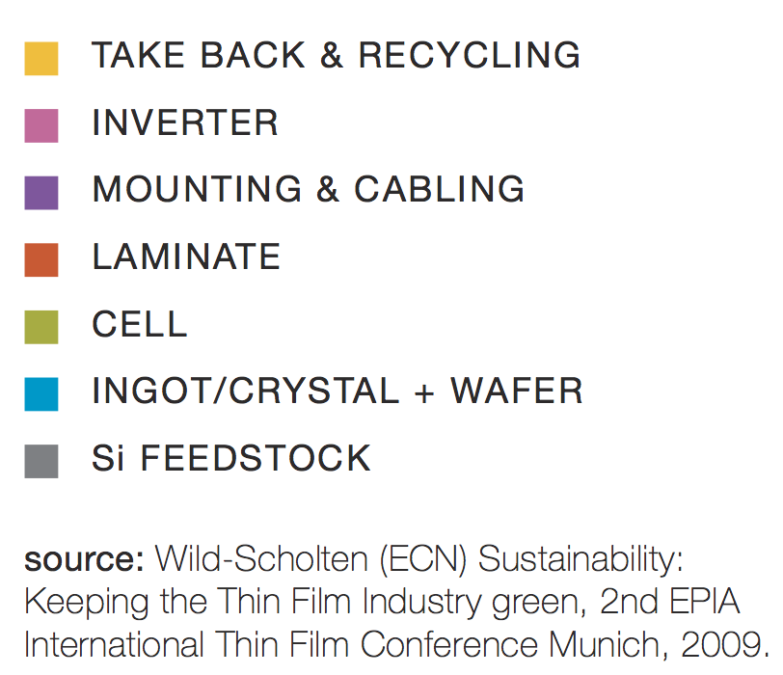
Here is an example of a solar energy EPBT study:
From a 2011 Greenpeace report ¹ citing an International Energy Agency database ²
(with my yellow annotations added)
Conventional Silicon
Non-Silicon & ultrathin Si
1) Greenpeace 2011 (page 84):
http://www.greenpeace.org/international/Global/international/publications/climate/2011/Final%20SolarGeneration%20VI%20full%20report%20lr.pdf
2) IEA WEO;
http://www.worldenergyoutlook.org/resources/energydevelopment/energyaccessdatabase/

Slide 8
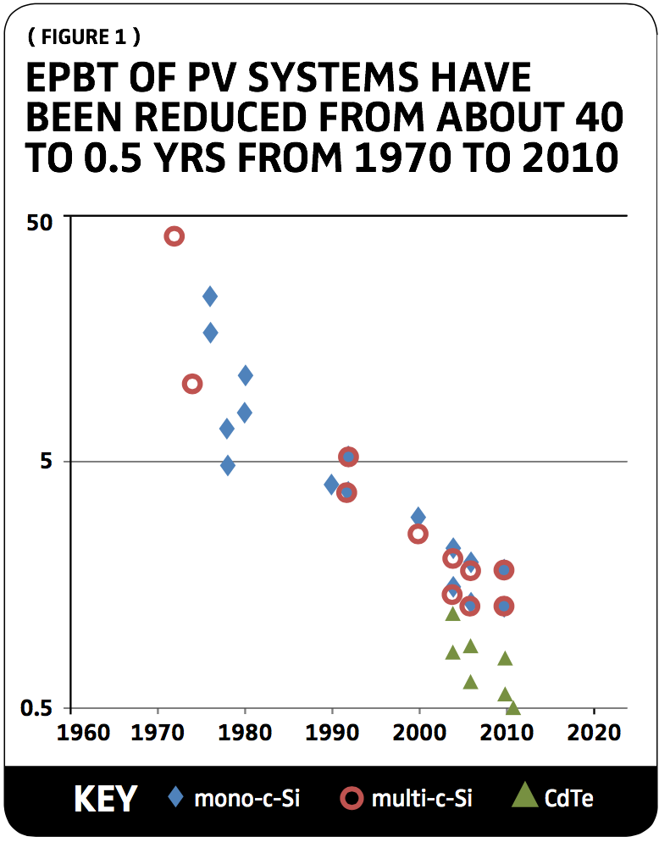
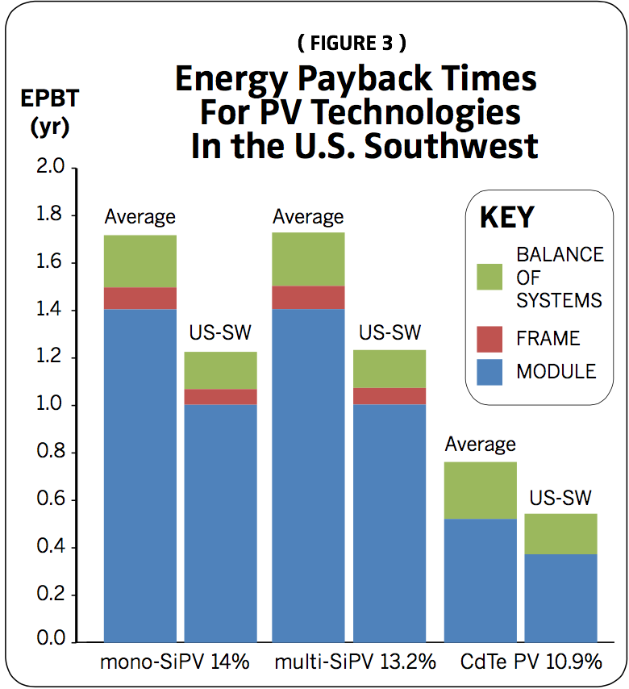
But are you ready to trust Greenpeace?
Here, instead, is a study from the U.S. National Society of Professional Engineers:
Fthenakis 2012) http://www.clca.columbia.edu/236_PE_Magazine_Fthenakis_2_10_12.pdf

Slide 9
The two studies are in surprisingly good agreement
So let's examine the first study in greater detail:
Colors identify how much energy was put into each stage of the solar cell's lifecycle:
In actual life cycle order:
Extracting & processing the raw Si "feedstock"
Converting it into large crystals, and then wafers
Manufacturing those wafers into solar cells
Laminating individual solar cells into a solar panel
Mounting and electrically connecting that panel
Building the circuit to "invert" the cell's natural low voltage DC into conventional grid AC power
Energy used in retiring & recycling this system

Slide 10
Trying to exploit these data:
EPBT = Energy put INTO these cells, so smaller EPBT is better, right?
That immediately suggests:
1) Avoid Conventional Silicon (Single crystal)
2) Choose instead cells made from either:
CIGS (Copper Indium Gallium Selenide)
um-Si (Micro/polycrystalline Si)
CdTe (Cadmium Telluride)
Would these indeed be your best choices?
Probably Not
Conventional Silicon
Non-Silicon & ultrathin Si

Slide 11
Because Energy Payback Times alone are just too incomplete!
First, because they omit often critical technical information: ¹
Single crystal Si is the most technologically & commercially mature material
And it has one of the very highest energy conversion efficiencies
Whereas the EPBTs in the right group are low because they are "thin films"
Which means that they do not employ single crystals
Making them less stable and thus prone to decomposition
Which, for CIGS and CdTe, invites release of toxic materials
But is it really fair to critique EPBT's on technological details?
After all, they were only MEANT to evaluate energy impact!
1) For details see: Today's Photovoltaic Solar Cells (pptx / pdf / key) Tomorrow's Solar Cells (pptx / pdf / key)

Slide 12
Let me zero out almost all of those technological details
By assuming, temporarily, that all of those cell types are technologically equivalent
Except for one thing: How long they will be able to generate power
Yes, this derives from some of those technological details
But isn't it a blatantly obvious question, one that any consumer would ask?
Even if you hadn't a clue about how a car actually works,
wouldn't you seek an estimate of its lifetime from a trusted source?
For solar cell's, let me try to fill in as that hopefully trustworthy source:
Single crystal Si solar cells can produce power for over 20 years
This may fall to 10 years for microcrystalline Si solar cells
And may be as little as three years for today's CIGS solar cells
An Introduction to Sustainable Energy Systems: WeCanFigureThisOut.org/ENERGY/Energy_home.htm

Slide 13
Combining this with the 1st study's EPBT data:
EPBT Energy Generation Lifetime
Single Crystal Si solar cells: 1.75 yrs > 20 years
Microcrystalline Si Solar cells: 1.25 yrs ~ 10 years
CIGS thin film solar cells: 1.4 yrs ~ 3 years
After paying off its energy debt, Crystal Si cells produce energy for ~ 18 years
After paying off its energy debt, Microcrystal Si cells produce energy for ~ 9 years
After paying off its energy debt, CIGS cells produce energy for ~ 2 years
My lifetime estimates for Microcrystalline Si and CIGS may be somewhat inaccurate
But I think I've made my point:
EPBT alone provides a poor (dumb?) basis for making energy decisions

Slide 14
It makes more sense to consider a full energy "investment cycle"
Before making a financial investment, you'd want to know its likely ratio of:
Income Produced / Monetary Investment ~ Return on Investment (ROI)
A similar energy measure would be the ratio of:
Lifetime Energy Produced / Lifetime Energy Invested
For years researchers gave this (or its reciprocal) different names, including:
Energy Intensity
Energy Intensity Ratio
Energy Return on Invested
Energy Return on Investment
Energy Return on (energy) Invested
Energy Return on Invested Energy

Slide 15
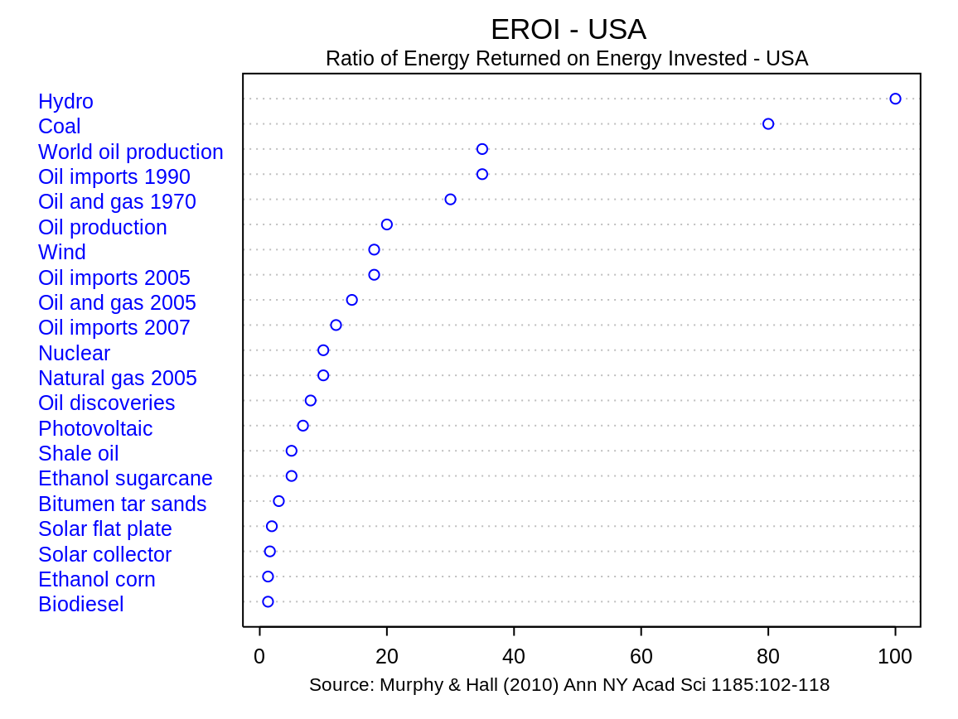
But thankfully, they've now converged on the simple abbreviation: EROI
Largely stimulated by the 2010 paper of D.J. Murphy & C.A.S. Hall entitled:
Year in Review: EROI or energy return on (energy) invested ¹
Wikipedia's plot of data from that seminal paper: ²
1) Or as I will denote it: Murphy 2010 - Year in review: EROI or energy return on (energy) invested
2) Energy Return on Energy Invested, Wikipedia, https://en.wikipedia.org/wiki/Energy_returned_on_energy_invested

Slide 16
But if you make it past "Pay Walls" to actually read that paper
You'll find it's mostly a discussion about the methodology of EROI calculation:
EROI's numerator, Lifetime Energy Produced, is pretty easy to pin down
But its denominator, Lifetime Energy Investment, is far more difficult
First, given that many energy technologies operate for a half or even a full century,
one must be extremely careful not to overlook any energy input over that span
But which energy INPUTS should be included?
For instance, should we include the chemical energy intrinsic to a fuel?
Most researchers say no, arguing that we should focus on man's energy input alone
For fuels that is the energy we put into mining/drilling, refining & transporting it
EROI's calculated on that basis are sometimes called external EROIs
An Introduction to Sustainable Energy Systems: WeCanFigureThisOut.org/ENERGY/Energy_home.htm

Slide 17
But there are subtleties in even "external EROI" calculation:
For instance, one must sniff out energy inputs lurking within raw materials
Such as the amount of energy put into the growth of Si solar cell crystals
Or into formulating the concrete used in massive nuclear & hydroelectric plants
And for fuels, what if some of that fuel is actually expended in the fuel's production?
As it is when sugar cane is burned as a part of ethanol's production process
Or when tar sand's oil extraction depends on heat from burning part of that oil
Or what if the byproduct of one fuel's production might supplant another fuel's use?
As when corn mash fermented to produce ethanol can be used as animal feed,
eliminating the energy otherwise needed for separate growth of feed plants
Or what about energy to repair roads, rails & pipelines essential for fuel transport?

Slide 18
And then there is the question of EROIs' larger significance:
Because, as with Energy Payback Times, by discussing only energy
EROI's provide a very incomplete picture of a technology's true viability
Leading many EROI research studies to extend their discussion into economics
Asking questions such as: Is there a MINIMUM acceptable value of EROI?
= An EROI below which economics too would almost certainly make no sense?
This is indeed discussed at length in Murphy & Hall's seminal EROI paper
With concludes that when the cost of economic "externalities" are included:
To succeed economically, a fuel's EROI must exceed ~ 3
But for all of their background and/or side discussion, I was surprised to find that:

Slide 19
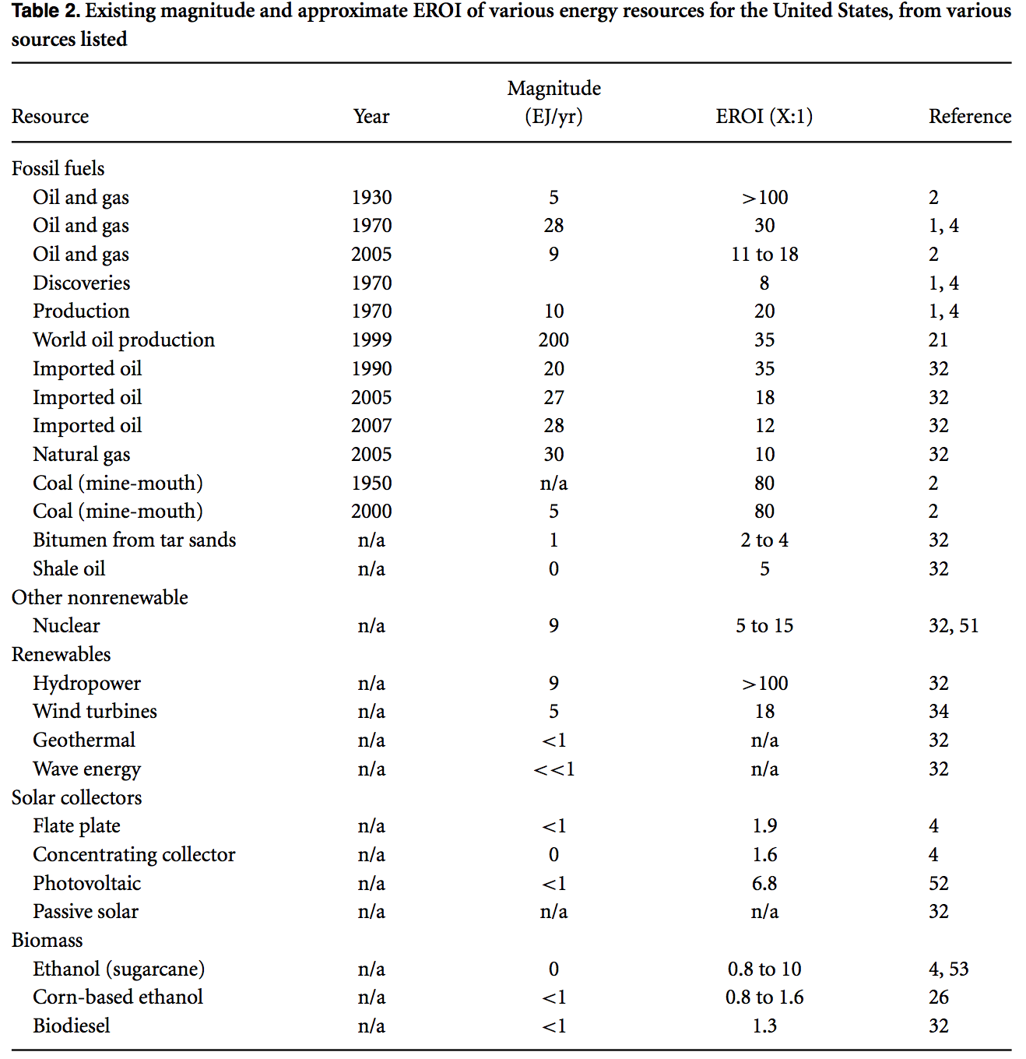
EROI papers often include little to no primary data or discussion
They rely on secondary data, generally presented solely through one or two tables
And even when data are explained, it's done in just 1-2 meager sentences
The key data table
from Murphy & Hall's paper:
As an experienced physical scientist, I found this paucity of primary data unsettling
Especially given the intense controversy surrounding many EROI values!

Slide 20
Many studies ALSO lack clarity on a fundamental point:
What TYPE of "Lifetime Energy Produced" is being counted?
Is it electrical energy, kinetic energy, heat energy, chemical energy . . . ?
Counting "all of the above" can lead to immense confusion!
An example of such confusion? The hugely higher FUEL EROI's of Murphy & Hall
Can such fuels really be 10X more energy efficient than renewables?!!
No! The preceding table is an "apples to oranges" comparison:
For the fuels, at the top of the table, the energy output is heat
For for the bottom half of the table, the energy output is electricity
How then can their EROI's be compared? Going back to EROI's definition:
EROI = Lifetime Energy Produced / Lifetime Energy Invested
An Introduction to Sustainable Energy Systems: WeCanFigureThisOut.org/ENERGY/Energy_home.htm

Slide 21
Correcting the EROI numerator:
Numerator: Lifetime Energy Out, here: Electrical Energy or Heat Energy
Many power plants CONVERT a fuel's heat output into electrical output
The EFFICIENCY of conversion can be evaluated for each plant, for example:
Coal-fired power plants convert heat to electricity at ~ 1/3 efficiency ¹
Yielding a way to translate EROI numerators:
Energy _{ELECTRICITY} = Energy _{HEAT} x Efficiency _{ELECTRICITY TO HEAT CONVERSION}
Applying this to the "Lifetime Energy Out" numerator of an EROI:
Plant Electrical Energy Out = Fuel Heat Energy Out x Efficiency of Conversion
Using Murphy & Hall's Coal fuel EROI of 80, plus a conversion efficiency of ~ 1/3:
Coal Plant EROI => Coal Fuel EROI x (1/3)= (80)( 1/3) ~ 27
But we're not done yet!
1) From my FOSSIL FUELS (pptx / pdf / key) note set

Slide 22
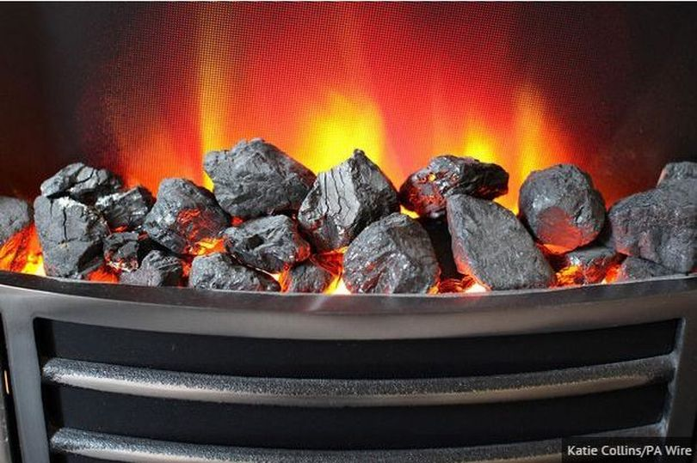
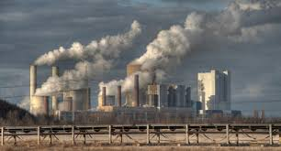
Correcting the EROI denominator:
Denominator = Lifetime Energy Input = All forms of energy EVER invested into:
A fireplace to produce heat: OR A power plant to produce electricity:
Even for the thousands of fireplaces required to match a plant's Coal consumption
Lifetime energy input for plant construction, operation & decommissioning
will almost certainly exceed the energy put into all of those fireplaces
Pulling Coal Plant EROI down even further from the Coal Fuel EROI
And thus making the last page's numerator-only correction a generous upper limit:
EROI _{Electrical Plant} << EROI _{Plant's Fuel} x Efficiency _{Heat of Electricity Conversion}
http://www.chroniclelive.co.uk/news/north-east-news/north-east-homes-burn-more-8690572
https://www.pakistantoday.com.pk/2016/06/08/pak-china-enter-into-agreement-for-coal-power-generation/

Slide 23
With all of those observations, caveats, doubts and conversions in mind:
I'll now draw data from an array of well-recognized EROI studies
By subject, in order of increasing controversy (decreasing EROI)
Starting with electrical energy producing technologies
Ending with heat producing fuels
And true to the spirit of WeCanFigureThisOut.Org
I'll also search out my own independent data sources
Including, most importantly, newer primary data sources
And generate my own independent analyses of both old and new data
For information on my background, visit: https://wecanfigurethisout.org/ABOUT/About.php

Slide 24
To aid YOUR independent investigation:
You may want make use of the very long list of publications I'm about to discuss
My usual note set practice is to insert the URLs of my sources
But even I find URLs near impossible to remember and/or keep track of
Thus, in this note set, I'm going to switch to a more conventional citation format of:
first author + year + (immensely more understandable & memorable) title
But if you DO set out on an independent investigation (as you always should!)
I hope you've realized that my note sets have companion Resource Webpages
Which provide my categorized references, along with URLs,
and (where pay walls permit) downloadable cached copies
For this note set, that can all be found at this link: EROI Resources Webpage
Onward!

Slide 25
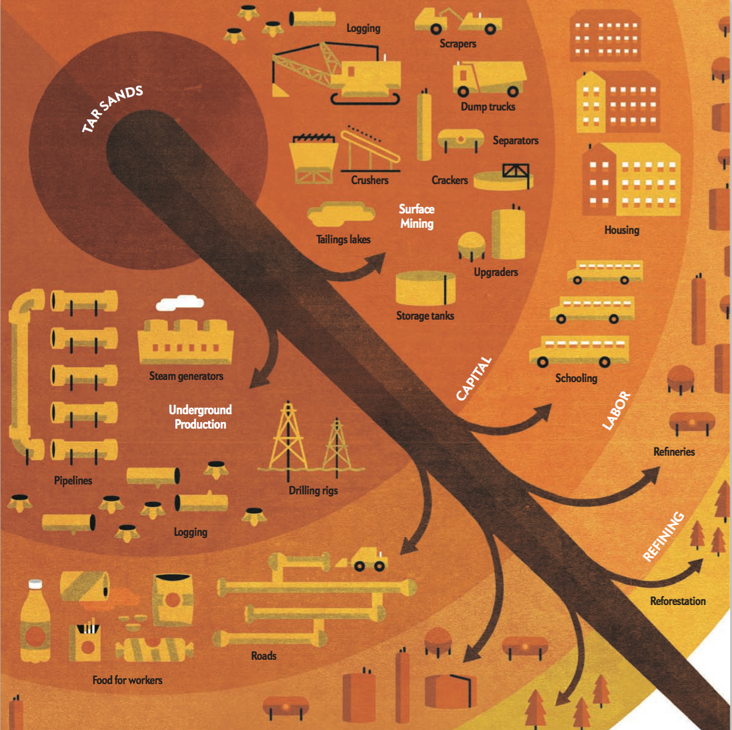
A particularly noteworthy review of EROI data was published in 2013
Its impact was exceptional both because it was published in Scientific American: ¹
The True Cost of Fossil Fuels, Mason Inman, April 2013, Scientific American
And because it was accompanied by a separate article discussing its methodology: ²
Behind the Numbers on Energy Return on Investment, Inman
With the author additionally sharing his work with a pair of energy bloggers: ³
Energy Return on Investment - Which Fuels Win?, Hope & Donald
1) Inman 2013a
2) Inman 2013b
3) Hope 2013

Slide 26
My rendition of the data from those 2013 Scientific American articles:
Colors reflect articles' conclusion that economic viability requires EROI of at least 5
Technology EROI
Heat from:
Conventional oil 16
Ethanol from sugarcane 9
Biodiesel from soy 5.5
Tar Sands 5
Heavy oil from California 4
Ethanol from corn 1.4
Electricity from:
Hydroelectric Dams 40+
Wind 20
Coal 18
Natural Gas 7
Solar PV 6
Nuclear 5

Slide 27
Now digging deeper
(Which will lead to my very different EROI figure given at the end of this note set)
EROIs for Power Plant Electricity Generation
An Introduction to Sustainable Energy Systems: WeCanFigureThisOut.org/ENERGY/Energy_home.htm

Slide 28
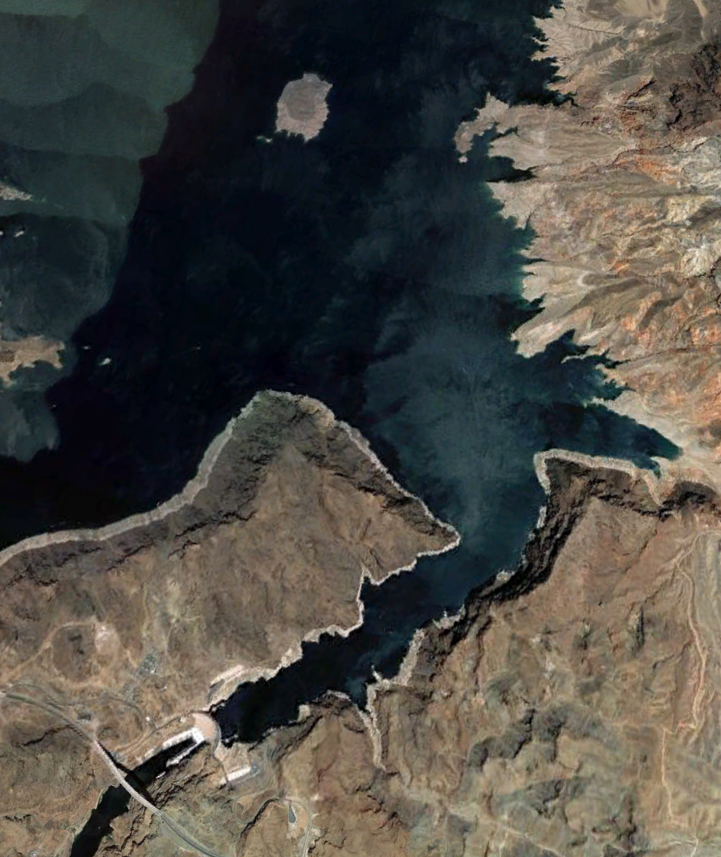
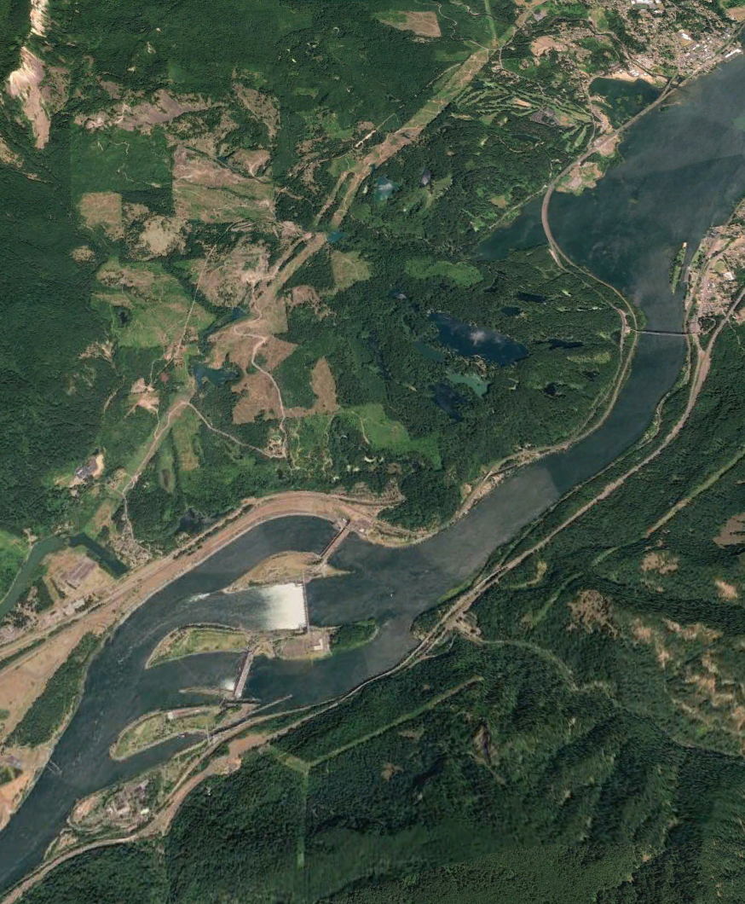
Electricity from Hydro
Hydro with Reservoir (Hoover Dam) Run-of-the-River Hydro (Bonneville Dam)
Images via Google Earth

Slide 29
Hydro Power Plant EROI
Murphy & Hall's data table (shown above) gives hydro's EROI as: >100
Its reference, #32, which is not discussed in the text, cites a series of postings
to an online energy discussion forum with no obvious connection to hydro
Inman, who was inspired by Murphy & Hall, cites instead the the work of Gagnon
Who in a 2002 paper mentions EROIs for both Quebec & international locations:
Hydro w/ Reservoir: Hydro Run-of-the-River:
Quebec: 205 267
International: 50-260 35-267
The 2002 Gagnon paper provides no correlation with hydroelectric plant size
More critically, it cites no sources beyond this note at the bottom of its data table:
The first energy forum link) http://www.theoildrum.com/node/3412
Gagnon 2002) Life-cycle assessment of electricity generation options: The status of research in year 2001

Slide 30
However, I eventually found a later Gagnon paper:
Which, in 2008, DID finally include sources for hydro EROIs he'd called out in 2002
But when I tried to track them down, key sources turned out to be
from arguably non-objective sources (e.g., Hydro-Quebec),
and they were written (or at least titled) in only French
Moving on, I then found a 2015 study by Atlason & Unthorsson
Which finally provided a detailed EROI study of a single hydroelectric plant
Concluding that an EROI of 110 was likely over its 100 year lifetime
But, located in Iceland, this plant may or may not have been typical
I next found the U.S. Department of Energy's 2016: Hydropower Vision which:
400+ pages long, called out "EROI" in its introductory table of acronyms
But only on page 306 briefly mentioned hydroelectric EROI of up to 470
Gagnon 2008) Civilisation and Energy Payback
Atalson 2015) Energy Return on Investment of Hydroelectric Power Generation Calculated Using a Standardised Methodology

Slide 31
But digging even deeper:
The DOE's Hydropower Vision gave as its source a 2011 paper by Kumar:
Which was actually Chapter 5 of the International Panel on Climate Change's
2011 Special Report on Renewable Energy Sources and Climate Change
But when I dug up that IPCC chapter
It's gave as its sources as the same two papers by Gagnon!
Thus, after digging up what first appeared to be a whole array of data sources,
from increasingly prestigious organizations, in increasingly long-winded reports
I ended up with data actually originating from ONLY TWO sources:
- One covering only a single hydro plant - but with the depth I had sought!
- The other based on possibly biased data, readable by only French speakers
My conclusion, based largely on the absence of dispute: Hydro EROI ~ 100
Kumar 2011) Chapter 5 – IPCC Special Report on Renewable Energy Sources and Climate Change Mitigation

Slide 32
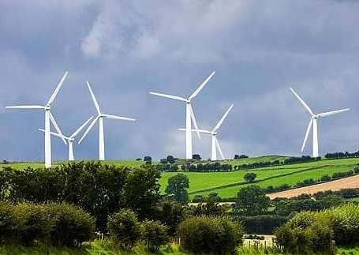
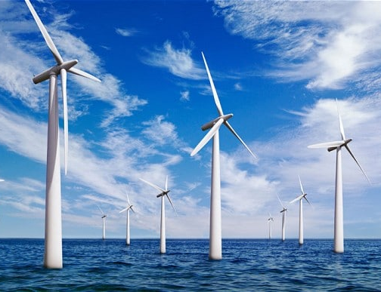
Electricity from Wind
Onshore Wind Farm: Offshore Wind Farm
http://www.telegraph.co.uk/news/earth/energy/windpower/12165896/Onshore-wind-farm-subsidies-could-continue-on-islands.html
http://www.telegraph.co.uk/news/uknews/scotland/11155227/Four-offshore-wind-farms-approved-despite-deadly-impact-on-seabirds.html

Slide 33
Wind Farm EROI
In 2008 Lund cited sources such as a 1998 paper by White & Kulcinski to conclude:
Onshore wind EROI = 34, but more complex Offshore wind EROI = 18
In 2010 Murphy & Hall cited a then new work by Kubiszewski et al. to conclude:
All wind EROI = 18 (which Inman seemingly just rounded up to 20)
But I've come to believe a major oversight was committed:
Kubiszewski et al. correlated EROI with wind turbine power capacity
(Even if they made little use of this correlation in their paper's conclusion)
Here the science of wind is extremely important (see my Wind Power (pptx / pdf / key) notes):
Wind speed increases rapidly with height
+
Wind power increases as (wind speed) ^{Cubed}
Smaller numbers
of much taller turbines
produce VASTLY more power
White 1998: Net Energy Payback and CO2 Emissions from Wind Generated Electricity in the Midwest
Lund 2008: Review of the Application of Lifecycle Analysis to Renewable Energy Systems
Kubiszewski 2010: Meta analysis of EROI for Wind - Renewable Energy

Slide 34
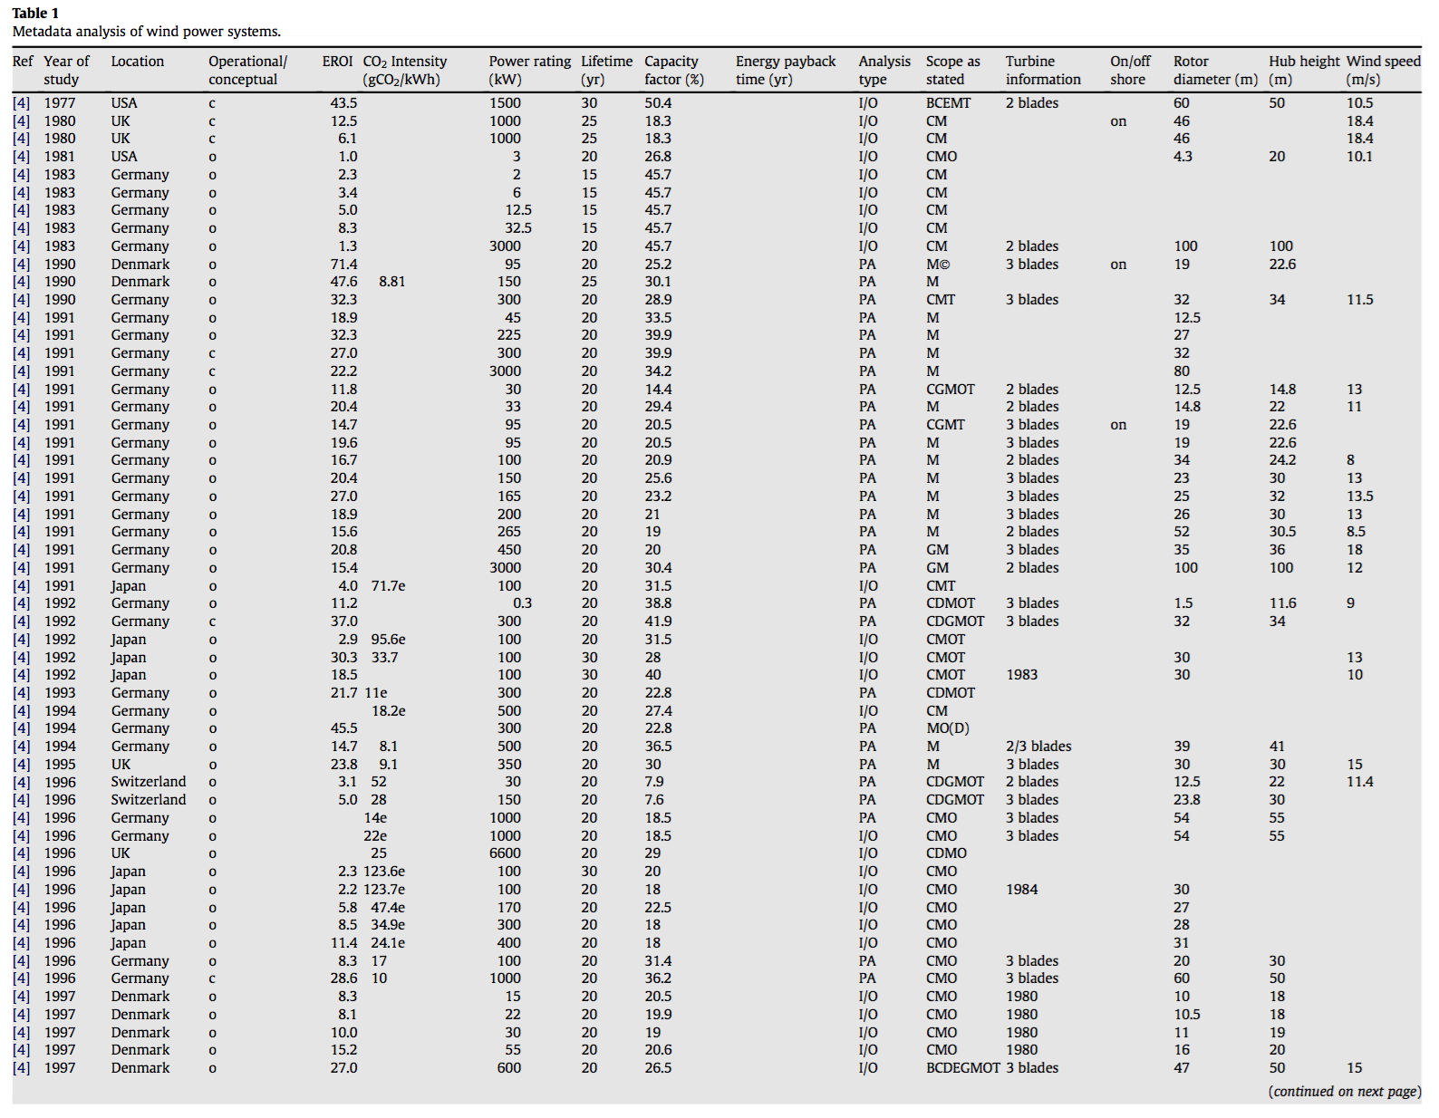
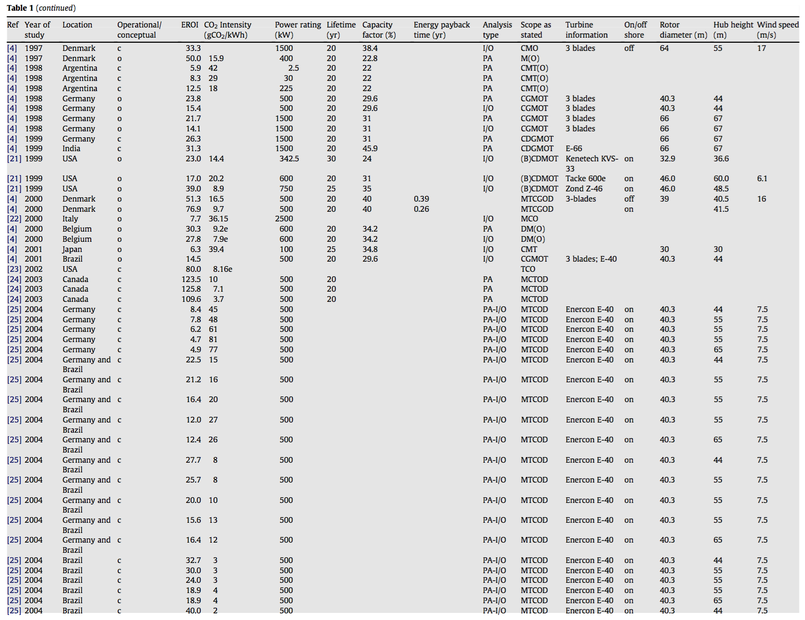
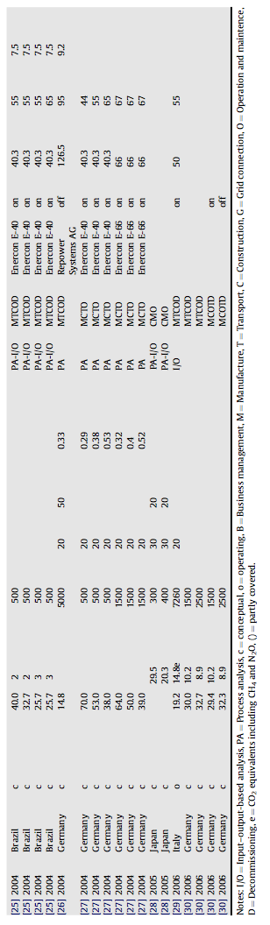
The richness of the 2010 Kubiszewski meta-dataset:
Kubiszewski 2010: Meta analysis of EROI for Wind - Renewable Energy

Slide 35
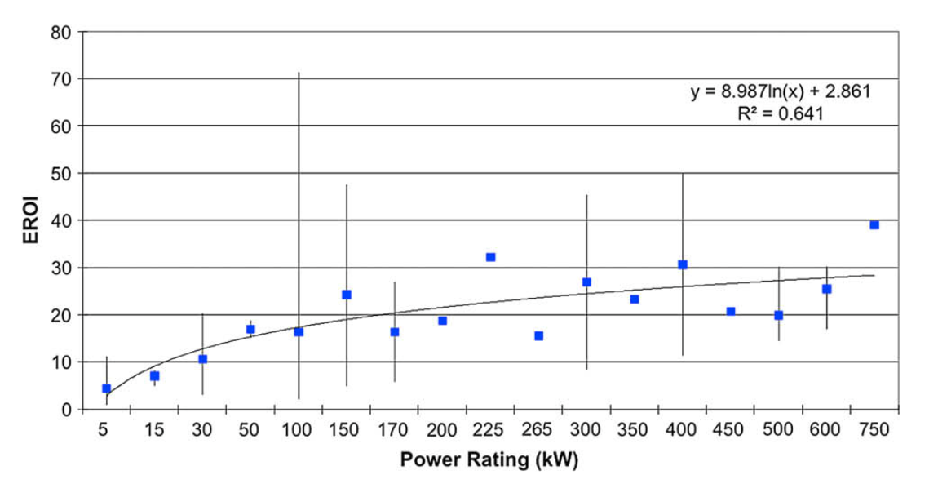
Which facilitated their correlation of EROI with turbine power rating:
Small turbines at left (obsolete by 2010) => Wind EROI's of 5-20
versus
Almost 1 MW turbines at right (then modern) => Wind EROI's of 30-40
Kubiszewski 2010: Meta analysis of EROI for Wind - Renewable Energy

Slide 36
Wind energy industry sources recognized the significance of this trend:
As in an editorial posted in 2013 by the American Wind Energy Association ¹
But even their discussion has now become very dated because:
Today's wind farms are now built around 4 MW turbines
And 6 MW turbines are planned for new farms
I was not able to find a post-2013 wind EROI study reflecting these developments
But based on straight-forward wind science it is virtually certain
that modern much taller/larger turbines will achieve much higher EROIs
Leading me to PREDICT that for TODAY's much larger wind turbines:
Onshore Wind EROI ≥ 40 (perhaps even substantially greater)
1) AWEA 2013: Setting the Record Straight about Wind’s Lifecycle Emissions and Return on Energy Invested

Slide 37
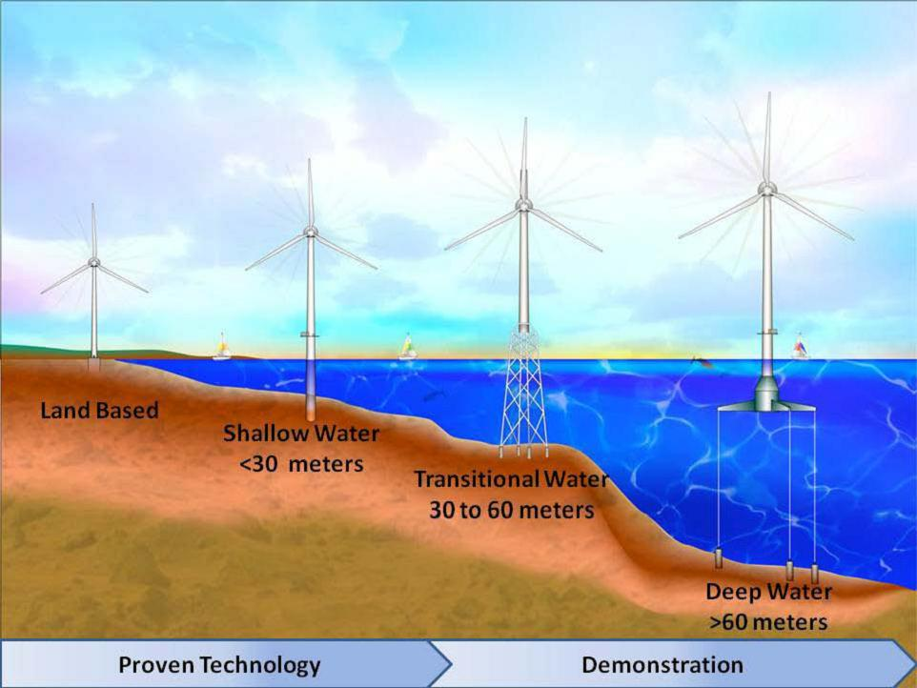
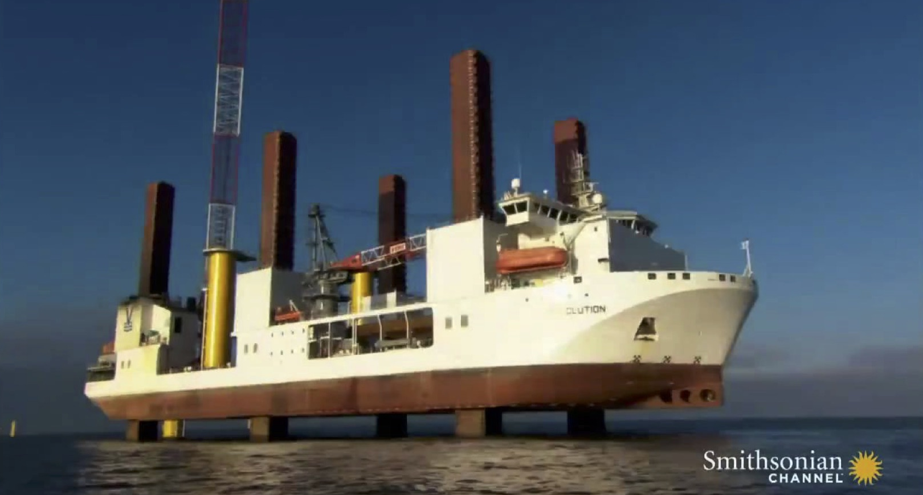
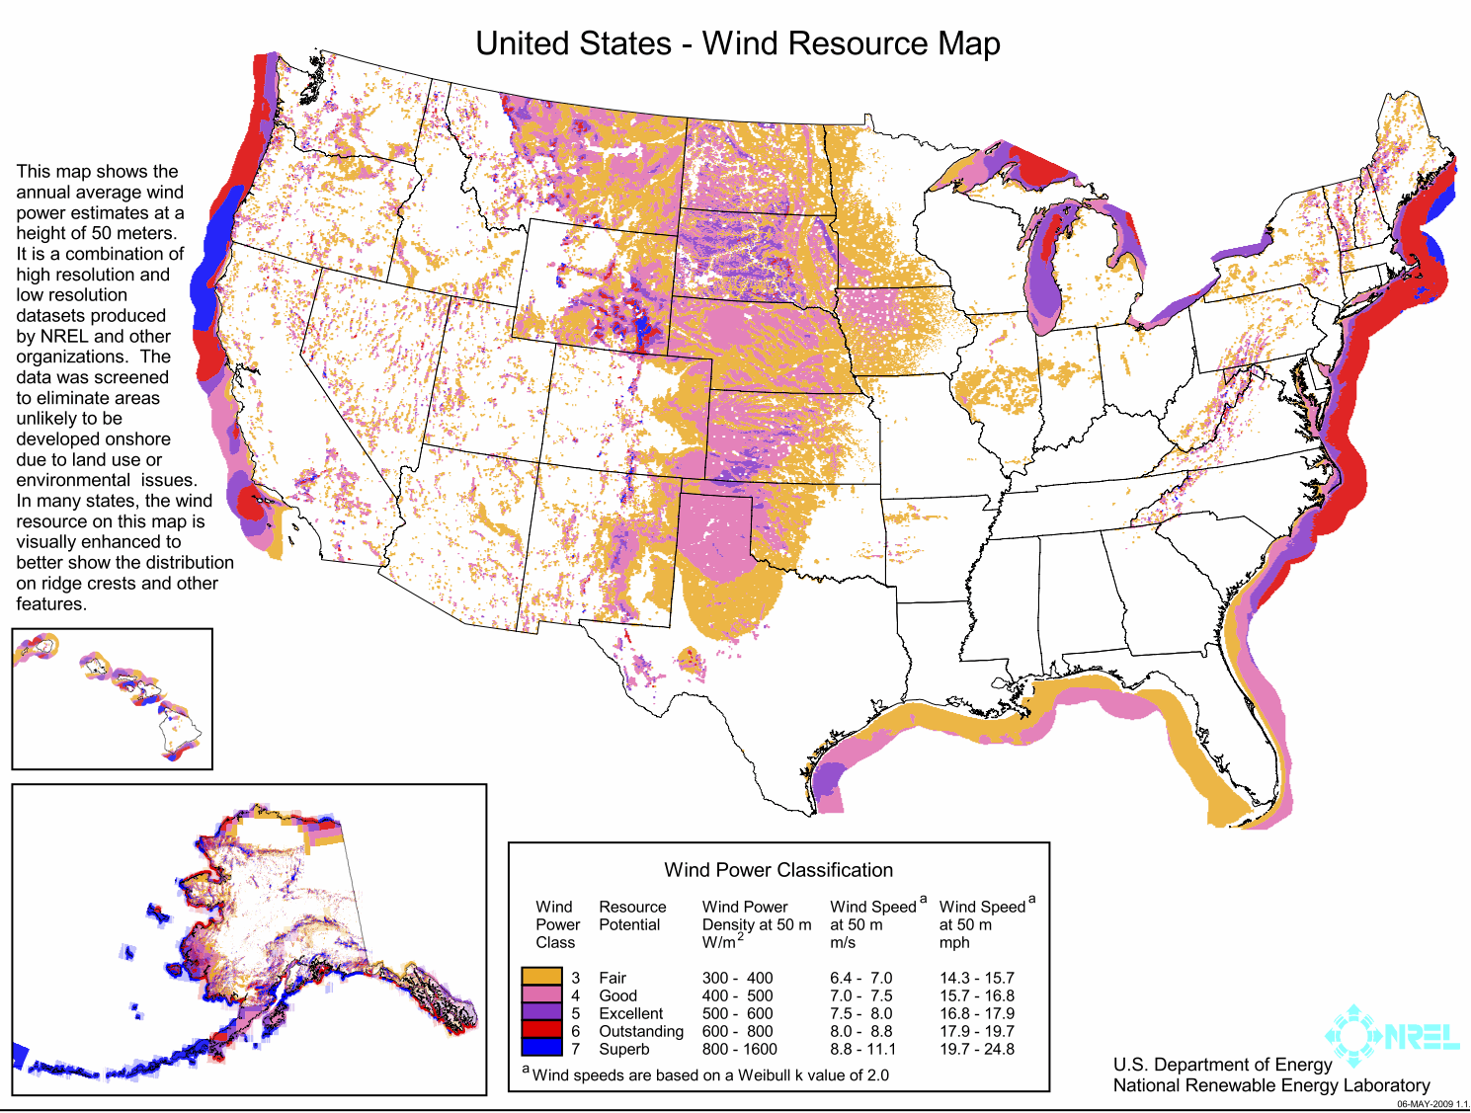
As to offshore wind:
It is so much newer that I did not find convincing Offshore Wind EROI data
Its technology IS substantially more complex, as is its installation:
But offshore wind is also much more intense and much less intermittent:
Advantages amplified by wind power being proportional to wind speed cubed
Suggesting offshore wind EROI might eventually match or exceed onshore EROI
Please see my Wind Power (pptx / pdf / key) note set for details and figure credits

Slide 38
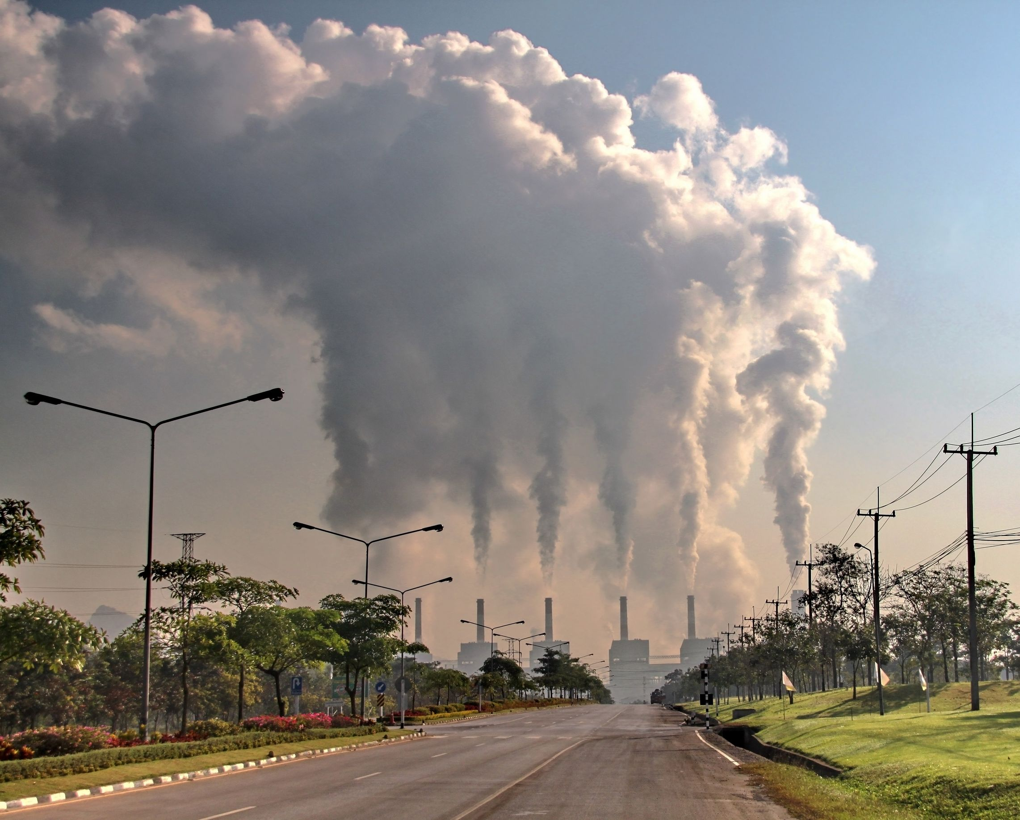
Electricity from Coal
Photo purchased from: ungnoilookjeab via 123RF.com

Slide 39
Coal Power Plant EROI
In their seminal paper Murphy & Hall report Coal EROI = 80
But this is for HEAT ENERGY output and not ELECTRICAL ENERGY output
In 2012 Raugei, citing German language sources, gave Coal EROI_{HEAT} ~ 40 - 80
He then multiplied this by a heat-to-electricity-conversion-efficiency
=> Coal EROI _{ELECTRICAL} = 12.2 - 24.6 (w/o EROI denominator correction!)
In 2013 Weissbach cited Spath's 1999 NREL report, and a German language source
to conclude Coal EROI _{ELECTRICAL} = 29 - 31
Inman took his Coal EROI _{ELECTRICAL} = 18 value from the middle of Raugei's range
But these sources (and EROI's) ignore the impacts of coal pollution
Assuming, perhaps, that coal's swift decline would soon make it irrelevant?
Raugei 2012: Energy Return on Energy Investmen of Photovoltaics: Methodology & Comparisons with Fossil Fuel Life Cycles
Weisbach 2013 Energy Intensities EROIs and Energy Payback Tmes of Electricity Generating Power Plants

Slide 40
That pollution prompted major changes in coal power plant design:
As described in my FOSSIL FUELS (pptx / pdf / key) note set, there are now:
- Quickly declining, essentially uncontrolled and heavily polluting, coal plants
- Less polluting integrated gasification and/or combined cycle coal plants
- Hopes (pipe dreams?) of "clean coal" plants with full carbon sequestration
But pollution controls not only alter coal's heat-to-electricity-conversion-efficiency
Their added technology also contributes to lifetime energy input
Gagnon's 2008 review was one of few clearly recognizing this change, as it used
a 1999 NREL report by Spath, and a 2003 IEA report by Gielen
to compute a Combined Cycle Coal EROI _{ELECTRICAL} = 2.5 - 5
I didn't find an EROI for full "integrated gasification + combined cycle" coal plants
(But an one might be calculable from Gielen's discussion of IGCC)
Gagnon 2008) Civilisation and Energy Payback
Spath 1999: Life Cycle Assessment of Coal-fired Power Production
Gielen 2003: Future Role of CO2 Capture in the Electricity Sector

Slide 41
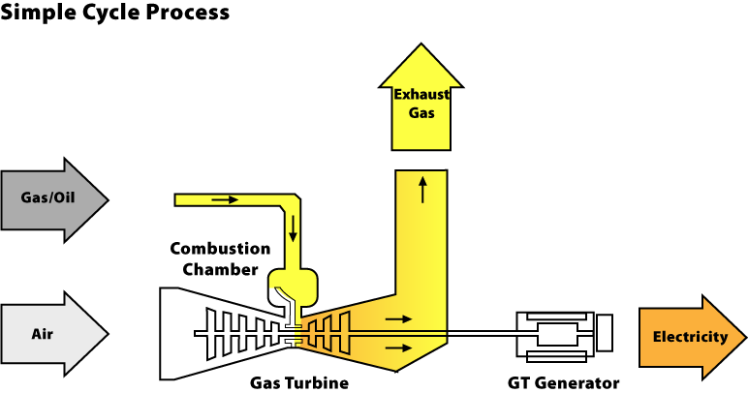
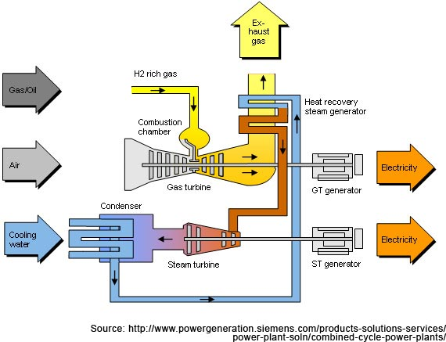
Electricity from Natural Gas (NG)
Open Cycle Gas Turbine (OCGT): Combined Cycle Gas Turbine (CCGT):
https://www.consumersenergy.com/content.aspx?id=1345
http://www.power-technology.com/projects/uskmouth/uskmouth2.html

Slide 42
Gas Power Plant EROI
Murphy & Hall reported a NG EROI = 10, but they group it with Coal's 80
Suggesting that this is also natural gas's EROI for HEAT ENERGY output
But it is very close to Inman's NG EROI _{ELECTRICAL} = 7 which he got converting
a NG EROI_{HEAT} value of 40 (from an unidentified source) and multiplying it
by a "typical" 40-45% NG heat-to-electricity-conversion-efficiency
(But making no correction for the change in Lifetime Energy Input!)
My FOSSIL FUELS note set instead identified OCGT NG plant efficiencies as ≤ 40%
Versus CCGT NG plant efficiencies in the low 60% range
Inman corroborated his calculation via King's 2010 "energy intensity" data
But King merged energy with economic supply & demand considerations
in a way that left me uneasy about their full equivalence to EROI's
King 2010: Energy intensity ratios as net energy measures of United States energy production and expenditures

Slide 43
More straightforward were reports such as:
Gagnon's 2008 paper, based on Spath's 2000 study of combined cycle gas turbines
Not to be confused with Spath's 1999 NREL study of coal-fired power plants!
Gagnon concluded that:
CCGT NG EROI _{ELECTRICAL} = 2.5 if plant's NG sources were 4000 km distant
CCGT NG EROI _{ELECTRICAL} = 5 if NG sources were substantially closer
In 2013 Weissbach, also clearly taking power plant technology into account
Reported a similarly low CCGT NG EROI _{ELECTRICAL} = 3.5
Consideration of power plant technology makes these studies far more credible!
But with such abysmally low EROIs, how can NG be thriving in the US?
Gagnon 2008) Civilisation and Energy Payback
Spath 2000: Life Cycle Assessment of Natrual Gas Combined-Cycle Power Generation System
Weisbach 2013 Energy Intensities EROIs and Energy Payback Tmes of Electricity Generating Power Plants

Slide 44
Possible explanations for NG's prosperity in the U.S.
Turbine EROI's are likely eroded by their use of ultrahigh temperature titanium alloys
which increase the "Lifetime Energy Input" denominator of their EROI
(Mirroring the way single crystal Si PV EROI's are pulled down)
Nevertheless, they may still be chosen because Combined Cycle Gas Turbine plants
have a substantially lower carbon footprint than alternative coal power plants
But I suspect the real reason is instead that:
U.S. natural gas plants are now mostly used for only one or two evening hours,
adding power to the grid when consumption peaks (= "peaking power")
For such largely idle plants, low turbine capital cost becomes all important
Demonstrating a disconnect between low economic cost and high energy cost!

Slide 45
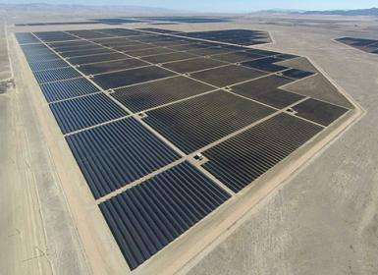
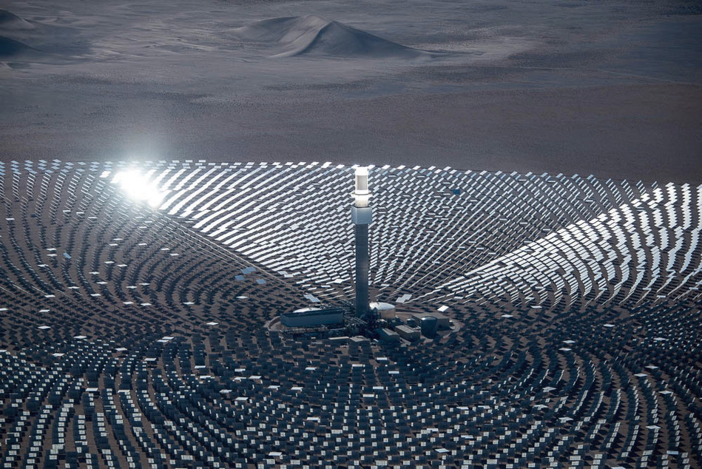
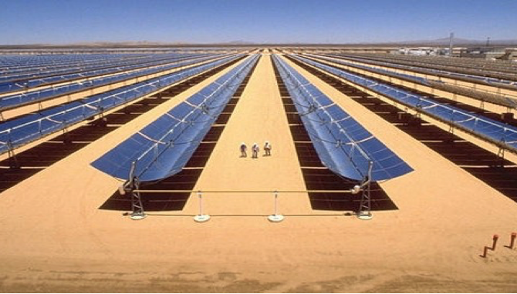
Electricity from Solar
Photovoltaic Solar Farm
(Topaz, California)
Solar Thermal Tower + Heliostats Solar Thermal Trough Concentrators
(Crescent Dunes, Nevada) (Quarzazate, Morocco)
https://techxplore.com/news/2014-11-world-largest-solar-farm-california.html
http://www.prnewswire.co.uk/news-releases/solarreserves-crescent-dunes-solar-energy-project-with-us-developed-storage-technology-receives-up-to-78-million-investment-from-capital-one-610901895.html
http://www.vilferelectric.com/en/2016/01/14/complejo-ouarzazate-planta-termosolar-nord-marruecos/

Slide 46
Solar Farm EROI:
Murphy and Hall's table does not clearly distinguish between
thermal vs. photovoltaic solar plants
nor between the many different types of photovoltaic cells
Instead just reporting Solar PV EROI = 6.8
Inman acknowledges the diversity of PV and its rapidly increasing EROIs
He cites Raugei's 2012 study which gives EROIs for various PV technologies as
single crystal Si = 6, multi-crystal Si = 6, Si ribbon = 9.5, CdTe = 11.8
But summarizes these as Solar PV EROI = 6 (consistent w/ crystal Si PV)
These EROIs values are very close to his estimated boundary of economic viability!
Thus, as EPBT numbers did, they have fueled already intense public debate
Raugei 2012: Energy Return on Energy Investmen of Photovoltaics: Methodology & Comparisons with Fossil Fuel Life Cycles

Slide 47
This debate is mirrored within the EROI research community
As in their lingering discussion of methodology (see, for instance, Carbajales)
But unresolved technological questions may be even more important, such as:
Under intense UV sunlight, what is the lifetime of a PV technology?
And, during that lifetime, how will its power output likely decline?
For younger PV technologies such as CIGS, there is very little real-world data,
and virtually NO real-world data for research PV stars such as Perovskites
But data on mature technologies (based on Si, GaAs & CdTe) are known
Further, intense interest in PV has stimulated a wealth of recent EROI research
But rather than burrowing into that long list of recent EROI studies,
it makes more sense to jump to their cumulative bottom line via this:
Carbajales 2015: Energy Return on Investment (EROI) of Solar PV: An Attempt at Reconciliation

Slide 48
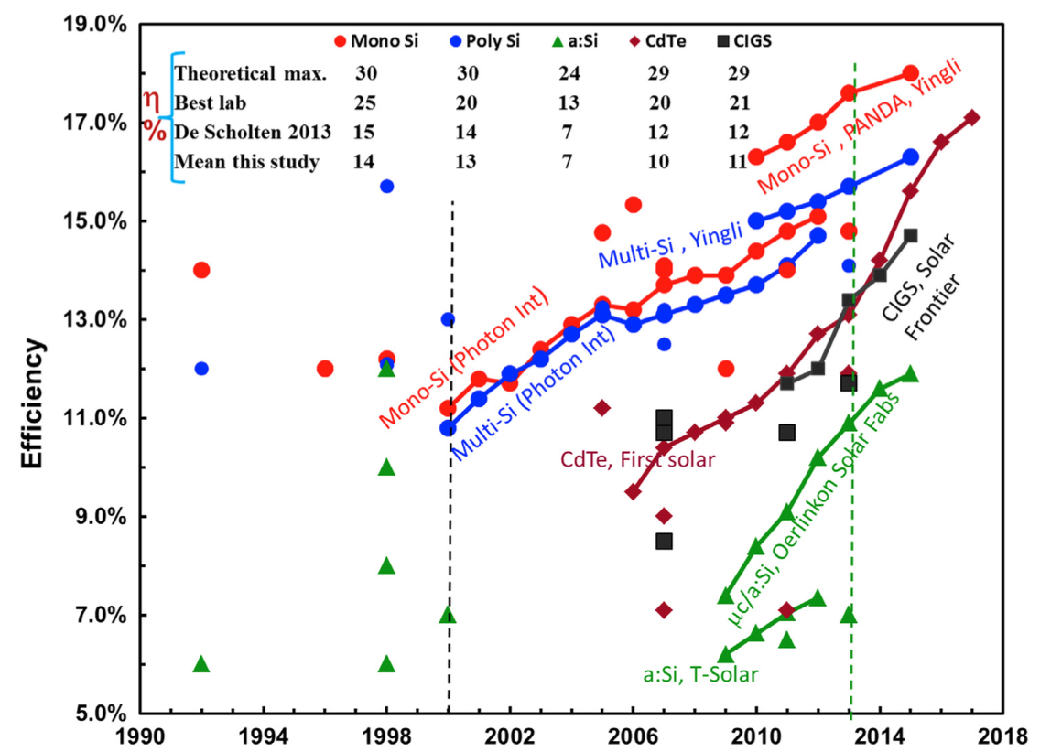
Meta-data analysis of 232 peer-reviewed PV EROI studies:
As presented in a 2015 Bhandari et al. paper that paid exceptional attention to
both technology-specific lifetimes and degradation patterns,
and to differing data credibility and confidence levels
That technology sensitivity can be seen in their plot of evolving solar PV efficiencies:
Bhandari 2015: Energy Payback Time and Energy Return on Investment of solar PV Systems: A Systematic Review and Meta-Analysis

Slide 49
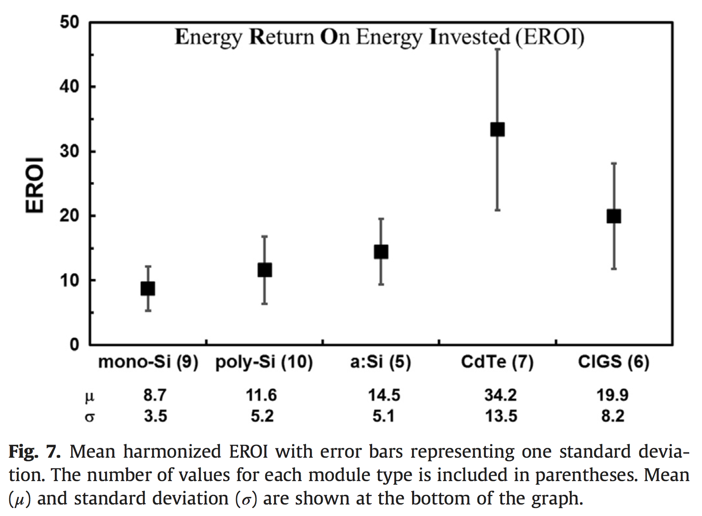
Based on that sensitivity . . .
This group did not just average data from its 232 contributing studies
Instead, each of those papers was examined and compared in detail
Resulting in both a down-selection of sources and weighting of their data
Leading to these composite results:
EROI Means:
Mono-crystalline Si PV = 8.7
Poly-crystalline Si PV = 11.6
Amorphous Si PV = 14.5
CdTe PV = 34.2
CIGS PV = 19.9
NOTE: These composite 2015 values
are 50-200% HIGHER
than Raugei's 2012 results!

Slide 50
But what about solar thermal power?
The output of a solar photovoltaic plant is proportional to sunlight intensity
But the output of a solar thermal plant is NOT!
This stems from its functional resemblance to coal & nuclear power plants
all of which heat water past its boiling point, producing steam to drive turbines
Getting water TO its boiling point takes a lot of time and energy!
Which is why 19th century locomotives took hours to "get their steam up"
But this means that one should never turn a steam-driven power plant OFF
Because then all of that painfully acquired heat energy is allowed to dissipate
For this reason, whenever possible, coal and nuclear power plants run 24/7
and are thus dedicated to providing the Grid's unvarying "base" power
An Introduction to Sustainable Energy Systems: WeCanFigureThisOut.org/ENERGY/Energy_home.htm

Slide 51
But solar thermal plants operate intermittently
Obviously loosing their sunlight power source every night
But also loosing much of that power source with every passing cloud
But where halving sunlight halves the power output of a solar PV plant
Halved sunlight can completely shut down a solar thermal plant
As can even the brief passage of particularly dark clouds
Why? Because if sunlight intensity falls far enough, or for long enough:
The plant's water (or oil) may no longer reach its boiling point,
leaving you with an effectively useless hot liquid!
Solar thermal power plants are thus uniquely vulnerable to solar intermittency
And their EROIs thus vary radically with their "capacity factor"
Which is their: (Actual energy output) / (Output under full sunlight)
~ the fraction of daytime they are fully illuminated

Slide 52
This has all sorts of weird consequences including:
- Some even fairly new solar thermal plants, such as California's Ivanpah,
must kick-start themselves every morning by burning natural gas
- Tower + heliostat plants can slightly outperform trough concentrator plants
Because "heliostat" mirrors can be steered toward cloud-free parts of the sky
These and other complications sharply elevate solar thermal's economic cost,
limiting solar thermal development to just a handful of plants worldwide,
mostly new and still experimenting with different design configurations
Myriad options also greatly complicate calculation of solar thermal energy cost
As can be seen in Larrain's 2012 attempt at calculating EROIs for solar plants
using different technological options, in different weather zones
Larrain 2102: Net Energy Analysis for Concentrated Solar Power Plants in Northern Chile

Slide 53
However, solar thermal plants can also store energy
At least if they use two fluids, one fluid heating the second fluid to boiling
And if that first fluid is a molten salt which can absorb a LOT of energy!
Indeed, molten salts can absorb so much energy that solar thermal plants might
continue boiling water for 6, 9, or even 12 hours after they loose sunlight
and thus continue producing power through cloudiness and nightfall
Which could make solar thermal the first really practical 24/7 renewable
Which is a BIG DEAL given that, as discussed in my PLANT ECONOMICS note set:
It costs as much to store solar PV and wind energy as it costs to make it!
But with these unsettled & untested options, firm solar thermal EROI's don't yet exist
To further explore this subject, I suggest reading Ted Trainer's paper:
Limits to Solar Thermal Electricity, Renewable Energy 41, 123-33 (2014)

Slide 54
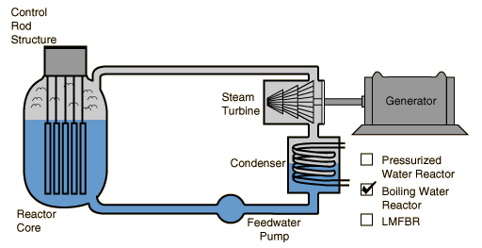
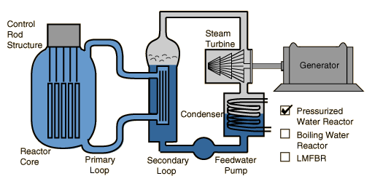
Electricity from Nuclear
Boiling Water Reactors (BWR): Pressurized Water Reactors (PWR):
The dominant types of "light-water" (enriched uranium fueled) nuclear reactor
http://hyperphysics.phy-astr.gsu.edu/hbase/nucene/reactor.html
An Introduction to Sustainable Energy Systems: WeCanFigureThisOut.org/ENERGY/Energy_home.htm

Slide 55
Nuclear Power Plant EROI
It will come as no surprise that Nuclear EROI's are intensely controversial
With the intensity of debate sometimes approaching hysteria
For instance, while investigating recent suspensions of nuclear plant construction
I found recurring discussion of an "Investment Watch" article entitled:
FALLING EROI KILLS WESTINGHOUSE:
2 U.S. Nuclear Reactors Construction Halted
But while the article DID include data on EROIs for oil,
nowhere in this article,
nor in any of its four cited sources,
did I find a single bit of bit of data about the EROI of nuclear!
SRSROCCO 2017 - Falling EROI kills Westinghouse - Investment Watch

Slide 56
The EROI literature is more sober
But, in the end, it too offers a large dose of controversy!
Based on their own earlier work, and a paper by Lenzen, Murphy & Hall cite:
Nuclear EROI = 5 - 15
Inman, citing both Murphy & Hall, as well as the same Lenzen paper, gives
Nuclear EROI = 5
It thus makes sense to take a much closer look at that Lenzen paper:
It is a fairly recent paper, published in 2008
It has a thorough discussion of methodology (and totals 22 pages)
It draws upon a large number of studies (21 in its EROI relevant table)
But it calculates "Energy Intensity" and not EROI
Murphy & Hall, as well as Inman, apparently assume EROI ~ 1 / (Energy Intensity)
Which is also consistent with my understanding of Lenzen's work
Lenzen 2008 – Lifecycle Energy and Emissions of nuclear - J Energy Conversion and Management

Slide 57
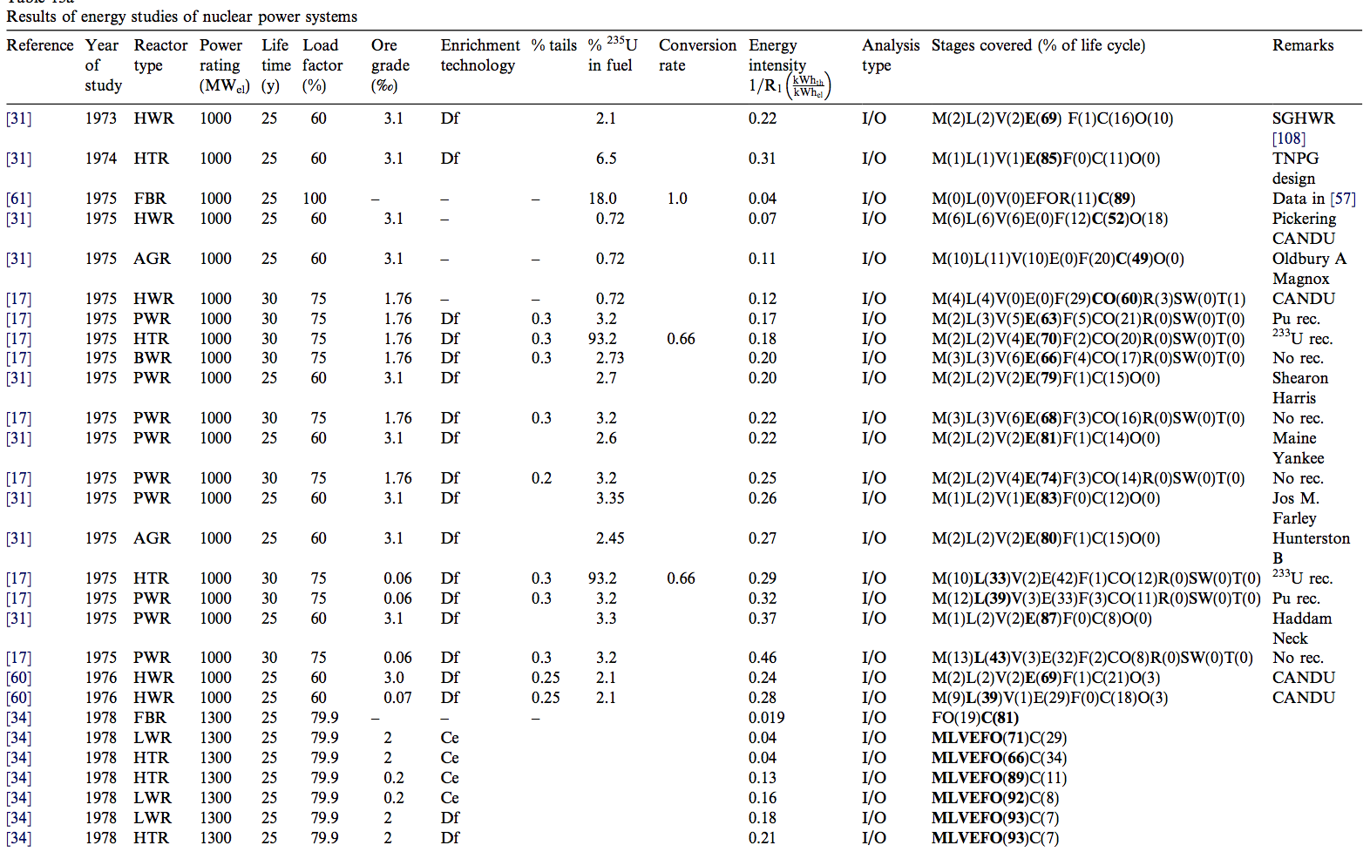
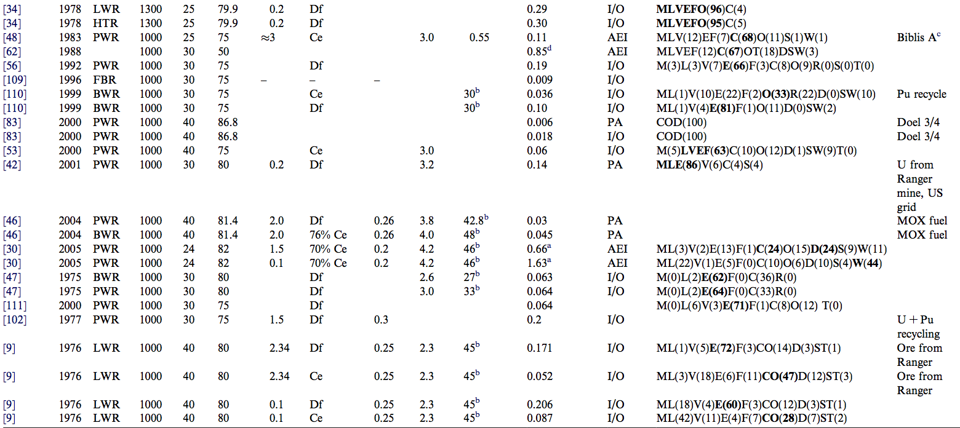
Lenzen's table presenting "energy intensities" for various reactors

Slide 58
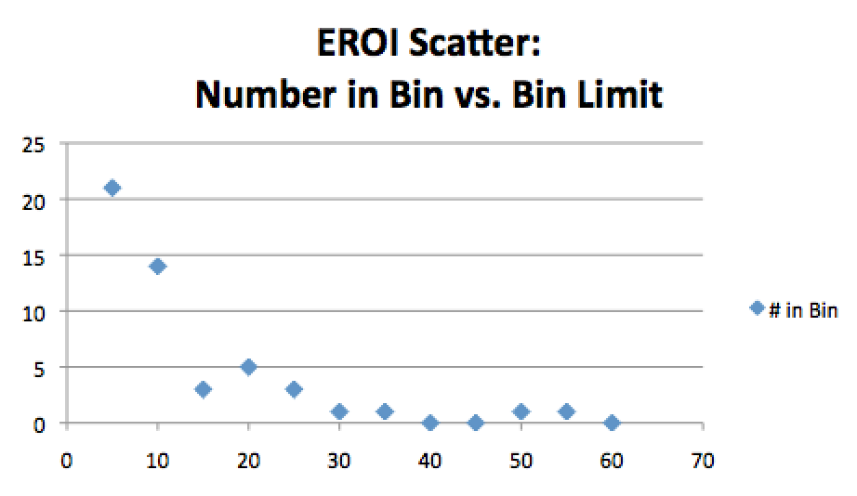
I ended up entering these data into an Excel spreadsheet
Which I provide on this note set's Resources Webpage
I did this for reasons I'll only fully explain a few slides further on
Taking the reciprocal of the "energy intensity" values that I highlighted in yellow
I generated this EROI scatter plot:
And I got an EROI average of 15.3
But many of that table's EROIs are instead in the 20's, 30's and even 50's
That is a VERY LARGE data scatter!
Especially for what should have been a pretty unambiguous energy calculation!

Slide 59
This prompted me to go looking for other data sources
Particularly sources taking into account the many differences between reactors
that I have learned about in my studies of nuclear energy
Differences between, for example, heavy and light water reactors:
One requiring energy-intensive heavy water enrichment
The other requiring energy-intensive uranium enrichment
Or differences between common light water reactors such at BWRs and PWRs
Which employ significantly different energy transfer schemes
But perhaps most importantly, given the newness of nuclear energy:
I wanted data relevant to today's commercial reactors
as opposed to more primitive research reactors built in the 50's & 60's
An Introduction to Sustainable Energy Systems: WeCanFigureThisOut.org/ENERGY/Energy_home.htm

Slide 60
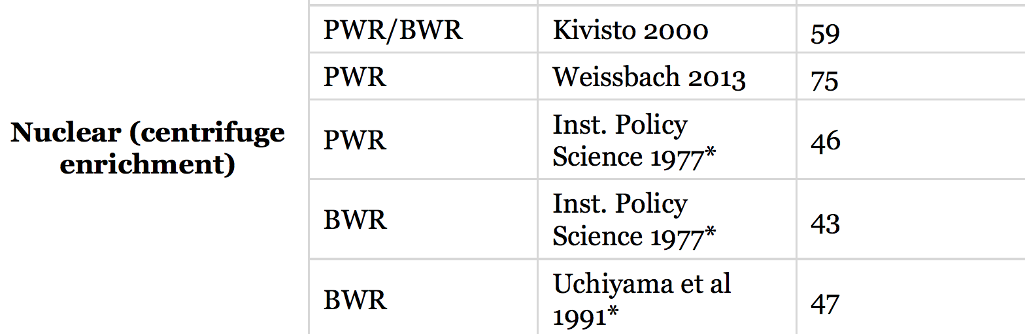
But I found few studies of that sophistication
And when I did find them, they often came from less than disinterested sources
Such as the World Nuclear Association (WNA)
The WNA has a lengthy 2017 webpage providing comparative EROI data
For centrifuge-enriched uranium fueled (= light water) reactors it gives this:
But these sources are NOT from the nuclear industry, they're 3rd party studies
One of which I immediately recognized:
Source:
EROI:
WNA 2017 - Nuclear Energy Return on Investment

Slide 61
Weissbach's 2013 comparative EROI study
Which is cited frequently and favorably throughout the EROI literature
Which had already led me to cite its results throughout this note set!
But Weisbach comes up with a radically higher Nuclear EROI = 75
He acknowledges that others calculate Nuclear EROI "a factor of 20 lower"
Including EROI research pioneers such as Hall
But he forcefully critiques those studies as:
"extremely unphysical" and/or "unsuitable for comparison"
He also notes that some still assume a < 40 year nuclear plant lifetime
Despite most nuclear plant operating licenses now being extended to 60 years
This, alone, could boost nuclear plant EROI by up to 50%
Weissbach 2013 - Energy intensities EROIs and energy payback times of electricity generating power plants - Energy

Slide 62
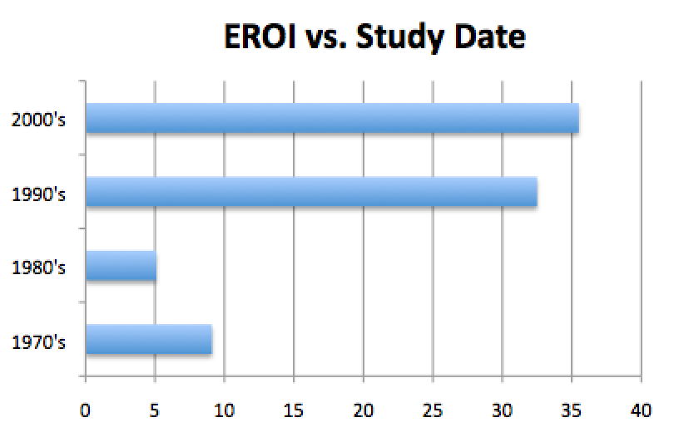
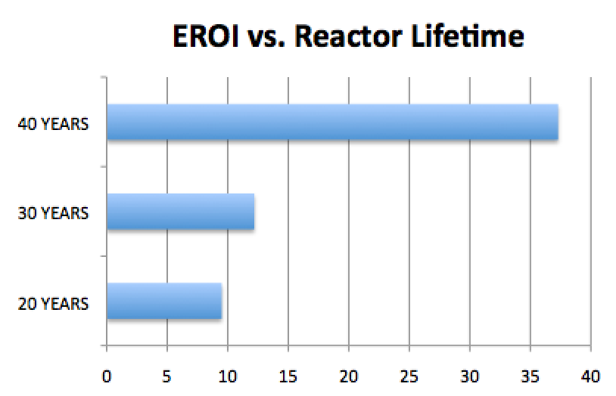
But how can Lenzen's & Weissbach's conclusions differ so radically?
THIS is what led me to enter Lenzen's earlier data into a spreadsheet
I wondered if the discrepancy lay in his inadequate data analysis
Specifically: Not filtering for data on more modern commercial reactors
I could have dug through all 21 of his sources, identifying the reactors they studied
But modern commercial reactors should dominate more recent studies
And they should be identifiable based on their longer operational lifetimes
Resorting Lenzen's table 13a data according to those criteria, I then found:

Slide 63
Leading to my very different conclusions about Nuclear EROI:
A simple average of Lenzen's data gave a Nuclear EROI = 15.6
Leading to Murphy & Hall's Nuclear EROI = 5-15 and Inman's Nuclear EROI = 5
Weisbach calculated a much larger value of Nuclear EROI = 75
But motivated by my technical knowledge about nuclear reactor evolution
I generated two resorts of Lenzen data highlighting modern commercial reactors
While these did not quite close the gap with Weissbach, they came very close:
Showing that even Lenzen's data supports a Modern Nuclear EROI ~ 35-40
NOTE: For both wind & nuclear I've now arrived at EROIs far above accepted values
WHY? Because researchers failed to recognize the evolution of those technologies
Leading to EROIs grossly misrepresenting their current state of development

Slide 64
Finally moving on to:
EROIs for Fuel Heat Generation
An Introduction to Sustainable Energy Systems: WeCanFigureThisOut.org/ENERGY/Energy_home.htm

Slide 65
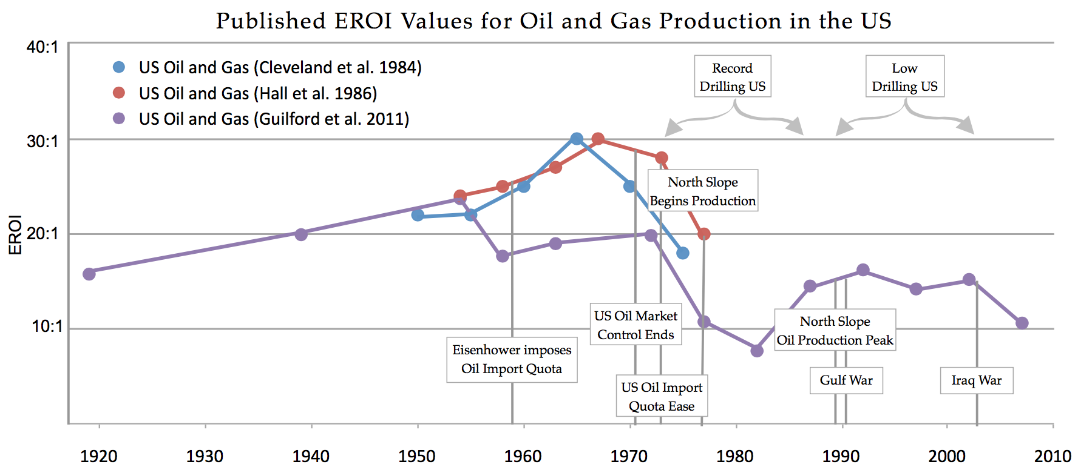
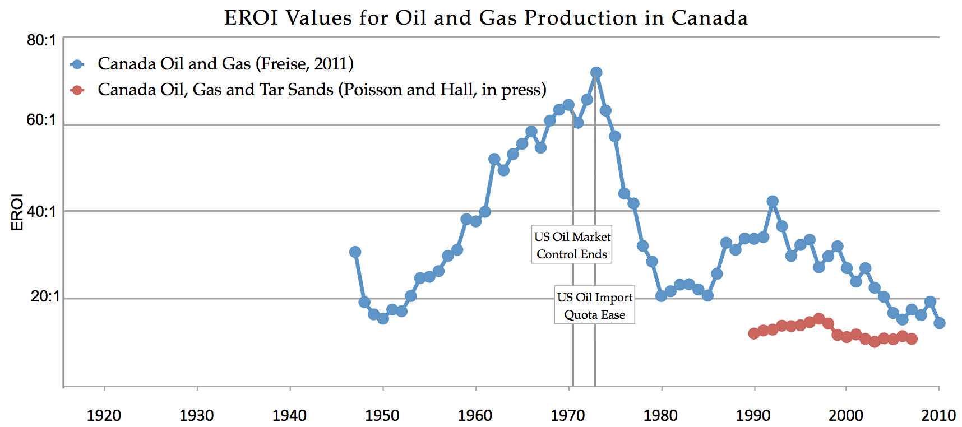
Here, ironically, research now focuses on time evolution
Because that evolution has become so very pronounced
As seen in these figures from a UK government review led by Lambert:
Lambert 2013 - EROI of Global Energy Resources - Status Trends Social Implications - Lambert - UK DID

Slide 66
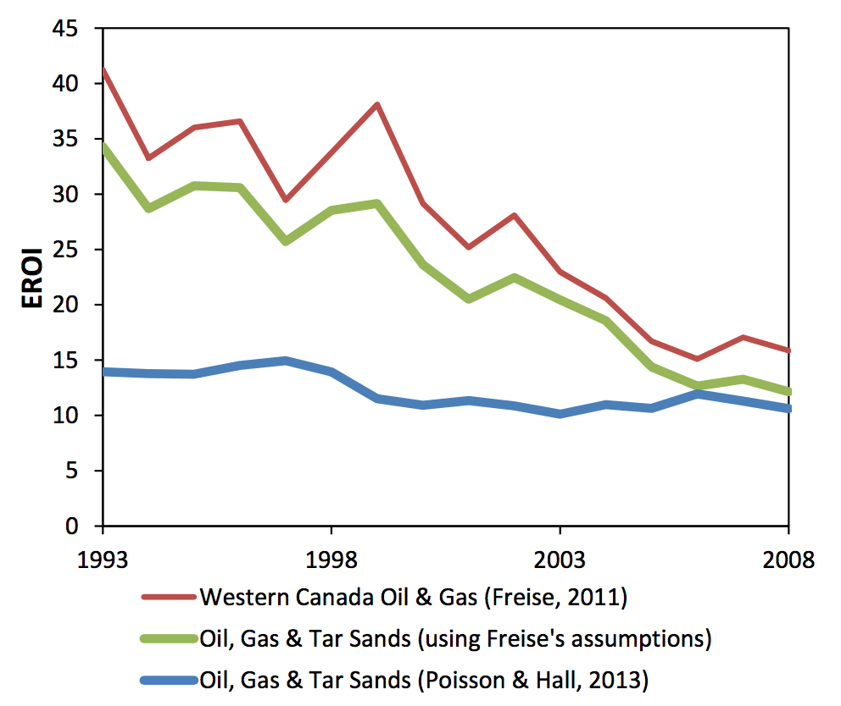
That evolution, in recent years, has been steadily downward:
As seen in this data summary from Poisson et al. in 2013:
Poisson 2013 - Time Series EROI for Canadian Oil and Gas

Slide 67
These curves echo the "Hubbert's Peak" phenomenon of:
A fuel's production following a bell-shaped curve over time
Because initial demand drives discovery of greater and greater reserves
(likely also driving development of LESS energy intensive extraction techniques)
Leading to increased production
Leading to increased dependence on that fuel
Driving up that fuel's price until:
Reserves of easily accessible fuel are depleted
Forcing a switch to less accessible deposits
(likely requiring much MORE energy intensive extraction techniques)
Which then drives the price of that fuel so high
That customers (and suppliers) seek out alternative fuels
Driving production of the initial fuel sharply back down

Slide 68
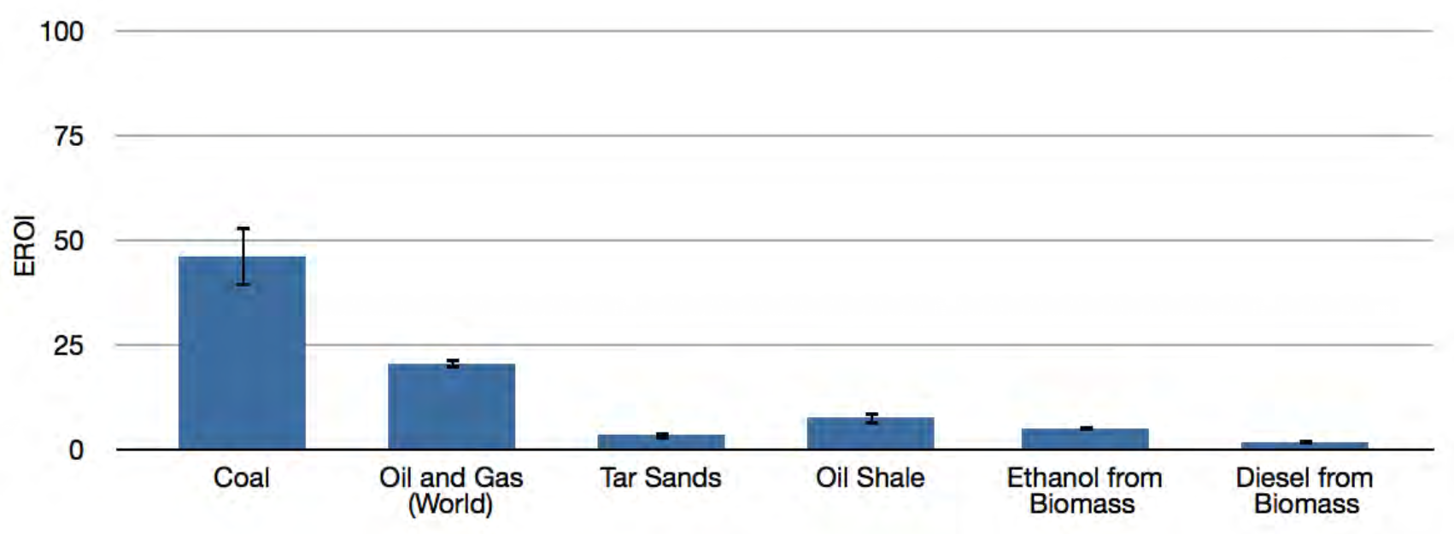
But, once again, one must be wary of lumping too much data together:
In the preceding section such lumping obscured technological evolution
Leading EROI studies to seriously undervalue current wind & nuclear technology
Likely undercutting the quality of sustainable energy decision making!
Here, instead, a research penchant for lumping all fossil fuels together
can obscure the very pronounced differences which still exist between them
Which, admittedly, IS recognized in this figure from Lambert:
Lambert 2013 - EROI of Global Energy Resources - Status Trends Social Implications - Lambert - UK DID

Slide 69
Looking at those differences more closely: COAL
COAL's EROI has fallen sharply:
Where Murphy & Hall's 2010 summary of historic data gave Coal EROI = 80
In 2013 Lambert identified the then current value as Coal EROI = 45
But both implicitly assume that you do nothing to offset coal's pollution
If pollution is instead filtered out by adding pollution control technology
the example of coal-powered electrical plants suggests
EROIs may decrease by a factor of ~ 10X => Coal EROI ~ 5

Slide 70
OIL & GAS:
Lambert (lumping them together) gives O & G EROI ~ 20
Versus Murphy & Hall's separate OIL EROI = 12-35 and NG EROI = 10
Decreasing supply + increasingly difficult extraction now drive both downward
But as a heat-producing fuel, oil and gas retain two crucial advantages:
1) Both can burn comparatively cleanly (at least if one ignores carbon footprint)
2) Both offer an EXTRAORDINARY amount of heat energy per mass
Making them today's 1st choice for powering ground and sea transportation
And today's only viable choice for powering air transportation

Slide 71
And then there are four apparent losers:
Tar Sands, Oil Shale, Ethanol & Diesel from Biomass
However, the petroleum industry is putting intense effort into tar sands & oil shale,
leading to intense concern about not only their environmental impacts,
but also about the impact of new pipelines proposed for their transportation
And while ethanol and diesel from biomass are traditional "green energy" darlings,
not only are their EROI's at the bottom of the heap but they even
flirt with EROI = 1 which would transform them into net energy sinks
Why are these fuel EROIs so terribly low?

Slide 72
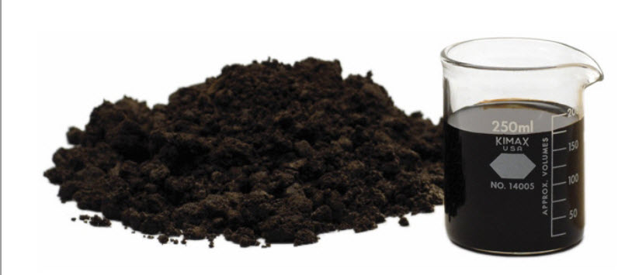
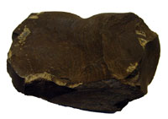
Tar Sands and Oil Shale:
Gases and liquids flow easily out of wells, sometimes even without pumping!
But Tar Sand & Oil Shale are tar embedded in sand or finely grained rock:
Tar Sand: Oil Shale:
Extracting these requires either:
1) Mining them out of the ground and then
2) Applying so much HEAT that the tar melts into flowable oil
OR: 1) HEATING them while still in the ground (via steam injection) and then
2) Pumping out the liquefied tar
https://www.2b1stconsulting.com/oil-sands/
http://ostseis.anl.gov/guide/oilshale/index.cfm

Slide 73
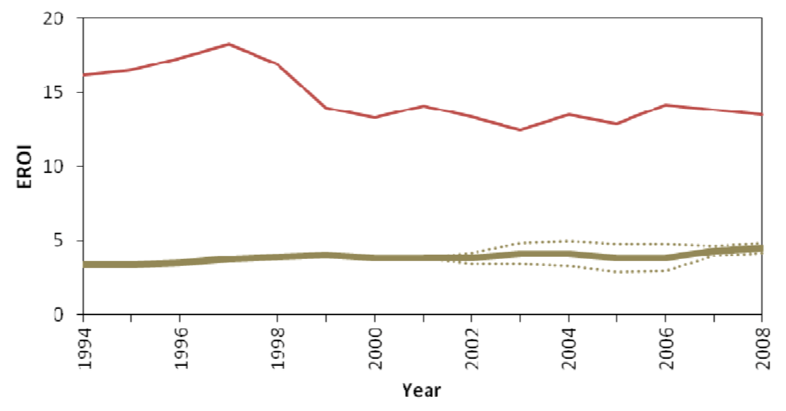
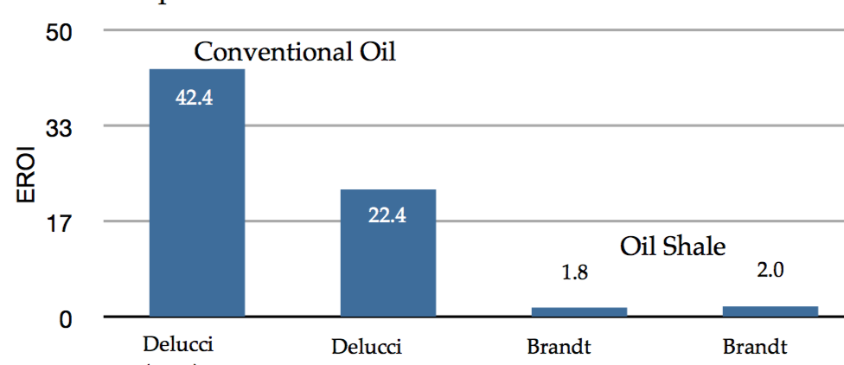
But both mining & pumping require energy, and heating requires MAJOR energy!
In fact, that heat is often obtained by burning up
a good fraction of the fuel just extracted!
Extraction of fuel from both Tar Sands and Oil Shales is relatively new
One article even described existing technology as more of a field experiment
But Poisson 2013 presented this: And Lambert 2013 offered this:
Tar Sand EROI = 3-5 Oil Shale EROI = 1.8-2
NOTE (!): Lambert's summary figure (shown 2 slides ago) instead shows Oil Shale EROI ~ 7
Conventional Oil & Gas
Tar Sand
Poisson 2013 - Time Series EROI for Canadian Oil and Gas
Lambert 2013 - EROI of Global Energy Resources - Status Trends Social Implications - Lambert - UK DID

Slide 74
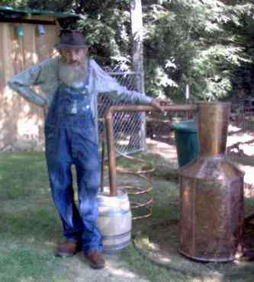
Biofuel EROIs are also driven down by excessive energy inputs:
From my Biomass & Biofuels (pptx / pdf / key), ethanol production requires energy to:
- Synthesize the exceptionally large quantities of fertilizer required by corn
- Break down the 'ligno cellusosic matrix" of that corn to expose its cellulose
- Rid the resulting "mash" of bacteria that could interfere with yeast growth
- Provide the sustained warmth that yeast requires to ferment sugars into alcohol
- Provide the sustained heat that distillation requires to separate out that alcohol
The exact steps may change if sugar cane is the feedstock
or if biodiesel is to be the output
But multiple biological and/or chemical synthesis steps
combined with final fuel separation steps
inevitably => exceptionally large energy inputs
Figure: http://www.apptrav.com/howto.html

Slide 75
And there is also the issue of not very well hidden research agendas
EROI was defined as: Lifetime Energy Output / Lifetime Energy Input
Thus, if harvesting sugar for ethanol involves burning off its fields,
that heat is considered an energy input because it could have been used
instead to homes, to create the steam in an electricity plant . . .
But many biofuel studies choose to redefine EROI as instead:
Lifetime Energy Output / Lifetime Fossil Fuel Input
Some even consider only inputs of single specific fuel
Why the sudden redefinitions? Because these studies are primarily focused on
eliminating the atmospheric carbon footprint of today's fossil fuels
And from such a climate-change-driven perspective,
YES, a fuel requiring less fossil fuel to create is more desirable!
An Introduction to Sustainable Energy Systems: WeCanFigureThisOut.org/ENERGY/Energy_home.htm

Slide 76
But EROI's were meant to clarify our energy decisions
Whereas mobile EROI definitions seem to only cloud those decisions. For example:
Airlines may soon be compelled to adopt supposedly carbon-neutral biofuels ¹
But if we force such a change, it will not be because it makes energy sense
It will be because it makes unavoidable climate sense
Why? Because jet travel can account for 1/3 of your personal carbon footprint
Its elimination may thus be so important that we switch to carbon-neutral fuels
even if those aircraft biofuels end up being net energy sinks!
Or to instead call upon Murphy & Hall's words from their seminal EROI publication: ²
  "In the case of corn ethanol, at least three different methods of net energy analysis had been employed in the literature, resulting in three different
  estimates of EROI that were mutually incommensurable"
1) For further discussion of biofuels in aviation, see my Biomass & Biofuels (pptx / pdf / key) note set
2) Murphy 2010 - Year in Review: EROI or Energy Return on (Energy) Invested

Slide 77
Specific sources of dispute?
- Missing energy inputs (e.g. for fertilizers or for farm machinery & infrastructure)
- Inflated claims about possible secondary use of energy
As in the possible use of waste heat for local heating of buildings
or for steam production in adjacent electrical power stations
- Inflated claims of byproduct ("co-product") energy value (output)
As in claims that used corn mash could largely replace corn livestock feed
despite fermentation having depleted it of much of its nutritional value
- Counter claims that co-product energies were omitted in specific papers
Despite clear evidence I found of their being included in those exact papers
(They might have been undervalued, but they weren't omitted!)
For more specifics, see the dozen plus biofuel papers I cite on the Resources Webpage

Slide 78
Hall and Lambert looked back on all of this in a joint 2014 review:
In that review they considered biofuel EROI research
From no less than 31 different studies
Considering feedstocks of wood, corn, sugar cane, molasses . . .
Which they rolled into a composite statement that Biofuel EROI ~ 5
But, as I've discovered, lumping EROI data together can be a lousy idea
Which almost compelled me to dig up each of those 31 studies
Separating EROI's for each feedstock, sorting data by date of study, etc.
Which I might have done had I not come to share their conclusion about biofuels:
"We believe that outside certain conditions in the tropics
most ethanol EROI values are at or below the 3:1 minimum extended EROI value required for a fuel to be minimally useful to society"
(John: But add to this their possible use in mitigating aviation's carbon footprint!)
Hall, Lambert & Balogh 2014 - EROI of Different Fuels and the Implications for Society

Slide 79
Thus jumping forward to my conclusions about EROI
An Introduction to Sustainable Energy Systems: WeCanFigureThisOut.org/ENERGY/Energy_home.htm

Slide 80
My earlier rendition of the Murphy & Hall / Scientific American 2013 data
Colors reflect articles' conclusion that economic viability requires EROI of ~ 3-5
Technology EROI
Heat from:
Conventional oil 16
Ethanol from sugarcane 9
Biodiesel from soy 5.5
Tar Sands 5
Heavy oil from California 4
Ethanol from corn 1.4
Electricity from:
Hydroelectric Dams 40+
Wind 20
Coal 18
Natural Gas 7
Solar PV 6
Nuclear 5

Slide 81
Versus my updated / expanded analysis of at least power plant EROI data:
Colors reflect articles' conclusion that economic viability requires EROI of ~ 3-5
Technology EROI
Heat from:
Conventional oil 16
Ethanol from sugarcane 9
Biodiesel from soy 5.5
Tar Sands 5
Heavy oil from California 4
Ethanol from corn 1.4
Electricity from:
Hydroelectric Dams 40+
Wind ~ 40
Coal (CC) 2.5-5
Natural Gas (CCGT) 3.5-5
  Solar PV 9, 12, 15, 35
Nuclear 35-40
Likely now lower for fossil fuels
and/or overstated for biofuels.
But insufficient new data
to support strong revisions
poly-Si
xtal-Si
α-Si
CdTe

Slide 82
Credits / Acknowledgements
Some materials used in this class were developed under a National Science Foundation "Research Initiation Grant in Engineering Education" (RIGEE).
Other materials, including the WeCanFigureThisOut.org "Virtual Lab" science education website, were developed under even earlier NSF "Course, Curriculum and Laboratory Improvement" (CCLI) and "Nanoscience Undergraduate Education" (NUE) awards.
This set of notes was authored by John C. Bean who also created all figures not explicitly credited above.
Copyright John C. Bean
(However, permission is granted for use by individual instructors in non-profit academic institutions)
An Introduction to Sustainable Energy Systems: WeCanFigureThisOut.org/ENERGY/Energy_home.htm

