Slide 1
A Renewable / Distributed Grid
John C. Bean
Outline
Characteristics of today's power plants and grid
Dealing with Wind & Solar's naturally Grid incompatible forms of electrical power:
  Wind's asynchronous AC power and Solar's DC power
Today's solution: Universal Power Converters
  Small versions of which now also charge the batteries of our personal devices
Opening the door to a 12/7 Renewable Grid
  Which, overnight, would leave you shivering or sweating in the dark
The additional elements required for a 24/7 Renewable Grid?
  Massive Energy Storage: To save daylight/wind energy for overnight use
  High Voltage DC Electrical Power Transmission:
    Allowing generation of renewable energy in the most advantageous locations
    But consumption of that energy where we most want/need it
(Written / Revised: November 2019)

Slide 2

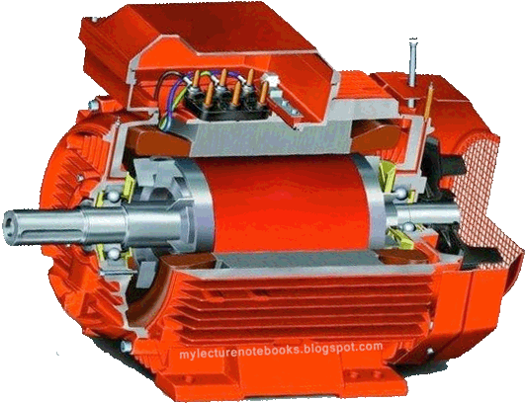
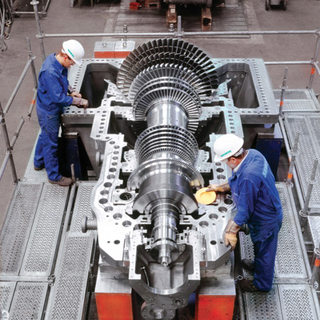
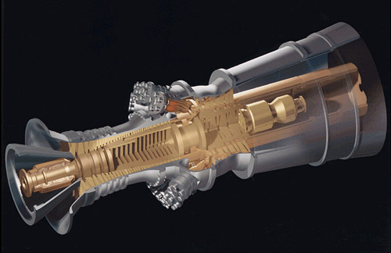
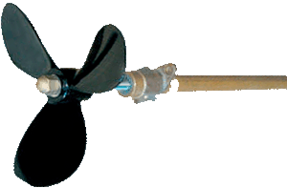
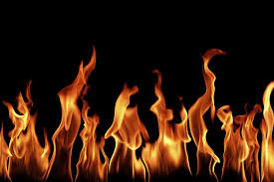
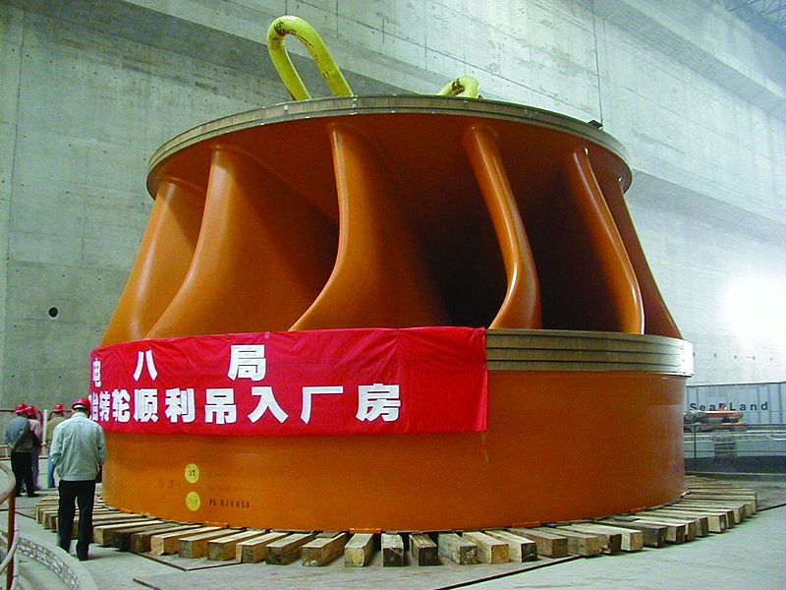
A Renewable / Distributed Grid
As described in my note set A Generic Power Plant and Grid (pptx / pdf / key):
We typically get most of our power from a single, large, not too distant, power plant
In 80% of such plants, electricity is produced by steam, driving a turbine generator
Represented as this: But with turbines actually more like these:
The other ~ 20% of plants just substitute water flow for steam flow
With that water driving turbines like this:
An Introduction to Sustainable Energy Systems: WeCanFigureThisOut.org/ENERGY/Energy_home.htm

Slide 3
Similarities between all of those present day power plants:
THEY ARE BIG:
Median size of modern turbine-generator based power plants is about 600 MW
With average U.S. power use per household at about 1.25 kW ¹
That means a typical U.S. power plant can power up to ½ million homes
THEY ARE NEARBY:
Made possible by the fact that we bring the fuel to the power plant
Via coal trains, gas pipelines, oil pipelines, or trucks bearing fuel rods
Saving us the trouble, and inefficiencies, of long distance power transmission
1) http://www.eia.gov/tools/faqs/faq.cfm?id=97&t=3

Slide 4
Power plant similarities (continued):
WE CONTROL THE FLOWS DRIVING SUCH PLANTS:
For the 80% of plants using steam:
  We control the heat sources that generate that steam
For most of the remaining 20% of U.S. power plants (using hydroelectric dams):
  We control the water flow
ALLOWING US TO SYNCHRONIZE THE ROTATION OF GENERATORS
Aided by motor/generator effects that tend to draw their speeds together
We can thus produce AC power at:
  60 Hz, within ~ 0.067 Hz, at phase differences within 1/36th of cycle
  and 110 Volts, within 5% (again, see earlier "Grid" lecture for details
An Introduction to Sustainable Energy Systems: WeCanFigureThisOut.org/ENERGY/Energy_home.htm

Slide 5
Most of this goes out the window in a renewable-based grid:
Because (as emphasized in both our textbook and my earlier lectures):
No single, simple, local, renewable energy source offers enough power
1) Which will compel use of smaller, or even downright small, power plants
  "Smaller" including mixes of solar, wind, tidal . . . energy farms
  "Downright small" including solar arrays on the roofs of individual homes
2) Many of which will NOT be nearby because to get enough renewable power
  We'll have to move plants TO the best sunlight, wind, tidal . . . sources
3) And there we will not control the input flows
  Because, instead, nature controls flows of solar, wind, tidal . . . energy
4) Result: Dispersed plants producing different voltages, currents & frequencies
  Essentially: Electrical chaos (unless we do something about it!)

Slide 6
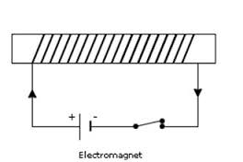
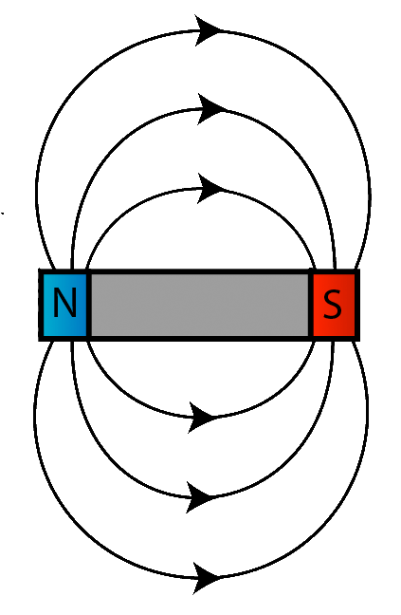
To illustrate the challenges, start by considering wind power:
For which uncontrolled wind flows are an immediate problem:
We've learned that wind speeds are highly variable
  And wind turbines thus naturally turn at highly variable speeds
But if this rotation is passed directly to an electrical generator:
That generator will produce a highly variable AC output voltage:
And if wind turbine #1's voltage is high, when wind turbine #2's voltage is low,
  they're going to shove power back forth, rather than working together
An Introduction to Sustainable Energy Systems: WeCanFigureThisOut.org/ENERGY/Energy_home.htm

Slide 7
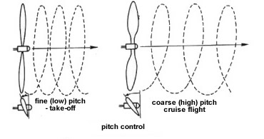

Early wind turbines dealt with this via "variable pitch" blades:
Which are also used (in reverse) on airplanes and ships
In variable pitch propellers, the angles of the propeller blades are changed
Here, so that an airplane engine operating at about the same speed can produce:
Lower speed takeoff airflows Higher speed cruising airflows
All done via a fairly simple gear mechanism within the hub:
top figure: http://www.pilotfriend.com/training/flight_training/fxd_wing/props.htm
bottom figure: http://www.explainthatstuff.com/how-propellers-work.html

Slide 8
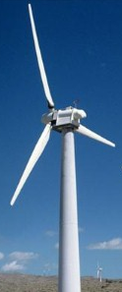
Turning this around for a wind turbine:
When wind speed is low, When wind speed is high,
flatten the blade angle: increase the blade angle:
Which will tend to keep the blade rotating at closer to a constant speed
  Which would work well for incompressible water, running thru a tunnel
But wind (air) is compressible, and it is not constrained to flow in a tunnel:
  Flatten the blades too much and wind's going to go around the turbine!
This: Becomes this: Losing power!

Slide 9
So modern wind turbines do something different:
They DO still use variable pitch blades, but they use them to either:
1) Maximize the energy extracted from the wind flow
  Which generally requires changing blade pitch AND rotation speed
2) Avoid damage in extreme winds (by then "feathering" the blades)
Meaning that they essentially give up on keeping rotation speed constant!
RESULT: Modern wind turbine generators produce highly variable AC power
To correct this, some sort of power conversion circuit must be added!
An Introduction to Sustainable Energy Systems: WeCanFigureThisOut.org/ENERGY/Energy_home.htm

Slide 10
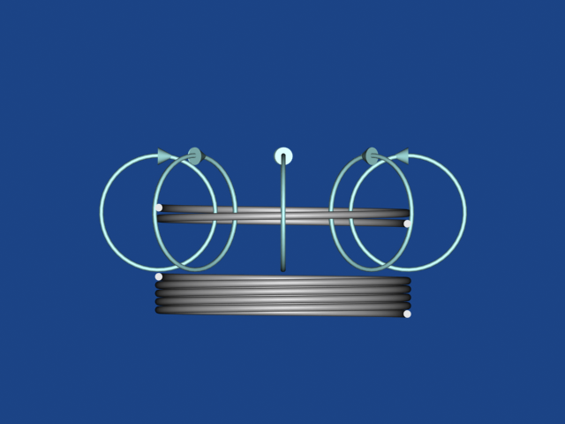
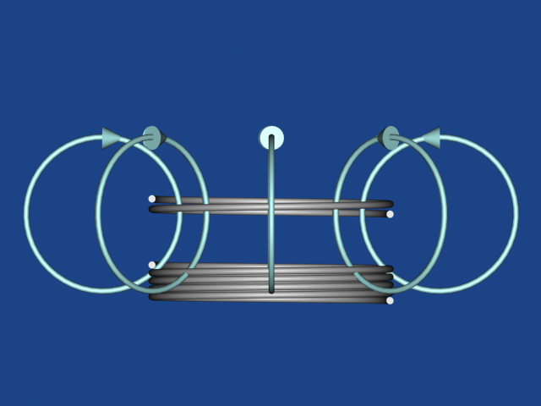
Conversion has traditionally been based on transformers:
Which, as explained in my note set on Magnetic Induction (pptx / pdf / key):
  Use pulsing electric current in one coil, to create pulsing magnetic fields,
    Which sweep through a second coil inducing currents in it:
Power (voltage x current) flowing in one coil => Power (V x I) flowing out the other
But the voltage can be increased (or decreased) at the expense of current:
Voltage _{in} x Current _{in} = Voltage _{out} x Current _{out} But:
Voltage _{out} x Number coil turns _{in} = Voltage _{in} x Number coil turns _{out}
Ability to easily transform voltage is WHY AC power was chosen in the first place!

Slide 11
As applied to our wandering wind turbine's output:
Raw wind turbine generator output, a 110 Volt-ish, 60 Hz-ish wobbly signal:
"Rectified" & smoothed into ~ DC (via the diodes & capacitors of my “Grid” lecture):
"Alternated" (chopped on/off with a switch) to make a 60 Hz square wave:
Then transformed and smoothed into ~ 110 Volt, 60 Hz AC:

Slide 12
But this didn't quite get us to our goal of constant 110 VAC power:
Raw wind turbine generator output varied in both amplitude and frequency:
We rectified out its natural oscillations, then added them back via 60 Hz chopping:
Which, via a transformer, then became almost constant 110 Volt 60 Hz AC:
But we really needed stronger transforming (to get to full 110 Volts) near end

Slide 13
It's similarly difficult to get constant 110 VAC from solar cells:
Solar "photovoltaic" cells naturally produce a trickle of near 1 Volt DC output
  Determined by material's electron bond liberation energy (a.k.a. “bandgap”)
Variable sunlight compounds problem by producing major shifts in output current
  Along with lesser shifts in output voltage
Now, solar cells ARE usually connected in "series" (i.e., connected nose to tail)
If you connect enough cells (about a hundred) you would get about 110 Volts out
  But this would be still be a DC (i.e. approximately constant) voltage
  And thus incompatible with our AC based grid
    And it would still wander in voltage as sunlight intensity changed
      So we again need some sort of power conversion circuit:
An Introduction to Sustainable Energy Systems: WeCanFigureThisOut.org/ENERGY/Energy_home.htm

Slide 14
Solar cell power output conversion:
Raw output of single solar cell, a 1 Volt-ish, DC-ish signal:
Connected in series with ~ 100 other such cells:
"Alternated" (chopped on/off with a switch) to make a 60 Hz square wave:
Transformed into a 60 Hz, but again not quite constant 110 Volt amplitude wave:

Slide 15
This might almost work if we were "off the grid"
That is, if we were only generating home wind or solar power,
  and only used that power for motors and heaters
But modern electronics (especially computers) demand near constant voltage
  And would get very unhappy with our 110 Volt-ish, 60 Hz-ish home brew
Further, if we tried to share our power with neighbors,
or supplement our home power with Grid AC power:
Higher voltage power supplies would send power to lower voltage power supplies,
  (with possibly catastrophic effects), rather than working together
So a modern renewable power grid requires ACTIVE power conversion
ACTIVE CONVERSION = Continuously monitored and tweaked conversion
An Introduction to Sustainable Energy Systems: WeCanFigureThisOut.org/ENERGY/Energy_home.htm

Slide 16
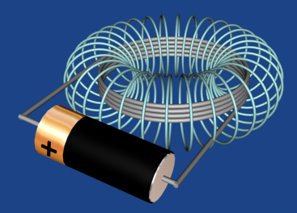
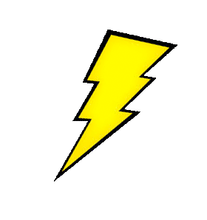
Continuous monitoring is done by modern integrated circuits
But how do they then control the power conversion?
By using another magnetic phenomenon: The energy stored in magnetic fields
As also detailed in my note set A Generic Power Plant and Grid (pptx / pdf / key):
When we first connect a battery (or power supply) to a coil
It begins to "push" current through that coil
But part of the battery's energy goes into generating a magnetic field
Which we represent as loops (around the path of the current)
Loops act sort of like rubber bands (storing energy in their stretch!)
When battery is disconnected, unsupported stretch of bands leads them to collapse
But in doing so they briefly push current/voltage backward

Slide 17
So now let an integrated circuit control current into a coil:
Bring DC power into the (simplified) circuit shown below
Controlling IC (integrated circuit) first closes the switch,
Allowing current to flow through BOTH coil (building up its magnetic field) and "load"
Current flow paths when switch is closed:
Control
IC
"LOAD"
(thing using power)
Closed Switch
Power In
Load

Slide 18
When time is right, control IC then opens up the switch
This stops incoming current – including part which had been going through the coil
Coil magnetic field then collapses, sending BIG pulse of voltage backward
But only route through which voltage pulse can now drive current is thru the load!
NEW higher current flow path:
Control
IC
"LOAD"
(thing using power)
Opened Switch
Power In
Load

Slide 19
Current passed through load with switch closed AND opened:
Load
Load
But current was strongest just after switch opened (due to magnetic field collapse)
IC controls how often switch opens, so power delivered to load can be varied:
OR:
Add to the "load" a capacitor (which stores charge and averages current) to get:
OR:
An Introduction to Sustainable Energy Systems: WeCanFigureThisOut.org/ENERGY/Energy_home.htm

Slide 20
So a specific, constant, output DC voltage can be "dialed in"
The IC doesn't care what the exact input DC voltage was
The IC will always adjust the switching to produce its target DC output
  The load can be sent higher charge/voltage
  OR with different IC programming, it can be sent lower charge/voltage
In some circuit variations, the IC can even cope with input AC voltage
  And, by switching at appropriate cycle times, still produce DC output
Still other variations, can covert AC to DC, or DC to AC, DC to other DC
In other words, these smart IC + inductive coil based circuits can function as:
UNIVERSAL POWER CONVERTERS

Slide 21
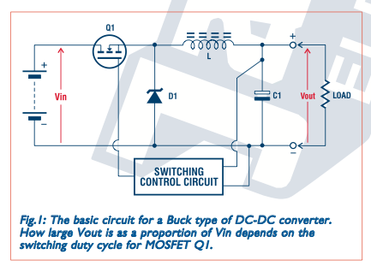
These include the new chargers we use for all of our batteries!
Which, unlike the old chargers:
  Are cool (i.e. far less wasteful of energy), small, and lightweight
  And don't care about voltage or frequency of socket they are plugged into
The complete circuits are a bit more complex than I depicted (but not much!)
For an excellent tutorial explaining the basic DC to DC converters, see:
"DC-DC Converters: A Primer" - Jaycar Electronics
My cached copy of now missing Jaycar web posting

Slide 22
Variants can also solve problems with sloppy wind/solar power conversion:
Raw wind turbine generator output, a 110 Volt-ish, 60 Hz-ish wobbly signal:
ACTIVE IC controlled conversion circuit can convert this to CONSTANT DC:
Open/closing switch then converts this to a constant amplitude 60 Hz square wave:
Which a transformer then smoothes into tightly controlled 110 Volt, 60 Hz AC:
An Introduction to Sustainable Energy Systems: WeCanFigureThisOut.org/ENERGY/Energy_home.htm

Slide 23
In fact, conversion can be even simpler:
Integrated circuit controlled "switching" conversion circuits can do it all:
  Largely, or even completely, eliminating transformers
    Along with their shortcomings of heat, size, and weight
Versions can even be used for HIGH VOLTAGE power conversion
  By using newer semiconductor materials,
    that are better able to handle high voltages,
      (which will come up to later in this lecture)
This solves the FIRST big challenge of renewable energy sources:
Their apparent incompatibility with the local 110 VAC grid
An Introduction to Sustainable Energy Systems: WeCanFigureThisOut.org/ENERGY/Energy_home.htm

Slide 24
An important ramification: Bigger is no longer necessarily better
For over a century, the most efficient way to generate controlled AC power
  has been BIG, CENTRALIZED POWER PLANTS (e.g., our 600 MW plants)
But larger conversion circuits are not necessarily cheaper or more efficient
In fact, because such conversion circuits still produce some waste heat,
  Getting rid of that heat can be more difficult if they are supersized
Thus, in a renewable grid, the simplest most intrinsically efficient unit may be:
  A single wind turbine with self-contained 110 VAC conversion OR
  A single bank of solar cells with self-contained/local 110 VAC conversion
In fact, even in a large wind or solar farms:
  Turbines & solar cell banks retain individual power conversion circuits
  Instead of using a shared, centralized, single power conversion facility

Slide 25
If you WANT more power at that location, fine, install more units
But cost / unit installed will not necessarily drop in proportion to farm size
CONTRASTING with fossil fuel / hydro / nuclear / geothermal / solar thermal
  Where economics of steam generation, turbines and re-condensation
    Almost always produce much higher efficiencies in large plants
So you COULD own a personal wind turbine, if costs were low enough,
  And if you accept that short turbines catch far less wind than tall turbines
    OR if you could talk neighbors into a shared tall turbine
And you COULD consider buying your own personal solar photovoltaic array
  If costs were low enough, and you have:
    A BIG properly oriented roof or a HUGE yard
Because solar power is so dilute!
An Introduction to Sustainable Energy Systems: WeCanFigureThisOut.org/ENERGY/Energy_home.htm

Slide 26
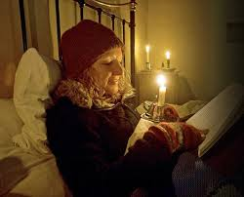
So where would we stand with such a "renewable" grid?
Well, at night we'd stand (or lay) in the dark and cold:
Because, from my note set Power Cycles & Energy Storage (pptx / pdf / key),
  Wind and solar power cycle like this:
Typical wind power
Typical summer/winter solar power
100%
100%
Midnight
Noon
Midnight
Midnight
Noon
Midnight
Photo: http://www.dailymail.co.uk/femail/article-1241772/Im-frozen-time-What-like-live-TVs-Victorian-Farm-electricity-running-water-outside-loo-5c.html

Slide 27
Power storage could eventually provide a solution
My lecture on that subject identified alternatives including:
Pumped storage hydro, super-capacitors, super-batteries & molten salts
But those now offer nowhere near the affordable storage capacity we would need
Especially if we try to "level out" power from a single renewable source:
We've got to shift enough power from the peak to fill in the blanks on both sides!
Power of Renewable at Peak
Peak Power Use
Midnight
Noon
Midnight
An Introduction to Sustainable Energy Systems: WeCanFigureThisOut.org/ENERGY/Energy_home.htm

Slide 28
A somewhat limp partial solution: Use two different renewables
For instance: Solar (peaking at noon) + Wind (peaking in mid/late afternoon):
Trying to fill in blank spots to left and right by doing a "eyeball integration:"
  For preceding single sustainable, we'd have to store/save ~ 1/2 of power
  But above, for each sustainable, this might fall to ~ 1/3 of power
Power of Renewable at Peak
Peak Power Use
Midnight
Noon
Midnight
An Introduction to Sustainable Energy Systems: WeCanFigureThisOut.org/ENERGY/Energy_home.htm

Slide 29
A somewhat less limp solution: Use two renewables, from two time zones
For instance solar from here (in Virginia) + wind from California:
Peaks are then offset by ~ 6 hours (VA sun at noon EST, CA wind at ~ 6pm EST)
Exploiting time zone differences, we might only only have to store ~ 1/4 of power
This is still well beyond our present day energy storage capability
But it might be done without extraordinary technology breakthroughs
Power of Renewable at Peak
Peak Power Use
Midnight
Noon
Midnight

Slide 30
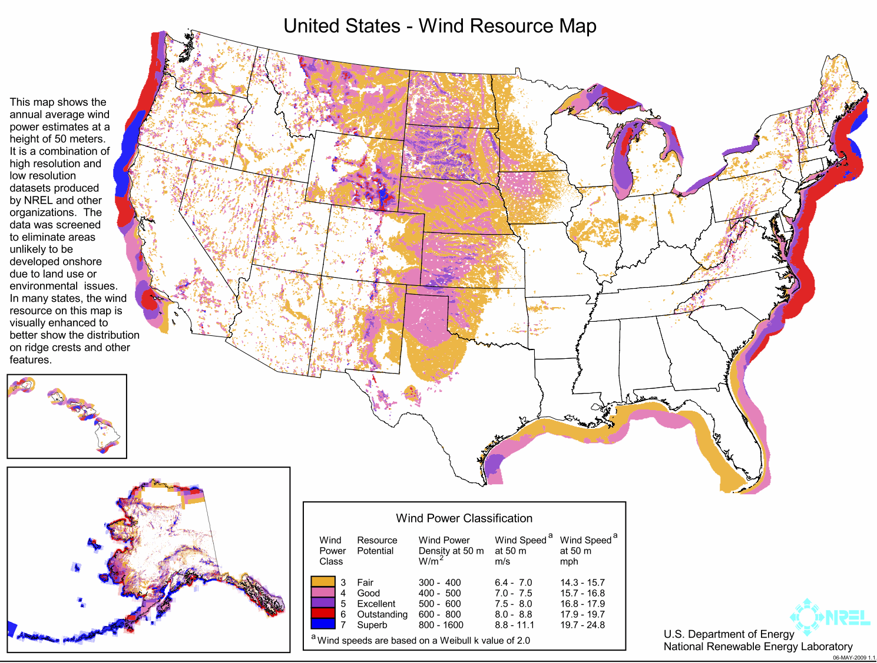
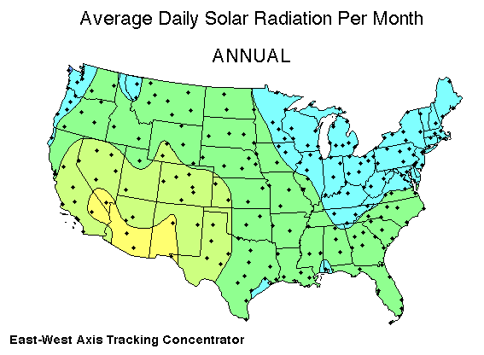
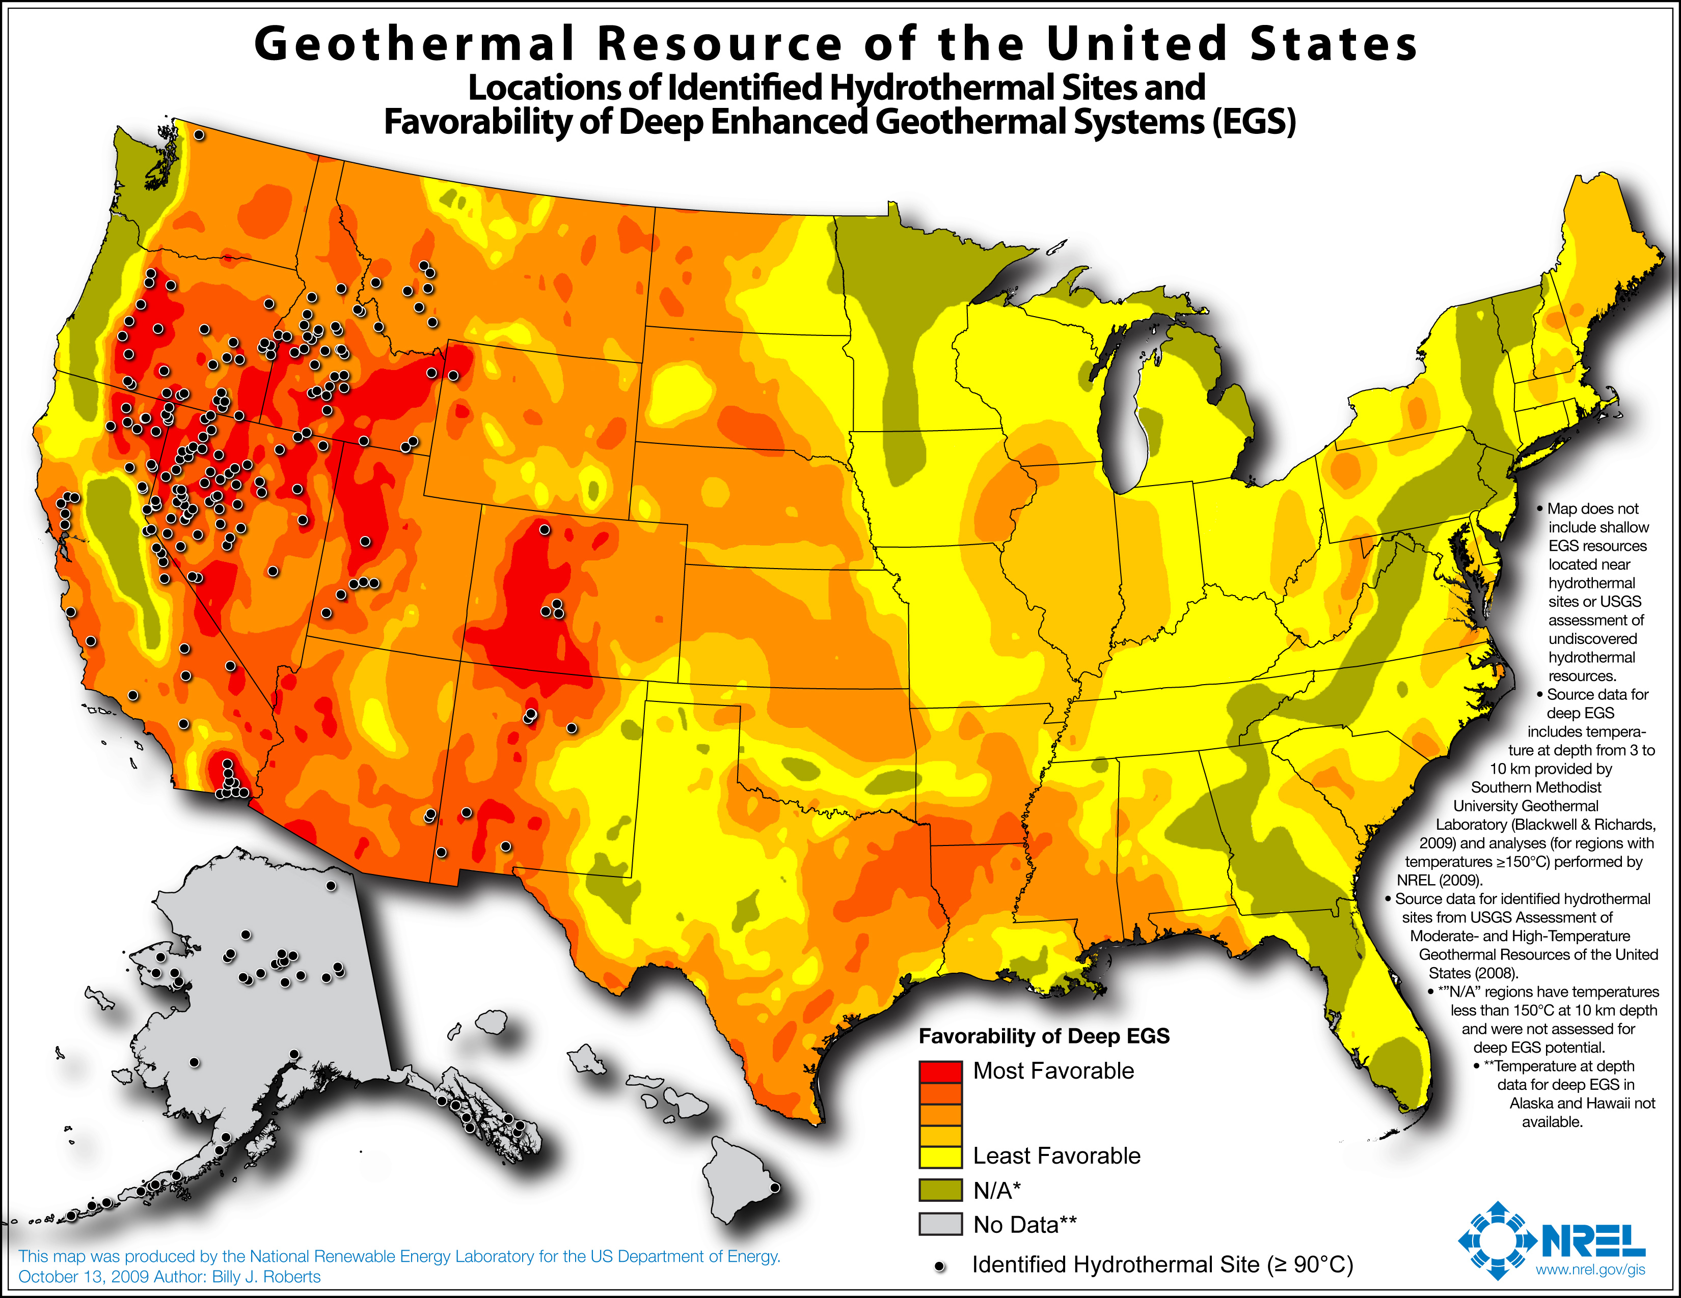
However, we'd then confront: long distance power transmission
Which, frankly, we were going to have to confront anyway
From my note set Power Plant Requirements: Land & Water (pptx / pdf / key):
Renewable energy sources are SO DILUTE
  That HUGE land areas are required to collect the power we now need/expect
    Providing a HUGE incentive to build renewable energy farms
      WHERE renewable energy sources are at their most intense:
Wind map: Solar map: Geothermal map:
An Introduction to Sustainable Energy Systems: WeCanFigureThisOut.org/ENERGY/Energy_home.htm

Slide 31
Losses and limits in long distance power transmission:
In my "Grid" note set I noted three things limit such transmission:
1) "Resistive power loss" (or "thermal limit"):
  Due to flowing electron current knocking into atoms, heating them up
  Compelling us to minimize electron flow = current
  But then, to maintain power, the voltage must be proportionally increased
    => High voltage / Low current AC or DC for power transmission
In the future superconductivity might offer a solution to this limit:
  In superconductors, resistive power loss disappears
  And with it, our reason for avoiding high currents
  => Low voltage / High current DC for power transmission
But superconductivity now requires unacceptably low temperatures!
An Introduction to Sustainable Energy Systems: WeCanFigureThisOut.org/ENERGY/Energy_home.htm

Slide 32
Next, as introduced in the "Generic Power Plant & Grid" lecture:
2) "Reactive power" (or "stability limit"):
  Due to AC current flow lagging behind the applied (pushing) voltage
    => High voltage / Low current DC (only) for power transmission
I explained this consequence of magnetic field energy via an analogy
A very stretchy rubber hose:
Turn on the faucet (electrical power), applying water pressure (voltage) to left end:
ONLY PART of the water (current) starts flowing along the pipe
OTHER PART "induces" a growing bulge in the hose's wall!

Slide 33
If the faucet (power) is then quickly disconnected:
Propelled by the stretched out rubber, water shoots back in our face!!
And this continues until the bulge fully relaxes:
Versus what would have happened if we'd just left faucet (power) on:
Bulge spreads out => Full length of hose expands slightly due to pressure:
An Introduction to Sustainable Energy Systems: WeCanFigureThisOut.org/ENERGY/Energy_home.htm

Slide 34
Applied to a long power transmission line:
When we first apply a voltage (as in the start of an AC wave cycle):
  Current (flow) through the wire builds up more slowly than expected
  Because part of driving energy is diverted to build up magnetic field
Acting like the growing bulge in our rubber hose
When applied voltage reaches maximum (as at the peak of an AC wave):
  The energy diverted to build up of the magnetic field diminishes
  Leaving more energy to go into pushing the electrons
And the growth of the current flow begins to catch up
When applied voltage again falls to zero (at the end of an AC half cycle):
  We expect the current flow to also fall to zero – but it doesn't!
Collapsing magnetic field continues to push electrons for awhile

Slide 35
Result: Current flow lags behind the pushing voltage:
What we expected - not taking magnetic fields into account:
Out the end of a moderately long AC transmission line we instead get:
Out the end of a very long AC transmission line:
Resultant Current
Applied Voltage
Resultant Current
Applied Voltage
Resultant Current
Applied Voltage

Slide 36
Longer line => Larger Lag => Less power out other end:
Short power line – Tiny current lag: Long power line – Major current lag:
Voltage (V):
Current (I):
Power = V I (falling to zero when EITHER V or I are zero):
Far less power out (at right) when account for effect of magnetic energy storage!

Slide 37
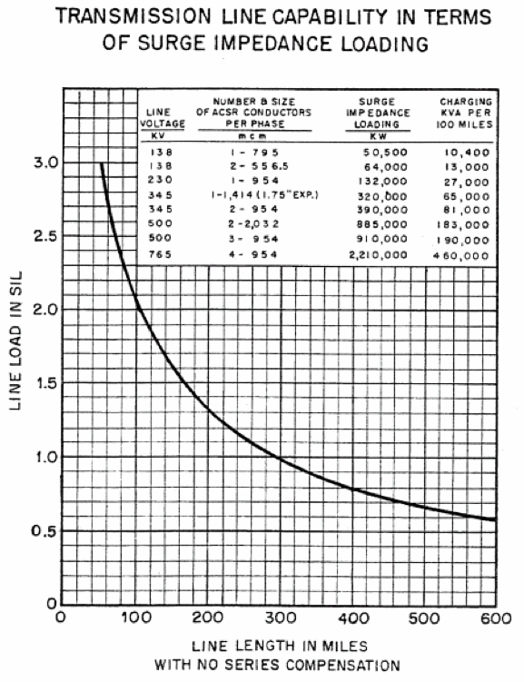
Current lag plagues AC transmission lines - But not DC transmission lines:
Because lag is only important just after power is switched on, or off
Thus in continuously switching AC lines, current is always lagging behind
But in non-switching DC power lines, current quickly catches up
Leading to this American Electric Power Corp. plot:
Which says that power through AC power lines
  plummets with in a few hundred miles!
All due to the AC voltage and AC current
  getting more and more out of step
  at the end of a long power line!
CONSEQUENCE? Today's largely high voltage AC based transmission grid
simply cannot effectively swap power across the entire country!
https://www.google.com/url?sa=t&rct=j&q=&esrc=s&source=web&cd=6&ved=0CEQQFjAF&url=https%3A%2F%2Fwww.pjm.com%2F~%2Fmedia%2Fcommittees-groups%2Fcommittees%2Fteac%2F20060711%2F20060710-aep-interstate-project-why-765kv-ac.ashx&ei=v1P8VK73CoKXgwT80oDIDQ&usg=AFQjCNFFTOyM9hVrGPhUJLEvCa8AEdnAEQ&sig2=vkGR8MKVGAwEWlb3m3g9uw&bvm=bv.87611401,d.eXY&cad=rja

Slide 38
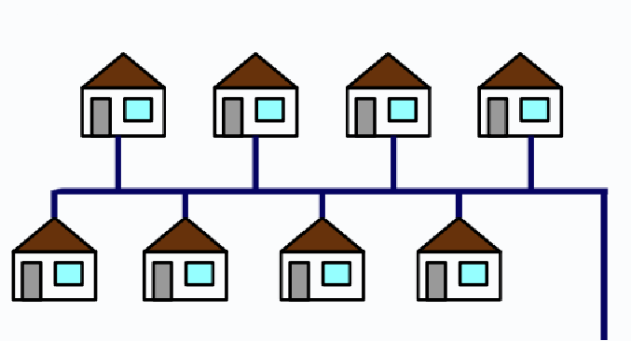
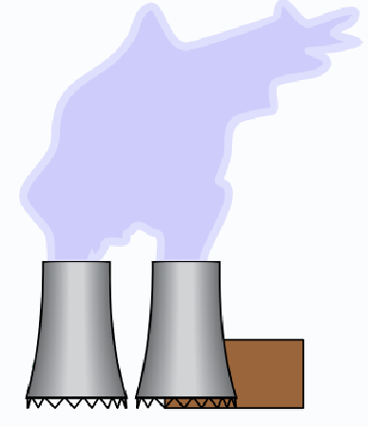
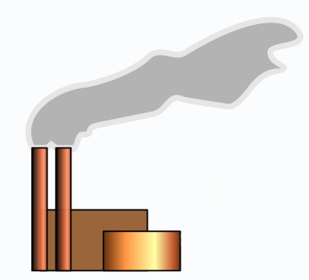
Then there is the third limit, which also affects only AC:
3) Impossibility of synchronizing power from distant AC power plants
Derived from the fact that electrical power cannot flow faster than light speed
  Which, traveling across US, takes a good fraction of a 60 Hz cycle time:
    2500 mi / (186,000 mi/sec) ~ 1/100 sec vs. 1/60 sec
Meaning AC power from one distant AC power plant won't be precisely in phase
  with the AC power coming from another distant AC power plant
We could tweak phase to realign for customers in one location
  But not for multiple locations Or for power sent via multiple possible paths:

Slide 39
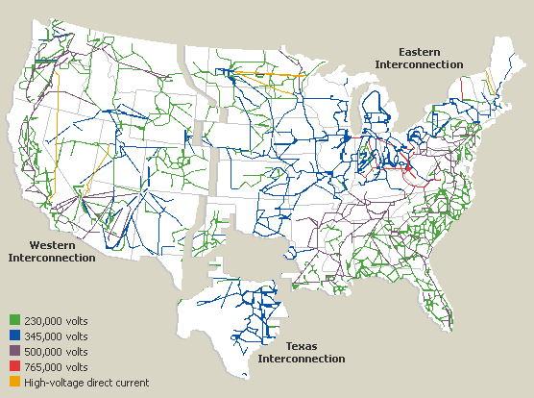
All driving us toward a grid with a strong high voltage DC backbone
But, instead, we now have only fragmented, weakly coupled, grids
Making minimal use of HVDC transmission (the very few orange sections!)
http://www.geni.org/globalenergy/library/national_energy_grid/united-states-of-america/americannationalelectricitygrid.shtml

Slide 40
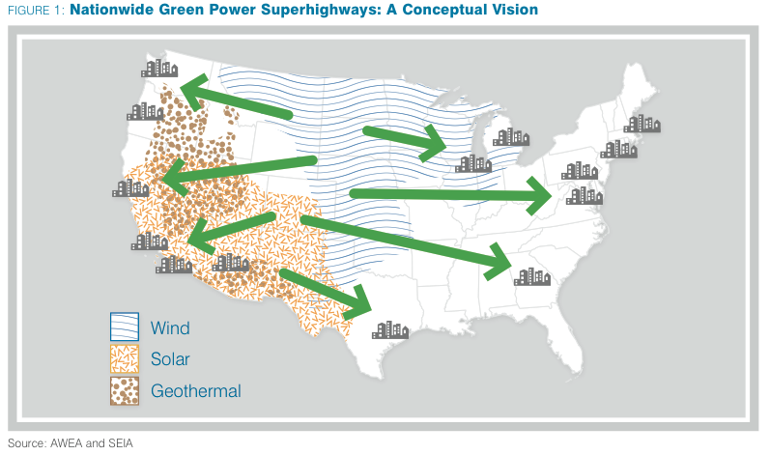
To share distributed renewable energy sources, we'd instead need:
A Green Power Superhighway, which has been proposed (surprise, surprise) by the
American Wind Energy Association & Solar Energy Industry Association ¹
http://www.awea.org/files/filedownloads/pdfs/greenpowersuperhighways.pdf

Slide 41
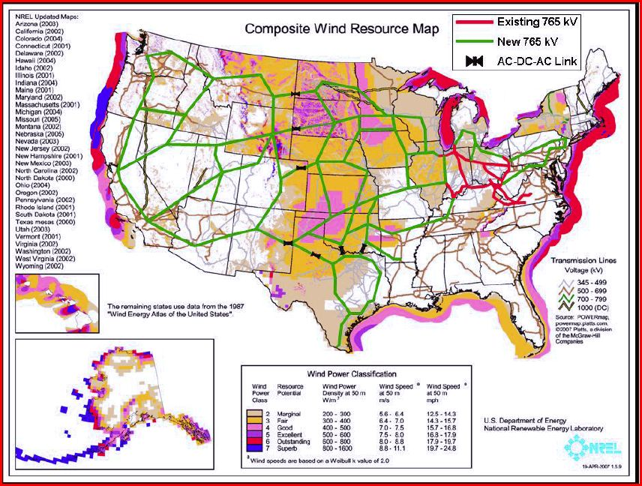
This is NREL's cheaper/short-term approximation to that proposal:
Nation-spanning links remain high voltage AC
But mid-route, short high voltage DC links would be inserted (black segments)
At these links, by going from AC to DC to new AC out:
  The voltage & current could be put back into step AND
  The new AC out of the link could be re-synchronized with the local power
Figure: http://https://http://www.geni.org/globalenergy/library/technical-articles/transmission/grid-integration-of-renewables/interstate-transmission-superhighways/index.shtml

Slide 42
This proposal really encapsulates the history of US electrical power:
1900: Dozens of AC power systems grow outward from major metropolitan areas
  AC because transformers can match "best" voltage to each application
As local grids grow, they begin to move some power via high voltage AC
  With that high voltage conversion also facilitated by transformers
Mid 1900's: Regional grids are finally almost all linked by high voltage AC lines
  Creating "The Grid" which, we've learned, is really a bit of a myth
Late 1900's: Semiconductor-based integrated circuits finally came along
  Facilitating "universal" conversion circuits => HV DC lines
Present Day: HV DC technology has improved
  But it's cost still inhibits widespread adoption HV DC transmission lines

Slide 43
Preceding illustrates technology issues of renewable / distributed grid
But there are also major business, policy and even political issues:
Our current "big is generally better" power plants are, quite naturally,
  almost always planned, financed, and built by very big power companies
Dominance of these companies led to them being granted monopoly status,
  But only with monitoring by Public Utility Commissions (PUC's)
PUC's (supposedly) require these monopoly power companies to
  Provide enough affordable power, now and in the future:
  Minutes from now - When we demand that our power be restored!
  Decades from now – Requiring whole new generations of power plants
An Introduction to Sustainable Energy Systems: WeCanFigureThisOut.org/ENERGY/Energy_home.htm

Slide 44
But a Renewable / Distributed Grid will be hugely more complicated:
Instead of a single, huge, solely responsible (and accountable) provider,
  Any small business or home owner can buy a small solar array
    And set themselves up as micro-power company
But what if China then used their domination of solar cell production to up prices?
  Or a new federal administration decided to drop a solar tax subsidy?
Micro-power CEO's (= you and me) would stop buying arrays
  U.S. power supply would crash, power prices would skyrocket . . .
So I'm betting we'll want the freedom of having personal micro-power systems
  While still expecting a large power company to retain core responsibility

Slide 45
Including, holding power company responsible for "base load"
Because renewables alone, even with plausible levels of energy storage,
  Are just not capable of providing enough power, all through the day
So we still need a 24/7 "base load" supply of power
  Of a magnitude demanding huge hydrocarbon power plants
  Or, for greener power, hydroelectric or nuclear power plants
Either of which will require retention of large (if not monopoly) public utilities:
In other words, this works: But this (alone) doesn't:
Dispatchable
load power plants
Base load power plants
Midnight
Noon
Midnight
Midnight
Noon
Midnight

Slide 46
AND we'll have to figure payments to micro-power producers (you & me):
1) First alternative: NET METERING
  = You pay for the NET power you draw from grid
    = (Power used in your home) – (Power produced in your home)
When sending power to grid, you'd expect payment at power's current cost / worth
  Midday payment should be ~ average value
  But evening payments should be higher!
But "fairness" gets very controversial
  And in some states you get paid only
    power's minimum daily cost /worth,
    no matter when you supply that power
      (e.g., as now occurs in Virginia)
Cost / Worth
Demand
Midnight
Noon
Midnight

Slide 47
Alternative micro-power payment scheme = Feed In Tariffs:
Net Metering (above) was blind to HOW the homeowner generates power
But what if a state WANTS citizens to invest in, say, rooftop solar cell panels?
  Perhaps, to protect scarce, local, now-undeveloped land
    from conversion into wind-farms or solar farms
Some states do this via FEED IN TARIFFS (FITs)
  Which are payment rates that depend on HOW you produced your power
    E.G., rate for power from rooftop solar can be pegged HIGHER
But you then need TWO POWER METERS on your home:
  1st Meter to measure power you draw from grid => Payment from you
  2nd Meter to measure power you send to grid => FIT payment(s) to you
Kept separate because payment rates (¢ents/kW-h) will differ!

Slide 48
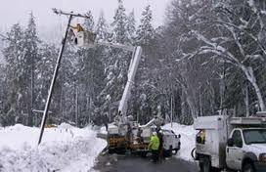
And to make things even MORE complicated:
During emergencies, household meters will have to SHUT OFF your power to grid
  So that power company repair crews
    will not be electrocuted:
Balance of power from power company vs. micro-power providers will also be critical
  Because BIG power plants can take a decade or more to build
    And must then operate for ~ 30-40 years to recover their costs
  So the micro-power share (from us) must somehow be stabilized
    Giving power companies time to build or gracefully retire power plants
BOTTOM LINE:
To power companies, Renewable/Distributed Grid = Potential Chaos
Photo: https://www.pacificpower.net/ed/po/or/wwdtrp.html

Slide 49
Credits / Acknowledgements
Some materials used in this class were developed under a National Science Foundation "Research Initiation Grant in Engineering Education" (RIGEE).
Other materials, including the "Virtual Lab" science education website, were developed under even earlier NSF "Course, Curriculum and Laboratory Improvement" (CCLI) and "Nanoscience Undergraduate Education" (NUE) awards.
This set of notes was authored by John C. Bean who also created all figures not explicitly credited above.
Copyright John C. Bean
(However, permission is granted for use by individual instructors in non-profit academic institutions)
An Introduction to Sustainable Energy Systems: WeCanFigureThisOut.org/ENERGY/Energy_home.htm

