Slide 1
Power Cycles and Energy Storage
John C. Bean
Outline
How to meet our daily cycle of electrical power consumption
Today's scenario: Base Load Power Plants (24/7) + Dispatchable Power Plants (evening only)
Possible future scenario: Base Load Plants + Massive Energy Storage
Candidates for Massive Energy:
Pumped Storage Hydro
Hydrogen Fuel Cells
Flywheel Energy Storage
Compressed Air Energy Storage (CAES)
Capacitor / Super Capacitor Energy Storage
Battery Energy Storage
Molten Salt Heat Energy Storage
How much of each is required for Base Load + Massive Energy Storage scenario?
More ambitious scenario of ALSO eliminating ALL non-green power sources
(Written / Revised: March 2020)

Slide 2
Power Cycles and Energy Storage
I talk about the puzzle of designing future power systems
"Puzzle," because so many factors must be balanced to:
Provide enough affordable power
While sustaining a high quality biosphere
We've also seen that renewables are not silver bullets
If only because they demand huge natural resource commitments
Meaning that future power systems will have to combine different technologies
Today you will see how the natural cycles of power consumption and production
ALSO drive the use of different technologies
And how energy storage will become critical

Slide 3
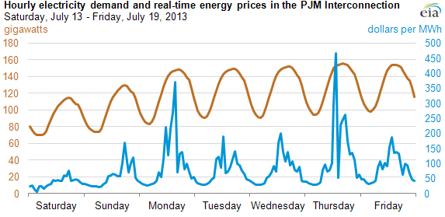
It all starts with this:
The cycles in our consumption of electrical power (and its real time cost):
Note the almost sinusoidal cycles:
Peaking at 6pm (cook dinner, cool down/heat up house, do laundry . . . )
With amplitude of the oscillation equaling ~ 40% of peak value
www.eia.gov/todayinenergy/detail.cfm?id=12711 YELLOW midnight lines added
An Introduction to Sustainable Energy Systems: WeCanFigureThisOut.org/ENERGY/Energy_home.htm

Slide 4
Simplifying a little bit, over one day:
Peak Power
80%
60%
Midnight
Noon
Midnight
We have a constant component at about 60% of the peak
Plus an oscillating component moving from there up to 100% at about 6 pm
With oscillating component's average at 80% (from its symmetry)
Meaning that time averaged total power is also about 80% of the peak power
An Introduction to Sustainable Energy Systems: WeCanFigureThisOut.org/ENERGY/Energy_home.htm

Slide 5
Or dividing these two up:
The constant "base" electrical load:
Plus a variable "dispatchable" component (so called because a dispatcher controls it?)
So we could also call Scenario #1: "Base + Dispatchable"
60% of
Peak Power
0%
Midnight
Noon
Midnight
40% of Peak Power
0%
Midnight
Noon
Midnight

Slide 6
Scenario #1) Base Power Plants + Dispatchable Power Plants + no storage:
This is TODAY's scenario, now in almost universal use
But, of course, power companies want to minimize costs (theirs and yours)
Costs come in two principal flavors: FIXED COSTS and VARIABLE COSTS
A fixed cost is just that, something you're going to have to pay no matter what
For power plants, the biggest are most often construction (capital) costs
Which are then translated into ongoing mortgage / bond payments
Which have to be paid, whatever power you are now producing
A variable cost is instead a cost that varies with the plant's power output
Which includes the labor cost of the operators as well as fuel costs
An Introduction to Sustainable Energy Systems: WeCanFigureThisOut.org/ENERGY/Energy_home.htm

Slide 7
The contrast between Base and Dispatchable Plants:
FIXED COSTS: For both base and dispachable plants are ~ mortgage payments
Which depend upon building cost, mortgage interest and duration
VARIABLE COSTS:
Base Plant = Labor & Fuel costs while power is being produced (= all the time)
Dispatchable Plant =
Labor & Fuel costs while power is being produced +
Labor & Fuel costs while plant is warming up (NOT producing power) +
Labor costs while plant is shutting down (NOT producing power) +
Some labor costs 24/7, for security, maintenance, deliveries . . .
But for all but open-cycle-gas-turbine dispatchable plants (which don't use steam):
Warm up time + Shut down time can easily exceed power production time!

Slide 8
The LCOE is still going to be hugely inflated, because it still equals:
LCOE = Levelized Cost / Energy Produced
With numerator still depending on FULL purchase/construction cost (via mortgage)
But denominator now hugely reduced: E.G., for plant operating 3 hours per day:
Denominator reduced by (3/24) = 1/8 => LCOE increases by 8X
Which is indeed seen in the blue cost of power time variation above!
Which is WHY our gas "peaking" power is ~ 4X cost of base power

Slide 9
Scenario #2) Add storage in place of dispatchable plants
Why pay for dispatchable power plants that sit idle almost all of the day!
INSTEAD: Choose the CHEAPEST CLEANEST TYPE(S) OF POWER PLANTS
Let them run ALL DAY AT FULL POWER (maximizing their bang / capital buck)
Size them so their power = 80% of peak power = average daily power
And STORE EXCESS POWER produced early in the day for use later in the day
Old Scenario #1: New Scenario #2:
Peak
Power
Peak Power
80%
Dispatchable
load power plants
80%
Stored energy
60%
Most effective power plants,
always at full power
Base load power plants
Midnight
Noon
Midnight
Midnight
Noon
Midnight

Slide 10
But how MUCH energy do we have to store early in the day?
From earlier discussion, average power per day = 80% of peak power
So daily energy = E_{daily} = 0.8 P_{peak} x 1 day
Assuming shape of energy stored & moved curve below is indeed sinusoidal:
From the diagram, amplitude of the sine = (0.2 x peak power)
Then, stored early day energy = integral (from 0 to day/2) of 0.2 P_{peak} Sin
= 0.2 P_{peak} x day / Pi = 0.064 P_{peak} x day = (0.064)(E_{daily}/0.8) = 8% of E_{daily}
Peak Power
So we could also call Scenario #2:
"Conventional Power
+
8% Storage"
80%
Stored energy
Most effective power plants,
always at full power
Midnight
Noon
Midnight

Slide 11
U.S. energy per day value:
From the Power Plant Land and Water Requirements lecture:
Total US energy production (2012) = 4,047,765 GW-h ⁽¹⁾ per year
Which translates into US energy production = 11,089 GW-h per day
So we'd need to store 8% of that early in the morning (for use later in that day):
Scenario #2 US energy storage required per day = 887 GW-h
So with that target figure in mind, what are the alternatives?
Peak Power
887 GW-h
80%
Stored energy
Most effective power plants,
always at full power
Midnight
Noon
Midnight
1) www.eia.gov/tools/faqs/faq.cfm?id=65&t=2

Slide 12
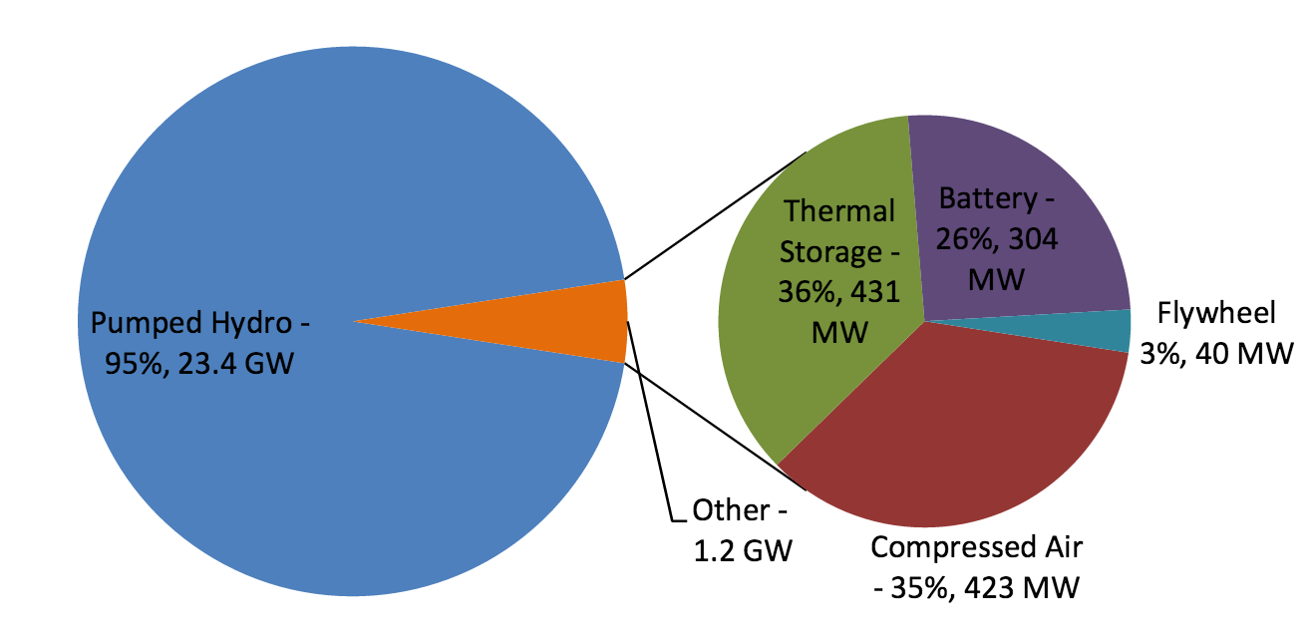
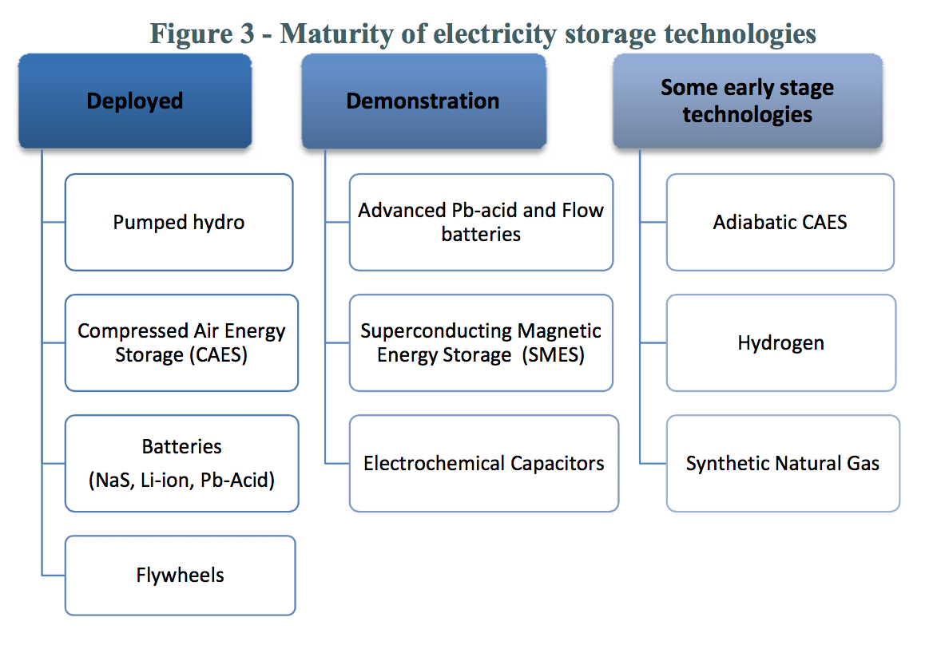
Candidate energy storage technologies:
From the U.S. Department of Energy (DOE) 2013:
Current U.S. energy storage capacity:
(ALMOST ALL of it is pumped hydro!)
Maturity of storage technologies:
NOTE WILD EXAGGERATION!
Net U.S. Hydro storage is still tiny
And it dwarfs other 3 "Deployed"
(which at BEST = 1-2 test plants)
http://www.sandia.gov/ess/docs/other/Grid_Energy_Storage_Dec_2013.pdf

Slide 13
Nevertheless, sorting the more plausible/mature candidates:
Which fall into two categories based on naturally different figures of merit
Energy storage SYSTEMS = Multi-component plants, spread over hectares:
a) Pumped Hydro Energy Storage
b) Hydrogen Fuel Cell Energy Storage
c) Flywheel Energy Storage
d) Compressed Air Energy Storage (CAES)
Energy storage THINGS = Components that would just be massively warehoused:
e) Capacitor / Super Capacitor Energy Storage
f) Battery Energy Storage
g) Molten Salt Heat Energy Storage
An Introduction to Sustainable Energy Systems: WeCanFigureThisOut.org/ENERGY/Energy_home.htm

Slide 14
For each of these candidates, we need to know:
How much is required for our #2 energy storage scenario?
That is, storing 8% of early day energy for later use => 887 GW-h
For all candidates, this involves their "round trip return efficiency"
Because energy returned = energy put in x return efficiency
For energy storage SYSTEMS, we need their plant footprint & storage capacity
In order to work out total number of plants and size required
For energy storage THINGS we need their energy storage density (kW-h / m³)
We could then assume, say, that they’d be warehoused ~1 meter high
Combining => Net national size of such energy storage warehouses
And for all candidates, we need their projected levelized cost

Slide 15
a) Energy storage via Pumped Storage Hydro (PSH)
The best current way to store power
Which, in my Hydropower / Windpower lecture I represented thusly:
Small dam and reservoir
Lake/river "Power House" located far below
But data from previous lecture was incomplete, so we must slow down:
An Introduction to Sustainable Energy Systems: WeCanFigureThisOut.org/ENERGY/Energy_home.htm

Slide 16
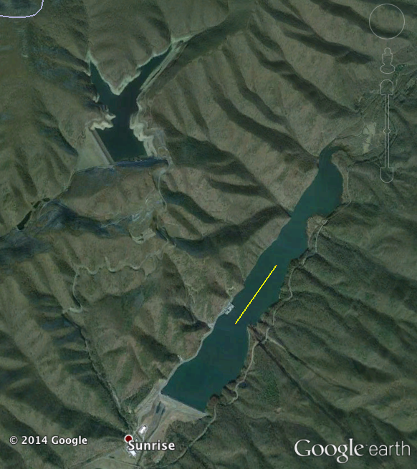
The Bath County Virginia pumped hydro storage plant:
From Dominion Power's website:¹
"The World's Biggest Battery" – but no numbers!
Supplies "over ½ million customers with (peak) power"
At rate "exceeding Hoover Dam"
One reservoir 1262 feet (385 m) above other reservoir
Max rate of flow back down =
13.5 million gallons / minute (852 m³ / sec)
Area of upper reservoir = 265 acres (1.07 x 10⁶ m²)
Its "water level fluctuates 105 feet (32 meters) during operation"
OK, now we have finally got enough information to calculate energy stored!
1 km
1) Link to webpage: www.dom.com/about/stations/hydro/bath-county-pumped-storage-station.jsp

Slide 17
Energy stored in Bath pumped storage energy plant:
Water's energy as it falls down into lower reservoir:
DE = M g h = r_{water} x (volume of water moved) x g x (height difference)
ρ_{water} = 1000 kg / m³ g = 9.8 m / sec²
height difference = 385 meters
volume of water moved = (1.07 x 10⁶ m²) (32 meters)
DE = (1000 kg / m³) (1.07 x 10⁶ m²) (32 meters) (9.8 m / sec²) (385 m)
= 1.29 x 10¹⁴ kg m / s² = 1.29 x 10¹⁴ Joules
= 1.29 x 10¹⁴ / (3,600,000,000) MW-h = 35.8 MW-h
Bath upper reservoir = 265 acres = 1.07 km²
If lower reservoir were reduced to same size => ~ 2 km² reservoir area

Slide 18
Round trip energy efficiency of pumped storage hydro?
Its largely limited by the HUGE electrical motor/generators/turbines required
Motors drive the turbines driving the water UP the hill, then:
Water turns turbines driving generators as it falls back DOWN
But some power may also be lost by turbulence-induced heating of the water itself
Overall power recovery, after accounting for all possible losses?
Various sources give efficiencies from 70% ¹ to 85% ²
I'll go with the NREL study ³ number: 80% efficiency
1) The Economist: www.economist.com/node/21548495?frsc=dg|a)
2) European Commission: etis.ec.europa.eu/publications/jrc-setis-reports/pumped-hydro-energy-storage-potential-transformation-single-dams
3) NREL: www.nrel.gov/docs/fy14osti/60806.pdf

Slide 19
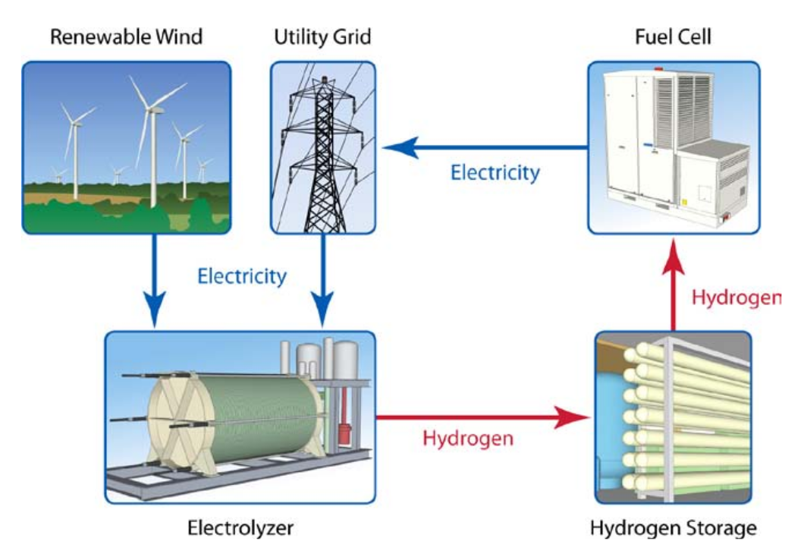
b) Fuel cell based energy storage:
Idea as depicted in an NREL presentation: ¹
U.S. National Renewable Energy Lab: "Analysis of Hydrogen and Competing Technologies for Utility-Scale Energy Storage"
http://www.nrel.gov/docs/fy10osti/47547.pdf

Slide 20
Fuel cell based storage has three stages:
- Electrochemical cell # 1 uses electrical energy to electrolyze water:
H₂O + electrical energy => H₂ + ½ O₂
- Gaseous H₂ (and possibly O₂) are then stored in pressurized tanks
- When energy is needed, gases are sent into Electrochemical cell #2:
H₂ + ½ O₂ => H₂O + electrical energy
ONE electrochemical cell COULD do both things (~ charging/discharging of battery)
But, apparently to optimize designs, input & output cells are separate
ALTERNATIVE: Stored H₂ is instead sent to a gas turbine generator
Eliminating fuel cell #2
Likely less efficient but also likely reducing capital cost
An Introduction to Sustainable Energy Systems: WeCanFigureThisOut.org/ENERGY/Energy_home.htm

Slide 21
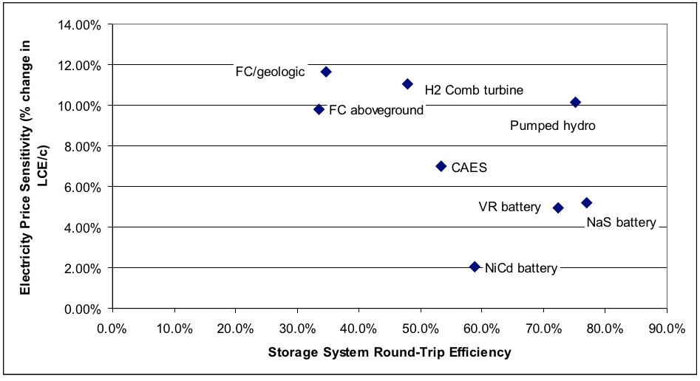
Fuel cell energy storage numbers?
From earlier Batteries and Fuel cell lecture:
What about energy storage density? It's very complicated:
"Storage" is in tanks, but RATE of energy storage and release
Will depend on size of input and output electrochemical cells
NREL's design studies are for 300 MW-h storage plants
But are now storing energy from single 10 kW wind turbine (i.e. ~ 50 kW-h)
Poor round trip efficiencies:
Only 30-35% !
U.S. National Renewable Energy Lab: "Hydrogen for Energy Storage Analysis Overview"
http://www.nrel.gov/hydrogen/pdfs/48360.pdf

Slide 22
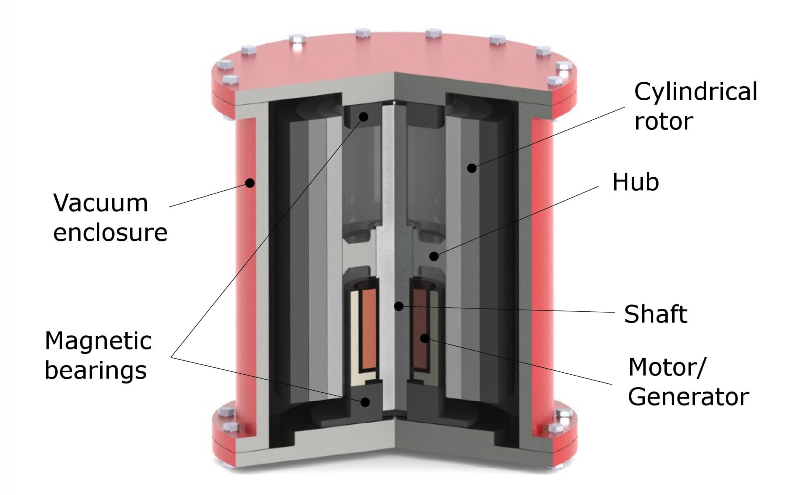
c) Flywheel based energy storage:
Maximum possible energy stored:
E_{max} = K x M x σ / ρ
K = "flywheel shape factor"
M = flywheel mass
σ = tensile strength of material
r = density of material
Why doesn't formula contain rotation speed? And why include tensile strength?
Because strategy is to run flywheel so fast it almost tears itself apart!
Thus almost-destructive-speed is what formula seemingly assumes
Round trip energy recovery efficiency? Energy is lost to heat in rotation bearings
Conventional bearings: "20-50% energy loss in two hours"
Magnetic levitation bearings: 85% round trip energy efficiency
https://en.wikipedia.org/wiki/Flywheel_energy_storage

Slide 23
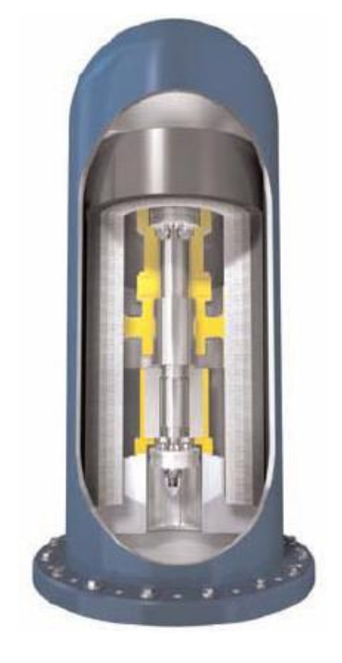
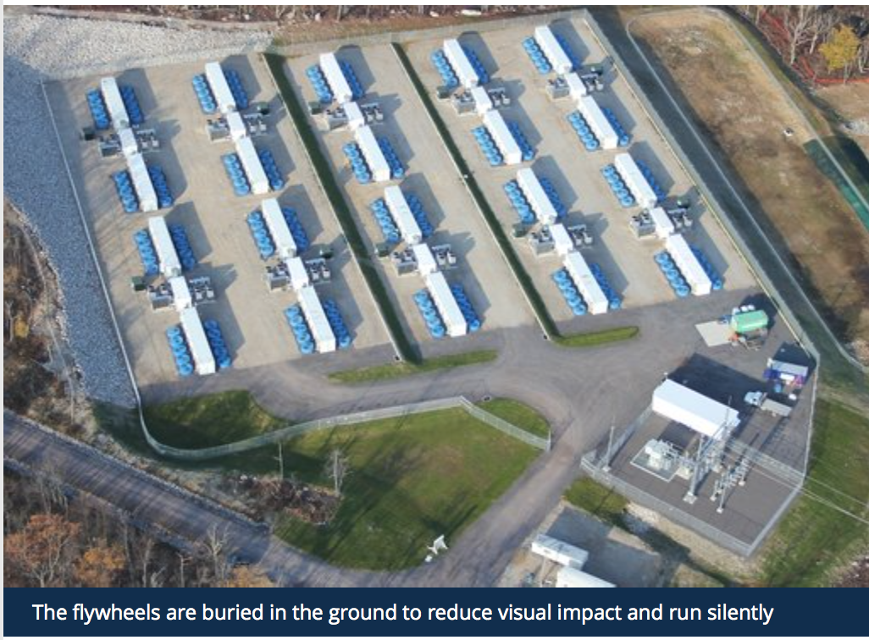
Flywheel energy storage numbers?
Web search produced information on only two experimental grid storage projects:
Beacon Power in Hazle Township, Pennsylvania – completion 2015 (?) ¹
Rhode, County Offalay, Ireland – completion 2017 ²⁻⁴
Data: Storage targets: Beacon 25 kW-h / Rhode 2 MW-h
Pennsylvania: 200 flywheels (as depicted at right)
Ireland: Projected efficiency: 85-90%
Carbon fibers / magnetic bearings / vacuum
Size? / Power storage density? Found no direct data
But from this picture is of Irish site ³
Footprint: ~ 2 hectares = 0.02 km²
1) http://energy.gov/sites/prod/files/2015/05/f22/Beacon-Power-Flywheel-Aug2013.pdf
2) http://www.theguardian.com/environment/2015/apr/08/new-energy-storage-plant-could-revolutionise-renewable-sector
3) http://www.rte.ie/news/business/2015/0326/689945-renewable-energy-storage/
http://schwungrad-energie.com/projects/rhode-hybrid-test-facility/

Slide 24
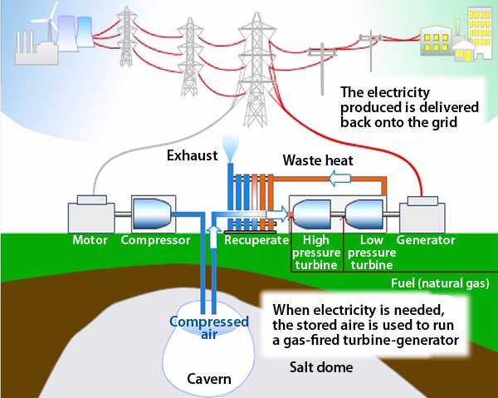
d) Compressed air energy storage (CAES):
Idea is potentially large scale:
Compress air into tank or reservoir / Release air to drive turbine generator
<= Natural Gas in ?
(I'll return to this!)
http://www.powermag.com/revived-energy-storage-technology-offers-major-grid-benefits/

Slide 25
Most sources make CAES sound simple - It isn't!
It sounds like you just need to invoke the Ideal Gas Law:
P V = n R T where R = the ideal gas constant
But rework this and you can spot a problem: P = n R (T/V)
So if you increase the pressure of a gas (P), what happens?
Does temperature (T) increase? Does volume (V) decrease? OR both?
REALITY CHECK: Try touching an air compressor, or even a bicycle tire pump
Actually don't, you'll burn your hand because compressing gas => heat
Refrigerators, air conditioners, and heat pumps are ALL partially based on:
- Fact that pressurizing gases HEATS them
- Fact that depressurizing gases COOLS them
An Introduction to Sustainable Energy Systems: WeCanFigureThisOut.org/ENERGY/Energy_home.htm

Slide 26
Faced by this reality, Wikipedia et al. ignore it
They pretend temperature stays constant, allowing them to use only Ideal Gas Law
But this also makes calculation of CAES efficiency impossible!
RIGHT thing to do is instead add a 2nd relationship: P V ^{m} = constant
This squirrely relationship describes a "Polytropic Process"
In it, the exponent m depends on the "heat capacity" of the gas
= Δ Energy that must be added to raise gas temperature by one degree
If heating is "reversible" (Δ Entropy = 0), heat capacity is constant => m is constant
THEN polytropic equation can be substituted into ideal gas law to produce:
Description of how pressurization changes BOTH V and T
=> Efficiency limits of Compressed Air Storage (CAES) ¹⁻³
1) https://www.princeton.edu/pei/energy/publications/texts/SuccarWilliams_PEI_CAES_2008April8.pdf
2) http://content.lib.utah.edu/utils/getfile/collection/etd2/id/86/filename/1430.pdf
3) https://www.eeh.ee.ethz.ch/uploads/tx_ethpublications/Samaniego_2010.pdf

Slide 27
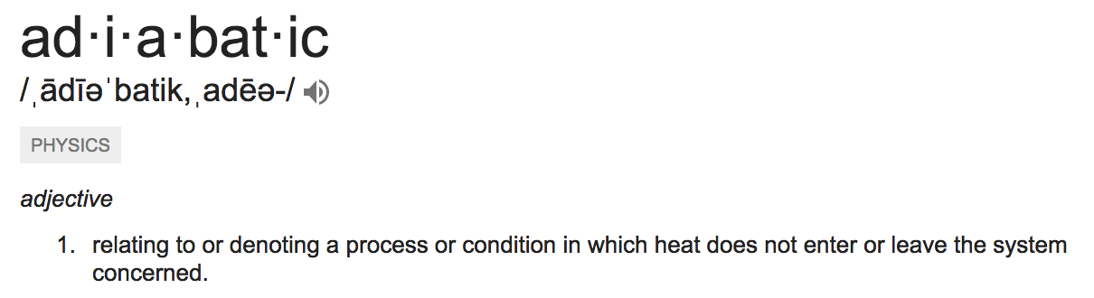
Challenge of heat loss => Multiple CAES versions:
The main ones are: DIABATIC CAES and ADIABATIC CAES
But what the heck do diabatic and adiabatic mean?
A quick Google search on "adiabatic" (= non-diabatic):
But Heat = Energy
So heat leaving a Compressed Air Energy Storage System = Energy lost
Nevertheless, only diabatic (heat-loosing) CAES has been tried to date!
An Introduction to Sustainable Energy Systems: WeCanFigureThisOut.org/ENERGY/Energy_home.htm

Slide 28
Contrasting the two main CAES approaches:
DIABATIC CAES (simple CAES) releases heat of compression to atmosphere
Which means that heat for re-expansion must come from other sources
If you've got plenty of time to wait, atmosphere can resupply the heat
But you DON'T have time to wait with grid energy storage thus:
Heat for re-expansion is instead supplied by burning natural gas
=> LOW NET EFFICIENCY (total energy out / total energy put in)
THIS is scheme shown in preceding (and almost all other) CAES figures
ADIABATIC CAES traps both air and heat (as it is released)
This requires tanks/cavities that are BOTH pressure-tight AND heat-tight
So that stored heat can later be applied to re-heating & expanding air
=> MUCH higher energy storage efficiencies, theoretically, up to ~ 100%

Slide 29
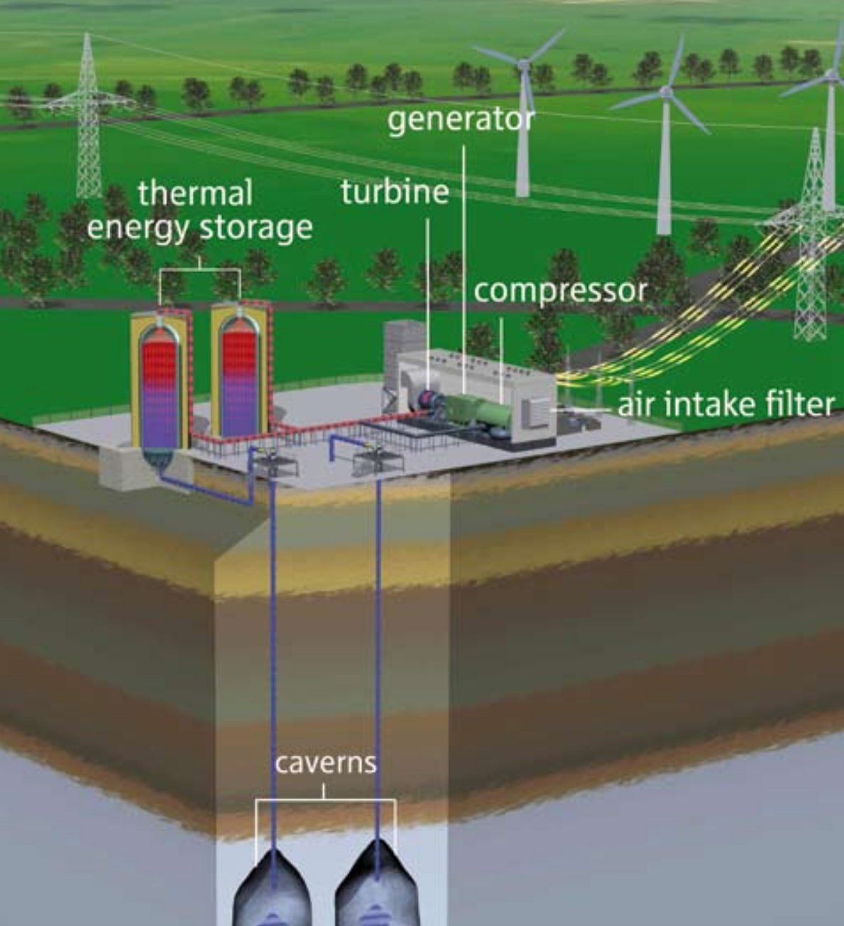
Compressed air energy storage numbers?
There are only two existing CAES plants worldwide, both diabatic (= heat wasting)
Huntorf Germany (42% efficient), McIntosh Alabama (54% efficient)
But a large new adiabatic (heat trapping) plant is being built: German "ADELE"
Liberated heat is stored in above-ground tanks
By warming the liquids they contain
While compressed gas goes to buried caverns
These are recombined to expand gas
Design goals (upon planned completion in 2018):
- Round trip energy efficiency: 70%
- Energy Storage: 1000 MW-h
- Footprint: ~ 1 hectare = 0.01 km²
https://www.rwe.com/web/cms/mediablob/en/391748/data/364260/1/rwe-power-ag/innovations/Brochure-ADELE.pdf

Slide 30
Did the ADELE CAES project achieve its 70% efficiency goal?
In December of 2019, I searched the web for an answer
To my surprise, post 2017 information about ADELE was virtually non-existent
A few CAES review articles suggested that ADELE had achieved its 70% efficiency
Their apparent source was a single 2017 conference paper about ADELE
which stated in its abstract: ¹
"After its completion in summer 2017 main achievements include the confirmation of a round-trip efficiency of about 70%"
But within that paper, the relevant section discussed only modeled results, about alternate technologies, none even identified as being relevant to ADELE:
"Thermodynamic calculations for different plant calculations and TES technology options confirm a substantial cost reduction potential and improved operation flexibility, albeit with an acceptable decrease in efficiency compared to the adiabatic process. Depending on the specific system configuration and the level of permissible costs the round-trip efficiency ranges from 60 to 70% and somewhat above, with CAPEX below 280 €/kWh"
1) "Electricity storage with adiabatic compressed air energy storage: Results of the BMWi-project ADELE-ING" https://ieeexplore.ieee.org/document/8278771

Slide 31
Another 2017 paper stated ADELE was on hold (possibly not even complete)
As published in the journal Energies (and posted by the University of Warwick) ¹
That article's (complete) discussion of ADELE reads:
"In Germany, as shown in Figure 15, the world’s first large-scale AA-CAES project - ADELE - with 70% cycle efficiency cycle efficiency has been designed by RWE Power, General Electric and other partners. The aim of this project is to optimize the co-existence and smooth interaction of the individual energy sources, especially for wind power. It is planned to have 1 GWh storage capacity and be capable of generating up to 200 MW, said the RWE power. The ADELE project could provide backup capacity within a very short time and replace forty state-of-the-art wind turbines for a period of 5 h. The project is now on hold due to uncertain business conditions [61]."
Note that paragraph's recurrent use of future tense AND its final sentence
If that did not confuse matters enough, when I clicked on the link provided in reference [61], I was taken to a U.S. EIA webpage which not only contained zero information about CAES, much less about ADELE. Further, that webpage was dated "June 29, 2012" (i.e., years before ADELE's construction even began).
Actual status of ADELE (or Adiabatic CAES in general)? Heck if I can figure it out!
1) "Overview of Compressed Air Energy Storage and Technology Development" http://wrap.warwick.ac.uk/91858/7/WRAP-overview-compressed-air-energy-storage-technology-development-Wang-2017.pdf 2) https://www.eia.gov/todayinenergy/detail.php?id=6910

Slide 32
e) Energy storage via Capacitors or Super-Capacitors
As mentioned in an earlier lecture, capacitors sidestep Maxwell's 1st equation:
Trying to push more charge into an object doesn’t really work:
Unless you fold the two plates over on top of one another:
No longer need charge balance on each plate
Excess +’s on top plate don’t like one another
But repulsion's balanced by attraction to -’s below
Amount of charge stored is proportional to the pushing voltage: Q = C V (1)
Constant (C) = "Capacitance" of the capacitor - It increases the closer the plates are:
Capacitance = Area x (dielectric constant of material in gap) / (gap thickness)
C = ε Area / d (2)
+
-
+
-
An Introduction to Sustainable Energy Systems: WeCanFigureThisOut.org/ENERGY/Energy_home.htm

Slide 33
But how much energy can a capacitor store?
Power of any type = Energy flow => P = ΔE / Δt (3)
But electrical power = voltage x current = voltage x (charge flow)
Charge flow into a capacitor = ΔQ / Δt (change in charge stored per time)
So power into a capacitor is: P_{capacitor} = V x (ΔQ / ΔT) (4)
Equations (3) and (4) BOTH give the power and are thus equal:
ΔE / Δt = V x (ΔQ / ΔT) Or in calculus terms: dE/dt = V dQ/dT
But from equation (1), Q = CV, substituting this in: dE/dt = C V dV/dT
Integrating over the capacitor's charging time: Energy _{capacitor} = ½ C V ²
Doubled voltage applied to a capacitor => Quadrupled energy stored
An Introduction to Sustainable Energy Systems: WeCanFigureThisOut.org/ENERGY/Energy_home.htm

Slide 34
Design of a SUPER CAPACITOR:
Here we want huge energy storage per volume = energy storage density
Volume _{capactior} = Area _{capacitor} x Thickness _{capacitor}
Simple capacitor: Gray = metal plates White = insulator
Thickness _{capacitor} = 2 T _{plate} + T _{insulator}
Then Energy stored in this stacked capacitor per volume is
Capacitor energy density = C V ² / [2 x A x (2 T_{plate} + T _{insulator})]
So thinning down both the plates and insulators is a good idea, however:
Plates have to be thick enough that electron flow won't overheat them
Insulator has to be thick enough that electrons cannot jump through it

Slide 35
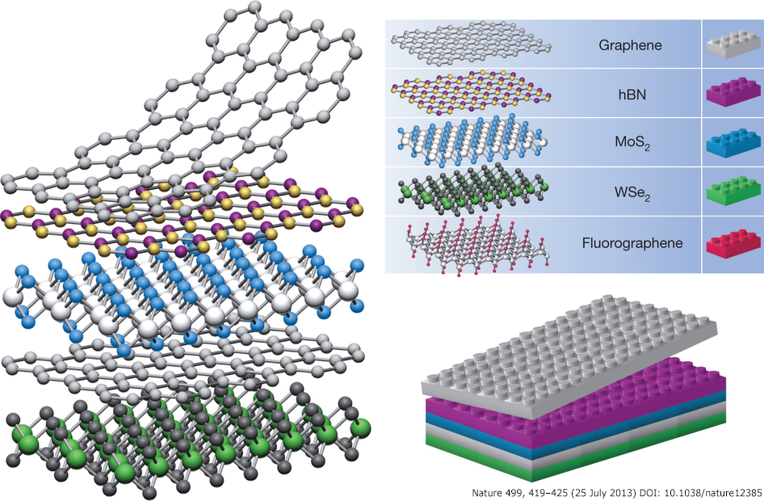
This all suggests use of ultrathin nano materials
Which might allow for capacitors using single atom thick plates and insulators
http://graphene.nus.edu.sg/barbaros/

Slide 36
But while there are extraordinarily good nano metals for the plates
Nano insulators are NOT exceptionally good at blocking electron flow
Key phenomenon is called dielectric breakdown
Which occurs when the electric field across insulator exceeds ξ _{breakdown}
Electrons then arc through, irreversibly damaging the insulator!
But electric field in insulator = Capacitor voltage / Thickness _{insulator} = V / T _{insulator}
To avoid breakdown, T _{insulator} must thus increase in proportion to voltage used
But from earlier formula, energy stored in a capacitor increases as voltage squared
So despite need for thicker insulators
It still makes sense to use higher voltages in these capacitors
As a conveniently "high" voltage, let's choose 110 volts (DC)

Slide 37
Calculating required insulator thickness:
Choosing a nano insulator from the above figure: hexagonal boron nitride:
For h-BN, ξ _{breakdown} is 700-900 MV / meter ^{1,2}
For our voltage choice of 110 volts (DC) if we use h-BN for insulator then:
For no sparks, need T _{h-BN} > 110 Volts / (700 MV/m) ~ 160 nanometers
For a safety margin, choose T _{h-BN insulator} = 200 nanometers
1) Nano Research, August 2013, Volume 6, Issue 8, pp 602-610
2) Journal of Physics: Conference Series 471 (2013)

Slide 38
Then calculating this "nano" capacitor's energy density:
Capacitor _{energy density} = C V ² / [2 x Area x (T _{plate} + T _{insulator})]
Where: C = ε Area / T _{insulator}
And for our choice of h-BN insulator using 110 VDC:
T _{h-BN insulator} = 200 micron = 10⁻⁶ m
T _{insulator} >> T _{plate}
e _{h-BN} = (3 to 4) x e_{o} ⁽¹⁾ ~ 30 x 10⁻¹² s⁴ Amp² / kg m³
Capacitor _{energy density} ~ (ε A / T _{insulator}) V ² / (2 A T _{insulator}) = ε V ² / 2 T_{insulator}²
= (3x10⁻¹¹ s⁴ Amp² / kg m³) (110 volts)² / 2 (0.2x10⁻⁶ m)²
= (3x10⁻¹¹)(1.2x10⁴)(0.5)(2.5x10¹³)(s² J²/kg-m⁵) = 4.5 MJ/m³ = 1.25 kW-h/m³
Likely efficiencies: ~ 100%
Area
200 nm
1) Journal of Physics: Conference Series 471 (2013)

Slide 39
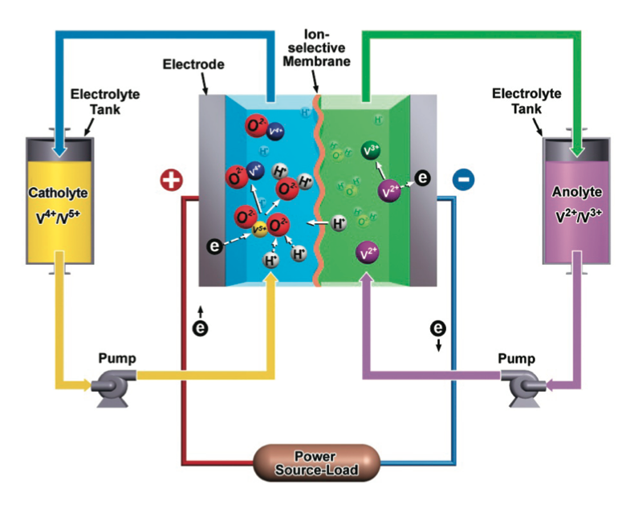
f) Energy storage via Super-Batteries
From note set on Batteries and Fuel Cells (pptx / pdf / key),
the top candidate might be flow batteries:
Which, recall, have this strange and complex configuration:
With two different electrolytes circulated in (via pumps) from external tanks
To a central cell with an "ion selective membrane"
Plus simple metal electrodes to either side

Slide 40
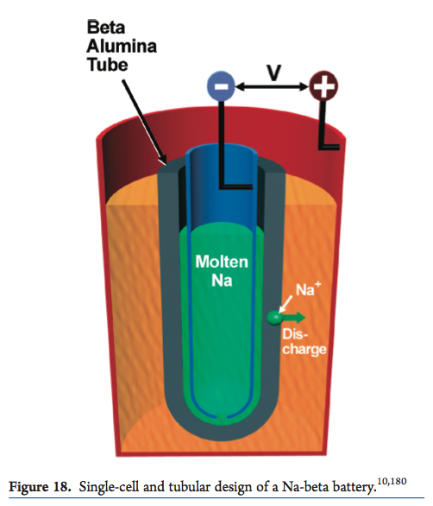
Molten sodium beta alumina batteries were a second candidate
With overall structure:
- Central (anode) reservoir of molten sodium (green)
- Membrane capable of passing Na⁺ ions (gray)
Typically: Al₂O₃ "beta alumina" ceramic
- Surrounding (cathode) outer cylinder (orange)
Typically: Sulfur / Sodium Sulfide (Na₂S_{x})
In the central anode: At the outer cathode:
2 Na => 2 Na⁺ + 2 e⁻ x S + 2 Na⁺ + 2 e⁻ => Na₂S_{x}
With Na⁺ ions formed in anode migrating through beta alumina toward cathode
Figure: Electrochemical Energy Storage for Green Grid, Yang et al., Chemical Reviews 111, 3577–3613 (2011)
1) http://en.wikipedia.org/wiki/Molten_salt_battery

Slide 41
Lithium ion batteries were a third candidate:
During CHARGING, Li is actually transferred from inside cathode to inside anode
-
-
-
Anode:
Li absorbing
and deionizing
+
+
Cathode:
Li dissolving and ionizing
+
DISCHARGE reverses this: Li transferred from inside the anode to inside cathode:
-
-
-
Anode:
Li desorbing
and ionizing
+
+
Cathode:
Li absorbing and deionizing
+

Slide 42
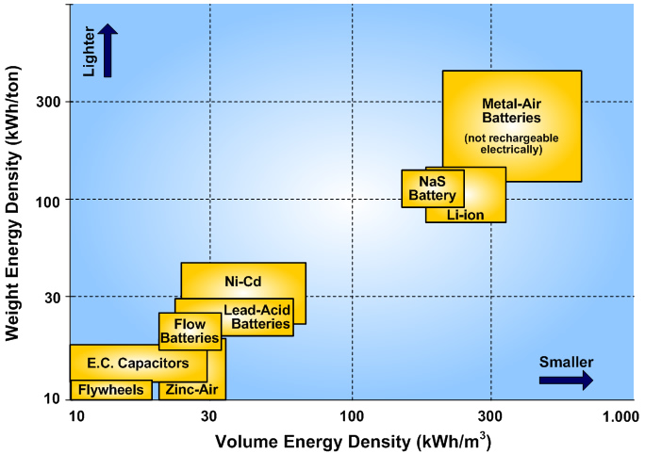
Comparative battery energy density data on all of these:
Molten Sodium
Flow
(vanadium redox)
Li Ion
Ion flow _{energy density} = Up to 30 kW-h / m³ at ~ 73% efficiency
Molten Na _{energy density} = Up to 270 kW-h / m³ at ~ 77% efficiency
Li Ion battery _{density} = Up to 350 kW-h / m³
Left) http://www.sc.ehu.es/sbweb/energias-renovables/temas/almacenamiento/almacenamiento.html
Right (compacted version of): http://www.nrel.gov/hydrogen/pdfs/48360.pdf

Slide 43
g) Heat energy storage via Molten Salts
Best batteries returned ~ 80% of electrical energy
Using electrical power in => electrical storage => electrical power out
Molten salts return only about 70% of heat energy
A 10% drop (compared to batteries) sounds significant
But while batteries are expensive, salt is cheap!
We might even mine AND store heat in the original SALT MINES!
NREL - Halotechnics Molten Salt Energy Storage Test Project, Emeryville CA:
35.45 kW-h stored in 0.19 m³ of salt, returning 25.1 kw-h (71%) ¹
Which gives:
Salt _{energy storage density} = 25.1 kW-h/0.19 m³ = 132 kW-h/m³
1) http://www.nrel.gov/docs/fy13osti/58595.pdf

Slide 44
FINALLY (!): Using ALL of the data from above:
To compute the impact of the most promising storage technologies when used in:
Scenario #2 = Conventional Power + 8% Storage:
Peak Power
887 GW-h
80%
Stored energy
Most effective power plants,
always at full power
Midnight
Noon
Midnight
An Introduction to Sustainable Energy Systems: WeCanFigureThisOut.org/ENERGY/Energy_home.htm

Slide 45
Projected numbers for nation-wide energy storage SYSTEMS:
Pumped Storage Hydro based energy storage SYSTEMS: 80% efficiency
Bath PSH = 35.8 MW-h occupying ~ 2 km²
Number of plants: 887 GW-h / 35.8 MW-h = 24,781 plants
Cumulative national footprint: (~ 25,000) x (~ 2 km²) => ~ 50,000 km²
Fuel Cell based energy storage SYSTEMS: 30-35% efficiency
”Planned” (future) plant capacity = 300 MW-h:
Number of plants: 887 GW-h / 300 MW => 2,956 plants
Current test plant = 50 MW-h, no info given on plant sizes
Number of plants: 887 GW-h / 50 MW => 17,740 plants
Cumulative national footprint: Not enough information given = ? km²

Slide 46
Projected numbers for nation-wide energy storage SYSTEMS (cont’d):
Flywheel based energy storage SYSTEMS: 85-90% efficeint
Current projects = 2 MW-h occupying ~ about 2 hectares
Number of plants: 887 GW-h / (2 MW-h) => 443,500 plants
Cumulative national footprint: ~ 90,000 hectares => 9000 km²
Adiabatic compressed air based energy storage SYSTEMS: 70% efficient
Adiabatic plant (under construction) = 1000 MW occupying ~ 1 hectare
Number of plants: : 887 GW-h / (1 GW-h) => 886 plants
Cumulative national footprint: ~ 900 hectares => 9 km²
Now moving onto energy storage THINGS:

Slide 47
Projected numbers for nation-wide energy storage THINGS:
Based on assumptions: Volume = 887 GW-h / (energy storage density)
Converted to a footprint by assuming these are piled ~ 1 m high in warehouses
Battery based energy storage THINGS: 70-80% efficient
Energy Storage Density – Flow Batteries: 30 kW-h/m³
Cumulative volume => footprint: 29 x 10⁶ m³ => 29 km²
Energy Storage Density – Molten Sodium Batteries: 270 kW-h/m³
Cumulative volume => footprint: 3.3 x 10⁶ m³ => 3.3 km²
Energy Storage Density - Lithium Ion Batteries: 350 kW-h/m³
Cumulative footprint: 2.5 x 10⁶ m³ = 2.5 km²
An Introduction to Sustainable Energy Systems: WeCanFigureThisOut.org/ENERGY/Energy_home.htm

Slide 48
Projected numbers for nation-wide energy storage THINGS (cont’d):
Capacitor based energy storage THINGS: likely nearly 100% efficient
Energy Storage Density – h-BN insulator : 1.25 kW-h/m³
Cumulative volume => footprint: 1.26 x 10⁸ m³ => 126 km²
Molten Salt based heat energy storage THINGS: 70% efficient
Energy Storage Density: 132 kW-h/m³
Cumulative volume => footprint: 6.7 x10⁶ m³ => 6.7 km²
However, if you could get them to efficiently store heat,
Salt Caverns might be a much better idea for cheap/large-scale storage
An Introduction to Sustainable Energy Systems: WeCanFigureThisOut.org/ENERGY/Energy_home.htm

Slide 49
Leading to the somewhat surprising result:
In contrast to note set Power Plants Requirements: Land & Water (pptx / pdf / key)
For this Scenario #2 = Conventional Power + 8% Storage
Land requirements of essentially all storage technologies are NOT excessive!
Indeed, especially for the technologies located primarily underground:
Surface ground use and overall environmental impact might be small
So WHY don't we already make extensive use of energy storage?
The answers must lie in:
The Cost of Grid Scale Energy Storage
An Introduction to Sustainable Energy Systems: WeCanFigureThisOut.org/ENERGY/Energy_home.htm

Slide 50
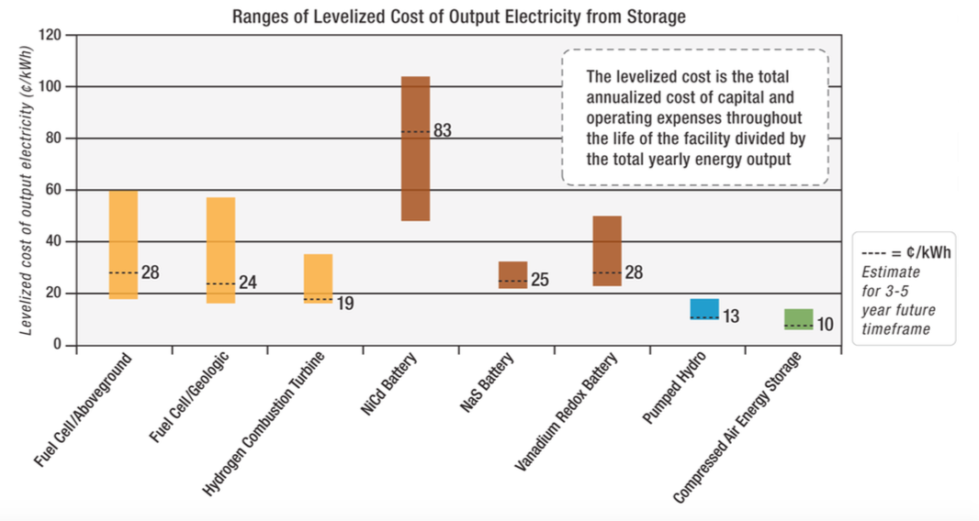
NREL estimates of energy storage LCOEs:
From a 2010 NREL presentation (with dashed lines giving anticipated 2015 costs):
Figure uses units of ¢/kW-hr rather than more common units of $/MW-h:
1¢/kW-hr => $10/MW-h (i.e. multiply by ten and change units)
100$/MW-h
U.S. National Renewable Energy Lab: "Hydrogen Energy Storage Overview"
http://www.nrel.gov/hydrogen/pdfs/48360.pdf

Slide 51
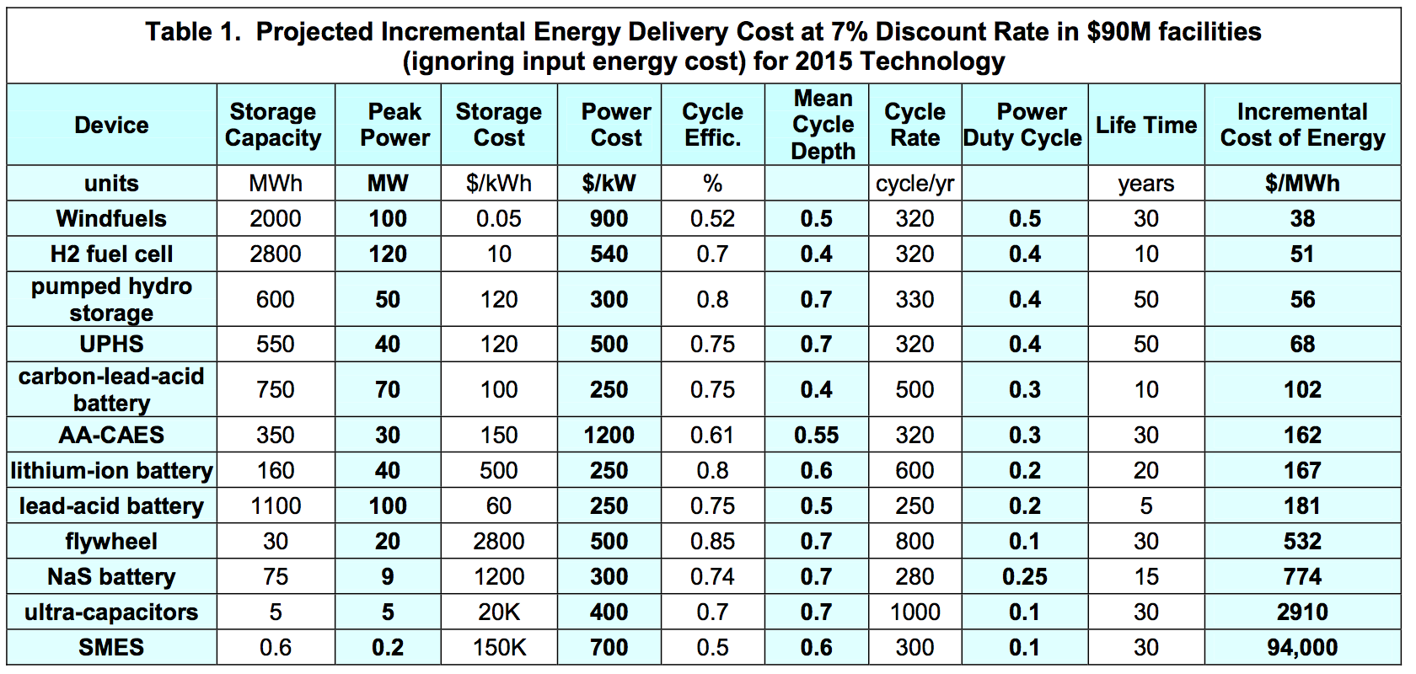
An independent corporate study:
"Projections of the Levelized Cost Benefit of Grid Scale Energy Storage Options"
From a 2010 conference paper presented by Doty Energy Corp.
Final column gives levelized cost due to storage using the indicated technology
http://dotyenergy.com/PDFs/Doty-90377-Storage-ASME-ES10.pdf

Slide 52
A comparison of those data (all in $/MW-h):
Storage Technology
Pumped Storage Hydro
Fuel Cell
V redox battery
Adiabatic CAES
Li ion battery
Flywheel
Lead Acid battery
NaS battery
NiCd battery
Ultra Capacitors
NREL LCOE
2010
130-180
100-600
220-500
100-165
220-320
480-1030
Doty LCOE
2010
56
51
162
167
532
181
774
2910
NREL LCOE
~ 2015
130
240-280
280
100
250
830

Slide 53
Quick analysis of storage LCOE's:
Pumped storage hydro (PSH / UPSH) is cheapest: ~ $50 / MW-h
Fuel cell storage: Doty: Comparable to PSH NREL: 4-5 X PSH
Adiabatic CAES & best battery storage ~ 2-3 X PSH = $100-150 / MW-h
Storage LCOE would be ADDED to energy's production LCOE = $70-150 / MW-h
Seemingly at least doubling or tripling the total cost of energy!
But not really, because under Scenario #2:
Storage cost is added to only to the ~ 8% of power we need to store
And competition = Scenario #1 evening power, already 2-4X more expensive!
Thus some experts say storage could
be competitive within five years

Slide 54
NEW Scenario 3: Use of ONLY “green” sustainable power sources
“Greenest” of renewable energy sources don't produce energy all of the time:
Examples include solar power, wind power, tidal power
And when they DO produce, it's not when we most need their production!
This, again, is how we LIKE to consume energy:
www.eia.gov/todayinenergy/detail.cfm?id=12711 YELLOW midnight lines added
An Introduction to Sustainable Energy Systems: WeCanFigureThisOut.org/ENERGY/Energy_home.htm

Slide 55
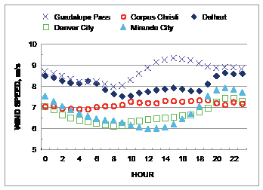
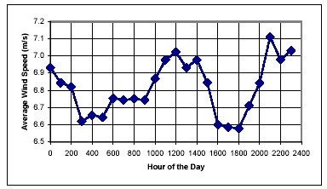
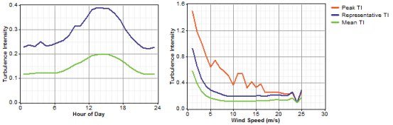
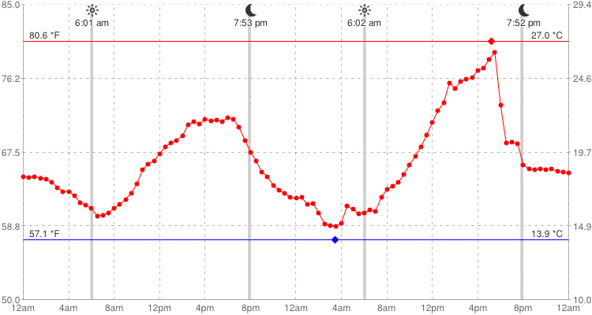
These are data on actual wind speeds vs. time of day
TEXAS: www.seco.cpa.state.tx.us/publications/renewenergy/windenergy.php
ONTARIO CANADA: www.omafra.gov.on.ca/english/engineer/facts/03-047.htm
NETHERLANDS: www.ekopower.nl/wind-energy-monitoring-data-logger-data-processing.htm
WISCONSIN: www.windpowerweather.com/history?date=last2days

Slide 56
Which, recalling that wind energy goes as wind velocity cubed:
Would lead to a typical wind energy versus time of day plot something like this:
(~ doubled afternoon wind speed => ~ 2³ X wind power)
Thus, with wind energy peaking sharply in the late afternoon, we'd get power like:
100%
Midnight
Noon
Midnight
An Introduction to Sustainable Energy Systems: WeCanFigureThisOut.org/ENERGY/Energy_home.htm

Slide 57
Solar energy peaks midday, but also varies by season:
Starts at sunrise, peaks at about noon, ends at sunset
And lasts longer and is more intense in the summer:
100%
Summer
Winter
Midnight
Noon
Midnight
An Introduction to Sustainable Energy Systems: WeCanFigureThisOut.org/ENERGY/Energy_home.htm

Slide 58
Wholesale use of renewables => HUGE NEED for storage!
What we now need/want in the way of daily power:
What we'd get from a wind plant: What we'd get from a solar plant:
100%
Midnight
Noon
Midnight
100%
100%
Midnight
Noon
Midnight
Midnight
Noon
Midnight

Slide 59
Let me (somewhat crudely) approximate either as half sine wave:
Power of Renewable at Peak
Peak
Power Use
80%
Midnight
Noon
Midnight
Area under half sinusoid = Amplitude x day / Pi = P_{peak_renewable} x day / Pi
But if this to be all our power, this must = 80% P_{peak_use} x day
Implying P_{peak_renewable} = 0.8 Pi P_{peak_use} = 2.5 P_{peak_use}

Slide 60
Whoops, so wind energy production would have to be more like:
Power of Renewable at Peak
Power of Renewable at Peak
≈
Peak Power Use
80% of Peak Power Use
Midnight
Noon
Midnight
Midnight
Noon
Midnight
But I now need to store and shift ALL energy above green "use" line!
Yellow Base ~ (0.8 P_{peak_use} )(d/2) = (0.4 d)(P_{peak_renewable} /2.5) = 0.16 P_{peak_renewable} d
Fraction that must be stored and shifted = 1 - Yellow base / All
= 1 – (0.16 P_{peak_renewable} d) / (P_{peak_renewable} d day / Pi) = 1 – 0.16 Pi = 50%
Making this the ”Green (only) Sustainables + 50% Storage” scenario

Slide 61
Whoops squared!
From previously having to store 8% of energy to accommodate our power use curve
If we use single "green" renewable (i.e. neither hydro or nuclear), we would have to:
Store and shift 50% of energy to accommodate our power use curve
Switch to renewables => Need to increase storage by ~ 6X
(vs. storage Scenario #2 which just eliminated evening "peaking" power plants)
Two renewables, peaking at different times (e.g. solar and wind) help a little
Two renewables, coming from different time zones, help a little more
But this strongly suggests that we will have to retain some 24/7 power sources
Producing a good fraction of the present day (Scenario #1) base load
It's going to be really hard to abandon hydro & nuclear power!

Slide 62
Credits / Acknowledgements
Some materials used in this class were developed under a National Science Foundation "Research Initiation Grant in Engineering Education" (RIGEE).
Other materials, including the "Virtual Lab" science education website, were developed under even earlier NSF "Course, Curriculum and Laboratory Improvement" (CCLI) and "Nanoscience Undergraduate Education" (NUE) awards.
This set of notes was authored by John C. Bean who also created all figures not explicitly credited above.
Copyright John C. Bean
(However, permission is granted for use by individual instructors in non-profit academic institutions)
An Introduction to Sustainable Energy Systems: WeCanFigureThisOut.org/ENERGY/Energy_home.htm

