Slide 1
Nuclear Energy – "But they blow up!"
John C. Bean
Outline
Tracking atomic Nuclei: What they contain, how that can change, and the energies involved
Nuclear Fission of abundant Uranium 238 vs. rare Uranium 235
Use of "moderators" to slow emitted neutrons => Sustained fission chain reactions
vs. neutron "poisons" vs. neutron "mirrors"
Chain reactions in bombs vs. chain reactions in nuclear reactors
Common "light water" moderated reactors:
Boiling Water Reactors (BWR) vs. Pressurized Water Reactors (PWR)
As opposed to carbon-moderated RBMK reactors
The Accidents:
Three Mile Island / Chernobyl / Fukushima Daiichi
Does massive use of concrete severely undermine nuclear's claim of near zero greenhouse emissions?
(Heavily Revised & Expanded: Summer 2024)

Slide 2
On this website, my sequence of topics has been a bit strange:
  I started by trying to explain the basic science behind electrical power
  I then described almost all of the ways we traditionally produce electrical power
  I followed that with descriptions of up-and-coming electrical power technologies
  Then, running short of possibilities, I explored a range of exotic long-shot solutions
Only now am I returning to our biggest source of nominally-carbon-free electricity:
Nuclear Power
I followed this strange path because I suspect many of you are uneasy about nuclear power
So am I
An Introduction to Sustainable Energy Systems: WeCanFigureThisOut.org/ENERGY/Energy_home.htm

Slide 3
And I may have a stronger personal reason to be uneasy than you:
Early in my marriage, when my wife and I were hoping for a first child
A nuclear reactor called Three Mile Island blew up
125 miles directly upwind from our home
And we had to decide whether to evacuate my possibly pregnant wife
So yes, I am uneasy about nuclear power, but following the path I've taken you along,
  I've reluctantly concluded that greener technologies may not be ready
to have a big enough impact, in a short enough time
This has led me and many others (including major scientific & environmental organizations ^{1,-4})
  to not only ask if we might be able to live with nuclear reactors,
    but if they can improved to the point that we feel comfortable living with them
1) https://climatecoalition.org/union-of-concerned-scientists-support-nuclear-power/
2) https://www.ucsusa.org/sites/default/files/attach/2018/11/Nuclear-Power-Dilemma-full-report.pdf
3) https://virginia-recycles-snf.com/wp-content/uploads/2020/03/The-Activists-Who-Embrace-Nuclear-Power-_-The-New-Yorker.pdf
4) https://www.npr.org/2022/08/30/1119904819/nuclear-power-environmentalists-california-germany-japan

Slide 4
"But they blow up!"
Yes they (or at least three of them) have (sort of) blown up
Leading many to now fear not only similar future explosions,
but also the possibility of a future explosion reaching full nuclear bomb intensity
To address those concerns this note set will explore:
The science & technology of nuclear reactors
The sometimes similar / sometimes different technology of nuclear-fission "atomic" bombs ¹
The history of WWII nuclear atomic bomb development, which provides insights into
how "nuclear energy" initiatives can provide cover for nuclear weapons proliferation
This will, however, require a bit of Nuclear Physics background
Which may never have featured in any class you ever attended
(and never even surfaced in any class preparing me for an Applied Physics career)
Fortunately, we only need a few concepts PLUS a modest dose of nomenclature and jargon
1) As opposed to later nuclear-fusion "Hydrogen" bombs - which are still triggered by nuclear-fission "Atomic" bombs

Slide 5
A Short(ish) Dive into Nuclear Physics:

Slide 6
Twentieth vs. Twenty-First Century Nuclear Physics
Nuclear Physicists of the last fifty years have been obsessed with sub-sub-nuclear particles
to which they delight in assigning weird names including:
up / down / top / bottom / strange / charmed quarks, leptons, bosons, gluons, . . . "god"
But Nuclear Reactors and Bombs can be explained by mid-twentieth century Nuclear Physics
in which sub-sub-nuclear particles still lurked secretly inside only two nuclear particles:
Positive Protons ("p" or ●) and Neutral Neutrons ("n" or ●)
Which DID, however, already exhibit a couple of weird behaviors:
1) They could transform into one another via incorporation or emission of negative electrons
1 Proton + 1 Electron → 1 Neutron OR 1 Neutron → 1 Proton + 1 Electron
2) These transformations DID NOT PRECISELY CONSERVE MASS
Instead, Einstein's E = mc² demanded that:
Even minute Gain of Mass required HUGE ENERGY INPUT
Even minute Loss of Mass led to HUGE ENERGY OUTPUT

Slide 7
Nuclear physics requires tracking those protons, neutrons & electrons:
Electron tracking evolved first, when pioneering Chemists realized that inter-atomic bonding
  was driven by the different number of electrons "belonging" to each type of atom
Which led those Chemists to classify different atoms based on their:
  Atomic Number = A lone un-ionized atom's # of nucleus-surrounding electrons
But in a lone un-ionized (charge neutral) atom,
  the # of nucleus-surrounding electrons must equal the # of nuclear protons
    implying Atomic Number is also defined by the # of nuclear protons
What about charge-less nuclear neutrons? Later more daunting science ¹ revealed that:
  Nuclei of small, light, common atoms tend to have # of neutrons = # of protons
  Less common variants & heavy atoms tend to have # of neutrons ≥ # of protons
    However, as neutrons are added, nuclei are held together more weakly,
      developing a tendency to spontaneously fall apart (i.e., radioactively fission)
Neutron count is buried in a nucleon count = # of protons + # of neutrons in a nucleus,
  used as a leading superscript - making common Hydrogen with a nucleus of 1 proton: ¹H
1) To learn more, I highly recommend: "The Making of the Atomic Bomb" by Richard Rhodes (ISBN978-1-4516-7761-4)

Slide 8
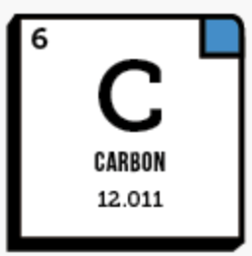
Applying (and expanding) those definitions for the special case of Carbon:
98.9% of Carbon nuclei have 6 protons (6 p) + 6 neutrons (6 n)
  Giving Carbon an atomic number of 6
    and a nucleon count of 12, as symbolized by ¹²C, or called "Carbon 12"
Atomic Mass CAN be stated in normal MKS gram or kilogram units, but the resulting
  tiny & complex numbers led instead to the use of Atomic Mass Units (AMU),
    defined as 1/12 th the mass of a lone ¹²C atom in its resting energy state
That definition meant (uniquely) that, ¹²C has exactly:
Atomic Number = 6 Nucleon Count = 12 Atomic Mass = 12
Why then does the periodic table show Carbon's mass as 12.011 AMU?
  Because 1.06% of Carbon nuclei have instead 7 neutrons
    And 10⁻¹⁰ % of Carbon nuclei have instead 8 neutrons
Together these are the ¹²C, ¹³C, and ¹⁴C isotopes of carbon, with the
  small / tiny fraction of heavier isotopes boosting the average C mass to 12.011 AMU

Slide 9
For Carbon, trying to capture all of that visually: ¹
Electrons
Electrons
Electrons
Protons, Electrons, Atomic # = 6 Protons, Electrons, Atomic # = 6 Protons, Electrons, Atomic # = 6
Neutrons = 6 Neutrons = 7 Neutrons = 8
Nucleons = 12 Nucleons = 13 Nucleons = 14
Symbol = ¹²C Symbol = ¹³C Symbol = ¹⁴C
Name = Carbon 12 Name = Carbon 13 Name = Carbon 14
Abundance = 98.9 % Abundance = 1.06 % Abundance = 10⁻¹⁰ %
Mean Lifetime ² = Infinite Mean Lifetime ² = Infinite Mean Lifetime ² = 5700 years
1) Nuclear physic's tracking of protons, neutrons & electrons can easily confuse. In these notes I've thus put particular effort into my use of colors, tables and figures. Pause to study them - they may help you keep things straight.
2) Which nuclear physicists instead call radioactive Half-Life

Slide 10
In nuclear reactors (and bombs) a few atoms play leading roles
Uranium (U), Plutonium (Pu) and, perhaps in the future, Thorium (Th)
Uranium, with an atomic mass of 238.02, is currently the major player
Its atomic mass suggests that Uranium's most common isotope is ²³⁸U, which is indeed the case:
Uranium Isotope: Abundance in Uranium Ore: Radioactive Half-Life:
²³⁸U 99.27% Half-life: 4.6 billion years
²³⁵U 0.72% Half-life: 703.8 million years
Plus other isotopes, but all with natural abundance < 0.01%
Finite lifetimes mean these isotopes are ALL radioactive, eventually fissioning apart
But these extremely long lifetimes mean there is minuscule decay within human lifespans
In reactors OR bombs SOMETHING must vastly accelerate radioactive decay!
An Introduction to Sustainable Energy Systems: WeCanFigureThisOut.org/ENERGY/Energy_home.htm

Slide 11
²³⁸U decay is strongly accelerated by collisions with HIGH energy neutrons:
Also called "hot" or "fast" neutrons (which I will emphasize by using red text):
²³⁸U + ¹n (hot/fast) → ²³⁹U → ²³⁹Np + β → ²³⁹Pu + β
where β ("beta") is nuclear physics speak for a high energy electron
(which, like all electrons, have mass ~ 1/2000 that of protons and neutrons)
But ²³⁸U fission CAN NOT SUSTAIN a nuclear chain reaction
Because while ONE hot neutron causes ONE ²³⁸U atom to fission
that neutron is captured and no replacement neutrons are generated
Which helps explain why ²³⁸U survives as Uranium's most abundant isotope
But it doesn't explain high historical interest in ²³⁸U's dead-end radioactive decay
THAT interest focused instead on one of ²³⁸U's nuclear fission products:
Plutonium 239 - Which produced the world's FIRST nuclear bomb explosion
at the 16 July 1945 "Trinity" test in Alamogordo New Mexico

Slide 12
²³⁵U decay is most strongly accelerated by collisions with LOW energy neutrons:
Also called "slow" or "thermal" neutrons (which I will emphasize by using green text)
Its most likely fission decay path is:
²³⁵U + ¹n (slow/thermal) → ²³⁶U → ⁸⁹Kr + ¹⁴⁴Ba + 2 ¹n (hot/fast) + 200 MeV ¹
But it has many other possible but less likely decay paths, including: ²
235U + 1n (slow/thermal) → 236U → 92Kr + 141Ba + 3 1n (hot/fast) + 170 MeV
235U + 1n (slow/thermal) → 236U → 94Zr + 139Te + 3 1n (hot/fast) + 197 MeV
The weighted average of all paths => ²³⁵U fission produces ~ 2.4 (hot/fast) neutrons
Incoming neutrons DO stimulate ²³⁵U fission, liberating larger numbers of outgoing neutrons
But this does NOT readily grow into a nuclear chain reaction
Because the liberated hot neutrons only weakly stimulate fission of other ²³⁵U atoms
(which, instead, interact strongly with only slow neutrons)
As circumvented in the Hiroshima Uranium Nuclear Bomb by means I'll discuss later
1) "eV" = (charge on 1 proton or electron) x (1 Volt) = 1.6 x10 ⁻¹⁹ Coulomb - Volts = 1.6 x10 ⁻¹⁹ Joules of energy
2) http://www.world-nuclear.org/information-library/nuclear-fuel-cycle/introduction/physics-of-nuclear-energy.aspx

Slide 13
Depictions summarizing ²³⁸U and ²³⁵U interactions with neutrons
238U: Slow incoming neutron: Fast incoming neutron:
(Neutron just keeps on going) Neutron capture → Nuclear fission
b
U238
U238
etc.
U239
235U: Slow incoming neutron: Fast incoming neutron:
Neutron capture → Nuclear fission (Most Neutrons just keep on going)
U235
U235

Slide 14
But what if a fissioning ²³⁵U's fast neutrons could be slowed down?
?
U235
U235
THAT could sustain a rapid ²³⁵U chain reaction, as neutrons emitted by one ²³⁵U fission
would then trigger fission of several more ²³⁵U's (and so on and so on)
And, at least in principle, there is an simple way of doing this:
Just force the hot neutrons to first bounce off the nuclei of a bunch of light atoms,
    where "light" means atoms with mass roughly comparable to that of the neutrons
Those light atoms will strongly rebound, each capturing part of the neutron's kinetic energy
Light atoms = NEUTRON "MODERATORS" (neutron energy absorbers)
Think of a fast cue ball slowed by bouncing repeatedly off other billiard balls

Slide 15
But in real-life there are a couple of other complicating possibilities:
Neutron collisions will hardly budge very heavy atoms
The neutrons WILL bounce off in another direction
But the heavier the target atom, the less Kinetic Energy it will siphon away
Heavy atoms = NEUTRON MIRRORS (redirecting but minimally slowing neutrons)
Which CAN be used to KEEP neutrons within the core of a nuclear reactor or bomb
Think of a fast cue ball bouncing off a big steel ball-bearing or small bowling ball
While the nuclei of certain atoms instead CAPTURE and HOLD neutrons
These, with many possible masses = NEUTRON ABSORBERS / POISONS / SINKS
Prominent examples include Xenon (Xe), Iodine (I), and Boron (B)
Their natural occurrence can hinder certain desired chain reactions, but in an
emergency their deliberate introduction can quench a runaway nuclear reactor
Think of a cue ball NOT bouncing off other glue-covered billiard balls
An Introduction to Sustainable Energy Systems: WeCanFigureThisOut.org/ENERGY/Energy_home.htm

Slide 16
Depicting hot neutron interaction with moderators, mirrors and poisons
Before: After:
Neutron Moderator (light atom that absorbs some of neutron’s kinetic energy):
Result:
Neutron Mirror (heavy atom that absorbs very little of neutron’s kinetic energy):
Result:
Neutron Poison (atom that absorbs and then holds neutron inside its nucleus):
Result:

Slide 17
But some atoms BOTH desirably Moderate AND undesirably Poison
Most notably, normal hydrogen (¹H) with its nucleus of a single lone proton:
Because of the near match in proton and neutron masses
a neutron striking normal hydrogen can transfer a LOT of energy to it
Further, lots of such hydrogen atoms are readily available in water
Making normal hydrogen (and H2O) a STRONG Neutron Moderator:
Producing:
But, while unlikely, ¹H's lone-proton nucleus can also absorb one or two neutrons
Making normal hydrogen a WEAK Neutron Poison:
Producing: Or eventually:
¹H ²H ³H

Slide 18
But poisoning atoms can be largely filtered away via Isotope Separation ^{1, 2}
Which is an array of obscure, difficult and terribly expensive processes by which
DIFFERENT isotopes of the SAME atom can be separated from one another
For which conventional chemical refining is useless because all isotopes of the same atom
have the same number & arrangement of electrons
which makes those isotopes form identical bonds with all other atoms
But isotopes can be DIRECTLY separated by applying Electromagnetic or Centripetal forces which, because F = ma, accelerate heavier isotopes more weakly thereby sending them along slightly different paths, facilitating their sorting
Or, many early techniques exploited the fact that thermal equilibrium gives different isotopes
(or isotope-containing molecules) the same Kinetic Energy which, because K.E. = 1/2 mv², means the heavier isotopes (or isotopic molecules) must have lower v's
making both their migration and vibration are minutely slower
Which minutely slows heavier isotope diffusion, decomposition & evaporation
Not enough to separate isotopes quickly or immediately, but enough to mostly
separate them if the process is repeated over and over thousands of times
The development and proliferation of Nuclear Weapons and Reactors was
(and continues to be) gated by the design & construction of Isotope Separation facilities
1) ) https://en.wikipedia.org/wiki/Isotope_separation 2) https://www.britannica.com/science/isotope/Isotope-separation-and-enrichment

Slide 19
Applying this to normal H2O's dual Neutron Moderating & Poisoning tendencies
To eliminate water's poisoning, use water with only H nuclei already containing neutrons
There is one such stable isotope, with 1 nuclear neutron, called Deuterium, or D:
Deuterium occurs naturally but it is very rare, with
only ~ 1 in 6400 H atoms of natural water being Deuterium ¹
But, per the preceding slide, D₂O's motion & vibration are minutely slower
which minutely slows D2O's electrolytic decomposition into D2 and O2 gases
So, if natural H2O is electrolyzed, gas emitted later has minutely enhanced D2 concentration
If ONLY that later gas is retained, recombined, condensed, and that process repeated
THAT resulting water will have even higher D2O concentrations
Repeat a HUGE number of times and almost pure D₂0 = "Heavy Water" is produced
  = A near ideal non-poisoning neutron moderator
¹H ²H = Deuterium
Light Water Heavy Water
O
O
H
H
D
D
As done by WWII Nazi nuclear bomb developers at the Telemark hydroelectric power plant
in occupied Norway - Only to then be sabotaged by Norwegian commando attacks ¹
1) ) https://en.wikipedia.org/wiki/Norwegian_heavy_water_sabotage

Slide 20
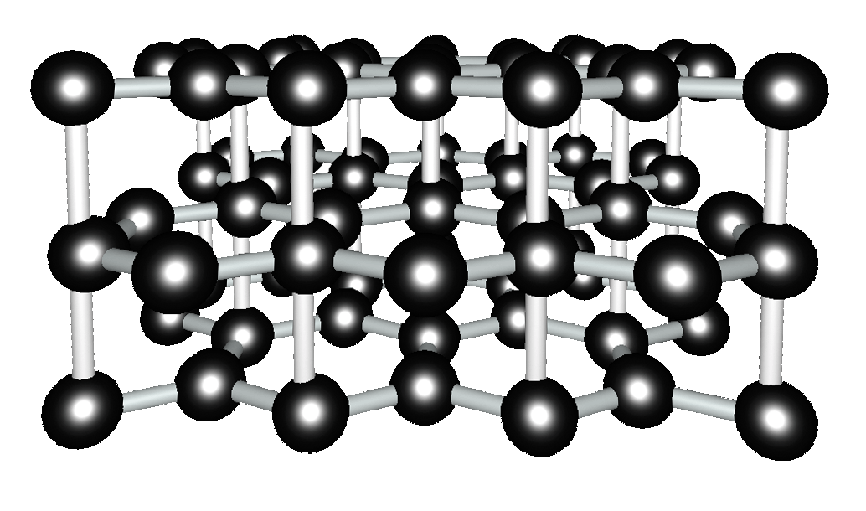
But one can moderate almost as well with the Carbon atoms of common Graphite
Common Carbon atoms are 12 times heavier than neutrons
meaning they absorb less energy from colliding neutrons
than is absorbed by a Hydrogen atom of near-neutron mass
But they make up for this by seldom if ever capturing neutrons which makes Carbon,
like Deuterium, a non-poisoning neutron moderator (unlike common ¹H or ¹H2O)
By using a Heavy Water OR Graphite Moderator, fission chain reactions can be
sustained in naturally-occurring Uranium consisting of 0.7% ²³⁵U + 99.3% ²³⁸U
Heavy Water Reactors thus shift "obscure, difficult & terribly expensive" isotopic separation
from their fuel to their water (which IS a lot easier and safer to separate)
Graphite Moderated Reactors entirely eliminate the need for ANY isotope separation
But incorporate a flaw that would hugely expand the impact of the Chernobyl disaster:
Superheated Graphite burns fiercely when suddenly exposed to air
Figure: Screenshot from my animation at: https://wecanfigurethisout.org/VL/Nanocarbon.htm/state/5

Slide 21
But reactors generally use a little bit of Uranium plus a WHOLE LOT of water
Thus, for easier and safer neutron moderation almost all "western" nuclear reactors now employ
unenriched "light water" MODERATOR - despite its slight neutron poisoning effect - which is
offset by the use of Uranium fuel mildly enriched by isotope-separation to 4-5% ²³⁵U
In such "Reactor Grade" / Low Enrichment Uranium (LEU) ¹ the chain reaction then becomes:
etc.
1) Radioactive decay of ²³⁵U provides "the Spark"
3) The Chain Reaction begins as
slow/cool neutrons stimulate the
radioactive decay of other ²³⁵U's
U239
b
O
O
U238
H
H
H
H
U235
U235
H
H
O
U238
2) Hot/fast neutrons are then "moderated" (slowed) via multiple collisions with light atoms of H2O yielding a slow/cool neutrons
b
U239
etc.
1) Vs. High Assay Low Enrichment Uranium (HALEU) = 5-20% ²³⁵U vs. Weapons Grade Uranium = 20-85% ²³⁵U
(https://en.wikipedia.org/wiki/Enriched_uranium)

Slide 22
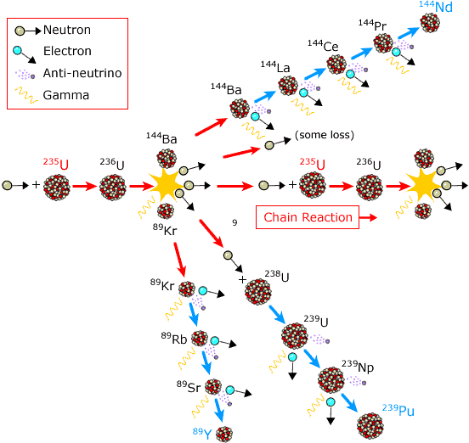
In real life, the fission reaction products break down even farther:
The 235 U fission path is depicted horizontally, including side branches into . . .
a ¹⁴⁴Ba fission path:
a ²³⁸U fission path:
and a 89Kr fission path:
But all of these paths take TIME
And they extend right off the page!
Importantly:
EVEN AFTER ²³⁵U FISSION STOPS
its decay products continue fissioning
for seconds, minutes or even hours!
Producing persistent intense HEAT that
induced the NON-NUCLEAR explosions
triggering 2 of 3 major Reactor Accidents
Modification of figure found at:
http://www.nobelprize.org/educational/physics/energy/fission_2.html

Slide 23
But could a full blown nuclear explosion instead be triggered?
Experts often rebut that possibility based on arguments citing "Critical Mass"
But their rebuttals are muddied by that simplistic and misleading term,
which actually obscures key differences between nuclear reactors and bombs
To sustain the chain reaction, a neutron released by one fissioning ²³⁵U
MUST successfully induce the fission and neutron release from another ²³⁵U
:
If probability is < 1 the chain reaction dies out, and state is labeled Sub-Critical
If probability = 1, the chain reaction continues at a constant rate labeled Critical
and the fuel involved is said to be of Critical Mass
If probability is > 1, the chain reaction grows and the state is then Super-Critical
But exceeding the "Critical" probability of 1 requires far more than just fuel mass
As can be demonstrated by the following simple diagrams:

Slide 24
Consider these contrasting possibilities:
Say that (on average) one fissioning ²³⁵U atom emits exactly 3 neutrons:
Then consider different ways of packing such atoms:
High total mass Low total mass
No collisions → No chain reaction Two Collisions → Rapidly growing chain reaction
BECAUSE tighter packing
makes collisions more probable!
Suggesting:
MASS / VOLUME or NUMBER / VOLUME
(a density) is instead the CRITICAL factor

Slide 25
But high mass or number density (alone) might also be insufficient:
Consider two shapes, with same Mass, Mass / Volume, and Number / Volume:
NO collisions → No chain reaction: One collision → Chain reaction:
Similar to heat, a shape with lower surface to volume ratio traps more neutrons
But high Total Mass AND Mass density AND Number density AND proper shape
may STILL not be enough to achieve "Critical Mass"

Slide 26
It also depends upon purity - Or what in this context is called "Enrichment"
Consider two Uranium shapes with different ²³⁵U ( ) to ²³⁸U ( ) ratios
Reactor Grade Uranium: 4-5% ²³⁵U Weapons Grade Uranium: > 80% ²³⁵U
One ²³⁸U collision → No neutron release One ²³⁵U collision → Chain reaction:
→ No chain reaction
So "Critical Mass" is ACTUALLY about mass, density, shape, enrichment . . .
And is ANY combination producing a chain-reaction of CONSTANT intensity ¹
For additional information see, for example: https://en.wikipedia.org/wiki/Critical_mass

Slide 27
Nuclear bombs require growing ("Super Critical") fission chain reactions,
But a bomb's Super Critical chain reaction must also be what experts label "Prompt"
What is THAT all about?
In a "Super Critical Mass," the fission chain-reaction becomes increasingly intense
yielding ever more intense heat that begins to fracture, melt & vaporize the fuel
which thereby flows, and increasingly blows, rapidly apart!
But if that fissioning material spreads too far apart, Super Criticality is lost
Reverting to one of the preceding too dilute and/or too spread out configurations
in which the probability of propagating a fission chain reaction falls below 1
A situation scientists gave the very descriptive name of nuclear FIZZLE
An Introduction to Sustainable Energy Systems: WeCanFigureThisOut.org/ENERGY/Energy_home.htm

Slide 28
But isn't "fizzle" just a euphemism for "a slow explosion"
NO! - Not in an all important way:
A nuclear fizzle releases immensely less energy than a nuclear explosion
Because:
A fizzle's slow early energy release, which IS due to nuclear fission,
drives away (via melting and vaporization) the remaining nuclear fuel
Which, spread out, is no longer of Super Critical Mass / Super Critical configuration
and not only does the chain reaction cease growing
but in much of the fuel the chain reaction is not even be sustained
In which case only a tiny fraction of the available fissionable material ever fissions
So a fizzle produces a much, much smaller net energy & radiation release
Which can be so weak that it ends up being more "meltdown" than explosion
An Introduction to Sustainable Energy Systems: WeCanFigureThisOut.org/ENERGY/Energy_home.htm

Slide 29
The Prompt in Prompt Super Critical Mass alludes to fizzle-beating speed
According to Wikipedia's "Critical Mass" webpage data: ¹
To fission ~ all of a nuclear bomb's fuel requires at least 80 chain reaction cycles
which must be completed within the ~ 1 microsecond before that
fuel is thrown so far apart that the chain reaction is largely extinguished
But, from above, ²³⁵U fissions into all sorts of things over
sub-microsecond to 1000's of second time scales
Bombs need a fizzle-avoiding design & fuel producing
Prompt (submicrosecond) Super Critical Mass
Reactors instead target a stable chain reaction rate
which requires a slightly Super Critical Mass of fuel
but stays well below Prompt Super Critical Mass thereby slowing any
chain reaction rate variation to correctable second to minute timescales
https://en.wikipedia.org/wiki/Critical_mass

Slide 30
But to give those concepts substance its time to dig into technologies, starting with:
The Technology of Nuclear-Fission "Atomic" Bombs

Slide 31
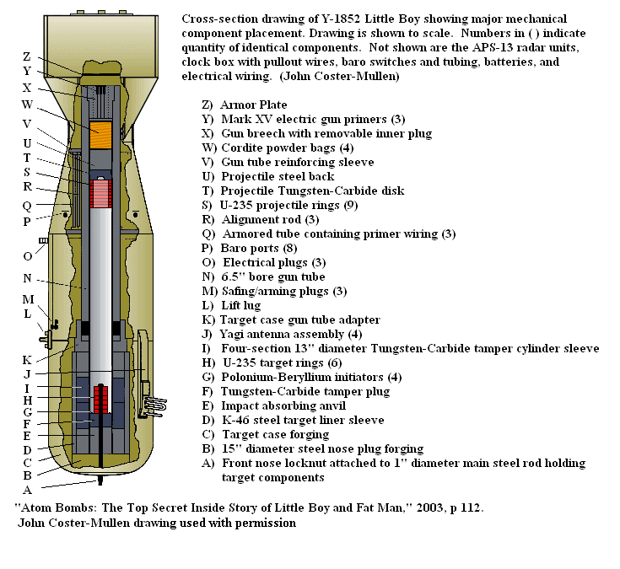
Producing a Prompt Super Critical Mass over Hiroshima required:
"The Little Boy"
http://en.wikipedia.org/wiki/Little_Boy

Slide 32
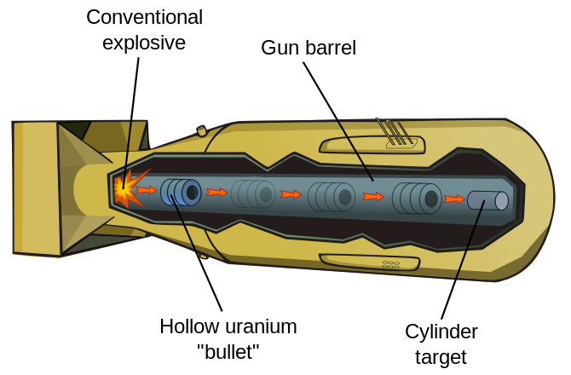



So named because it WAS little and relatively simple:
http://en.wikipedia.org/wiki/Little_Boy
An 80-90% ²³⁵U Tube was SHOT thru a cannon into place around a cylinder of 80-90% ²³⁵U
  Before cannon fired: After cannon fired → ²³⁵U Prompt Super Critical Mass:
Enhanced by a surrounding Neutron Mirror bouncing back neutrons leaking outward
which was the ONLY way it BEAT the initial heat starting to push things back apart,
avoiding fizzle, getting MOST of ²³⁵U to fission → ~ Complete energy liberation

Slide 33
The Manhattan Project didn't even advance test the Little Boy design:
1) Because they were almost certain it's simple idea / implementation would work
2) Because they'd produced so little of the absolutely necessary 80-90% enriched ²³⁵U
(to be contrasted with the 0.7-5.0% ²³⁵U fueling common reactors)
Why had so little ²³⁵U been produced? Because ²³⁵U is SO HARD TO ENRICH!
As discussed earlier, 235U is chemically identical to 238U and
separation must instead somehow exploit their mere 1% mass difference
Requiring isotope separation plants repeatedly sending Uranium feedstock through
diffusion barriers OR mass spectrometers OR high-speed centrifuges OR . . .
Almost half of the WWII Manhattan Project's 27 billion dollar budget ^{1, 2}
was spent developing & building such Uranium isotope separation plants ²⁻⁴
1) As expressed in equivalent 2023 U.S. dollars
2) https://en.wikipedia.org/wiki/Manhattan_Project
3) "The Making of the Atomic Bomb" by Richard Rhodes, 25th Anniversary Edition, Simon & Schuster (ISBN978-1-4516-7761-4)
4) https://www.nps.gov/mapr/learn/uranium.htm

Slide 34
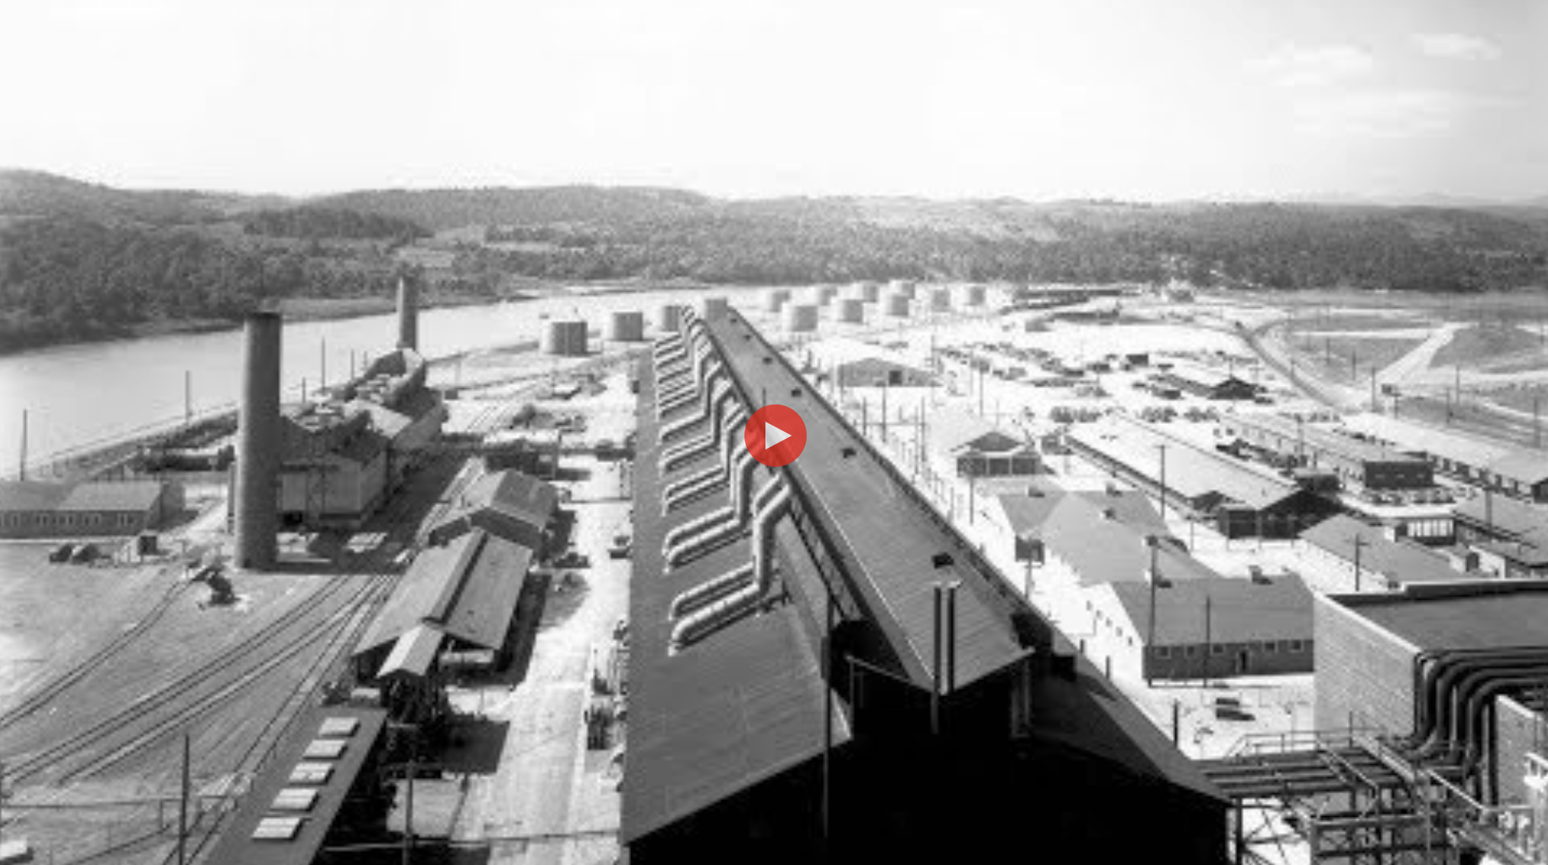
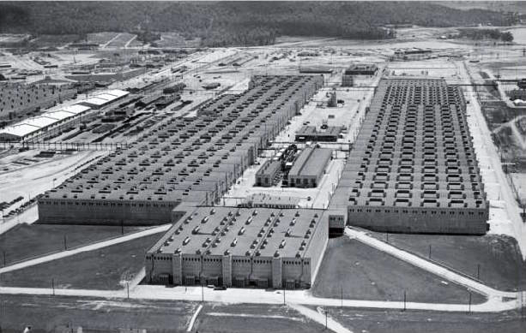
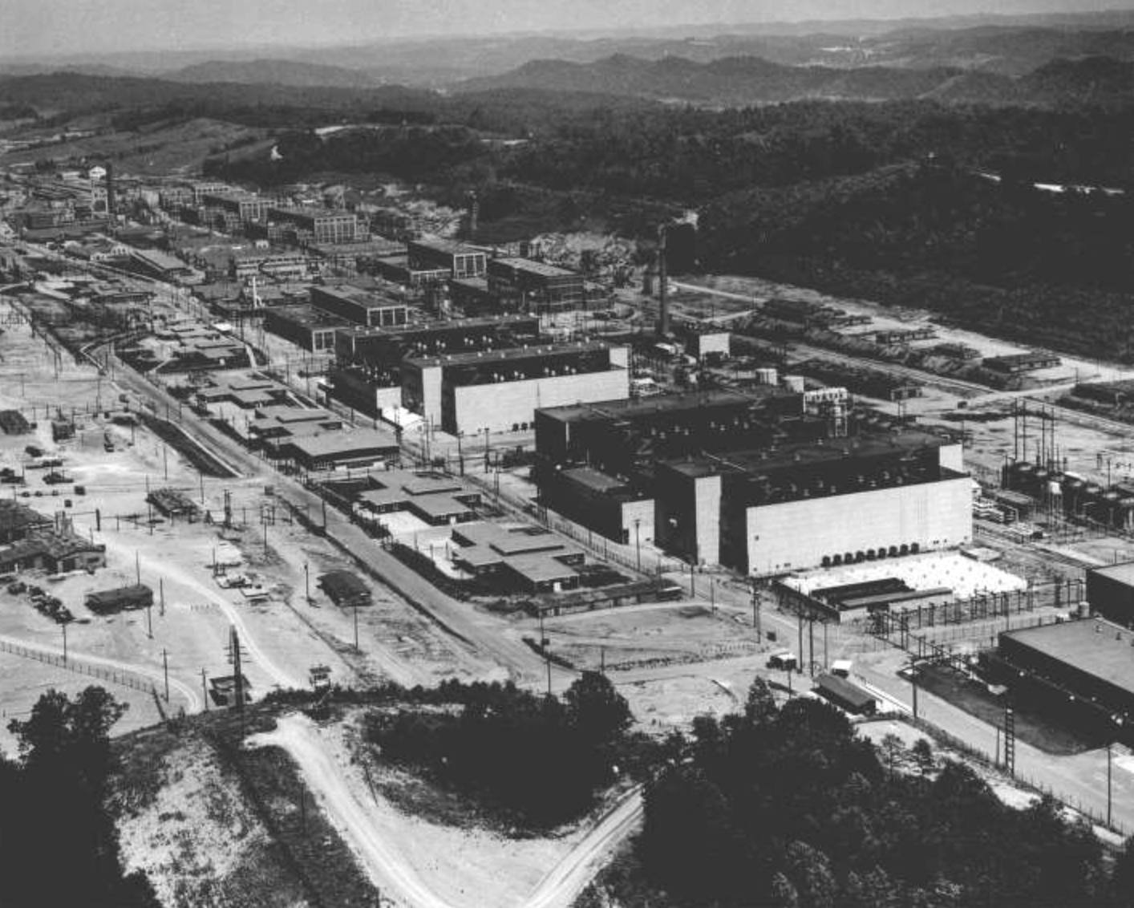
Located in what had been the backwoods of Oak Ridge Tennessee:
Where, after being converted into UF6, natural Uranium (99.3% ²³⁸U + 0.7% ²³⁵U)
was sent through these three plants, very, very gradually filtering out ²³⁸U in favor of the ²³⁵U
0.7% ²³⁵U → 0.9% ²³⁵U
Liquid Diffusion "S-50" Plant
0.9% ²³⁵U → 23% ²³⁵U
Gaseous Diffusion "K-25" Plant
23% ²³⁵U → 80-90% ²³⁵U
Electromagnetic "Y-12" Plant
Designed to house 1600 liquid thermal diffusion columns connected in progressive purification stages
Housing 2892 gaseous diffusion tanks connected in progressive purification stages, inside of what was then the world's largest building: Four stories tall, half mile long, 42.6 acre footprint
With 11 electromagnetic "racetracks" through which only ²³⁵U could readily pass, organized into two progressive purification stages
https://en.wikipedia.org/wiki/S-50_(Manhattan_Project)
https://en.wikipedia.org/wiki/Y-12_National_Security_Complex
https://en.wikipedia.org/wiki/K-25
https://ahf.nuclearmuseum.org/ranger/tour-stop/s-50-plant/
https://teva.contentdm.oclc.org/digital/collection/p15138coll18/id/305/
Plus references given on the preceding slide

Slide 35
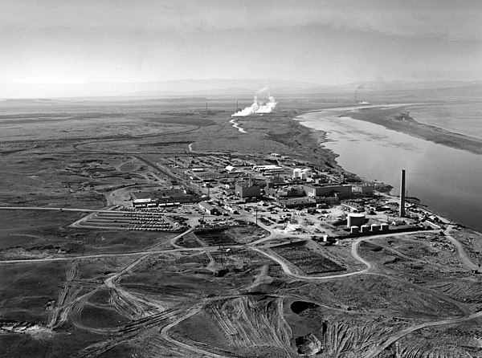
As compared to the Plutonium required for the other WWII Nuclear Bomb:
Which was instead a direct product of ²³⁸U fission decay within a nuclear reactor:
238U + 1n (hot/fast) => 239U => 239Np + β => 239Pu + β
Then easily separated from co-products because different numbers of electrons
meant that those co-products chemically bonded to different things
(Remembering that while ²³⁹U, ²³⁹Np and ²³⁹Pu share an atomic mass of 239
their electron counts = proton counts = atomic numbers are 92, 93 and 94)
The Manhattan Project hid its reactor in the badlands of Eastern Washington State
within what was later named the "Hanford Nuclear Reservation" ¹
now better known as the Hanford Superfund Nuclear Waste Cleanup site ²
U.S. Government Accountability Office - 2022: ³
"One of the largest and most expensive environmental cleanup projects in the world"
"estimated that completing cleanup of the entire site (will) cost between $300 billion and $640 billion ⁴ and take decades"
1) https://en.wikipedia.org/wiki/Hanford_Site
2) https://www.hanford.gov/page.cfm/AboutHanfordCleanup
3) https://www.gao.gov/assets/730/722024.pdf
4) Equaling 10-20 times the entire WWII cost of the Manhattan Project ⁵

Slide 36
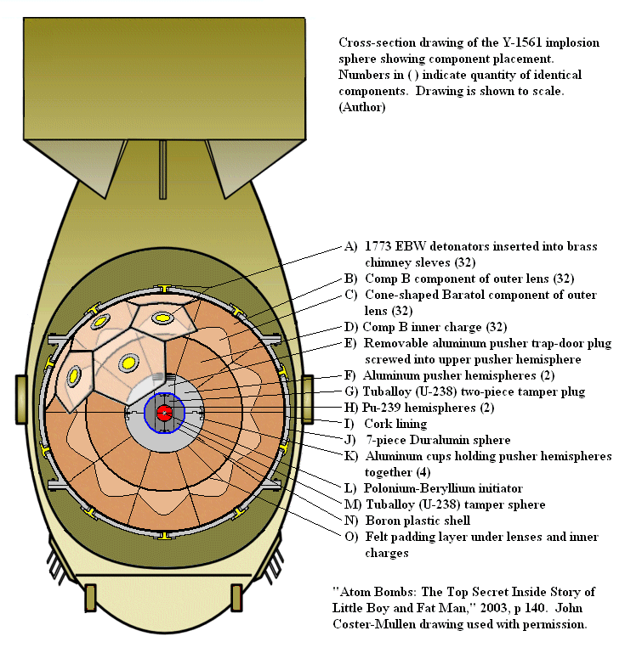
They had PLANNED to use that plutonium in the same Little Boy design
But they discovered that the plutonium fission reaction started up so much faster that
Pu would have begun blowing apart well BEFORE the canon
could fully merge the Pu tube and Pu cylinder, thereby producing a FIZZLE
So they were compelled to develop the much more complex "Fat Man" design:
A spherical shell of explosives surrounding a spherical shell of Pu designed to
compress the Pu shell into a prompt supercritical sphere in < 1 micro-Sec ¹
THIS is what they tested at Alamogordo NM . . . and then dropped on Nagasaki
"Shaped" conventional explosive shell
Smaller embedded Plutonium shell
Final prompt supercritical sphere (---)
← http://en.wikipedia.org/wiki/Fat_Man
1) Virtually all sources note that higher speed is needed for Pu vs. U, but I found no source actually giving comparative times

Slide 37
Bomb vs. Reactor comparison up to this point:
Uranium Bombs:
Are fueled by 80-100% ²³⁵U + 20-0% ²³⁸U
Before triggering, that fuel is separated and/or distributed such that it remains sub-critical
Triggered chemical explosives then compress that fuel into a prompt super-critical condition
Rapidly growing fission reactions then produce heat working to counter that compression
But if the compression is forceful enough and fast enough (completed in ~ 1 microsecond)
virtually all of the fuel fissions before super-criticality is lost due to re-expansion
Reactors:
Are fueled by 0.7-5% ²³⁵U + 99.3-85% ²³⁸U
The Uranium fuel mass alone (even if lumped together via accidental meltdown) is sub-critical
But inside an operating reactor, a sustained critical reaction is induced by the addition of:
Neutron Moderation generally (in the West) via cooling / heat-transferring water
Balanced by Neutron Poisoning from within movable control rods
Understanding a reactor's induced sub-critical → critical transition calls for a deeper look into:

Slide 38
The Science & Technology of Nuclear (Fission) ¹ Reactors:
1) The "Fission" clarifier is actually unnecessary because, after almost three-quarters of a century of
intense and lavishly funded research, not a single practical Nuclear "Fusion" Reactor has yet been built ²
2) For further discussion of Fusion Reactors see my note set: Exotic Power Technologies (pptx / pdf / key)

Slide 39
Think of it this way: A Reactor = Sub-Critical Mass + an Accelerator + a Brake
The Accelerator is the neutron moderator (light / common water in most reactors)
The Brake is neutron poison (absorbers) contained within movable "control rods"
The GOAL is to balance those competing effects to such that:
Exactly one neutron ejected by first ²³⁵U is then absorbed by a second ²³⁵U
Which then decays (and so on an so on) => Constant energy release
That balancing act is aided by an important characteristic of neutron emission:
Very few neutrons (~0.65%) are "prompt" = Released extremely quickly
Most neutrons instead take milliseconds to several seconds to emerge
Which means that the reaction can only build over seconds to minutes
Giving "control rods" much more time to move (and thereby control)
(Plus in many reactors, an additional intrinsic control mechanism - to be discussed shortly)

Slide 40
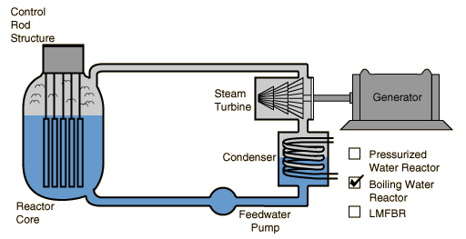
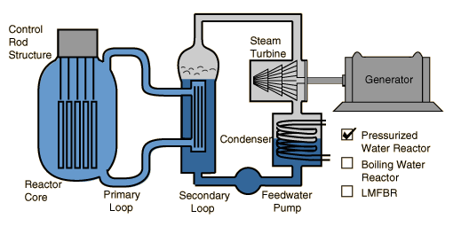
Light Water (normal water) Reactors come in two types:
Boiling Water Reactors (BWRs): Pressurized Water Reactors (PWRs):
Both use uranium enriched to 4-5% ²³⁵U
Both use normal water to moderate some of the neutrons released by ²³⁵U fission
Both use neutrons (moderated & unmoderated) to stimulate further ²³⁵U + ²³⁸U fission
Both use fission heat to produce steam to spin turbines driving electrical generators
But they use different schemes to transfer that water-borne heat to produce that steam
Leading to their use of different control mechanisms & safety containment structures
Figures: http://hyperphysics.phy-astr.gsu.edu/hbase/nucene/reactor.html

Slide 41
Details of Boiling Water Reactors (BWRs):
Which exploit both a mechanical AND a subtle intrinsic control mechanism:
Control Rod
Control Rod
Reactor
Core
Fuel Rod
Fuel Rod
Fuel Rod
Fixed-in-place Fuel Rods are immersed in the partially water-filled reactor core
These are extremely heat-resistant zirconium tubes (1-2 cm dia. / 3-4 m long)
containing tall stacks of cylindrical 4-5% ²³⁵U + ²³⁸U fuel pellets
Interleaved with similar but movable Control Rods filled with neutron poisons
Which can be lowered to increasingly obstruct neutron paths between Fuel Rods,
absorbing more neutrons and thereby "braking" the fission reactions
While surrounding water provides moderation "accelerating" the fission reactions
As fission heat drives that boiling water's expansion into turbine-spinning steam

Slide 42
After driving the turbine, the steam is cooled, condensed & returned to the reactor
But what if water is somehow lost (and not replaced by automatic systems)?
This is where a subtle intrinsic BWR control mechanism can come into play
Use of enriched 4-5% ²³⁵U adds more neutrons, countering water's mild poisoning of them
Water's strong effect is then moderating hot neutrons so that they split more ²³⁵U atoms
To start the reactor, its neutron-poisoning Control Rods are gradually withdrawn,
a fission chain reaction begins and the reactor core & surrounding water begin to heat,
until the water is hot enough that steam begins to bubble up out of it which is
then piped to the turbine-generator beginning production of electrical power
For MORE power, Control Rods are withdrawn further, the rate of Uranium fission increases,
the water boils more vigorously, the additional steam spins the turbine-generator faster
However: Because steam bubbles contain ~ 2000X less water/volume than liquid water,
there are fewer water molecules between the Fuel Rods, cutting neutron moderation
making it harder and harder to increase heat-producing fission within the reactor
Which SHOULD make an out-of-control BWR core meltdown much less likely

Slide 43
But there is an offsetting potential problem with Boiling Water Reactors:
The turbine-generators are located OUTSIDE the reactor safety containment structure
because they are complex machines requiring ongoing attention & maintenance
Meaning water from the very core of the nuclear reactor
    must continuously cycle in & out of the safety containment structure
Fortunately, pure water (¹H2 ¹⁶O) cannot become strongly / persistently radioactive:
Neutron-induced ²H (D) is stable while ³H is only very weakly radioactive
Neutron-induced heavier oxygen isotopes (e.g. ¹⁷O & ¹⁸O) are stable
An Introduction to Sustainable Energy Systems: WeCanFigureThisOut.org/ENERGY/Energy_home.htm

Slide 44
The alternative of Pressurized Water Reactors (PWRs):
Partially inspired by concerns about BWR reactor core water exiting its containment:
Because if that water picked up impurities, THEY could become strongly radioactive
Or if the reactor Fuel Rods leaked, that water would transport massive radioactivity
So instead of the BWR's one water loop, in a PWR there are two water-cooling loops:
A highly-pressurized & superheated Primary Water Loop enters the reactor's core
Outside the core - but still within the containment structure - heat is transferred to
A Secondary Water Loop which exits the containment to drive the turbine-generator
http://hyperphysics.phy-astr.gsu.edu/hbase/nucene/reactor.html

Slide 45
Subtleties of Pressurized Water Reactors (PWRs):
The Primary Loop's job is maximizing heat delivered to the Secondary Loop
In a PWR, that Primary Loop is therefore highly pressurized which allows its water to:
1) Be heated far above it's normal 100°C boiling temperature - carrying more heat
2) But still remain a dense liquid (rather than a dilute vapor) - carrying more heat
Both of which can enhance the overall "thermal efficiency" of PWRs, possibly yielding
more generated electrical power per Uranium fuel input & nuclear waste output
But the water in the PWR's Primary Loop is ALSO its NEUTRON MODERATOR
Under pressurization, THAT liquid water cannot significantly expand or vaporize
So the degree of neutron moderation (which accelerates ²³⁵U fission)
will not automatically decrease as the reactor core heats up
So Pressurized Water Reactors (PWRs) lack the intrinsic negative feedback mechanism
that enhances the stability of competing Boiling Water Reactors (BWRs)

Slide 46
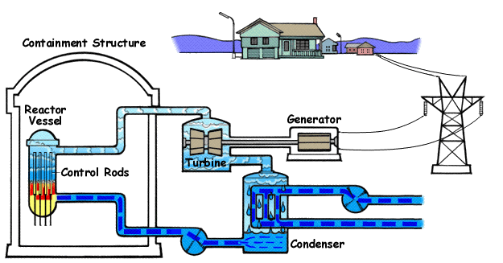
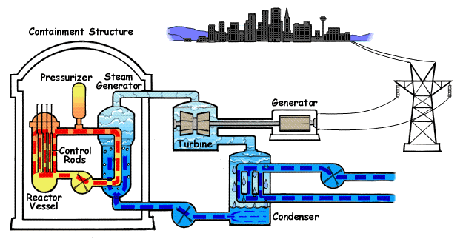
Comparisons focusing on water's temperature, flow, liquid vs. steam state:
Boiling Water Reactor:
www.nrc.gov/reading-rm/basic-ref/students/animated-bwr.html
Pressurized Water Reactor:
www.nrc.gov/reading-rm/basic-ref/students/animated-pwr.html
(These animations play within Powerpoint & Keynote)

Slide 47
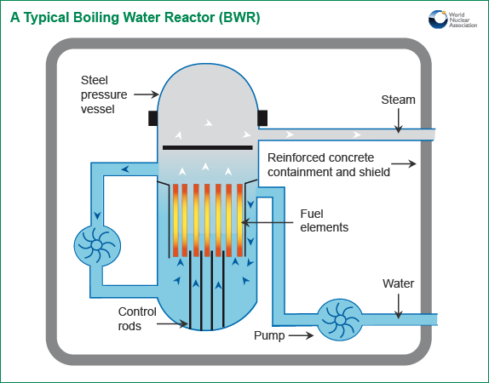
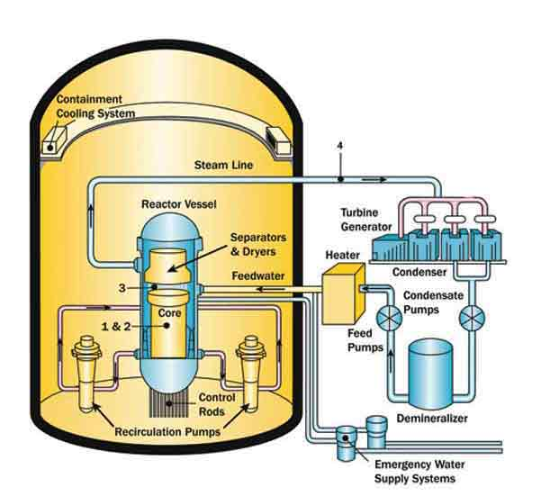
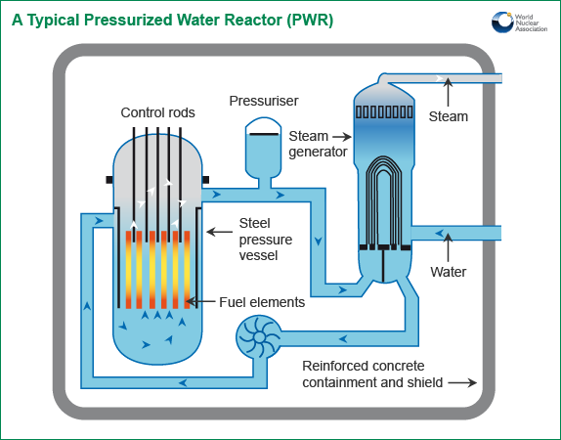
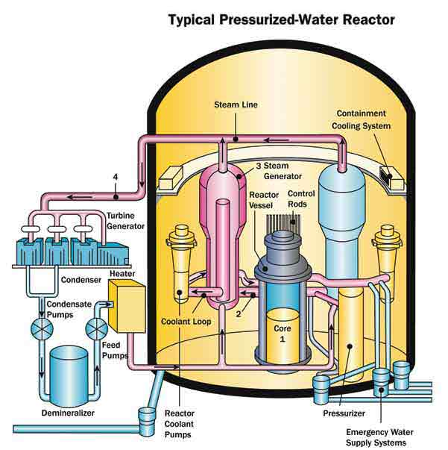
Comparisons focusing on details - but weak on big picture (such as containment)
Boiling Water Reactor:
www.world-nuclear.org/info/Nuclear-Fuel-Cycle/Power-Reactors/Nuclear-Power-Reactors/
www.nrc.gov/reactors/bwrs.html
Pressurized Water Reactor:
www.world-nuclear.org/info/Nuclear-Fuel-Cycle/Power-Reactors/Nuclear-Power-Reactors/
www.nrc.gov/reactors/pwrs.html

Slide 48
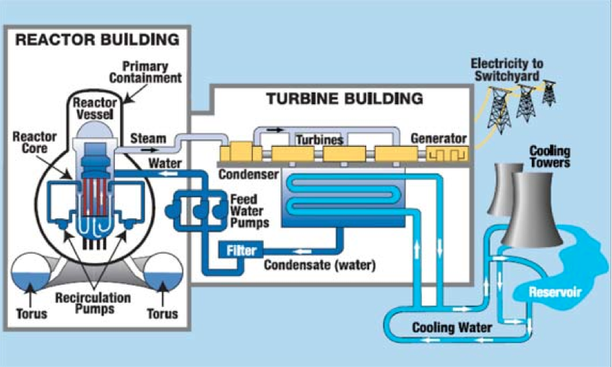
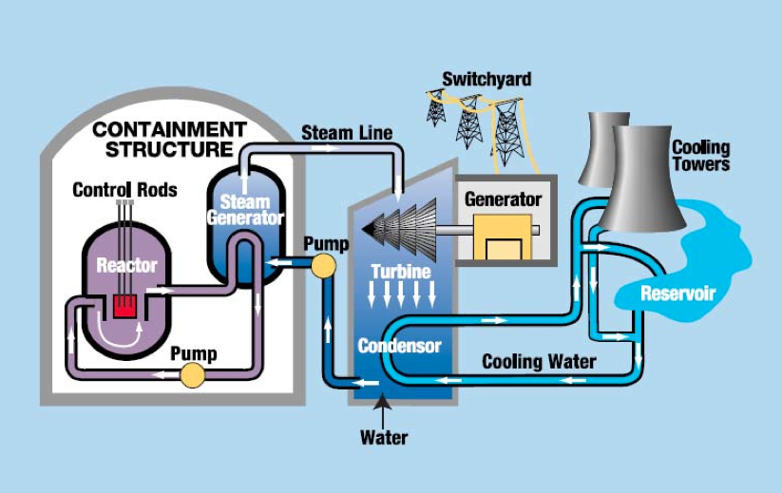
Finally, more accurate depictions of containment strategies & structures:
Boiling Water Reactor:
Strong reactor vessel containment
Weak reactor building containment
(often conventional flat walls & roofs)
No turbine building containment
Pressurized Water Reactor:
Weak reactor vessel containment
Strong reactor building containment of
reactor vessel & steam generator
(steel-reinforced concrete domes)
No turbine building containment
Source: CRS Report to Congress – "Power Plants: Characteristics and Costs" (November 13, 2008) - Order Code RL34746
https://fas.org/sgp/crs/misc/RL34746.pdf

Slide 49
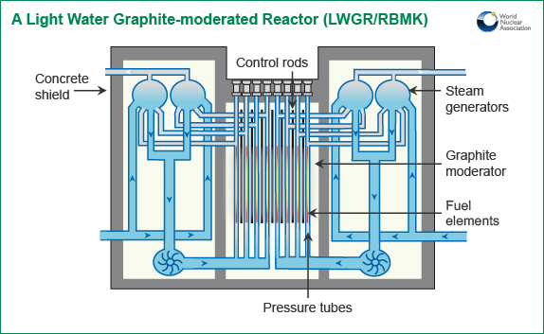
But we also need to consider one other (non-Western) type of reactor:
The RBMK (Reaktor Bolshoy Moshchnosti Kanalnyy) reactor – as used at Chernobyl
http://www.world-nuclear.org/info/Nuclear-Fuel-Cycle/Power-Reactors/Appendices/RBMK-Reactors/

Slide 50
RBMK Reactors
RBMKs use partially pressurized cooling water, that is allowed to boil
Putting them somewhere between the previous BWR and PWR designs
But they use water ONLY for heat transfer and NOT for neutron moderation
Instead, fuel rods rest in oversized metal-lined holes in blocks of Graphite
With thin layers of cooling water flowing between rods and liners
Plus gas flow for heat transfer between liner and block / block to block
The graphite (alone) produces near complete neutron moderation
Graphite blocks with holes/liners
for fuel rods and control rods
Fuel rods containing uranium
Control rods containing neutron poison

Slide 51
Unique design goals & characteristics of RMBK reactors:
Design goals were to:
- Use much cheaper un-enriched natural uranium: 0.7% ²³⁵U + 99.3% ²³⁸U
- Produce BOTH electrical power PLUS plutonium for weapons
- Build unusually large high power reactors, at unusually low costs
Which was accomplished via:
- Complex heat transfer scheme combining thin layers of water + inert gas flows
- Constant, heavy, neutron moderation provided by (flammable) graphite blocks
With neutrons already moderated, water's moderation becomes unimportant!
- WITHOUT heavily reinforced reactor containment vessel / containment building
As used in western reactors including both BWR and PWR designs above

Slide 52
The Three Major Nuclear Reactor Accidents:

Slide 53
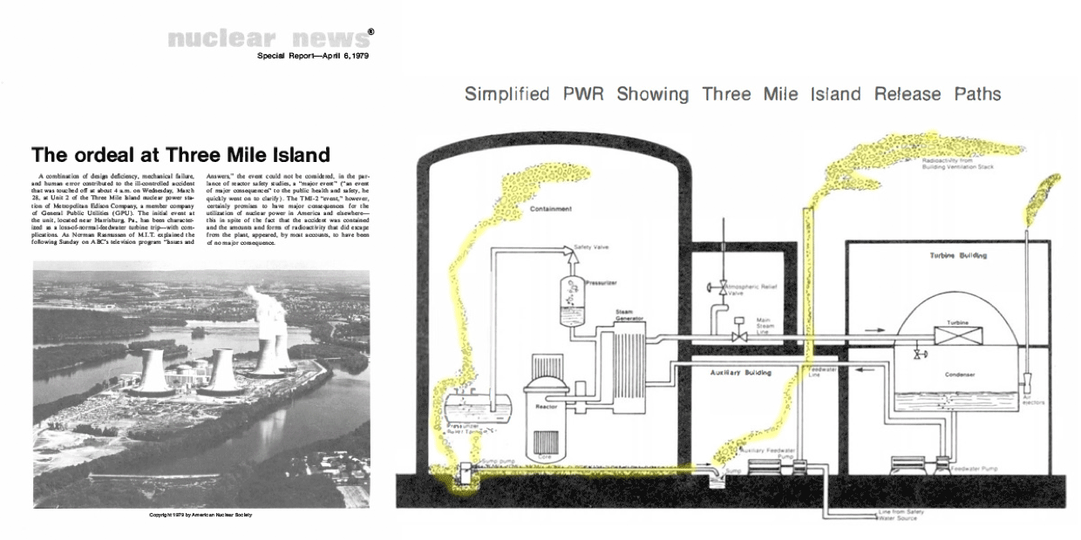
Yellow highlighting of Radiation Release Paths added
The Three Mile Island Accident
Eastern Pennsylvania - 28 March 1979
Babcock & Wilcox Pressurized Water Reactor #2 (one of two on site)
Figure from the "Nuclear Newswire" - American Nuclear Society Reports, 1979 & 2022:
1) https://www.ans.org/file/6411/TMI%20Report%20Featured%20Image.jpg
2) https://www.ans.org/news/article-3916/the-three-mile-island-special-report/

Slide 54
Drawing from Presidential, Nuclear Regulatory Commission & Press Reports: ¹⁻³
Initial fault was in the secondary water cooling loop (outside the containment):
A filter clogged, operators tried to clean it by injecting compressed air
The resulting over-pressurized water leaked into a pneumatic control line
Hours later the compromised pneumatic line caused secondary loop pumps to trip off
→ Secondary loop could no longer remove heat from the reactor core's primary loop
Primary cooling loop then overheated, initiating automatic "SCRAM" shutdown
Ramming control rods fully downward to quench ²³⁵U fission in the reactor's core
But there was already a HUGE amount of latent heat within the reactor core
Plus heat still being generated by the continued breakdown of ²³⁵U fission products:
1) https://www.osti.gov/biblio/6986994
2) https://www.nrc.gov/reading-rm/doc-collections/fact-sheets/3mile-isle.html#tmiview
3) https://www.graphicnews.com/en/pages/38900/us-40th-anniversary-of-the-three-mile-island-accident

Slide 55
With the SCRAM, three emergency pumps automatically turned on to cool the core
But two were blocked by manual shutoff valves left closed after earlier maintenance
Thereby dramatically diminishing the emergency cooling system's effectiveness
The Primary loop heated to point its pressure relief valve (PORV) was energized to open
When excess pressure was vented, that valve should have then closed
Stopping further loss of water from that primary cooling loop
But the pressure relief valve instead stuck open continuing its release of cooling water
As PORV's had stuck open nine previous times on Babcock + Wilcox reactors ¹
But dark control room light indicated that power to open the valve had been removed
And there was no light indicating whether or not valve HAD actually closed
Operators misinterpreted dark "open" light as indicating PORV valve closure:
Undetected stuck-open valve continued water release from primary cooling loop
Which operators did not notice because the reactor had been designed & built with
no direct way of measuring the cooling water level around the reactor core (!) ¹
1) Report of the President's Commission on the Accident at Three Mile Island - page 11: https://www.osti.gov/biblio/6986994

Slide 56
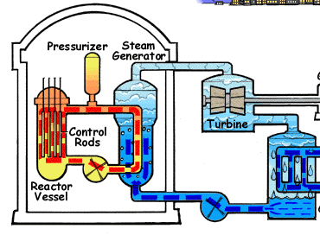
Secondary Cooling Loop:
Shut down by filter-cleaning
But instruments DID suggest water was in the Pressurizer ABOVE the reactor
So operators assumed that the reactor below it must still be fully immersed in water
Then, because of pump vibrations, and fearing pressurizer would overfill (and fail):
Operators shut down automatic pumps trying to add water to the primary loop
In fact, the water level had already fallen below the top of the reactor's core,
falling ever lower as steam continued to exit via the stuck-open valve
The water pumps had vibrated because they'd been trying to pump steam!
Pressure Relief Valve (PORV):
Stuck open / venting steam
Primary Cooling Loop:
Steam replacing water
Water-Adding Pumps:
Blocked or disabled by operators
Water Circulation Pumps:
Vibrating / pumping steam

Slide 57
Confusion reigned for four hours during which:
About half of the reactor's core melted down releasing uranium inside the containment
As in "The China Syndrome" movie which coincidentally debuted the very same week
The superheated Zr metal of the fuel rod tubes began catalyzing steam's decomposition:
2 H2O + hot Zr → 2 H2 + O2
Filling the containment building with H2 and O2
which eventually found an ignition source and explosively recombined ¹
(luckily) blowing only relatively small holes in the containment's walls,
venting proportionally small amounts of radioactivity to the surroundings
The same mechanism that would produce Fukushima's explosions 32 years later
Which continued until a fresh clearer-headed new shift of operators figured out that:
rather than needing LESS water, the reactor's core desperately needed MORE water,
thereby finally beginning to bring the TMI reactor accident under control
1) Report of the President's Commission on the Accident at Three Mile Island - pages 87, 99 & 107: https://www.osti.gov/biblio/6986994

Slide 58
Partial list of faults and errors:
Equipment failures:
Stuck open primary loop pressure relief valve
Indicator giving only intended state of that valve and not its true state
Lack of dedicated indicator giving water level in core
Control system producing over 100 simultaneous alarms in first minutes of failure
Management / operator / training errors:
Initial procedure for cleaning out secondary cooling loop's clogged filter
Emergency cooling system manual valves left closed after earlier maintenance
Misinterpretation of badly designed pressure relief valve indicator
Operator mistrust of automatic safety systems (for cause?), leading to:
Operator misuse & override of water cooling systems, replicating errors that
18 months earlier almost brought down another Babcock & Wilcox reactor:
A previous near disaster about which TMI operators were never informed ¹⁻³
1) Report of the President's Commission on the Accident at Three Mile Island - page 10: https://www.osti.gov/biblio/6986994
1) https://en.wikipedia.org/wiki/Three_Mile_Island_accidentor.htm 2) https://en.wikipedia.org/wiki/Davis-Besse_Nuclear_Power_Station

Slide 59
Quoting directly from the
Report of the President's Commission on the Accident at Three Mile Island: ¹
Excerpt from "Handling of the Emergency" (page 17):
"The response to the emergency was dominated by an atmosphere of almost total confusion. There was lack of communication at all levels. Many key recommendations were made by individuals who were not in possession of accurate information, and those who managed the accident were slow to realize the significance and implications of the events that had taken place."
Excerpt from "Warning" (page 24):
"We have stated that fundamental changes must occur in organizations, procedures, and, above all, in the attitudes of people. No amount of technical "fixes" will cure this underlying problem. There have been many previous recommendations for greater safety for nuclear power plants, which have had limited impact. What we consider crucial is whether the proposed improvements are carried out by the same organizations (unchanged), with the same kinds of practices and the same attitudes that were prevalent prior to the accident. As long as proposed improvements are carried out in a "business as usual" atmosphere, the fundamental changes necessitated by the accident at Three Mile Island cannot be realized."
In light of the above, I must note that in researching modern TMI "information webpages"
posted by BOTH industry associations AND federal agencies
many (if not most) still fail to mention central critical errors,
some omitting even the egregious failure to reopen emergency valves after earlier maintenance.
Suggesting, sadly, that the Commission's final warning has fallen on largely deaf ears
1) Report of the President's Commission on the Accident at Three Mile Island: https://www.osti.gov/biblio/6986994

Slide 60
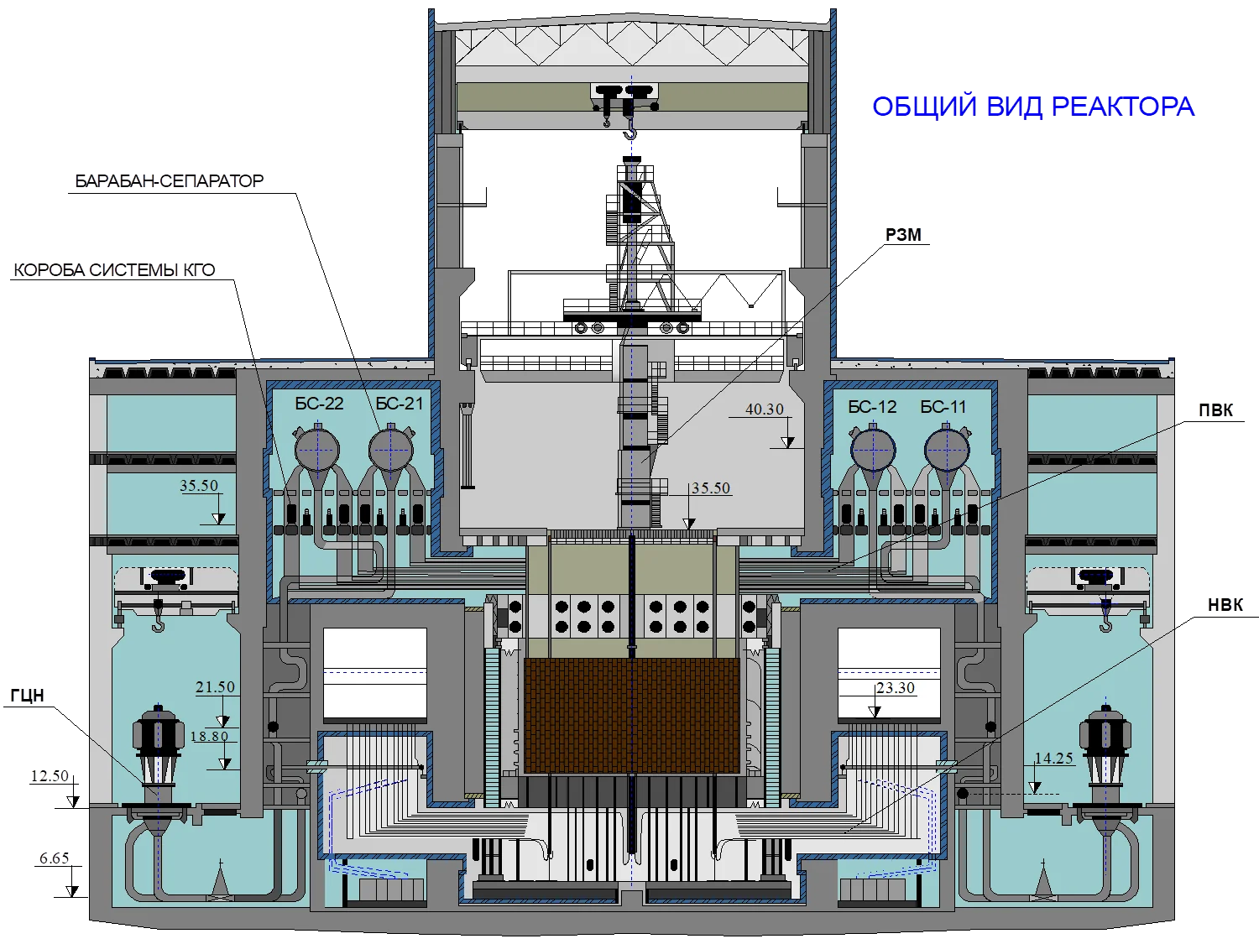
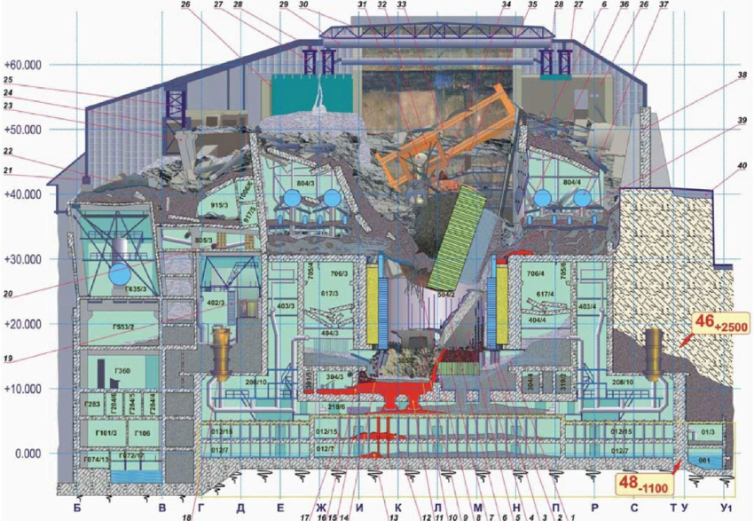
        Before:
The Chernobyl Accident
Ukraine (then Soviet Union) - 26 April 1986
RBMK Reactor #4 (one of four on site)
        After:
        As now entombed inside a massive "sarcophagus"
https://www.researchgate.net/publication/353120989_Preliminary_results_on_dry_Cutting_FOR_Segmentation_of_non-homogeneous_FCM_at_ChNPP_Unit_4_with_advanced_laser-technologies
https://hotcore.info/babki/chernobyl-nuclear-reactor.htm

Slide 61
Unlike almost all Western Nuclear Power Plants . . .
Chernobyl's RBMK reactors use masses of Graphite as a Neutron Moderator
This solid does not expand and then boil away as temperature increases
Thus, as reactor power increases, its neutron moderation does not diminish
vs. moderating water whose loss would have dampened fission
Graphite cores produce strong, continuous, neutron moderation:
Initially hot neutrons with extremely high kinetic energy
undergo many, many collisions with cooler graphite (carbon) atoms
leading to neutron kinetic energy approaching that of the ambient atoms
So from then on, these cooled neutrons are almost as likely
to gain energy from atomic collisions as lose energy from atomic collisions
An Introduction to Sustainable Energy Systems: WeCanFigureThisOut.org/ENERGY/Energy_home.htm

Slide 62
Leading to Chernobyl's 1st positive feedback loop:
Water no longer moderated these already slowed down neutrons
However, water did still absorb neutrons, slowing nuclear fission reactions
But then, when the reactor began to overheat and its water started to boil:
There was less water per volume →
There was less neutron absorption per volume →
Leaving more neutrons to accelerate nuclear fission
This acceleration of fission, upon creation of steam bubbles, is called a:
Positive void coefficient ¹⁻³
“Positive” in the sense that it provides positive feedback, stoking the fission reaction
So when Chernobyl started to overheat, this further accelerated the heating
1) https://en.wikipedia.org/wiki/Void_coefficient 2) https://en.wikipedia.org/wiki/RBMK 3) https://en.wikipedia.org/wiki/Chernobyl

Slide 63
Chernobyl’s 2nd positive feedback loop: Its strange control rods
Neutron absorber
Displacer
Water
Reactor core
A control rod's job is to slow nuclear fission when it's pushed into the reactor core
  But before a control rod enters the reactor core, its hole is filled with water
  Which (per discussion above) already absorbs some neutrons
Designers wanted strongest possible drop in neutrons when the absorber entered
So they decided to kill off the initial absorption of the neutrons in water,
  by first pushing out water, via a unique Displacer extension of the control rod
But that meant as a control rod entered reactor, neutron population changed as:
Medium (due to water) → High (no loss in displacer) → Low (due to absorber)
In the middle (with only displacer inserted) nuclear fission instead accelerated
Accelerating even more because displacer was made of neutron moderating graphite

Slide 64
Chernobyl’s 3rd and 4th positive feedback loops: Involving Neutron "poisons"
I described earlier how things like Xenon, Boron & Iodine act as neutron poisons
Absorbing but not re-emitting any neutrons (taking them out of play)
But fission chain reactions themselves produce poisons within the fuel mass
Meaning Control Rods must be gradually withdrawn to maintain reactor power
But more subtly (and potentially deadly):
At HIGH reactor power strong neutron flux can make Control Rod poisons radioactive
Causing them to fission away into new non-poison elements
Diminishing the effectiveness of the Control Rods
→ Positive feedback loop driving the reactor power output even higher
At LOW reactor power neutron poisons tend to build back up (per first point above)
Which drives nuclear fission rate down even further
→ Positive feedback loop driving the reactor power output even lower

Slide 65
Before the accident, the Chernobyl Reactor had been running at low power
Meaning the fourth positive feedback loop had been in effect for a long period
leading to a higher than normal net amount of neutron poison within the reactor
As the operators now wanted to bring the reactor back to full power
they knew they would have to withdrawal control rods farther than normal
or withdraw more fuel rods than they would normally withdraw
But as the reactor heated up, accumulated poisons would begin to burn off (fission away)
meaning operators would have to drive control rods back to their normal operating depth
or increase the number of fully inserted control rods back to the normal number
This normal, carefully balancing Chernobyl reactor start-up procedure was spelled out
As similar careful start-up procedures are spelled out for reactors around the world
because they ALL suffer from this same poison build-up / burn-off phenomenon
But late at night, doing a much delayed test, in the absence of senior reactor staff,
these particular Chernobyl operators were in a hurry
and they withdrew many more than the recommended number of control rods

Slide 66
Four positive feedback loops → Instability → Sudden intense spike in fission
And, due to their abnormal procedures, they’d left themselves no margin for error
Likely leading to ("likely" because witnesses were dead and the damage overwhelming):
- A Massive Steam explosion blowing the lid right off the top of the reactor
- Which immediately exposed the super-hot reactor core to air (and its O2)
because RBMK's were built without western-style containment buildings
- Allowing air (w/ its oxygen) to reach the super hot graphite moderator blocks
- Causing those graphite blocks to near instantaneously burst into flame
- Producing the strong smoke plumes and thermal updrafts which, in short order,
distributed radioactive debris & dust all across eastern Europe
Extraordinarily bad reactor design OR extraordinary human error?
I'd argue "both" - which I invite you to personally research ¹⁻³
But given RMBK's limited Western use, I'm instead going to move onward to . . .
1) https://en.wikipedia.org/wiki/RBMK 2) https://en.wikipedia.org/wiki/Chernobyl
3) Or my highly recommended long read: Adam Higginbotham's book Midnight in Chernobyl (ISBN 978-1-5011-3461-6)

Slide 67
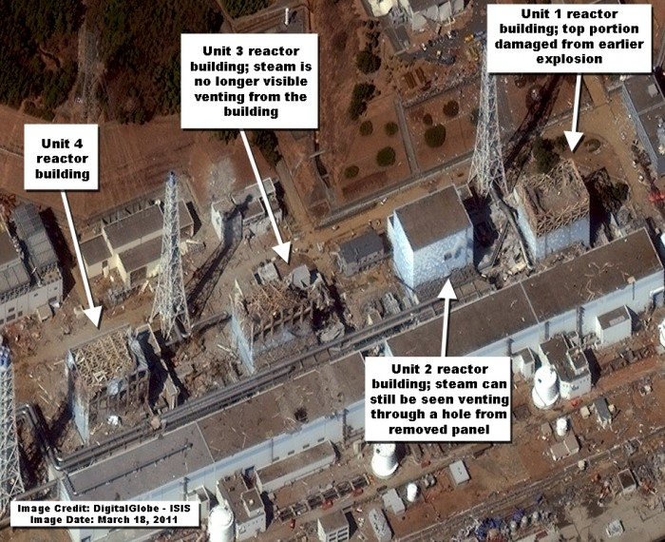
The Fukushima Daiichi Accident
Fukushima, Japan - 11 March 2011
General Electric Boiling Water Reactors #1 - #4
Figure: Institute for Science and International Security report (only one week after accident) ¹
1) https://isis-online.org/isis-reports/detail/new-march-18-satellite-image-of-fukushima-daiichi-nuclear-site-in-japan/37

Slide 68
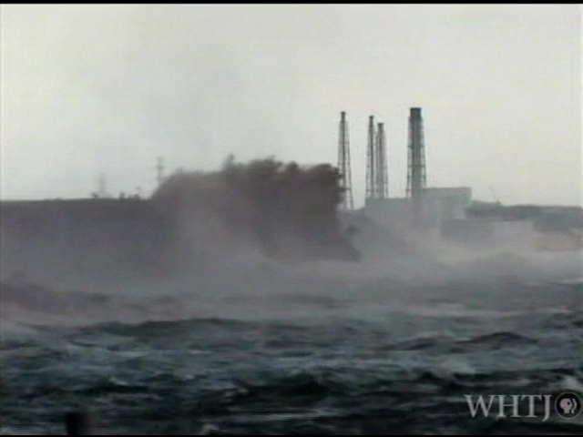
Tōhoku Earthquake and Tsunami ¹
14:46 PM: Richter 9.1 earthquake occurs ~ 70 km east of the Fukushima shore
Local electric power grid crashes due to earthquake damage
But earthquake sensors automatically initiate shutdown of reactors
Activating reactor-site diesel backup generators which:
Power SCRAM insertion of control rods to quench ²³⁵U fission
Energize emergency water cooling pumps
15:36 PM: Tsunami waves flood reactor sites
Shutting down diesel backup generators
Halting emergency shutdown procedures
Eliminating power to control room instruments
Leaving plant operators literally in the dark
1) https://en.wikipedia.org/wiki/2011_Tōhoku_earthquake_and_tsunami
Video: Excerpt from PBS Nova's "Nuclear Meltdown Disaster" (2015)
(This video plays within Powerpoint & Keynote)

Slide 69
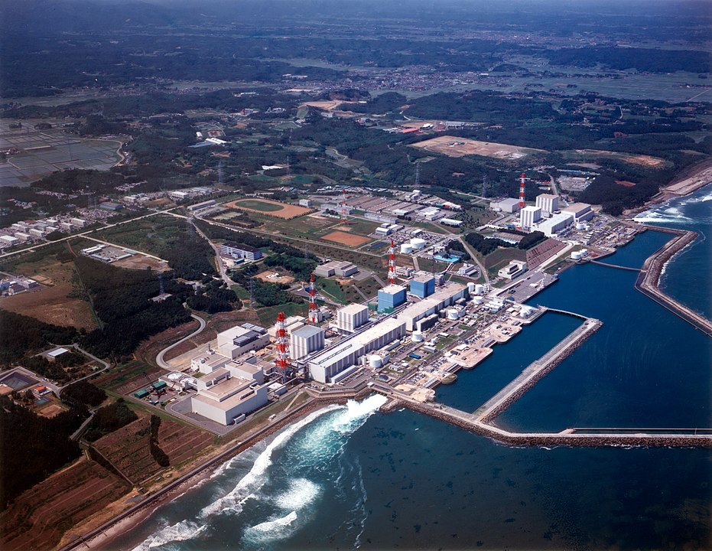
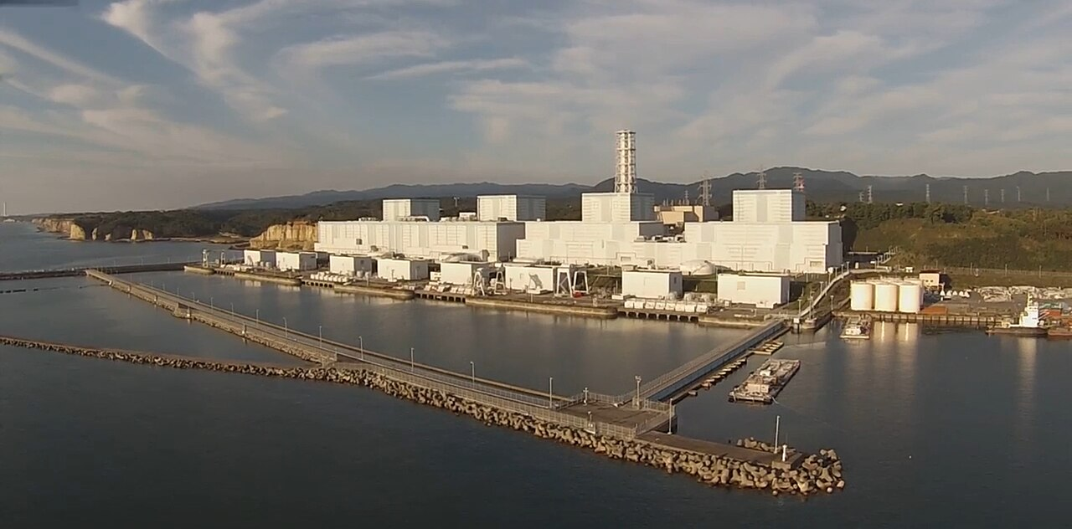
Fukushima's TWO Reactor Complexes:
Fukushima Daiichi (Fukushima #1):
Six 1967 vintage General Electric BWR's, ~ 225 km northeast of Tokyo ¹
Three operating when 11 March 2011 tsunami struck, precipitating their destruction
Fukushima Daini (Fukushima #2) located 12 km to the south:
Four 1982 vintage reactors of same basic design, all four in operation that day ²
But here, heroic and often inspired operator action prevented reactor destruction ³
1) https://en.wikipedia.org/wiki/Fukushima_Daiichi_Nuclear_Power_Plant
2) https://en.wikipedia.org/wiki/Fukushima_Daini_Nuclear_Power_Plant 3) Upon which I will elaborate below

Slide 70
I found reams of information about the Fukushima accident
With much more detail & consensus than I found for the TMI & Chernobyl accidents
But in the end, it wasn't all necessary, because this accident was easy to figure out:
It wasn't due to unpredictable equipment breakdowns
It wasn't due to lack of operator training or operator errors
It was instead due to design shortcomings and compromises
that were well known and had been recognized for decades,
but which were accepted based on the cost reductions they facilitated
Accepted by reactor's owners: Tokyo Electric Power Company (TEPCO)
Accepted by the reactors' designers & builders: GE / Toshiba / Hitachi
And accepted by the responsible Japanese Government Regulators
An Introduction to Sustainable Energy Systems: WeCanFigureThisOut.org/ENERGY/Energy_home.htm

Slide 71
Fukushima design shortcoming #1 (shared by all reactors):
As discussed earlier: Turning off a reactor doesn't really turn it off
A reactor is "turned off" by inserting control rods containing Neutron poisons
absorbing so many neutrons that fission of ²³⁵U (but only ²³⁵U) is abruptly curtailed
But a rich population of previously created ²³⁵U fission products continue fissioning,
releasing large amounts of heat, for additional seconds, minutes or hours,
adding to the heat that had already built up within the then operating reactor!
The Reactor Core itself may be able to withstand the resulting temperatures
because it's built with expensive & exotic high temperature materials, possibly including:
Melting Points (ºC): Titanium 1670 Zirconium 1854 Tantalum 2950 Tungsten 3400
But the reactor shell and piping can be substantially less temperature resistant:
Melting Points (ºC): Irons 1127-1204 Carbon Steels 1371-1593 Stainless Steel 1510
Metal melting point data from: https://fractory.com/melting-point-of-metals-chart/

Slide 72
The result: AFTER shutdown reactors MUST be cooled for DAYS
Future reactors might be able to do this using only stored water + gravity
For instance, GE's ESBWR design and certain Small Modular Reactor (SMR) designs
But I have yet to learn of a single such passively cooled reactor in actual operation
Today's reactors are instead actively cooled, meaning that upon shutdown
electric pumps must circulate cooling water for the required multiple days
Shutting down a Nuclear Power Reactor thus requires days of Electrical Power
Which can't be supplied by the then shutting-down or already shut-down reactor
And if unavailable from a neighboring still operating reactor
it's imperative that electrical power remain available from SOMEWHERE ELSE
So how did the builders / owners / regulators of Fukushima address this challenge?
For backup shutdown electrical power they added to each reactor installation
banks of batteries AND diesel-powered electrical generators

Slide 73
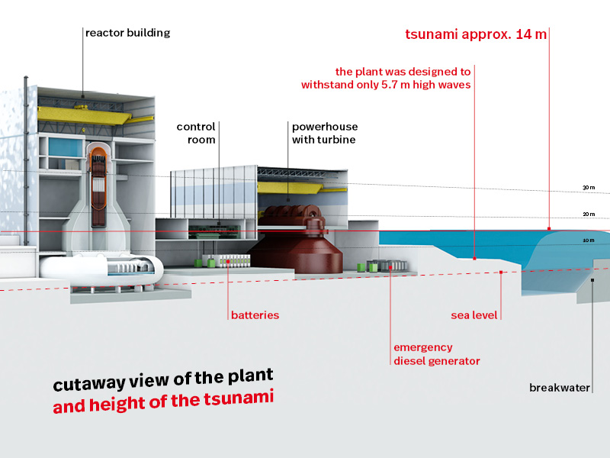
But WHERE were those batteries & diesel electric generators placed?
On the edge of perhaps the world's most seismically active & tsunami prone coast
Indeed, on one of the coasts where "tsunamis" actually got their name!
Where these back-up batteries and diesel electric generators were built into
BASEMENTS . . . AT NORMAL SEA LEVEL (right figure, highlighted by red box)
WHY locate plant, pumps & generators AT sea level (vs. up the adjacent hill)?
Likely only to allow use of cheaper pumps/pipes unable to pump water up/down that hill
Left) https://en.wikipedia.org/wiki/Fukushima_Daiichi_Nuclear_Power_Plant
Right) With title text hidden and emphasizing red box added:
https://www.base.bund.de/EN/ns/accidents/fukushima/fukushima.html

Slide 74
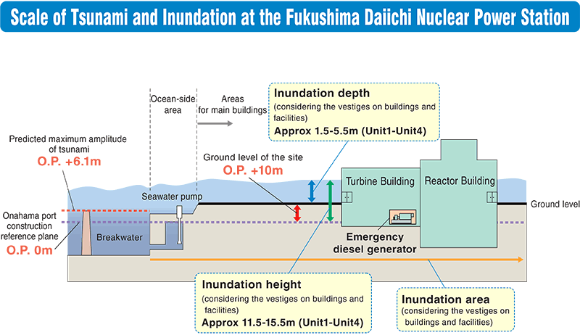
Compounded by Fukushima design shortcoming #2: Inadequate Tsunami protection
From the summary of a later Federation of Electric Power Companies of Japan (FEPC) report: ¹
Interpreting figure's O.P. ("Onahama port construction reference plane") as normal sea level:
- An offshore Tsunami Barrier was built reaching 6.1 meters above O.P.
- Behind which the reactor complex's ground level was 10 meters above O.P.
- But, according to this figure, the emergency diesel generators were actually BELOW O.P.
Meaning they could even have been flooded by everyday groundwater seepage
All mooted by the arrival of a Tsunami extending 15.5 METERS ABOVE above O.P.
1) https://www.fepc.or.jp/english/nuclear/power_generation/overview/

Slide 75
But those shortcomings were actually identified well before the "accident" ¹⁻³
First, while the design's goal was to block tsunami's of 10 METERS height
the actual design incorporated an only 6.5 meter high offshore barrier
apparently just hoping it would slow 10 meter high water enough that it would
not then flood up upon onto the 10 meter high ground around the reactors
But even that optimism-based scenario was undermined by subsequent studies
suggesting that the risk of even larger tsunamis was too high
and that the barrier height should be very significantly increased
TEPCO considered those studies but ultimately decided against higher barriers
Fearing that admission of their design error at Fukushima might lead to calls for
similar barriers, or barrier heightening, at other Japanese nuclear plants
(including at sites where the tsunami threat was less acute)
Instead, SOME of the backup generators were moved up to the top of the hill
But their power lines and circuit breakers were left down in those basements
where they were flooded and knocked out of service when the tsunami hit
1) https://www.base.bund.de/EN/ns/accidents/fukushima/fukushima.html
2) https://eta.lbl.gov/sites/default/files/seminars/fukushima1_technical_perspective_lbl_eedt_04052011-1.pdf
3) https://nap.nationalacademies.org/catalog/18294/lessons-learned-from-the-fukushima-nuclear-accident-for-improving-safety-of-us-nuclear-plants

Slide 76
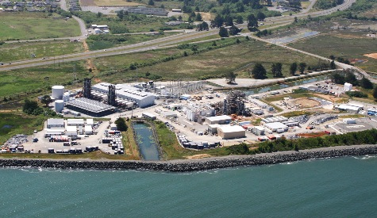
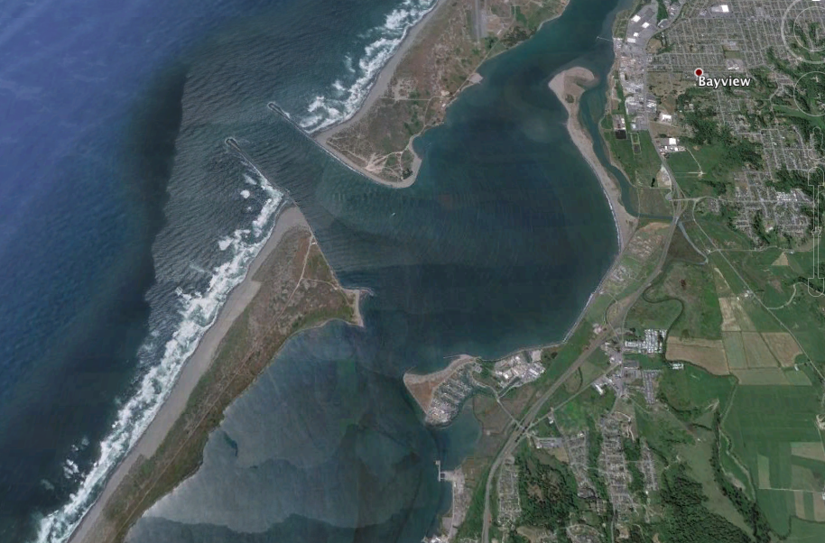
Have we in the U.S. been any smarter, wiser, or less-penny pinching?
Humboldt Bay Nuclear Power Plant (first of three U.S. west coast Nuclear Plants): ¹
1960: Construction begun on the northern California coast,
with the plant was sited on the Pacific Ocean waterfront,
at essentially sea level, but behind a modest piled stone berm
1964: Record-breaking 1964 Alaskan Earthquake triggers tsunami
devastating the nearby Northern California town of Crescent City ²
Subsequent study indicates that city had
"experienced tsunami conditions 31 times between the years 1933 and 2008" ²
1963: Construction of the Nuclear Plant completed and plant commissioned
2004: Plant operator PG&E announces that it has lost three nuclear fuel rods
2020: Plant decommissioned, in part due to discovery of new nearby earthquake faults
Minor natural protection
(Google Earth)
Stone berm
Reactor
1) https://en.wikipedia.org/wiki/Humboldt_Bay_Nuclear_Power_Plant 2) https://en.wikipedia.org/wiki/Crescent_City,_California

Slide 77
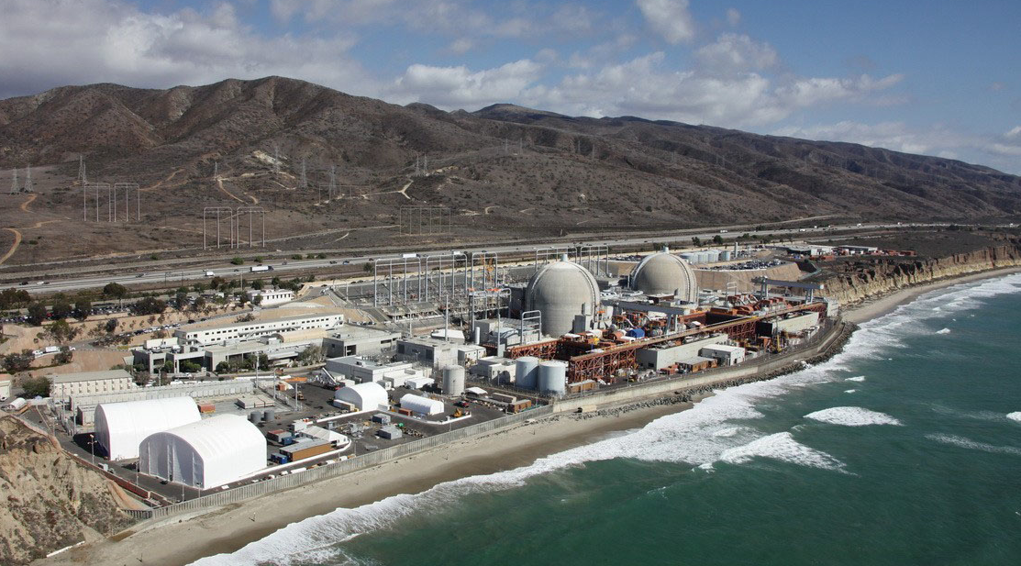
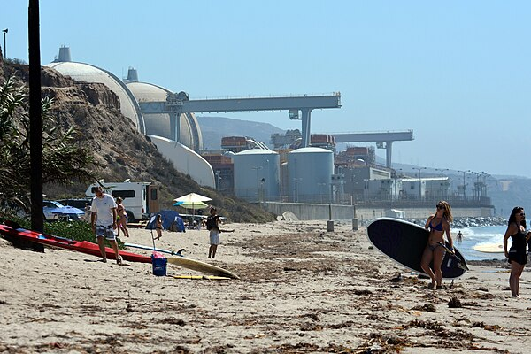
San Onofre Nuclear Power Plant (second of three U.S. west coast Nuclear Plants): ¹
1964: Construction begun on the southern California coast, not far north of San Diego
with plant sandwiched between Interstate Highway 5 and Pacific Ocean waterfront,
immediately south of popular state park & beach (where I vacationed as a child)
Built at essentially sea level, without natural or added artificial tsunami barriers
2012: Both reactors shut down:
"after premature wear was found on more than 3,000 tubes in replacement steam generators that had been installed in 2010 and 2011"
2013: U.S. Senate Environment and Public Works Committee chairman claims plant:
"posed a danger to the eight million people living within 50 miles of the plant"
2013: Plant decommissioned
Left Photo: www.kpbs.org/news/2011/mar/24/san-onofre-operators-welcome-nrc-review/
Right photo and reference 1) https://en.wikipedia.org/wiki/San_Onofre_Nuclear_Generating_Station

Slide 78
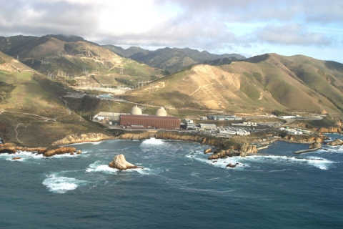
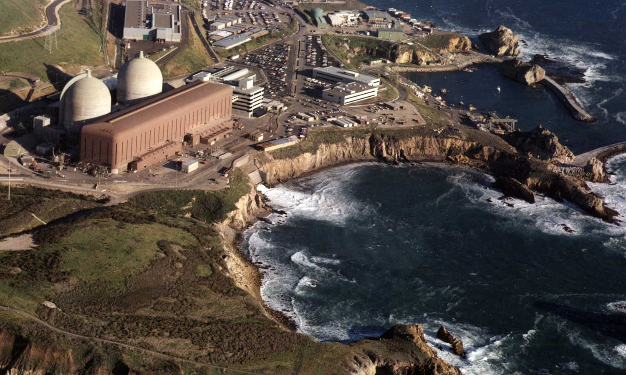
Diablo Canyon Nuclear Power Plant (third of three U.S. west coast Nuclear Plants): ¹
1968: Construction begun on very lightly populated California coast roughly midway
between San Francisco and Los Angelas, atop a 26 meter tall cliff
Later discovered that plant was within 5 km of two previously unknown earthquake faults
But Nuclear Regulatory Commission comparative review of U.S. nuclear power plants
concluded that Diablo Canyon had "a high level of preparedness and strong capability
  in terms of equipment and procedures to respond to severe events"
2021: Among vigorous calls for plant's shutdown, a MIT / Stanford study concluded:
"keeping Diablo Canyon running until 2035 would reduce the state's carbon emissions from electricity generation by 11% every year, save the state a cumulative $2.6 billion . . . and improve the reliability of the grid" ¹
Present Day: That debate continues
Photo: www.ojaipost.com/2011/03/diablo-canyon-nuclear-plant/
Photo: https://wonderfulengineering.com/wp-content/uploads/2021/10/diablo-canyon-exterior-2-2.jpg
1) https://en.wikipedia.org/wiki/Diablo_Canyon_Power_Plant

Slide 79
Returning to Fukushima: where within minutes of the tsunami wave . . .
SEVEN operating Nuclear Reactors (3 at Fukushima Daiichi + 4 at Fukushima Daini)
have SCRAMMED, quenching ²³⁵U fission within their cores
But products of earlier ²³⁵U fission continue their fission decay
adding more and more heat energy into those reactor cores
Which have now lost both normal AND emergency backup cooling
due to massive basement-level tsunami flooding
Allowing the reactor cores to get hotter and hotter
AND for the spread of intense heat into other parts of the reactor
never intended to operate at such extreme high temperatures
Threats now compounded by . . .

Slide 80
Fukushima design shortcoming #3 (shared by many/most reactors): Spent Fuel
"Spent fuel" is really not all that spent:
After two years in a reactor ≤ 25% of the ²³⁵U actually fissions, but it must
nevertheless then be replaced because ²³⁵U fission can no longer be sustained
(i.e., because what started as 4-5% ²³⁵U fuel has become ~ 3-4% ²³⁵U fuel)
Thus, rather than trying to immediately bury it for millennia, it makes much more sense
that it be re-enriched (removing ²³⁸U), boosting it back up to reactor grade 4-5% ²³⁵U
However, rich in still-fissioning ²³⁵U & ²³⁸U products, spent fuel is intensely radioactive
and rather than trying to move, and eventually ship away that fuel,
the accepted practice is to keep it at the reactor site for at least a few years
during which decay of shorter-lived fission products reduces its radioactivity
But to minimize its handling, and contain it while it IS STILL intensely radioactive,
spent fuel is now generally stored IMMEDIATELY ADJACENT to the reactor
An Introduction to Sustainable Energy Systems: WeCanFigureThisOut.org/ENERGY/Energy_home.htm

Slide 81
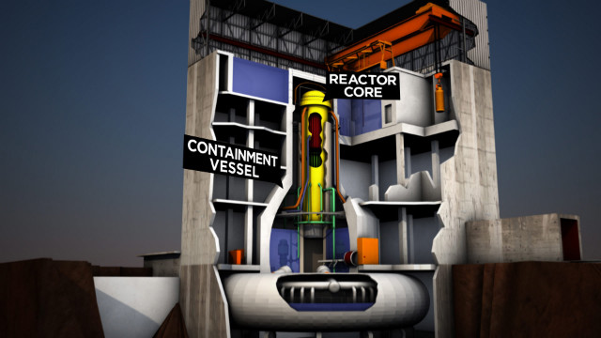
The amount of STORED spent fuel can easily exceed that INSIDE the reactor
Thereby doubling, tripling, or even quadrupling the TOTAL amount of fuel
Further, because that "spent" fuel is still fissioning, it must also be cooled
typically via immersion in nearby pools of cooled water
To get that spent fuel out of the reactor core and into those water pools quickly & safely
in the GE-designed Fukushima reactor pools were placed beside the reactor's lid
allowing for a simple lift from the core, short sideways move, descent into a pool
Spent fuel storage pools
Traveling beam crane
www.cnn.com/2012/02/17/us/us-nuclear-reactor-concerns/

Slide 82
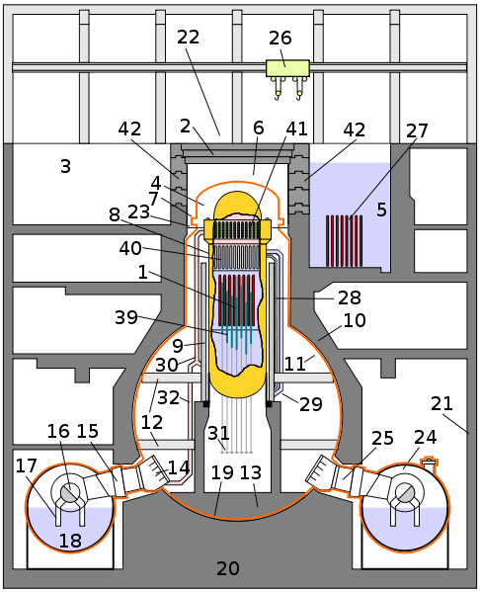
Or diagrammatically:
Crane for fuel rod loading / unloading
"Spent" fuel rod storage pool
Reactor vessel
Reinforced reactor enclosure
The high position of storage pools DOES make them quicker and easier to reach
But they are already outside of the main reinforced reactor enclosure and,
above the reactor, they are susceptible to damage and cooling water loss
These three Fukushima design shortcomings set the stage for . . .
http://en.wikipedia.org/wiki/Fukushima_Daiichi_Nuclear_Power_Plant

Slide 83
Fukushima design shortcoming #4 (shared by many/most reactors):
High temperature catalytic decomposition of H₂O by zirconium
Fuel rods hold enriched ²³⁵U inside zirconium metal alloy tubes
because it's one of very few materials that can withstand full reactor core heat
At Fukushima Daini, operators had improvised an off-the-books way of cooling their 4 reactors
But the operators of the 4 Fukushima Daiichi reactors were less successful
The Fukushima Daiichi #1-3 reactors thus reached near 2000°C temperatures where
Zirconium catalyzes steam/water decomposition: 2 H₂O => 2 H₂ + O₂
Those gases accumulated until within 3 Daiichi reactors,
they reached explosive levels, found an ignition source, and chemically recombined:
2 H₂ + O₂ => 2 H₂O + large amount of energy ( = explosion)
Despite meltdowns, to that point radiation had been confined within the reactor buildings
because the reactor's "containment structures" had still been doing their jobs!
But hydrogen + oxygen explosions now blew open those containment structures!
http://en.wikipedia.org/wiki/Fukushima_Daiichi_Nuclear_Power_Plant

Slide 84
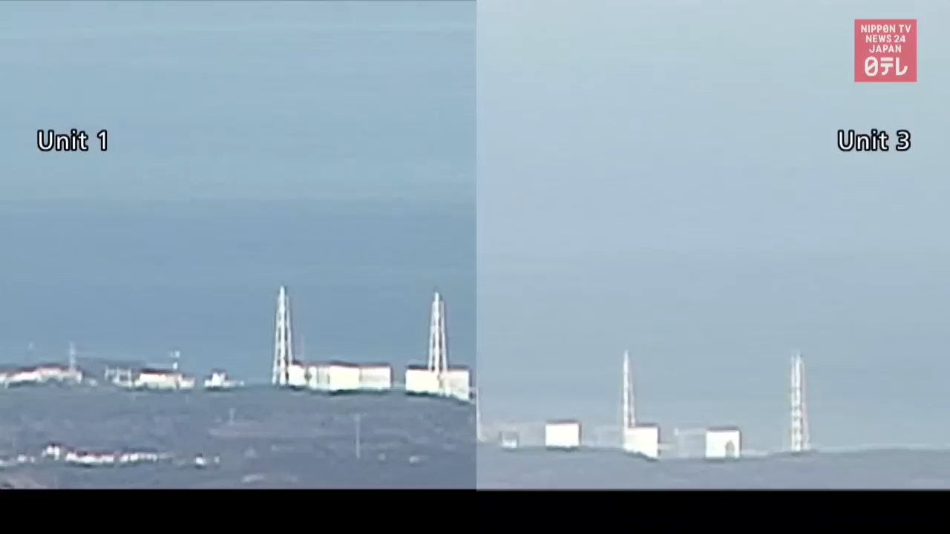
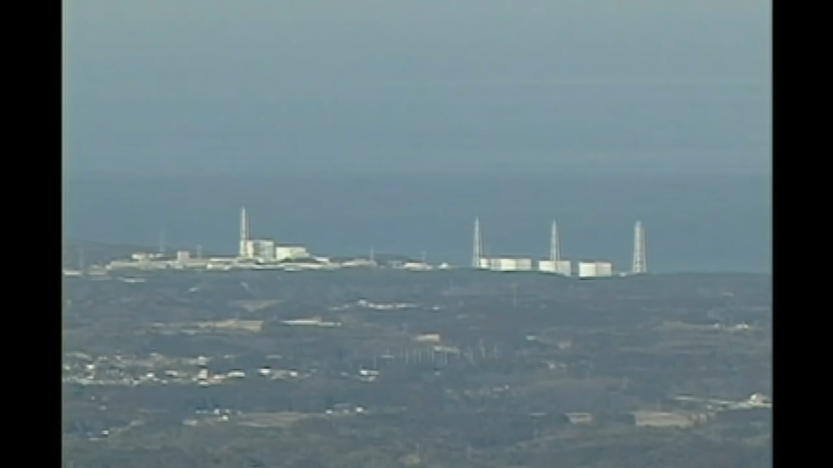
(This video plays within Powerpoint & Keynote)
But these were NOT "nuclear explosions"
They were NOT even "nuclear fizzles"
These were classic chemical explosions: 2 H₂ + O₂ => 2 H₂O + Heat Energy
And their energy release was immensely less than even the earliest nuclear bombs
(even though, yes, it was fission heat that had driven zirconium catalytic splitting of H₂O)
Only then were large quantities of radioactive materials widely dispersed →
"DIRTY BOMB" = Bomb using conventional explosives to spread radioactive materials
Video segment excerpted from: https://www.youtube.com/watch?v=IMVi-XmM-SU

Slide 85
Later insights from a 2015 PBS Nova investigative documentary: ¹
Of the six Fukushima Daiichi reactor "units" only Units 1-3 had been in operation
As shown in preceding video, Unit 1 & Unit 3 were blown open by hydrogen explosions
But mysteriously:
Unit 2 did not explode
Because, it was discovered, its building was punctured by the adjacent Unit 1 explosion
Which vented Unit 2's accumulated H2 preventing its own explosion, but also
allowing its release of deadly radioactive Cesium into the countryside
But Unit 4 did explode
Despite its being out of operation, undergoing fuel rod replacement
Ultimately explained by the fact that it shared a venting chimney with Unit 3
Which allowed enough of Unit 3's pre-explosion H2
to leak into unit 4, setting the stage for its explosion
1) PBS Nova's "Nuclear Meltdown Disaster" (2015)

Slide 86
A hydrogen explosion also occurred at Three Mile Island
(thirty two years earlier)
And high temperature zirconium catalysis of water was also identified as the cause.
even in the 1979 Presidential Commission Report about TMI
And once again, the hydrogen chemical explosion shifted the accident from
a contained meltdown to an external radiation release
That is, the explosion moved a problem within a single reactor building
into the beginnings of a large area environmental disaster
But fortunately, the TMI hydrogen + oxygen explosion was much, much smaller
and the damage to the containment was proportionally reduced
such that radiation leakage at TMI was minimal
And it took a 2nd go round (at Fukushima) to fully play out this disaster scenario

Slide 87
Producing this local damage:
Before:
After:
https://en.wikipedia.org/wiki/Fukushima_Daiichi_Nuclear_Power_Plant
https://isis-online.org/isis-reports/detail/new-march-18-satellite-image-of-fukushima-daiichi-nuclear-site-in-japan/37

Slide 88
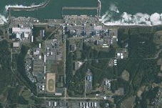
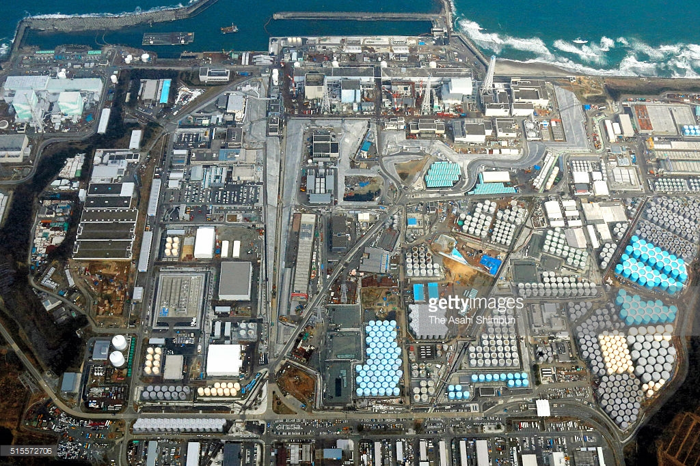
As well as this much broader eventual transformation:
Before: Barely discernible seaside reactors + surrounding countryside:
After: Barely discernible seaside reactors + massive clean-up / nuclear waste-storage
Left: http://metro.co.uk/2011/03/14/pictures-japan-earthquake-aftermath-3053782/combination-photo-shows-satellite-images-of-fukushima-daiichi-nuclear-power-plant-in-japan-taken-by-the-geoeye-1-satellite-on-november-15-2009-l-and-on-march-11-2011-after-magnitude-8-9-earthquak/
Right: http://www.gettyimages.de/ereignis/fukushima-daiichi-nuclear-power-plant-five-years-after-meltdown-610095217#in-this-aerial-image-tokyo-electric-power-cos-fukushima-daiichi-on-picture-id515572706

Slide 89
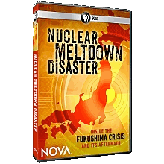
Fukushima shortcoming #5: Major Operator Errors (as at TMI & Chernobyl)?
No!
Multiple studies concluded that the operators met or exceeded training expectations
But for me the commitment, indeed the heroism of Fukushima operators
was driven home by the 2015 PBS Nova investigative documentary:
Nuclear Meltdown Disaster
Which retold the Fukushima story based almost entirely on interviews with
operators & experts on the ground at Fukushima as the disaster unfolded
That video HAD been available on U.S. Public Television (and via YouTube posted copies)
but as of 2024 it can apparently only be viewed via this Amazon Prime link
(Which I urge you to do)

Slide 90
In the interim I have re-viewed that documentary and offer these highlights:
When BOTH grid power and emergency onsite backup power failed at Diaichi and Daini
an event TEPCO never anticipated and for which they provided no operator training:
Operators ran up the hill to steal batteries from cars and trucks in the parking lots
with which they jury-rigged power to instruments in the blacked out control rooms
  providing them with the first information about what was occurring inside the reactors
Which revealed the dire state of those reactors prompting operators at Daini (with less flooding)
to venture out into the countryside to find and tap hoses into an abandoned water line
And, when they eventually found one remote building that had regained power:
They managed to have shipped in five miles of heavy duty electrical cable
which would normally have taken a month to connect that building to the reactors
but as a crew of 200 they managed haul it on their shoulders into place in a day
Which put them in a position to finally energize pumps to deliver water to the reactors
but only after certain valves were opened, by hand, in reactor basements
where radiation was at lethal levels, but into which they nevertheless ventured
And when asked by the film's interviewers how they could take such a risk, their response was:
By then none of them expected to even survive the disaster
so in whatever time remained for them, why not do everything possible to save others?

Slide 91
My personal conclusions regarding the Fukushima disaster:
Fukushima's shortcomings were well known
and alternatives or fixes were obvious (if not always easily affordable)
Specifically, regarding tsunami protection at beachfront nuclear reactor sites:
I can't believe much higher tsunami barriers would have strongly impacted overall cost
Nor I can believe that placing batteries & diesel electric generators OUT of basements
and UP the hill behind would have greatly impacted the Fukushima sites' overall cost
But why was a beachfront reactor site even considered when, for half a century,
Diablo Canyon reactors had been successfully water-cooled atop a 26 meter tall bluff?
Finally, while I acknowledge the difficulty of eliminating hydrogen-catalyzing fuel rods,
I found no more than a few isolated & sporadic research efforts even targeting that goal
All of which reenforces the TMI Presidential Commission Report's prophetic:
"As long as proposed improvements are carried out in a 'business as usual' atmosphere,
fundamental changes necessitated by the accident (now accidents) . . . cannot be realized"

Slide 92
And finally:
What about Nuclear Energy's Supposedly Small Carbon Footprint?

Slide 93
Which might seem an extreme change of topic
But given this note set's focus on arguments for not even considering a Nuclear Future,
claims that Nuclear might NOT be a low Greenhouse Gas technology are relevant
Those claims parallel criticisms of Hydroelectric Energy, because both technologies
make massive use of concrete (as incorporated in their dams & reactor complexes)
Which I first analyzed in my note set about Hydroelectric Power (pptx / pdf / key),
but which I will here now slightly adapt to apply to reactors
(in the interest of keeping this note set about Nuclear largely self-contained)
An Introduction to Sustainable Energy Systems: WeCanFigureThisOut.org/ENERGY/Energy_home.htm

Slide 94
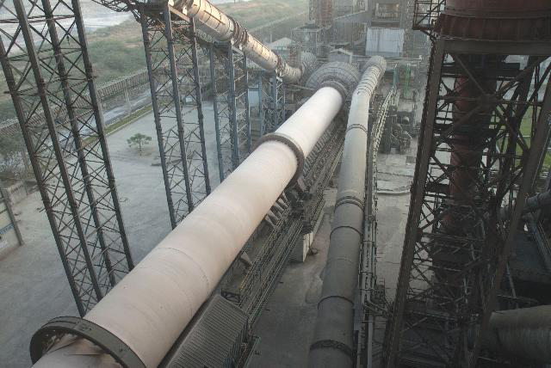
Concrete: What is it?
Concrete consists of gravel ("aggregate") glued together with a cement
Portland cement is the most commonly used modern glue
It contains calcium silicates (e.g., Ca₃SiO₅ and Ca₂SiO₄) which,
when exposed to water, form hydrates that bind the gravel together ¹
The source of that Ca is naturally occurring limestone (CaCO₃)
Ca is liberated by heating the limestone at 1400-1600°C in HUGE rotating kilns: ²
1) Portland cement science:
http://matse1.matse.illinois.edu/concrete/prin.html
2) Photo: https://www.cemnet.com/Articles/story/39950/acc-s-mega-kiln-line-project.html

Slide 95
Concrete's Carbon Footprint:
The above process has a huge carbon footprint due to:
- Burning of carbon fossil fuels to produce the 1400-1600°C kiln temperatures
- The need to constantly heat those massive kilns, even when not in production
- The release of CO₂ that occurs as Ca is liberated from the limestone (CaCO₃)
The 2024 EPA Inventory of US Greenhouse Gas Emissions & Sinks reported ¹
that 2022 U.S. Portland cement production produced a carbon footprint of:
41.9 million metric tonnes CO₂ equivalent
Annual U.S. Portland cement production that year was ~ 95 million tonnes ² and thus:
1 tonne of Portland cement => 0.44 tons of CO₂ equivalent released
Concrete (aggregate + Portland cement) is ~ 11% Portland cement by weight ³ =>
1 tonne of Concrete => 0.05 tonnes of CO₂ equivalent released OR
Concrete's Carbon Footprint = 0.05 tonnes CO2 eq. / tonne Concrete
1) Sections 2.2 and 4.1 of: https://www.epa.gov/ghgemissions/inventory-us-greenhouse-gas-emissions-and-sinks-1990-2022
2) https://pubs.usgs.gov/periodicals/mcs2023/mcs2023-cement.pdf
3) www.cement.org/cement-concrete-basics/concrete-materials

Slide 96
Using that to compute Nuclear's carbon footprint due to concrete:
A "typical" nuclear plant requires "up to 350,000 cubic yards" of concrete ¹
Which, given concrete's density ² of 1.9 tons/yd³ => 603,000 tonnes of concrete
But, using that same concrete, the reactor then operates for at least 40 years,
making the plant's time-averaged annual use of concrete 15,075 tonnes of concrete / yr
Which, using the previous page's result for carbon footprint from concrete's manufacture,
(15,075 tonnes of concrete / yr) x (0.05 tonnes CO2 eq. / tonne concrete) yields:
Nuclear plant carbon footprint = 754 tonnes CO2 eq. / yr
Nuclear plants typically output of about 1.5 GW of electrical power, so footprint per power is
(754 tonnes CO2 eq. / yr ) / (1,500,000 kW)
Nuclear power footprint = 0.0005 tonnes CO2 eq. / kW-yr
Total U.S. electrical power is now ~ ½ Tera-Watts of which Nuclear produces 19.7% = 9.8 x 10⁷ kW,
with (9.8 x 10⁷ kW) x (5 x 10⁻⁴ tonnes CO2 eq. / kW-yr) then yielding:
Cumulative U.S. Nuclear power plant carbon footprint = 49,900 tonnes of CO₂ eq. / yr
1) www.concreteconstruction.net/construction/construction-of-nuclear-power-stations.aspx
2) http://hypertextbook.com/facts/1999/KatrinaJones.shtml

Slide 97
Comparing that to Carbon Footprint of other U.S. Power Technologies
Using the "Where Do We Go from Here?" (pptx / pdf / key) note set's analyses:
Coal Plant Power: 0.001 metric tonne CO₂ eq. / kW-hr = 8.8 tonne CO2 eq. / kW-yr
OCGT Gas Plant Power: 0.0007 metric tonne CO₂ eq. / kW-hr = 6.1 tonne CO2 eq./ kW-yr
CCGT Gas Plant Power: 0.00045 metric tonne CO₂ eq. / kW-hr = 3.9 tonne CO2 eq./ kW-yr
All hugely larger than Nuclear Power at 0.0005 tonne CO2 eq. / kW-yr
In 2016 Coal Power Plants provided 30.4% of U.S. power => 1.52 x 10⁸ kW
Carbon footprint = (1.52 x10⁸ kW) x (8.8 tonne/kW-yr) = 1.3 x 10⁹ tonnes CO₂ / yr
= 26,000 times the cumulative Nuclear Plant carbon footprint
In 2016 Natural Gas Power Plants provided 33.8% of U.S. power => 1.69 x 10⁸ kW
Which, if it were produced using half OCGT and half CCGT, would represent
Carbon footprint = (1.69 x10⁸ kW) x (5.0 tonne/kW-yr) = 8.5 x 10⁸ tonnes CO₂ / yr
= 17,000 times the cumulative Nuclear Plant carbon footprint
Nuclear Power's CO₂ footprint is MINISCULE compared to fossil fuel power!

Slide 98
My personal takeaways?
As I stated in my opening, I too am uneasy about nuclear power
But in the face of accelerating of global warming,
and our still meager reductions in Greenhouse Gas emissions,
I wondered if low-emission Nuclear (as I just verified) might be an acceptable answer
I've now provided information & sources upon which you can reach your own conclusions
But, for myself, I am still uneasy:
Three Mile Island and Chernobyl seem like accidents that were just waiting to happen
Fukushima would never have happened if reactors were uphill just 100 meters to the west
Possibly encouraging, had their actual siting not been such an obviously terrible decision
on the part of the plants' owners, designers and government regulators
My plan is to now search for nuclear reactor designs that would not only passively shut down,
but do so in ways that are almost certainly both idiot-proof and natural-disaster-proof
And looking farther forward, for reactors producing radically less long-lived radioactive waste
I'll write up what I discover - Keep checking my WeCanFigureThisOut Energy Webpage
John C. Bean - Summer 2024

Slide 99
Credits / Acknowledgements
Some materials used in this class were developed under a National Science Foundation "Research Initiation Grant in Engineering Education" (RIGEE).
Other materials, including the "Virtual Lab" science education website, were developed under even earlier NSF "Course, Curriculum and Laboratory Improvement" (CCLI) and "Nanoscience Undergraduate Education" (NUE) awards.
This set of notes was authored by John C. Bean who also created all figures not explicitly credited above.
Copyright John C. Bean
(However, permission is granted for use by individual instructors in non-profit academic institutions)
An Introduction to Sustainable Energy Systems: WeCanFigureThisOut.org/ENERGY/Energy_home.htm

