Slide 1
Exotic Power Sources
John C. Bean
Outline
Geothermal Power
Ocean Thermal Energy Conversion
The Physics of Tapping into Water Power
Tidal Barrage Power
Tidal Stream Power
Wave Power
Floating Photovoltaic Farms
Wind Power Balloons & Kites
Solar Power Satellites
Fusion Power
(Written / Revised: August 2022)

Slide 2
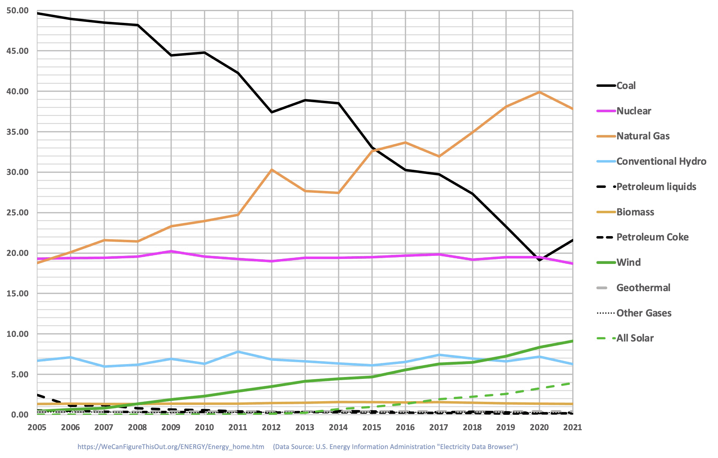
Exotic Power Sources
This note set is about power technologies missing from this figure ¹
(plus one that does appear, but only as the figure's flat gray baseline)
Sources of U.S. Electrical Power
But this note set is also about technologies capturing major popular press attention,
emerging technologies upon which many place their hopes for a greener world
In response I will try to not only introduce these technologies but to use basic science
to estimate how much available power each technology is trying to tap into,
which should provide a basis for judging that technology's ultimate potential
1) From my note set; U.S. Energy Production & Consumption (pptx / pdf / key)

Slide 3
Geothermal Power
An Introduction to Sustainable Energy Systems: WeCanFigureThisOut.org/ENERGY/Energy_home.htm

Slide 4
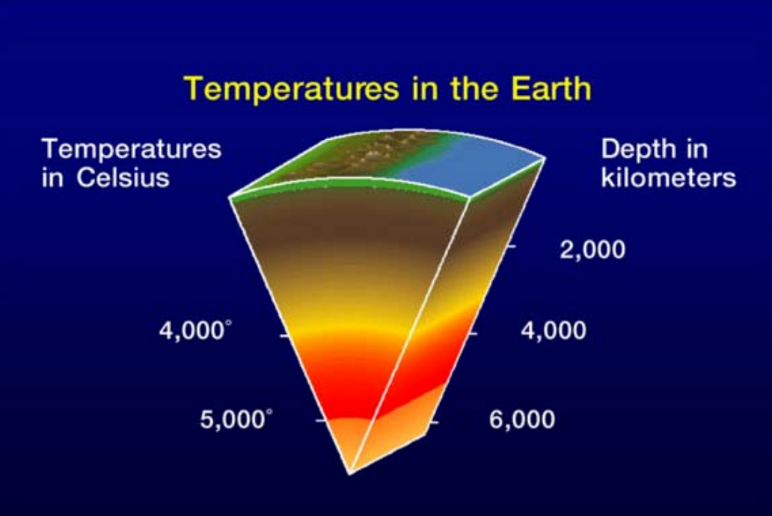
Geothermal Power is actually driven by radioactivity
Specifically, the fission decay of trace radioactive elements in the earth's core
That's why, 4.5 billion years after its formation, the earth's core remains molten
This heat drifts (via convection & conduction) upward towards the earth's surface
Where it is transferred to the atmosphere (by conduction)
or through the atmosphere (by weak infrared radiation)
The net result is a steep drop in temperature towards the earth's surface:
Figure:
Geothermal 101: Basics of Geothermal Energy Production and Use:
https://geothermalcommunities.eu/assets/elearning/7.15.geo_101.pdf

Slide 5
It's called the Geothermal Gradient:
Away from crustal irregularities (e.g., plate tectonic boundaries or vulcanism),
the Geothermal Gradient is typically 25-30 °C / km of depth ¹
As a result, while near-surface ground is typically a cool 10-15 ºC (50-60 ºF),
Two kilometers below, the temperature is 60-75 ºC (140-170 ºF)
Hot enough to boil many organic fluids into high-pressure vapor
Three kilometers below, the temperature is 85-105 ºC (185-220 ºF)
Hot enough to begin boiling water into high pressure steam
By piping those organic fluids or water down into the ground 2-3 km deep
(or by heating them via another fluid piped to and from those depths)
The resulting high-pressure vapor / steam can drive turbine electrical generators
yielding Geothermal Electrical Power + Heat (for local factories / homes)
1) See for example Wikipedia's webpage: https://en.wikipedia.org/wiki/Geothermal_gradient

Slide 6
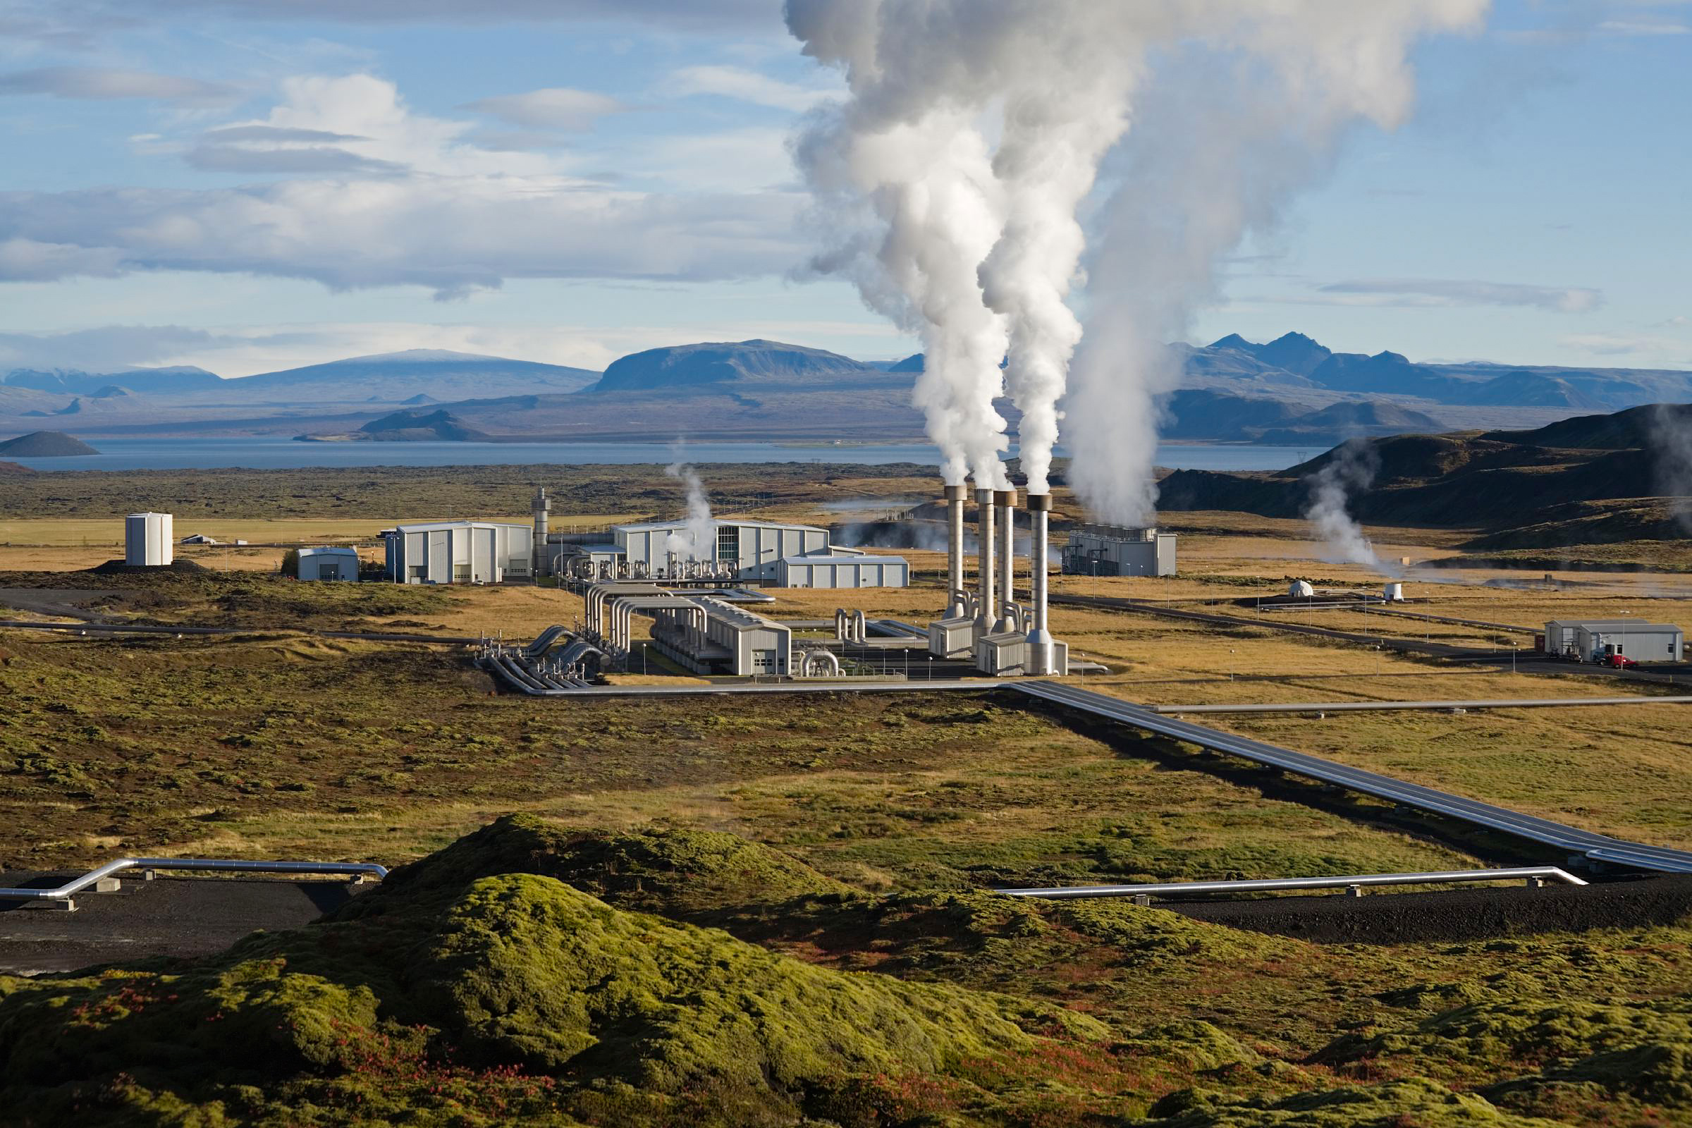
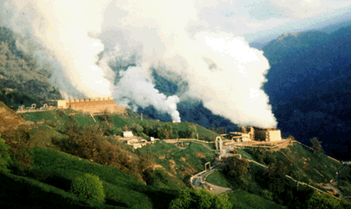
Examples of large present day Geothermal Power Plants?
They naturally favor sites where the Geothermal Gradient is exceptionally steep
Which occurs near those "crustal irregularities" where plate tectonics
has drawn hot magma reservoirs unusually close to the surface
As in plate-tectonic-boundary-straddling Iceland: Where 25% of power is Geothermal ¹
And in "Ring of Fire" (tectonic-plate-subduction-overlying) Northern California:
Where the 15 "Geysers" power plants together produce up to 725 MW ²
Iceland's Nesjavellir Power Plant:
https://en.wikipedia.org/wiki/File:NesjavellirPowerPlant_edit2.jpg
One of the California "Geysers" Plants:
https://pubs.usgs.gov/gip/dynamic/geothermal.html
1) Orkustofnun – National Power Authority: https://nea.is/geothermal/ 2) www.geysers.com/geothermal.aspx

Slide 7
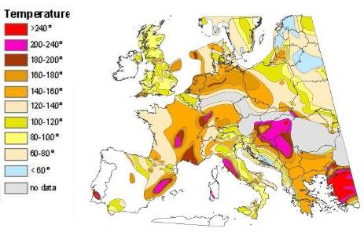
What are the most promising European locations?
Extrapolated ground temperatures at 5 km depth have been plotted as:
Europe's hottest Geothermal prospects?
Turkey, eastern Spain, Balkan mountains, some pockets in France
Source: http://ec.europa.eu/research/energy/eu/index_en.cfm?pg=research-geothermal-background

Slide 8
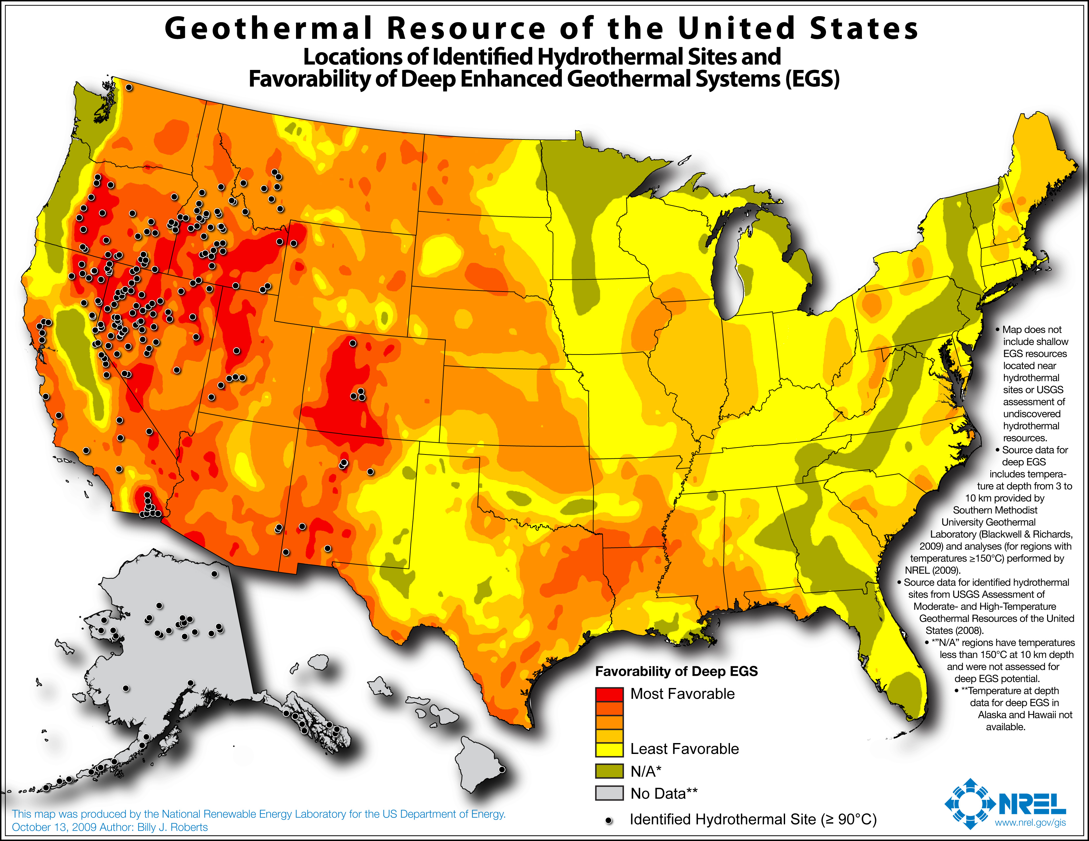
Or the most promising U.S. locations?
"Favorability" according to a U.S. National Renewable Energy Lab (NREL):
Small print: "Least Favorable" yellow sites have ground < 150 ºC at 10 km depth
Source: http://www.nrel.gov/gis/images/geothermal_resource2009-final.jpg
The U.S.'s hottest Geothermal prospects? In lower 48's west / northwest
(With data needed Alaska & Hawaii - where I'd expect some excellent prospects!)

Slide 9
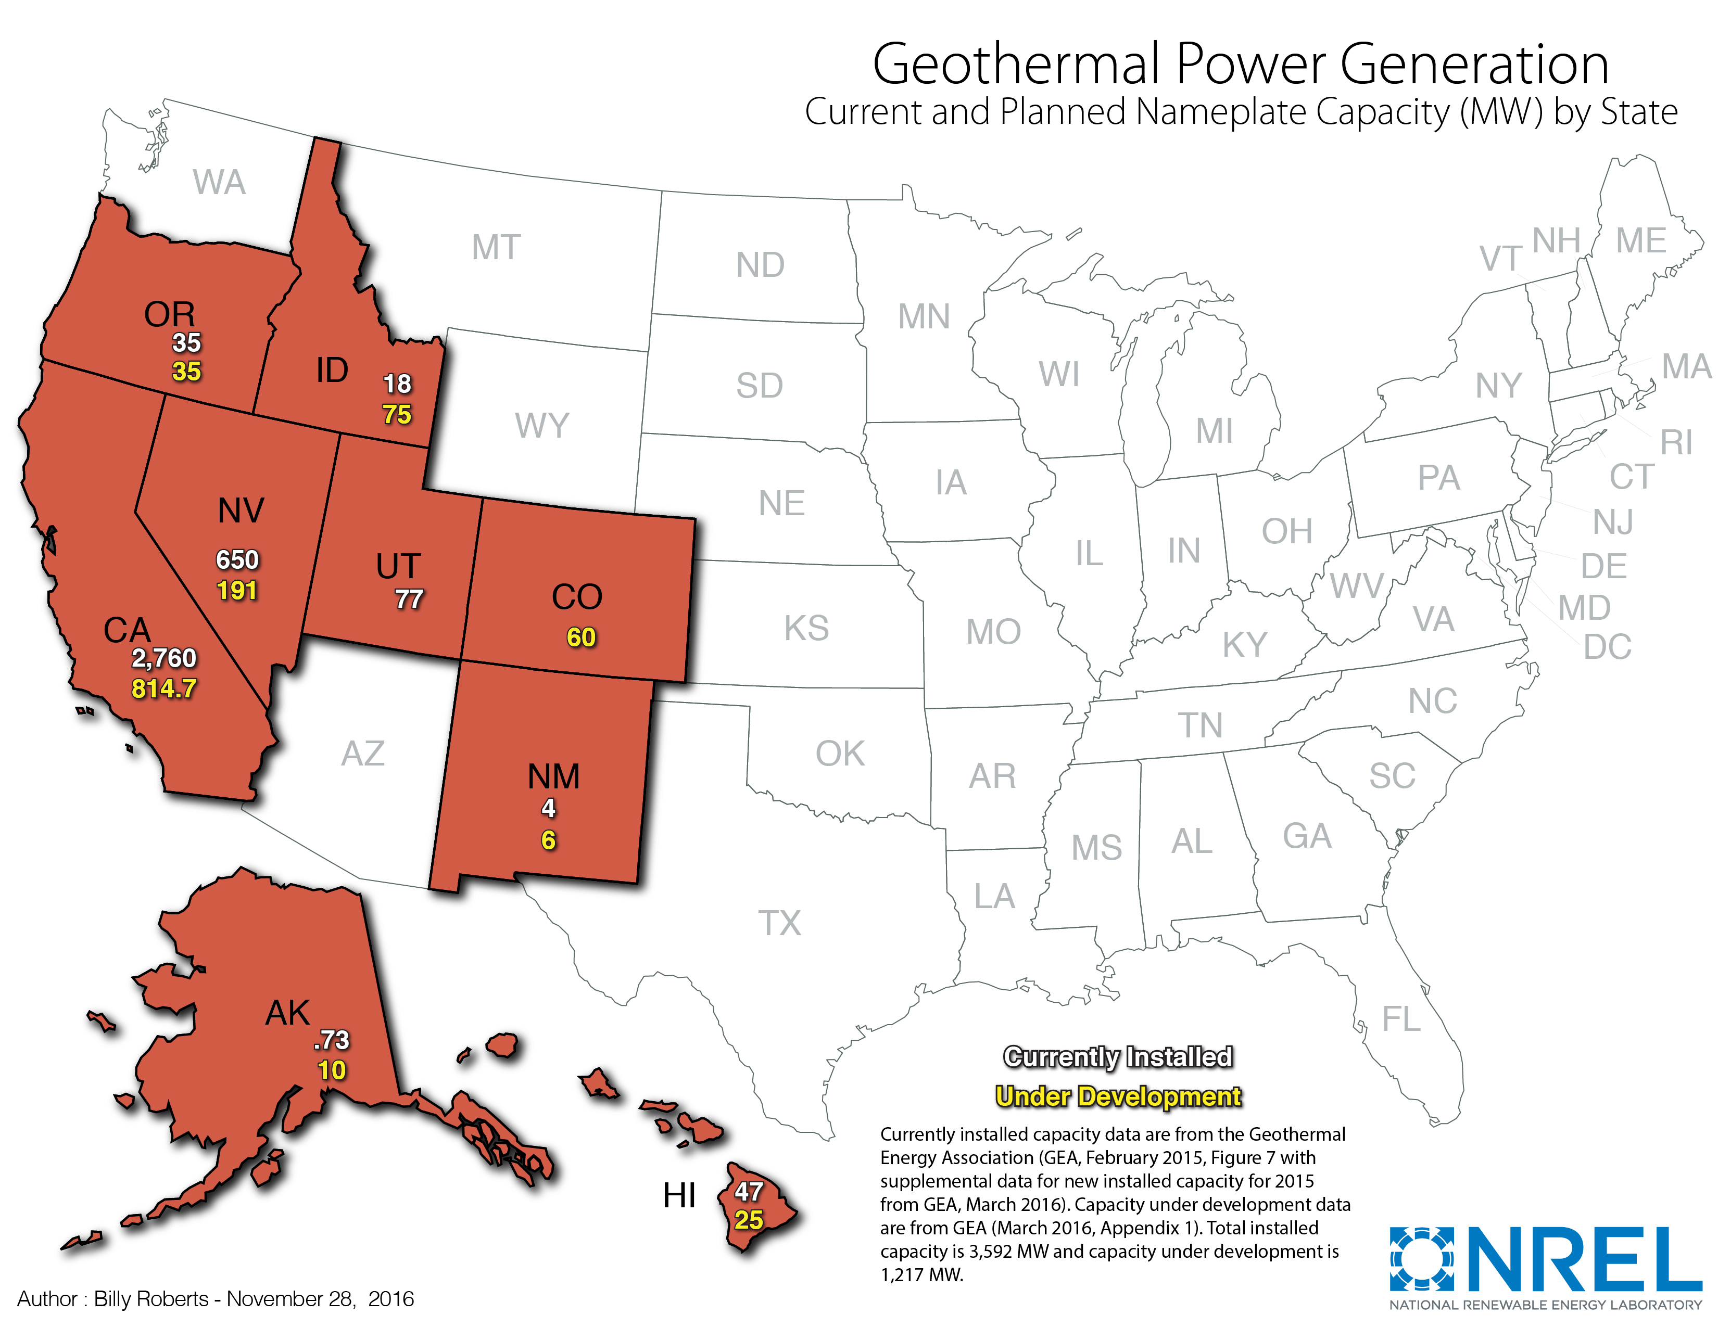
The Good News: Plants built / being built in 48's W / NW + AK + HI:
A different NREL map of "Current and Planned" Geothermal Plants by state giving:
MW Geothermal Capacity of existing state plants (numbers in white)
MW Geothermal Capacity of planned state plants (numbers in yellow)
Source: https://www.nrel.gov/gis/images/2016-11-28_Geothermal_Capacity.jpg
The Bad News:
TOTAL existing capacity is 3592 MW (comparable to ~ 6 "typical" U.S. power plants)
TOTAL excluding California is 832 MW (comparable to ~ 1 "typical" U.S. power plant)

Slide 10
Those Geothermal power capacity numbers are discouraging
Especially when you consider Geothermal's claimed green energy qualities:
- It employs simple, well known, low risk, technologies (described later)
- It produces constant 24/7 ("base load") power that requires
neither supplemental energy storage technology nor large reservoirs
- It emits no greenhouse combustion gases
- It seems to neither produce nor release dangerous wastes
- Its plants require minimal ground surface area
- Their "fuel" is drawn entirely from the hot ground immediately below them
But time-averaged U.S. power consumption is ~ 1/2 TW (= 500,000 MW) ¹
To supply even 10% of that power, from the previous slide's numbers:
Geothermal capacity would have to increase by ~ 5x10⁵ MW / 3592 MW
= 140X
1) That 1/2 TW number is discussed in my note set: U.S. Energy Production & Consumption (pptx / pdf / key) note set:

Slide 11
The proposed solution? EGS
Which stands for Enhanced / Engineered Geothermal Systems
From Geothermal 101: Basics of Geothermal Energy Production and Use: ¹
"Although the deeper crust and interior of the Earth is universally hot, it lacks two of the three ingredients required for a naturally occurring geothermal reservoir:
Water and interconnected open volume for water movement.
Producing electricity from this naturally occurring hot, but relatively dry rock requires enhancing the potential reservoir by fracturing, pumping water into and out of the hot rock, and directing the hot water to a geothermal power plant."
EGS might allow expansion of Geothermal out from Red into Orange U.S. areas:
1) https://geothermalcommunities.eu/assets/elearning/7.15.geo_101.pdf

Slide 12
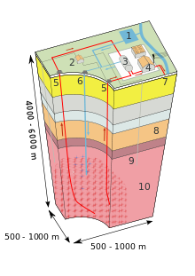
What would an EGS Geothermal Plant look like?
In this Wikipedia figure, EGS plant components are:
1) (Surface) Reservoir
2) Pump house
3) Heat exchanger
4) Turbine Hall
5) Production Well
6) Injection Well
7) Hot Water to District Heating
8) Porous Sediments
9) Observation Well
10) Crystalline Bedrock
Source: http://en.wikipedia.org/wiki/Geothermal_electricity

Slide 13
What are all those components doing?
Pump house (2) pushes supply water down into the
Injection Well (6) from which it then flows through deep extremely hot
Porous Sediments (8) causing the water to superheat and/or boil, then exit via the
Production Well (5) from which it is then routed to a
Heat exchanger (3) boiling mineral-free water with that clean steam going to the
Turbine Hall (4), with output possibly diverted to nearby shivering people via
Hot Water to District Heating (7), with all output steam/hot water then sent to
Surface Reservoir (1) to be fully re-condensed by other heat exchangers, circled by
Crystalline Bedrock (10) keeping plant's water from wandering away, plus
Observation Well (9) which Wikipedia neglects to explain but I'd guess monitors
temperature of Porous Sediments, facilitating fine-tuning of plant operation

Slide 14
But returning to Geothermal 101's definition of EGS:
It's key phrase stated that the "E" of engineering required for an EGS plant involved:
"fracturing, pumping water into and out of the hot rock"
That sounds an awful lot like natural gas fracking
Suggesting that EGS reservoir creation might entail the same:
Massive potential for ground water / aquifer pollution
And for local air pollution
And for activation of dormant earthquake faults
Drawing from my note set on Fossil Fuels (pptx / pdf / key)
and its detailed discussion of natural gas fracking techniques:
An Introduction to Sustainable Energy Systems: WeCanFigureThisOut.org/ENERGY/Energy_home.htm

Slide 15
To fracture rock, frackers inject extremely high pressure water
It blows open interconnected cracks in the rock,
which then allows pockets of natural gas to drain out,
at least if cracks are not then clogged by hydrocarbon residues (e.g., tars)
and if they don't just collapse when the water pressure is reduced
To inhibit re-closure, fine sand is added to the water, tending to wedge cracks open ¹
To inhibit hydrocarbon clogging, solvents & detergents are added to the fracking water
(with their composition now not even disclosed to the U.S. public or government)
EGS field creation in low hydrocarbon rock might not require those chemicals
Finally, to inhibit tight re-closure of cracks, their walls are also generally roughened
via the addition of rock-etching acids to the fracking water
These chemicals probably would be desirable in creation of an EGS fields
1) The sand is called a "proppant" (so named because it "props" the cracks open?)

Slide 16
To explore this (and other) issues I found a massive MIT led study:
The Future of Geothermal Energy ¹
Echoing information above, that report's synopsis states (p. 1-1):
"Although conventional hydrothermal resources are used effectively for both electric and nonelectric applications in the United States, they are somewhat limited in their location and ultimate potential for supplying electricity.
Beyond these conventional resources are EGS resources with enormous potential for primary energy recovery using heat­ mining technology, which is designed to extract and utilize the earth’s stored thermal energy."
That report moves on to then make a striking claim (p. 1-3):
"With a reasonable investment in R&D, EGS could provide 100 GW_{e} or more of cost­-competitive generating capacity in the next 50 years."
A "cost competitive" 100 GW would equal 20% of today's U.S. power generation
1) https://www1.eere.energy.gov/geothermal/pdfs/future_geo_energy.pdf
An Introduction to Sustainable Energy Systems: WeCanFigureThisOut.org/ENERGY/Energy_home.htm

Slide 17
The report additionally claims that:
(p. 1-4): "Field studies conducted worldwide for more than 30 years have shown that EGS is technically feasible in terms of producing net thermal energy by circulating water through stimulated regions of rock at depths ranging from 3 to 5 km. We can now stimulate large rock volumes (more than 2 cubic km), drill into these stimulated regions to establish connected reservoirs, generate connectivity in a controlled way if needed, circulate fluid without large pressure losses at near commercial rates, and generate power using the thermal energy produced at the surface from the created EGS system. Initial concerns regarding five key issues - flow short circuiting, a need for high injection pressures, water losses, geochemical impacts, and induced seismicity - appear to be either fully resolved or manageable with proper monitoring and operational changes."
But it later concedes that:
(p. 1-21): "Extensive drilling for petroleum, geothermal, and mineral resources during the past century has demonstrated that the largest heat resource in the Earth’s crust, by far, is contained in rocks of low natural permeability. Recovery of heat from such rocks at commercial rates and competitive costs is the object of the EGS program."
And seemingly undercuts the earlier claim that issues have been largely resolved:
(p. 1-21): As expected in the early development of any new technology, many lessons have been learned from 30 years of EGS field research in the eight countries listed above. For example, the initial concept of producing discrete hydraulic fractures has largely been replaced by stimulating the natural fracture system. Although the goal of operating a commercial­sized EGS reservoir has not been achieved yet, field testing has successfully demonstrated that reservoirs of sufficient size with nearly sufficient connectivity to produce fluids at commercial rates can be established.

Slide 18
But what about EGS's need for something resembling fracking?
Discussion of hydraulic fracturing is woven throughout the 372 page MIT EGS report
Addition of chemicals to fracturing fluids is also repeatedly mentioned
E.G., on page 4-45: "dilute acids" or on page 5-4: "other chemicals"
But in this otherwise very detailed report, in its chapter on Environmental Impacts,
the entire discussion of water pollution (8.2.2) spans two short paragraphs,
and it includes no specific reference to fracking chemicals employed
That left me VERY uneasy about possible parallels between EGS and fracking
I nevertheless recognize a key difference between those technologies:
To extract depletable natural gas, new natural gas fields must be continuously fracked
But to extract effectively undepletable earth heat, once an EGS field is created
it could provide ~ endless power, and it might do so from a smallish field in an
isolated rock formation, from which water pollution could not easily spread

Slide 19
How plausible is a 20% EGS contribution to U.S. power ?
In the spirit of "We can figure this out" let's try a quick calculation:
How much Geothermal heat is flowing up to the earth's surface?
Wikipedia ¹ specifies this as 65 mW / m² on land (vs. 110 at ocean bottom)
The U.S. Geological Survey ² reports a "normal" number equivalent to 63 mW / m²
"Sustainable Energy without the Hot Air" ³ gives a similar value of 50 mW / m²
What fraction of that heat energy might we be able to capture?
The Carnot Cycle ⁴ gives an idealized maximum power extraction efficiency of
~ (T_{high} – T_{low}) / T_{high} x 100
For geothermal heat engines, T_{low} ~ earth surface temperature ~ 300°K
Deep ground might be 200°C hotter (i.e., 500°K) giving theoretical limit of
Max geothermal efficiency ~ (500 - 300 / 500) x 100 ~ 40%
Combining: Max extractable Geothermal power ~ 65 mW / m² x 40% = 26 mW / m²
1) from Wikipedia's Geothermal Gradient webpage: https://en.wikipedia.org/wiki/Geothermal_gradient 2) USGS: Geothermal Energy: https://pubs.usgs.gov/circ/1965/0519/report.pdf 3) Sustainable Energy - Without the Hot Air: https://www.withouthotair.com/ 4) Discussed in my note set: Generic Power Plant and Grid (pptx / pdf / key)

Slide 20
The total land area of the U.S. is 9,147,593 km²
Multiplying that number ¹ by the preceding slide's capturable Geothermal energy/m²:
Max U.S. Geothermal Power = 9,147,593 km² x 26 mW / m² x (10⁶ m² / km²)
= 2.4 x 10¹⁴ mW = 2.4 x 10⁵ MW = 0.24 TW
As noted earlier, average total U.S. power consumption is ~ 1/2 TW
Thus, if 100% of U.S. land area were effectively used for EGS,
Geothermal could produce (at best) ~ .24 / 0.5 ~ 50% of U.S. power
OR, to provide 20% of U.S. power (as claimed in the report discussed above):
Geothermal would require ~ 2/5^{ths} of the total U.S. land (including Alaska)
Not likely! Especially when NREL rates HALF of the lower 48 unfavorable for EGS:
1) From Wikipedia: https://en.wikipedia.org/wiki/List_of_U.S._states_and_territories_by_area

Slide 21
Ocean Thermal Energy Conversion
An Introduction to Sustainable Energy Systems: WeCanFigureThisOut.org/ENERGY/Energy_home.htm

Slide 22
Ocean Thermal Energy Conversion = OTEC
OTEC and Geothermal power have a lot in common - Both employ:
A turbine-electrical-generator driven by high pressure vapor
that was boiled by heat acquired from a HOT reservoir, and then
re-condensed by dissipating heat into a COLD reservoir
But OTEC's reservoirs are flipped:
The upper HOT reservoir is warm water near the surfaces of some oceans
The lower COLD reservoir is near-freezing water in the depths of some oceans
And because "HOT" ocean surfaces are not hot enough to boil water,
some other "working fluid" must be vaporized & condensed,
something that boils between deep & shallow seawater temperatures
The working fluid chosen in most OTEC projects is ammonia
https://www.makai.com/ocean-thermal-energy-conversion/
An Introduction to Sustainable Energy Systems: WeCanFigureThisOut.org/ENERGY/Energy_home.htm

Slide 23
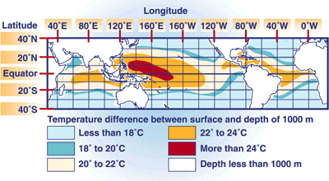
But Ammonia's one atmosphere boiling point is -33.34 ºC
Which is below saltwater's freezing point
Meaning that even deep cold (liquid) seawater cannot condense ammonia
OTEC gets around this by pressurizing the ammonia, which elevates its boiling point
Developers seek ocean locations where warm (shallow) water and cold (deep) water
differ in temperature by at least 20 ºC ^{1, 2}
And, to economically access that cold water, they want locations where
sufficiently cold water is no deeper than ~ 1000m
Satisfying BOTH requirements is difficult:
These conditions are met only within
the Red / Orange bands of
our tropical oceans: ¹
1) https://en.wikipedia.org/wiki/File:Temperaturunterschiede_Ozeane.png 2) https://www.britannica.com/technology/ocean-thermal-energy-conversion

Slide 24
And even 20 ºC is not much of a temperature difference:
Thermodynamics says that thermal power conversion efficiency cannot exceed:
~ (T_{high} – T_{low}) / T_{high} x 100 (the highly idealized & optimistic Carnot maximum)
For Geothermal Power that efficiency was ~ (500 ºK - 300 ºK) / 500 ºK => 40%
Compared to OTEC where Tlow is the temperature of deep liquid salt water,
which even with its salt, can't be much colder than 0 ºC = 273 ºK
Thus, for ocean regions with the preceding map's Δ T = T_{high} – T_{low} = 20 ºC,
the sea surface "high" temperature must be ~ 20 ºC = 293 ºK
Leading to a maximum OTEC thermal power conversion efficiency of:
~ (T_{high} – T_{low}) / T_{high} x 100 = (293 ºC - 273 ºC) / 293 ºC = 7%
Thus, to MATCH the power output of Geothermal, OTEC plants must process
~ six times more water, requiring some exceptionally large pipes & pumps!
1) https://en.wikipedia.org/wiki/File:Temperaturunterschiede_Ozeane.png 2) https://www.britannica.com/technology/ocean-thermal-energy-conversion

Slide 25
But tropical islands DO often lack acceptable power alternatives
Small / isolated islands seldom have large local fossil fuel reserves,
or the rivers necessary for hydroelectric power,
or the large tracks land required for for solar farms
Many such islands also lack the vulcanism supporting shallow Geothermal power,
or have cultures hesitant about exploiting vulcanism (e.g., as is possible in Hawaii)
Finally, dependence on tourism may make scenery-marring technologies unacceptable,
including any form of solar power, as well as both onshore & offshore wind power
The island potential of OTEC's was thus realized as early as the 1880's,
as evident in French Physicist Jacques Arsene d'Arsonval's Cuban test plants ¹
And in the latter half of the 20th century, test plants were built in locations ranging from
West Africa's Ivory Coast, to Japan's Nauru Island, to India's Tamil Nadu ^{1, 2}
This progression now continues in an Hawaiian test project:
1) https://en.wikipedia.org/wiki/File:Temperaturunterschiede_Ozeane.png 2) https://www.britannica.com/technology/ocean-thermal-energy-conversion

Slide 26
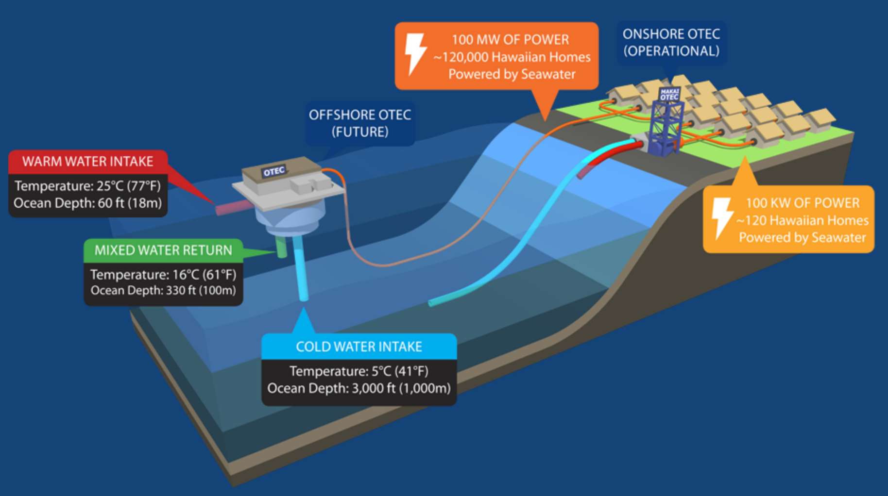
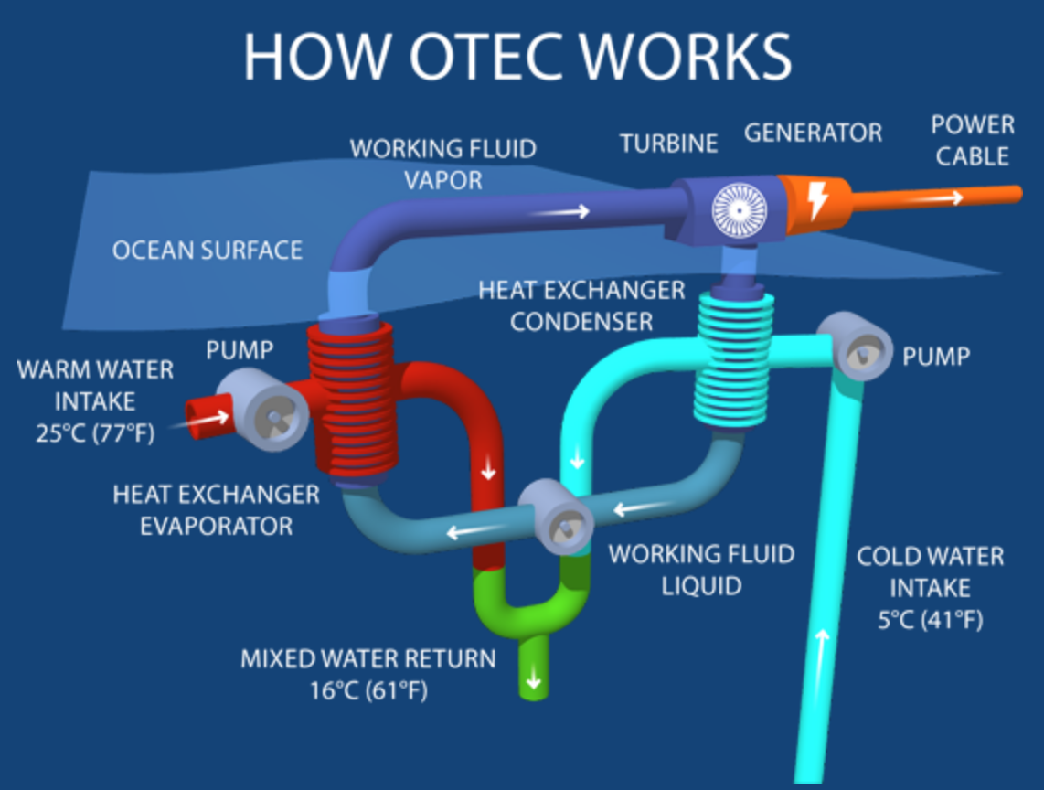
Kona Hawaii's ongoing OTEC test project:
OFFSHORE: Hot (18m deep) & Cold (1000m deep) seawater intakes / returns
ONSHORE: Heat exchangers boiling then re-condensing ammonia working fluid,
its steam driving 24/7 turbine generators (100 KW now => 100 MW planned)
Stage II (planned) =>
<= Stage I (2015)
A cooperative project involving Makai Corp ¹ & U. Hawaii's Natural Energy Research Institute ²
Figs. & Ref 1) https://www.makai.com/ocean-thermal-energy-conversion/
2) https://www.hnei.hawaii.edu/

Slide 27
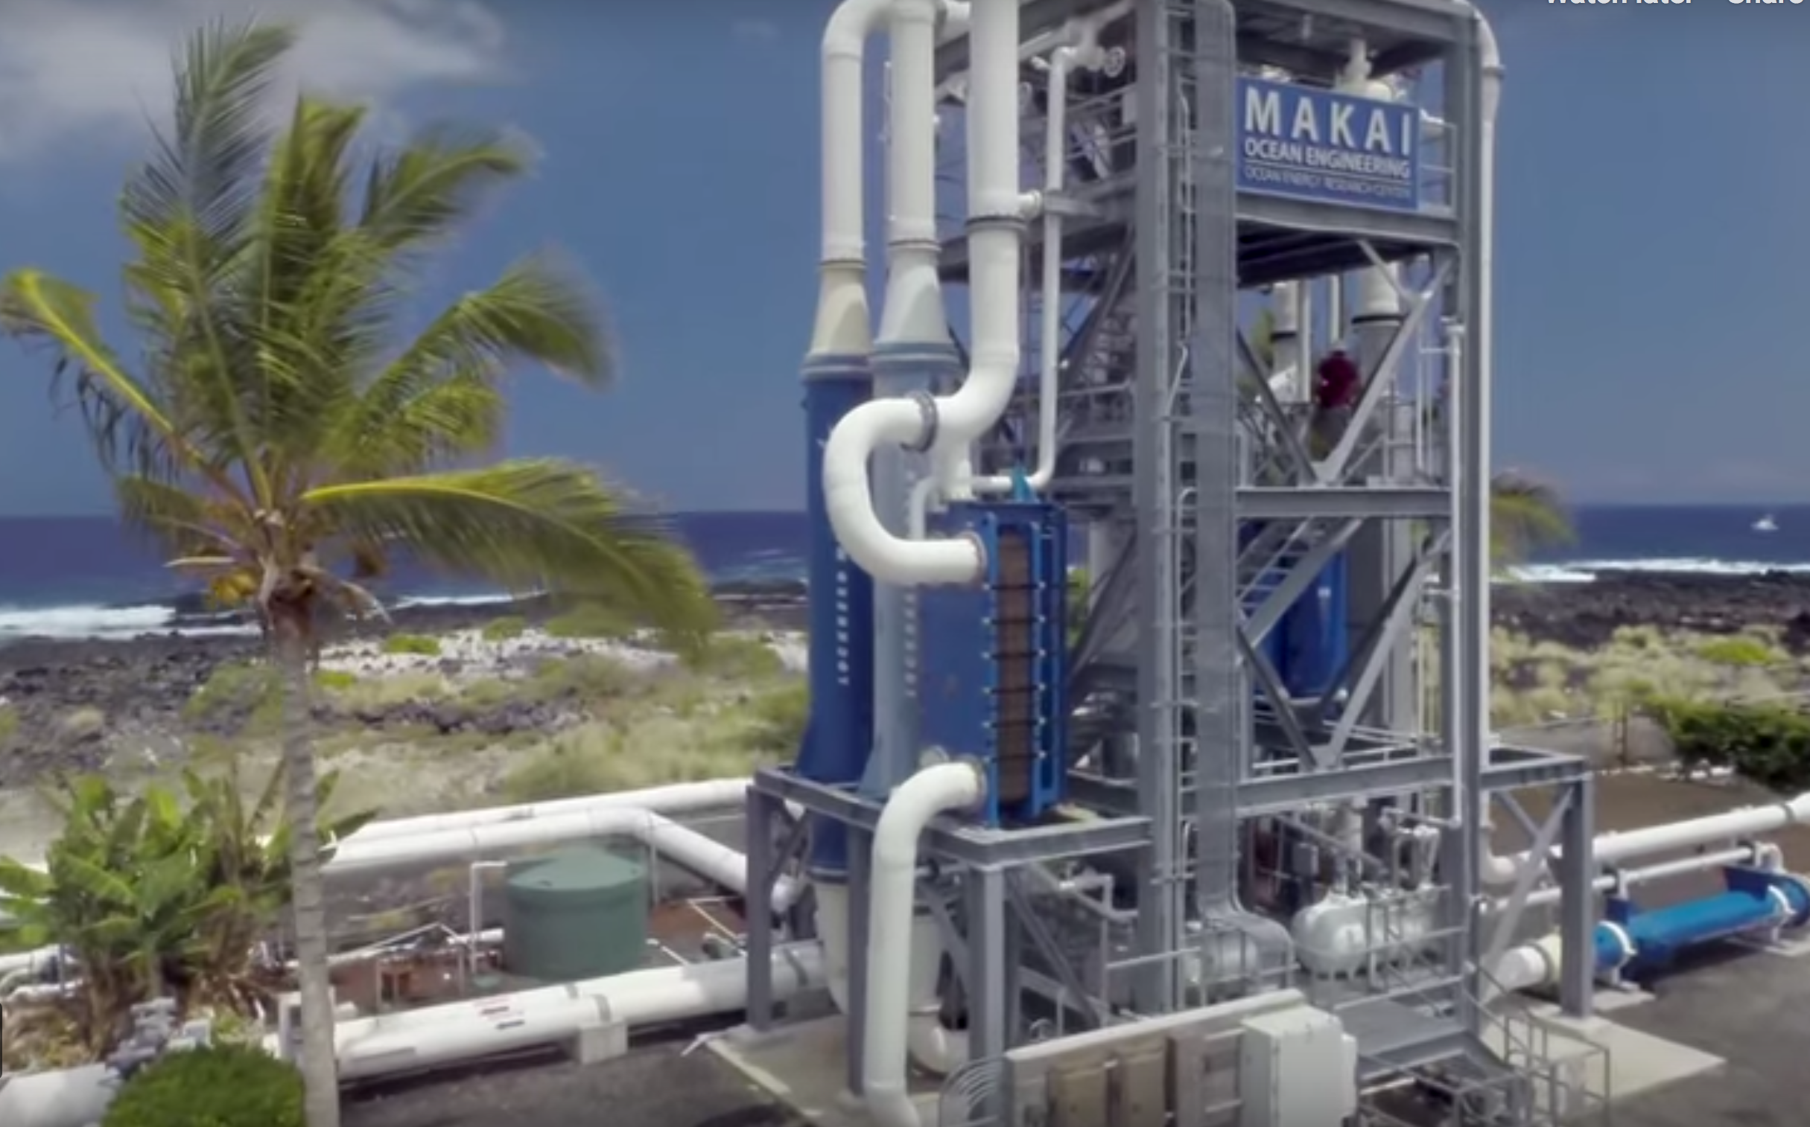
A Makai video further explaining that test project:
Makai webpage embedding video: https://www.makai.com/ocean-thermal-energy-conversion/
Direct YouTube link: https://www.youtube.com/watch?v=LJV4d4XtHuo
An Introduction to Sustainable Energy Systems: WeCanFigureThisOut.org/ENERGY/Energy_home.htm

Slide 28
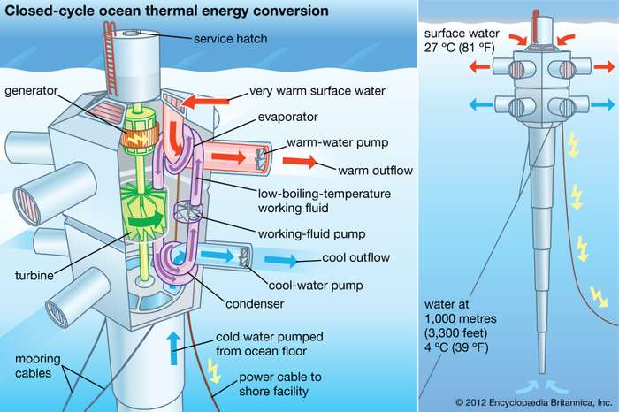
On & Offshore components could be combined within a floating tower
Which would eliminate long (expensive) runs of large-bore seawater pipe connecting
onshore heat exchangers / turbine generators with
towers floating ~ 1000m above the necessary cold (but deep) seawater
Encyclopedia Britannica: Ocean Thermal Energy Conversion Technology
https://www.britannica.com/technology/ocean-thermal-energy-conversion
Likely downsides? Higher cost of much more complex floating tower
Higher cost of maintaining offshore heat exchangers & generators
Possibility of offshore (in sea) leaks of ammonia working fluid

Slide 29
OTEC plants are now being considered in:
The Bahamas, Hainan China, Japan, U.S. Virgin Islands,
Kiribati, Korea, Martinique and The Maldives ¹
But the technology has yet to be extensively tested
Indeed, not a single commercial scale (100's of MW) plant has yet been built
(much less operated for an extended amount of time)
So the technology must still be considered to be in its infancy
Bottom lines regarding Ocean Thermal Energy Conversion?
Based on our admittedly very limited worldwide experience with OTEC, it appears that:
While OTEC may contribute strongly to power on isolated islands or mainland coasts,
impact within heavily populated continental areas seems unlikely
An Introduction to Sustainable Energy Systems: WeCanFigureThisOut.org/ENERGY/Energy_home.htm

Slide 30
The Physics of Tapping into Water Power
An Introduction to Sustainable Energy Systems: WeCanFigureThisOut.org/ENERGY/Energy_home.htm

Slide 31
Water can provide power from either its kinetic or potential energy:
Water's potential energy is captured by forcing falling water to do work
From high school physics, gravitational potential energy is:
E_{gravity} = M g h where g = Earth's surface gravity and h = the water's height
The change in energy after falling a distance Δh is then: Δ E_{gravity} = M g Δh
And the power extractable from that falling water is:
Power water_gravity = Δ Egravity / Δ Time = M g Δh / Δt = (mass of water falling / time) g Δh
But the mass of water falling per time = (volume of water flow) x (density of that water)
Labeling that flow (a volume per time) as: F and the water's density as: ρwater
We get for the power extractable from a falling flow of water:
Powerwater_gravity = g Δh F ρwater OR: Powerwater_gravity = g ρwater Flow x Δh
Substituting in g = 9.8 m / sec², ρwater = 1 g /cc, and using fact that 1 kJ = 1 kW-sec:
Power_{water_gravity} = 9.8 (kW-sec / m⁴) x Flow x Δh

Slide 32
To extract water's kinetic energy, you must force it to slow down
For instance, by forcing that flowing water to turn a propellor connected to a generator
Again from high school physics, kinetic energy (K.E.) = (1/2) M x velocity²
making the kinetic energy per volume of flowing water:
(1/2) ρwater velocitywater² (because water M / volume = density = ρwater)
The water power passing through a plane (where we'll put the propellor) is then:
Power water flow = (Water K.E. / Volume) x (Volume of water through that plane / time)
However: Volume passing plane / time = (Perpendicular area of plane) (velocitywater)
Combining all three expressions yields a possibly surprising result:
Power water flow = (1/2) ρwater velocitywater² x Areaplane x velocitywater or rearranging:
Power water flow = (1/2) ρwater x Areaplane x velocitywater ³
Yes: Power of a flow crossing a plane varies as flow's velocity cubed (not squared)!
Because, while a particular volume of flow has kinetic energy promotional to v²,
the flow is delivering those volumes to that plane at a rate also proportional to v

Slide 33
But you can't hijack all of a flow's kinetic energy - at least not continuously
You could do it momentarily by suddenly inserting a barrier into its path
Which would give that barrier a kick convertable into electrical power
But, once stopped by the barrier, no more flow would arrive => No more power out!
What you could do is instead insert a propellor geared to a generator such that
the water manages to flow through it at say, half its original velocity
Note here that because water is almost incompressible, to maintain this situation
part of the incoming flow would have to divert out and around that propellor
Nevertheless, you'd have slowed part of the flow to half its velocity, resulting in:
Lost power = (1/2) ρwater x Aplane x vwater ³ ⁻ (1/2) ρwater x Aplane x (vwater / 2) ³
= (1/2) (1 - 1/8) ρwater x Aplane x vwater ³
= (7/8) Water's incoming flow power = Power to your generator!
(At least for the fraction of the flow that continued onward through your propellor)

Slide 34
The value & utility of those water power formulas
These formulas evaluate the power input to water power plants
Which determines an absolute upper limit on power output from such plants,
This can often expose exaggerated claims made for new energy technologies
But their value in estimating an actual power plant's output is mixed
The difficulty is in evaluating the conversion efficiency of a particular type of plant
Gravitational energy is a best case, because its conversion to electrical energy is uncomplicated
Real hydroelectric plants thus convert 80-90% of input power calculated by the 1st formula
Flow energy is more of a worst case, because its conversion is so very complicated
As noted above, to keep from killing the flow, you can only partially slow it, meaning that:
1) You can capture only a fraction of its total incoming kinetic energy (2nd formula)
2) And much of the flow's material must bypass your converter (e.g., the turbine)
The latter point implies that turbines will have to be widely spaced,
which further reduces the fraction of flow's total input energy that can be captured
An Introduction to Sustainable Energy Systems: WeCanFigureThisOut.org/ENERGY/Energy_home.htm

Slide 35
These distinctions mean that, in this note set:
For Tidal Barrages converting water's gravitational potential energy,
I will use the relevant formula to optimize a Tidal Barrage's design
I will further calculate the likely total power produced by a real life Tidal Barrage
Whereas for Tidal Flow farms converting water's kinetic energy,
I will use the relevant formula to identify flows maximizing input power
But I cannot accurately estimate total power produced by a specific turbine farm
THAT instead requires extremely complex computer-based modeling
I will discuss one such study which calculates maximum likely output power
from turbine farms planned for a specific location,
but which provides frustratingly incomplete information about the
turbine & farm designs yielding that maximum power output
An Introduction to Sustainable Energy Systems: WeCanFigureThisOut.org/ENERGY/Energy_home.htm

Slide 36
Tidal Barrage Power
Covered more completely in my note set on Hydro Power (pptx / pdf / key)
An Introduction to Sustainable Energy Systems: WeCanFigureThisOut.org/ENERGY/Energy_home.htm

Slide 37
A Tidal Barrage is a dam NOT filled by an incoming river
Conventional Dam: Outgoing River / Large Dam / Large Reservoir / Incoming River
Continuous power from thru-flowing river
Tidal Barrage: Big Tidal Ocean / Small Dam / Small Reservoir
Ocean
Dammed inlet or manmade basin
Power generated on outgoing tide
Power generated on incoming tide
An Introduction to Sustainable Energy Systems: WeCanFigureThisOut.org/ENERGY/Energy_home.htm

Slide 38
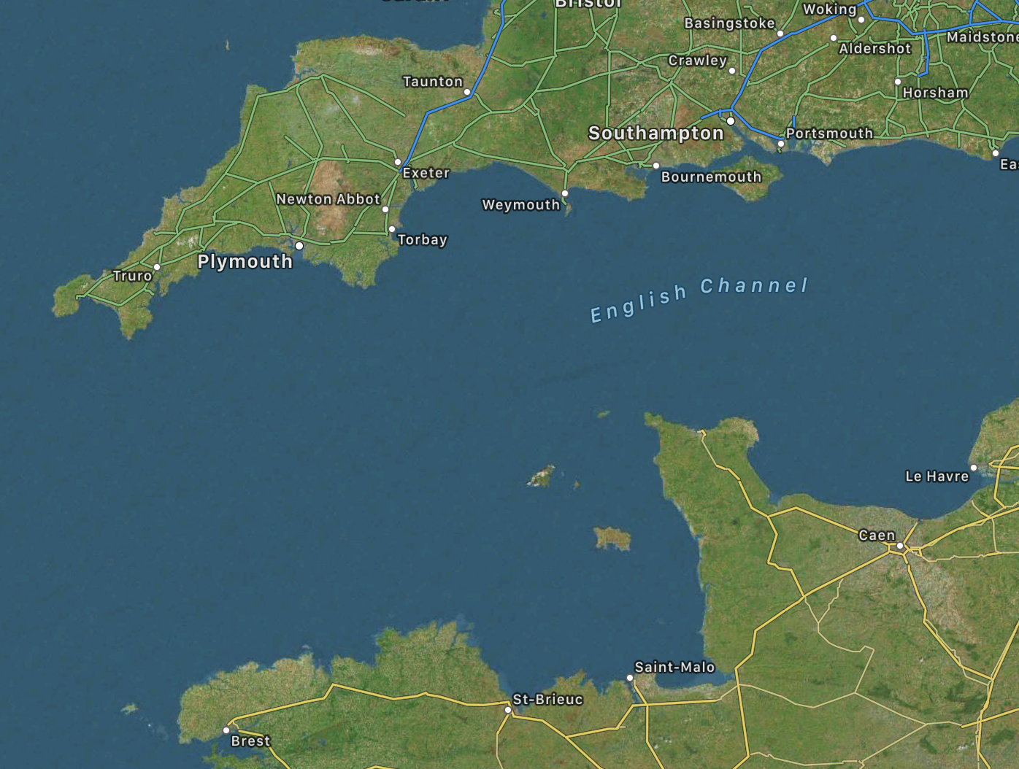
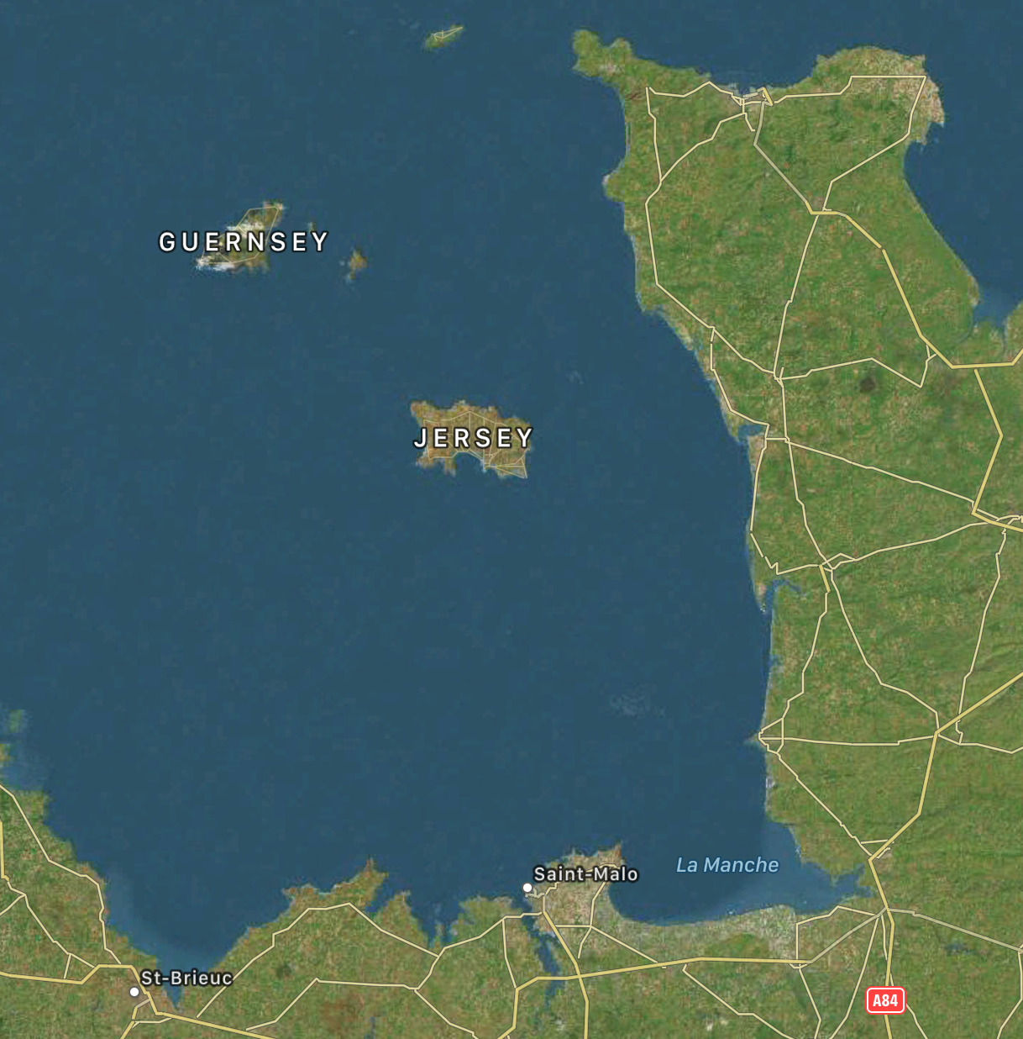
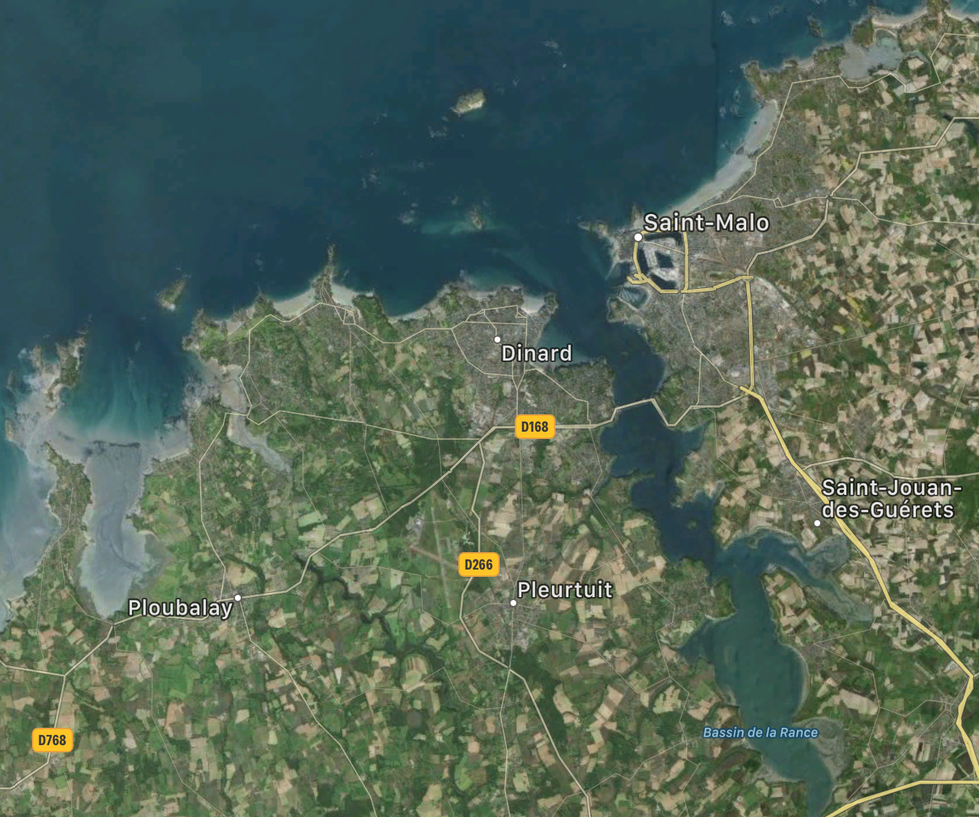
Higher the tides - Higher a Tidal Barrage's power
But as they reach our coasts, tides typically rise and fall by only 2-3 meters ¹
The solution: Seek out nature's many atypical coastal tides
such as those created where tides are squeezed into narrowing inlets & bays
Such funneling occurs on several scales as tides approach France's Brittany coast,
leading to 8 meter tides in the Rance River estuary, adjacent to Saint Malo
Satellite images from Apple Maps
1) https://www.infoplease.com/encyclopedia/earth/geology-oceanography/info/tide/the-magnitude-and-effects-of-tidal-ranges

Slide 39
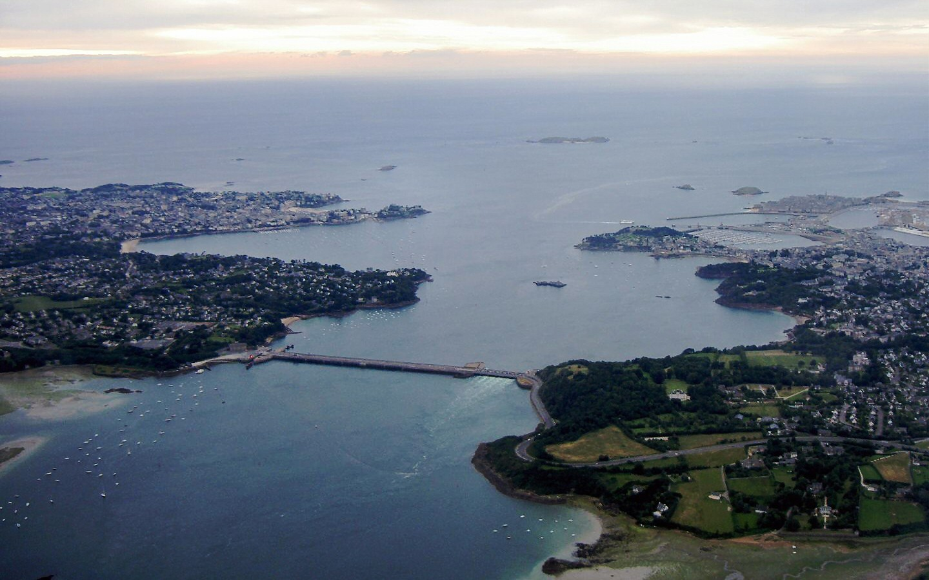
The (circled) road crossing Saint Malo's estuary was in fact a Tidal Barrage:
Built in 1966, it remained the world's largest tidal barrage until 2011
But as seen below, it appears to be little more than a small / low river crossing
As with solar & wind, Tidal Power output mirrors nature's cycles of power input
But with ~ two tides per day, and peak flows for both incoming & outgoing tides,
Tidal Barrage power plants produce four daily cycles of power
At the peaks in those tidal flows, the Rance Tidal Barrage produces 240 MW
But its cycle-averaged power is 57 MW
Which is small for a power plant
But not bad for a plant with such a
small footprint & visual impact
Which exploits essentially free "fuel"
And produces no exhaust or pollution
1) http://en.wikipedia.org/wiki/Rance_Tidal_Power_Station

Slide 40
But why is a small 1966 plant still the prime example of this technology?
Especially when "small footprint" suggests low-cost plant construction & maintenance
Which, combined with "free fuel" and "no exhaust or pollution,"
sounds like a recipe for near certain power plant success
The disconnect may lie in the Rance Barrage's "small footprint" which required
construction of only a short low dam across a small natural estuary
Large Tidal Barrages would instead require long dams across large estuaries
But we already use large natural estuaries for LOT of things, including:
shipping and/or fishing and/or as ecological and/or recreational reserves
These would be disrupted or totally blocked by conversion into Tidal Barrages
And it is likely that artificial single-purpose Barrages would be hugely expensive
An Introduction to Sustainable Energy Systems: WeCanFigureThisOut.org/ENERGY/Energy_home.htm

Slide 41
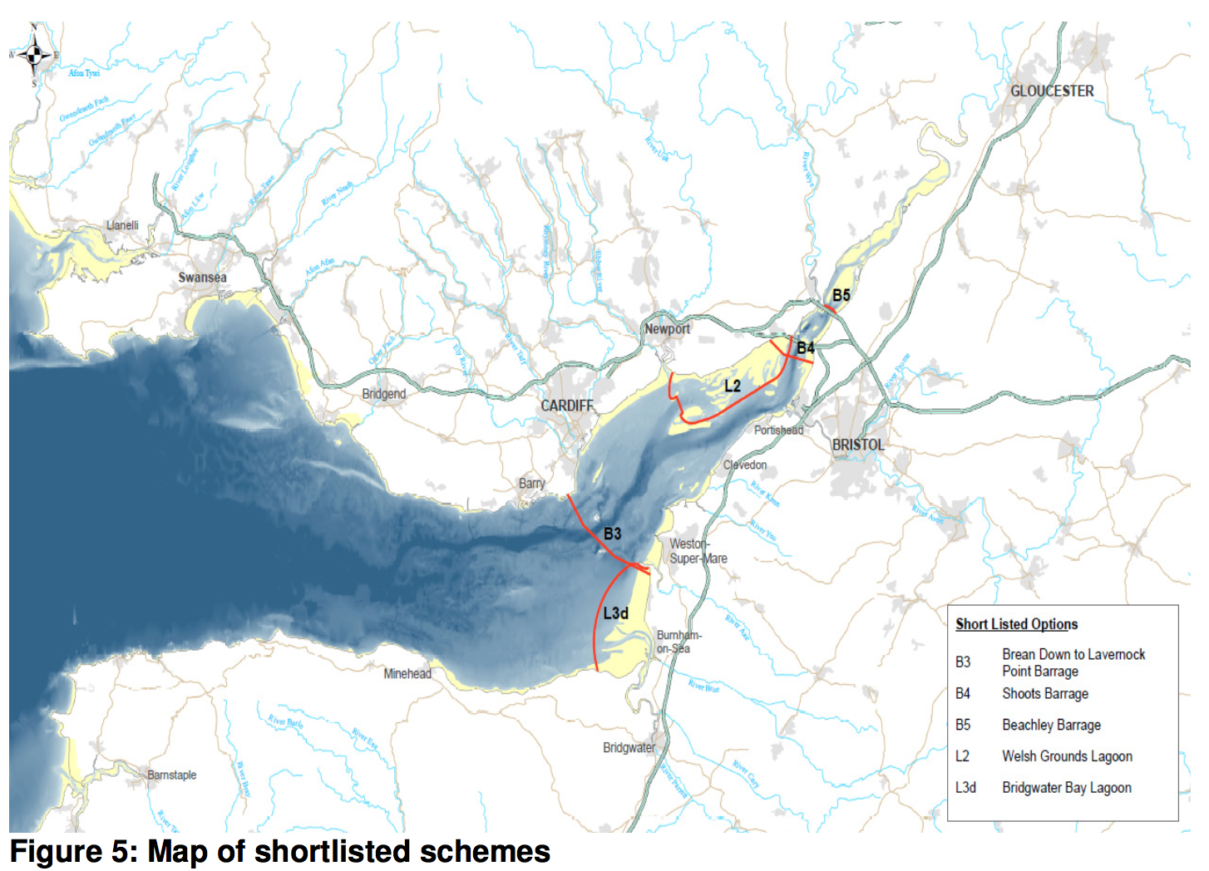
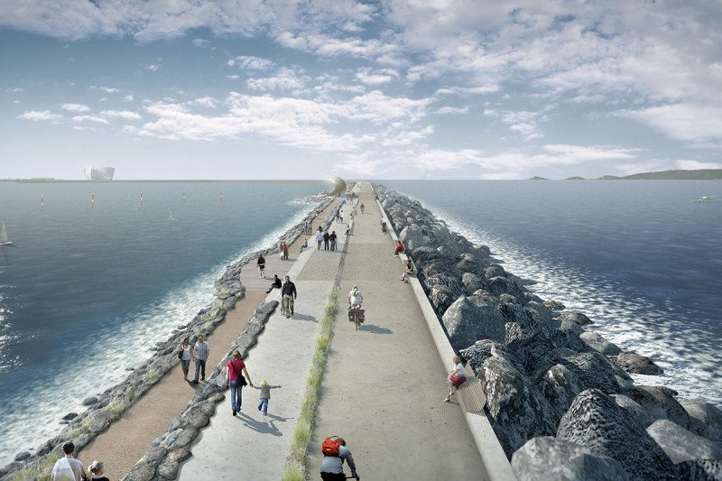
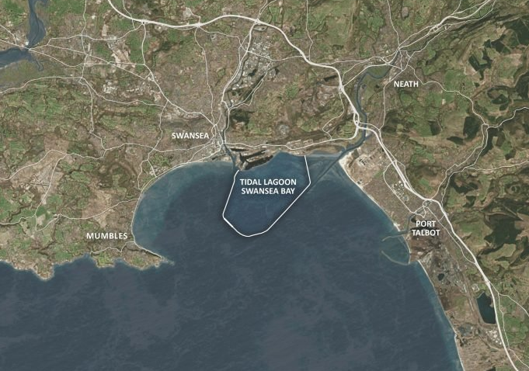
The scale of those challenges is suggested in these figures:
Which depict intensely controversial Tidal Barrages now proposed in Britain
Proposed Tidal Barrages obstructing the heavily trafficked Severn River estuary:
Possible barrier dams ("barrages")
https://www.gov.uk/government/uploads/system/uploads/attachment_data/file/50064/1._Feasibility_Study_Conclusions_and_Summary_Report_-_15_Oct.pdf
Would-be drone & satellite views of a huge looping tidal barrier off the Swansea coast:
https://www.newscientist.com/article/2117792-uk-urged-to-push-ahead-with-world-first-tidal-lagoon-power-plant/
http://www.tidallagoonpower.com/projects/swansea-bay/

Slide 42
UK feasibility studies are discussed in my Hydropower Power note set ¹
Highlights of those often strongly disagreeing UK studies include:
Estimates that power from those mega Tidal Barrages might
cost from two to seven times more than we now typically pay in the U.S.
i.e., from 0.17 to 0.6 £ / kW-h (equivalent to ~ 22 - 78 ¢ / kW-h)
And one UK government report claims that:
"A tidal power scheme . . . is high cost and high risk in comparison to other ways of generating low-carbon electricity"
"In most cases other renewables (e.g. wind) and nuclear power represent better value"
"Scale and impact of a scheme would be unprecedented in an environmentally designated area"
"Fish are likely to be severely affected with local extinctions and population collapses predicted"
But one must recognize that (as in the U.S.) UK green energy has been intensely politicized
With seemingly every negative report countered by a positive report,
in a battle that (to my personal knowledge) has raged for at least two decades,
1) Hydro Power (pptx / pdf / key)

Slide 43
A simpler question: What is the upper limit on Tidal Barrage power?
The Barrage is powered by water flowing through its turbines
But the ultimate source of that power is the gravitational potential energy
added to the water lifted into the Barrage by the incoming tide
That lifted water is upper right in this figure - which depicts a tide of height H:
The added water has mass: M = ρseawater x Area x H (ρseawater ⁼ 1029 kg / m³) ¹
Lifting increased each unit of water's potential energy by: M g Δh
But while water at the top rose by H
Water at the bottom base rose by 0
Making for an average rise of Δh = H/2
The total potential energy added within the Barrage was thus:
Added Tidal Energy = M g Δh = (ρseawater x Area x H) g (H/2)
Rearranging: Added Tidal Energy = ρseawater g Area H² / 2
Area
H
H/2
0
1) https://en.wikipedia.org/wiki/Seawater

Slide 44
That much energy would be capturable over each tidal cycle
The average available tidal-driven power would thus be:
Power tidal = (Tidal Energy) / (Tidal Cycle Time)
For a typical tidal cycle time of ~ 12 hours = 43,200 seconds:
Power tidal = [ρseawater g Area H² / 2] / [Tidal Cycle Time]
= [(1029 kg / m³) (9.8 m / s²) Area H² / 2] / [43,200 s]
= 0.12 (kg / m² - s³) Area H²
Using the definition of a Watt: W = J / s = (kg m² / s²) / s = kg m² / s³ we then get:
Power tidal = 0.12 Watts / m⁴ x (Area x H²)
For a 1 km² Tidal Barrage with a worldwide average coastal tide ¹ of 2.5m:
Power tidal = 0.12 Watts / m⁴ x (10⁶ m² x 6.25 m²) = 0.75 MW
1) https://www.infoplease.com/encyclopedia/earth/geology-oceanography/info/tide/the-magnitude-and-effects-of-tidal-ranges

Slide 45
But the Rance Tidal Barrage has an area of 22.5 km² with 8m tides: ¹
So its time-averaged available tidal power should approach:
Power tidal = 0.12 Watts / m⁴ x (22.5 x 10⁶ m² x 64 m²) = 172 MW
Given that the real Rance Tidal Barrage produces an average of 57 MW,
this suggests that real-world Tidal Barrage power conversion efficiency is ~ 33%
That is identical to the real-world efficiency of coal power plants
But more closely related Pumped Storage Hydro plants achieve 80%
Suggesting shortcomings in my simple potential-energy-based model
Using the real-world Rance power, but adjusting for more typical 2.5m tides:
Power tidal / km² = 57 MW x (2.5 m / 8 m)² / 22.5 km² = 0.25 MW / km²
which is ten times larger than Geothermal's 26 mW / m² = 0.026 MW / km²
But at least fifty times smaller than Solar's 12-50 W / m² = 12-50 MW / km² (Ref. 2)
Bottom Line: Barrages will require HUGE AREAS for nation-scale power
1) http://en.wikipedia.org/wiki/Rance_Tidal_Power_Station 2) My note set: Today's Photovoltaic Solar Cells (pptx / pdf / key)

Slide 46
Tidal Stream Power
An Introduction to Sustainable Energy Systems: WeCanFigureThisOut.org/ENERGY/Energy_home.htm

Slide 47
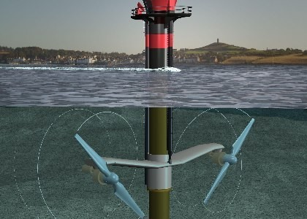
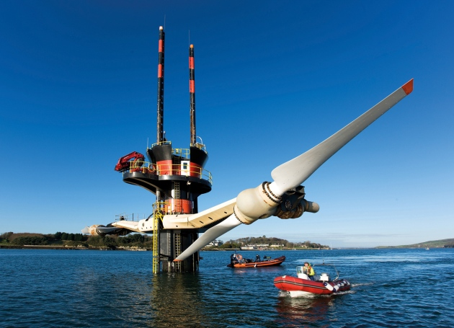
Tidal Stream power taps into the kinetic energy of flowing water
http://subseaworldnews.com/2012/01/17/uk-seagen-tidal-turbine-gets-all-clear-from-environmental-studies/
https://www.nature.com/news/power-from-the-oceans-blue-energy-1.15045
This Tidal Stream turbine, in Northern Ireland's Strangford Loch produces 1.2 MW
Which, disappointingly, is only ~ 1/500th of an typical U.S. Power Plant
Or 1/8th to 1/6th the power of a single modern commercial wind turbine
Tidal Stream turbines resemble wind turbines in their conversion of kinetic energy
Both types of flow transport kinetic energy at a rate yielding a power of:
Power flow = (1/2) ρ x Area x velocity ³ where ρ is the density of the flow

Slide 48
But water's density is ~ 1000X that of air:
So why don't water flows carry 1000X the power of wind flows?
Because while wind velocities easily reach several ten's of kilometers per hour,
tidal flows are typically only several kilometers per hour
In the formula, this gives wind flows a (10)³ = 1000X velocity cubed advantage
Which exactly offsets water flow's 1000X density advantage
Tidal Stream power plants must thus seek out exceptionally fast tidal flows
Where, given the flow power equation's factor of velocity cubed,
short extremely fast flows may deliver MORE power than long fast flows
Where might one find exceptionally fast, if not always sustained, tidal flows?
Where tides from a large bay flow through a narrow passage to the ocean,
My west coast roots call to mind two U.S. candidates:
- The mouth of Puget Sound (The Strait of Juan de Fuca) and
- The mouth of San Francisco Bay (the "Golden Gate")

Slide 49
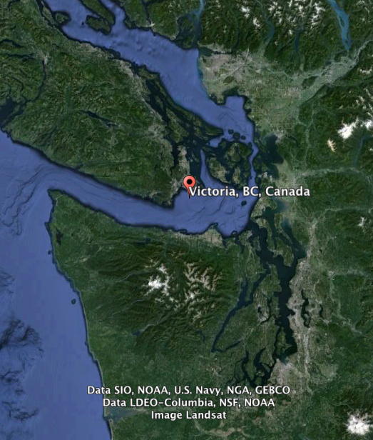
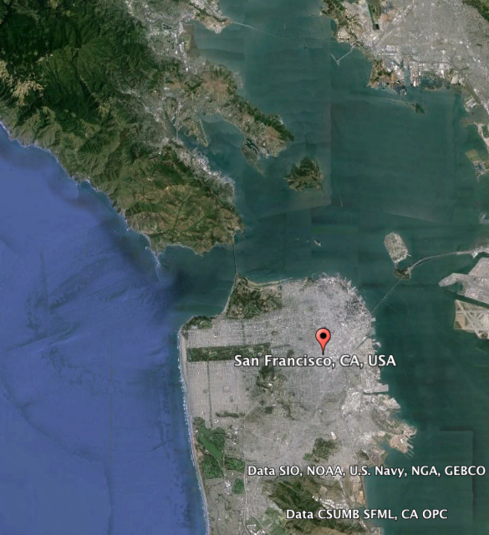
The Golden Gate has the larger bay to inlet size ratio:
Leading to tidal large whirlpools forming at the north side of the Golden Gate
Which, as impressive as they are when viewed from the bridge above,
are little short of terrifying when viewed from the deck of a small sailboat
(from which I once had the "opportunity" to view them)
Google Earth

Slide 50
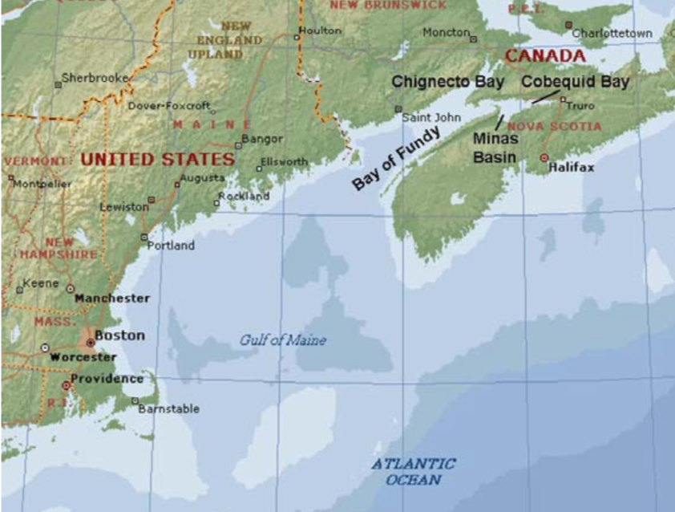
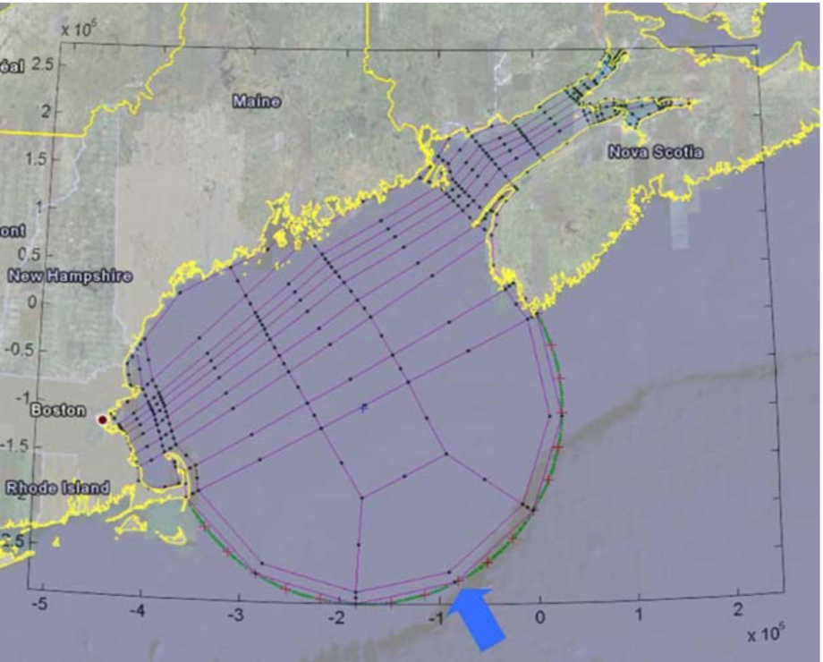
But some weird physics can provide for even faster flows
For instance, in Nova Scotia Canada's Bay of Fundy
Fundy's 160 million tonne tidal flow exceeds the combined flow of all the world's rivers
That flow produces tides rising and falling up to 16 meters (~ 58 feet),
and flowing at speeds up to 5.1 m / s = 18.4 km / hr (11.4 mph) ¹
This is the product of a bathtub-like sloshing phenomenon called Tidal Resonance
The "bathtub" is formed by the Bay of Fundy + Gulf of Maine + Continental shelf ²
Ref 1) https://www.oceannetworks.ca/observatories/atlantic/bay-fundy-minas-passage
Ref 2 / Figures) https://www.researchgate.net/publication/49115803_HARBOR_RESONANCE_A_COMPARISON_OF_FIELD_MEASUREMENTS_TO_NUMERICAL_RESULTS

Slide 51
Acting like an ultra-broad wave, a tide comes in off the deep ocean
That incoming tide raises the water level in the Gulf of Maine, some of which
is then driven into the narrowing Bay of Fundy, at the upper right
As the tide retreats, water pours back out of the Bay as a broad wave traveling SW
Some of that wave eventually rebounds off Massachusetts and its Cape Cod
Other spreading parts reflect back at the edge of the Continental Shelf
These combined reflections then move back toward the coast & Bay of Fundy
But due to the Gulf + Bay geography, this
ECHO of the original tide returns ~ 12 hours later
and it thus adds to the subsequent tide
= Tidal Resonance ~ Bathtub sloshing ^{1, 2}
Ref 1 / Figure: https://www.researchgate.net/publication/49115803_HARBOR_RESONANCE_A_COMPARISON_OF_FIELD_MEASUREMENTS_TO_NUMERICAL_RESULTS
Ref 2) https://pdfs.semanticscholar.org/9c3b/d3750c1c3e02b331d1170ca7254eb57be302.pdf?_ga=2.61210730.738248831.1576318026-1968116301.1576318026

Slide 52
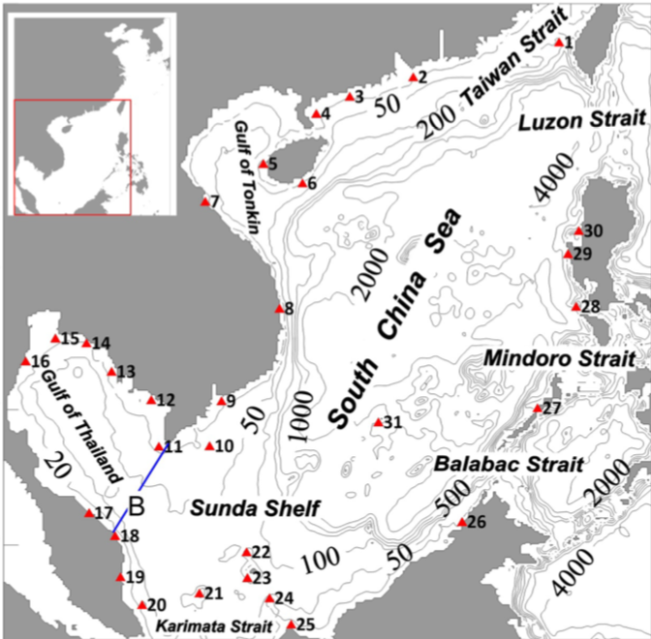
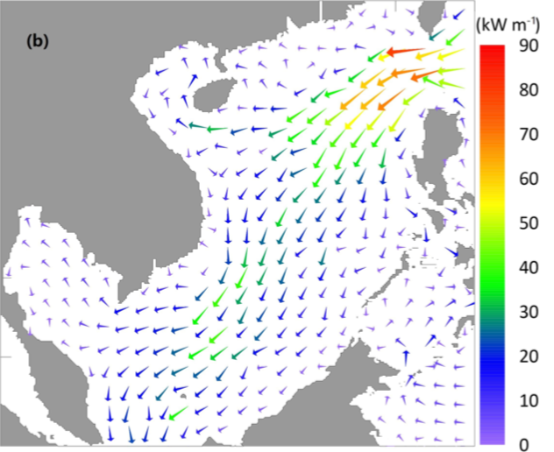
Such echo-induced resonances occur for all types of waves
Including light waves, sound waves, seismic waves, and even "electron waves"
Light wave resonances enable the Internet's backbone of fiber optics
Seismic wave resonances can topple poorly conceived skyscrapers
Electron wave resonances are the very foundation of "Quantum Mechanics" ¹
Relevant to Tidal Stream power, varying degrees of Tidal Resonance occur worldwide
Including in the Gulf of Thailand (a.k.a. the "South China Sea"): ²
1) For more about wave resonance (including videos) see my Nanoscience note set Electron Waves (pptx / pdf / key)
2) https://www.ocean-sci.net/15/321/2019/

Slide 53
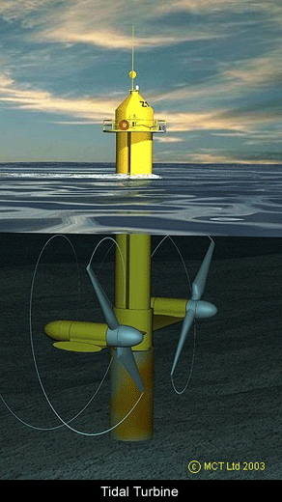
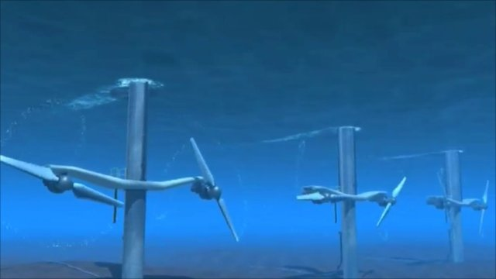
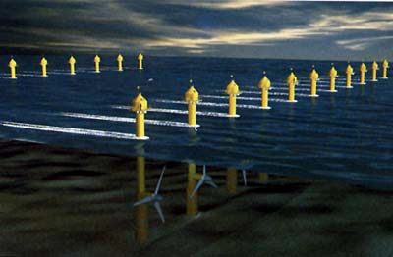
But what sorts of turbines could survive in such super-tidal locations?
As noted earlier, even normal inlets & bay mouths are busy places, with all sorts of
huge slowly moving (and thus only weakly steerable) ships passing through
Making it very likely that Tidal Steam turbines such as these designs (real & proposed),
might have very short - if possibly very exciting - operational lifetimes
(That's if shipping & fishing interests allowed them to be built in the first place)
http://www.bbc.co.uk/news/uk-wales-north-west-wales-11037069
http://www.fujitaresearch.com/reports/tidalpower.html
http://www.global-greenhouse-warming.com/tidal.html

Slide 54
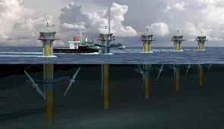
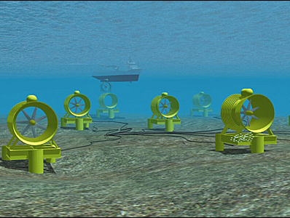
Bottom-hugging designs are far more plausible:
They overcome the common trap of mimicking tall willowy wind turbines, substituting
compact & heavy turbines that sink and cling to the ocean bottom
Eliminating any surface obstruction to navigation (= target for ship collisions) AND
Removing the need for VERY hard to construct undersea foundations (=$$$)
I.E., instead of this:
Something more like this:
Ship about to ram tidal turbine:
Ship oblivious to tidal turbines:
http://www.marineturbines.com/3/news/article/37/anglesey_tidal_energy_plan_moves_forward_
http://news.bbc.co.uk/2/shared/spl/hi/pop_ups/07/uk_enl_1193829329/html/1.stm

Slide 55
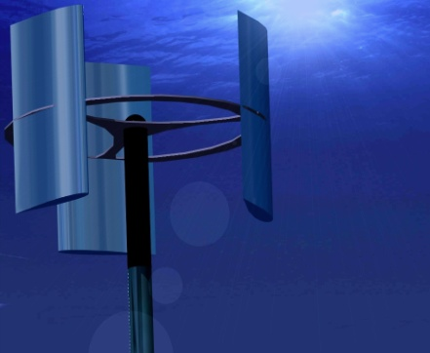
Vs. less well thought out proposals:
http://www.esru.strath.ac.uk/EandE/Web_sites/10-11/Tidal/tidal.html
Here someone apparently just Photoshopped the image
of a vertical axis wind turbine onto an undersea background
The only advantage of such wind turbines is that wind from any direction turns them
But tides flow in one direction (and its opposite), so why use this flimsy design?
Further, the force on a turbine = Flow momentum transferred from fluid / time
= (momentum/volume) (volume/time) = (ρv) (Area v) = A ρ v²
=> (1000X) (1/10X)² = 10X times the force on comparable wind turbine
So a corresponding tidal turbine would have to be ten times thicker / stronger!

Slide 56
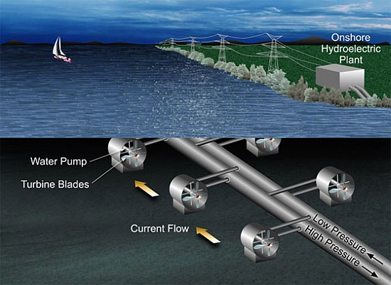
Vs. just plain dumb proposals:
http://www.ecofriend.com/eco-tech-nasa-s-jpl-develops-a-cost-effective-way-to-harness-ocean-energy.html
Instead of producing electricity AT the undersea turbines,
and then delivering it to shore via simple efficient ELECTRICAL CABLES
This proposal suggests using ocean bottom tidal turbines to pump water,
through BIG LONG PIPES,
all the way to an onshore hydro power station
Can you imagine the energy lost to friction & turbulence in those long pipes?
(to say nothing of the cost / difficulty in laying down those long pairs of pipes!)

Slide 57
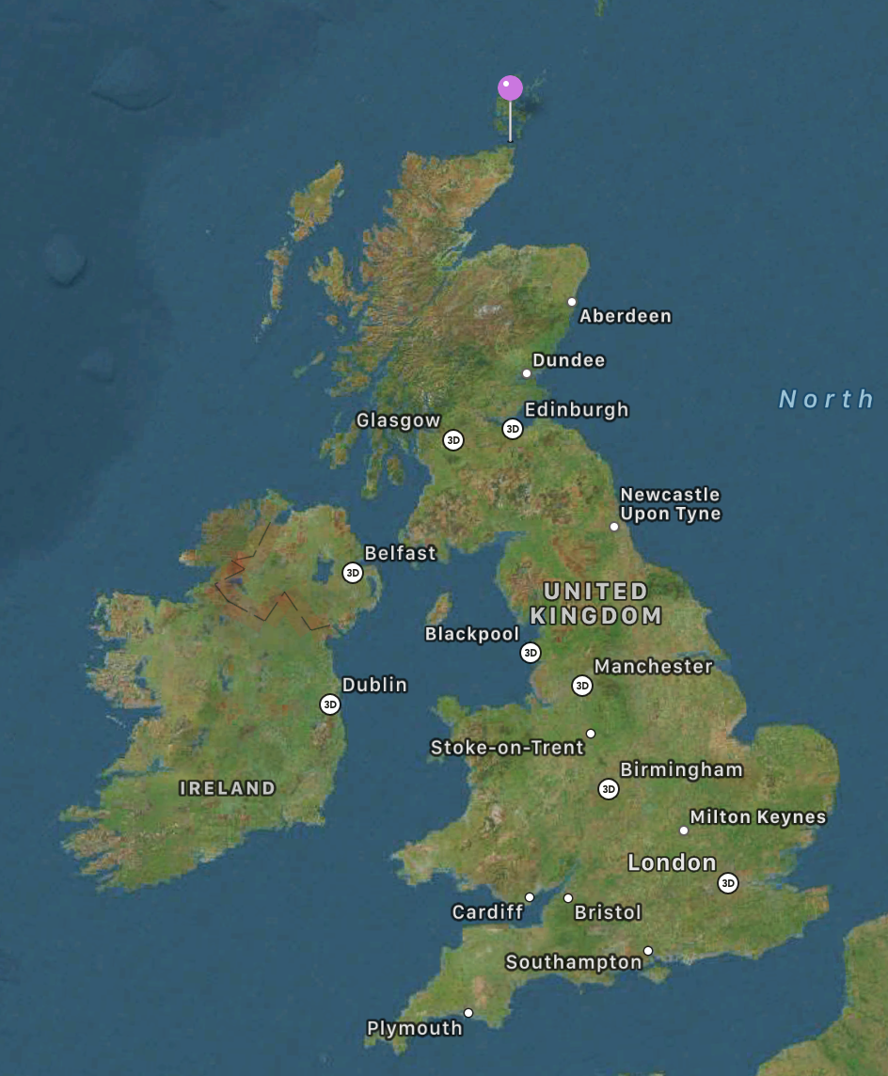
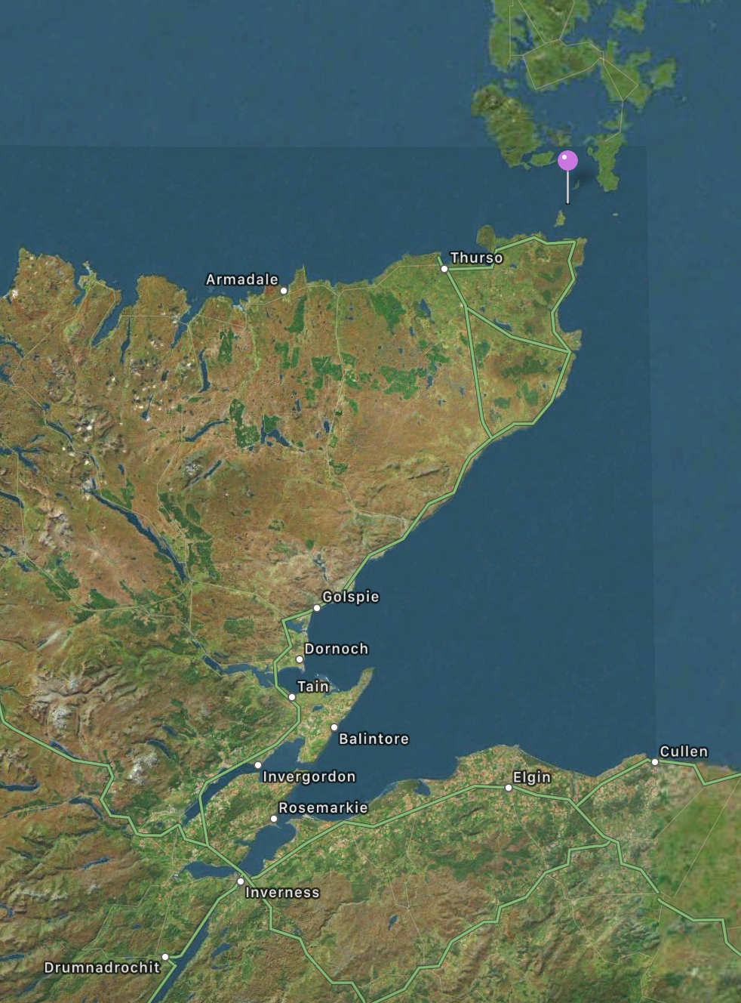
Can we identify apparently successful / proven Tidal Stream designs?
MeyGen in Scotland's Pentland Firth is the largest ongoing Tidal Stream project
That "Firth" is the strait separating mainland Scotland from the Orkney Islands
Its up to 5 m/s water flow speeds equal those found in the Bay of Fundy ^{1, 2}
Satellite Images from Apple Maps
The project's Phase IA placed four 16m diameter, 1.5 MW turbines on the ocean floor ³
The first turbine became fully operational in 2017, and the fourth by 2018
1) https://en.wikipedia.org/wiki/MeyGen 2) https://www.oceannetworks.ca/observatories/atlantic/bay-fundy-minas-passage 3) https://www.theguardian.com/uk-news/2016/sep/12/worlds-first-large-scale-tidal-energy-farm-launches-scotland

Slide 58
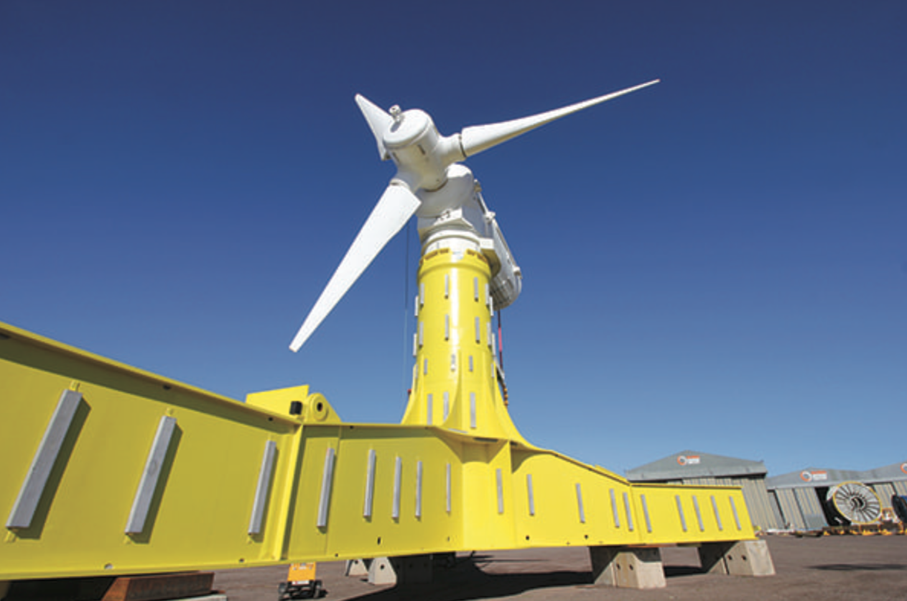
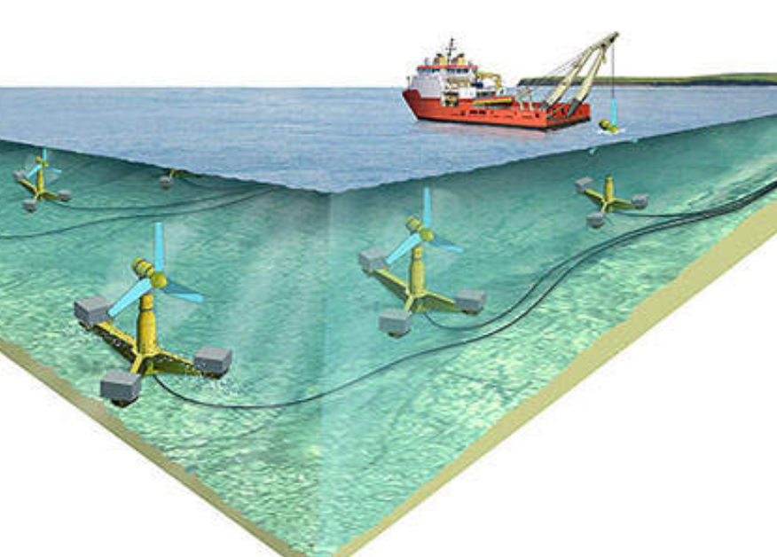
Its four operational turbines are indeed compact, foundation-less, bottom-clinging
Figure from reference 3
Figure from reference:4
Phase 1B (now in progress) will bring the project's total turbine count to 8 ^{1, 4}
Phase 1C (targeting 2021) would bring turbine count to 49 & capacity to 86 MW ¹
A proposed 2nd phase would bring turbine count to 269 and capacity to 398 MW ⁴
with the total installation then occupying 3.3 to 3.5 km² of ocean floor ^{3, 4}
1) https://en.wikipedia.org/wiki/MeyGen
2) https://www.theguardian.com/uk-news/2016/sep/12/worlds-first-large-scale-tidal-energy-farm-launches-scotland
3) https://www.powermag.com/meygen-array-sets-global-records-for-harnessing-tidal-power/?printmode=1
4) https://www.power-technology.com/projects/pentland-firth-tidal-power-plant-scotland/

Slide 59
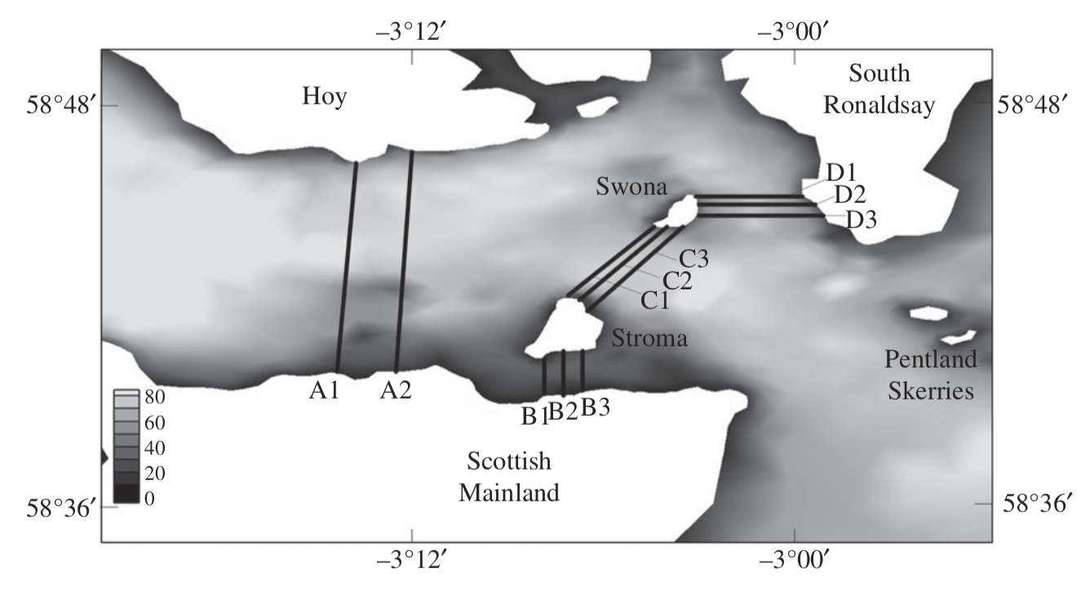
It's claimed Pentland Firth could provide 43% of Scotland's power ¹⁻³
This comes from a 2013 study involving U. Oxford & Edinburgh researchers ^{1, 2}
Which, based on modeling of Firth water flows in the presence of turbine farms,
concluded that 1.9 GW of Tidal Stream power might be harvestable via:
"three rows of turbines extending across the entire width of the Pentland Firth and blocking a large fraction of the channel"
1) https://royalsocietypublishing.org/doi/full/10.1098/rspa.2013.0072
2) https://www.eng.ed.ac.uk/about/news/20140128/tidal-energy-potential-pentland-firth-revealed
3) https://www.bbc.com/news/uk-scotland-north-east-orkney-shetland-25800448
Turbine patterns & spacings were among the input parameters in this study
But I did not find final estimates of the number of turbines required for 1.9 GW
Extrapolation from MeyGen suggests: 269 x (1.9 GW / 398 MW) ~ 1300 turbines

Slide 60
But do these MeyGen turbines really qualify as "successful and proven?"
Only 4-8 turbines are now in operation, the oldest operating for only ~ three years
For Tidal Stream power to succeed, turbines had better operate for dozens of years,
with little or no maintenance (likely requiring them to be hauled up off the seabed)
Further, as noted above, water turbines must withstand huge tidal forces
suggesting the use of the very best high high-strength steels,
which, unfortunately, start rusting immediately upon contact with salt water
causing joints, seals and bearings to freeze up, if not crumble apart
(to say nothing of the catastrophe of salt water + electronics) ¹
Earlier projects in the Bay of Fundy provide an apocryphal history:
1) See this story of the Jaws' robotic shark: https://www.tested.com/art/movies/456576-robot-shark-technology-jaws/
An Introduction to Sustainable Energy Systems: WeCanFigureThisOut.org/ENERGY/Energy_home.htm

Slide 61
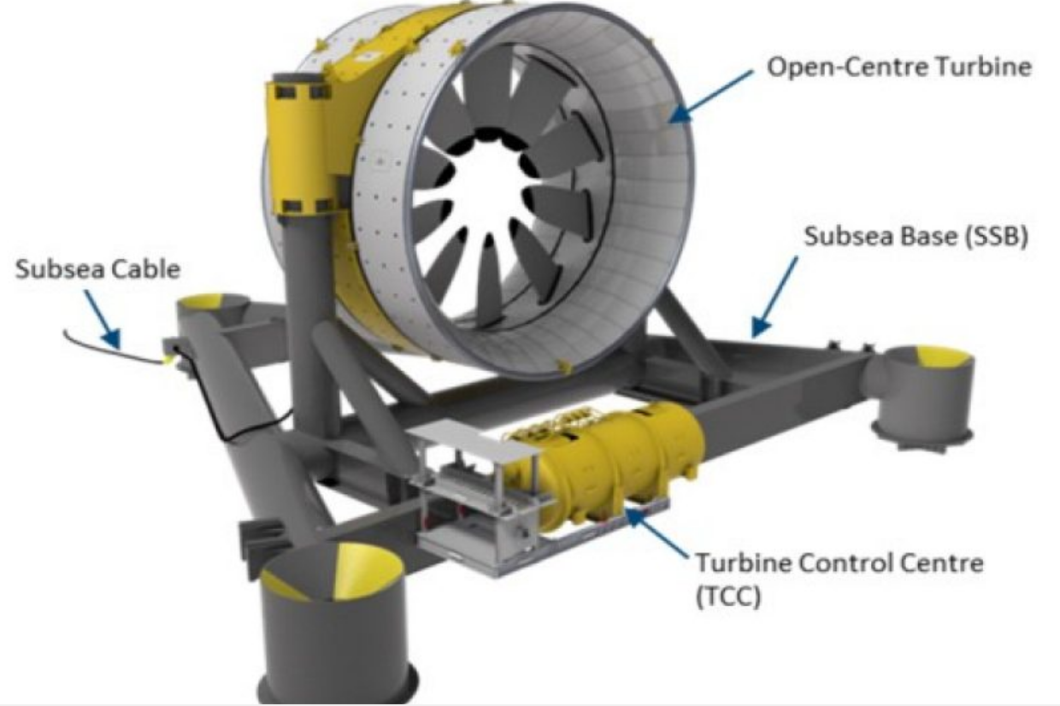
A Brief / Disappointing History of Tidal Stream Power in the Bay of Fundy:
It is mostly about turbines developed by Naval Energies' OpenHydro subsidiary
OpenHydro's turbines were compact, foundation-less, and bottom-clinging
But rather than connecting turbine blades inward to a central shaft
OpenHydro's turbine blades connected outward to a spinning ring
This distributed the tidal flow's force across different parts of the turbine
But it required more / larger moving parts, all in contact with corrosive seawater
Figure: https://warktimes.com/2018/08/03/cape-sharp-turbine-spinning-with-no-monitoring-for-effects-on-sea-creatures/

Slide 62
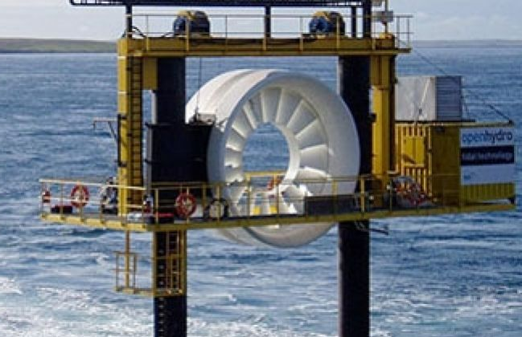
The first OpenHydro prototype was lowered into the Bay of Fundy in 2009:
Figure:
https://www.greentechmedia.com/articles/read/a-big-setback-for-tidal-power
The scale of this 1 MW prototype is seen by comparing its lifting rig's guard rails
The Bay of Fundy destroyed this turbine's blades within three weeks ¹⁻⁶
This sent OpenHydro "back to the drawing board,"
resulting in a 2 MW second generation turbine design,
of which two were scheduled for Bay of Fundy deployment in 2016
1) https://fundyforce.ca/resources/f1c21770b59114114866df4d491b4dc2/Appendix1-2019-Cape-Sharp-Tidal-Venture-Monitoring-Report-FORCE.pdf
2) https://fundyforce.ca/about-us
3) https://www.cbc.ca/news/canada/nova-scotia/failed-tidal-turbine-explained-at-symposium-1.1075510
4) https://www.nationalobserver.com/2017/06/06/analysis/tidal-power-bay-fundy-dream-without-danger
5) https://www.greentechmedia.com/articles/read/a-big-setback-for-tidal-power
6) https://warktimes.com/tidal-timeline/events-of-2010/

Slide 63
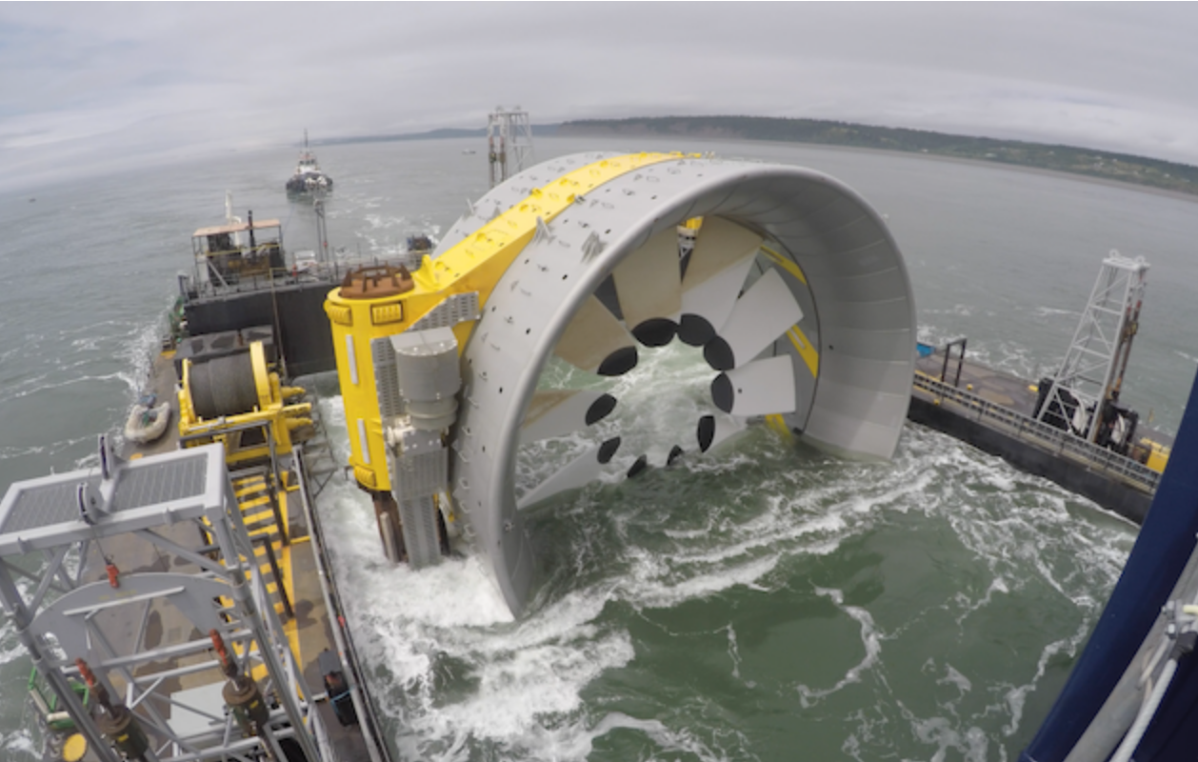
The first of these 2MW turbines was deployed on 7 November 2016
Figure:
https://www.halifaxexaminer.ca/featured/losses-from-the-failed-tidal-generation-project-continue-to-mount/
This turbine's increased size is again judged by comparing its barges' guard rails
Detailed information is very had to find, but combined news reports¹⁻⁴ indicate that
not long after deployment, the force of the tides was so strong
that the turbine, on its triangular platform, was dragged along the seabed
This apparently led to the chain of a platform anchor becoming entangled
with the turbine's power output and sensor/control cables, causing it to fail
1) https://fundyforce.ca/resources/f1c21770b59114114866df4d491b4dc2/Appendix1-2019-Cape-Sharp-Tidal-Venture-Monitoring-Report-FORCE.pdf
2) https://fundyforce.ca/about-us
3) https://www.saltwire.com/news/local/timeline-tidal-power-in-the-minas-passage-224062/?location=annapolis-valley
4) https://www.halifaxexaminer.ca/featured/losses-from-the-failed-tidal-generation-project-continue-to-mount/

Slide 64
While that turbine lay abandoned, OpenHydro modified its sister 2 MW turbine
Those modifications continued for two years
During which legal battles raged over recovery of the abandoned turbine
The sister 2 MW turbine was finally lowered to the Fundy seabed on 22 July 2018
And its power output and sensor/control cables connected two days later ^{1, 2}
But only two days after that, OpenHydro's mother company Naval Energies
announced it was abandoning tidal power and shutting down OpenHydro ¹
When, in early September, the new turbine was briefly reconnected,
it was found that its turbine had for some reason ceased spinning ^{1, 3}
Eventually, as a part of lawsuit investigations, the Supreme Court of Nova Scotia
determined that in September the turbine had been “damaged beyond repair" ⁴
1) https://fundyforce.ca/resources/f1c21770b59114114866df4d491b4dc2/Appendix1-2019-Cape-Sharp-Tidal-Venture-Monitoring-Report-FORCE.pdf
2) https://fundyforce.ca/about-us
3) https://globalnews.ca/news/4461039/team-investigating-why-rotor-not-turning-on-cape-sharp-tidal-turbine/
4) https://globalnews.ca/news/4644316/cape-sharp-tidal-turbine-damaged/

Slide 65
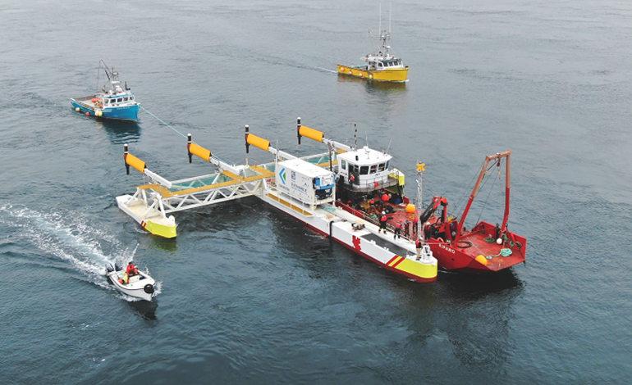
As of 2019, there is a new Tidal Stream player in the Bay of Fundy:
Sustainable Marine Energy (SME), which deployed this turbine platform: ^{1, 2}
Figure:
https://renews.biz/54496/sme-gets-nova-scotia-tidal-green-light/
It's the first of three planned platforms - which seem to represent a step backwards:
The platform's four rear turbines appear to have two very conventional blades,
And they each look to be no more than three meters in diameter
Indeed, with the whole platform rated at only 0.420 MW, ² individual turbine capacity
must be only 0.105 MW = 1/15th that of MeyGen, 1/20th that of OpenHydro
1) https://www.cbc.ca/news/canada/nova-scotia/sustainable-marine-energy-minas-tidal-lp-bay-of-fundy-tidal-power-1.5304276
2) https://sustainablemarine.com/news/pempaq-project

Slide 66
Bottom Lines regarding Tidal Stream Power:
Necessarily fast tidal flows are much more common than at least I had expected:
This is due to funneling of tides within narrowing bays or straits (a.k.a. "firths")
and / or subsequent tides re-enforcing one another via Tidal Resonance
Based on such flows, studies now suggest that Tidal Stream
could provide a good fraction of at least a smallish nation's power ¹
Early vulnerable / shipping-interfering Tidal Stream towers have now been superceded
by far more plausible "compact, foundation-less, and bottom-clinging" designs
The largest of these new turbines have power production capacities not far below
that of today's very commercially successful wind turbines (i.e., ~1/8 to 1/4 as big)
However, turbine numbers are miniscule compared to what will be required for impact
Further, one of two large turbine designs failed almost immediately in real-world testing,
and the other has thus far survived barely 1/10th of the 20+ years likely
to be necessary for cost-effective large-scale power production
1) I hope my MacBane ancestors take no offense at my use of "smallish" in referring to their possibly-soon-to-be independent nation

Slide 67
Wave Power
An Introduction to Sustainable Energy Systems: WeCanFigureThisOut.org/ENERGY/Energy_home.htm

Slide 68
Waves seem to be everywhere, and they cycle up & down so very often!
Suggesting that they're almost like a super Tidal Barrage:
One that cycles once every wave period - rather than once every ~12 hours
And one that spans vast areas - rather than just a paltry few dozens of km²
But that resemblance is deceptive:
Waves DO cycle specific volumes of water up & down,
but they do so by passing power onward with the moving wave
Thus, if an ideal converter captured ALL of a wave's energy as it crossed a line
there would be no energy left to drive waves onward beyond that line
(leaving the water surface behind that converter absolutely wave-free)
So wave energy will NOT be harvestable across vast areas
With realistic converters, it will instead be harvested when incoming waves
try to move through long obstructing bands of those converters
An Introduction to Sustainable Energy Systems: WeCanFigureThisOut.org/ENERGY/Energy_home.htm

Slide 69
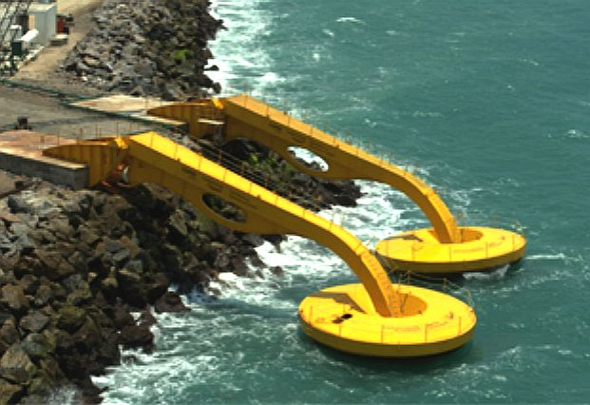
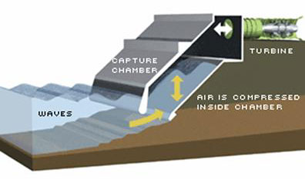
Wave Power converter prototypes & concepts:
Keeping moving parts & generators OUT of corrosive saltwater makes a lot of sense:
As done via these shoreline converters developed & tested at Brazil's Coppe Subsea Technology Lab ¹
Or as would occur with this shoreline conversion scheme proposed by the U.S. National Renewable Energy Lab (NREL) ²
But to produce a LOT of power, these would have to stretch along our coasts,
completely occupying (and desecrating) the shorelines that so many of us cherish
1) http://www.bluebird-electric.net/wave_power_energy_generation.htm
2) https://openei.org/wiki/Wave_Energy

Slide 70
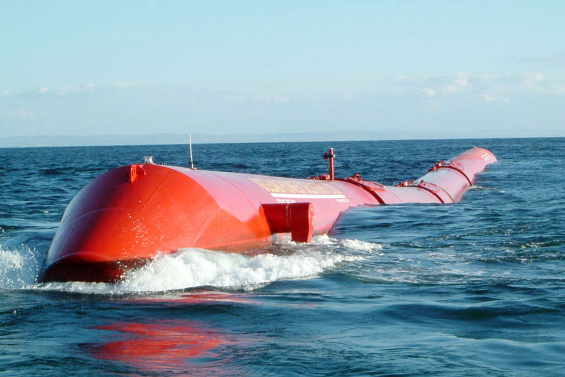
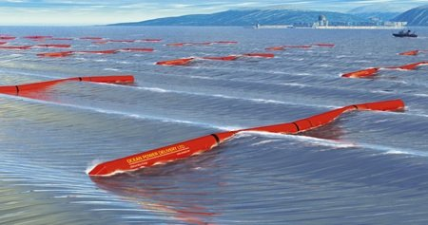
This scheme would instead position converters offshore:
Pelamis Wave used hydraulic pistons inside flexing joints to capture wave power
Which, unfortunately, DID submerge both pistons & joints in corrosive seawater
One prototype was built for the European Marine Energy Center, Orkney Scotland
A second prototype was built for Scottish Renewables
But after delivering only those two prototypes in 2010, the company folded ¹
And their vision of offshore bands of such serpents (right) was left unrealized:
!) https://en.wikipedia.org/wiki/Pelamis_Wave_Energy_Converter
http://www.biggreensmile.com/green-glossary/wave-power.aspx
http://www.biggreensmile.com/green-glossary/wave-power.aspx

Slide 71
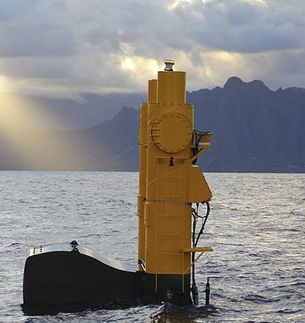

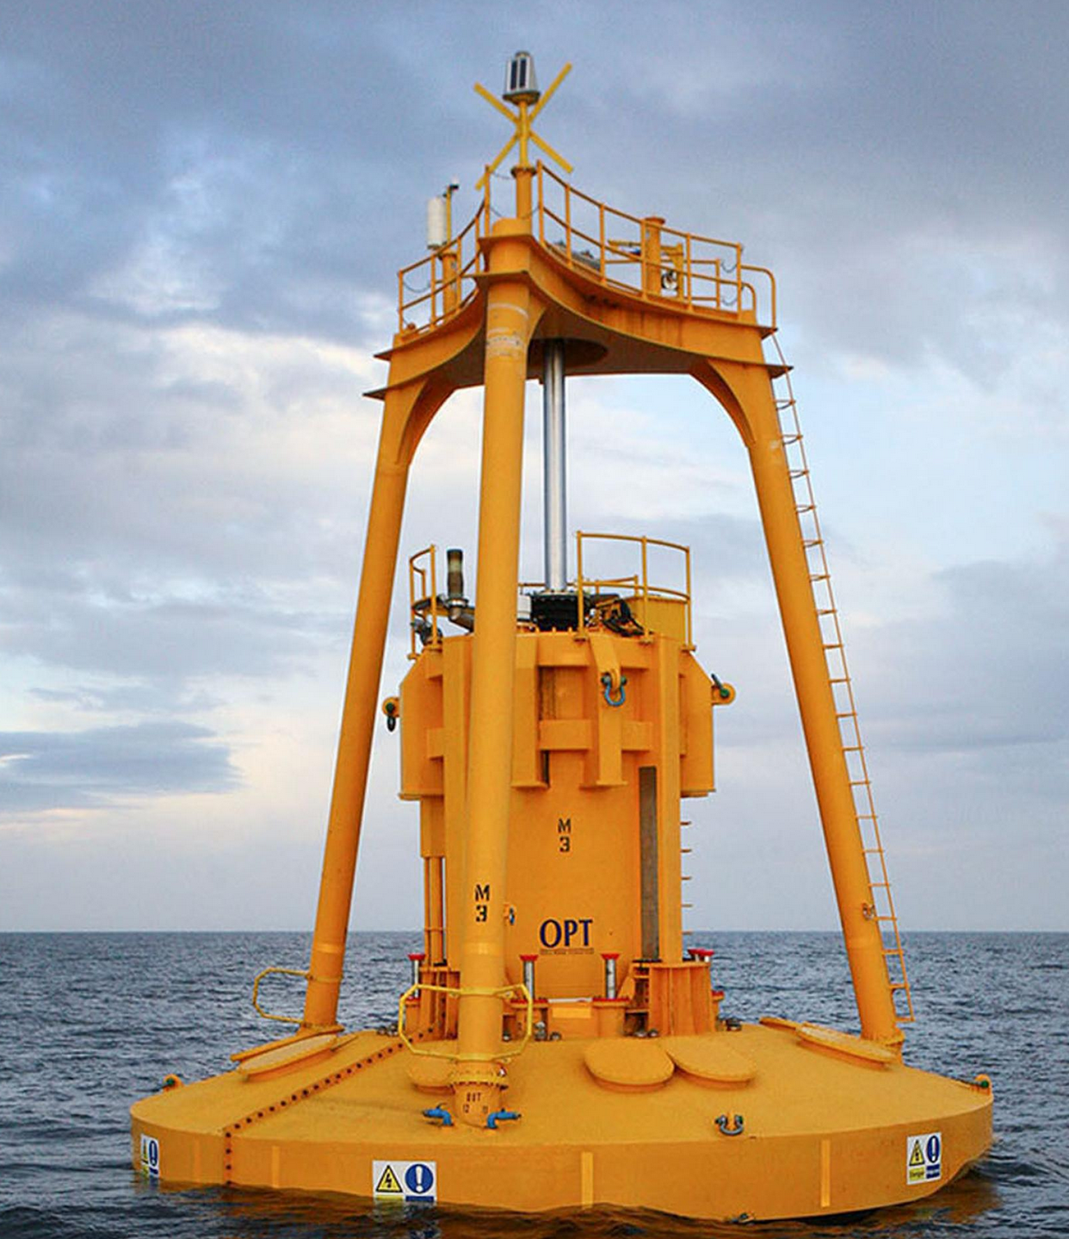
Other offshore schemes would use tethered buoys:
Hydraulic pistons, in cylinders above the buoy (and thus above the seawater),
are pulled downward on each wave crest, producing electrical power (center) ¹
(PgDn to start animation)
Northwest Energy Innovations produced the 20 KW "Azura" buoy (left) & promised
a 0.5 MW successor by 2017 (which is no longer mentioned on their website) ²
National Geographic covered Ocean Power Technologies' 2014 buoy (right) ³
but wave power is now (also) barely discussed on that company's website ⁴
1) Center: https://en.wikipedia.org/wiki/Azura_(wave_power_device) 2) Left: http://azurawave.com/projects/hawaii/ 3) Right: https://www.nationalgeographic.com/news/energy/2014/02/140220-five-striking-wave-and-tidal-energy-concepts/ 4) https://www.oceanpowertechnologies.com/about

Slide 72

The mWave converter would instead reside on the sea bottom ¹
There (like newer Tidal Stream units) it would be less threatened by passing ships
But rather than exploiting the water motion within water waves,
it would exploit the weight (and hence cycling pressure) of waves passing above
Within its reef-like structure, an air-filled flexible rubber bladder
is connected to an inflexible air tank
The increased water pressure below each passing wave then
squeezes air from the bladder, though a turbine generator, to the tank
1) https://www.bomborawave.com/mwave/ Figure Wikipedia's Wave Power:https://en.wikipedia.org/wiki/Wave_power

Slide 73
What is the MAXIMUM power that waves might provide?
We can estimate this based on the flow of gravitational potential energy:
Wave at one point in time: And half a wave period later:
Time = 0
Time = ½ period = (½) (1 / frequency)
To simplify this estimation, approximate the Time = 0 wave as being rectangular:
Squared off it has a height of H,
a width of λ (the common symbol for its wavelength)
and a length of L (its perpendicular extension)
H
l
From earlier in this note set, each unit of water has gravitational potential energy:
Egravity = M g h = (ρwater Volume) g h = ρwater Volume h

Slide 74
Mapping the wave's movement in three dimensions:
T = 0 wave with this cross-section: Becomes this 3D shape:
L
H
H
l
l
One wave period later, that wave is "gone" (shifted by λ out of frame to the right)
But its water molecules have NOT in fact moved λ to the right
they've instead fallen downward,
surrendering their gravitational energy,
which is then transferred forward out of frame to the right,
where it is reinvested into new water molecules,
which rise to form the wave as we see it one period later

Slide 75
How much gravitational potential energy moves forward from the T = 0 wave?
The wave's total volume of water = V total = H (λ / 2) L
Gravitational potential energy of that volume of water = ρwater g Volume Δ h
The fall distances (Δ h)? As in our Tidal Barrage calculation:
Water at the top of the bar falls H
Water at the bottom of the bar falls 0
Giving an average fall of H / 2
Total gravitational potential energy lost (and transferred forward):
Δ E gravity = ρwater g (Total Water Volume) (Average fall) = ρwater g (H λ L / 2) (H / 2)
Δ E gravity = (1/4) ρwater g H² λ L
Wave power = That energy / time to move one wavelength = Δ E gravity x (v wave / λ):
Power of Wave = (1/4) ρwater g H² vwave L
= Basis for estimating total wave power striking a coast
L
H
l

Slide 76

More complex models refine this equation (but the end result is unchanged)
One refinement acknowledges that the water in waves actually swirls in circles:
From Wikipedia on Wind Waves:
https://en.wikipedia.org/wiki/Wind_wave
(PgDn to start animation)
Our formula already accounts for the energy of vertical water movement
But it should also account for the energy of horizontal water movement
An obscure bit of Physics, the Equipartition Theorem, ¹ says that
Nature puts equal energy into both movements
That DOUBLES the energy within a volume of wave water
Which then DOUBLES the power transferred forward by the wave
1) See, for instance Wikipedia's write up: https://en.wikipedia.org/wiki/Equipartition_theorem

Slide 77
But another obscure bit of physics then halves that energy:
It says that wave energy does not move forward with the wave crests
It instead moves forward at HALF of the velocity of the wave crests
That's illustrated in this mathematical simulation of moving groups of waves:
(PgDn to start animation)
From Wikipedia on Group Velocity: https://en.wikipedia.org/wiki/Group_velocity
The wave groups (and their energy) move forward as the green dots
But wave crests move forward through those groups (as the speedier red dots)
This slower rate of energy movement HALVES the power delivered by waves
EXACTLY COUNTERING the previous slide's DOUBLING, taking us back to:
Power of Wave = (1/4) ρwater g H² vwave L
An Introduction to Sustainable Energy Systems: WeCanFigureThisOut.org/ENERGY/Energy_home.htm

Slide 78
Some other bits of obscure physics are more useful:
Water waves slow as they enter shallower water. Why?
Because ocean bottom increasingly impedes the wave's swirling water motion
This increasingly bunches up the waves (i.e., shortens their wavelength)
Which, to conserve energy, demands that those waves become higher
NOTE: This is why low but extremely broad deepwater waves become
extremely high (but narrower) Tsunami waves as they move onshore
This would greatly complicate our calculation of wave power if not for the fact that,
while waves change shape moving TOWARD a shore,
they continue carrying the same power
(at least until they begin to break up and/or reflect AT that shore)
So all we really need is information about the waves as they start out in deepwater
An Introduction to Sustainable Energy Systems: WeCanFigureThisOut.org/ENERGY/Energy_home.htm

Slide 79
Physics provides one such bit about deepwater waves:
In deepwater, waves move at a velocity of: v wave = g (Wave Period) / 2 π ¹
But Wave Period = The time interval between passing wave crests, thus:
(Wave Period) = (Wavelength) / (Wave Velocity) Or, in the common symbols:
T = λ / v wave
Substituting this into the deepwater equation at the top of this page:
v wave = g (λ / v wave) / 2 π Solving this for v wave:
v wave = (g λ / 2 π ) ^{1/2}
Substituting that into our earlier Wave Power equation:
Power of Wave = (1/4) ρwater g H² [ g^{1/2} λ^{1/2} / (2 π)^{1/2} ] L
Power of Wave = (1/ 32π)^{1/2} ρwater g^{3/2} λ^{1/2} H² L
AlI we now need is "typical" wavelengths (λ's) and wave heights (H's)
1) http://folk.ntnu.no/falnes/teach/wave/TFY4300/WaveLectJF2016ut2.pdf

Slide 80
You can easily find such wave information online:
From Wikipedia's Sea State webpage: ¹
Waves 1.25 to 2.5 meters high are considered "moderate" (Sea State 4)
From Wikipedia's Wind Wave webpage: ²
1.5 meter high waves typically have a wavelength of ~ 33.8 meters
Allowing me to calculate the power of "moderate" waves with: H = 1.5m & λ = 33.8m
Power of "moderate" Wave = (1/ 32π)^{1/2} ρwater g^{3/2} λ1^{/2} H² L
= (1/ 32π)^{1/2} (1000 g / m³) (9.8 m / s²)^{3/2} (33.8 m)^{1/2} (1.5 m)² L
Power of "moderate" Wave: ~ 110 (kW / meter) L
where L is the length of coastline struck by "moderate" (1.5m x 33.8m) wave
1) Wikipedia on Sea State: https://en.wikipedia.org/wiki/Sea_state
2) Wikipedia on Wind Waves: https://en.wikipedia.org/wiki/Wind_wave

Slide 81
So COULD Wave Power compete in Pentland Firth or Hawaii?
Pentland Firth:
Green = Tidal Stream generators producing
earlier study's "up to 1.9 GW"
Red = ~ 50 km long shoreline of the Firth
~ 20 km
Using equation from the previous page, wave power incident on that shoreline is:
Maximum Pentland Firth wave power = (110 kW / m) (50,000 m) = 5.5 GW
First answer: YES, Firth's wave power exceeds its tidal stream power
Might waves on Oahu's 365 km coastline ¹ satisfy its ~ 2 GW consumption? ²
Maximum Oahu wave power = (110 kW / m) (365,000 m) = 40.1 GW
Second answer: EASILY, at least with the RIGHT wave power technology
1) https://www.hawaiiandreamvacations.com/about-oahu/about-oahu/
2) Estimated from non-Maui data on: https://www.hawaiianelectric.com/about-us/power-facts

Slide 82
But what about pressure-driven schemes like mWave?
The above wave power equation offers little insight - but diagrams like this still do:
From Wikipedia on Wind Waves:
https://en.wikipedia.org/wiki/Wind_wave
(PgDn on to start animation)
They correctly indicate that water motion diminishes rapidly beneath the waves
But that implies lateral pressure differences also diminish rapidly beneath the waves
If not, their persistence would continue to drive lateral water movement
Imagine you were below a wave as its crest passed directly overhead,
its adjacent wave troughs would then be almost overhead
The deeper you were, the smaller the difference between directly and almost
with pressure more and more reflecting time-averaged water height above you

Slide 83
My intuition thus suggested pressure waves would damp out quickly
With amplitudes likely plummeting at depths greater than one water wave wavelength
To check on my intuition, I dug up class notes from an MIT Hydrodynamics class ¹
The notes analyzed this situation of a wave moving atop a sea of depth Htotal:
l
Z
x
Z = - Htotal
It took seven pages of physics + mathematics to finally come up with an equation
describing the pressure wave at a depth z below such a water wave
That equation was the product of two terms:
The first term gave the pressure wave at the base of the wave (i.e., at z = 0)
The second term scaled that pressure wave downward at depths below z = 0
1) https://ocw.mit.edu/courses/mechanical-engineering/2-016-hydrodynamics-13-012-fall-2005/readings/2005reading7.pdf

Slide 84

Using "Mathcad" software, I plotted out the scaling term: ^{1, 2}
For that plot, I expressed both z (the observer's depth) & Htotal (the total ocean depth)
in units of λ (i.e., in multiples of the water wave's wavelength)
Here are my plots for seas with total depths of 0.1 λ, 0.2 λ, 0.3 λ, 0.4 λ and 0.5 λ
Per my intuition, pressure wave amplitudes DO fall rapidly with depth (to the left)
Indeed, they damp out at even depths << one water wave wavelength
Pressure Wave Amplitude (at depth z / λ)
For Htotal = 0.1 λ
For Htotal = 0.2 λ
For Htotal = 0.3 λ
For Htotal = 0.4 λ
z / λ
But the plots also showed something that I did NOT expect:
Damping is much more gradual in shallower seas (e.g., the sea 0.1 λ deep)
1) https://wecanfigurethisout.org/ENERGY/Web_notes/Exotics/Exotics%20-%20Supporting%20-%20Files/Pressure%20below%20water%20waves.mcd 2) https://wecanfigurethisout.org/ENERGY/Web_notes/Exotics/Exotics%20-%20Supporting%20-%20Files/Presssure%20below%20water%20waves%20-%20mathcad.pdf

Slide 85
Consequences for mWave-like submerged pressure wave converters?
It's not only desirable but extremely desirable that they be placed close to shore,
where water depth is only a small fraction of the local water waves' wavelength
But from above, typical wavelength for a "moderate" / "Sea State 4" wave is ~ 34m
A small fraction of that (e.g., less than 1/4) would be only < 8m (< 24 feet)
At that depth, normal water movement (and thus force) might be withstood
But storm wave movement / force might easily demolish submerged converters
While at the surface, storm water movement / force would be even more severe
making floating wave power converters even more susceptible to damage
Wave Power (of all kinds) thus confronts at least two severe challenges:
The protection of any submerged moving parts from seawater corrosion
The protection of all parts from extreme weather conditions
An Introduction to Sustainable Energy Systems: WeCanFigureThisOut.org/ENERGY/Energy_home.htm

Slide 86
Bottom lines regarding Wave Power:
Contrary to at least my expectations:
Calculations show that wave energy incident upon our coasts is
large enough that it could someday provide much of our coastal power
But conversion schemes explored to this point seem to be:
Impractical
Prone to unacceptably early failure
Easily damaged by or damaging of the Environment
Which brings to mind a statement made by multiple sources:
"Wave Power seems to be where Wind Power was 30 years ago"
Which is to say:
Wave Power's huge potential is finally becoming appreciated
All we've got to do now is is figure out HOW to do it!

Slide 87
Floating Photovoltaic Farms
An Introduction to Sustainable Energy Systems: WeCanFigureThisOut.org/ENERGY/Energy_home.htm

Slide 88


One final form of water-based power:
Which uses no-longer-exotic solar power, but in an EXOTIC LOCATION:
On platforms floating out in the middle of smallish Lakes
https://www.scientificamerican.com/article/putting-solar-panels-on-water-is-a-great-idea-mdash-but-will-it-float/
https://news.energysage.com/floating-solar-what-you-need-to-know/
Why go to such trouble? Because, as noted in my evaluation of Tidal Stream power:
Solar farms produce low power per land area: 12-50 W / m² = 12-50 MW / km²
Further, unlike wind farms, they require EXCLUSIVE USE of the land they occupy ¹
1) See my note set: Today's Photovoltaic Solar Cells (pptx / pdf / key)

Slide 89
But open land is often not available near our cities & factories
Or, if available, those cities & factories have probably driven up its expense
So the idea is to instead put small arrays of solar cells on floating platforms
Which might be no more than slightly-reinforced slabs of styrofoam
And to then tie those individual platforms into flexible rafts
With ties possibly provided by the solar cell output cables themselves
But why limit such floating solar farms to only "smallish" lakes?
Wouldn't LARGE LAKES offer the opportunity to build LARGE floating farms?
For instance, around the edges our U.S. Great Lakes
Ecological impact on such lakes is of course a concern
But there's also the issue of Water Wave power (as discussed above):
On any large body of water, winds can produce large waves
which might EASILY devastate fragile solar cells & floating platforms

Slide 90
The potential of FPV (Floating Photovoltaic) power?
Just a few years ago it seemed (at best) not much more than a curiosity
If so, it's a curiosity that has now found its niche:
Its claimed that in 2016-17, 200 MW of FPV power was installed
And that by the end of 2018 that it had reached 1.1 GW ¹
That remarkable growth is attributed to factors including: ¹⁻⁴
- Costs only 25% higher than land-based solar due to:
Elimination of land costs
Elimination of foundations & supporting structures
Elimination of often otherwise required artificial PV cell cooling schemes
Simple / inexpensive construction & decommissioning (float out / float off)
- Massive (up to 80%) reduction in evaporation from water storage reservoirs
- Elimination of algae blooms (and resultant fouling) in industrial cooling ponds
1) https://en.wikipedia.org/wiki/Floating_solar 2) https://www.solarpowerworldonline.com/2019/07/will-floating-solar-arrays-float-or-sink/ 3) https://www.scientificamerican.com/article/putting-solar-panels-on-water-is-a-great-idea-mdash-but-will-it-float/ 4) https://news.energysage.com/floating-solar-what-you-need-to-know/

Slide 91

Global warming makes FPV's suppression of reservoir evaporation very attractive
But FPV's use in cooling ponds also has very substantial potential,
especially in the cooling ponds already frequently associated with power plants
A particularly large example: Virginia's largest lake, 53 km² Lake Anna, ¹
which is actually the manmade "cooling pond" for a dual nuclear power plant:
The possibility:
From a few slides ago:
Solar PV farms = 12-50 MW / km²
Multiplying that by Lake Anna's 53 km²:
=> Possible PV plant of 636 - 2650 MW
The upper (likely optimistic) number actually
exceeds dual nuclear plants' 1790 MW ²
1) rhttps://en.wikipedia.org/wiki/Lake_Anna 2) https://en.wikipedia.org/wiki/North_Anna_Nuclear_Generating_Station

Slide 92
Wind Power Balloons & Kites
An Introduction to Sustainable Energy Systems: WeCanFigureThisOut.org/ENERGY/Energy_home.htm

Slide 93

Is there an analogous "EXOTIC LOCATION" awaiting wind power?
It wouldn't be out on the water because, for wind power, that is no longer exotic:
Near shore & floating-wind turbines are already mainstream technologies ¹
Flying Wind Turbines would still qualify as exotic - But why go to the trouble?
One reason: As with water flows, wind flow power increases as velocity cubed
Which makes reaching even modestly faster winds very desirable
Winds are ultimately driven by thermal gradients high in the atmosphere
And they are ultimately slowed by interaction with the ground (& things on it)
The net result: Wind speed increases rapidly above the ground: ^{2, 3}
1) See my notes set: Wind Power - Part II (pptx / pdf / key)
2) See my note setL Wind Power I (pptx / pdf / key)
Figure & 3) http://rockets2sprockets.com/issue-cross-winds-wind-tunnels/

Slide 94


The reach higher / faster winds, turbine towers have grown taller:
The logical progression (according to at least some entrepreneurs)?
Airborne wind turbines
Figure: p 63. Wind Vision Report – US DOE: https://www.energy.gov/eere/wind/wind-vision

Slide 95


Which might actually look more like this:
As featured in a 2014 Popular Science Magazine article: ¹
The Massachusetts startup company Altaeros was assembling a "Buoyant Air Turbine"
- A helium-filled cylindrical wing held aloft by the
combination of helium's buoyancy + wing's lift
- To fly at up to 2000 feet, in winds up to 75 MPH
Prototype's Specifications (picture at right):
- Fourteen feet long
- Designed for 30 kW power out
- Larger model to produce 200 kW (with megawatt unit envisioned)
Target Markets?
- Remote sites with weak sunlight (=> grant from Alaska Energy Authority)
- Temporary industrial sites (e.g. construction or well drilling)
- Sites with low ground wind speeds
1) https://www.popsci.com/article/science/quest-harness-wind-energy-2000-feet/

Slide 96


Or it might be simpler (and safer) to just: Go Fly a Kite
As featured in a 2012 Spectrum Magazine article: ¹
The North Carolina company WindLift proposed getting rid of balloons:
- Eliminating their very expensive helium
- Keeping the heavy electrical generator on the ground, thus decreasing
required lift AND the mass available to fall on someone / something
Kite tugs out rope turning ground based generator (motor)
Motor (generator) then reels back in partially collapsed kite - then repeat cycle:
Prototype kite
Ground generator unit
1) http://spectrum.ieee.org/energy/renewables/the-benefits-of-airborne-wind-energy

Slide 97
These designs would exploit faster high altitude winds
But being so much smaller than present day ground-based wind turbines,
they would intercept vastly narrower wind area,
with probable result of producing far less wind power per turbine
Further, while Floating Photovoltaics operating in their "exotic location"
would produce power in the absence of human operators
Wind turbine balloons & kites would require human monitoring during operation,
plus likely intervention morning & evening to raise & lower them
It's thus unsurprising that Altaeros's website no longer discusses wind power ¹
Or that, while WindLift continues to pursue that goal, ²
its website now describes an entirely different non-kite design,
which appears to have now "flown" in only computer simulations
1) http://www.altaeros.com/
2) https://windlift.com/

Slide 98
Solar Power Satellites
An Introduction to Sustainable Energy Systems: WeCanFigureThisOut.org/ENERGY/Energy_home.htm

Slide 99

To have a much larger impact, what about: Orbiting Solar Arrays?
Which have been proposed by the Japanese Aerospace Exploration Agency (JAXA): ¹
Said to be possible within twenty five years, with 1 GW power output
Their power would be beamed down via microwave radio or laser beams
Array would weigh more than 10,000 tonnes and be several kilometers across
1) How Japan Plans to Build an Orbital Solar Farm, IEEE Spectrum Magazine, April 2014
online at: http://spectrum.ieee.org/green-tech/solar/how-japan-plans-to-build-an-orbital-solar-farm

Slide 100


Motivation (at least) is crystal clear:
As described in my Solar Power note sets:
Our atmosphere absorbs ~ 1/4 of sun's power: 1.35 kW / m² => 1 kW / m²
Remainder is diluted when incident at shallow angles (i.e., not at noon)
And totally blocked by the earth itself (for a particular location) half the time
Net result (from U.S. National Renewable Energy Lab calculator website):
But 1 kW-h/m²/day = 41.6 W / m²
So BEST U.S. sites have annual average incident solar power of ~ 200 W / m²
http://rredc.nrel.gov/solar/old_data/nsrdb/1961-1990/redbook/atlas/serve.cgi

Slide 101
Versus an orbital solar array:
Once aimed at the sun, it should stay aimed at the sun (except for tidal effects)
And, when not blocked by the earth, a satellite receives that constant 1350 W / m²
Almost 7X better than our BEST U.S. sites
And ~ 15X better than at our poorer (non-desert contiguous 48 state) sites
But the (first) big caveat is "when not blocked by the earth"
Time for a little orbital mechanics:
We want an object (the solar array) to orbit at a distance r above earth's center
Acceleration of object due to earth's gravity = G M / r²
Inducing a centripetal acceleration on object = v² / r
Where v = orbital circumference / orbital period = 2 π r / T
An Introduction to Sustainable Energy Systems: WeCanFigureThisOut.org/ENERGY/Energy_home.htm

Slide 102
Equating gravitational and centripetal forces to get orbits:
G M / r² = (4 π² r² / T²) / r which yields (4π² / GM) r³ = T²
G (universal gravitational constant) = 6.67 x 10⁻¹¹ m³ / (kg – s²)
Earth parameters: M = 5.97 x 10²⁴ kg Radius = 6371 km
So earth's circumference = 40,029 km
(Which I remember as 24,000 miles => Equatorial spin of 1000 MPH)
Constant (4π² / GM) in equation then becomes: 9.913 x 10⁻¹⁴ s² / m³
Some space agency is going to have to launch pieces of solar array into orbit
Most launches are into LEO (low earth orbit) 160-2000 km above surface
ISS orbits ~ 400 km above earth => orbital radius of 6800 km, and a period of:
T = √[9.913 x 10⁻¹⁴ s² / m³ x (6.8 x 10⁶ m)³] = 5,583 sec = 93 minutes
An Introduction to Sustainable Energy Systems: WeCanFigureThisOut.org/ENERGY/Energy_home.htm

Slide 103

Problems with low earth orbit (LEO):
Earth will still block the sun half the time
We just lost half of our potential power enhancement!
Satellite won't stay above our location
Assuming that world is not willing to share in the cost & benefit of the satellite,
How do WE (the builders / financers of the array) get all of its power?
We'd have to store power until array passed overhead - which is NOT once per orbit!
It passes overhead far less frequently
Because the earth is rotating under its orbit:
Figure plots flyovers as ~ once in 8 orbits
=> twice a day (only!)
So we'd ALSO need HUGE orbiting energy storage (12 GW-hours of it!)
Figure: http://www.universetoday.com/89063/must-see-video-falling-nasa-uars-satellite-observed-while-still-in-orbit/

Slide 104
So instead use a geosynchronous orbit:
Meaning that we now want an orbital period of one day to match our rotation
Put T = 24 hours = 86,400 seconds into (4π² / GM) r³ = T² and solve for r:
r = [(8.64 x 10⁴ s)² / (9.913 x 10⁻¹⁴ s² / m³)]^{1/3} = 42,227 km
Subtracting out earth's radius => 35,856 km above earth surface
How much time will orbiting solar array then spend in earth's shadow?
Orbital circumference is now 2 π x 42,227 km ~ 265,000 km
Width of earth's shadow ~ earth diameter = 2 x 6371 km = 12,742 km
Fraction of time in shadow ~ 12,742 / 265,000 ~ 4.8%
So we'd then get almost full 7X–15X enhancement of solar energy to the array!
An Introduction to Sustainable Energy Systems: WeCanFigureThisOut.org/ENERGY/Energy_home.htm

Slide 105
But at least two very non-trivial issues remain:
First: The cost of launching array's parts into geosynchronous orbit:
NASA figure for cost to launch into (unspecified) orbit is $10,000 / kg ¹
This, almost certainly, refers to low earth orbit only
Gravitational potential energy goes as 1/r
r for high geosynchronous orbit is ~ 6X r for low earth orbit
If cost scales as potential energy of orbit, geosynchronous cost => ~ 60 k$ / kg
Planned Japanese station weighs 10,000,000 kg => $6 x 10¹¹ = 600 B$ to launch
If array provided 1 GW (10⁶ kW) power for 20 years (limited by cell lifetimes):
Launch cost (alone) = $6 x10¹¹ / [(20 x 365 x 24 hours) x (10⁶ kW)]
To cover that cost (alone), charge for satellite's power would have to be:
3.42 $ / kW-hour vs present day U.S. power costs of 10-20 cents /kW-h
(i.e., solar array's power would be 17 to 34 times more expensive)
1) http://www.nasa.gov/centers/marshall/news/background/facts/astp.html_prt.htm

Slide 106

The second issue: The array's 1 GW power beam:
Now only possible using microwaves (not lasers)
Which would be aimed at offshore receivers:
But microwave beams naturally spread out
And there is the nightmare scenario of a beam
being deliberately diverted as a weapon
Hard proof of RF radiation harm is as yet very slim
But many worry about cell phones & AC power lines
For which US / Euro power limits are currently:
1.6 - 2 W of RF radiation / kg of tissue ¹
A 1 GW beam could exceed that limit even spread over 500,000,000 kg of living tissue
I wouldn't want to go anywhere near the proposed power receiver (figure), and
I'd be uneasy with an unfriendly country's array orbiting anywhere above me
How Japan Plans to Build an Orbital Solar Farm, IEEE Spectrum Magazine, April 2014
1) http://en.wikipedia.org/wiki/Mobile_phone_radiation_and_health

Slide 107
Fusion Power
An Introduction to Sustainable Energy Systems: WeCanFigureThisOut.org/ENERGY/Energy_home.htm

Slide 108
What about the holy grail of clean power: Nuclear Fusion?
To start at the beginning, what exactly is nuclear fusion?
And how does it compare with conventional chemical fusion (i.e., chemistry)?
Chemical fusion combines atoms into molecules (or larger molecules)
Nuclear fusion combines atoms (or atom fragments) into larger atoms
Compare those alternatives for a pair of starting "Deuterium" atoms:
Deuterium = Hydrogen with a nucleus of 1 proton ( ) PLUS 1 neutron ( )
(Starting with both protons + neutrons simplifies nuclear fusion)
The Reactants:
Electron Clouds
An Introduction to Sustainable Energy Systems: WeCanFigureThisOut.org/ENERGY/Energy_home.htm

Slide 109
The products of chemical fusion vs. nuclear fusion:
Chemically fused pair of Deuterium atoms:
(=> 1 Deuterium molecule)
Nuclear fused pair of Deuterium atoms:
(=> 1 Helium atom)
~ 10⁻¹⁰ m
~10⁻¹⁵ m
Energy liberated:
9.6 electron-Volts per molecule
=> 222 kcal per mole ¹
Energy liberated:
17.6 Million electron-Volts per atom ²
=> 409 million kcal per mole
Nuclear Fusion's energy advantage: ~ 2 million times
PLUS the fact that its products are often benign simple atoms
1)https://atct.anl.gov/Thermochemical%20Data/version%201.118/species/?species_number=348
2) hhttp://hyperphysics.phy-astr.gsu.edu/hbase/NucEne/fusion.html

Slide 110
The challenge is GETTING nuclear reactions to even occur
Chemical reactions require close approach of the reactant atom's electron clouds
A catalyst can facilitate this by getting those atoms to
settle down on its surface, immediately beside one another
Or in the absence of an effective catalyst, heat can be added to accelerate
reactants' motion to the point that collisions will drive them close together
Nuclear reactions require close approach of the reactant's nuclei
For intact atoms, negative electron cloud repulsion prevents such an approach
Instead, extreme heat must be added to the point that:
1) Electron clouds are torn from nuclei (creating what's called a plasma)
And that
2) Nuclei accelerate to speeds so fast that their positive nuclear charge
repulsion is overcome by the momentum / energy of their motion
An Introduction to Sustainable Energy Systems: WeCanFigureThisOut.org/ENERGY/Energy_home.htm

Slide 111
How hot is hot enough?
That's determined by how close the speeding nuclei must come to one another
The answer (NOT taught in high school physics, or even most college physics classes):
Nuclei must come close enough for the Stong Nuclear Force to kick in
It's "strong" because it offsets the charge repulsion between the nucleis' protons
Fortunately, all we need to know about the Strong Nuclear Force is that
it only becomes significant at nuclear separations < 1 femtometer (10⁻¹⁵ m)
(i.e., as in my preceding figure, at dimensions comparable to the size of nuclei)
For Nuclear Fusion to begin, two speeding nuclei must have enough kinetic energy
that they can overcome the potential energy barrier created by
their charge repulsion at that critical separation of about 1 femtometer
Once / if they top that potential energy barrier, the Strong Nuclear Force takes over,
drawing those two nuclei together, fusing them into a new larger single nucleus
An Introduction to Sustainable Energy Systems: WeCanFigureThisOut.org/ENERGY/Energy_home.htm

Slide 112
A "back of the envelope" calculation of that "ignition" condition:
From high school physics, for two atoms with n protons in each of their nuclei,
the charge repulsion energy between those nuclei when separated by r is:
E charge repulsion = (1/4 π ε_{o}) (n q) ² / r
Where q = is magnitude of proton charge = 1.6 x 10⁻¹⁹ Coulombs
ε_{o} = permittivity of free space = 8.85 x 10⁻¹² Coulombs / Volt-meter
n = number of protons in each nucleus
r = separation of the nuclei
Which plots as:
Repulsive Energy AT 1 fm
= (1/4πε_{o}) (n q)²/(1 fm)
Charge Repulsion Energy
r
1 fm
1 fm

Slide 113
Nuclei must start toward one another with that much kinetic energy
A particle's kinetic energy is determined by its temperature
In fact they are virtually synonymous, with their relationship being
Kinetic energy of a particle (at temperature T) ~ k T
k = Boltzmann's constant = 1.38 x 10⁻²³ kg-m² / s² °K
To get the required temperature, equate that kinetic energy with the
repulsive barrier's height at 1 fm (where Strong Nuclear Force takes over):
k T = (1/4 π ε_{o}) (n q)² / (1 fm) Or: T = (1/4 π ε_{o} k) (n q)² / (1 fm)
Putting in the numbers for Deuterium nuclei (where number of protons n = 1):
T = (1.6x10⁻¹⁹ C)²/(4π)(8.85 x 10⁻¹² C/V-m)(1.38 x 10⁻²³ kg-m²/s² °K)(10⁻¹⁵ m)
= 17 billion °K (C-V / kg-(m/s)²) things in parenthesis = Joule/Joule => 1
Temperature to initiate hydrogen fusion is ~ 17 BILLION degrees (K) ¹
1) Wikipedia's official / supposedly expert plots show onset of strong fusion at ~ 1-10 billion degrees Kelvin: https://en.wikipedia.org/wiki/Nuclear_fusion

Slide 114
That is (literally) an otherworldly high temperature:
In fact, until 1 November 1952, it was only reached deep within stars
One barrier to Fusion is thus GETTING nuclei up to such stellar temperatures
Another barrier to Fusion is KEEPING nuclei at such temperatures
LONG ENOUGH enough for them to experience a chance collision
ANY CONTACT / INTERACTION WITH NORMAL MATTER (still a billion times cooler)
and they'll immediately loose energy to that matter, quenching their temperature
To accomplish this, in most experimental Fusion Reactors (the ONLY kind we have!):
1) Nuclei are suspended in ultrahigh vacuum chambers (which are ~ matter-free)
2) They're held away from chamber walls by specially-shaped magnetic fields
2) They're heated via pulsed electromagnetic fields
An Introduction to Sustainable Energy Systems: WeCanFigureThisOut.org/ENERGY/Energy_home.htm

Slide 115


Confining those ultrahot nuclei via magnetic fields:
The necessary fields are created by strong electromagnets wrapped around
the plasma/nuclei-containing ultrahigh vacuum chamber
These create the magnetic field configuration known a "magnetic bottle"
As explained in my note set about Electric and Magnetic Fields (pptx / pdf / key):
Magnetic fields push charges sideways, without affecting their energy
This strangeness is described by the "first right hand rule:"
The result: Charge trying to cross Magnetic field lines instead
ends up looping around or spiraling along those lines:
http://www.swapyournotes.com/articledetail/articledetail.html/632/
http://astarmathsandphysics.com/a-level-physics-notes/electricity/a-level-physics-notes-the-magnetic-bottle.html

Slide 116



Early Magnetic Bottles were sealed by magnetic mirrors at both ends:
http://astarmathsandphysics.com/a-level-physics-notes/electricity/a-level-physics-notes-the-magnetic-bottle.html
The "mirrors" were just concentrated / intensified end magnetic fields
which caused the nuclei to slow, and then reverse the direction of their spiral
such that (most) went back and forth until (hopefully) a collision occurred
Work on such Magnetic Confinement Fusion ¹ began in the 1940's
The first major advance came in the 1960's with Russia's toroidal Tokamak
in which nuclei could just continue spiraling along loops of magnetic field
http://new.math.uiuc.edu/math198/MA198-2009/farrell1/
http://ffden-2.phys.uaf.edu/211_fall2002.web.dir/paul_gradney/gradney_fusion/tokamak.htm
1) https://en.wikipedia.org/wiki/Magnetic_confinement_fusion

Slide 117


Over the last 75 years non-magnetic schemes have also been tried:
Most notably Internal Confinement Fusion ¹ which resembles a hydrogen bomb
in its use of a surrounding explosive force to implode a nuclear charge
But in contrast, the quantity of nuclear fuel is extremely small (e.g., 10 mg) ¹
And implosions are extremely short (typically induced by ultrashort laser pulses)
Best known was U.S. Lawrence Livermore National Lab's National Ignition Facility ²
in which 192 ultrahigh power laser beams converged on a single pellet of fuel
1) https://en.wikipedia.org/wiki/Inertial_confinement_fusion Left: https://en.wikipedia.org/wiki/National_Ignition_Facility
Right: https://lasers.llnl.gov/news/inside-look-advanced-radiographic-capability-arc-laser

Slide 118
Progress over that 75 years?
In 2012 the National Ignition Facility program was officially discontinued ¹
having achieved only 1/10th of the conditions required to ignite Nuclear Fusion, ¹
after a net expenditure (estimated by the NIF itself) of 3.5 billion dollars ²
Projects have demonstrated the occurrence of nuclear fusion, but none has yet even
achieved breakeven (where fusion power out = net power put into the reactor)
I could not even find a source willing to plot a history of fusion power out vs. in
Continuing work? The International Thermonuclear Experimental reactor (ITER) ³
Based in France, this cooperative project costing 20 billion dollars ⁴
does not even have a breakthrough or game-changing idea in their sights
Indeed, contradicting some theoretical studies,⁵ ITER's plan is to just build a
BIGGER Tokamak reactor in the hopes of learning enough along the way,
that a viable fusion reactor might eventually be designed and built
1) https://www.iter.org/newsline/-/3037 2) https://lasers.llnl.gov/about/faqs 3) https://en.wikipedia.org/wiki/ITER
4) https://www.sciencemag.org/news/2016/04/updated-panel-backs-iter-fusion-project-s-new-schedule-balks-cost 5) http://iopscience.iop.org/article/10.1088/0029-5515/55/3/033001/pdf

Slide 119
To me as a scientist, 75 years of slow incremental progress strongly suggests:
That it's time to try something REALLY different!
And you may have heard a lot of buzz about new approaches to Fusion, for example:
- Lockheed Martin's secret mini reactor (that will fit on a truck!) ¹
- Lawrence Plasma Physics' proton-boron fusion reactor ²
- Helion energy's magnetic compression reactor ³
- General Fusion's liquid metal vortex shockwave reactor
- University of Washington's "Dynomak" variation on existing Tokomak
But none of these have been built (or there's zero public proof of this!)
Instead, many appear as yet to be little more than crowd-funding solicitations
And a few carry the distinct reek of cynical corporate image building
1) http://www.lockheedmartin.com/us/products/compact-fusion.html
2) http://spectrum.ieee.org/energywise/energy/nuclear/how-far-can-crowdfunded-nuclear-fusion-go
3) http://spectrum.ieee.org/energywise/energy/nuclear/silicon-valley-goes-long-on-nuclear-fusion

Slide 120
What about Cold Fusion (and the "scientific conspiracy" against it)?
For the full first half of my career, I worked at the basic research branch of Bell Laboratories
There I rubbed shoulders with a thousand or so fellow physicists, chemists, engineers . . .
In those 21 years, no other event so electrified us as the first rumors of cold fusion
When the unpublished manuscript announcing it began to circulate, anyone and everyone having relevant knowledge and appropriate laboratory equipment dropped whatever they had been researching, and began trying to replicate the reported results
But by late in that week our shared lack of success was becoming more and more discouraging (especially given the relative simplicity of the experiments that had been reported)
Nevertheless, on the following Saturday night, attending a dinner party, some of us still risked irritating our spouses by repeatedly calling back into the lab, hoping to learn of a last minute breakthrough . . .
Yes, chemists' success at Cold Fusion would have embarrassed nuclear physicists
But the overwhelming majority of scientists were hoping (indeed dreaming) it was for real
And thus, in the end, we were just as disappointed as everybody else
An Introduction to Sustainable Energy Systems: WeCanFigureThisOut.org/ENERGY/Energy_home.htm

Slide 121
WHEN might we achieve commercial scale Fusion Power?
On this note set's Resources webpage¹ I've collected predictions about Fusion's future:
The Path to Fusion Power
Fusion as a Future Power Source: Recent Achievements and Prospects
Nuclear Fusion - Do The Math
It's the 21st Century - Where's My Fusion Reactor?
Why Nuclear Fusion Is Always 30 Years Away
The Uncertain Future of Fusion Energy
Why Nuclear Fusion is Gaining Steam – Again
Some are opaquely technical, others surprisingly understandable (e.g., Do the Math)
A few offer bullish predictions of success, most are much more cautious
But nearly all put a prototype fusion reactor at least 30 YEARS IN THE FUTURE ²
Add to that 20 YEARS for taking a prototype through full development & deployment
And you are almost certainly too late to counter catastrophic climate change
1) Resources Webpage: https://wecanfigurethisout.org/ENERGY/Web_notes/Exotics/Exotics%20-%20Supporting.htm
2) FYI: To my personal knowledge, Nuclear Fusion has been predicted to be "30 Years in the Future" since at least the 1960's

Slide 122

Leading to my personal takeaways from this note set:
I'll continue to pin my hopes on some of the technologies already in this figure:
Sources of U.S. Electrical Power
Or on "exotic" (a.k.a. "emerging") technologies for which scientific calculation
confirms that the power source into which they hope to tap is large enough
that there's the possibility of someday qualifying for such a figure
At least if no "as yet unimaginable" breakthrough is required to capture that power
1) From my note set; U.S. Energy Production & Consumption (pptx / pdf / key)

Slide 123
Credits / Acknowledgements
Some materials used in this class were developed under a National Science Foundation "Research Initiation Grant in Engineering Education" (RIGEE).
Other materials, including the WeCanFigureThisOut.org "Virtual Lab" science education website, were developed under even earlier NSF "Course, Curriculum and Laboratory Improvement" (CCLI) and "Nanoscience Undergraduate Education" (NUE) awards.
This set of notes was authored by John C. Bean who also created all figures not explicitly credited above.
Copyright John C. Bean
(However, permission is granted for use by individual instructors in non-profit academic institutions)
An Introduction to Sustainable Energy Systems: WeCanFigureThisOut.org/ENERGY/Energy_home.htm

