Slide 1
Energy Consumption in Transportation
John C. Bean
Outline
Transportation's Energy Consumption & Environmental Impact
Statistics on World & U.S. transportation energy consumption
Statistics on World & U.S. transportation greenhouse gas emissions
Unique impacts & concerns about cars OR trucks OR trains OR planes OR ships
The science behind HOW energy is spent in moving things
Yielding predictions of how power varies with vehicle size, weight, speed, altitude . . .
Suggesting ways of reducing power for each mode of transportation
Energy saving technologies now proposed and/or being developed for:
Trains, planes and ships
Including discussion of possible electric planes, electric & ammonia powered ships
But with cars & trucks covered in subsequent separate note set: Green(er) Cars & Trucks
(Revised: March 2024)

Slide 2



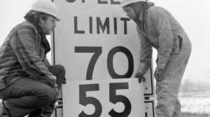
Energy Consumption in Transportation:
For the second Earth Day in 1971, Walt Kelley drew this now iconic cartoon: ¹
In the immediate aftermath of 1970-80's Gas Crises, this view led to calls for sacrifice,
including the infamous Oval Office "sweater speech," while on America's highways:
1) Pogo, by Walt Kelly, Post Hall Syndicate

Slide 3
40 years later our view is more nuanced . . . and a bit more optimistic:
Why?
Because in the latter half of the last century energy consumption had grown hugely
But that growth was driven largely by astonishingly cheap oil (especially in the U.S.)
Meaning that, for almost 50 years, we'd put minimal effort into saving energy
The result?
Our homes, cars & trucks remained astonishingly inefficient (especially in the U.S.)
While, in almost every other area, technologies improved by leaps and bounds
But now:
Motivated by the threat of climate change (and other effects of profligate energy use),
we are finally seeing comparable innovation in energy-saving technologies
And, to a surprising degree, we are finding that solutions often save energy
while enhancing the performance, cost & comfort of our homes and vehicles

Slide 4
But before discussing solutions, we need to better define the challenge
To that end, I will begin with statistics about transportation energy consumption
for both the world and the U.S.
for both today and extrapolated to mid-century
Next, because consumption levels alone are an incomplete indicator of impact,
I'll add data about transport related greenhouse gas (GHG) emissions,
and explore impacts & consequences unique to specific modes of transport
Then, because they can clarify patterns & trends in transport energy consumption,
I'll develop science-based models of various forms of transportation
And finally, armed with the above data & tools, I'll explore energy saving innovations
now being discussed or explored for each of the major forms of transport,
including the complete transformations now proposed for aviation & shipping
An Introduction to Sustainable Energy Systems: WeCanFigureThisOut.org/ENERGY/Energy_home.htm

Slide 5
Country-by-Country Per Capita Annual Energy Use
(for all purposes, including transportation)
An Introduction to Sustainable Energy Systems: WeCanFigureThisOut.org/ENERGY/Energy_home.htm

Slide 6
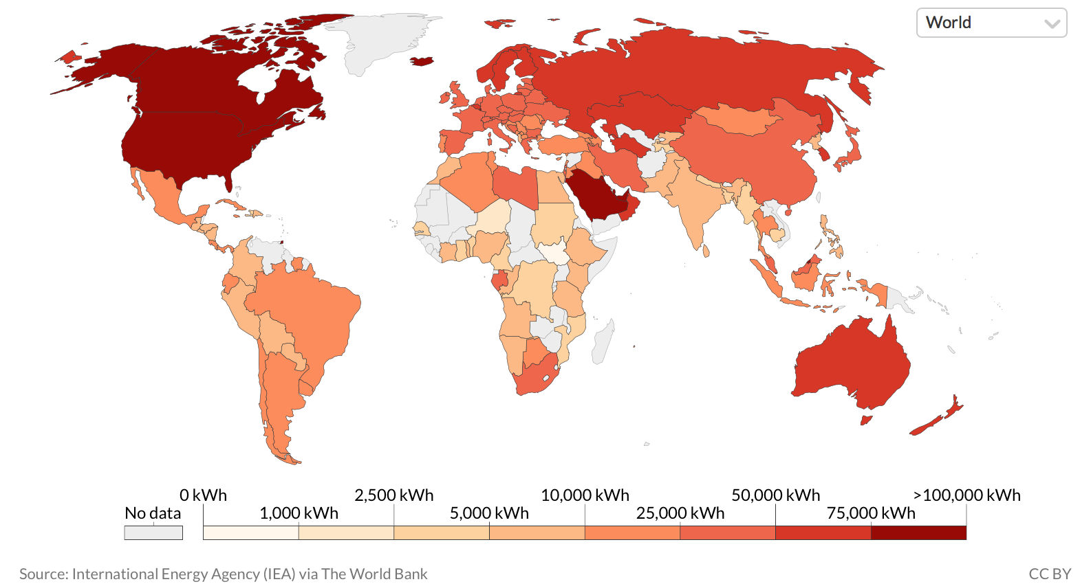
2015 per capita energy consumption (in units of kW-hours):
From OurWorldInData.org: ¹
NOTE: As with most such energy maps, widening color bands are used
This spreads low energy color range, but compresses high energy color range
Which obscures differences between high energy consumption countries
1) https://ourworldindata.org/energy

Slide 7
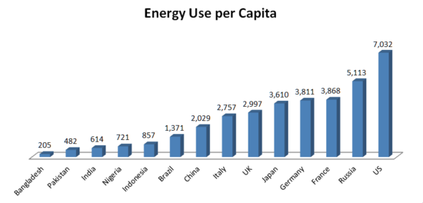
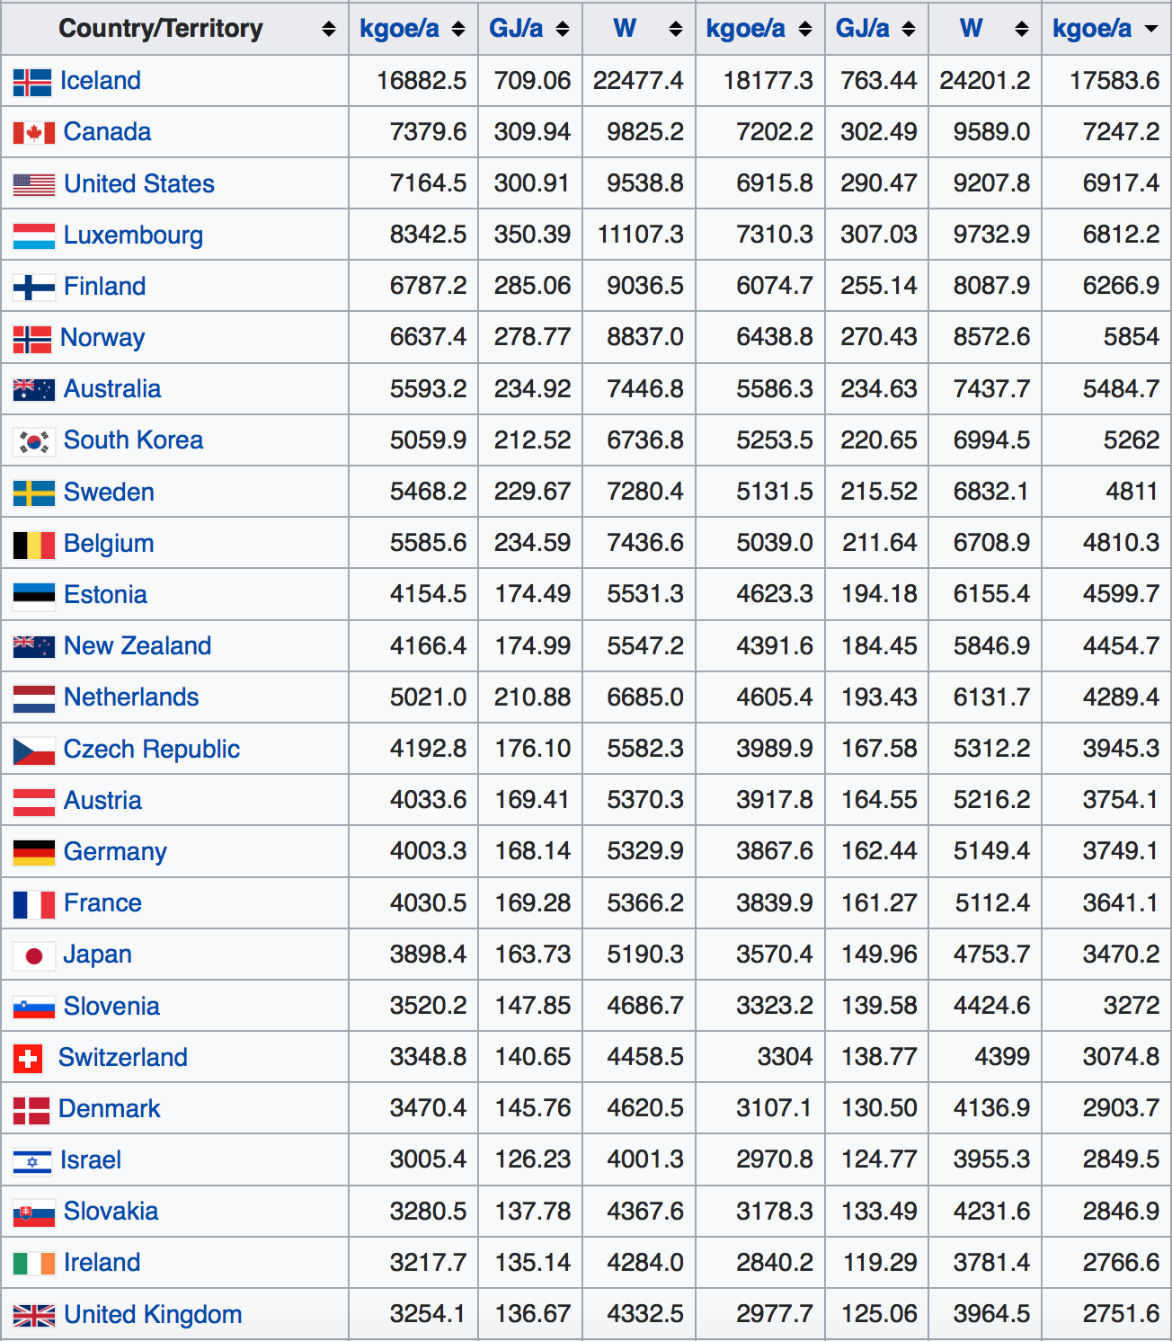
Raw numbers reveal those differences (here in kg oil equivalent = 11.6 kW-h): ¹
2011:
2014 Rank order:
Range of energy consumption among affluent countries:
Canada 7247
U.S. 6917
Sweden 4811
Germany 3749
France 3641
Japan 3470 UK 2751
~ Half or less of U.S. energy use
1) https://en.wikipedia.org/wiki/List_of_countries_by_energy_consumption_per_capita

Slide 8
Global Transportation Energy
An Introduction to Sustainable Energy Systems: WeCanFigureThisOut.org/ENERGY/Energy_home.htm

Slide 9
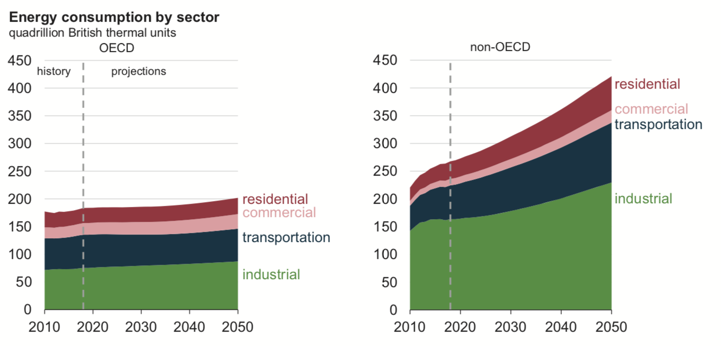
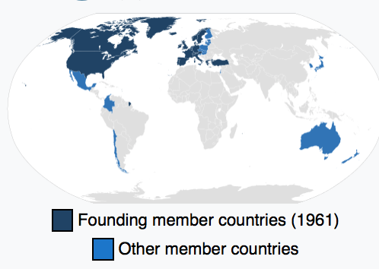
Global Transport Energy Consumption:
First, from the U.S. Energy Information Administration's
"International Energy Outlook 2019 - With Projections to 2050" ¹
Transportation accounts for ~ 1/4 of today's global energy use
What is "OECD" ? It stands for the:
Organization for Economic Cooperation & Development
Which has these governmental members: ²
1) Page 27 in: https://www.eia.gov/outlooks/ieo/pdf/ieo2019.pdf 2) https://en.wikipedia.org/wiki/OECD

Slide 10
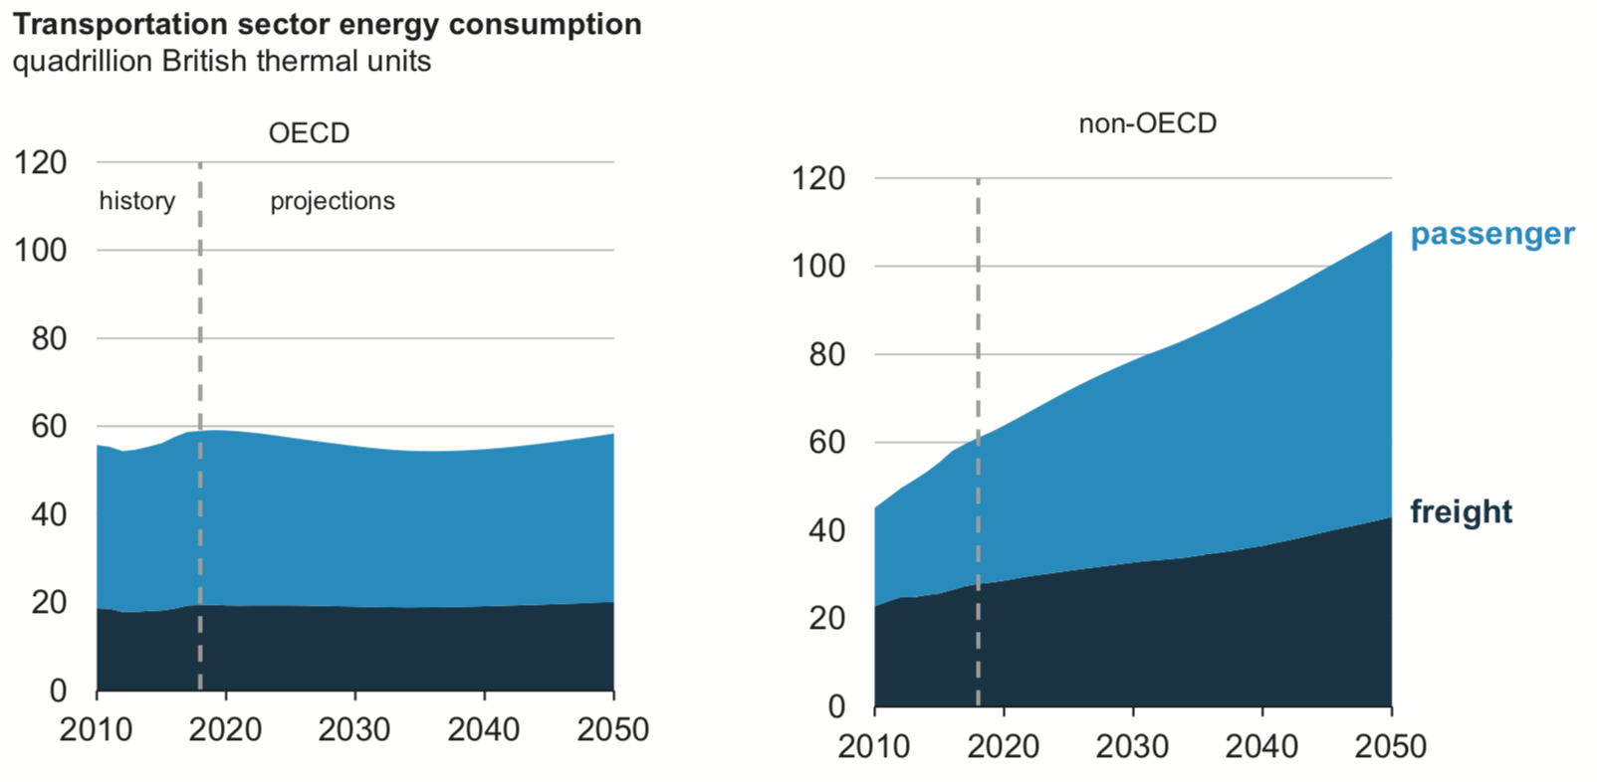
How is global transport energy divided between passengers & freight?
From that same U.S. Energy Information Administration report: ¹
And finally:
1) Page 69 in: https://www.eia.gov/outlooks/ieo/pdf/ieo2019.pdf

Slide 11
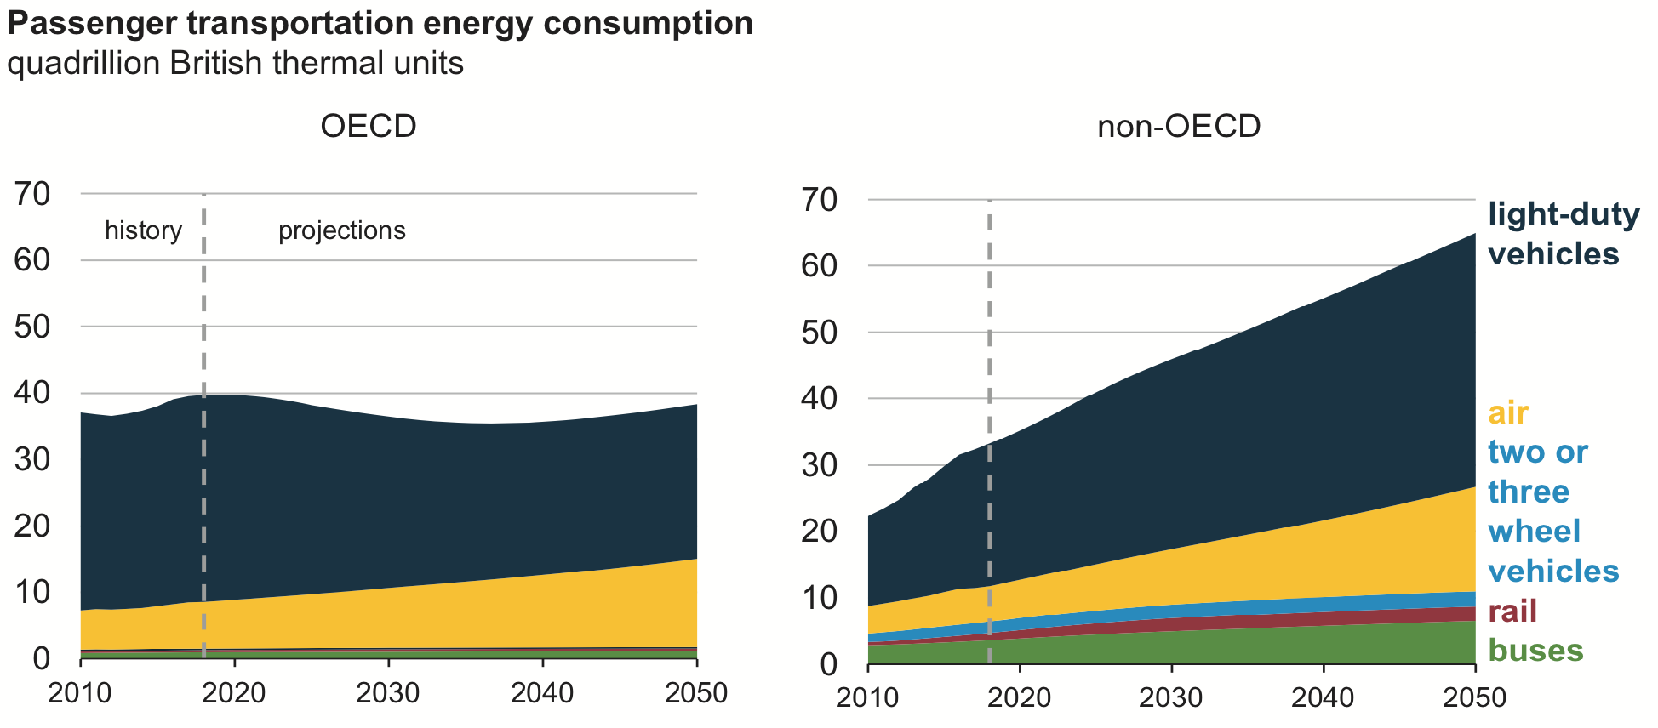
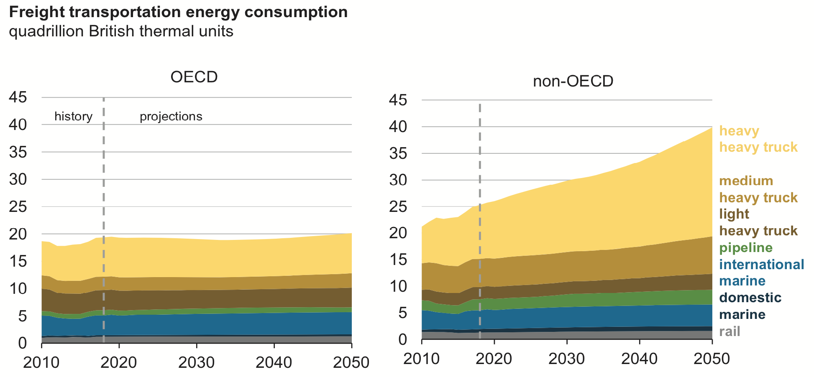
How are passengers & freight divided between transport modes? ¹
From the same report: ¹
Passenger
Transport
Freight
Transport
1) Ibid: pages 71 & 73
(1 BTU = 0.293 W-hr Thus: 1 Quadrillion (10¹⁵) BTU = 293 TeraWatt-hr)

Slide 12
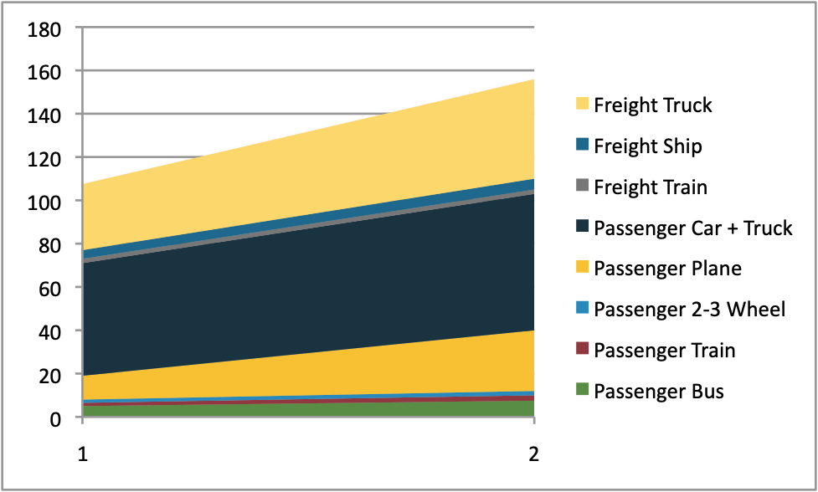
Okay I GET it! The EIA really wants me to recognize that:
Transport Energy growth is now overwhelming driven by "non-OECD" countries
Nevertheless, because we all ultimately share the world's air & climate,
I also wanted a plot of likely GLOBAL transport energy growth mode-by-mode,
which I've now (laboriously if crudely) created from the preceding EIA figures: ¹
Breakdown of Global Transport Energy Growth by Mode
2015
2050
Passenger Car & Truck +20% Freight Truck +50% Passenger Air +150%
1) Excel spreadsheet in which I merged EIA's OECD + non-OECD data into this plot (link)

Slide 13
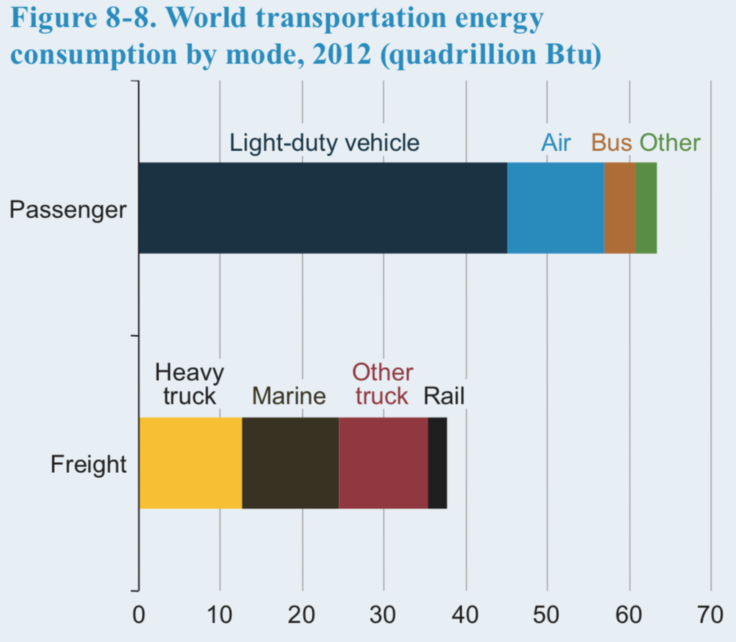
But more precise near-present day numbers can be extracted from:
The EIA's earlier "International Energy Outlook 2016," which included this figure: ¹
Percentages of the 100 Q-BTU total: *
Passengers (~62%):
Light Duty Vehicles (cars & trucks) 44%
Air 13%
Bus 3%
Other (e.g., trains) 2%
Freight (~39%):
Heavy truck 13%
Marine (ships & barges) 12%
Other truck 12%
Rail 2%
* (Again: 1 BTU = 0.293 W-hr Thus 1 Quadrillion (10¹⁵) BTU = 293 TeraWatt-hr)
1) Page 131 in: https://www.eia.gov/outlooks/ieo/pdf/0484(2016).pdf

Slide 14
Comparing those EIA results with a Finnish academic study:
From a journal publication entitled: "Global Transportation Demand Development . . . " ¹
Net transport load and mode are identified for both passengers and freight:
Passenger Transport LOAD:
(in units of total passenger-km traveled)
Freight Transport LOAD:
(in units of total tonne-km traveled)
Road: 80-85%
Air: 10-15%
Rail: ~ 5%
Ship: tiny
Road: ~ 10%
Air: < 1%
Rail: ~ 5%
Ship: 70-80%
1) https://www.mdpi.com/1996-1073/12/20/3870/htm#

Slide 15
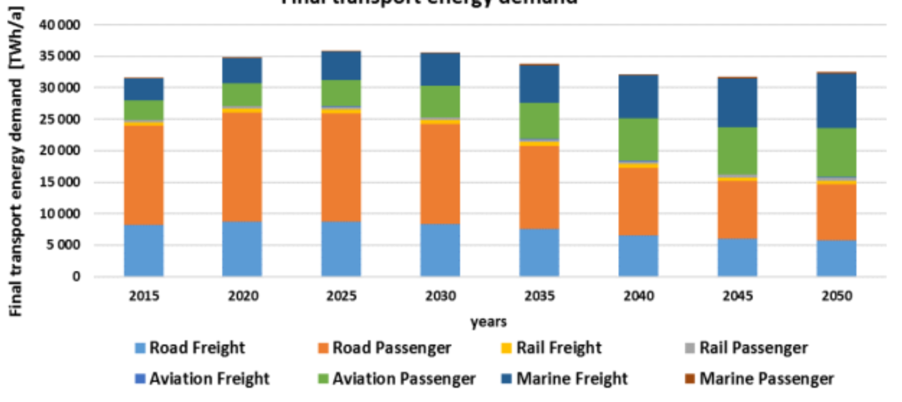
But it's claimed increased loads need NOT increase total transport energy:
From that same Finnish academic study: ¹
Projected TOTAL Transportation Energy - 2015 to 2050
With growing populations AND vehicle use, HOW can this possibly be true?
It's based primarily on prediction of more efficient road vehicles (passenger & freight)
And secondarily on the massive introduction of electrified airplanes & electrified ships
1) https://www.mdpi.com/1996-1073/12/20/3870/htm#

Slide 16
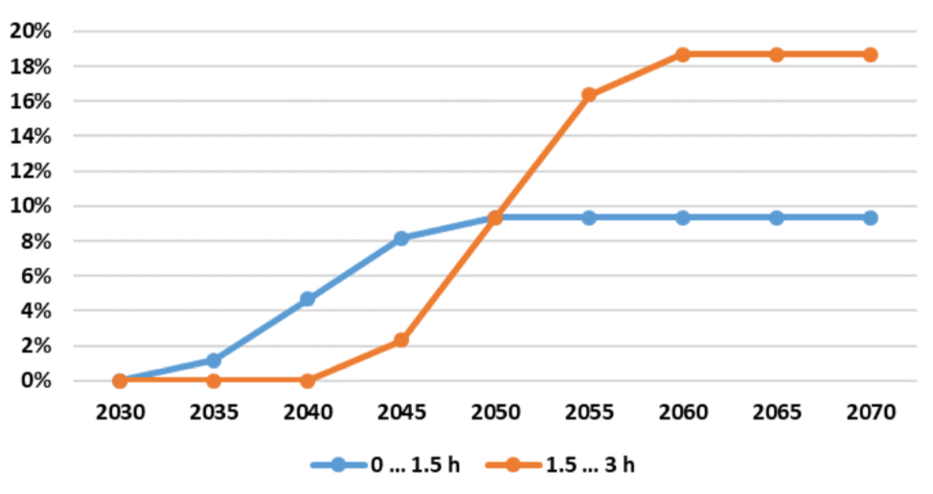
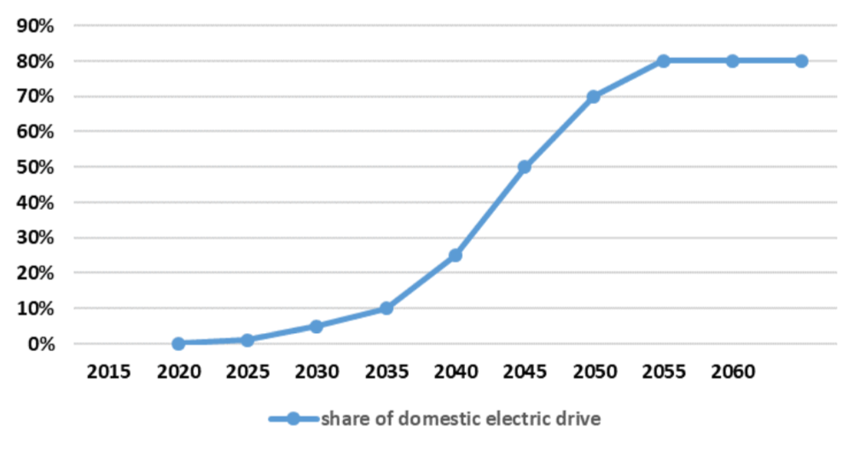
How plausible are such predictions?
Data later in this & my subsequent Green(er) Cars & Trucks (pptx / pdf / key) notes
support the likelihood of a dramatic decrease in energy use per road vehicle,
but that may not offset the present rapid growth in number of vehicles
And here are the report's predictions regarding plane & ship electrification:
Projected growth of electric aviation:
Projected growth of electric shipping:
As noted in the report's text, these transitions would require technology breakthroughs
But I know those "breakthroughs" to be equivalent to 10-100 fold improvements
I'll thus examine BOTH scenarios in separate later sections of this note set

Slide 17
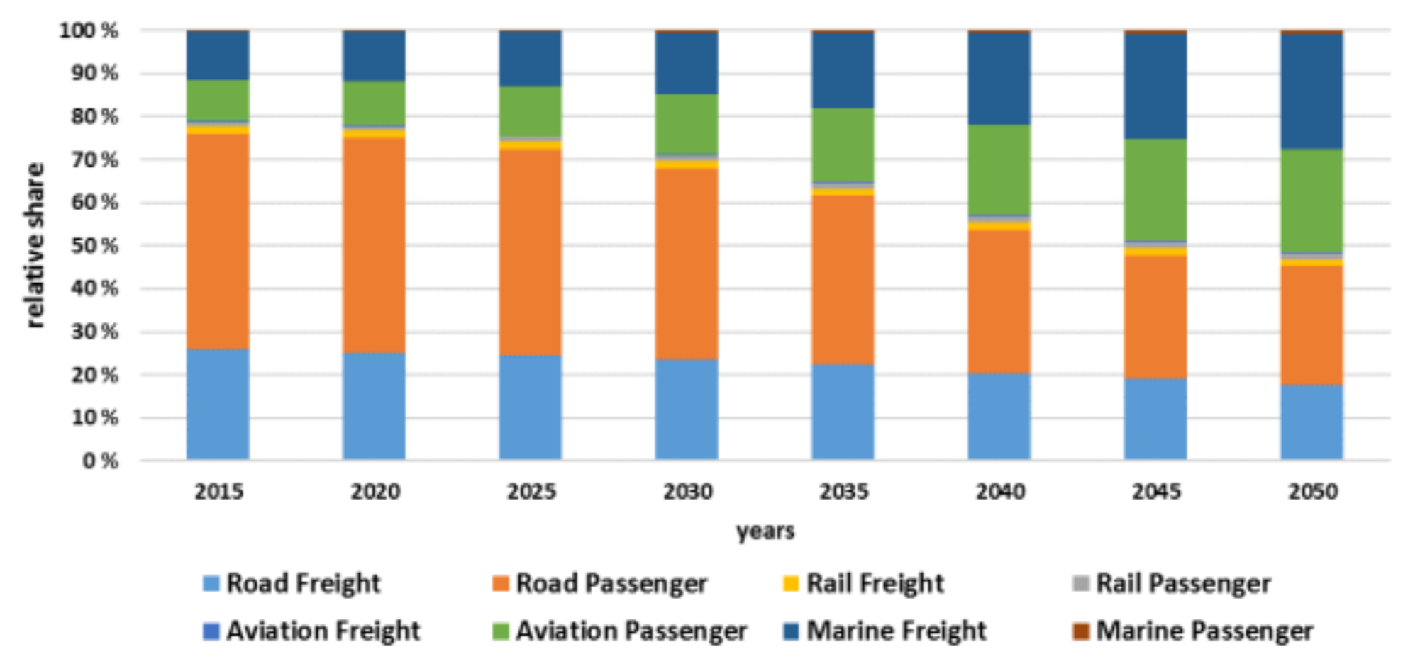
But is there at least agreement about TODAY's Transport Energy?
Finnish breakdown (using 2015 data at far left): vs. EIA 2016 breakdown
Passengers (~60%):
Road Passenger 50%
Aviation Passenger 9%
Rail Passenger 1%
Marine Passenger < 1%
Freight (~40%):
Road Freight 26%
Aviation Freight < 1%
Marine Freight 12%
Rail Freight 2%
Passengers (~62%):
Light Duty Vehicles (cars & trucks) 44%
Air 13%
Bus 3%
Other (e.g., trains) 2%
Freight (~39%):
Heavy truck 13%
Other truck 12%
Marine (ships & barges) 12%
Rail 2%

Slide 18
Which IS good agreement about Today's Global Transport Energy:
Global
Transport fraction of TOTAL ENERGY: 25%
Fraction of TRANSPORT ENERGY used by:
Fossil-fueled cars & trucks 70-85%
Fossil-fueled ships ~12%
Fossil-fueled airplanes 10-15%
Fraction of TRANSPORT ENERGY used by:
Passengers: 45-50% in Cars & Trucks
9-13% in Airplanes
1-2% in Trains or Buses
< 1% in Ships
Freight: 25-26% in Trucks
12% in Ships
2% in Trains
< 1% in Airplanes

Slide 19
U.S. Transportation Energy
An Introduction to Sustainable Energy Systems: WeCanFigureThisOut.org/ENERGY/Energy_home.htm

Slide 20
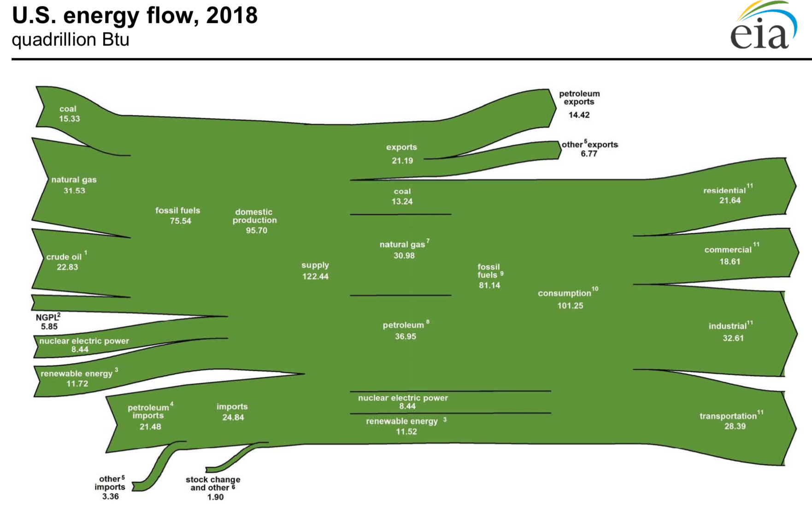
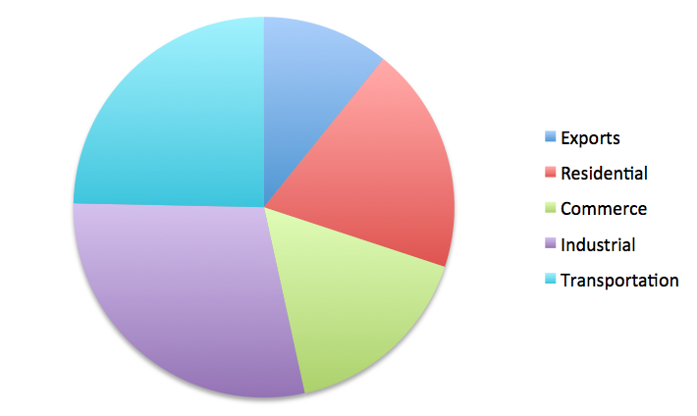
Transportation's contribution to total U.S. Energy Consumption:
From the U.S. Energy Information Administration (EIA)'s 2018 "U.S. Energy Flow" ¹
"Outputs" translated into my pie chart:
Exports (fuels): 17.3%
Commerce: 17.7%
Residential: 15.2%
Transportation: 26.6%
Industrial: 23.2%
1) EIA U.S. Energy Flow 2018: https://www.eia.gov/totalenergy/data/monthly/pdf/flow/total_energy.pdf

Slide 21
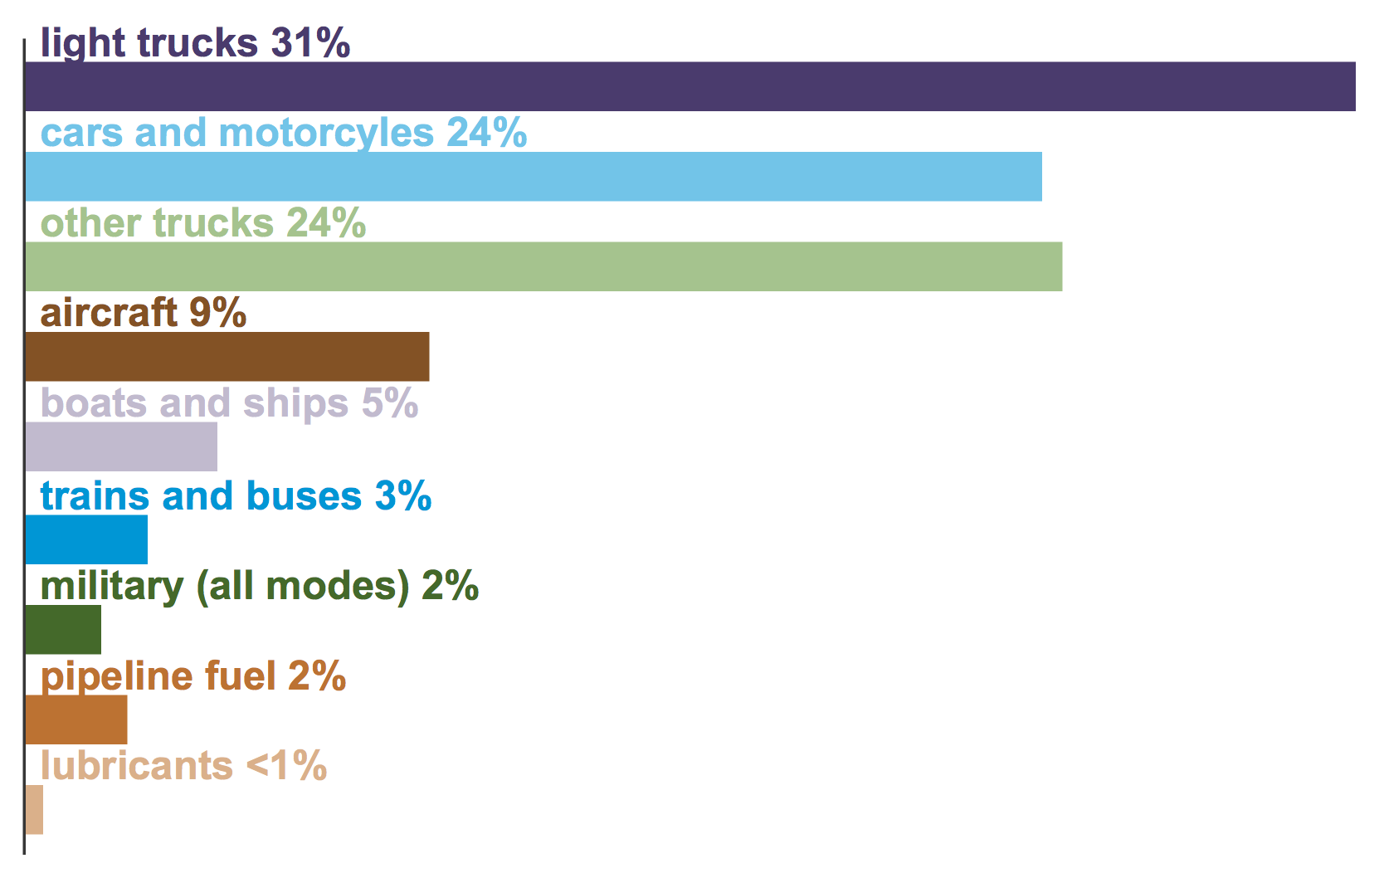
Breakdown of that U.S. Transportation Energy use by mode:
From a U.S. Energy Administration (EIA) webpage (accessed June 2020):
"Use of Energy Explained - Energy Use for Transportation (In Depth)" ¹
1) https://www.eia.gov/energyexplained/use-of-energy/transportation-in-depth.php

Slide 22
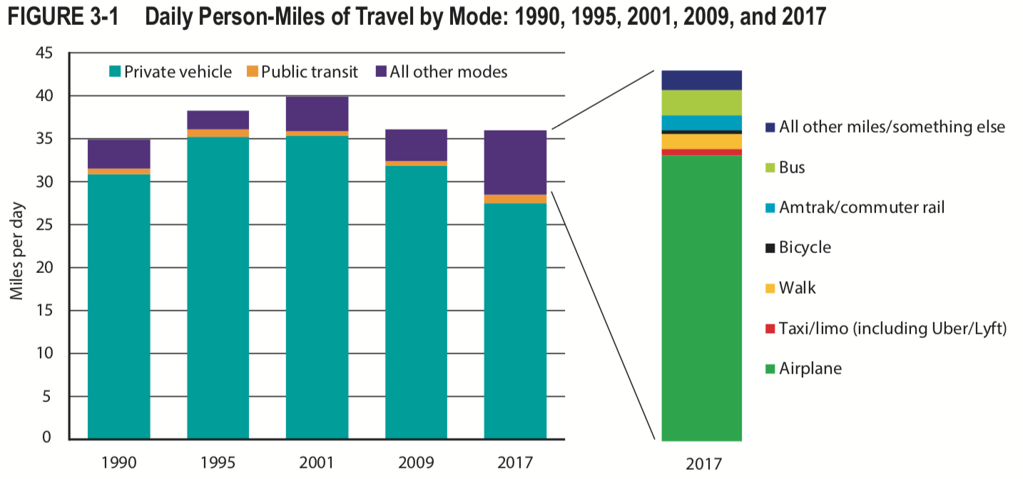
Pertaining to only U.S. Passenger Transport:
From the U.S. Department of Transportation (DOT)'s
"Transportation Statistics Annual Report- 2018" ¹
Expansion of orange-purple
(non-private vehicle) bands:
Private vehicle (cars / light tucks)
1) Page 3-5 (with labels added) in: https://www.bts.dot.gov/sites/bts.dot.gov/files/docs/browse-statistical-products-and-data/transportation-statistics-annual-reports/Preliminary-TSAR-Full-2018-a.pdf

Slide 23
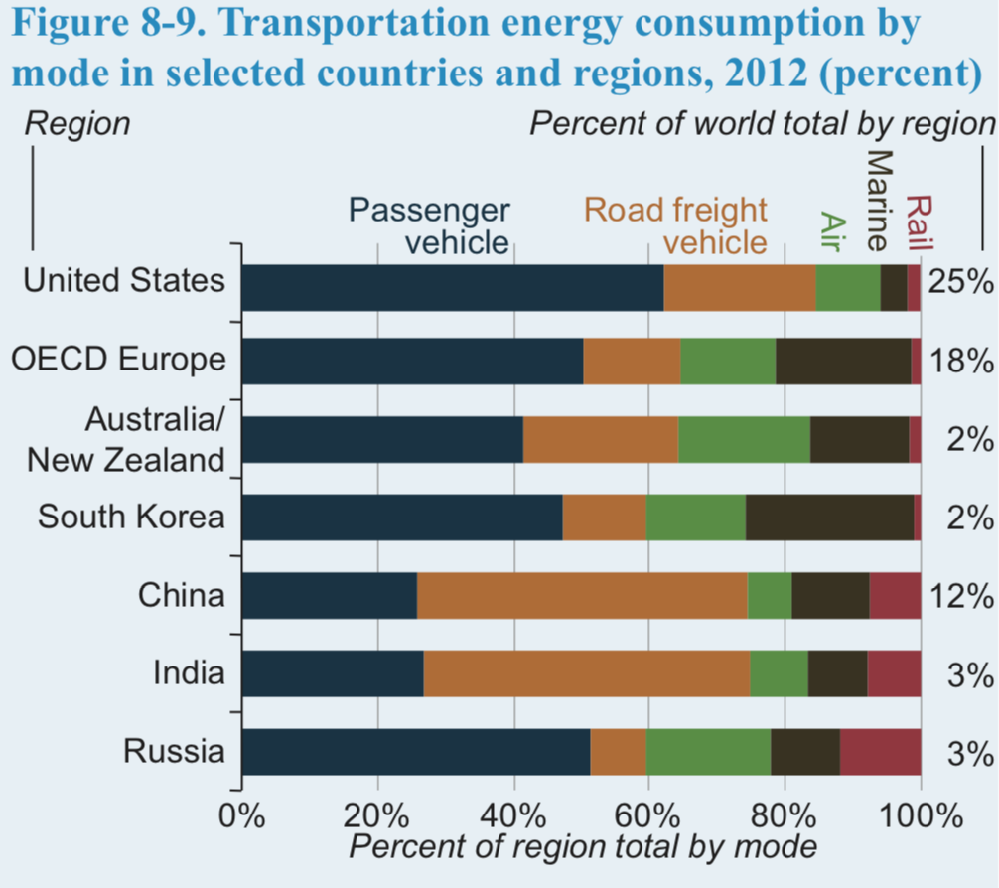
The DOT conspicuously omitted a comparable freight ton-miles summary
But the earlier EIA "International Energy Outlook 2016" included this figure: ¹
Assuming:
U.S. "Rail" is ~ all freight,
U.S. "Air" is ~ all passenger,
U.S. "Marine" is ~ all freight
Figure would imply:
Passengers (by all modes ~ 71%):
Cars & light trucks ~ 62%
Air ~ 9%
All other < 1%
Freight (~ 29%):
Heavy truck ~ 22%
Marine ~ 3.5%
Rail ~ 2%
But U.S. marine freight of 3.5% is much smaller than the earlier Global value of 12%
(Compare the 2nd-from-right dark brown "Marine" bands top to bottom in figure above)
1) Page 131 in: https://www.eia.gov/outlooks/ieo/pdf/0484(2016).pdf

Slide 24
Two reasons why U.S. ship transport energy might be lower:
1) Relative Distances:
The size of most countries is much smaller than the size of the world's oceans
Distance traveled by goods from Asia in ships is thus much longer than
distance traveled in trucks & trains to distribute goods within the country
But the continental U.S. is ~ 1/2 as wide as the Pacific Ocean
Which shifts the distance balance away from ships towards trucks & trains
2) Deceptive Reporting:
Nations want to polish their image by minimizing their apparent energy footprint
which the U.S. might be doing by omitting or sharply discounting the
energy used transporting goods TO the U.S. via internationally flagged ships
(which, while it might be legally defensible, strikes me as deceptive)
An Introduction to Sustainable Energy Systems: WeCanFigureThisOut.org/ENERGY/Energy_home.htm

Slide 25
Summary comparison of Global vs. U.S. Transport Energy:
Global U.S.
Transport fraction of TOTAL ENERGY: 25% vs. 26.7%
Fraction of TRANSPORT ENERGY used by:
Fossil-fueled cars & trucks 70-85% vs. ~84%
Fossil-fueled ships ~12% vs. 3.5-5%
Fossil-fueled airplanes 10-15% vs. ~9%
Fraction of TRANSPORT ENERGY used by:
Passengers: 45-50% vs. ~62% in Cars & Trucks
9-13% vs. ~9% in Airplanes
1-2% vs. <1% in Trains or Buses
< 1% vs. <1% in Ships
Freight: 25-26% vs. ~22% in Trucks
12% vs. ~3.5% in Ships
2% vs. 2% in Trains
< 1% vs. < 1% in Airplanes

Slide 26
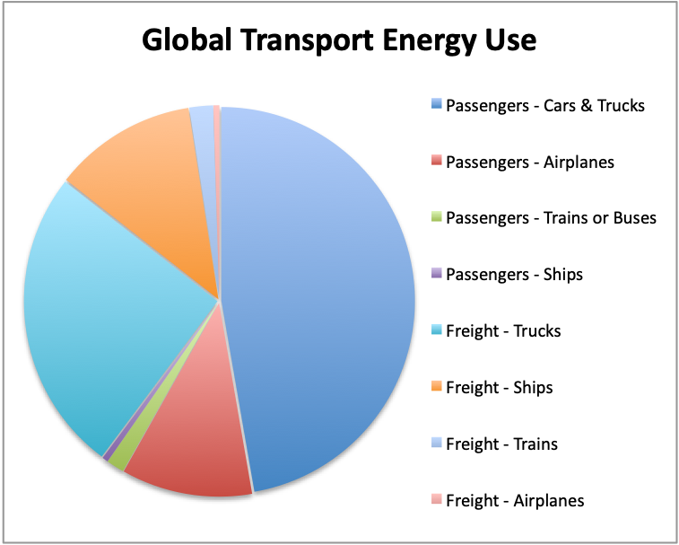
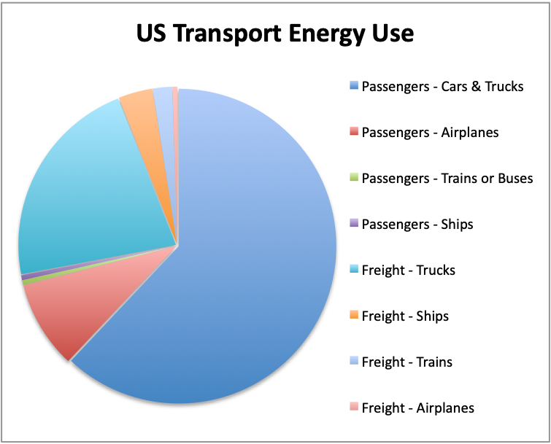
Transport Energy breakdowns in the form of pie charts:

Slide 27
Greenhouse Gas Emissions
An Introduction to Sustainable Energy Systems: WeCanFigureThisOut.org/ENERGY/Energy_home.htm

Slide 28
Energy Impact vs. Greenhouse Gas Impact?
The above energy expenditures have huge economic & environmental consequences
But while economic impact may scale roughly with AMOUNT of energy used
Environmental impact may also vary with HOW that energy is used
Why?
Because, depending on HOW energy is used, it ultimately liberates:
Heat alone - as mostly occurs when energy drives electric motors OR
Heat + innocuous gases - as occurs when hydrogen is burned OR
Heat + greenhouse gases - as occurs when fossil fuels are burned
So we must now examine the GHG emissions of each transportation mode:
An Introduction to Sustainable Energy Systems: WeCanFigureThisOut.org/ENERGY/Energy_home.htm

Slide 29
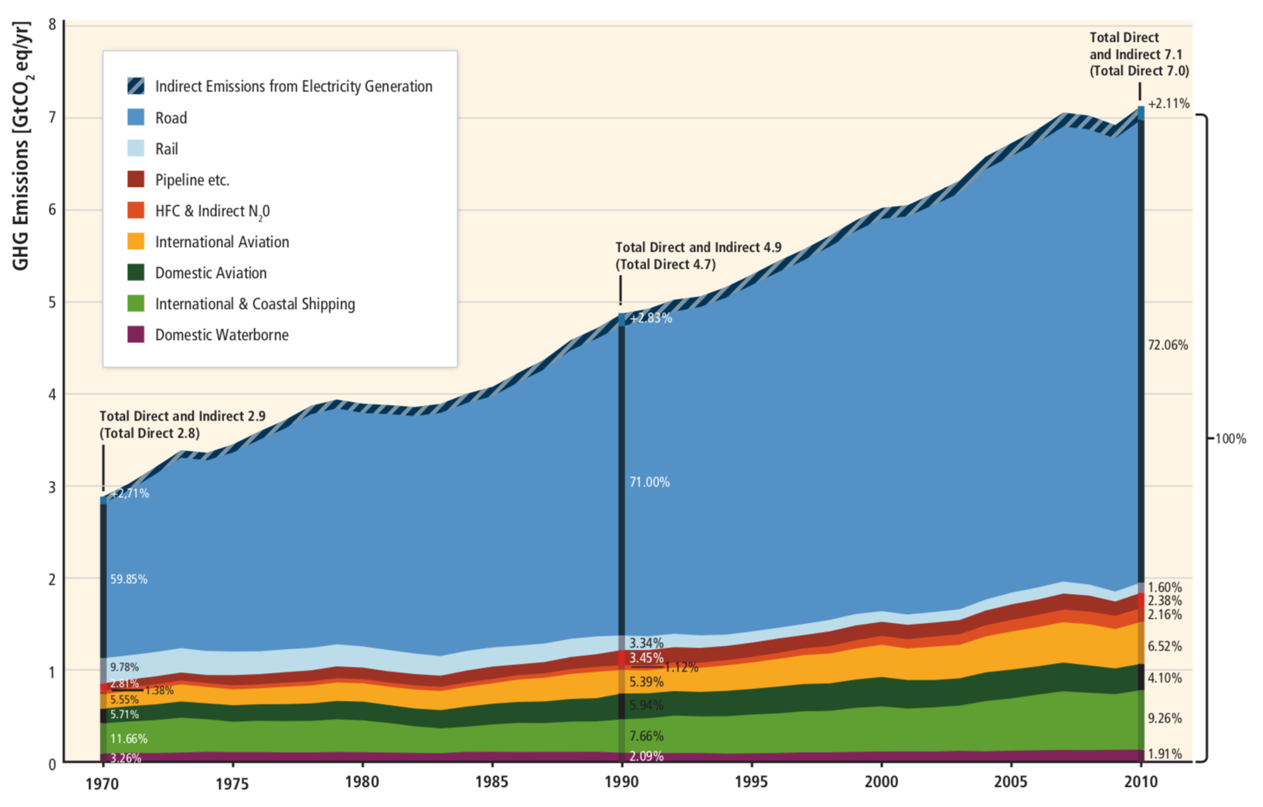
Transportation's contribution to Global Greenhouse Gas Emissions:
From: Transport - Chapter 8 - Climate Change 2014 - IPPC Fifth Assessment ¹
(Note: Unlike earlier projection figures, in this history figure TODAY is at RIGHT END)
GHG Emission Share:
Transportation:
Cars & Trucks: 72%
Ships (intl/coastal) 9.2%
Planes (intl) 6.5%
Planes (domestic) 4.1%
Ships (domestic) 1.9%
Trains 1.6%
Non-transportation:
Power Plants (indirect) 2.1% *
All Other ~ 4%
Cars & Trucks
Trains
International Planes
Domestic Planes
Ships (international + coastal)
* Compare this 2.1% "indirect electricity generation" GHG number with data on following two slides
1) White labels added to: https://www.ipcc.ch/site/assets/uploads/2018/02/ipcc_wg3_ar5_chapter8.pdf

Slide 30
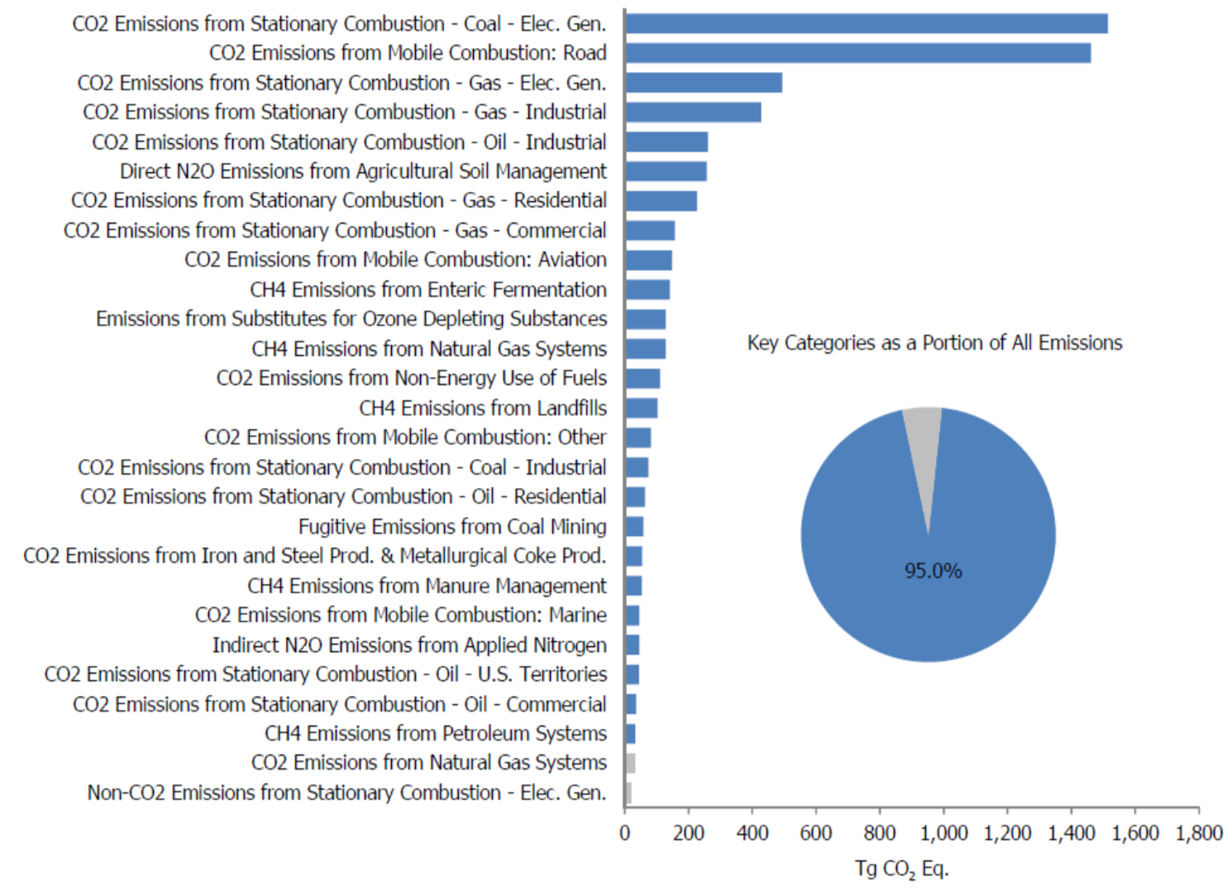
Transportation's contribution to U.S. Greenhouse Gas Emissions:
From: "EPA Inventory of U.S. Greenhouse Gas Sources & Sinks - 1990-2012" ¹
Cars & Trucks
Aviation
Ships
Note top line identifying coal electricity generation plants alone as the top U.S. GHG emitter
1) Now disappeared EPA document: link WeCanFigureThisOut.org cached copy: link

Slide 31



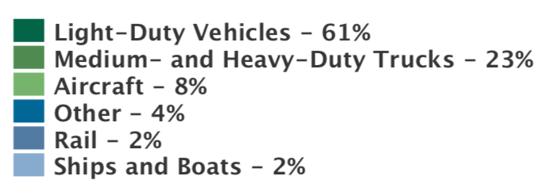
Or this enumeration of U.S. Greenhouse Gas Emissions:
From online 2017 archive of the U.S. Environmental Protection Agency's
"Fast Facts on Transportation Greenhouse Gas Emissions" ¹
All U.S. GHG Emissions: Transportation U.S. GHG Emissions:
AT LEFT: Note electricity generation's 30% GHG share - What WAS the 2.1% IPCC referred to in earlier slide?
Possibility: GHG's due to tiny fraction of electricity generation now used by electric trains & cars
1) https://19january2017snapshot.epa.gov/greenvehicles/fast-facts-transportation-greenhouse-gas-emissions_.html

Slide 32
A possibly surprising observation / conclusion:
Car + truck GHG emission share = Car + truck energy share
Globally both are ~ 72% For the U.S. both are ~ 84%
Similarly, airplane GHG share and energy share are both ~ 10% (Global and U.S.)
And rail GHG share and energy share are both ~ 2% (Global and U.S.)
Indicating use of a SINGLE cross-cutting technology: Fossil fuel combustion
Producing either motion directly (in cars, trucks, trains, planes, ships . . .) OR
Producing electricity then used to produce motion (in electric cars & trains)
YES: There has yet to be any recognizable reduction in GHG's due to
Electric vehicles using power from low GHG electric power plants
Suggesting: Too few electric vehicles and/or too few low GHG electric power plants
Indeed, the fraction of cars now powered electrically is still very very small
And even where most passenger trains are electric, the electricity is not low GHG
A possible exception: French electric passenger trains using nuclear electricity

Slide 33
Unique Impacts & Concerns about Specific Transport Modes:
An Introduction to Sustainable Energy Systems: WeCanFigureThisOut.org/ENERGY/Energy_home.htm

Slide 34
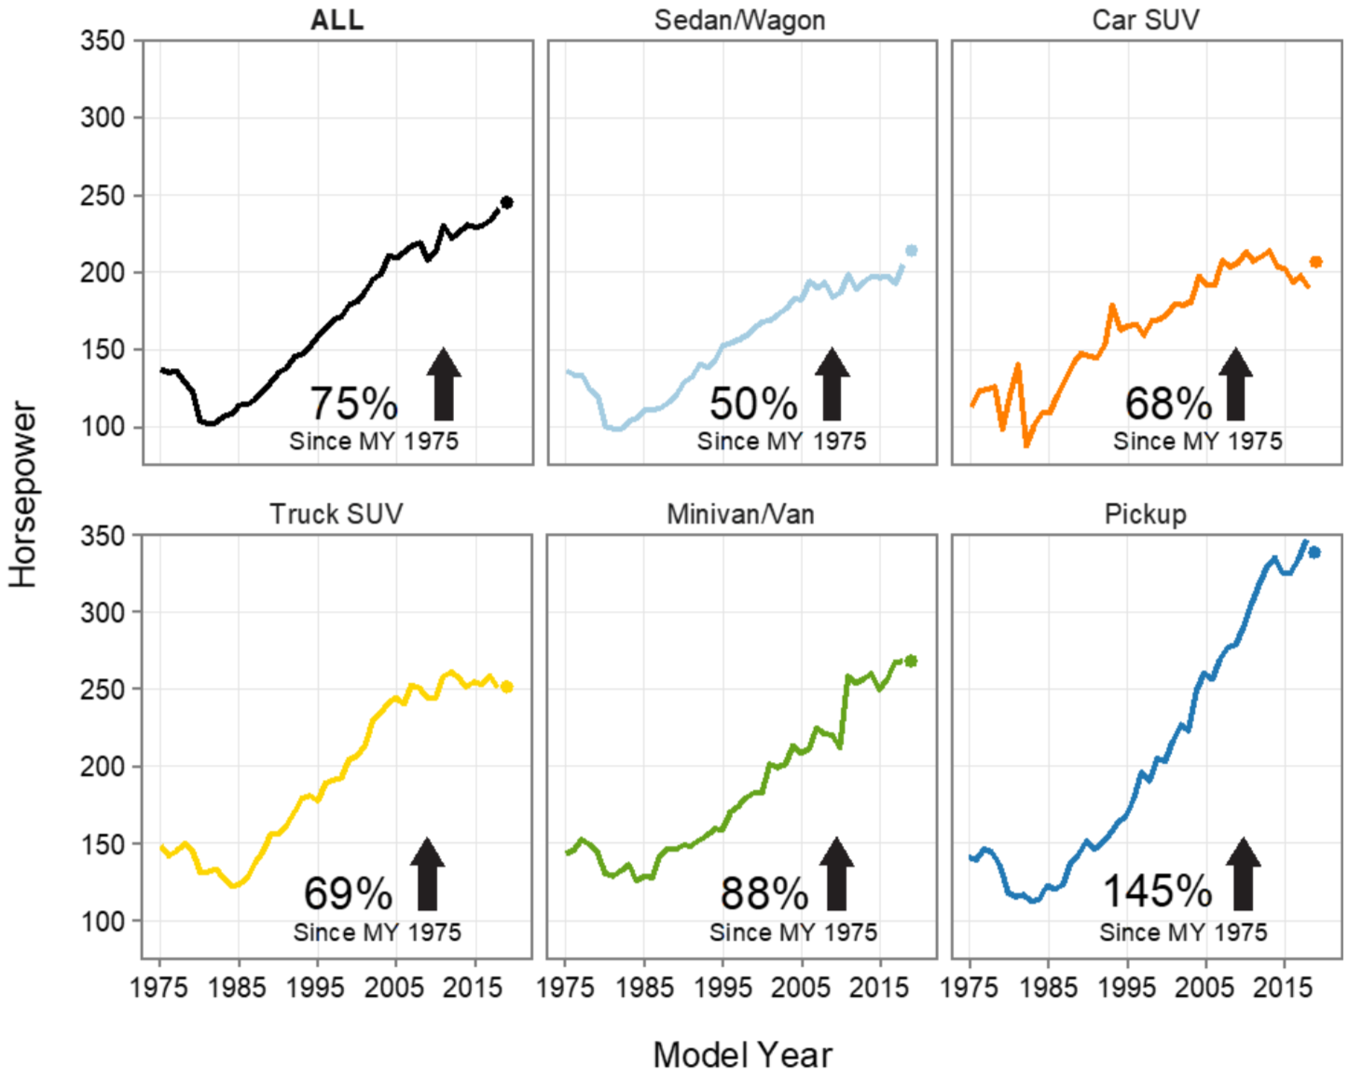
Cars & Trucks:
From the U.S. Environmental Protection Agency (EPA)'s
"2019 EPA Automotive Trends Report" ¹
The engine power of U.S. road vehicles has skyrocketed!
1) Page 5 in: https://nepis.epa.gov/Exe/ZyPDF.cgi?Dockey=P100YVFS.pdf

Slide 35
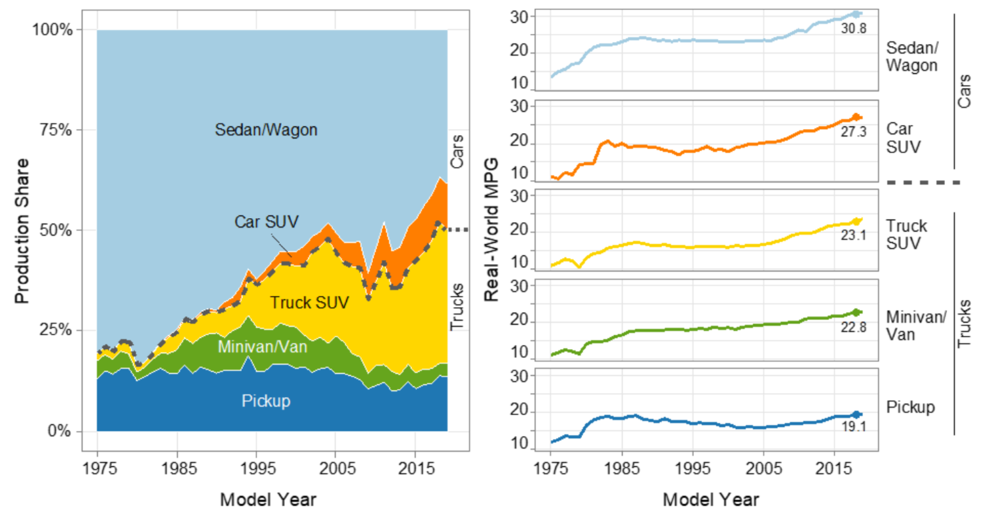
Despite which: Fuel mileage has improved for all except pickup trucks:
From the "2019 EPA Automotive Trends Report" ¹
Production share and estimated real-world average U.S. fuel economy:
1) Page 16 in: https://nepis.epa.gov/Exe/ZyPDF.cgi?Dockey=P100YVFS.pdf

Slide 36
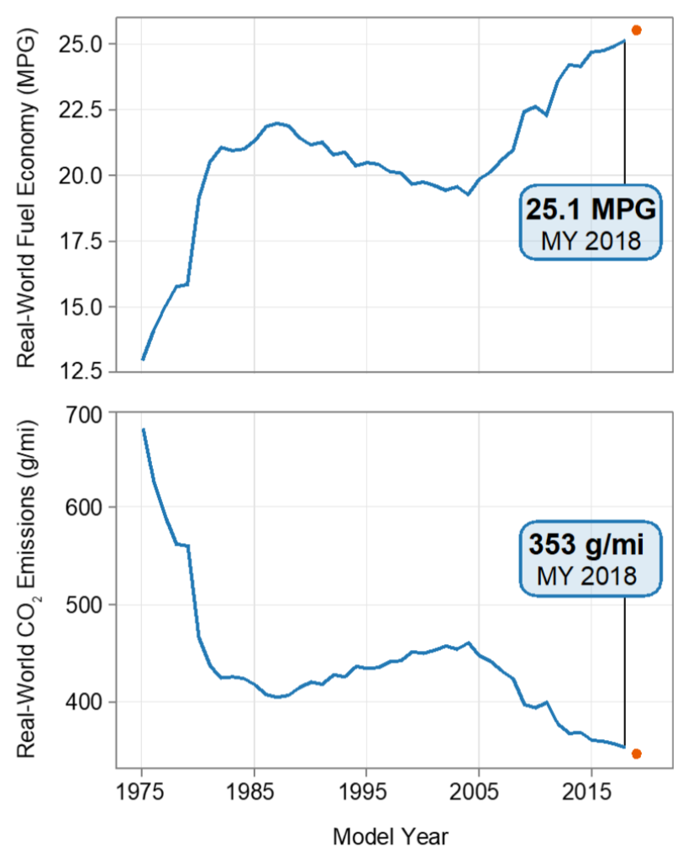
Leading to overall improvement 2005 onward:
From the "2019 EPA Automotive Trends Report" ¹
Overall real-world average U.S. auto fuel economy and CO2 emissions:
Likely reasons for the sustained post 2005 improvement?
Market forces alone began driving the industry to higher mileage levels 2005 onward
FURTHER, despite four years of rhetoric, the Trump administration has yet to replace
higher mileage standards implemented under an Obama / Industry agreement ²
1) Page 5 in: https://nepis.epa.gov/Exe/ZyPDF.cgi?Dockey=P100YVFS.pdf
2) https://obamawhitehouse.archives.gov/the-press-office/2012/08/28/obama-administration-finalizes-historic-545-MPG-fuel-efficiency-standard

Slide 37
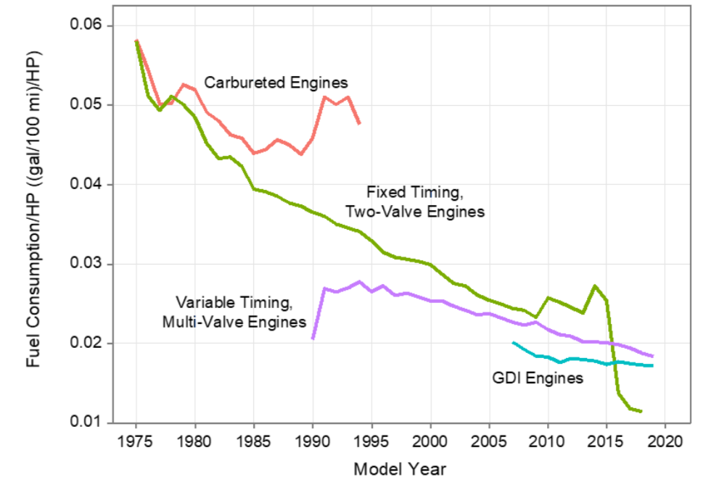
All enabled by this evolution in car & truck engine technology:
From the "2019 EPA Automotive Trends Report" ¹
These ongoing improvements to fossil-fueled car & trucks are so massive,
as are the improvements promised by electrification of cars & trucks,
that I am devoting a separate entire note set to their exploration:
Green(er) Cars & Trucks (pptx / pdf / key)
1) Page 46 in: https://nepis.epa.gov/Exe/ZyPDF.cgi?Dockey=P100YVFS.pdf

Slide 38
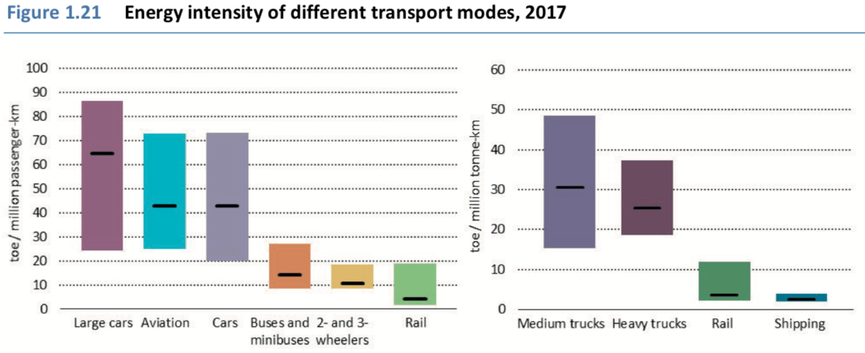
Trains:
From the International Energy Agency (IEA)'s 2019
"The Future of Rail - Opportunities for Energy and the Environment"
Rail is the MOST EFFICIENT means of PASSENGER transport
And almost ties with shipping as most efficient means of FREIGHT transport
Passengers
Freight
Boxes = Worldwide Range Bars = Worldwide Average
1) Page 48 (red labels added) in: https://www.iea.org/reports/the-future-of-rail
An Introduction to Sustainable Energy Systems: WeCanFigureThisOut.org/ENERGY/Energy_home.htm

Slide 39
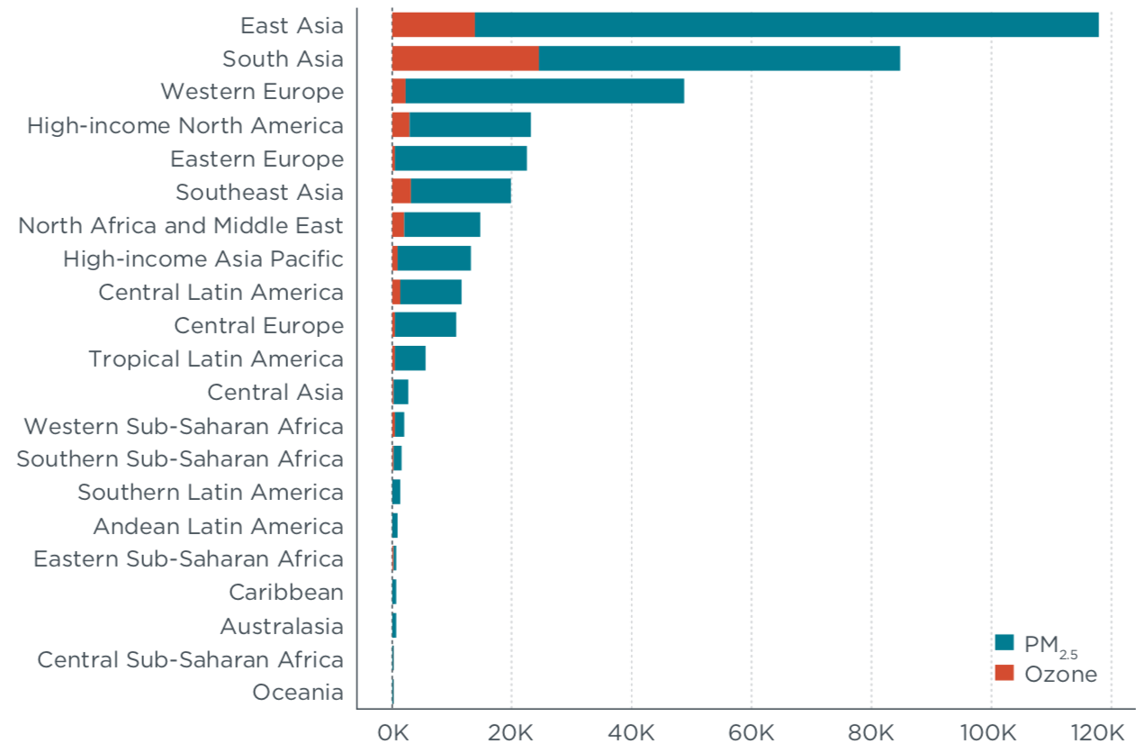
Airplanes:
Planes account for only ~ 10% of world transport energy use & GHG emissions
Nevertheless, the International Council on Clean Transportation (ICCT)'s 2019
"Global Snapshot of Air Pollution Related Health Impacts of Transportation"
claims that aviation has a major worldwide health impact:
Due to Particulate Emission
Due to Ozone Emission
Deaths Attributed to Aviation Pollution in 2015
1) Page 17 (with labels added) in: https://theicct.org/publications/health-impacts-transport-emissions-2010-2015

Slide 40
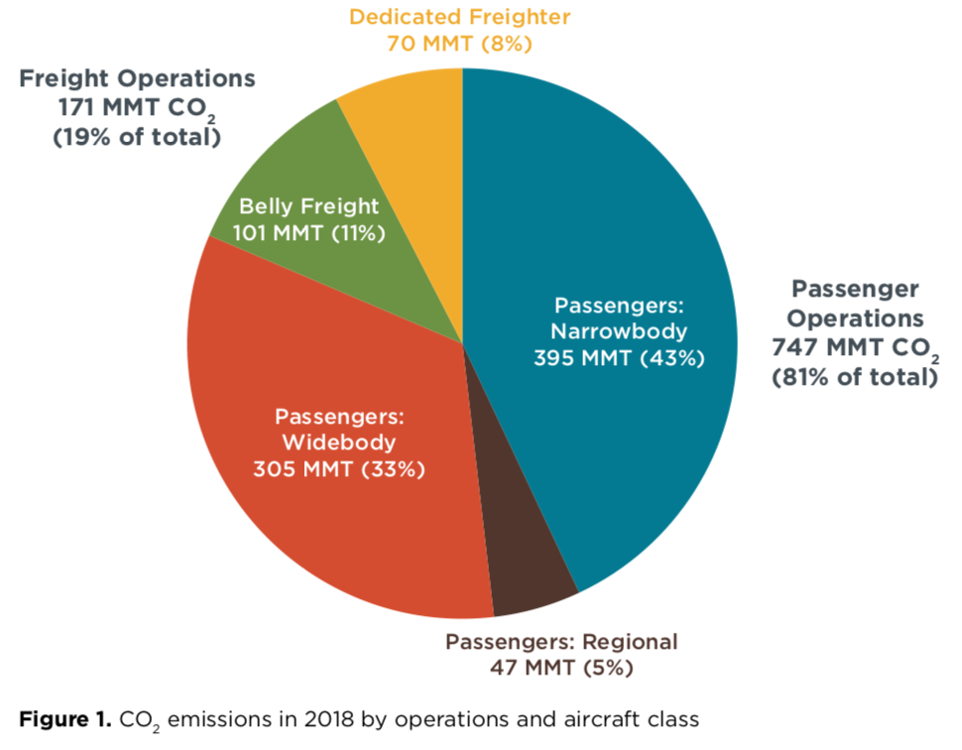
Airplane GHG emissions are also of special concern:
Because of the exceptional difficulty in reducing aviation's use of fossil fuels
Which is a challenge that I will explore in depth later in this note set
Who / what is now most responsible for aviation's CO2 emissions?
From the ICCT's 2018 "CO2 Emissions from Commercial Aviation" ¹
Global 2018 CO2 emissions by type of air service:
Passenger Operations: 81%
Belly Freight: 11%
Dedicated Freight: 8%
1) https://theicct.org/publications/co2-emissions-commercial-aviation-2018

Slide 41
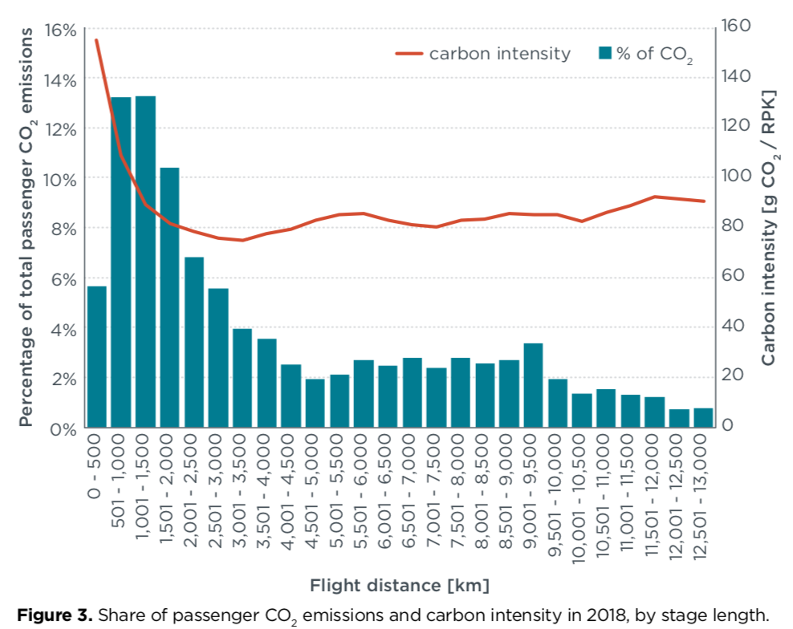
The same report suggests disproportionate role of long / international flights:
CO2 emissions & carbon intensity attributed to passengers vs. flight distance:
Intercontinental Distances
This CO2 impact despite the much lower "carbon intensity" of long distance flights
Carbon Intensity = Grams CO2 per Revenue Passenger Kilometers (flown)
Lower for long flights because fuel is burned much faster during ascent than cruising
1) (yellow label & arrow added): https://theicct.org/publications/co2-emissions-commercial-aviation-2018

Slide 42
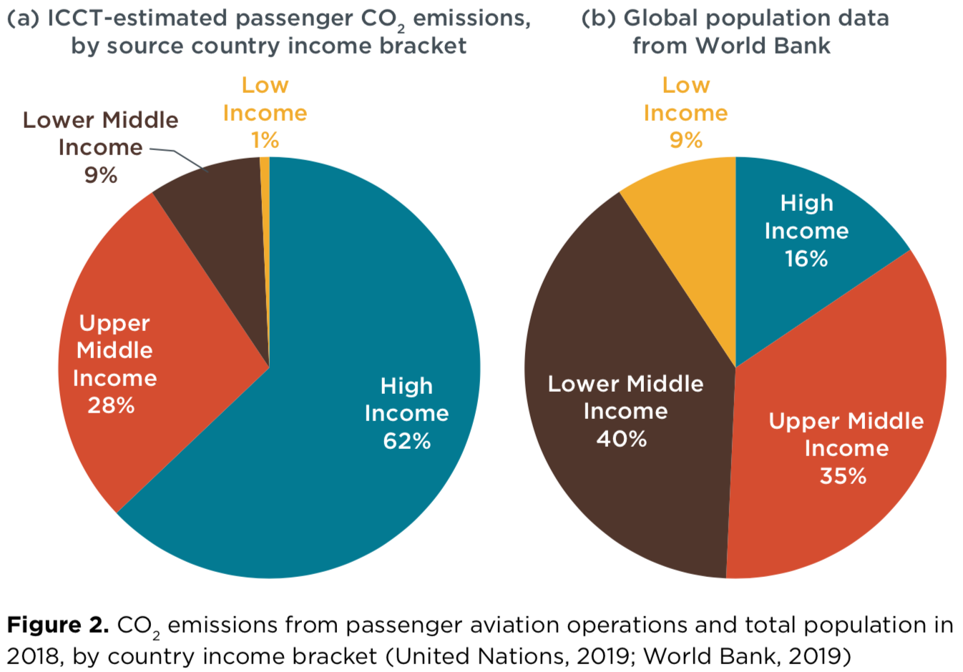

But oft reported surge in middle income air travel is not the culprit:
From the International Council on Clean Transport (ICCT)' s
"CO2 Emissions from Commercial Aviation:"
CO2 due to passengers
vs. passenger income:
As contrasted with
Global income distribution:
https://theicct.org/publications/co2-emissions-commercial-aviation-2018

Slide 43
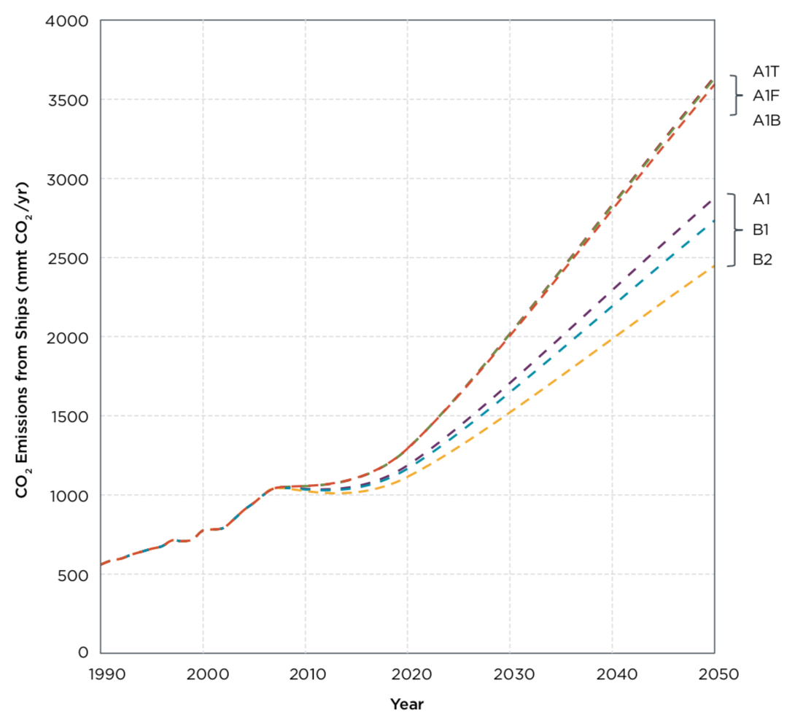
Shipping:
Sources above describe ships as the MOST energy efficient mode of freight transport
And note that ships now account for less than 2% of world GHG emissions
But not mentioned was the fact that today's ships use of some of the dirtiest fossil fuels
Or that, while now overshadowed by other modes, shipping's impact is soaring:
Projected Growth by 2050
From above:
Passenger Car & Truck +20%
Freight Truck +50%
Passenger Air +150%
From plot at left: ¹
Shipping +300-500%
Projected Shipping GHG emissions
1) Reducing the Greenhouse Gas Emissions from Ships - Cost Effectiveness of Available Options - ICCT - 2011􏰒􏰋􏰅􏰓􏰍: https://theicct.org/sites/default/files/publications/ICCT_GHGfromships_jun2011.pdf

Slide 44
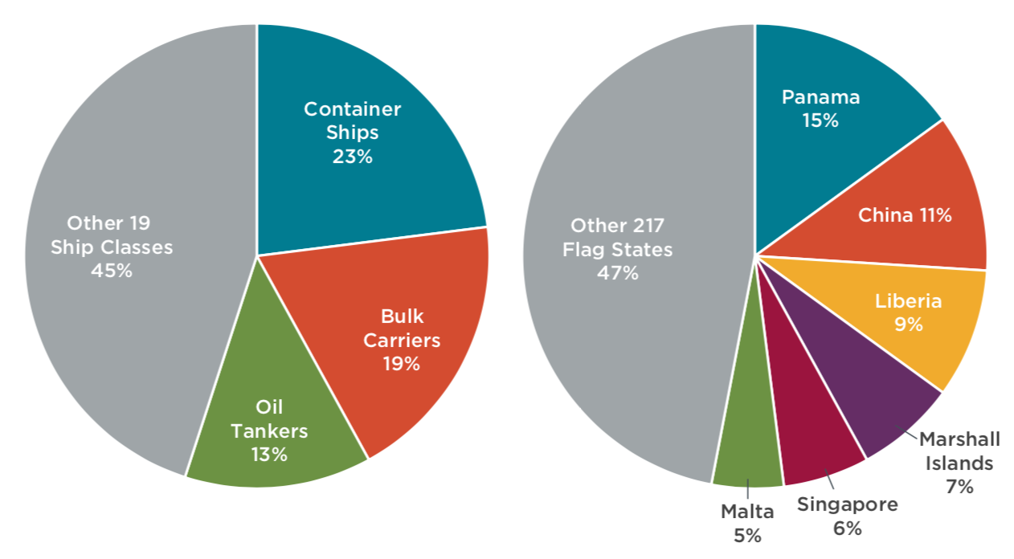
Impact is mostly due to just 3 classes of ship, flying just 6 national flags:
From the International Council on Clean Transport (ICCT)'s
"Greenhouse Gas Emissions from Global Shipping 2013-2015:" ¹
1) https://theicct.org/publications/GHG-emissions-global-shipping-2013-2015

Slide 45
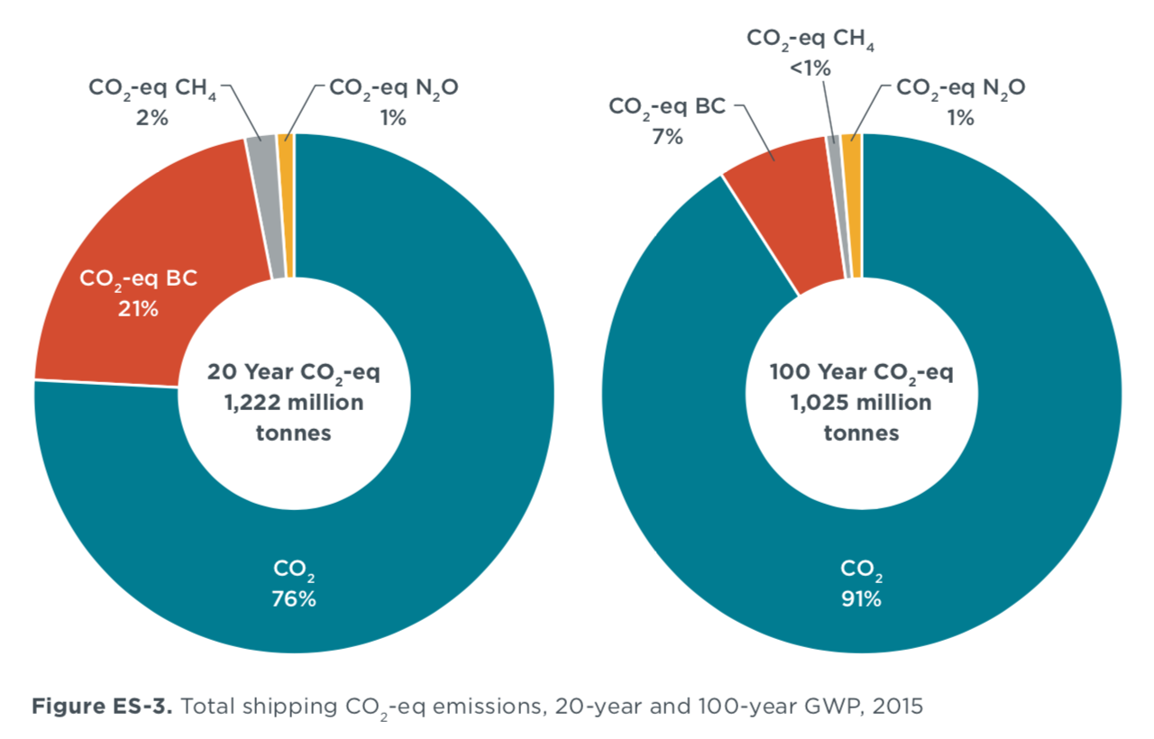
"Black carbon" is identified as a particular climate change culprit: ¹
Black carbon (BC) = Particulates stemming from ship's use of low grade fossil fuels ²
Bad news: They are unusually effective at causing global warming
Good news: As particles, they fall out of the atmosphere more quickly than gases
Meaning that IF their emission were soon curtailed, their latent global warming
impact would diminish in 10's rather than 100's of years
BC warming impact
over 20 vs. 100 years
(in CO2 equivalents)
1) https://theicct.org/publications/GHG-emissions-global-shipping-2013-2015
2) https://www.ccacoalition.org/en/slcps/black-carbon

Slide 46
Science Behind How Energy is Spent in Moving Things
An Introduction to Sustainable Energy Systems: WeCanFigureThisOut.org/ENERGY/Energy_home.htm

Slide 47
Science-based Models:
THEIR STRENGTHS:
We will soon move on to discussion of reducing real-world transport energies
And you will see that, not only are there many modes of transport,
but that for each mode there is a long list of would-be "solutions"
The resulting list of lists can be overwhelming
And even if the proposed "solutions" separately seem to make sense,
prioritizing them on the basis of their likely impact can be very, very difficult
But transport can be modeled based on high-school-level Sir Isaac Newton science
Specifically, based on his laws describing force, momentum and kinetic energy
The resulting models can identify WHERE each form of transport uses energy
Further, via relatively simple equations they can predict HOW energy use
varies based on the vehicle's size, weight, speed, altitude, etc.

Slide 48
Science-based Models:
THEIR WEAKNESSES:
Precison demands that Newton's Laws be applied to every moving object involved
That is possible for A car, or A truck, or A train, or A plane, or A ship
It's also possible if volumes of air or water are treated as single moving units
Moving vehicles DO cause blocks of air & water to move as units, but they also
stir up individual atoms & molecules within that air and water, producing heat
But applying Newton's Laws to ~10²³ atoms or molecules is nearly impossible
The following models thus treat air & water as ONLY single blocks/volumes for which,
if block's velocity changes by Δv, velocity of each atom/molecule also changes by Δv
By ignoring differences in the movement of individual atom & molecules
these models neglect the loss of energy to heating of air and water,
making these models useful, but optimistic, approximations of the real world

Slide 49
MODEL 1: Stop-and-Go Vehicles ¹
Assume vehicle moves a distance L, at velocity v_{max}, stops, then repeats this cycle
At the start of each cycle, fuel energy is transformed into vehicle kinetic energy of:
E_{vehicle_kinetic} = ½ M_{vehicle} v_{max} ²
As in all of these models, energy put into air heating is neglected
But if vehicle never goes very fast, energy put into moving blocks of air is also small
Leaving the above vehicle kinetic energy as the major expenditure of energy
That energy (almost alone) carries the vehicle a distance L, yielding:
Energy per distance stop_go = M_{vehicle} v_{max} ² / 2 L
OR, rate of energy consumption while vehicle is moving = Δ E / Δtime = Power
Over moving part of cycle: Δ E = ½ M_{vehicle} v_{max}² Δtime = L / vmax yielding:
Power_{stop_go} = M_{vehicle} vmax³ / 2 L
This model approximates car city driving AND commuter rail travel
1) This and models that follow build upon David J.C. McKay's chapters "Cars II" (link) & "Planes II" (link),

Slide 50
Ways of minimizing this energy of stop and go travel
Based on: Energy per distance stop_go = M_{vehicle} v_{max} ² / 2 L
1) Decrease vehicle's weight (reduce Mvehicle):
Vehicle with 1/2 the weight gets you there with 1/2 the energy
2) Slow down (reduce v_{max}):
Vehicle traveling 1/2 as fast gets you there with 1/4 the energy
3) Find a route with fewer stop signs / stop lights / stations (increase L)
OR INSTEAD: RECLAIM most of vehicle's kinetic energy when it stops
Via "Regenerative Braking" / "Kinetic Energy Recovery Systems (KERS)"
which, instead of dumping kinetic energy into brake heating, converts it to electricity
A conversion that is particularly easy for electric vehicles because when
an electric motor is forced to turn, it becomes an electric generator
(for details, see my note set: Magnetic Induction (pptx / pdf / key))

Slide 51

MODEL 2: Steadily Moving Vehicles
Which is mostly what is going on during long trips:
Then, the interval between accelerations is vastly stretched out
Diluting the kinetic energy investment during acceleration described by MODEL 1
The dominant energy loss then becomes the loss due to the "drag" of air
That is, the vehicle accelerates & drags along a volume of air at almost its own speed
That moving air thereby acquires its own kinetic energy (and gradually spreads out)
But while the energy going into moving those blocks of air is now accounted for,
energy going into air friction / heating is still neglected
which is again a better approximation for lower speeds of travel
This model will approximate car highway driving AND long distance rail travel
Car image from: www.clipartlord.com/category/transportation-clip-art/

Slide 52
The analysis:
Consider a cylinder of air that WAS stationary in front of the vehicle
but is now being dragged along behind it at a nearly the vehicle's speed
The cross-section of that air cylinder will depend upon the car's streamlining
Better streamlining => Less air accelerated => Smaller cylinder cross-section (A):
Area_{air} = c_{drag} Area_{vehicle}
That is, the air's cross section = c_{drag} x (vehicle's frontal cross-section area)
With c_{drag} likely being < 1 and decreasing with better and better streamlining
Then, over a time interval t, the volume of accelerated air = A_{air} x (v_{steady} x t)
with that accelerated volume now moving at ~ vehicle's velocity = vsteady

Slide 53
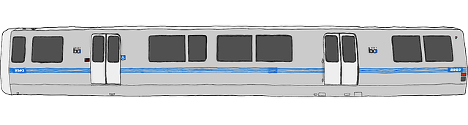
Energy gained by trailing cylinder of air:
For air of mass density ρ_{air}, we can then calculate its gained kinetic energy:
E_{air_kinetic} = E_{drag} = ½ Mair v_{steady}² = ½ ( ρ_{air} x volume of air ) v_{steady}²
But from above, volume of air = A_{air} x (v_{steady} x t) = cdrag Avehicle vsteady t and thus:
E_{drag} = ½ ρ_{air} (A_{air} v_{steady} t ) v_{steady} ² => ½ ρ_{air} c_{drag} A_{car} t v_{steady}³
Dividing that by distance (vsteady x t) gives the energy expended per distance:
Energy per distance steady = ½ ρ_{air} c_{drag} A_{vehicle} v_{steady}²
Or dividing it by time gives the power used while moving:
Power_{steady} = ½ ρ_{air} c_{drag} A_{vehicle} v_{steady} ³
OR

Slide 54
Ways of minimizing the energy of steadily moving travel?
Based on: Energy per distance steady = ½ ρ_{air} c_{drag} A_{car} v_{steady}²
1) Slow down - as with earlier stop and go model:
Vehicle traveling 1/2 as fast gets you there with 1/4 the energy
2) Reduce drag: By reducing c_{drag} (a function of the vehicle's shape) OR
By reducing A_{vehicle} (= vehicle's head-on cross sectional area)
NEITHER VEHICLE LENGTH NOR MASS APPEAR IN EQUATION ABOVE
Suggesting longer / heavier vehicles consume no more energy per distance
Yes, this model considers only how much energy is added to air as it is taken
from being stationary ahead of a vehicle to being dragged at speed behind it
Real world vehicles moving through air also produce chaotic turbulence which,
at finer and finer scales, ends up enhancing atom & molecular movement = Heat
NEVERTHELESS: LONGER rail & road trains DO make excellent energy sense!

Slide 55
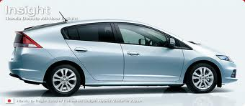
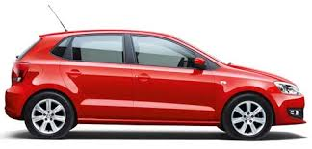
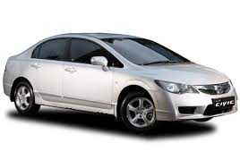
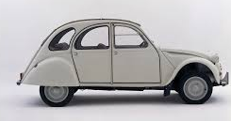
The first way of reducing a vehicle's drag:
1) Reduce its Drag Coefficient (c_{drag}) via better streamlining:
cdrag:
Honda Insight 0.25
Prius 0.26
Renault 25 0.28
Honda Civic 0.31
Volkswagen Polo 0.32
Peugeot 206 0.33
Ford Siesta 0.34
Audi TT 0.35
Honda Civic 0.36
Citroen 2CV 0.51
For modern cars (≠ Citroen 2CV):
Streamlining => diminishing returns
- Somewhat boxy Polo: c_{drag} = 0.32
- Teardrop shaped Insight: c_{drag} = 0.25
- Total range: Ratio of 1.5 to 1
So more severe streamlining is not
likely to be an energy "silver bullet"
Especially as we are already cutting into
usable head room & cargo space
After "Sustainable Energy without the Hot Air" (page 257)

Slide 56
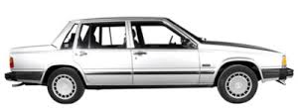
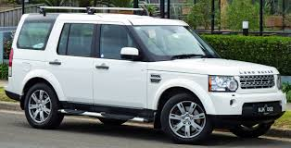
The second way of reducing a vehicle's drag:
2) Reduce its Drag Area (c_{drag} A_{vehicle}) - numbers below are given in m²:
cdrag Avehicle
Honda Insight 0.47
Volkswagen Polo 0.65
Honda Civic 0.68
"Typical Car" 0.8
Volvo 740 0.81
Land Rover
Discovery 1.6
For modern cars (≠ Citroen 2CV):
SIZE MATTERS A LOT!
- Small Honda Insight: 0.47
- "Typical Car:" 0.8
Sub-range: Ratio of almost 2 to 1
- Land Rover pushes ratio to almost 3:1
- As would popular large U.S. SUV's
Full range: Ratio of 3 to 1
("We have met the enemy, and he is us")
After "Sustainable Energy without the Hot Air" (page 257)

Slide 57

MODEL 3: Steadily Moving Planes
To offset the force of gravity, planes must exploit Newton's Action = Reaction:
An airplane's wings thus steadily push a LARGE volume of air downward
Neglecting air heating AND details such as wingtip vortices AND
approximating volumes of air pushed downward as simple cylinders:
Mass_{lift_cylinder} = density x volume = ρ_{air} x (v_{plane} t Area_{lift_cylinder})
Where ρ is air density, A is cylinder's cross-sectional area
And (v_{plane} t ) is the distance the plane flies in a time t
Jet image from: www.clipartlord.com/category/transportation-clip-art/

Slide 58
(continuing)
Over span of plane's wings, air is forced downward at a velocity v_{air_down}
Cylinder's downward momentum = M_{lift_cylinder} v_{air_down} = (ρ_{air} v_{plane} t A_{lift}) vair_down
That momentum per time = Force imparted by plane's wings => Force lifting plane
Force = ρ_{air} v_{plane} A_{lift} v_{air_down}
Which had better match the force of gravity pulling that plane downward = M_{plane} g
Equating those forces and solving for v_{air_down} = M_{plane} g / (ρ_{air} v_{plane} A_{lift})
Using value of vair_down to calculate kinetic energy lost to that downward moving air:
½ M_{air} v_{air_down}² = ½ (ρ_{air} v_{plane} t Area_{cylinder}) (M_{plane} g / (ρ_{air} v_{plane} A_{lift}))²
= t (M_{plane} g)² / (2 ρ_{air} v_{plane} A_{lift})
So the power (= energy / time) transferred to that lift air is:
Power_{lift} = (M_{plane} g)² / (2 ρ_{air} v_{plane} A_{lift})

Slide 59
But additional energy is expended on drag:
For which the analysis is just like that for the earlier steadily moving car or train:
Meaning that we only have to update the subscripts in Model 2's formula,
but noting that dragged air cylinder is only ~ width of plane's fuselage (not wings)
Power_{drag} = ½ ρ_{air} c_{drag} Afuselage v_{plane}³
Then, adding the (now color coded) LIFT and DRAG power expenditures:
Power_{total} = Power_{lift} + Power_{drag}
= (M_{plane} g)² / (2 ρ_{air} v_{plane} A_{lift}) + ½ c_{drag} ρ_{air} A_{fuselage} v_{plane}³
+

Slide 60
Finally, converting energy per time to energy per distance:
Energy / distance = (Energy / time) (time / distance) = Power / velocity =>
Energy_per_distance flight = (M_{plane} g)² / (2 ρ_{air} v_{plane}² A_{lift}) + ½ c_{drag} ρ_{air} Afuselage v_{plane}²
But to minimize this, airplanes try to travel at the most energy conserving speed
At such an optimum speed (from Calculus): dEper_distance / dvplane => 0
Differentiating top equation for Eper_distance, then setting result equal to zero:
ρ_{air} v_{plane_optimum}² = M_{plane} g / (c_{drag} A_{fuselage} A_{lift})^{1/2} OR:
v_{plane_optimum}² = M_{plane} g / ρ_{air} (c_{drag} A_{fuselage} A_{lift})^{1/2}
Unlike both Models 1 & 2, slowing down is NOT better!
Taking optimized ρ_{air} v_{plane_optimum}² and substituting it into both terms of top equation,
after a whole lot of algebra, you find that at energy minimizing speed:
Energy per distance _{flight_at_optimum_speed} = (c_{drag} A_{fuselage} / A_{lift})^{1/2} x M_{plane} g

Slide 61
Carefully analyzing that final optimized flight equation:
Energy per distance _{flight_at_optimum_speed} = (c_{drag} A_{fuselage} / A_{lift})^{1/2} x M_{plane} g
Airplane's ENERGY EFFICIENCY is not improved by:
Making plane bigger or smaller: Changes in A's cancel, negating effect
Changing altitude: Because air density dropped out of energy per distance equation
But to fix v_{plane_optimum}² = M_{plane} g / ρ_{air} (c_{drag} A_{fuselage} A_{lift})^{1/2} despite dropping Mplane
(due to fuel burn), planes gradually climb over span of flight (=> smaller ρair)
Airplane's ENERGY EFFICIENCY is improved by:
Decreasing the plane's drag coefficient, i.e. by making plane more "streamlined"
Limited by the need to retain sufficient space for paying passengers & cargo
Making the plane lighter, which can be done in three ways:
By building it with lighter structural materials OR
Hauling less/fewer passengers, cargo, bags OR using lighter fuel

Slide 62
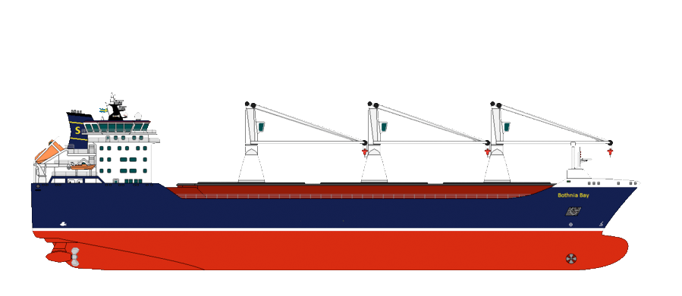
MODEL 4: Steadily Moving Ships?
There are three obvious ways in which moving ships expend energy:
a) Above the waterline, the upper hull/superstructure drags air along behind it
b) Below the waterline, the submerged lower hull drags water along behind it
c) The submerged lower hull also pushes up waves => wake & turbulence
But a & b are just versions of the earlier "Steady Movement" of Model 2,
in which a "fluid" (now either air or water) is dragged behind a vehicle
Then, if c_{a} A_{a &} c_{b} Ab are the effective cross-sections above & below the water surface:
Energy per distance a + b = ½ ρ_{air} c_{a} A_{a} v_{steady}² + ½ ρ_{ωατερ} c_{b} A_{b} v_{steady}²
But while those effective cross-sections are similar in size,
the density of water (ρωατερ ) is 1000 times larger than that of air (ρ_{αιρ} ),
making the second term (b) hugely greater than the first term (a)

Slide 63
Might we similarly neglect energy lost to the wake (term c)?
Wakes are so complex that I found no mathematical model of their energy
But most large ships DO now have bulbous bows intended to calm (diminish) wakes
Wakes = Waves kicked up from the leading edge of shapes moving through water:
Wake of conventional bow:
Wake of bulbous bow (alone):
Wake of their combination:
+
=
Waves from the conventional + bulbous bow are offset, tending to cancel one another
But actual cancellation is imperfect & wake amplitudes diminish by perhaps only 1/2
Nevertheless, real-world bulbous bows cut ship propulsion power by ~ 15% ¹
That suggests completely uncalmed wakes siphon away about 1/3 of a ship's power
Which means that the wake term (c) is NOT << the dragged water term (b)
So we can't neglect either, and there is NO simple Model 4 for ships
1) A value I found cited on Wikipedia's "Bulbous Bow" webpage, AND on multiple shipping industry webpages

Slide 64
Energy Saving Technologies for Cars & Trucks:
An Introduction to Sustainable Energy Systems: WeCanFigureThisOut.org/ENERGY/Energy_home.htm

Slide 65
Mitigation of air pollution has already driven car & truck technology for 50+ years
The resulting improvement in fossil-fueled Internal Combustion Engines (ICE's)
has been absolutely stunning, as seen in these earlier figures:
But looking forward, the sustained downward slopes seen in such plots,
plus the industry's easy acceptance of almost doubled mileage standards in 2012, ¹
indicate that the list of potential ICE vehicle improvements is far from depleted
To which we can add the potential benefits of a transition to all electric vehicles
At least when they are finally "fueled" by non-polluting electric power plants
Plus the benefits of autonomous vehicles - such energy-efficient convoying
At least if they don't also strongly suppress use of more efficient transport options
1) https://obamawhitehouse.archives.gov/the-press-office/2012/08/28/obama-administration-finalizes-historic-545-MPG-fuel-efficiency-standard

Slide 66
Adequately exploring the resulting options upon options
would have doubled the length of this note set
Which is why that exploration has instead become a separate note set entitled:
Green(er) Cars & Trucks (pptx / pdf / key)
With "Greener" alluding to its discussion of nearer term ICE possibilities
and "Green" to its exploration of longer term electric and/or autonomous car & truck options
So, for now, I'll move on to:

Slide 67
Energy Saving Technologies for Trains:
An Introduction to Sustainable Energy Systems: WeCanFigureThisOut.org/ENERGY/Energy_home.htm

Slide 68
Trains are already one of our most energy efficient transport options
As seen in this earlier IEA figure:
Passengers
Freight
And according to Rail's science-based model there are few "knobs left to turn:"
Energy per distance steady = ½ ρ_{air} c_{drag} A_{vehicle} v_{steady}²
Decreasing ρ_{air} requires eliminating that air
Which IS the basis of Elon Musk's as yet untested "Hyperloop" proposal ¹
Decreasing c_{drag} requires better streamlining
Which Japan's Shinkansen has already pushed close to its practical limits ²
Decreasing A_{vehicle} would require smaller passengers or less cargo
While decreasing v_{steady} would undercut high speed rail's fundamental appeal
1) https://en.wikipedia.org/wiki/Hyperloop 2) https://en.wikipedia.org/wiki/Shinkansen

Slide 69
But back in the non-idealized world:
A 2016 International Railways Union report spent almost 200 pages
listing "27 technologies and potential developments in rail systems"
none of which ultimately seemed to offer more than incremental improvement ¹
A 2019 International Energy Agency study of rail transport
also failed to identify opportunities for radical technology improvement ²
Indeed, the common thread to both reports seemed to be that:
Passenger rail's main challenge is wider access to high speed trains
which will require extension of electrified high-speed rail routes
as supported by increased investment, stimulated by public policy
Freight rail's main challenge is competing with end-to-end truck transport
which will require much better integration of rail with short haul trucking
such that distance rail + local truck shipments can be completed more rapidly
1) https://uic.org/IMG/pdf/_27_technologies_and_potential_developments_for_energy_efficiency_and_co2_reductions_in_rail_systems._uic_in_colaboration.pdf
2) https://www.iea.org/reports/the-future-of-rail

Slide 70
Energy Saving Technologies for Planes:
An Introduction to Sustainable Energy Systems: WeCanFigureThisOut.org/ENERGY/Energy_home.htm

Slide 71

1) A long delayed work in progress: Route Optimization
To minimize energy consumption, a plane should obviously follow the shortest route
Less obviously, it should fly at speed: v_{plane_optimum}² = M_{plane} g / ρ_{air} (c_{drag} A_{fuselage} A_{lift})^{1/2}
Which, as the plane burns off fuel (thus loosing mass), says that it should
steadily climb (thereby compensating by rising into lower density air)
But planes can't adhere to such rules - because routes are NOW dictated by: ^{1, 2}
Overworked ground controllers, making decisions based on very limited information,
supplied by 50+ year old ground radar + altitude transponder technologies,
who then call to the planes via similarly antiquated limited-range voice radio
To compensate, controllers now try to maintain safety by spreading planes far apart:
Assigning them to different, generally straight, constant altitude, flight segments
1) https://en.wikipedia.org/wiki/Mitigation_of_aviation's_environmental_impact
2) https://en.wikipedia.org/wiki/Air_traffic_control

Slide 72
But technology has not been similarly stagnant ABOVE the ground:
A modern state-of-the-art passenger aircraft will likely have on board:
A plane-to-plane radar-based collision warning & avoidance system
A satellite signal based GPS system continuously calculating the plane's
3D position and speed, and doing so at accuracies far greater than ground radar
Global topography databases allowing the GPS to track & warn of ground obstacles
That real-time info is sent via un-congested two-way satellite data links which,
unlike ground control voice radio, maintain contact out over oceans and in bad weather
But this information is now shared with only the plane's operating company!
If a new automated flight routing system could tap into even a fraction of that information
airplanes could be much more closely spaced, and they could follow much more
direct / short routes, at continuously optimized altitude
The obstacle? Decades of failure at implementing a new computer-based control system
that can reliably outperform today's harried human controllers + antiquated technology

Slide 73
2) The ever-expanding use of Lightweight Composites
Which comes right out of our flight model's other equation:
Energy per distance _{flight_at optimum_speed} = (c_{drag} A_{fuselage} / A_{lift})^{1/2} x M_{plane} g
Early planes maintained strength but reduced Mplane by substituting aluminum alloys
New planes reduce it by substituting even lighter & stronger composite materials
Composite materials consist of criss-crossed mats or stacked layers of parallel fibers
that bend easily but are extremely hard to pull apart (i.e., are very strong in tension)
These are then soaked in a resin that, once it solidifies, resists compression
Working together, this yields exceptionally light but flexible and strong material
Very early composites (e.g., "Bakelite") used wood fibers
"Fiberglass" was later strengthened by mats of glass fiber
And now even stronger composites use carbon fibers:
Figure: https://www.appropedia.org/Composites_in_the_Aircraft_Industry

Slide 74
Extent of lightweight composite use? Savings in fuel / CO2?
In the Boeing 787, indicated green wing areas are made of fiberglass composites while
grey wing areas + major body areas are made of carbon fiber composites ¹
It's widely claimed that the resulting aircraft weight reduction is typically about 20%,
and that reduction in fuel use, and hence CO2 emission, is about 10-12%
The data trail I followed led to those final claims being pulled right out of thin air (!) ^{2, 3}
Nevertheless, expanding use of composites in aircraft clearly confirms their value
1) https://www.appropedia.org/Composites_in_the_Aircraft_Industry
2) https://www.sciencedirect.com/science/article/pii/S2212540X18300191
3) https://www.researchgate.net/publication/268814067_Advanced_Lightweight_Aircraft_Design_Configurations_for_Green_Operations

Slide 75
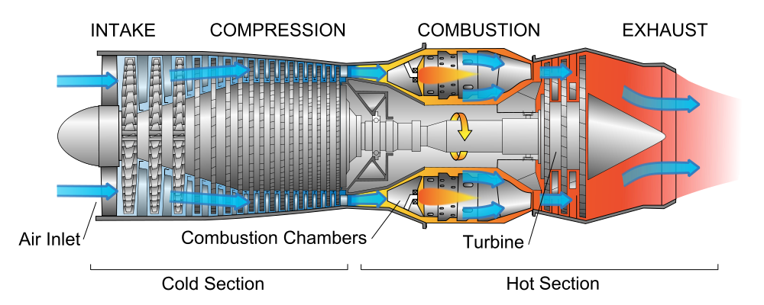
3) More energy efficient Geared Turbofan Engines
At the center of a 1950's jet engine, compressed air entered a combustion chamber
where it was mixed with jet fuel vapor, and the mixture ignited
That now hot & expanding "exhaust gas" then passed thru a series of turbine blades,
and then "jetted" out the rear of the engine providing thrust for a Boeing 707 or DC-8
Those turbine blades were attached to shaft thereby spun by the exhaust gas
At the front of that spinning shaft a series of compressor blades were also attached,
which compressed thin incoming high-altitude air enough to maintain combustion
1) https://en.wikipedia.org/wiki/Jet_engine

Slide 76
But then someone apparently wondered:
Why not also add a big propeller to the front end of that turbine's shaft?
But large conventional propellers must spin much more slowly than jet turbines
So a speed-reducing gearbox must also be added, which produced the
turboprop engine still powering many/most short-haul commuter aircraft: ¹
TURBINE rotating at: 35,000 RPM
GEARBOX ratio: 18:1
together driving
PROPELLER rotating at: 1,900 RPM ²
But by the late 1960's, a new smaller and specially designed high-speed "fan" was
being attached directly to the front of rapidly spinning turbines, producing:
1) https://en.wikipedia.org/wiki/Turboprop 2) https://www.boldmethod.com/learn-to-fly/systems/this-is-how-a-turboprop-engine-works/

Slide 77
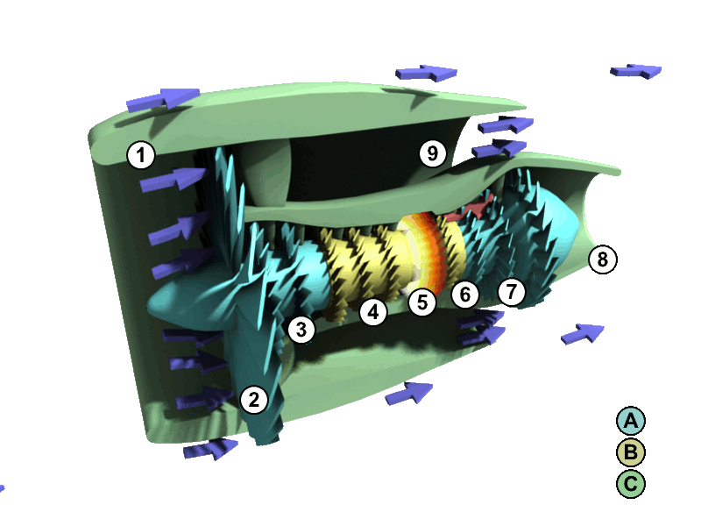
Today's jumbo-jet standard, the Turbofan Engine
The front fan produces a much larger but slower and calmer flow of air
Most of which actually bypasses the turbine (passing around and along it)
This greatly enhances overall engine thrust and does so with less noise
(if necessary, click on this Wikipedia image to trigger its animation)
"Fan"
1) https://en.wikipedia.org/wiki/Turbofan

Slide 78
But that fan still rotates so fast that its blade tips go supersonic
And their resulting mini sonic booms waste energy because
their noise must be muffled by adding layers to the engine's shell (increasing Mplane)
and their turbulence also degrades the engine's fuel consumption / CO2 emission
Leading to present day proposals that they be replaced by Geared Turbofan Engines
Which actually represent a half step back towards Turboprops:
Fan
(non-supersonic)
Inline Gearbox
Turbine
GEARED TURBOFAN:
(Pratt & Whitney / United Technologies version) ¹
TURBINE rotating at: 9,160 RPM
GEARBOX ratio: 3:1
together driving
FAN rotating at: 3250 RPM
VS. earlier turboprop's 35,000 RPM turbine => 18:1 Gearbox => 1900 RPM Propeller
1) https://en.wikipedia.org/wiki/Pratt_&_Whitney_PW1000G

Slide 79
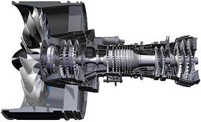
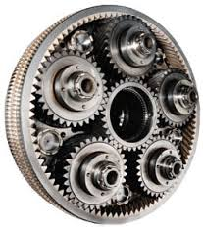
But at 9160 RPM, inside a jet engine, that's got to be one heck of a gearbox!
Which Forbes Magazine thus christened "United Technology's Billion Dollar Bet" ¹
Technical drawing of the entire engine: Photo of prototype inline gearbox: ²
Their Geared Turbofan design goal:
"16% greater fuel efficiency while reducing the noise footprint by up to 75% ³
1) http://www.forbes.com/sites/danielfisher/2013/01/23/the-billion-dollar-bet-on-jet-tech-thats-making-flying-more-efficient/
2) http://www.airplanegeeks.com/2012/01/24/episode-182-alan-epstein-and-the-geared-turbofan-engine/
3) According to United Technologies full page ads running in the Washington Post, February 2015

Slide 80
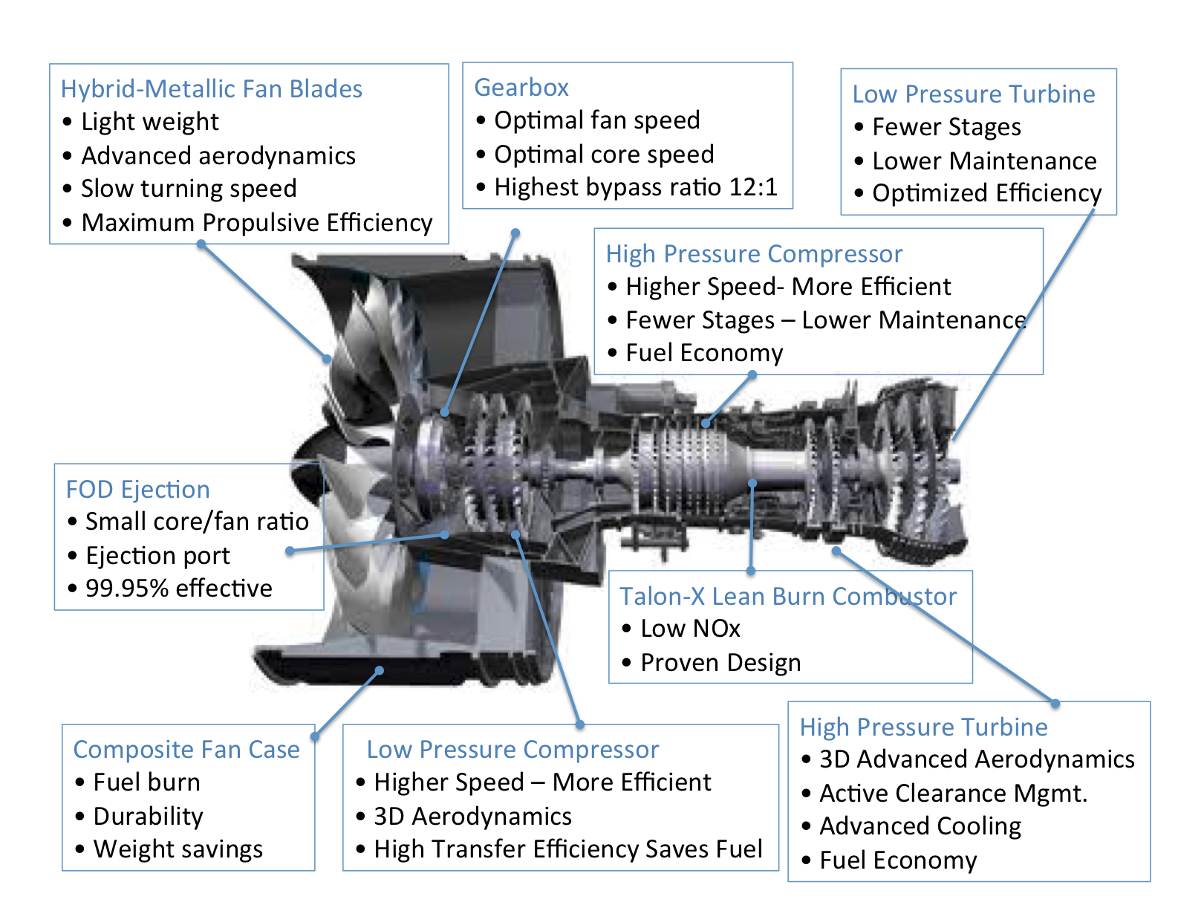
Or if you'd like even greater detail: ¹
1) https://aviation.stackexchange.com/questions/11586/what-is-a-high-bypass-geared-turbofan-and-why-is-it-so-much-more-efficient

Slide 81
But recent reports indicate that Geared Turbofans are now on hold
Wikipedia's webpage about Geared Turbofans lists six different industry projects
but closes abruptly by simply declaring that GE has abandoned its project
and that Pratt & Whitney was "postponing its use for a future application" ¹
Another webpage about Pratt & Whitney's geared turbofan says that in 2008
a prototype was ground tested and achieved its targeted 16% fuel savings,
and that other prototypes successfully powered 747 and A340 test aircraft
But ends with a confusing account of ongoing production & deployment difficulties ²
A final webpage says Rolls Royce's two geared turbofans will be available only by the
"end of the 2020's" (Advance) or "could be ready for service from 2025" (Ultrafan) ³
Which is consistent with promotional webpages I found on a Rolls Royce website
referring to "multi-shaft" (gearbox) engines as being only the "Future of Flight" ^{4, 5}
1) https://en.wikipedia.org/wiki/Geared_turbofan 2) https://en.wikipedia.org/wiki/Pratt_&_Whitney_PW1000G
3) https://en.wikipedia.org/wiki/Rolls-Royce_Trent#UltraFan
4) https://www.rolls-royce.com/media/our-stories/innovation/2016/advance-and-ultrafan.aspx#challenge#challenge
5) https://www.rolls-royce.com/media/our-stories/innovation/2016/advance-and-ultrafan.aspx#solution

Slide 82
Those improvements would be nice, but they're not game changers:
Composites claimed to produce 10-12% reductions in fossil fuel consumption
Geared Turbofans, in early tests, produced 16% reductions
Route Optimization, I'd guess, might someday produce ~ 10% reductions
Together raising the possibility of net ~ 1/3 reduction in aircraft fossil fuel use
Too little? Possibly Too late? Almost certainly:
Because the above cited wait for fully realized Geared Turbofans = 5-10 years
And the likely wait for full Route Optimization = Decades
Given that its required computer-controlled Air Traffic Management (ATM) system
has already fallen multiple decades behind its development schedule
Suggesting the need for much more timely & radical solutions, such as:
1) https://www.rolls-royce.com/media/our-stories/innovation/2016/advance-and-ultrafan.aspx#application

Slide 83
The Possibility of Electrically Powered Planes:
An Introduction to Sustainable Energy Systems: WeCanFigureThisOut.org/ENERGY/Energy_home.htm

Slide 84
A major challenge in electrifying EITHER planes or ships
Which can be seen in a table from an earlier set of my web notes
Specifically, a table I compiled for my note set about Fossil Fuels (pptx / pdf / key)
in which I compared the energy stored per mass, and per volume
for just about every single energy storage technology
discussed anywhere on this WeCanFigureThisOut website
In addition to specific numbers for each technology,
in yellow highlighted columns and rows,
I compared each technology's energy storage to that of gasoline
Which yielded this rather sobering result:
An Introduction to Sustainable Energy Systems: WeCanFigureThisOut.org/ENERGY/Energy_home.htm

Slide 85

Energy of various Materials & Storage Technologies: ¹
Increasing Energy per Mass →
1) Drawn from notesets: Fossil Fuels (pptx / pdf / key), Batteries & Fuel Cells (pptx / pdf / key), Hydrogen Economy (pptx / pdf / key)

Slide 86
Approximating those ratios to gasoline, and highlighting battery results:
Energy / Mass
3
1
3/4
1/3
1/12
1/25
1/75
1/100
1/150
1/2000
1/200000
Energy / Volume
1/20
1
1
1/2
-
1/8
1/20
-
1/50
1/600
1/40000
Hydrogen gas at 150 Atm. pressure
Gasoline / Diesel / Jet Fuel
Fat / Coal
Carbohydrates / Protein / Wood
High Explosives
Experimental Lithium Batteries
Lithium Batteries
Flywheels
Conventional Batteries
Super Capacitors
Capacitors
BIG TAKEAWAY: Fossil Fuels pack 25X to 150X the energy of Batteries!

Slide 87
The impact of heavy batteries on Electric Planes: ¹
We think of planes expending most of their energy pushing air out of their way
Which suggests that the key to lower energy flight will be streamlining
But from the earlier science-based model of flight (Model 3)
Air MUST be ALSO be pushed downward to offset the pull of gravity on the plane
It's just another example of Newton's "Action equals Reaction"
Thus, heavier planes must push proportionally more air downward,
requiring proportionally greater expenditure of energy per mile traveled
So if future planes substitute heavy batteries for extraordinarily light fossil fuels,
they're going to use much more energy per distance traveled
But how MUCH more?
1) This discussion of Electric Planes is also part of my note set: Batteries and Fuel Cells (pptx / pdf / key)

Slide 88
To answer that, we need to know more about aircraft weight:
Assume we are talking about medium / large aircraft
carrying passengers and / or cargo,
over distances comparable to medium sized continents or oceans
The forces of physics & economics have driven a convergence of aircraft design
Which is why it's now difficult to tell one transport aircraft from another
A particularly successful / widely used / newer aircraft is Boeing's 777
Wikipedia's webpage on that aircraft included a massive data table
including entries for four different 777 models having different ranges ¹
On the following page I've edited together that table's entries pertaining to weight
For each model I then worked out the percentage of fully loaded aircraft weight
due to the empty aircraft itself, it's fossil fuel, and it cargo/passenger load
1) https://en.wikipedia.org/wiki/Boeing_777

Slide 89

From Wikipedia'a data table on the Boeing 777 ¹
Max Takeoff Weight
Empty Weight
Load weight (Passengers + Cargo) = (Max. Takeoff weight) - (Empty weight) - (Max. Fuel weight):
Aircraft Model's Range:
Max takeoff Wt (=100%):
Aircraft Empty Wt:
Max Full Fuel Load Wt:
→ Passenger + Cargo Wt =
10,000 km
247200 kg
135850 kg ~ 55%
94240 kg ~ 38%
17110 kg ~ 7%
11,000 km
299370 kg
160530 kg ~ 54%
94240 kg ~ 32%
44600 kg ~15%
13600 km
351533 kg
167829 kg ~ 48%
145538 kg ~ 41%
38166 kg ~ 11%
16,000 km
347452 kg
145150 kg ~ 42%
145538 kg ~ 42%
56764 kg ~ 16%
Leading to the conclusion that for a typical, fully loaded, trans-continental or oceanic flight:
Load Weight is approximately ~ 3/4 Fuel versus 1/4 (Passengers + Cargo)
1) With two expanded acronyms, excerpted from main table at: https://en.wikipedia.org/wiki/Boeing_777

Slide 90
Consequences of those huge fuel loads:
Say typical super-sized passenger + carry-ons + checked luggage → 115 kg (250 lbs)
Requiring addition of ~ 3 x 115 kg = ~ 350 kg of fuel, which is mostly C (mass 12)
Which is then burned into ~ 350 kg x (44 / 12) = 1.3 tonnes of CO2 (mass 44)
1 roundtrip long flight thus adds 2-3 tonnes to your personal carbon footprint ¹
Also based on load weight now being ~ 3/4 Fuel + 1/4 (Passengers + Cargo):
If aircraft replaced fossil fuel with batteries storing equivalent energy, but weighing
just 1.33 times more, it could carry zero passengers on that long flight
But BEST of today's batteries weight / energy is ~ 25 times more than fossil-fuels
Meaning that to fly today's passenger + cargo loads, energy carried
would be slashed by 25X, reducing aircraft's range down from
10,000-15,000 kilometers to a mere 400-600 kilometers
1) For more about personal carbon footprints, see my note set entitled Where Do We Go From Here? (pptx / pdf / key)

Slide 91
As "sanity check" I dug up articles with widely varying viewpoints & target audiences
Links to those articles, as well as cached copies
are provided on the Resource Webpage for this note set
In chronological order, the article titles and sources were:
Electric Aircraft - The Future of Aviation or Wishful Thinking? Phys Org, Aug 2015
The Age of Electric Aviation Is Just 30 Years Away, Wired, May 2017
Electric Flight is Coming, but the Batteries Aren't Ready, The Verge, Aug 2017
Preparing for Electric Flight, Royal Aeronautical Society, Aug 2017
The Long Road to an Electric Airplane Motor, ZDNet, Sept 2018
Short Hops, Clear Air and the Sweet Spot for Electric Aircraft, NewAtlas 2019
In that order, they stated or implied that today's batteries are overweight by a factor of:
43X, 50X, 43X, (?), 14X, 40-48X
Which, sadly, is entirely consistent with my above analysis
An Introduction to Sustainable Energy Systems: WeCanFigureThisOut.org/ENERGY/Energy_home.htm

Slide 92
No article predicted near / mid term battery-powered air transports
The most enthusiastic articles instead dwelt on possible opportunities for
small short-hop aircraft and / or
immensely less cost-constrained corporate executive jets
With commercial passenger / cargo aircraft predicted to be ~ 30-50 years in the future,
based on their need for revolutionary & thus unpredictable battery breakthroughs
In fact, as described in my note set: Biomass and Biofuels (pptx / pdf / key):
A much more plausible near term path to green aviation
is the development of affordable biofuels
which, while their burning still releases greenhouse gases,
are net carbon neutral over their entire lifecycle ¹
1) https://www.greenbiz.com/article/heres-what-it-will-take-get-aviation-biofuels-ground

Slide 93


World's Largest All-Electric Aircraft Ready for First Flight
The Guardian, 27 May 2020 ¹
"Can carry nine passengers . . . range of 100 miles"
Its commercial application is likely feeding rural passengers into main hub airports
But passengers within ~ 50 miles may just drive into the hub airport
Plane's success thus likely depends on transporting passengers from ~50-200 miles out
But to allow for air traffic delays & weather diversions, international regulations
require that aircraft be able to stay airborne for at least an extra 30-45 minutes ²
To maintain such a reserve, this plane might be limited to routes well under 100 miles
Commercial viability thus likely requires at least doubling its range (& passenger load)
1) https://www.theguardian.com/world/2020/may/27/worlds-largest-all-electric-aircraft-set-for-first-flight?CMP=Share_iOSApp_Other 2) https://aviation.stackexchange.com/questions/3740/what-are-the-icao-fuel-reserve-requirements

Slide 94
Energy Saving Technologies for Ships:
An Introduction to Sustainable Energy Systems: WeCanFigureThisOut.org/ENERGY/Energy_home.htm

Slide 95

Global CO2 emissions from the ships facilitating international trade:
From the International Council on Clean Transport (ICCT)'s
"Greenhouse Gas Emissions from Global Shipping 2013-2015:" ¹
1) Page 13 in: https://theicct.org/publications/GHG-emissions-global-shipping-2013-2015

Slide 96

Effectiveness & cost of shipping's CO2 abatement options:
From the International Council on Clean Transportation (ICCT)'s 2011 report:
"Reducing the Greenhouse Gas Emissions from Ships - Cost Effectiveness of Available Options" ¹
CO2 Emission Abatement Potential & Cost of Fuel Saving:
CO2 Reduction Percentage:
Speed Reduction 8.5%
Hull Cleaning 4.8%
Propeller Polishing 4%
Water Flow Optimization 2.8%
Wind Power 2.4%
Waste Heat Reduction 2.2%
Propeller upgrade 1.8%
Weather Routing 1.7%
Air Lubrication 1.6%
Autopilot 1.7%
Hull Coating 1.1%
Speed Controlled Pumps 0.4%
Engine Retrofit: 0.2%
Solar Power 0.1%
Lighting 0.03%
1) Page 10 : https://theicct.org/sites/default/files/publications/ICCT_GHGfromships_jun2011.pdf

Slide 97
Some quick observations about some of those rank-ordered options:
Speed Reduction: Comes from earlier discussion about drag's role in ship energy loss:
Energy per distance water drag = ½ ρ_{ωατερ} c_{b} A_{b} v_{steady}²
Thus ship moving at 1/2 the speed puts 1/4 the energy into dragging along water
Hull Cleaning: Partly what it sounds like: Scrapping off drag inducing barnacles . . .
But also about possibility of special paints inhibiting initial attachment of barnacles . . .
Wind Power: Only a possible SUPPLEMENT to main fossil-fuel engines that requires
SIGNIFICANT additional equipment producing only MINOR added propulsive power
Air Lubrication: Air jets creating foamy water layer against hull => Viscosity / drag reduction
Solar Power: Only a possible SUPPLEMENT to main fossil-fuel engines that requires
MAJOR additional equipment producing only MINUSCULE added propulsive power
These follow from papers linked to this note set's Resources Webpage, including:
Study on Energy Efficiency Technologies for Ships Ship Energy Efficiency Measures - Status and Guidance
Basic Principles of Ship Propulsion Reducing Fuel Consumption In Shipping Via Propulsion Efficiency
How to Design a More Efficient Ship (Parts I & II)

Slide 98

Versus the OECD's suggestions about decarbonizing the seas:
From "Decarbonizing Marine Transport - Pathways to Zero Carbon Shipping by 2035" ¹
First, where possible, move freight transport off the seas and onto clean trains:
"(Rail is) attractive for highly time-sensitive goods, such as fashion, electronics, car parts and perishable goods, such as food.
Compared to air transport, rail transport has a cost advantage (2 times cheaper) with longer transport time (6 times longer)
Compared to sea transport, it has a time advantage (1.7 times quicker) with higher transportation costs (5 times more expensive).
1) Pages 22-23 in: https://www.itf-oecd.org/decarbonising-maritime-transport

Slide 99



And for the ships that remain, the OECD suggests: ¹
Change ship DESIGN:
Change ship OPERATION:
Change ship POWER SOURCE:
1) Pages 26, 28 and 32 in: https://www.itf-oecd.org/decarbonising-maritime-transport

Slide 100
The OECD & ICCT pretty much agree on ship design & operational changes
But the OECD introduces the possibility of completely new ship fuels:
The fuels with maximum GHG reduction / minimum controversy or downside risk are:
Biofuels, Hydrogen, Ammonia, and Electricity
Biofuels are discussed in my note set: Biomass and Biofuels (pptx / pdf / key)
Hydrogen fuel is covered in my note set: A Hydrogen Economy? (pptx / pdf / key)
So here I'd like to instead explore the remaining options of:
Electric Powered Ships ¹
Ammonia Powered Ships
1) This discussion of Electric Ships is also part of my note set: Batteries and Fuel Cells (pptx / pdf / key)

Slide 101
The Possibility of Electrically Powered Ships:
An Introduction to Sustainable Energy Systems: WeCanFigureThisOut.org/ENERGY/Energy_home.htm

Slide 102


What do these large modern ships have in common?
Having crammed on top ever more stateroom decks or layers of cargo containers:
These ships are incredibly top heavy, and to prevent capsizing
they NEED low offsetting weight
Below their waterlines, beneath that income-producing upper deck space:
Batteries might supply that weight while powering such ships
But in contrast to aircraft, you wouldn't need light batteries, such as Li-Ion's
You'd instead want normal or even exceptionally heavy batteries
But below those waterlines, is there enough space for enough batteries?
Left: https://www.limos4.com/blog/european-cruising-largest-cruise-ships-in-2016 Right: http://www.shipspotting.com/gallery/photo.php?lid=2536561

Slide 103
To answer that question, we need to figure out two things:
The typical below waterline volume of such modern megaships
The energy needed to power such ships through the long legs of their voyage
Despite ship diversity, below waterline volume is often limited by a single consideration:
Retaining the option of someday using the Panama Canal
Figures and data from) https://en.wikipedia.org/wiki/Panamax
The Canal's older locks accommodate hulls with length x width x draft of:
290m x 32m x 12m which defines the so-called Panamax class of ship
The Canal's new (2016) locks accommodate hulls with length x width x draft of:
366m x 51m x 15m, which is called the New Panamax or Neopanamax class ¹
Crudely approximating those below deck spaces as simple rectangular boxes:
Panamax => 111,360 m³ Neopanamax => 279,990 m³

Slide 104
Next: Energy to move such a ship from China to the U.S. or Europe?
I found two sources giving the peak power of megaship diesel engines:
An exceptionally large 2004 engine produced up to 110 khp => 86 MW ¹
A broad 2007 study cited container ship engine powers of 22 - 54 MW ²
Container and cruise ships have since grown very significantly in size,
but during most of their voyage engines may operate at more like 50% power,
so let's estimate a new ship's trip-average power as ~ 50 MW = 50,000 kW
Which must then be multiplied by the duration of the trip:
Sources give trip length China to US as 20-35 days vs. ~ 30 days to Europe ^{3, 4}
Using 30 days, energy required = 50,000 kW x 30 x 24 hours = 36,000,000 kW-hr
From the Energy Storage Cross Comparison table shown a dozen or so slides above:
Today's BEST experimental batteries store ~ 0.5 kW-h / kg or ~1.2 kW-h / liter
1) https://newatlas.com/most-powerful-diesel-engine-in-the-world/3263/
2) http://www.dieselduck.info/machine/01%20prime%20movers/2007%20Wartsila%20engines%20for%20panamax%20containerships.pdf 3) https://www.chinaimportal.com/blog/how-long-does-it-take-to-ship-from-china/ 4) https://www.theodmgroup.com/calculating-container-shipping-time/

Slide 105
From those data, to provide voyage-long power:
Such a ship would have to carry: 72,000 tonnes of batteries
Which would occupy: 30,000 cubic meters
But you would also need massive shelves on which to secure those batteries
Plus intervening passages and / or overhead space to accommodate
servicing, cooling, and wiring between those batteries
Suggesting that overall battery space might be more like 60,000 cubic meters
But looking back at our estimated below-waterline hull volumes:
Panamax: 111,360 m³ Neopanamax => 279,990 m³
So this scheme could work in a Panamax ship, and work easily in a Neopanamax ship
especially as electric motors are much more compact than diesel engines
and should thus fit easily in the remaining below-waterline space
Unlike battery-powered long-distance flight (calculated to now be wildly impractical),
battery-powered long-distance shipping survives back-of-the-envelope analysis

Slide 106
Then what's holding up electric shipping?
The most likely answer is, of course, economics
Bloomberg New Energy Finance put 2018 Li-Ion battery cost at $175 / kW-h ¹
So our hypothetical megaship, requiring a voyage long 36,000,000 kW-hr,
might need as much as 6.3 billion dollars in batteries
(Which might need replacement every 5, 10, 15 years?)
For today's fossil-fueled megaships I found sources giving total construction costs of:
- 105 million dollars for a 12,000 container-capacity container ship ²
(today's container ships range up to 23,000 containers)
- Up to 1.5 billion dollars for cruise ships (e.g., Royal Caribbean's Allure of the Seas) ³
So it sounds like cost is indeed the problem:
Battery-powered container ships could cost as much as ~ 60X more to build
Battery-powered cruise ships could cost as much as ~ 5X more to build
1) https://about.bnef.com/blog/behind-scenes-take-lithium-ion-battery-prices/ 2) https://en.wikipedia.org/wiki/Container_ship 3) https://www.cheatsheet.com/culture/how-much-do-cruise-ships-cost.html/

Slide 107
Which explains why:
The claimed "World's Largest All Electric Cargo Ship" is this: ¹
Instead of carrying 12-20,000 containers, over 30 days, at 16-25 knots (18-29 mph) ²
this ship, launched by China in 2017, will carry "2,200 tons of cargo"
for a total of "50 miles at a top speed of 8 miles per hour"
before needing a two hour battery recharge ²
From the photo, assuming the total container stack is 4 high x 4 wide x pictured 6 long,
this ship's full container load looks to be no more than 100 containers
1) https://oilprice.com/Alternative-Energy/Renewable-Energy/China-Launches-Worlds-First-All-Electric-Cargo-Ship.html 2) https://en.wikipedia.org/wiki/Container_ship

Slide 108
I can think of an additional BIG challenge for battery powered ships:
Economics compels captains to absolutely minimize unproductive time in port
Container ships now unload, reload, and leave port within 24-48 hours
My postulated mega container ship needed 36,000,000 kW-hr of battery capacity
Which, in port, it would want to recharge within that same 24-48 hours
Assuming that its batteries could cope with such rapid recharging,
it would require incoming electrical power of 36000 MW-hr / (24-48 hr)
= 750 - 1500 MW
If that harbor served just ten such docked and recharging ships at any point in time:
The total necessary harbor electrical power would be 7.5 - 15 GW,
REQUIRING AT LEAST 5 TWO-REACTOR NUCLEAR POWER PLANTS
(or a larger, to hugely larger, number of non-nuclear plants)
An Introduction to Sustainable Energy Systems: WeCanFigureThisOut.org/ENERGY/Energy_home.htm

Slide 109

Why not just add solar roofs to the top layer of containers?
They could then power the ship & charge batteries during day, with that smaller number
of batteries continuing to power the ship overnight
Calculating deck sizes:
Panamax: 290m x 32m = 9280 m²
Neopanamax: 366m x 51m = 18,666 m²
Drawing on calculations given in my note set: Today's Solar Cells (pptx / pdf / key):
Averaged around the clock, for 20% efficient Si PV-solar cells, in different weather:
Output Power = 25 - 50 Watts / m² = 0.025 - 0.05 kW / m²
A full deck or container top solar array would thus produce average output power of:
Panamax: 9280 m² x (25-50 W/m²) = 232 - 464 kW
Neopanamax: 18,666 m² x (25-50 W/m²) = 464 - 933 kW
Comparing that to power now used moving such ships (estimated earlier at 50,000 kW),
SOLAR PV + BATTERIES => LESS THAN 1/50th POWER NEEDED FOR SHIPPING
Figure: https://www.industryabout.com/industrial-news/801-news-transportation/48073-historic-un-deal-for-shipping-industry-could-lead-to-solar-powered-ships

Slide 110

The Possibility of Ammonia Powered Ships:
Figure from: "Safe and effective application of ammonia as a marine fuel" Niels de Vries - Thesis - University of Delft - 2019.pdf
https://repository.tudelft.nl/islandora/object/uuid:be8cbe0a-28ec-4bd9-8ad0-648de04649b8?collection=education

Slide 111

Why even consider smelly & irritating Ammonia as a shipping fuel?
It goes right back to my earlier table about Energy Storage Densities:
Liquid Ammonia has an energy density ~ 1/3 that of fossil fuels,
allowing ships to carry enough of it to complete full transoceanic voyages
NOTE HOWEVER (per my earlier "Model 3" / aircraft weight discussion):
Ammonia's tripled weight alone would prevent an airplane from ever taking off,
made even worse by Ammonia's need for more complex / heavier fuel tanks:
1) Figure at right from page 7 in: https://royalsociety.org/topics-policy/projects/low-carbon-energy-programme/green-ammonia/

Slide 112
Hydrogen's energy density numbers are almost as good
And it is neither irritating (in low concentrations) nor toxic (in higher concentrations)
But this is where consideration of pressure & fuel tanks comes strongly into play: ^{1, 2}
Hydrogen boils at minus 253.9 ºC = Hugely below room temperature
Thus, to concentrate it up to the energy densities cited in those charts
it must be pressurized at up to ~ 700 atmospheres
That intense pressurization requires use of high-energy-consumption compressors,
And once pressurized, H2 must be it held within either massive heavy-walled tanks
OR by diffusing it into exotic (and hence expensive) H2 absorbing materials
In comparison, pure Ammonia boils at minus 33.3 ºC and thus at room temperature
it liquifies at only ~ 9 atmospheres ¹ requiring fairly simple compressors & tanks
Ones comparable to those used in our homes by carpenters and DIY'ers
Further, if tanks are cooled toward -33.3 ºC, pressures fall toward 1 atmosphere
Addition of refrigeration thereby facilitates use of even more lightly built tanks
1) https://www.engineeringtoolbox.com/ammonia-pressure-temperature-d_361.html 2) https://www.mdpi.com/2077-1312/8/3/183/htm

Slide 113
Generating Ammonia - Today's Process:
1) Nitrogen gas is separated from air via either: ¹
Refrigeration to condense N2 into a separable liquid at 77.4 ºK (-350 ºC) OR
Repeated pressurization to condense molecular N2 layers onto zeolite surfaces
2) Hydrogen gas is produced from methane (natural gas) via steam reforming: ²
CH4 + H2O (steam) => CO + 3 H2 ∆H = -206 kJ / mole
CO + H2O (steam) => CO2 + H2 ∆H = -41 kJ / mole
Combined: CH4 + 2 H2O (steam) => CO2 + 4H2 ∆H = -247 kJ / mole
3) N2 and H2 are then combined via the Haber-Bosch Process to form Ammonia: ³
At ~ 100 atmospheres pressure and 400-500ºC, in the presence of metal catalyst:
N2 + 3 H2 => 2 NH3 ∆H = -91.8 kJ / mole
But a single pass converts only about 15% of the reactants, so the process
is repeated over and over until ~ 97% reactant conversion is achieved
1) https://en.wikipedia.org/wiki/Air_separation 2) https://en.wikipedia.org/wiki/Steam_reforming 3) https://en.wikipedia.org/wiki/Haber_process

Slide 114
The very serious shortcomings of today's process:
Both methods of separating N2 from air consume energy to provide
either the extremely cold temperatures or repeated pressurization cycles required
H2 liberation via methane steam reforming requires
major heat energy input of which only 65-75% goes into bond breaking & making ¹
Further, the central chemical reaction liberates the greenhouse gas CO2
Haber synthesis of NH3 involves repeated cycles of high pressure & temperature
Both require massive direct and indirect energy inputs
of which only 60% goes into bond breaking & making ²
Putting all of that together, it is estimated that: ²
"Ammonia production (alone!) consumes about 2% of the world's energy
and generates 1% of its CO2"
1) https://en.wikipedia.org/wiki/Steam_reforming
2) https://www.sciencemag.org/news/2018/07/ammonia-renewable-fuel-made-sun-air-and-water-could-power-globe-without-carbon

Slide 115
But low-GHG Ammonia will require much more low-GHG electrical energy:
The N2 separation step requires electrically-driven refrigerators or pumps
Which, to be low-GHG, would have to be powered by low-GHG grid electricity
The existing H2 generation step must be eliminated (based on its CO2 emission)
And, as detailed below, alternate sources of H2 require low-GHG grid electricity
The Haber synthesis step requires pressurization via electrically driven pumps,
and heat from fossil-fuel heaters that would have be supplanted by electric heaters
ALL of which would then require low-GHG grid electricity
Thus, as with so many seemingly simple "green innovations" (such as electric cars),
low-GHG Ammonia requires a low-GHG electrical grid which,
in most of the industrialized world, is still more dream than reality
Possible exceptions:
Nuclear-powered France? Hydro-powered Quebec or Washington State?

Slide 116
Alternate sources of H2:
There are a number of possibilities, but the most obvious and well-developed is:
Electrolysis of Water
Which in its simplest form requires only electrical power + two inert metal electrodes: ¹
At the left negatively charged cathode:
4 H⁺ (aq) + 4 e⁻ => 2 H2 (g)
While at the right positively charged anode:
2 H2O (l) => O2 (g) + 4 H⁺ (aq) + 4 e⁻
Industrial scale electrolysis boosts reaction rates by adding an alkaline electrolyte ²
Then labeled "ALK electrolysis" it has an energy efficiency of ~ 65-68%
Much higher gas pressures can be generated via proton exchange membranes ²
This newer "PEM electrolysis" achieves comparable efficiencies of 57-64%
While emerging solid oxide electrolysers offer the possibility of higher efficiencies ²
1) and figure: https://en.wikipedia.org/wiki/Electrolysis_of_water
2) https://www.irena.org/-/media/Files/IRENA/Agency/Publication/2018/Sep/IRENA_Hydrogen_from_renewable_power_2018.pdf

Slide 117

The Royal Society suggests two more futuristic possibilities: ¹
The first is low temperature production of H2 via biological processes
based on the anaerobic digestion of biomass by microbes,
but altered to block normal CH4 & CO2 generation in favor of H2 liberation:
1) https://royalsociety.org/~/media/policy/projects/hydrogen-production/energy-briefing-green-hydrogen.pdf

Slide 118

Royal Society suggestions (cont'd):
A second suggestion is using sunlight
in ways inspired by photosynthesis
that would split water into H2 and O2
while capturing atmospheric CO2
(possibly in the form of useful biofuels)
NOTE that while this Royal Society ¹ report included
many enticing concepts, it omitted any detail
on how these might some day be realized!
1) https://royalsociety.org/~/media/policy/projects/hydrogen-production/energy-briefing-green-hydrogen.pdf

Slide 119

But others suggest completely trashing the existing NH3 process
And replacing it with "reverse" fuel cell synthesis of Ammonia, using electricity
to drive the intake of H2O + N2 directly from the air,
pushing Ammonia's normal fuel cell oxidation reaction backward:
4 NH3 + 3 O2 <= 2 N2 + 6 H2O
But while this possibility is widely noted in both government and NGO studies,
I could only track down only a handful research efforts actually pursuing this goal
One was featured in the 2018 Science Magazine article which introduced this figure:
Figure:
https://www.sciencemag.org/news/2018/07/ammonia-renewable-fuel-made-sun-air-and-water-could-power-globe-without-carbon

Slide 120




But that figure was inspired by a single 3.5 page "paywalled" journal article
Which I was only able to access via my connections as a former professor
The article claimed two innovations, one of which was a "nano-patterned" iron catalyst
that would draw H2O molecules ( ) and dissolved N2 molecules ( )
onto adjacent sites where they could then react to form Ammonia (),
That process was depicted schematically in this pane of the article's first figure:
1) https://pubs.rsc.org/en/content/articlelanding/2017/ee/c7ee02716h#!divAbstract

Slide 121
Versus an SEM micrograph of the actual "nano-patterned" iron catalyst:
Which was not directly nano-patterned (a very difficult & time-consuming process),
but spontaneously patterned via the natural growth of adjacent Fe nanocrystals:
The other claimed innovation was the use of "non-aqueous Ionic Liquid" electrolytes
to enhance dissolved N2 concentration, thereby enhancing NH3 synthesis
Which would have made sense if a truly non-aqueous electrolyte would not
also block NH3 synthesis by eliminating the other necessary reactant, H2O
But using what I assume must really have been a low-aqueous electrolyte,
the researchers reported a ten-fold enhancement in the cell's "Faradaic Efficiency"
Figure pane from: https://pubs.rsc.org/en/content/articlelanding/2017/ee/c7ee02716h#!divAbstract

Slide 122

A second study only proposed a new NH3 synthesis scheme:
It would expose a fuel cell's cathode surface to almost pure H2 + N2 gas + H2O vapor,
which would electrolytically react forming NH3 & H2 on that cathode side of the cell,
while sending OH⁻ ions across to cell to the anode where they would react
forming O2 gas then exhausted from that anode side of the cell
But what would generate that almost pure H2 + N2 + H2O? Some outlying equipment:
Figure is slightly modified from: https://pubs.acs.org/doi/pdf/10.1021/acsenergylett.0c00455

Slide 123

Circling clockwise from the below:
3) Water is sprayed into that mixture
of H2 + N2 + H2O to increase its H2O content
and this is then piped back to the cathode
2) A small amount of air (N2 + O2) is mixed with
the piped in H2 + N2 and then ignited producing
an almost pure mixture of H2 + N2 + H2O
1) From the cathode (blue), H2, N2 & NH3 are piped
to a condenser that separates out the NH3 product
while piping onward the remaining H2 + N2
Figure is slightly modified from: https://pubs.acs.org/doi/pdf/10.1021/acsenergylett.0c00455

Slide 124
Those are clever and promising NH3 reverse fuel cell ideas
But the first study amounts to what can be considered only a proof of concept
While the second study is no more than an announcement of concept
The Royal Society reached similar conclusions about fuel cell synthesis of Ammonia: ¹
"Electrochemical production is a technology for producing green ammonia directly from water and nitrogen using electricity. Importantly there is no separate hydrogen production process step . . .
However, to date, only low rates of ammonia production have been demonstrated in laboratory studies. New electrocatalysts, electrolytes and systems must be developed that can produce ammonia in preference to hydrogen and achieve competitive production"
Science Magazine's 2018 survey of NH3 reverse fuel cell projects also concluded
that then existing fuel cell synthesis needed to be improved by "orders of magnitude" ²
Meaning that, for now, "greening" of Ammonia will likely be limited to switching
the synthesis of reactant H2 from methane steam-reforming to electrolysis
Moving on to how green (or at least greener) Ammonia might then be used:
1) https://royalsociety.org/~/media/policy/projects/hydrogen-production/energy-briefing-green-hydrogen.pdf
2) https://www.sciencemag.org/news/2018/07/ammonia-renewable-fuel-made-sun-air-and-water-could-power-globe-without-carbon

Slide 125
The many ways in which Ammonia might power ships: ^{1, 2}
Ammonia could be burned inside a
Diesel OR Spark-Ignition Internal Combustion Engine (ICE)
which could then drive EITHER the ship's propellers
OR electric generators, powering electric motors, driving the propellers
OR
Ammonia could be used as only an easily-stored energy-dense medium
then decomposed onboard as needed into H2 for use in combustion or fuel cells
(effectively using H2 as the ship's fuel but avoiding complications & cost of H2 storage)
OR
Ammonia could be used as one of the inputs to some type of fuel cell
generating electricity, powering electric motors, driving the propellers
1) https://www.mdpi.com/2077-1312/8/3/183/htm
2) https://www.transportenvironment.org/sites/te/files/publications/2018_11_Roadmap_decarbonising_European_shipping.pdf

Slide 126




That resulting complex range of options was explored in a 2020 study on
"Alternative Ship Propulsion System(s) Fueled by Ammonia" - which included: ¹
Mixture of NH3 + H2 (from NH3) burned in ICE
driving ship's propeller
H2 (from NH3) burned in ICE driving electric generators
powering propellers' electric motors
H2 (from NH3) feeding fuel cells producing electricity
powering propellers' electric motors
NH3 feeding fuel cells producing electricity powering propellers' electric motors
1) https://www.mdpi.com/2077-1312/8/3/183/htm

Slide 127

The first group using Ammonia Internal Combustion Engines (ICE's):
The shipping industry now relies upon Diesel ICEs in which
compression heats the fuel to its "auto-ignition temperature"
However, while normal diesel fuels auto-ignite at 210-225 ºC
Ammonia requires an impractically high 651 ºC ¹
But Ammonia + fossil-fuel mixtures do diesel auto-ignite
which could reduce, but not eliminate diesel GHG emission
This is seen as a near term way of reducing ship pollution
A cleaner approach would be to first decompose some of the NH3
producing H2 then mixed with the remaining NH3
yielding diesel auto-ignition with zero GHG emission ¹
PgDn to start animation
http://www.kruse-ltc.com/Diesel/diesel_animation.html
Or future ships might be built with new car-like spark-ignition ICE engines
But this would do nothing for existing ships living out their decades long lifetimes
Further, spark-ignition may not produce complete (and thus clean) NH3 combustion ²
1) https://www.transportenvironment.org/sites/te/files/publications/2018_11_Roadmap_decarbonising_European_shipping.pdf
2) See page 11 in: https://www.mdpi.com/2077-1312/8/3/183/htm

Slide 128

The second group using Ammonia as a Hydrogen Storage Medium:
These exploit what is effectively just a cheaper H2 gas tank - Cheaper because:
Cooled to -33.3 ºC, NH3 tanks are not pressurized and do not require thicker walls
While room temperature tanks need withstand only 9 atmospheres of NH3 pressure
Versus the massive construction required for 700 atmosphere H2 tanks
Liquid NH3 Tank
But H2 is then easily produced via thermal decomposition of NH3 ("cracking")
And from that point onward, ships could fully exploit the mainstream H2 technology
described in my note set: A Hydrogen Economy? (pptx / pdf / key)
The only unique challenge concerns the completeness of NH3 => H2 conversion,
because some fuel cells using H2 to produce electricity can be poisoned Ammonia
In fact, as little as 1ppm of Ammonia is said to poison non-alkaline H2 fuel cells ¹
Use of H2 from NH3 might thus require intense onboard purification
1) https://www.transportenvironment.org/sites/te/files/publications/2018_11_Roadmap_decarbonising_European_shipping.pdf

Slide 129

The third group using Electricity from Ammonia Fuel Cells:
Here, for shipping, current attention focuses on Solid Oxide Fuel Cells (SOFCs)
The SOFC Cathode (right) would decompose the O2 in air passing by its outer surface:
3/2 O2 (g) + 3 e- => 3 O⁻ (aq)
Moving across the cell, at the Anode arriving O⁻ ions would react with passing NH3:
2 NH3 (g) + 3 O⁻ (aq) => N2 (g) + 3 H2O (g) + 3 e⁻
Thereby producing 3 e⁻ of electricity via: 2 NH3 (g) + 3/2 O2 (g) => N2 (g) + 3 H2O (g)
1) https://en.wikipedia.org/wiki/Solid_oxide_fuel_cell

Slide 130


The most commonly cited work on NH3 Solid Oxide Fuel Cells?
At a 2018 conference, Japan's IHI Corporation described this NH3 SOFC prototype
Reporting 56% efficient output above 1kW, with stable thermally independent operation
Figure: https://nh3fuelassociation.org/wp-content/uploads/2018/11/AEA-Imp-Con-01Nov18-Toshiyuki-Suda-Session-2.pdf

Slide 131

The first ever high-power NH3 SOFC will be installed on the "Viking Energy"
As funded by the European Union's fourteen nation ShipFC project, ¹
which in 2020 signed a contract for SOFCs with Norway's Prototech corporation ²
Their fuel cells are slated to produce 2 MW of electricity (~ 2700 horsepower)
With installation on the Viking Energy test vessel scheduled for late 2023:
1) https://www.prototech.no/news/2020/01/23/prototech-awarded-contract-to-supply-2mw-zero-emission-ammonia-fuel-cell-module/
2) https://www.prototech.no

Slide 132
Bottom lines regarding Ammonia powered ships?
The cited 2020 review of "Alternative Ship Propulsion System(s) Fueled by Ammonia" ¹
concluded that Ammonia powered alternatives to fossil-fueled diesel ships would:
Require 1.6 - 2.3 times the volume
Be 1.4 - 1.6 times heavier
Have a total life cycle cost 3.5 - 5.2 times larger
But could reduce GHG emissions by 83.7 - 92.1%
Going beyond that study, based on the long list of barely 50-75% efficient technologies
(including multiple sets of fuel cells, compressors, heaters, coolers, purifiers . . . ),
NH3 shipping seems to need far more net energy input than today's shipping
all supposedly coming from a new low-to-no-GHG electrical grid
Bringing to mind my earlier calculation that to recharge battery-driven Electric Ships,
a single port might need the full electricity output of multiple nuclear power plants
1) https://www.mdpi.com/2077-1312/8/3/183/htm

Slide 133


Enter these estimates of new grid energy required for all-green EU shipping:
From a "Roadmap to Decarbonising European Shipping" - TransportEnvironment.org: ¹
NH3 Fuel Cell Powered
H2 ICE Powered
H2 Fuel Cell Powered
NH3 ICE Powered
Total Green EU Power 2015
Percent additional electricity required
Battery Powered
Confirming my prediction of massive grid energy required for battery-powered shipping,
but indicating that H2 and NH3 alternatives would require several times MORE
1) Page 15 (my labels added): https://www.transportenvironment.org/sites/te/files/publications/2018_11_Roadmap_decarbonising_European_shipping.pdf

Slide 134
Conclusions about Transportation Energy:
The good news:
I have identified many ways of decreasing transportation's energy consumption
And many ways in which we can mitigate transportation's environmental impact
(even if some forms of mitigation require increased energy expenditure)
Similarly abundant & plausible options are identified in my note sets about:
Energy Consumption in Housing (pptx / pdf / key)
Green(er) Cars & Trucks (pptx / pdf / key)
So we're NOT up against a wall: There are MANY IMPACTFUL THINGS WE CAN DO!
An Introduction to Sustainable Energy Systems: WeCanFigureThisOut.org/ENERGY/Energy_home.htm

Slide 135

Conclusions - Part II:
The bad cautionary news:
Identifying the best solutions requires Wisdom
Because few if any of of these solutions are magical "silver bullets"
(the closest might be buying no vehicle having more than 20X your own weight)
And the more appealing & easily understood solutions are seldom the best ones
Prime examples: The simple & romantic ideas of wind or solar powered ships
as widely promoted online and in the popular press: ^{1, 2}
Despite Wisdom (in the form of only a little investigation) indicating GHG reductions
of as little as 2.4% for added wind power, and far less than 1% for solar power ³
1) https://www.theguardian.com/environment/2018/may/03/future-sailors-what-will-ships-look-like-in-30-years
2) https://www.industryabout.com/industrial-news/801-news-transportation/48073-historic-un-deal-for-shipping-industry-could-lead-to-solar-powered-ships
3) https://theicct.org/sites/default/files/publications/ICCT_GHGfromships_jun2011.pdf

Slide 136
Conclusions - Part III:
More bad cautionary news:
Implementing those solutions requires Willpower
The best example from this note set may be the contrast between aviation & shipping:
Greener Ammonia powered shipping is now being actively promoted via
academic & industry projects,¹ government initiatives ² and industry associations ³
Versus aviation, which now produces 5X greater GHG emissions, but is nevertheless
specially exempted from international climate control agreements ⁴
And for which the most plausible solution, biofuel development,
is receiving little more than token industry involvement
The best example of which is United Airline's annual use of 1 million gallons of biofuel
versus their continuing annual use of 1 billion gallons of fossil-fuel ⁴
1) https://www.ammoniaenergy.org/articles/development-of-direct-ammonia-fuel-cells/
2) https://vpoglobal.com/2020/01/24/major-project-to-convert-offshore-vessel-to-run-on-ammonia-powered-fuel-cell/
3) https://www.ammoniaenergy.org/
4) https://www.greenbiz.com/article/heres-what-it-will-take-get-aviation-biofuels-ground

Slide 137
Credits / Acknowledgements
Some materials used in this class were developed under a National Science Foundation "Research Initiation Grant in Engineering Education" (RIGEE).
Other materials, including the "Virtual Lab" science education website, were developed under even earlier NSF "Course, Curriculum and Laboratory Improvement" (CCLI) and "Nanoscience Undergraduate Education" (NUE) awards.
This set of notes was authored by John C. Bean who also created all figures not explicitly credited above.
Copyright John C. Bean
(However, permission is granted for use by individual instructors in non-profit academic institutions)
An Introduction to Sustainable Energy Systems: WeCanFigureThisOut.org/ENERGY/Energy_home.htm

