Slide 1
Energy Consumption in Housing
John C. Bean
Outline
Our homes consume over 1/5th of U.S. energy
90% of which involves producing and moving heat
How that heat is moved:
CONDUCTION = Transfer of vibrational energy between atoms/molecules
CONVECTION = Movement of hot atoms/molecules to cooler places
RADIATION = Flow of energy via electromagnetic waves (e.g., as infrared heat)
Detailed analysis of how each of these mechanisms affect our homes
And the often simple & cheap things we can do to decrease their impact
Long term energy-saving strategies, including passive solar and smart(er) homes
Versus big savings available NOW via things like "condensing furnaces" and "heat pumps"
(Written / Revised: February 2021)

Slide 2

A digression concerning many of the sources cited in this note set:
Early (pre 2017) versions of this note set drew heavily on Department of Energy data
But beginning in the Spring of 2017, the cited webpages began to disappear:
Searches using old webpage wording also turned up mostly broken links
As have searches repeated up to this day
Environmental Protection Agency webpages also began disappearing
But for those disappearances I found an unambiguous explanation:

Slide 3
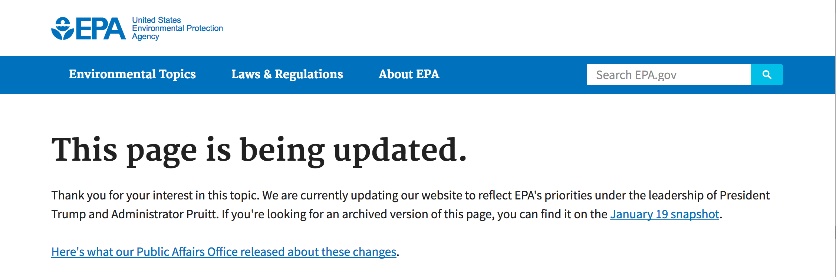

Accessing the "Inventory of Greenhouse Gas Emissions" 29 April 2017, I instead got: ¹
The news release found at the preceding link:
1) http://www.epa.gov/climatechange/Downloads/ghgemissions/US-GHG-Inventory-2014-Main-Text.pdf

Slide 4
Earlier, I'd not had to worry about disappearance of governmental data
If fact, my bigger concern was about the persistence of governmental webpages
which, once posted, were often left unaltered for years (or even decades)
Meaning that their information could often become obsolete and/or irrelevant
And that I didn't always bother caching those webpages (as I now do)
Thus, in this note set, a number of important cited sources can no longer be accessed
Mostly those from the U.S. DOE, its daughter labs such as NREL, and the EPA
But where I could not identify newer sources with comparably relevant data
I have retained my original summaries of those now lost pre-2017 sources,
as supported only by their footnoted original web links
(but followed, where I could find them, by links to cached copies)
ONWARD:

Slide 5
Energy Consumption in Housing
Every one of my (many) energy/environmental textbooks has a chapter on autos
Of course: they're one of the biggest ways we, as individuals, use energy!
But, strangely, only one textbook has a whole chapter devoted to housing
Despite it being the other big way that we, as individuals, use energy
To be fair, most of those textbooks DO have chapters on heating and cooling
Which DO turn out to be major contributors to household power use
But heating & cooling power diminish hugely in a well built & well maintained home
So today I am also going to discuss our homes, themselves
Because, with a little DIY'ing (do-it-yourself 'ing),
your home offers you your #1 way of saving energy
An Introduction to Sustainable Energy Systems: WeCanFigureThisOut.org/ENERGY/Energy_home.htm

Slide 6
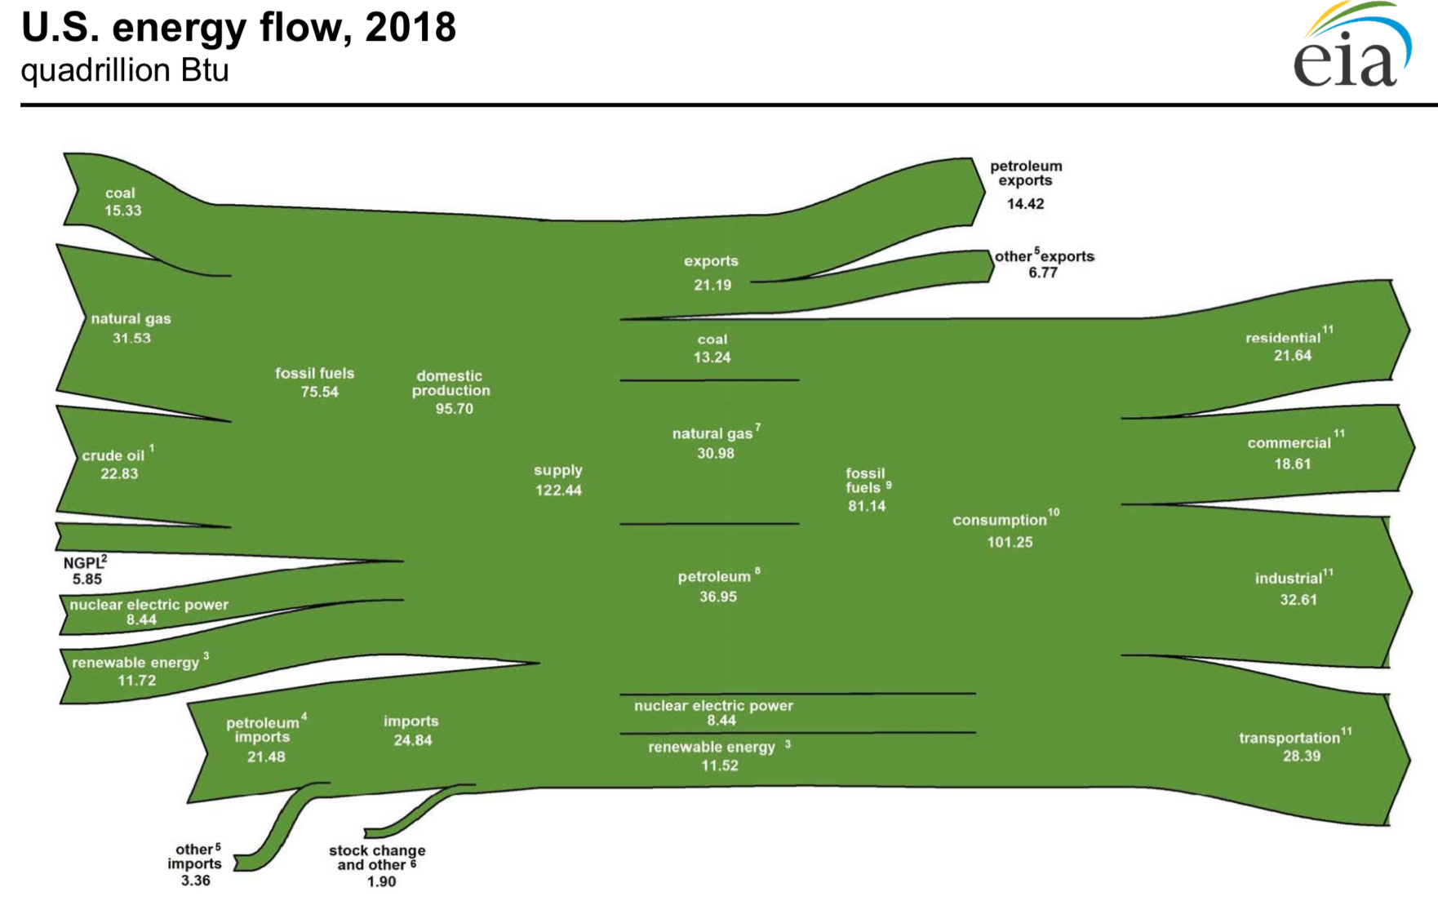
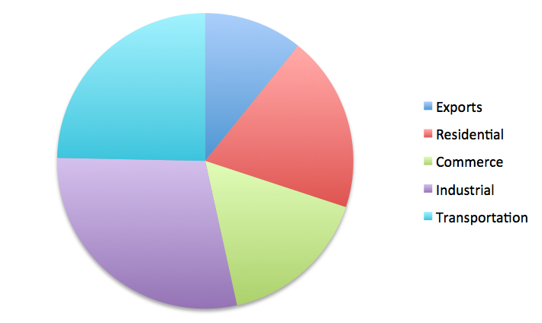
2018 "U.S. Energy Flow" according to our Energy Information Administration:
From which I generated this U.S. power consumption pie-chart:
Exports (fuels): 17.3%
Commerce: 17.7%
Residential: 15.2%
Transportation: 26.6%
Industrial: 23.2%
EIA U.S. Energy Flow 2018: https://www.eia.gov/totalenergy/data/monthly/pdf/flow/total_energy.pdf

Slide 7
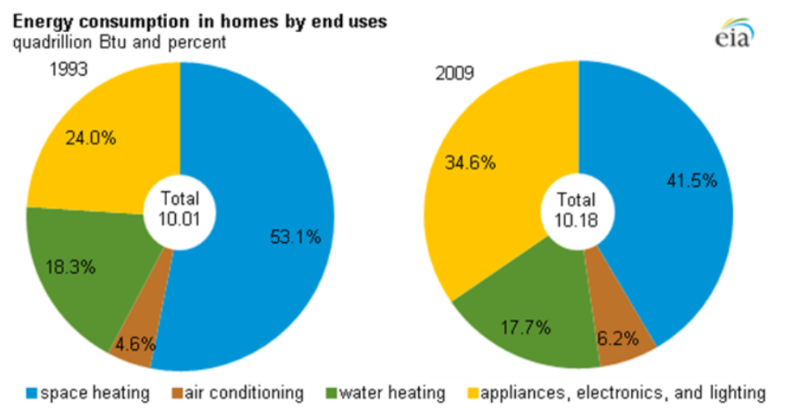
Where do we WE use that "residential" 15.2% of U.S. Energy?
Also from the U.S. Energy Information Administration (EIA):
OLD HOMES:
53.1% air heating / 18.3% water heating / 4.6% air cooling / 24% appliances + electronics + lights
NEW HOMES:
41.5% air heating / 17.7% water heating / 6.2% air cooling / 34% appliances + electronics + lights
EIA Energy Data Facts - Residential: https://rpsc.energy.gov/energy-data-facts

Slide 8
From which one can conclude: Home energy use is mostly about heat, its movement, or removal
Old Homes: Heating + Cooling = 76% of their energy consumption
Suggesting: 15.2% x 76% => 11.6% of TOTAL U.S. energy consumption!
New Homes: Heating + Cooling = 65.4% of their energy consumption
Suggesting: 15.2% x 65.4% => 9.9% of TOTAL U.S. energy consumption!
For MIX of OLD and NEW HOMES, let's take Heating + Cooling average ~ 70%
Accounting for 15.2% x 70% = 10.6% of TOTAL U.S. energy consumption!
Or is the heat component even larger?
To answer, look more closely at the "appliances" contribution of ~ 1/3:
An Introduction to Sustainable Energy Systems: WeCanFigureThisOut.org/ENERGY/Energy_home.htm

Slide 9
U.S. Department of Energy data on power of appliances
Which I've converted to energy use based on approximate time used per day:
Device Power Use/day Energy/day
Air Conditioner 0.6 kW 12 h 7 kW-h/d
Coffee Maker 1 kW ½ h 0.5 kW
Clothes Washer 0.4 kW * 1 h 0.21 kW-h/d
Clothes Dryer 4 kW * 1 h 4 kW-h/d
Cooktop range 3.3 kW ½ h 1.6 kW-h/d
Dishwasher 2 kW 1 h 2 kW-h/d
Microwave Oven 1 kW 1/3 h 0.3 kW-h/d
Oven 3 kW ½ h 1.5 kW-h/d
Refrigerator 0.7 kW 24 h 1.75 kW-h/d
* vs. implausible MacKay textbook statement (p. 51) that Clothes Washer = Clothes Dryer = 2.5 kW
http://energy.gov/energysaver/articles/estimating-appliance-and-home-electronic-energy-use (no cached copy)

Slide 10
Re-sorting those in energy consumption order:
Device Power Use/day Energy/day
Air Conditioner 0.6 kW 12 h 7 kW-h/d
Clothes Dryer 4 kW 1 h 4 kW-h/d
Dishwasher 2 kW 1 h 2 kW-h/d
Refrigerator 0.7 kW 24 h 1.75 kW-h/d
Cooktop range 3.3 kW ½ h 1.6 kW-h/d
Oven 3 kW ½ h 1.5 kW-h/d
Coffee Maker 1 kW ½ h 0.5 kW
Microwave Oven 1 kW 1/3 h 0.3 kW-h/d
Clothes Washer 0.4 kW 1 h 0.21 kW-h/d
RED = All/mostly about heat Pink = Partially about heat
http://energy.gov/energysaver/articles/estimating-appliance-and-home-electronic-energy-use (no cached copy)

Slide 11
Assuming my usage times are ballpark correct:
And that every home has one of the above appliances
The RED appliances are ~ 100% about heat
The PINK appliances are ~ 50% about heat
Fraction of "appliance" energy consumption due to heating (or moving heat) is then:
(7 + 4 + 2/2 + 1.75 + 1.6 + 1.5 + 0.5 + 0.3)
= 93.6%
(7 + 4 + 2 + 1.75 + 1.6 + 1.5 + 0.5 + 0.3 + 0.21)
Multiplying by earlier fractions of home energy use due to appliances (24% or ~34%)
Adding home energy percentages due to air & water heating, and air cooling:
Heating + Cooling + Appliance/Electronics/Lighting Heat => ~ 90% of Home Energy
~ 14% of TOTAL U.S. energy consumption!
An Introduction to Sustainable Energy Systems: WeCanFigureThisOut.org/ENERGY/Energy_home.htm

Slide 12
Did I leave some things out?
Sure! Huge TV's and HiFi systems can be big hitters, as can personal computers
Especially as these combine high power with high use times
But the energy that goes into these things must be conserved
And in our homes, almost no energy is being added to chemical bonds
Nor is very much energy being put into sound, light, radio waves
Which means that almost all of the input power ultimately ends up as HEAT
In fact, for almost all appliances & electronics: Power input ~ HEAT output
So to McKay's rant in "Sustainable Energy - Without the Hot Air" that:
"It's NOT about every little thing, it's about every big thing!"
Let me add my rant that:
"If it isn't producing (or moving) HEAT, don't worry about it!"

Slide 13
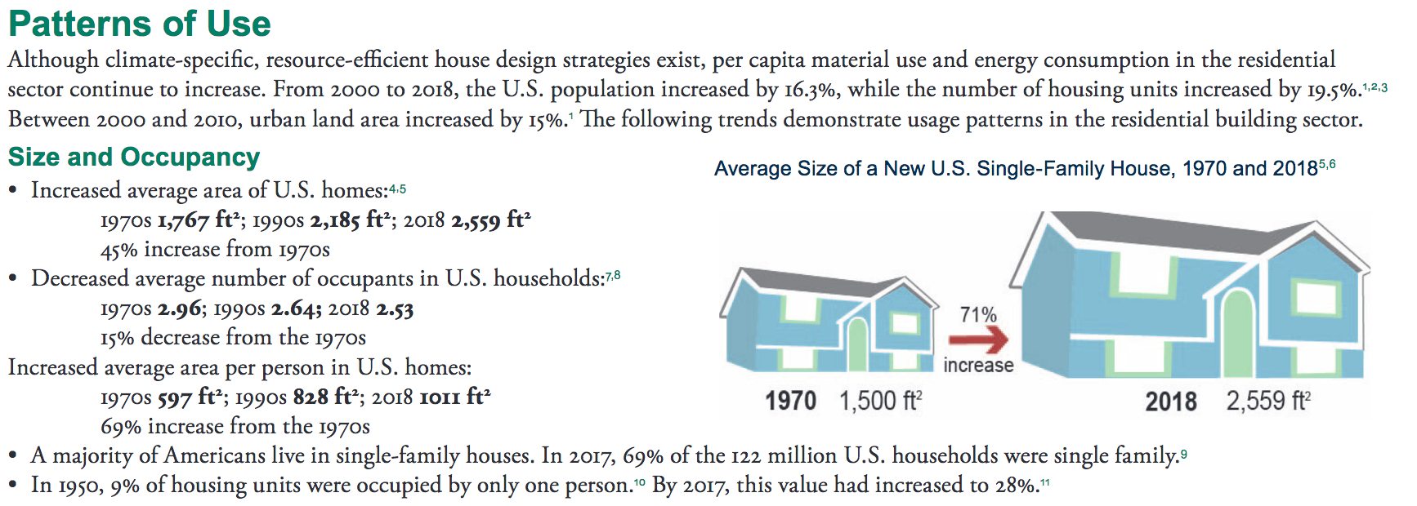
But rather than percentages of total U.S. energy consumption,
what about the actual levels of U.S. residential energy consumption?
In 2018 the University of Michigan's Center for Sustainable Systems
released a Fact Sheet about U.S. Residential Power ¹
It noted that, since 1950, U.S. residential power use increased 16 fold,
(while the U.S. population only slightly more than doubled ² )
The Fact Sheet also reported these trends:
1) http://css.umich.edu/factsheets/residential-buildings-factsheet
2) https://en.wikipedia.org/wiki/Demographic_history_of_the_United_States

Slide 14
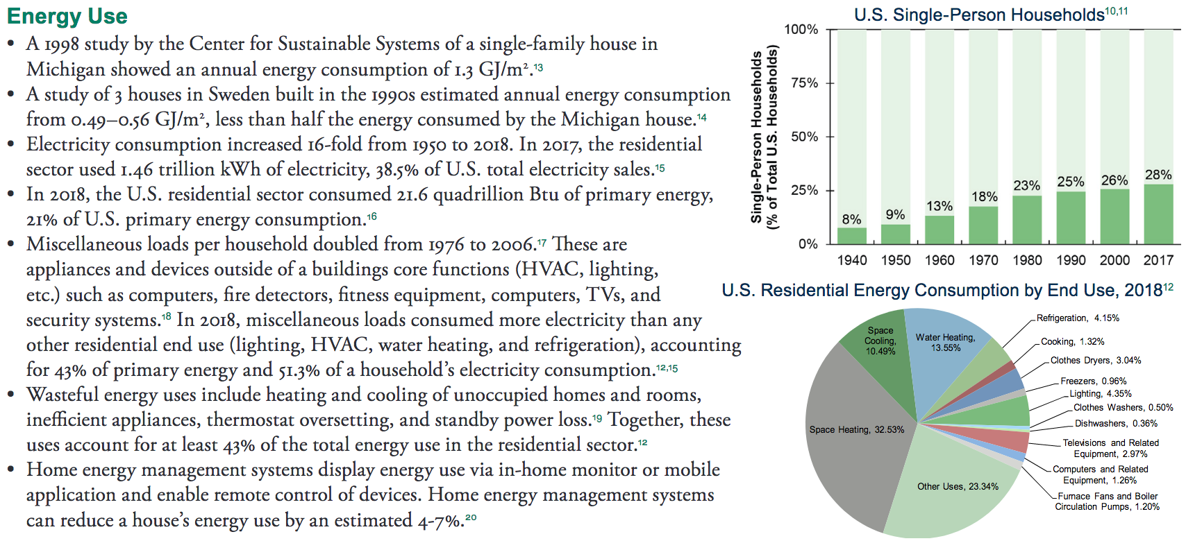
That "Fact Sheet" also included these figures & factoids:
Which included these highlights:
U.S. homes are both larger AND consume 2.5X the energy per area of Swedish ones
"Miscellaneous" electronic devices are now the major U.S. home energy consumers
Wasteful / avoidable home energy use accounts for 43% of total home consumption
Energy monitoring & management devices alone could reduce that by up to 7%

Slide 15
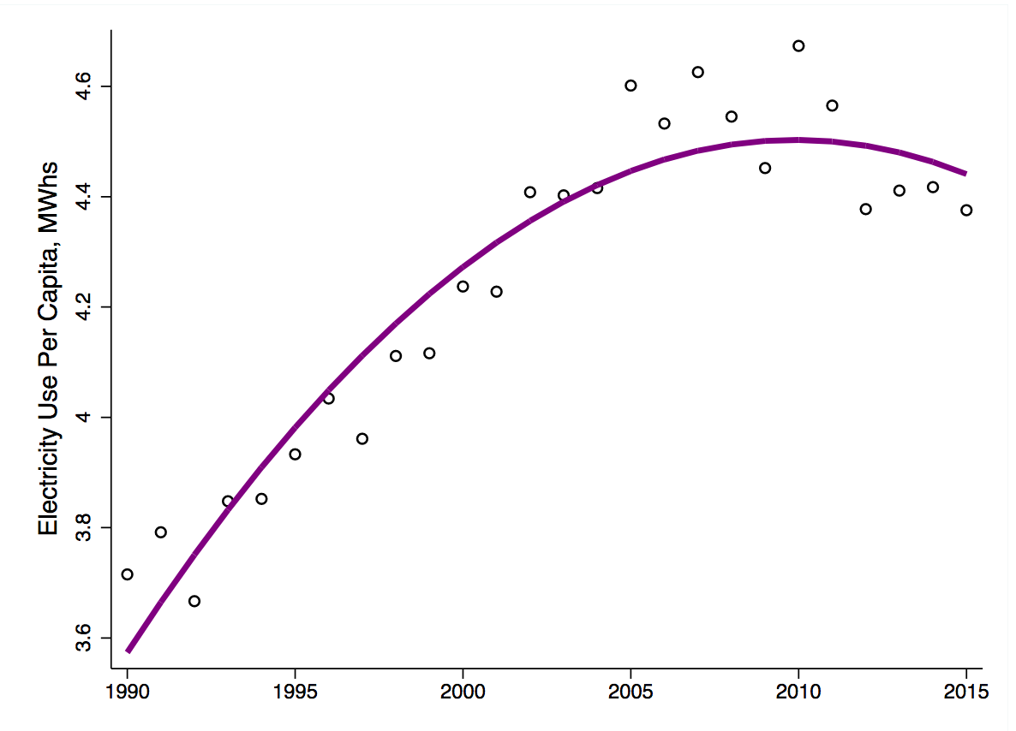
But another study DID suggest recent flattening in U.S. home energy use:
This non-peer reviewed study (out of University of California Berkeley) also estimated
the energy likely saved by recent increased use of LED lighting in U.S. homes,
and concluded that LED use alone might account for the observed rolloff ¹
1) https://www.haas.berkeley.edu/wp-content/uploads/WP279.pdf

Slide 16
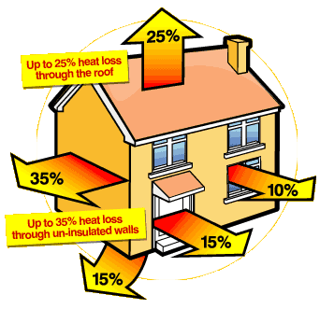
The statistics indicate that home energy use is almost all about heat
And that half of this energy use has to do transfer of air heat in and out of our homes
So how DO U.S. homes loose and gain heat?
On this topic, the U.S. Department of Energy maintains its almost unbroken record
of offering minimally useful/detailed educational or consumer information!
But I did find this figure used on several UK government websites:
It has the unfortunate shortcoming that:
1) UK homes are built differently than in U.S.
Mostly with thermally conductive brick & tile
2) Figure shows WHERE heat exits, but not HOW
By heat conduction?
By air air leakage?
By something else?
http://www.newcastle-staffs.gov.uk/housing_content.asp?id=SXBC10-A780DDF0&cat=1403 (no cached copy)

Slide 17

So let's dig into heat transfer mechanisms on our own:
From high school physics: Heat energy can be transferred in one of three ways
1) Conduction = Transfer of vibrational energy between atoms/molecules
2) Convection = Movement of hot atoms/molecules to cooler places
That is, by gravity pushing cooler (denser) gases below hotter gasses
3) Radiation = Flow of energy via electromagnetic waves (e.g., infrared light)
With that radiation emitted from vibrating atoms & molecules:
More intense the vibration (= hotter) => More intense the radiation
As dictated by the "Black Body Radiation" laws
(for more about them see: Greenhouse Effect (pptx / pdf / key))
6000°K
Light
Power
5000°K
4000°K
100
500
1000
1500
2000
2500
Visible
Wavelength (nm)

Slide 18
1) Conductive Heat Transfer:
"Transfer of vibrational energy between atoms/molecules"
Which transfers heat through the walls, ceilings and floors of our homes
Consider one wall/ceiling/floor: How much heat moves through it?
1) It scales with the difference in temperature across it: ΔT
2) It scales with its area: A
3) It depends on how wall/ceiling/floor is made
Its thickness, composition, detailed design . . .
Which is sometimes lumped into a number, κ
Yielding an equation for Heat flow = κ A ΔT
Higher κ, larger area, greater temperature difference: All => Greater heat flow
An Introduction to Sustainable Energy Systems: WeCanFigureThisOut.org/ENERGY/Energy_home.htm

Slide 19
It's rewritten a bit differently when applied to buildings & housing:
1) In Europe and in engineering textbooks:
Heat flow = U A ΔT where U must be the same as κ
Lower U values => Lower heat loss!
The units of U? Inverting the equation, U = (Heat Flow) / A ΔT = (Power) / A ΔT
= (Watts) / (Area) (Temperature difference) = Watts / m² - °C
2) Or in the U.S. where, in housing, we're still cursed with antiquated British units:
Heat flow = A ΔT / R where the "R value" must just equal 1 / κ
Higher R value => Lower heat loss!
The units of R value? R = A ΔT / (Heat Flow) = ft² - °F / (Btu / hr)
= ft² - hr - °F / Btu where Btu = a "British Thermal Unit" = 1055 Joules
To convert: Metric "U value" = 0.176 / (U.S. "R value")

Slide 20
Some R and U values for housing (plus their cross conversions):
Material Thickness R (ft²-hr-°F/Btu) U (W/m²-°C)
Solid wood door¹ 2" (0.067) 2.6
Wood¹ 1" (0.063) 2.8
Hard/Soft woods² 1" 0.9 – 1.25 (1.95-0.14)
Plywood² ½" 0.62 (0.28)
Sheetrock (Gypsum)² ½" 0.45 (0.39)
Fiberglass insulation² 3 1/2" / 6" 10.9 / 19 (0.016 / 0.0093)
Polyurethane foam² 1" 6.3 (0.028)
Cellulose insulation² 1" 3.7 (0.047)
Single pane glass¹ (0.0347) 4.7
Single pane glass³ (0.035) 5.0
Double pane glass¹ (0.0628) 2.8
Double Pane glass³ 20 mm gap (0.10) 1.7
Solid brick wall¹ 10" (0.088) 2
Solid brick wall³ 9" (0.08) 2.2
Insulated brick wall³ 11" (0.29) 0.6
Timber framed floor³ (0.25) 0.7
Solid concrete floor³ 0.22) 0.8
1: http://www.engineeringtoolbox.com/heat-loss-transmission-d_748.html
2: "Energy – Its Use and the Environment," Hinrichs & Kleinbach, Chapter 5, Table 5.1, page 128 (Brooks/Cole 2013)
3: "Sustainable Energy without the Hot Air," McKay, Chapter E, Table E.2, page 290 (UIT Cambridge 2009)

Slide 21
Warning / Disclaimer:
The preceding table took me hours to compile!
Not because I could not find data sources
But because they so often disagreed . . . even radically!
I ended up gathering data from three or more sources, for virtually all materials
And then tossing the outliers
Nevertheless:
Seek out additional verification before relying upon any of those data!
http://www.designingbuildings.co.uk/wiki/U-values

Slide 22
But how would you then use such (verified) data?
You'd add all the heat flows, as calculated from Heat flow = U A ΔT = A ΔT / R
So for each wall, ceiling or floor, you'd need its R (or U) value
What if you couldn't find U/R data for your particular wall/ceiling/floor?
If you knew it consisted of ½" sheetrock + 3.5" fiberglass insulation + 1" plywood
You'd ADD the R values for each of its layers (e.g., from table above):
R_{total} = R_{sheetrock} + R_{3.5" insulation} + R_{0.5" plywood} = 0.45 + 10.9 + 0.62 = 11.98
While U's are a bit harder to use because:
U_{total} = 1 / Sum (1/U_{1st layer} + 1/U_{2nd layer} + . . . + 1/U_{last layer})
Above would be a "timber frame" wall built to minimal current U.S. standards
Which is still hugely better than traditional British R_{solid brick wall} = 0.08 !
An Introduction to Sustainable Energy Systems: WeCanFigureThisOut.org/ENERGY/Energy_home.htm

Slide 23
Next you'd need areas through which the heat is flowing
Which you'd get by measuring the areas of the exterior walls/ceiling/floors
Subtracting out the area of any doors or windows
(and later calculating their heat flows separately)
FINALLY, you'd need the temperature difference across those barriers
Which you could measure at a particular time . . . or much better:
To get heat flow over a full season, consult "degree day map"
Those maps integrate the following quantity over a whole heating season:
(Average inside temp. - Outside temp.) x (Net time spent at that difference)
With a "heating season" defined as part of year when it's colder outside
And a "cooling season" defined as part of year when it's hotter outside
An Introduction to Sustainable Energy Systems: WeCanFigureThisOut.org/ENERGY/Energy_home.htm

Slide 24
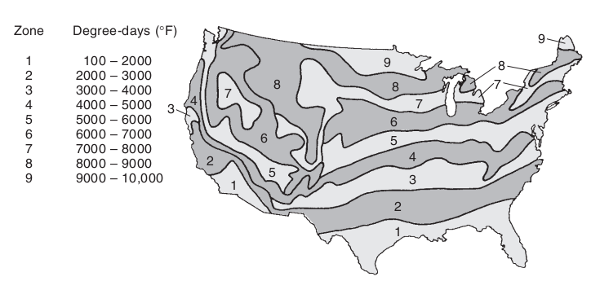
Yielding degree-day maps such as this:
A heating season degree day map:
So for central Virginia, a house's total cool season conductive heat loss would be
For ONLY walls/ceilings/floors/doors/windows exposed to outside temperature:
= Sum [ A_{wall i}/R_{wall i} + ... + A_{floor j}/R_{wall j} +...+ A_{door k}/R_{door k} +...+ A_{window l}/R_{window l} ]
x [4500 °F days]
X
Figure: "Energy – Its Use and the Environment," Hinrichs & Kleinbach, page 135 (Brooks/Cole 2013)

Slide 25
How big a deal is such conductive heat loss / gain ?
As noted above, I found little information on housing energy in textbooks and online
But we can look back to that British figure to make an estimate:
There homes make much heavier use of bricks and ceramic roof tiles
Which makes their walls & attic/roofs MUCH more thermally conductive
In such homes, these outside surfaces account for 60% of the total home heat loss
But I'd be surprised if U.S. homes cut this below 20%
Leaving another ~ 80% of energy loss to account for
Thus, moving on to our next candidate:
http://www.newcastle-staffs.gov.uk/housing_content.asp?id=SXBC10-A780DDF0&cat=1403 (no cached copy)

Slide 26
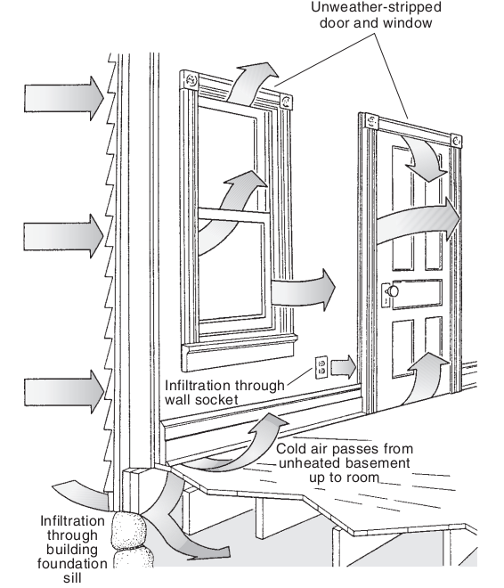
Convective Heat Transfer
"Movement of hot atoms/molecules to cooler places as driven by
gravity pushing cool/dense air below hotter/less-dense air OR by winds"
The MANY, MANY paths by which outside air can be driven into our homes
But how important can these tiny cracks/holes be?
It is estimated that a typical U.S. home experiences
1 complete home air exchange PER HOUR
In other words, every hour your furnace must:
Heat, from outside to inside temperature,
the air volume of your entire house
=> ~ 1/3 of U.S. home heating energy ¹
Which can double when outside wind speed rises to just 20 mph!
Figure: "Energy – Its Use and the Environment," Hinrichs & Kleinbach, page 133 (Brooks/Cole 2013)
1) http://en.wikipedia.org/wiki/Infiltration_%28HVAC%29

Slide 27
But don't we need some fresh air?
Won't we suffocate otherwise? Or be poisoned by household chemicals?
Amer. Soc. of Heating, Refrigerating & AC Engineers (ASHRAE) had a standard of:
7 cfm/person + 1 cfm/(100 ft² of floor space) ("cfm" = cubic foot / min)
Assume 4 people living in a 2000 ft² home (with typical 8' ceilings):
Required air exchange: 7 x 4 cfm + 1 x 20 cfm = 48 ft³/min
Air volume of home: 2000 x 8 ft³ = 16,000 ft³
Required home air changes/hour = 60 x (48/16,000) = 0.18
In 2013, the standard was changed to 7 cfm/person + 3 cfm/(100 ft² of floor space)
New required air exchange: 7 x 4 cfm + 3 x 20 cfm = 88 ft³/min
New required home air changes/hour = 0.33
Both are a lot less then the 1 full exchange/hour you're likely getting now!
http://www.greenbuildingadvisor.com/blogs/dept/musings/how-much-fresh-air-does-your-home-need

Slide 28
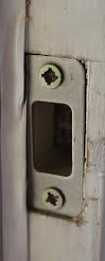
My (confirming) experience with leaky American homes
Our incredibly poorly designed U.S. doors / door frames:
Our doors DO have slender rubber weather-sealing gaskets for which:
~ 0 mm squeeze => Crack for air to funnel in
~ 3 mm squeeze => Medium Compression / Good air seal
~ 6 mm squeeze => Strong Compression requiring slamming of door
What determines the squeeze of these gaskets? The door striker plate:
Which determines the point at which the door latches
So this plate should be positioned with ~ 2 mm accuracy, right?
U.S. doors are mostly factory built, complete with hinges, in a frame
But the striker plates are NOT installed, nor are holes cut for them
Why? So that we can choose our favorite style of door latch ("lockset")

Slide 29
I've owned 3 homes and built ~ 40 Habitat for Humanity homes:
It is almost impossible to chisel out the recess required for the striker plate
And then drill the necessary screw holes
With the required ~ 2 mm accuracy
(particularly if you're also installing a deadbolt lock)
Further, because buyers DO immediately notice the need to slam a door closed
Builders err on the side of more loosely positioned striker plates
Meaning that door gaskets range from 0 to proper compression
You don't believe me?
On a windy day, run your hand down the edge of a door
Or at dawn/dusk look at the sunlight coming in at edges of some doors!
An Introduction to Sustainable Energy Systems: WeCanFigureThisOut.org/ENERGY/Energy_home.htm

Slide 30
My response as a DIY homeowner?
I first tried chiseling new recesses + new screw holes for the striker plates
But a NEW screw hole must be ~ 4 mm away from OLD screw hole
Meaning that new hole often => Over-compression / Need to slam door
I DID eventually find online ONE adjustable striker plate
That, in my already chewed up doorframes only sort of worked
I finally enlarged the old screw holes, and glued in replacement wood plugs
(which required buying a special "dowel/plug" cutting drill set)
And then tried to drill new properly positioned holes in the plugs
The ALTERNATIVE, RATIONAL, but still STILL CHEAP ($5 to $20) solutions?!
i) Factory-installed latches/striker-plates (you could still choose doorknobs!)
ii) Adjustable or pull-tight types of latches
(As already used in Scandinavia and other parts of northern Europe)

Slide 31
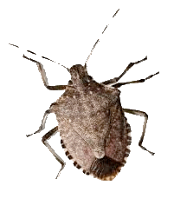

A further energy lesson taught to me by stink bugs:
After going through all of the above door repair/modifications
In a fairly new, fairly well built house, we were still plagued by winter drafts
Then I noticed a trail of stink bugs crawling in at a door's corner
On hands and knees I figured out HOW they were getting past the door's seal:
Proper door seals: My door seals:
To save the (miniscule) cost of
miter cutting the gasket corners
(i.e. "picture framing")
They just cut the pieces ~ 1" short
Leaving breezeways & bugways
At all four door corners

Slide 32
(continuing)
These weren't cheap doors (and I've seen same problem on other not-cheap doors)
My solution for this problem?
I spent an hour on the Internet identifying replacement gaskets, then
For $35 I bought enough to REGASKET every exterior door on my house
But I measured carefully AND made 45° razor blade cuts at their ends
Which took me a grand total of about 1 hour for six doors
(And would have taken door manufacturers trivial time & money!)
RESULT: My previously drafty house is no longer drafty
=> Same winter comfort at 1-2°C cooler heating temperature
WHY do we Americans put up with this pennywise / pound foolishness!
An Introduction to Sustainable Energy Systems: WeCanFigureThisOut.org/ENERGY/Energy_home.htm

Slide 33
Cutting convective heat loss is thus all about little things:
Which, in its own way, is good news
Because for conductive heat loss, only thing a DIY homeowner can easily do is:
Install insulating sheets of fiberglass in attic or under crawlspace floors
Whereas for convective heat loss that same homeowner can:
Caulk cracks (anywhere and everywhere!)
Install rubber gaskets in electrical outlets located on exterior walls
Replace door and window seals
Or, if you are more ambitious, replace/repair door and window latches
=> Saving VASTLY more in heating costs than these DIY repairs cost you
Even saving money if you have to pay someone to do these repairs for you!
An Introduction to Sustainable Energy Systems: WeCanFigureThisOut.org/ENERGY/Energy_home.htm

Slide 34
Bringing us to: Radiative Heat Transfer
"Flow of energy via electromagnetic waves (e.g. infrared light)"
With radiation emitted from vibrating atoms & molecules:
More intense the vibration (= hotter) => More intense the radiation
From the physics of "Black Bodies," materials naturally radiate an amount of energy:
ε σ T⁴ where T is their absolute temperature (in degrees Kelvin, K),
σ is the "Stefan-Boltzmann Constant" = 5.670 x 10⁻⁸ W/m²-K⁴
and ε is the material's "emissivity"
Which, for most organics, including wood & paints, is about 0.95
For an opaque material, the relevant temperature is its surface temperature
But earlier convective heat transfer cools outside surface temperature
of a well insulated wall to almost the surrounding air temperature

Slide 35
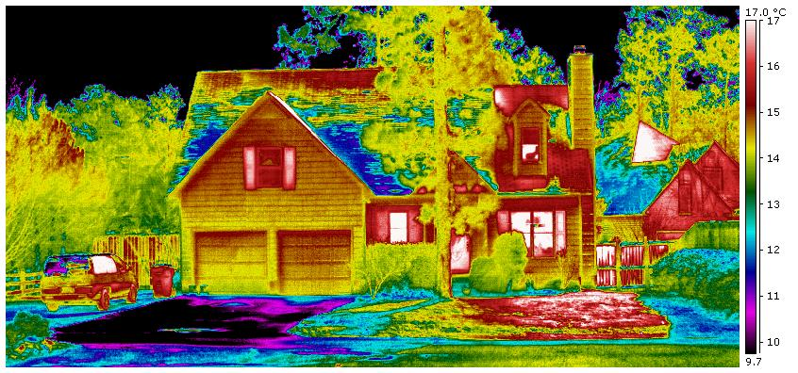
Yielding infrared images like this for well-insulated homes:
Wall surfaces are at almost the surrounding temperature (above, ΔT~ 1-2°C), thus:
Radiation FROM walls TO environment ( ε σ T_{wall_surface}⁴) is only a bit higher
than radiation FROM environment TO walls ( ε σ T_{environment}⁴)
So there's little NET radiative heat transfer from a well insulated wall
But apparent window temperatures are right off the top of the scale!
Image: http://www.nicolascretton.ch/Astronomy/Spitzer_IR_space_telescope/Spitzer.html

Slide 36
"Apparent window temperatures" because:
The outside surface temperature of the window glass itself is also ~ T_{environment}
But because glass is transparent, it passes radiative heat out from the hotter interior
Let's run some numbers from temperatures given in preceding image:
T_{environment} ~ 14°C, T_{wall surface} ~ 15.5°C, T_{interior} ~ 21°C translating to °K:
T_{environment} ~ 287.1°K, T_{wall surface} ~ 288.6°K, T_{interior} ~ 294.1°K
Net heat loss per square meter (assuming all emissivities ~ 0.95):
Heat thru wall to environment: ε σ (288.6⁴ – 287.1⁴) W = 7.7 W / m²
Heat thru window to environment: ε σ (294.1⁴ – 287.1⁴) W = 37 W / m²
5X more radiative heat (per area) from windows than walls!
So radiative heat transfer is almost all about windows
An Introduction to Sustainable Energy Systems: WeCanFigureThisOut.org/ENERGY/Energy_home.htm

Slide 37
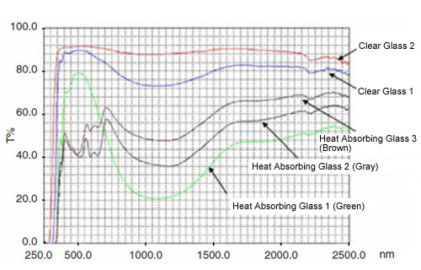
Windows are intended to pass visible light:
But most radiative heat transfer occurs at invisible infrared (IR) wavelengths
Do normal plate glass windows transmit infrared light? Yes!
Some glasses do absorb IR: Summer sun would then heat outer glass
Which would help if you still had cooler inner pane(s) of glass
Visible Light
UV Light
Infrared Light
<= Normal glass
% Transmission
Absorbing glasses
Wavelength
https://www.shimadzu.com/an/industry/ceramicsmetalsmining/chem0501005.htm

Slide 38
But you can also reflect part of all light colors:
By making your windows into partial mirrors (that are, for instance, 25% reflective)
During the day you'd hardly notice if light from the outside was 25% dimmer
And if you did notice, you'd probably end up appreciating it
A night, from outside, your inside lights would appear 25% dimmer
But optical tricks can ALSO produce stronger reflection in only the infrared:
It's done by setting up destructive or constructive interference of light waves
from surfaces of additional, very thin, metal coating-layers
Sum of all 3 tricks (absorption + all color reflection + enhanced IR reflection)
=> "Low E" Glass & Windows
Where "E" again stands for emissivity = surface's efficiency at emitting light
An Introduction to Sustainable Energy Systems: WeCanFigureThisOut.org/ENERGY/Energy_home.htm

Slide 39
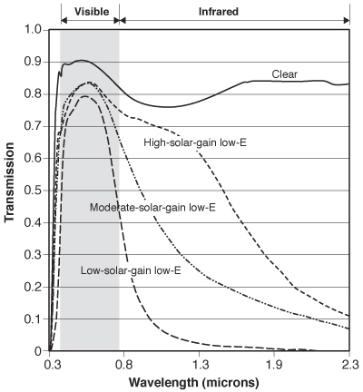
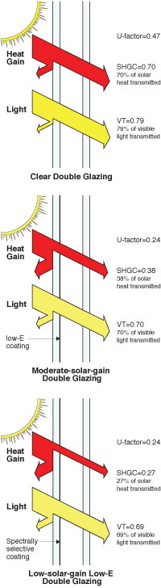
Transmission of Low E glass / windows:
Now based more on changes in reflection, rather than absorption:
https://www.efficientwindows.org/lowe.php

Slide 40
Energy savings with low-E windows?
Here I (finally) found some semi-useful info from the U.S. Department of Energy: ¹
"On average, low-e storm windows can save you 12%–33% in heating and cooling costs.
This Equates to $120–$330 in annual savings, assuming a $1,000 annual heating/cooling bill."
Then working a bit with the Home Depot purchasing app:
Home Depot brand double-hung NON Low-E windows ran ~ $200 each
Anderson brand double-hung windows, all Low-E, started at ~ $400 each
I doubt that simple low-E process cost more than $50 of the added $200 per window
IF Department of Energy's "typical" U.S. house had 15 such windows:
- To replace with Low-E windows => 15 x $400 = $6000 => 20-40 year payback
- To build with Low-E windows (assuming my $50 ΔP is correct) = $750 cost
Which would mean an energy savings payback in as little two years
1) http://energy.gov/energysaver/projects/savings-project-install-exterior-storm-windows-low-e-coating (no cached copy)

Slide 41
So that's how normal homes loose/gain heat
But what about abnormal PASSIVE SOLAR HOMES ?
These attack home heating and cooling losses point by point:
To deal with CONDUCTIVE Heat Transfer:
WALLS: Go from 2x4 wood-framed walls to 2x6 or 2x8 framed walls
Space for insulation goes up by ~ 50-100%, as does R value
Cutting wall heat loss by 33-50%
CEILINGS and FLOORS: Just pile on more fiberglass insulation blankets
WINDOWS: Move from double to triple pane glass
An Introduction to Sustainable Energy Systems: WeCanFigureThisOut.org/ENERGY/Energy_home.htm

Slide 42
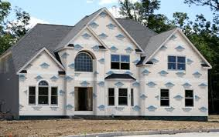
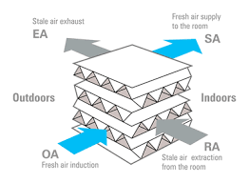
To deal with CONVECTIVE Heat Transfer:
Passive solar homes:
Use ultra-tight-latching doors and windows
Seal all remaining cracks and holes
Wrap whole house in wind impermeable "house wrap" (e.g., "Tyvek")
Potential Problem: House's air changes may fall below desirable 1/3 per hour
In which case you add an "air-to-air heat exchanger"
Which pushes inside air out, and outside air in:
Forcing them to pass closely, ~ averaging temperatures
So incoming air gets ~ halfway to inside air temperature
Thus ~ halving load to furnace/AC/heat pump
Top: http://www.nachi.org/housewrap-inspection.htm Bottom: http://www.celsiusair.co.uk/projects/callcentres.htm

Slide 43
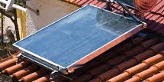
Finally, to deal with RADIATIVE Heat Transfer:
Passive solar homes reduce heat absorbed from sun by painting walls light colors
And similarly reduce heat to roof by abandoning black shingles for lighter shingles
But then passive solar homes make bigger changes:
They add south-facing rooftop passive water heaters, saving most
of the 18% of residential power now used for water heating
But they DON'T use low-E windows - Instead they size and locate windows to:
Capture solar heat in the winter, but avoid it in the summer
How? Some new type of selectively mirroring window? No (at least not yet)
Instead, they just redesign window overhangs and re-orient house:
Figure: http://environment.nationalgeographic.com/environment/green-guide/buying-guides/water-heater/shopping-tips/

Slide 44
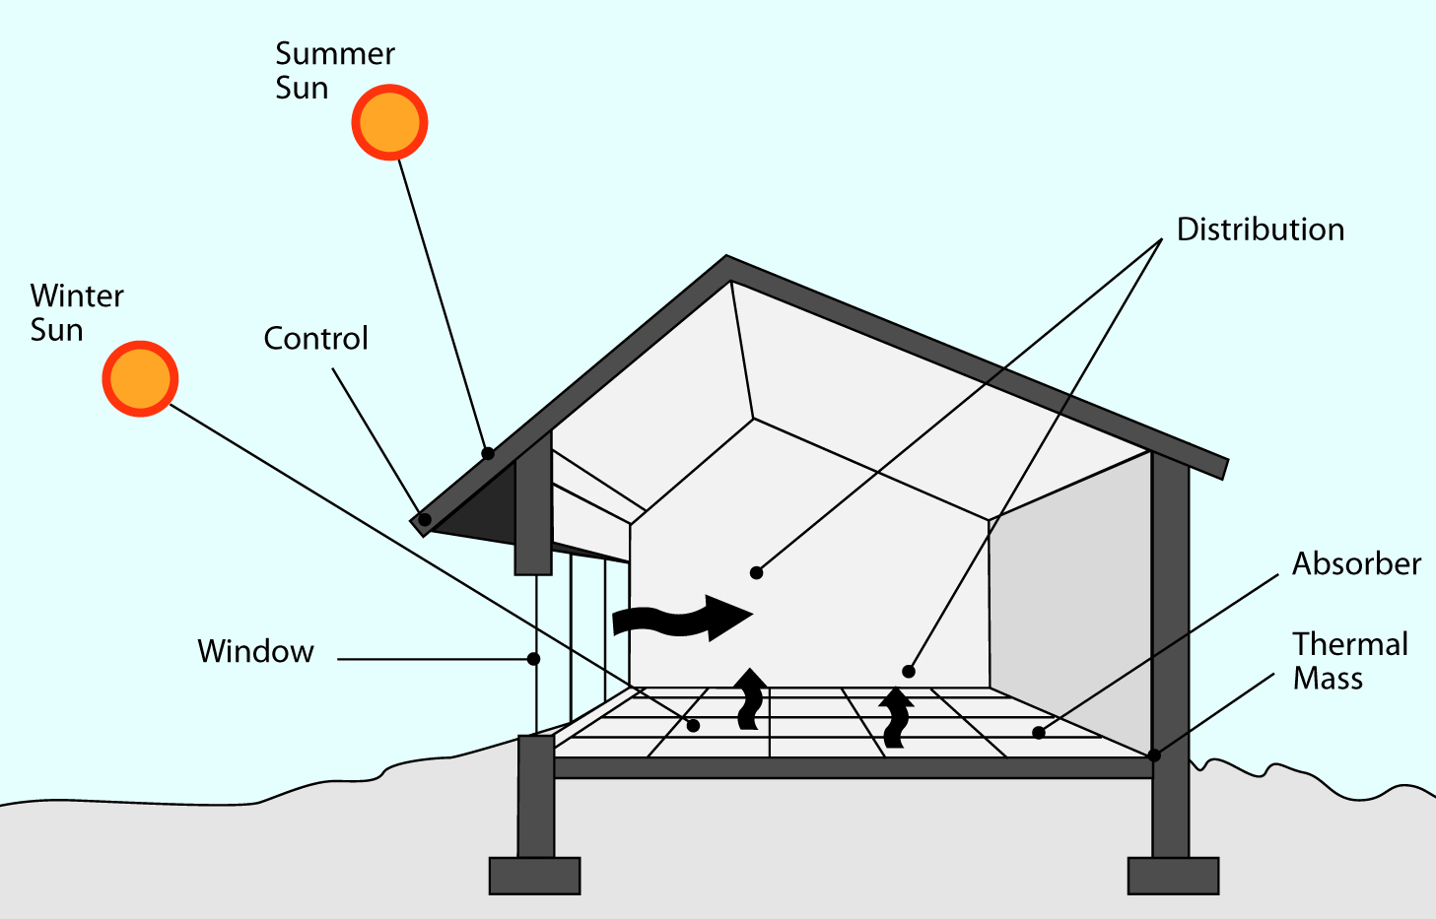
The U.S. DOE's “five elements of passive solar design:” ¹
1) Vast majority of window APERTURES should be on home's south face (in U.S.)
2) CONTROL the entry of solar radiation into those windows via roof overhangs
allowing only low winter sun to reach the window, but not higher summer sun
(and don’t use Low-E glass to block infrared heat from that winter sun!)
3) Inside those windows install dark ABSORBER surfaces to collect that winter IR
1) http://energy.gov/sites/prod/files/guide_to_passive_solar_home_design.pdf (cached copy)

Slide 45
The “five elements of passive solar design” (continued) ¹
4) Beneath those absorbing surfaces install THERMAL MASS
Things like stone or concrete that absorb a lot of energy as they heat up
5) Then provide for HEAT DISTRIBUTION from those thermal masses
so that when sun sets, heat from the thermal mass is distributed throughout home
1) http://energy.gov/sites/prod/files/guide_to_passive_solar_home_design.pdf (cached copy)

Slide 46



An early example of U.S. passive solar homes:
The “Betatakin Cliff Dwelling” I photographed on a late May afternoon in Arizona:
Built by the Anasazi's ~1000 years ago (all across Arizona & New Mexico)
Not generally in a cliff (as for defense), but at the base of an overhanging cliff
Facing to the south (or sometimes southwest)
Where houses would ONLY get DIRECT sunshine in the winter
Which would then heat the houses AND the surrounding stone
In other words, they nailed the whole idea of passive solar design!

Slide 47
So why can’t WE now “nail” the use of passive solar design?
You DO need to aim most of your windows southward:
Which, if you didn’t want to be staring at the side of your neighbor's house
Means that houses should probably lie on ~ east to west streets
So south would be out toward either front yard or back yard
But the rest is really easy (simple and cheap):
- Overhanging roof on south face of house
- Dark light/heat-absorbing stone or concrete floors in south facing rooms
- Air circulation to share stored heat with other rooms
- Plus well insulated and light-colored roof and W/N/E walls to shed summer heat
Which could give many/most of us low to no heating & cooling houses
Saving 2/3 of residential (~ 21% of U.S. total) power consumption!

Slide 48
But what about the homes we NOW mostly buy or live in?
We can still shop for homes implementing some of today's best practices
or, as owners, make certain best practice changes ourselves,
while also making better choices when home appliances are replaced
This note set's Resources Webpage includes a list of "Best Practices" sources
Of particular note are step-by-step webpages from the Zero Energy Project:
Step 1 - The Design Process
Step 2 - Use Energy Modeling
Step 3 - Super Seal the Building Envelope
Step 4 - Super Insulate the Building Envelope
Step 5 - Heat Water Wisely
Step 6 - Specify Highly Insulated Windows and Doors
Step 7 - Choose Solar Tempering
Step 8 - Create an Energy Efficient Fresh Air Supply
Step 9 - Select Energy Efficient Heating and Cooling System
Step 10 - Select Energy Efficient Lighting
Step 11 - Select Energy Efficient Appliances & Electronics
Step 12 - Use the Sun

Slide 49
Drawing from that and other Best Practice sources:
Air Heating & Cooling (and their minimization) are always a top priority
Recall the governmental data I cited at beginning of this talk:
Winter heating alone => 30-40% of U.S. residential power consumption
And how do we typically produce such heat?
By passing electricity through "resistor" heating elements
OR by burning hydrocarbon fuels in furnaces
How efficient are these processes (and how might they be improved)?
Resistive heating elements already convert electricity to heat VERY efficiently
But the problem is then that our still dominant fossil-fuel power plants
convert fossil fuels to electrical energy at only 1/3 - 2/3 efficiency
An Introduction to Sustainable Energy Systems: WeCanFigureThisOut.org/ENERGY/Energy_home.htm

Slide 50
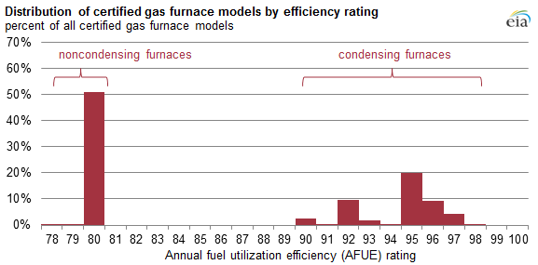
What, instead, about furnaces burning fossil-fuels right in our home?
They are now much more efficient than fossil-fuel power plants!
Types of furnaces (and percentage of such models) vs. heat delivery efficiency:
So what IS a condensing furnace, and why are they ~ 15% more efficient?
https://www.eia.gov/todayinenergy/detail.cfm?id=14051

Slide 51
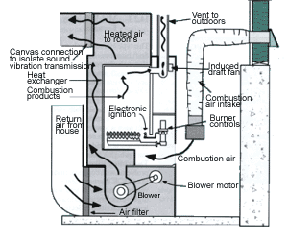
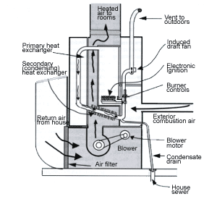
Non-condensing (conventional) vs. condensing furnaces:
Both have a central chamber where fuel burns using inside house air (white)
Producing "exhaust" = very hot air + water vapor + byproducts = Orange
Adjacent to which, other house air passes, picking up some of this heat
Producing warm air to be returned to house = Pink (warm) / Red (warmer)
Non-condensing furnace: Condensing furnace:
(colors added)
Original black and white figures from: http://www.r2000manitoba.com/heating_heat_dist6.shtml

Slide 52
But in condensing furnace, exhaust loops back to pass by incoming air:
That exhaust contains water vapor
Cooled by incoming house air, its water vapor condenses into liquid water
Water vapor then gives up its "heat of vaporization"
Which is partially absorbed by incoming house air
Pre-heating house air, before it passes burn chamber
This also cools the exhaust enough that a brick chimney is no longer required
It is replaced by small blower + PVC plastic pipe:
Elimination of chimney = Big cost reduction AND
PVC pipe allows furnaces to be placed in more efficient locations

Slide 53
But there is an even newer
and radically more efficient heating alternative!
An Introduction to Sustainable Energy Systems: WeCanFigureThisOut.org/ENERGY/Energy_home.htm

Slide 54
Heat Pumps:
A LOOP of copper piping, with a very narrow segment at one point (capillary/valve)
Plus "heat exchanger" zig-zags inside house (left), and outside house (right)
Filled with "coolant" that normally boils at around room temperature
Purpose:
Pump pressurizes "coolant" gas entering house, causing it to condense into liquid
Losing heat TO inside air
Leaving house, liquid sprays thru restriction
Droplets gain heat FROM outside air
Converting coolant back to gas
(and process repeats over and over)
Pressurizing
Pump
Liquefied Coolant
Vaporized Coolant
Indoor
Heat
Exchanger
Outdoor
Heat
Exchanger
Restricting Valve
or Capillary
An Introduction to Sustainable Energy Systems: WeCanFigureThisOut.org/ENERGY/Energy_home.htm

Slide 55
But wait, doesn't that sound a lot like Air Conditioners:
A LOOP of copper piping, with a very narrow segment at one point (capillary/valve)
Plus "heat exchanger" zig-zags inside house (left), and outside house (right)
Filled with "coolant" that normally boils at around room temperature
Purpose:
Pump pressurizes "coolant" gas leaving house, causing it to condense into liquid
Losing heat TO outside air
Entering house liquid sprays thru restriction
Droplets gain heat FROM inside air air
Converting coolant back to gas
(and process repeats over and over)
Pressurizing
Pump
Vaporized Coolant
Liquefied Coolant
Indoor
Heat
Exchanger
Outdoor
Heat
Exchanger
Restricting Valve
or Capillary
An Introduction to Sustainable Energy Systems: WeCanFigureThisOut.org/ENERGY/Energy_home.htm

Slide 56
Yes, they are the same with just the pumping direction reversed!
"Killing two birds with one stone" by combining separate heating & cooling units
But it's even better when you look at the heating cycle:
A fuel-burning furnace produces 0.8-0.95 Watts of heated air per Watt of fuel energy
But a heat pump uses energy only in MOVING HEAT
That pump moves 3-4 Watts of heat per every 1 Watt it uses =>
80-95% furnace efficiency vs. 300-400% heat pump efficiency ^{1,2}
Hold it! How can anything be 300-400% efficient?
Energy going into the pump is not producing the heat, it's just moving it
So think of a heat pump as a "heat transportation system"
And, with optimized design, transportation systems can be quite efficient
1) http://energy.gov/energysaver/articles/tips-heat-pumps (no cached copy) 2) https://en.wikipedia.org/wiki/Heat_pump

Slide 57
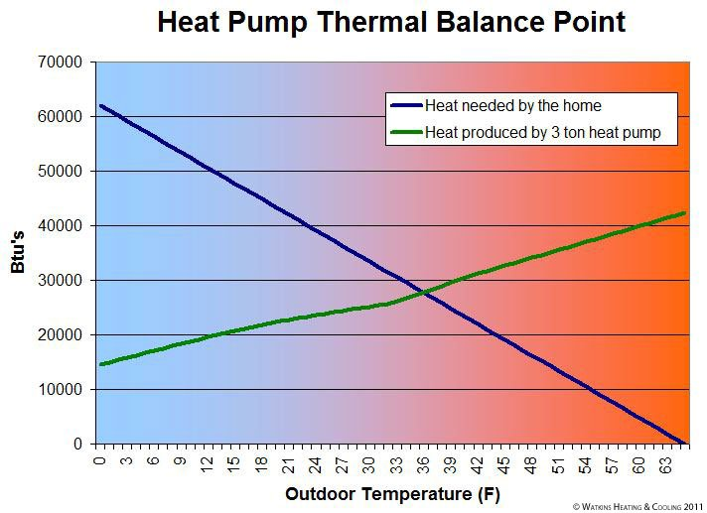
Shortcomings?
Heat pump heating efficiencies fall as outside temperature decreases
Because it's harder to pick up heat from that colder outside air
Note: Here a "ton" is antiquated U.S. way of rating heating/cooling capacities
Defined by cooling power once provided by melting 1 ton of ice
Figure: http://www.watkinsheating.com/blog/heat_pump_operation_102/

Slide 58
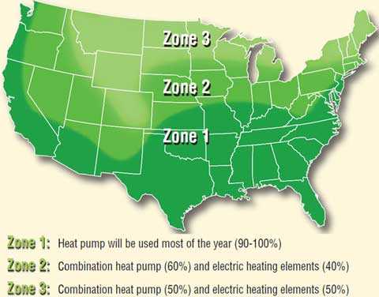
Leading to heat pump usage maps like this:
Which recommended adding electric heating elements in colder climates
Despite low efficiency of those elements (due to 1/3 - 2/3 efficient power plants)
http://waterheatertimer.org/Review-GE-Heat-Pump-water-heater.html

Slide 59
But a more modern fix is to add back in a fuel burner
This produces what is called a "hybrid" heat pump in which:
For outside temperatures below ~ 45°F, heat pump shuts down
And fuel burner takes back over, continuing to heat the building
Remember: Fuel Burners are 80-95% efficient
My hybrid heat pump also has an inside heat exchanger that was
carefully optimized to condense out more water from humid summer air
This made that air much more comfortable
and led us to increase summer inside home temperatures by 2-3°F (~1.5°C)
When I replaced my Furnace + AC with a Hybrid heat pump:
My heating/cooling bills dropped by more than 1/3
A level of savings also cited on official / governmental websites

Slide 60
Other potential energy saving "big hitters?"
What about all of our appliances?
Which government figures say account for ~ 1/3 of residential power use?
Motors: They can be big energy users, but they are already highly efficient
So only alternative here is to settle for lower powered appliance motors
As Europe did in recent ban on high power vacuum cleaners
But most home motors are just not used enough to matter very much
"Vampire Chargers" as decried by UK politicians quoted in McKay textbook?
McKay: "It's NOT about every little thing, it's about every big thing!"
Chargers ARE now "little things" wasting very little power
Because, as explained in: A Renewable Distributed Grid (pptx / pdf / key):
Cool semiconductor AC/DC conversion circuits replaced hot transformers

Slide 61
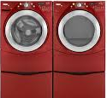
Instead identifying heat-seeking targets based on my rant that:
"If it isn't producing (or moving) HEAT, don't worry about it!"
Eliminate hot incandescent light bulbs:
Wonder of wonders, the U.S. Congress has already banned them!
Buy "Euro" style front loading clothes washing machines:
Hold it! Earlier DOE data said these used only 400W, for short periods
Yes, but they are followed by dryers consuming 4000W, for longer
But to save water, those washers don't just drown clothes in volumes of rinse water
They add a little water, then spin like crazy to remove that water
As a result, clothes leave the washing machine MUCH less wet
Thus requiring ~½ the time in the energy hogging dryer!
In another of their almost useless, never more than one page long postings,
the U.S. Department of Energy cites a 70% energy savings for new washing machines.
But it's typically vague as to if this is for washers alone, or washers plus dryers ¹
1) http://en.wikipedia.org/wiki/Induction_cooking

Slide 62
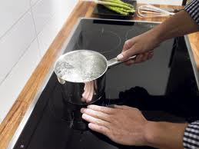
Continuing on our heat-seeking mission:
Induction cooktop ranges:
For normal gas ranges, hot air quickly passes by pots/pans, to be lost in the room
And the fraction of burner heat energy transferred TO the pots/pans is only ~ 44% ¹
Induction ranges replace burners with embedded wire "coils"
Fed by pulsing electricity, these coils generate pulsed magnetic fields that
excite electrical currents in nearby metals, thereby heating them
Energy transfer efficiencies thus approach 74% (with manufacturers claiming up to 84%)
But what about rings & watches (as carefully omitted in this marketing photo ²)
Won't their metal also be heated, burning hands & arms?
Most websites claim coils can only heat magnetic metals
Or, more specifically, iron or predominantly iron steels
RIGHT ANSWER BUT FOR THE WRONG REASONS!
1) http://en.wikipedia.org/wiki/Induction_cooking
2) https://www.appliancesonline.com.au/academy/wp-content/uploads/2012/10/Appliances-online-australia-induction-cooking-recipes1.jpg

Slide 63
As explained in my note set about Magnetic Induction (pptx / pdf / key):
Pulsed electricity flowing in an "induction coil" creates a pulsed magnetic field
That field extends upward penetrating pots, pans (arms, rings & watches) above
But the movement of magnetic fields creates a force on electrons
If those electrons are free to move (as they are in metals),
they will begin to flow back and forth (in time with the pulsing magnetic field)
This is the basis of both electrical motors and transformers,
both of which get slightly warm as those moving electrons bump into things
Heating is reduced by use of "low resistance metals" in which bumps are less frequent
Metals such as nearly pure and atomically-ordered gold, silver, copper or aluminum
(the sorts of metals we also favor in our jewelry)
But bumping (and heating) increase in less pure and more atomically-disordered metals
Such as cast iron & steels, with are mixtures of iron, carbon, and other impurities
(making them the strongly-heating metals used in inductively-heated cookware)

Slide 64
Less dramatic, but nevertheless high impact ways of saving home energy:
Incrementally improved but particularly high use/energy appliances:
For instance, Water heaters, refrigerators, and air conditioners
As improved via better burners, insulation, coolant cycles, etc.
These are used so heavily (most of them almost constantly) that result is:
Water heaters alone now account for ~ 18% of our U.S. residential power
Air Conditioner's topped my estimated household energy list at 7 kW-h/day
Followed by clothes dryers (which I've already discussed above)
And below that, refrigerators at 1.75 kW-h/day
Dramatic energy and money savings can thus be achieved by replacing an old unit
with a newer "Energy Star" design that is only 10-20% more efficient
1) http://en.wikipedia.org/wiki/Induction_cooking

Slide 65
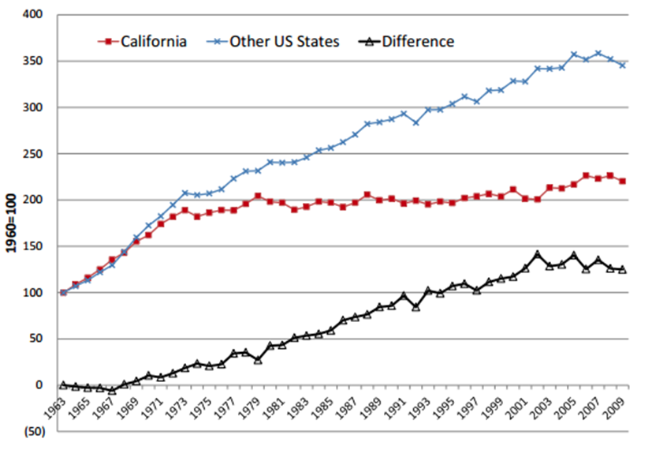
Figuring out appliance by appliance savings impact is difficult
But here is what California has achieved with incentives / regulations:
Per Capita Electricity Use
Year
http://berc.berkeley.edu/californias-classic-chart-really-caused-energy-savings/ (no cached copy)

Slide 66

Federal government has also gotten into appliance improvement:
In the form of "Energy Star" labeling
Telling you how many $ you can save by buying a better appliance
AND in new homes builder's are required retain such labeling
So READ (and pay serious attention to) THESE LABELS!
However, did YOU know washing machine choice could save big dryer expense?
That still came as a surprise to me!
Suggesting HUGE energy saving opportunities via public education
Knock, knock, knock: U.S. Department of Energy, wake up (damn it)!
An Introduction to Sustainable Energy Systems: WeCanFigureThisOut.org/ENERGY/Energy_home.htm

Slide 67
Even more could be done via state-mandated home building codes
Because:
1) We consumers seldom know enough to make such home construction decisions
Didn't parts of my long home-owning experience surprise you?
2) OR we lack the leverage over builder's choices to ensure that they choose well
Builder's often ignore single purchaser's requests or overcharge for them!
So despite prevailing anti-big-government / don't tread-on-me sentiments
I strongly suggest following the lead of states such as California:
Incorporating more energy saving requirements into home building codes
We could also require landlords to separately bill for an apartment's energy use
Also requiring them to divulge recent charges to be would-be renters
Which would incentivize construction of energy-efficient apartments

Slide 68
Independent of saving energy, what about saving the planet?
For even the SAME energy use,
we could significantly reduce our CARBON FOOTPRINT
by shifting energy usage AWAY from peak evening hours
HOW/WHY?
Evening "peak power" requires special "peaking power plants"
Which, because they only produce power for a couple of hours a day,
must be both very fast-starting and very cheap ("low capital cost")
Today that means that they likely burn natural gas, and do so in the dirtiest way:
Via lower efficiency single cycle gas turbines ("OCGT")
See: Generic Power Plant & Grid (pptx / pdf / key) & Fossil Fuels (pptx / pdf / key)
An Introduction to Sustainable Energy Systems: WeCanFigureThisOut.org/ENERGY/Energy_home.htm

Slide 69
Motivating & Facilitating such a Shift in Energy Consumption:
MOTIVATION can be provided just by forcing us to pay more for evening power
Which IS in fact considerably more expensive for power plants to produce
FACILITATION is commonly suggested via either:
1) Using Smart Appliances + Internet of Things
to INFORM us of costly evening power use (hopefully leading us to curtail it!)
OR:
2) Using Smart Grid + Internet of Things
to give power companies the ability to CONTROL our evening power use
But these raise serious efficacy, security, and privacy concerns
Leading me, in Smart Grid (pptx / pdf / key) notes, to make some alternative suggestions
An Introduction to Sustainable Energy Systems: WeCanFigureThisOut.org/ENERGY/Energy_home.htm

Slide 70
Credits / Acknowledgements
Some materials used in this class were developed under a National Science Foundation "Research Initiation Grant in Engineering Education" (RIGEE).
Other materials, including the WeCanFigureThisOut.org "Virtual Lab" science education website, were developed under even earlier NSF "Course, Curriculum and Laboratory Improvement" (CCLI) and "Nanoscience Undergraduate Education" (NUE) awards.
This set of notes was authored by John C. Bean who also created all figures not explicitly credited above.
Copyright John C. Bean
(However, permission is granted for use by individual instructors in non-profit academic institutions)
An Introduction to Sustainable Energy Systems: WeCanFigureThisOut.org/ENERGY/Energy_home.htm

