Slide 1
A Hydrogen Economy?
John C. Bean
Outline
Vision(s) of a Hydrogen Economy
Reactions from the Press, Environmental, Science & Industry Organizations
Today's NOT so simple Hydrogen
From where do we now get Hydrogen?
White vs. Green Electrolytic vs. Gray, Brown, Black & Blue fossil-fuel-based Hydrogen
How do we now use Hydrogen?
Tomorrow's Hydrogen
Energy Sources vs. Energy Storage Media
Energy conversion efficiencies of electrolysis & fuel cells vs. batteries & synthetic fuels
Climate-change-driven vs. Industry-driven versions of a Hydrogen Economy:
Massive Electrification + Green Hydrogen vs. Gray to Blue Hydrogen + Carbon Capture
The surprisingly stark differences between economically-driven Carbon Capture & Utilization
versus climate-driven Carbon Capture, Utilization and SUSTAINED Sequestration
The intrinsic energy content of Hydrogen vs. Fossil Fuels vs. Batteries vs. . . .
plus the EFFECTIVE energy densities of differently stored & transported Hydrogen
Impacts of those energy contents & densities upon future:
Hydrogen transport and infrastructure
Applications of Hydrogen in Heating, Electricity Generation, Cars, Trains, Ships & Planes
Along with energy-calculation-based comparisons to competing technologies
(Revised - March 2024)

Slide 2
The Vision(s) of a Hydrogen Economy:
An Introduction to Sustainable Energy Systems: WeCanFigureThisOut.org/ENERGY/Energy_home.htm

Slide 3
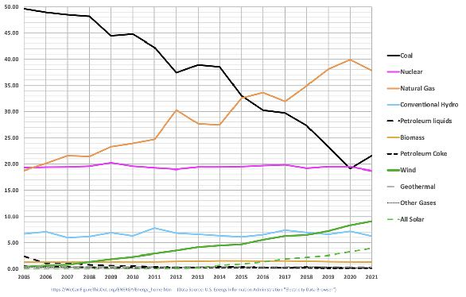
The reasoning goes something like this:
Nearly 60% of U.S. electrical power now DEPENDS upon CO2 emission (37.8% + 21.6%) ¹
Sources of U.S.
Electrical Power
Natural Gas: 37.8%
Coal: 21.6%
Nuclear: 18.7%
Wind: 9.1%
Hydro: 6.3%
Solar: 3.9%
Biomass: 1.3%
Nearly 100% of U.S. road, sea & air transport now DEPENDS upon CO2 emission ²
  Even electric cars now DEPEND upon electricity that's 60% based on burning fossil-fuels
Nearly 100% of U.S. industrial & residential heating now DEPENDS upon CO2 emission
Eliminating fossil-fuels from that huge variety of technologies will be a BIG challenge
Eliminating it fast enough to mitigate climate change might be an OVERWHELMING challenge
1) See my webnotes: U.S. Energy Production and Consumption (pptx / pdf / key):
2) See my webnotes: Energy Consumption in Transportation (pptx / pdf / key)

Slide 4
So instead of REPLACING those systems, why not just REPLACE their fuel?
We now exploit combustion reactions of the form: CX + O2 → CO2 + Byproducts + Energy
C input comes from fossil-fuel hydrocarbons such as
gasoline, diesel fuel, coal or natural gas (NG = mostly methane)
O2 input comes directly from the atmosphere's 21%
But their combustion then releases into the atmosphere CO2 ,
a particularly potent & persistent Greenhouse Gas (GHG) ¹
REPLACE those combustion reactions with that of Hydrogen gas: H2 + 1/2 O2 → H2O + Energy
H2 input comes from . . . well, the same place we now get it for things like balloons
O2 input still comes from the atmosphere's 21%
But their combustion then releases only H2O into the atmosphere ²
which is already extremely rich in H2O vapor (e.g., clouds)
and has an environmentally friendly way of removing excess H2O vapor (i.e., rain)
1) Aside from statistically insignificant situations where that CO2 is now effectively & economically "sequestered" (more about this later)
2) Plus, if that combustion is very hot, compounds of oxidized atmospheric nitrogen, not now generally identified as a significant problem

Slide 5

Leading to depictions such as this: ¹
H2 or Biofueled Aircraft
Green Grid Energy Sources
H2 Fueled Backup Power Plant
Electrolysis Plant
H2 Pipelines
Biofuel Refueling Station
H2 Refueling Station
Biofuel Refinery
H2 Storage
Visions such as these are promoted by: ²
- Industry backed organizations including:
The Hydrogen Fuel Cell Partnership (formerly The California Fuel Cell Partnership)
The Hydrogen Council
The Clean Hydrogen Future Coalition
The Fuel Cell and Hydrogen Energy Association
- Major governmental studies, including those compiled by:
  The European Commission
  The U.S. Department of Energy
1) Enlarged captions added to: https://www.researchgate.net/publication/316087225_Hydrogen_Economy_for_Arab_Countries
2) See this webnotes' Resources Webpage (link) for links to reports produced by these organizations (as well as cached copies)

Slide 6
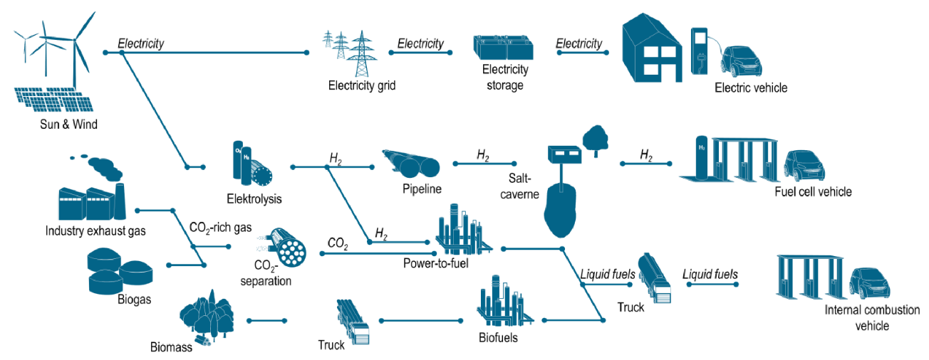
But that figure was decidedly lacking in detail:
Particularly about the all-important source of the system's H2
which all came from a small single building labeled Electrolysis Plant:
Another illustration offered a seemingly more technical & complete diagram: ¹
But it is also vague about the Electrolysis plant, which stands almost alone,
having only ONE familiar input (Sun & Wind Electricity) and ONE benign output (H2)
1) Figures both found in web-posted document: https://www.researchgate.net/publication/316087225_Hydrogen_Economy_for_Arab_Countries
That figure credited as: "Renewable Hydrogen Production, Storage, Transport and Utilization for Transport, Household and Industry. Urban Power Station
© Forschungszen- trum Jülich GmbH"

Slide 7


Despite an absence of detail, the idea seems downright elegant in its simplicity:
In the U.S. we don't build a NEW High Voltage DC (HVDC) Grid
as required to efficiently send electricity
FROM locations best suited for solar & wind farms
TO consumers in far distant population centers:
Instead, we just send Hydrogen gas through our EXISTING
national network of natural gas pipelines:
With the added bonus that, while a HVDC Grid requires a new
network of wires strung between especially tall towers,
3 million miles of underground gas pipelines
already criss-cross the the U.S. (!) ¹
Similarly, over oceans, we might use versions of the tankers
already shipping huge loads of Liquified Natural Gas:
Map of a proposed HVDC Electrical Grid
Map of existing U.S. natural gas network
Top Map: https://infrastructureusa.org/interactive-map-visualizing-the-us-electric-grid/
Reference 1 & bottom map:
U.S. Energy Information Administration (EIA): https://www.eia.gov/energyexplained/natural-gas/natural-gas-pipelines.php

Slide 8
Hydrogen might even solve the huge problem of variable solar & wind energy:
Solar and wind energy, peaking either midday or late afternoon,
won't be able to supply enough electricity in the evenings when we most need it
Meaning that dependence on solar & wind will require massive electrical energy storage
based on mostly untested or undeveloped technologies, including:
Pairs of "Pumped Storage Hydro" lakes (the only tried & well tested idea)
Huge farms of batteries, capacitors, or flywheels
Vast underground tanks/reservoirs of molten salt or compressed air
(see my noteset: Power Cycles and Energy Storage (pptx / pdf / key))
Instead: AT solar & wind power farms their electricity could be used to generate Hydrogen Gas
with its resulting cyclic generation then matched to the different cycles of electricity demand
by temporarily storing that hydrogen in simple high-pressure gas tanks:
Figure: https://aoghs.org/transportation/hortonspheres/

Slide 9


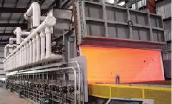
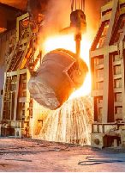



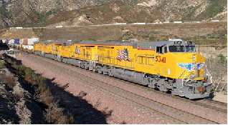

Then, often with only minor modification of existing equipment:
H2 could fuel the myriad burners upon which our homes, businesses & industry depend:
Gas
Electricity
And if enough H2 can be stored onboard, it could also power the combustion engines moving:
An Introduction to Sustainable Energy Systems: WeCanFigureThisOut.org/ENERGY/Energy_home.htm

Slide 10
Reactions:
An Introduction to Sustainable Energy Systems: WeCanFigureThisOut.org/ENERGY/Energy_home.htm

Slide 11
The doubts of Environmental & Scientific Organizations:
The Natural Resources Defense Council:
"A focus on hydrogen must not detract from other strategies and technologies that could produce much larger environmental and energy security benefits in the near term . . . It will take at least two decades before hydrogen can even begin to make a significant contribution to reducing global warming pollution, improving air quality, and reducing U.S. oil dependence" ¹
The Sierra Club
"The fossil fuel industry is hyping hydrogen of all kinds as a low-carbon replacement for all sorts of uses of fossil fuels - from powering vehicles and heavy industry to heating buildings. In reality, many hydrogen projects will only lock us in to continued fossil fuel use and additional investments in fossil fuel infrastructure" ²
Renew Org Australia:
"Hydrogen is an inefficient option to propel a vehicle, compared to using renewable electricity via a battery . . . (Hydrogen) costs 4 to 5 times as much as a petrol equivalent . . . Hydrogen should not be allowed to distract us from the mainstream opportunity, which is wind and solar generation supported by transmission lines and energy storage" ³
The International Renewable Energy Agency:
"Hydrogen will likely trail other strategies such as electrification of end-use sectors, and its use will target specific applications. The need for a dedicated new supply infrastructure may limit hydrogen use to certain countries that decide to follow this strategy. Therefore, hydrogen efforts should not be considered a panacea" ⁴
The American Physical Society (in Physics Today):
"The gap between the present state of the art in hydrogen production, storage, and use and that needed for a competitive hydrogen economy is too wide to bridge in incremental advances. It will take fundamental breakthroughs of the kind that come only from basic research" ⁵
1-5) Full links given on subsequent page

Slide 12
As echoed in recent Business, Popular & Technical Press Headlines:
Why are we still talking about Hydrogen?
Forbes - 6 Feb 2021 ⁶
Clean Energy Superstar or Smokescreen for Fossil Fuel Use?
Washington Post - 17 March 2022 ⁷
Get Tax Right or Clean Hydrogen Will be a Bigger Boondoggle than Biofuels
Washington Post - 27 April 2023 ⁸
Before We Invest Billions in This Clean Fuel, Let’s Make Sure It’s Actually Clean
New York Times - 14 April 2023 ⁹
Green Hydrogen Or Dirty Fuel? . . . Tax Credit Will Determine Industry’s Future
Forbes - 17 April 2023 ¹⁰
Synthetic Gasoline Promises Neutral Emissions - But the Math Doesn't Work
ARS Technica - 5 May 2023 (includes discussion of H2 fuel) ¹¹
E-fuels - How Big a Niche Can They Carve out for Cars?
The Guardian- 5 May 2023 (includes discussion of H2 fuel): ¹²
6-12) Full links given on subsequent page

Slide 13



















Versus the enthusiasm of established Petrochemical & Energy Companies:
As seen in their well-moneyed and sustained promotion of Hydrogen, via organizations such as:
The Hydrogen Fuel Cell Partnership (formerly The California Fuel Cell Partnership) ¹³
The Hydrogen Council ¹⁴
The Clean Hydrogen Future Coalition ¹⁵
The Fuel Cell & Hydrogen Energy Association ¹⁶
Which, on their homepages, proudly post their governing board & member logos including: ¹⁷⁻²⁰
Which is a virtual "Who's Who" of the world's entrenched Petrochemical & Energy Companies
13-20) Full links given on next page

Slide 14
Sources cited in the previous three pages:
First page:
1) https://www.nrdc.org/sites/default/files/hydrogen.pdf
2) https://www.sierraclub.org/articles/2022/01/hydrogen-future-clean-energy-or-false-solution
3) https://renew.org.au/wp-content/uploads/2019/06/HydrogenHelpOrHype02d.pdf
4) https://www.irena.org/-/media/Files/IRENA/Agency/Publication/2019/Sep/IRENA_Hydrogen_2019.pdf
5) https://physicstoday.scitation.org/doi/10.1063/1.1878333
Second page:
6) https://www.forbes.com/sites/jamesmorris/2021/02/06/why-are-we-still-talking-about-hydrogen/?sh=70b10937f044
7) https://www.washingtonpost.com/climate-solutions/2022/03/17/hydrogen-clean-energy-climate-change/
8) https://www.washingtonpost.com/opinions/2023/04/27/clean-hydrogen-tax-credit-stringent-rules/
9) https://www.nytimes.com/2023/04/14/opinion/hydrogen-fuel-tax-credit-climate-change.html?searchResultPosition=2
10) https://www.forbes.com/sites/energyinnovation/2023/04/17/green-hydrogen-or-dirty-fuel-treasury-department-rules-on-45v-tax-credit-will-determine-industrys-future/?sh=6303579ee6a1
11) https://arstechnica.com/cars/2023/05/synthetic-gasoline-promises-neutral-emissions-but-the-math-doesnt-work/
12) https://www.theguardian.com/business/2023/may/05/e-fuels-cars-aviation
Third page:
13) https://h2fcp.org/ 14) https://hydrogencouncil.com/en/ 15) https://cleanh2.org/ 16) https://www.fchea.org/
17) https://h2fcp.org/members 18) https://hydrogencouncil.com/en/members/ 19) https://cleanh2.org/ 20) https://www.fchea.org/members
PLEASE ALSO NOTE: As with all of my notesets, on a companion "Resources" webpage (link), I list the sources I studied while writing that noteset (as text citations, web links, and where not "paywalled," as cached copies), as well a certain critical figures and videos
(~120 such sources are already listed on this noteset's Resources webpage)

Slide 15
What explains the enthusiasm of well-established Petrochemical & Energy Companies?
What explains the contrasting negativity of not only Environmental & Scientific Groups
but also that of the Business, Popular & Technical Press?
To understand those reactions, we must first dig more deeply into:
Today's Not So Simple Hydrogen
An Introduction to Sustainable Energy Systems: WeCanFigureThisOut.org/ENERGY/Energy_home.htm

Slide 16
From where do we NOW get Hydrogen Gas?
Do we get it from natural sources?
After all, Hydrogen atoms are the most abundant atoms in the universe
And while Hydrogen atoms account for only about 0.14% of the Earth's crust,
a large fraction of those atoms reside in vast and readily-available bodies of water ¹
Leading one to also expect readily-available natural terrestrial sources of Hydrogen Gas
And, in fact, there ARE natural sources of H2 - mostly based upon extreme high temperature
interaction of stone & water within the earth's crust & at sub-ocean hydrothermal vents ²
Such naturally occurring H2 has been labeled White Hydrogen
About which, in 2021, the "world's first" conference was held, labeling it The New Frontier ³
But beyond that label, and that conference, I found essentially zero information about its use
Why? Because the H atoms of H2 rebond so easlily to OTHER atoms (such as C & O) that
natural H2 is incorporated into other compounds long before it can ever accumulate!
1) https://www.britannica.com/science/hydrogen
2) https://en.wikipedia.org/wiki/Natural_hydrogen
3) https://geoscientist.online/sections/unearthed/natural-hydrogen-the-new-frontier/

Slide 17
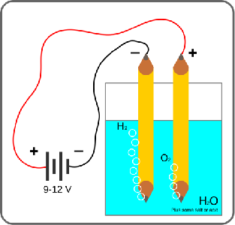
So instead of Getting H2 Gas we must now Produce H2 Gas
The technique suggested in the earlier "Vision" figures is Electrolysis:
H2 or Biofueled Aircraft
Green Grid Energy Sources
H2 Fueled Backup Power Plant
Electrolysis Plant
H2 Pipelines
Biofuel Refueling Station
H2 Refueling Station
Biofuel Refinery
H2 Storage
Electrolysis applies electricity to two metal electrodes immersed water:
The negatively charged "Cathode" injects electrons into the water, liberating H2 + OH⁻ ions:
2 H2O (liquid) + 2 e⁻ → H2 (gas) + 2 OH⁻ (in water)
The positively charged "Anode" takes electrons from the OH⁻ ions, liberating O2 + water:
2 OH⁻ (in water) → 1/2 O2 (gas) + H2O (liquid) + 2 e⁻
Yielding an overall H2 + O2 Gas Production Reaction:
2 H2O (liquid) + Electrical Energy Input → 2 H2 (gas) + O2 (gas)
Left figure: Enlarged captions added to: https://www.researchgate.net/publication/316087225_Hydrogen_Economy_for_Arab_Countries
Right figure: https://en.wikipedia.org/wiki/Electrolysis_of_water

Slide 18
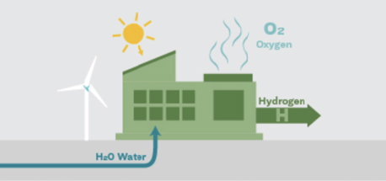
Characteristics of today's "Electrolytic" production of Hydrogen Gas
Drawing from sources including International Energy Agency (IEA) ¹ reports ^{2, 3}
And International Renewable Energy Agency (IRENA) ⁴ reports ^{5, 6}
- Today's Electrolysis electrodes require exotic materials such as Platinum, Titanium and Gold ⁷⁻⁹
- Latent energy content of H2 fuel produced vs. the Electrical Energy needed to produce it:
For Electrolysis: H2 Energy Output / Electrical Energy Input = 64 - 68% ⁶
- Only 4% of world H2 gas is now produced using Electrolysis ^{5, 6, 10}
Only 0.03% of world H2 gas is now produced by Electrolysis using Renewable Electricity ¹¹
(i.e., Electricity derived from Wind, Solar, Hydro, Biomass AND Nuclear)
ONLY THAT 0.03% of today's worldwide H2 gas qualifies as Green Hydrogen
12

Slide 19
Sources cited on the previous page:
International Energy Agency (IEA:
1) https://www.iea.org/
2) https://www.iea.org/reports/the-future-of-hydrogen
3) https://www.iea.org/reports/global-hydrogen-review-2021
International Renewal Energy Agency (IRENA):
4 ) https://www.irena.org/
5) https://www.irena.org/Energy-Transition/Technology/Hydrogen
6) Page 20 in: https://www.irena.org/Publications/2018/Sep/Hydrogen-from-renewable-power
Addition Information about Electrolysis of Water:
7) https://en.wikipedia.org/wiki/Electrolysis_of_water
8) https://en.wikipedia.org/wiki/Alkaline_water_electrolysis 9) https://en.wikipedia.org/wiki/Proton_exchange_membrane_electrolysis
10) https://en.wikipedia.org/wiki/Electrolysis_of_water
11) Page 109 in: https://www.iea.org/reports/global-hydrogen-review-2021
Figure (from the Sierra Club):
12) https://www.sierraclub.org/articles/2022/01/hydrogen-future-clean-energy-or-false-solution

Slide 20
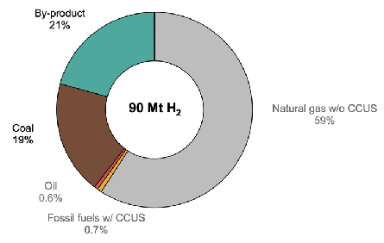
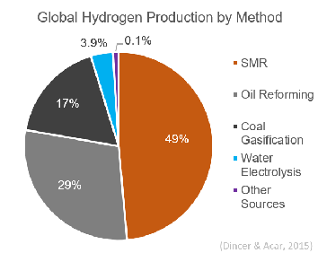
Then from where does the remaining 96% of today's Hydrogen Gas come?
Consistent breakdowns are surprisingly hard to find:
IRENA's "Overview" states: "almost 47% of the global hydrogen production is from natural gas, 27% from coal, 22% from oil (as by-product) and only around 4% comes from electrolysis" ¹
Vs. figure from a 2020 International Energy Agency (IEA) report, at left ²
Vs. figure from Wikipedia ³ citing publication locked behind publisher's (Elsevier) paywall, at right ⁴
  IRENA: IEA: Wikipedia: Range:
Natural Gas SMR * 47% 59.7% 49% 47 - 59.7%
Coal * 27% 19% 17% 17 - 27%
Oil Byproduct * 22% 21% 29% 22 - 29%
Electrolysis # ~ 4% (~ 0%) 3.9% ~ 0 - 4%
* Virtually ALL w/o carbon capture # Virtually ALL now using non-renewable Electricity
1) https://www.irena.org/Energy-Transition/Technology/Hydrogen 2) Page 108 in: https://www.iea.org/reports/global-hydrogen-review-2021
3) https://en.wikipedia.org/wiki/Steam_reforming - citing as its source: 4) https://www.sciencedirect.com/science/article/abs/pii/S0360319914034119

Slide 21
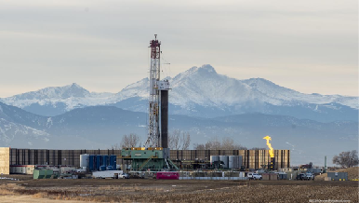
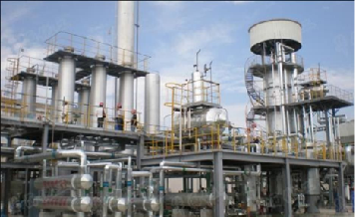
Steam Methane Reforming (SMR): ~ 50-60% of today's worldwide Hydrogen Gas
Though a U.S. DOE source states that it accounts for 95% of the United States' H2 gas ^{1, 2}
The Methane source? Gas wells, often injecting high-pressure fracking chemicals,
  and sometimes burning off ("flaring") unwanted gas at the well site (as seen in left photo):
Steam Methane Reforming (SMR) plants (right photo) exploit two chemical reactions: ³
One "reforming" methane: CH4 + H2O + (206 kJ / mol) ↔ CO + 3 H2
A second "reforming" the CO byproduct: CO + H2O ↔ CO2 + H2 + (41 kJ / mol)
Yielding the net reaction: CH4 + 2 H2O + (165 kJ / mol) ↔ CO2 + 4 H2
Inputs: Heat (1100 ºC) CH4 H2O Outputs: CO2 4 H2
Energy balance? Approximate values in kJ/mol: ⁴ CH4 (890) + Heat (165) = 1055 → 4 x H2 (286) = 1144 SMR strips oxygen from H2O to "burn" CH4's carbon, thereby liberating H2 from both CH4 & H2O
1) Published paper now locked behind an American Chemical Society paywall: https://pubs.acs.org/doi/pdf/10.1021/acs.est.8b06197
2) https://www.osti.gov/pages/biblio/1546962 3) https://en.wikipedia.org/wiki/Steam_reforming 4) https://en.wikipedia.org/wiki/Heat_of_combustion
Left Figure: https://www.bizjournals.com/denver/news/2020/10/29/colorado-oil-natural-gas-flaring-emissions-cogcc.html
Right Figure: https://www.hydrogenproduction-plant.com/sale-12437032-steam-methane-reforming-hydrogen-generation-plant-purity-up-to-99-999-v-v.html

Slide 22
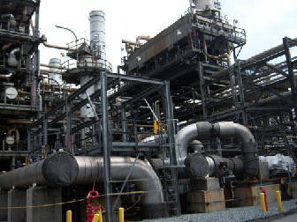
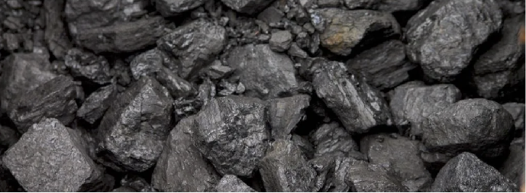

Coal Gasification: ~ 20-30% of today's worldwide Hydrogen Gas
Gasification Plants (photo at left) use different types of coal, often grouped and labled as:
Black Coal, including bituminous, sub-bituminous & anthracite varieties (center)
OR Brown Coal, the lower grade lignite variety derived from decayed peat (right) ^{2, 3}
Black Hydrogen is produced from Black Coals (which are richer in C), via the reactions ¹
3 C (in that coal) + O2 + H2O (steam) + (intense energy) ↔ H2 + 3 CO
with that CO byproduct (again) processed to yield additional H2 via:
CO + H2O (steam) ↔ CO2 + H2 + (41 kJ / mol)
Brown Hydrogen is produced from Brown Coal (poorer in C, but richer in H2O) that can instead
be produced by slightly altered reactions from which added steam is omitted
1) https://en.wikipedia.org/wiki/Coal_gasification
Left & Center Figures: https://bettermeetsreality.com/brown-coal-vs-black-coal-comparison-differences-emissions-more/
Right Figure: https://www.phxequip.com/plant.107/coke-and-coal-gasification-plant-2-200-tpd.aspx

Slide 23
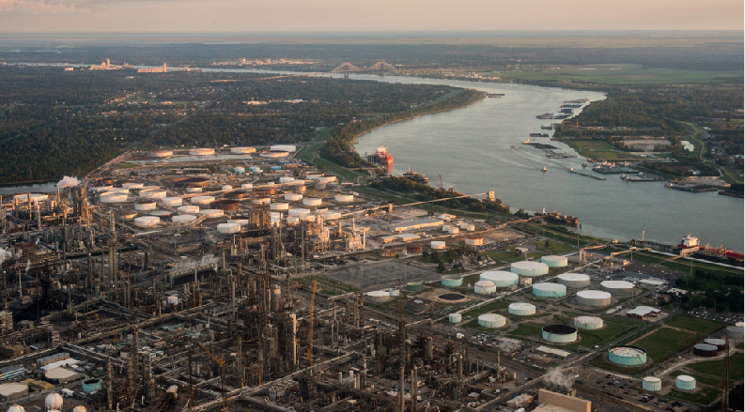
Liquid Petroleum Refining: ~ 20-30% of today's worldwide Hydrogen Gas
That refining, parts of which are also called Catalytic Reforming, ¹
occurs in the huge worldwide complex of oil refineries ² that feed our fossil-fuel economies:
But despite the substantial quantity of H2 generated in such refineries,
Hydrogen Gas is a mere byproduct of processes actually focused on the much more massive production of liquid fossil-fuels & chemicals
1) https://en.wikipedia.org/wiki/Catalytic_reforming 2) https://en.wikipedia.org/wiki/Oil_refinery
Photo source: https://creakhousenews.blogspot.com/2020/04/inside-louisianas-horrifying-cancer.html

Slide 24
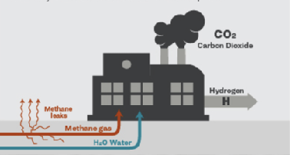
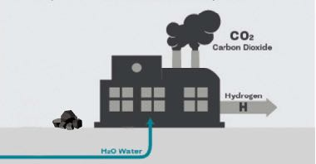
Summarizing the answer to: "From where do we now get Hydrogen Gas?"
50-60% Steam Methane Reforming
Using: CH4 + H2O → CO2 + H2
Gray Hydrogen
20-30% Coal Gasification:
Using: Coal + O2 + H2O → CO2 + H2
Brown or Black Hydrogen
20-30% Oil Refining:
Using many GHG-emitting reactions
Grayish Hydrogen
Recurring theme in all three H2 production processes:
C bonds to O that was stripped from H2O → GHG CO2 + H2 / H2
Echoing the process of fossil-fuel burning:
C bonds to O that was stripped from O2 → GHG CO2
Making all three of the H2 processes (~ 96% of today's H2) contributors to global warming
Left Figure: https://www.sierraclub.org/articles/2022/01/hydrogen-future-clean-energy-or-false-solution
Center Figure: My altered version of Left Figure Right Figure: http://clipart-library.com/refinery-cliparts.html

Slide 25

But Gray Hydrogen's dependence on Methane has an additional hidden impact:
Natural Gas's ~ 75% Methane is a much more potent Greenhouse Gas than CO2 (~ 25-30X)
Which is WHY wells sometimes burn off their excess NG, converting it into less harmful CO2
But Natural Gas infrastructure is massively & pervasively LEAKY
as noted at the left of the Sierra Club's Gray Hydrogen illustration:
According to the U.S. Energy Information Administration (EIA): "Oil and gas operations worldwide emitted just over 70 Mt of methane into the atmosphere in 2020. Converted into equivalent amounts of CO2 . . . these methane emissions are comparable to the total energy- related emissions of the European Union" ¹
As documented in this excellent TV news report
originating in West Texas Oil Country (click): ²
1) https://www.iea.org/reports/methane-tracker-2021 2) https://www.youtube.com/watch?v=DE1Jvc6U5gI

Slide 26
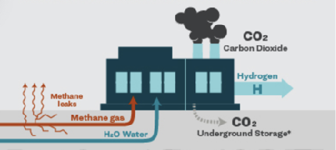
"But what about Blue Hydrogen?"
Blue Hydrogen = Gray Hydrogen + Carbon Capture, Utilization & Storage (CCUS)
But according to a 2019 report from the International Renewal Energy Agency (IRENA): ¹
"Overall, less than 0.7% of current hydrogen production
is from renewables or from fossil fuel plants equipped with CCUS" ²
Meaning that Blue Hydrogen plays almost ZERO role in TODAY's hydrogen production
Making Blue Hydrogen irrelevant to the my first question:
From where do we NOW get Hydrogen Gas?
Bringing us to my second question:
1) https://www.irena.org
2) The Future of Hydrogen - IRENA 2019: https://www.iea.org/reports/the-future-of-hydrogen
Figure: https://www.sierraclub.org/articles/2022/01/hydrogen-future-clean-energy-or-false-solution

Slide 27
How do we now USE Hydrogen Gas?
One International Energy Administration (IEA) report broke down 2019 world use of H2 as: ¹
33% for oil refining
27% for production of ammonia
11% for production of methanol
3% for chemical reduction of the iron ore used in steel production
But the uses of the remaining 26% were not enumerated
Another IEA report put 2021 world H2 production at ~ 97 Mega tonnes (Mt), ²
Its breakdown of major uses was similar to the 2019 report, but it went on to note that:
H2 use in road transportation had increased 60% over the preceding year,
including a 60X (!) increase in heavy-duty hydrogen-powered trucks
But that still brought net use in transportation to only 30 kilo tons → 0.03% ³
Similarly underwhelming was H2 use in buildings and electrical power generation,
both of which were quickly dismissed using the same word: "negligible" ^{4, 5}
1) Page 89 in: https://www.iea.org/reports/the-future-of-hydrogen
2) Page 18 in: https://www.iea.org/reports/global-hydrogen-review-2022 3) Ibid., page 40 4) Ibid., page 57 5) Ibid., page 64

Slide 28
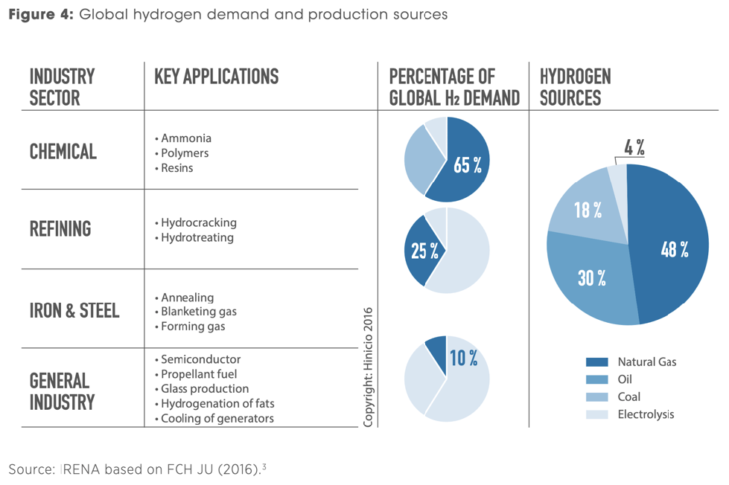
To more concisely answer the same question, IRENA offered this figure:
From the IRENA report "Hydrogen from Renewable Power:" ¹
Which, using rounded numbers, is entirely consistent with the preceding page's IEA factoids
1) https://www.irena.org/publications/2018/Sep/Hydrogen-from-renewable-power

Slide 29
Meaning that right NOW Hydrogen has virtually ZERO impact on ANY of these:
But in the discussion of Hydrogen Economy Vision(s)
THESE were identified as the PRIME TARGETS for H2 supplanting Fossil Fuels
Meaning that:
Far from being based upon an already tried, tested and now readily scalable fuel,
a "Hydrogen Economy" is still very much ONLY a Vision
(i.e., an extrapolation based upon only severely limited experience or proven technology)
(What software engineers sometimes label vaporware)
An Introduction to Sustainable Energy Systems: WeCanFigureThisOut.org/ENERGY/Energy_home.htm

Slide 30
USING what we've learned about Today's Hydrogen to help define viable possibilities for
Tomorrow's Hydrogen
An Introduction to Sustainable Energy Systems: WeCanFigureThisOut.org/ENERGY/Energy_home.htm

Slide 31
Perhaps the KEY thing we have learned:
Mother Nature put energy into Fossil Fuels allowing us to now use them as ENERGY SOURCES
But WE must put energy into creating H2 Gas making it instead an ENERGY STORAGE MEDIUM
Which makes Hydrogen's direct competition NOT Fossil Fuels
but instead OTHER Energy Storage Media - most particularly: BATTERIES
Further, while full use of Energy Sources requires only ONE process - For Fossil Fuels:
Energy Release during Consumption via Combustion:
CX + O2 → CO2 + Energyoutput + Byproducts (made up of C + O + constituents of X)
Full use of Energy Storage Media involves TWO linked processes - In one Hydrogen scenario:
Energy Investment during Synthesis via SMR:
2 HX + Y + Energyinput → H2 + Byproducts (made up H + constituents of X & Y)
Energy Return during Consumption via Combustion:
H2 + 1/2 O2 → H2O + Energyoutput where Energyoutput < Energyinput (often MUCH less)
An Introduction to Sustainable Energy Systems: WeCanFigureThisOut.org/ENERGY/Energy_home.htm

Slide 32
Those distinctions mean that:
While an ENERGY SOURCE's key figure of merit is Energyoutput
An ENERGY STORAGE MEDIUM's key figure of merit is Energyefficiency = Energyoutput / Energyinput
Also very important are its: Energy Density per Mass and Energy Density per Volume
Because high Energy Density per Volume makes it much more effective in these:
And because high Energy Density per Mass is absolutely IMPERATIVE in these:
An Introduction to Sustainable Energy Systems: WeCanFigureThisOut.org/ENERGY/Energy_home.htm

Slide 33
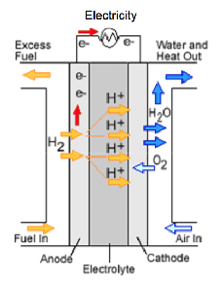
Which Process Pairings would optimize H2 as an Energy Storage Medium?
Here Environmentalist & Petrochemical / Energy Industry Vision(s) begin to radically diverge
vs.
The Climate Driven Choice is to focus strongly on the use of:
1) Electrolysis powered by Green Electricity to produce Green Hydrogen which, we learned earlier, uses exotic materials such as Platinum, Titanium and Gold
Yielding: H2 Energyout / Electrical Energyin = 64 - 68% ~ 66% ¹
2) Fuel Cells consuming that Green Hydrogen to return Green Electricity
These based on similar but reversed electrochemical reactions
Yielding: Electrical Energyout / H2 Energyin of = 40 - 60% ~ 50% ^{2, 3}
Combined they yield a Cumulative Energy Efficiency of (64-68%) x (40-60%):
"Round Trip" Electrolysis to Fuel Cell Energy Efficiency
Electricityout / Electricityin = 26 - 41% ~ 33%
Electricity →
→ Electricity
1) Page 20 in: https://www.irena.org/Publications/2018/Sep/Hydrogen-from-renewable-power 2) https://en.wikipedia.org/wiki/Fuel_cell 3) https://www.energy.gov/sites/prod/files/2016/06/f32/fcto_fuel_cells_comparison_chart_apr2016.pdf

Slide 34

But for storing electricity, Li Batteries are much more energy efficient:
Li Batteries use a SINGLE TECHNOLOGY (running first one way and then the other) to produce:
"Round Trip" Battery in / Battery out Energy Efficiency
Electricityout / Electricityin = 83 - 93% ~ 88% ¹⁻³
Electricity →
→ Electricity
Making the paring of Electrolysis & Fuel Cells only ~ 44% as energy efficient as Batteries alone
Then, in electric cars ~ 75% of Electricity Storage Medium's Energy is delivered to the vehicle's wheels: ⁴
Battery Electric Vehicle: Electricity Energyin / Wheel Energyout: (75%)(88%) ~ 66%
Electrolysis / Fuel Cell Vehicle: Electricity Energyin / Wheel Energyout: (75%)(33%) ~ 25%
What if Electrolytic H2 were instead burned in a car's internal combustion (IC) engine?
Taking into account that earlier Electrolytic synthesis of H2 was only ~ 66% energy efficient
But assuming Internal Combustion engines burn Fossil Fuels or H2 with same energy efficiency,
then deliver energy thru transmission & drivetrain to wheels with same 13-20% efficiency: ⁴
Fossil Fueled IC Vehicle: Wheel Energyout / Fuel Energyin ~ 13-20%
Electrolytic H2 fueled IC Vehicle: Wheel Energyout / Electricity Energyin = (66%)(13-20%) ~ 7-13%
1) https://atb.nrel.gov/electricity/2022/commercial_battery_storage 2) https://en.wikipedia.org/wiki/Comparison_of_commercial_battery_types
3) https://www.irena.org/-/media/Files/IRENA/Agency/Events/2017/Mar/15/2017_Kairies_Battery_Cost_and_Performance_01.pdf
4) For a more comprehensive discussion, see my noteset: Green(er) Cars & Trucks (pptx / pdf / key)

Slide 35
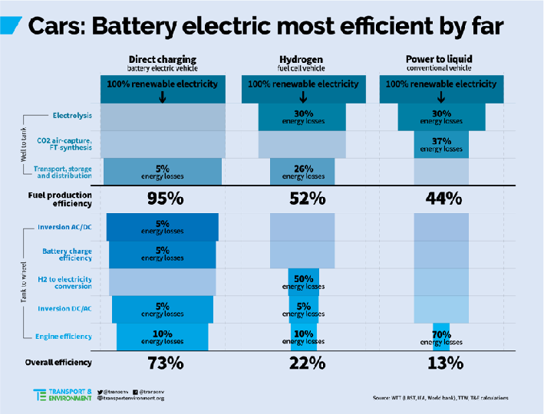
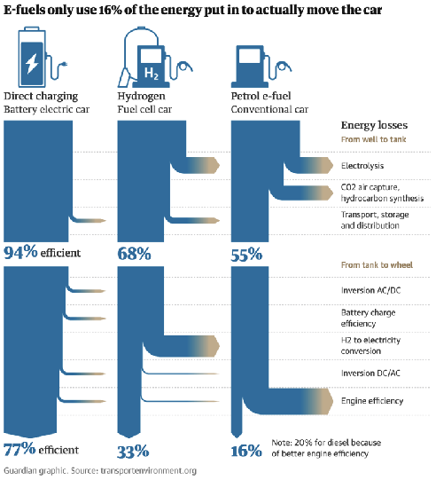
A variety of reports, drawing on other data sources, reach near identical conclusions:
Including even more damning numbers for synthetic fuel / "e-fuel" vehicles (at right of their figures):
From a 2020 CleanTechnica article ¹ From a 2023 Guardian article ²
Plus a 2021 report in the business publication Forbes (cited early in this noteset) estimating:
73% for Battery Electric Vehicles (BEVs) vs. 23% for Fuel Cell Electric Vehicles (FCEVs) ³
(My BEV result was smaller because I used studies giving 83-93% Battery Round Trip Energy Efficiency vs. the 95 & 94% above)
1) https://cleantechnica.com/2020/06/10/this-stunning-chart-shows-why-battery-electric-vehicles-win/
2) https://www.theguardian.com/business/2023/may/05/e-fuels-cars-aviation
3) https://www.forbes.com/sites/jamesmorris/2021/02/06/why-are-we-still-talking-about-hydrogen/?sh=620907267f04

Slide 36

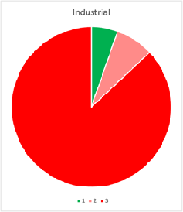



But ANY FORM of complete Electrification will require VASTLY more Electricity:
These charts (with areas scaled in proportion to energies represented) depict: ^{1, 2}
2021 U.S. Electrical Energy Supply (Pink = GHG-linked / Green = Non-GHG linked)
2021 U.S. Total Energy Consumption by category (Red = GHG-linked Non-Electrical)
Transportation
Industrial
Electrical Energy
Residential
7.88 QW-h
Commercial
3.78 QW-h
7.59 QW-h
3.39 QW-h
2.67 QW-h
From which, in my noteset U.S. Energy Production and Consumption, I calculated that: ¹
Eliminating GHG-Electricity ALONE would require 2.5X more Green Electricity
Also eliminating other GHG-linked Energy Consumption would require 7-12X Green Electricity!
1) U.S. Energy Production and Consumption (pptx / pdf / key) 2) Q = Quadrillion = 10¹⁵ = 1,000,000,000,000,000

Slide 37
To stimulate such a VAST expansion of U.S. clean Electrical Power Capacity . . .
A Biden Administration-proposed, Congressionally-approved, but not yet implemented
45V Tax Plan LINKS H2 R&D and infrastructure tax credits to three requirements:
1) Hydrogen plants must be powered by NEW clean electrical power plants (wind, solar, hydro . . .)
2) Hydrogen plants must be located close to those NEW clean electricity plants
Eliminating need for long-distance High Voltage DC electrical transmission lines
3) Hydrogen plant output must follow the natural generation cycles of the coupled electricity plants
E.G., if coupled to only new local solar + wind power plants, Electrolytic H2 production
would typically ramp up with the rising sun, and fall with the diminishing evening winds
This 45V Tax Plan, implemented WITH those requirements stimulated these earlier headlines:
"Get Tax Right or Clean Hydrogen will be a Bigger Boondoggle than Biofuels" - Washington Post ⁷
"Before We Invest Billions in this Clean Fuel, Let’s Make Sure It’s Actually Clean" - New York Times ⁸
"Green Hydrogen Or Dirty Fuel? . . . Tax Credit Will Determine Industry’s Future" - Forbes ⁹
7) https://www.washingtonpost.com/opinions/2023/04/27/clean-hydrogen-tax-credit-stringent-rules/
8) https://www.nytimes.com/2023/04/14/opinion/hydrogen-fuel-tax-credit-climate-change.html?searchResultPosition=2
9) https://www.forbes.com/sites/energyinnovation/2023/04/17/green-hydro...s-on-45v-tax-credit-will-determine-industrys-future/?sh=34ced0ffd226

Slide 38
WITH those requirements, few if any existing U.S. H2 plants could qualify
Not 50-60% using Steam Methane Reforming
Not 20-30% using Coal Gasification:
Not 20-30% using Oil Refining:
The strongest candidates for a share of the multi-billion-dollar 45V Tax Plan credits are instead:
The ~ 1% of plants now using H2 Electrolysis powered by green electricity
The ~ 3% of plants now using H2 Electrolysis powered by NON-green electricity
Though both could qualify ONLY if their existing or new green electricity suppliers were local
Which has led to massive Petrochemical / Energy Industry pushback & lobbying
Up to and apparently including the formation of the aforementioned Clean Hydrogen Future Council
Which was founded in 2021, exactly as the 45V Tax Plan was being formulated
Unlike the Hydrogen Fuel Cell Partnership, Hydrogen Council & Fuel Cell and Hydrogen Energy Assoc.
which have all released lengthy Vision or Roadmap statements:
The Clean Hydrogen Future Coalition (CHFC) has published only a short position statement
entirely concerned with ways in which all three 45V Tax Plan eligibility requirements
could be relaxed to benefit the remaining 96% of existing GHG-linked H2 suppliers ¹
1) https://cleanh2.org/wp-content/uploads/CHFC-Position-Statement-on-use-of-RECs-for-45V-Implementation-April-2023.pdf

Slide 39
Brushing aside the GHFC's tax-lobbying, what ELSE is industry arguing for?
vs.
Their visions of a Hydrogen Economy are NOT based on green-electricity-driven Electrolytic H2 They instead envisage continued reliance on Steam Methane Reforming which,
it must be acknowledged, DOES NOT require VAST Green-Electricity expansion
But rather than just maintaining "business as usual," under which existing SMR plants
would continue to release massive amounts of Greenhouse Gas CO2,
they foresee a shift from Gray Hydrogen SMR plants to Blue Hydrogen SMR Plants
Which differ only in adding Carbon Capture, Utilization and Sequestration (CCUS)
(or as it was promoted in the last decade's arguments for coal-powered electricity, just CCS)
An Introduction to Sustainable Energy Systems: WeCanFigureThisOut.org/ENERGY/Energy_home.htm

Slide 40
A three page review of why Carbon Capture is desirable: ¹
Our garden greenhouses become warmer because,
while their glass ceilings pass sunlight of all visible colors,
inside those greenhouses that absorbed visible light (VIS) begins to warm things
causing them to emit increasing amounts of invisible infrared light (IR)
most of which CANNOT pass back through glass and is thus trapped inside
CO2 and CH4 are labeled Greenhouse Gases (GHG's) because in our atmosphere
they mimic greenhouse glass by interacting / interfering very little with visible light's passage
while absorbing infrared light trying to come back up from the ground
And even if they DO re-emit that IR, much of it is sent Back down to the ground:
Sunlight
IR Radiation from Earth
Earth
1) For a more complete discussion, see my noteset: Greenhouse Effect, Carbon Footprint & Sequestration (pptx / pdf / key)

Slide 41
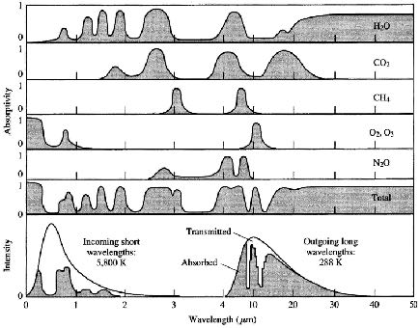
So to be a Greenhouse Gas, that gas must strongly absorb / emit Infrared Light
Perhaps surprisingly, the DOMINANT GHG in the Earth's atmosphere is WATER VAPOR
It is water vapor's GHG action that kept our planet from becoming a frozen (Mars-like) rock,
letting it instead climb to temperatures hospitable to living organisms such as ourselves
Adding a new gas that absorbs / emits SIMILAR infrared colors makes very little difference
because its added effect is swamped by water vapor's already much stronger effect
But adding a new gas that absorbs / emits DIFFERENT infrared colors makes a lot of difference
because it is as if the slight cooling effect of a previously open small greenhouse window
is suddenly lost after that small window is closed, heating the Greenhouse even further
Which is why my more COMPLETE examination of
the Greenhouse Effect quickly devolved into a complex examination of gases' absorption in both the infrared and solar visible light ranges: ¹
CO2 and CH4 are among the WORST ACTORS at closing down our atmosphere's windows!
1) For a more complete discussion, see my noteset: Greenhouse Effect, Carbon Footprint & Sequestration (pptx / pdf / key)

Slide 42
CO2 & CH4 concentrations are thus extremely important - but so is their persistence:
By this I mean how long (on average) a Greenhouse Gas molecule stays in the atmosphere
before being converted into something else (which may or may not also be a GHG)
or removed from the atmosphere (by photosynthesizing plants, absorbing oceans, etc.)
To reverse Global Warming we must not only STOP ADDING new GHG's to the atmosphere
Which is the goal of so-called Net Zero / Carbon Neutrality initiatives ¹
We must also lower EXISTING record-breaking GHG levels
But while inventors now dream of our pulling GHGs right out of the atmosphere,
a practical, literally worldwide process is still far, far beyond our reach
So we must WAIT for natural processes to pull today's GHGs out of the atmosphere,
and while we are waiting, sequester (i.e., hold) any newly manufactured GHG's
And how LONG must we wait while sequestering any new GHG's?
For about as long as today's GHG's persist
Here CO2 is again one of the worst actors, persisting for CENTURIES ²
1) https://en.wikipedia.org/wiki/Carbon_neutrality
2) See for example the EPA's Overview of Greenhouse Gases: :https://www.epa.gov/ghgemissions/overview-greenhouse-gases

Slide 43

So we must not only CAPTURE but then HOLD any new GHG's for CENTURIES
In the twenty-teens supporters of coal-powered electrical power insisted that
coal's atmospheric damage could be eliminated by Carbon Capture & Sequestration (CCS),
to be accomplished by pumping the CO2 down into abandoned gas and oil wells
For which there turned out to be (at least) three major problems:
1) Analyses indicating CCS would add at least 50% to the cost of coal-based electricity which was already the most expensive large source of U.S. electrical power ¹
2) The resulting fact that virtually no one would build a full-scale CCS-equipped coal plant 3) Skepticism that "Pumping CO2 down a hole and then walking away"
could actually work for the centuries required to curtail global warming
Skepticism was fueled by the petrochemical industry's long history of gas and oil leaks
ESPECIALLY from abandoned / disused wells
As graphically described in the earlier video:
Skepticism was then validated by the petrochemical industry's 2015-2016 demonstration:
1) See my noteset: Power Plant Economics: Analysis Techniques & Data (pptx / pdf / key)

Slide 44

The massive 111 day leak from the Porter Ranch / Aliso Canyon Natural Gas storage plant:
Timeline and public impacts as reported by television station KCAL 9 - CBS LA (click to play): ¹
1) https://www.youtube.com/watch?v=EdGIpKi-A_E
An Introduction to Sustainable Energy Systems: WeCanFigureThisOut.org/ENERGY/Energy_home.htm

Slide 45
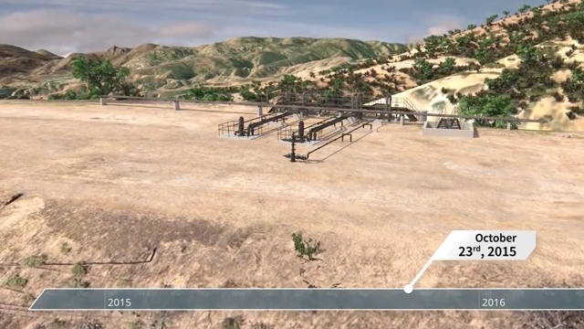
The long list of NG storage plant flaws cited in the official California report:
From a Root Cause Analysis ordered by the California Public Utilities Commission (CPUC) and
Department of Conservation’s Division of Oil, Gas & Geothermal Resources (DOGGR): ^{1, 2}
1) CPUC & DOGGR announcement of Root Cause Analysis to be performed by Blade Energy Partners:
https://docs.cpuc.ca.gov/PublishedDocs/Published/G000/M292/K947/292947433.PDF
2) Video summary of that study released by Blade Energy Partners: https://www.youtube.com/watch?v=Z3D1DvqBcgU

Slide 46
A decade later, CCUS is now proposed to clean up SMR production of H2
CCUS adds a "U" to CCS yielding: Carbon Capture, Utilization and Sequestration
This rebranding is an obvious effort to distance such proposals from earlier failures
Nevertheless, addition of "Utilization" could have major real world significance:
Gas molecules are really good at slithering out of even well-built containers ¹
Holes in the dirt are NOT well-built containers & over centuries they're miserable containers ²
But IF "Utilization" converts CO2 gas into stable weather-resistant solids, CCUS might just work
Do proposed CCUS techniques include viable means of stably solidifying carbon?
If yes: Can use of those CCUS techs grow fast enough to blunt climate change?
For answers, I first identified nominally unbiased reports about projected CCUS capabilities:
As offered by Wikipedia, ³ two International Energy Agency (IEA) reports, ^{4, 5}
a McKinsey & Co. study ⁶ and the U.S. Government Accountability Office (GAO) ⁷
Which then needed to be measured against data on the levels of human GHG generation:
As provided by both the International Energy Agency (IEA) ⁸ and OurWorldinData.org ⁹
1) Speaking from an entire scientific career spent managing gases 2) Speaking from a childhood spent above the San Andreas Fault
3) https://en.wikipedia.org/wiki/Carbon_capture_and_utilization 4) https://www.iea.org/reports/about-ccus
5) https://www.iea.org/reports/carbon-capture-utilisation-and-storage-2
6) https://www.mckinsey.com/industries/oil-and-gas/our-insights/scaling-the-ccus-industry-to-achieve-net-zero-emissions
7) https://www.gao.gov/products/gao-22-105274 8) https://www.iea.org/reports/co2-emissions-in-2022 9) https://ourworldindata.org/co2-emissions

Slide 47
I was immediately struck by those source's lack of interest in Sequestration
Particularly in the Wikipeida write-up (which even omitted "Sequestration" from its title), ³
but also in the two International Energy Agency papers ^{4, 5}
Their strong focus was instead on resource & economic opportunities offered by CCU (w/o the S)
Specifically, CCU was seen as a potential source of carbon fuels and feedstocks
that would sidestep the need for new fossil-fuel sources
Which would be done by recycling the CO2 combustion product of past Fossil Fuel burning
back into new carbon, available for new fuels and new feedstocks
This would address concerns that we are in danger of running out of new Fossil Fuels
and/or (at least eventually) might even become a cheaper way of acquiring new carbon
But Wikipedia placed no emphasis on the CCU applications offering longer-lived Utilization
Further, it argued (with minimal support) that CCU could produce lower GHG emissions
than today's direct petrochemical synthesis of Fossil fuels and feedstocks
Despite noting that breaking captured CO2 back apart into usable carbon will require
intense energy input - which (today) implies comparably large additional GHG releases
3) https://en.wikipedia.org/wiki/Carbon_capture_and_utilization
4) https://www.iea.org/reports/about-ccus 5) https://www.iea.org/reports/carbon-capture-utilisation-and-storage-2

Slide 48
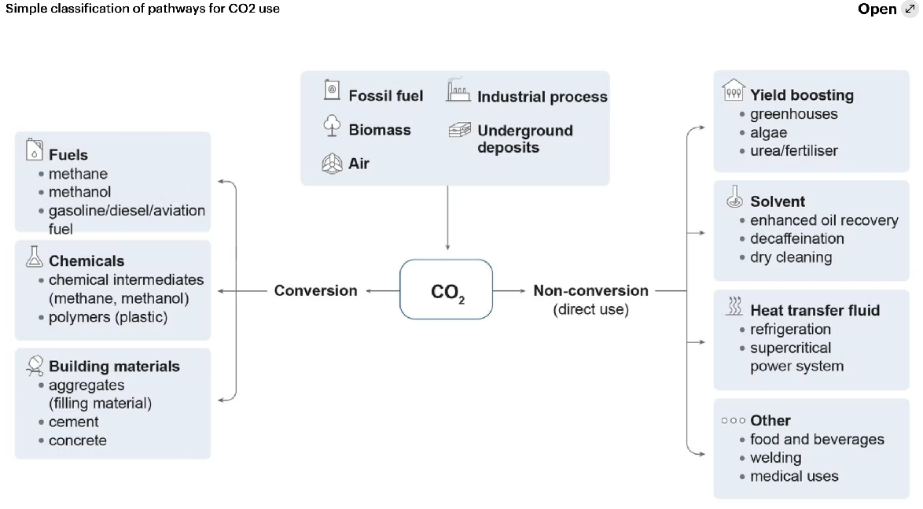
The IEA described Capture & Utilization in even greater detail ^{4, 5}
Using this summary figure in one report (with a title downgrading "Utilization" into mere "Use"): ⁴
But outdoing Wikipedia, these two IEA reports did not even mention which of these uses
would delay GHG atmospheric re-emission for the longest periods of time!
4) https://www.iea.org/reports/about-ccus 5) https://www.iea.org/reports/carbon-capture-utilisation-and-storage-2

Slide 49
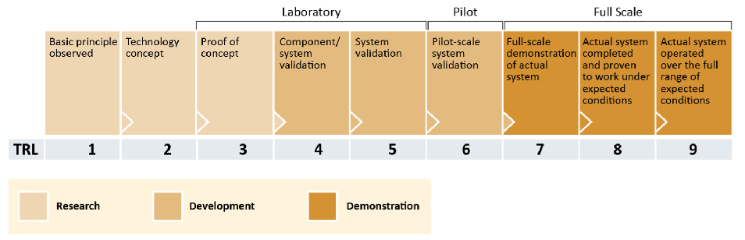
ONLY the GAO confronted the need to Utilize or Sequester carbon for CENTURIES
After listing possible roles for CCUS, the GAO immediately responded with the statement: ⁷
"In all of these roles for CCUS, the amount of CO2 reduced or removed will depend on what happens to the captured CO2. Geologic storage is generally considered permanent (millions of years), as is conversion into certain products, such as concrete.
Other CO2 utilization products only retain CO2 for amounts of time that may be short (days to years) or moderate (decades to centuries), after which the CO2 is released to the atmosphere"
For CCUS techniques, the GAO then defined a scale of Technology Readiness Level (TRL):
7) https://www.gao.gov/products/gao-22-105274

Slide 50
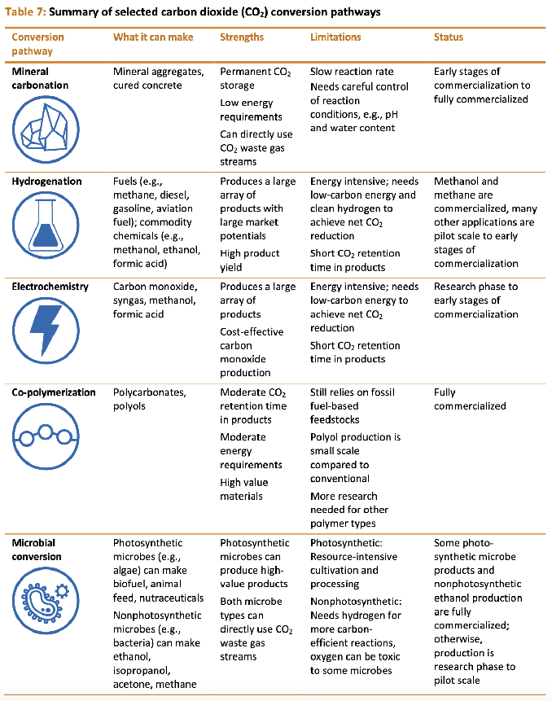
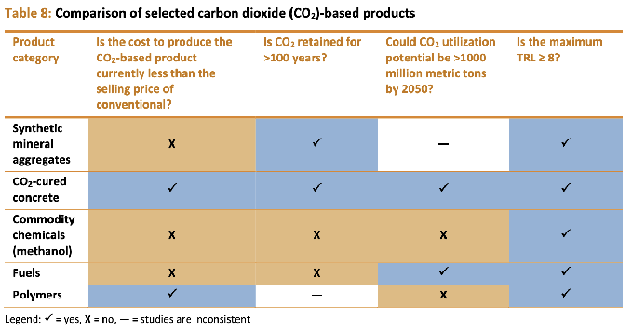
The GAO then proceeded through a detailed analysis of CCUS technologies
Summarized here by CCUS "pathway" groups:
Within each pathway, technologies were next scored based on answers to 4 critical questions:
Is cost lower than conventional tech?
Is CO2 retained for > 100 years?
Could it capture > 1000 Mt CO2 by 2050? ¹
Is its Technology Readiness Level > 8?
From which they identified the leading prospects:
"Check" = Yes ""X" = No " -" = Maybe
1) To ensure climate change impact, I assume this means 1000 Mt of
ANNUAL CO2 capture by 2050, not cumulative capture by 2050

Slide 51
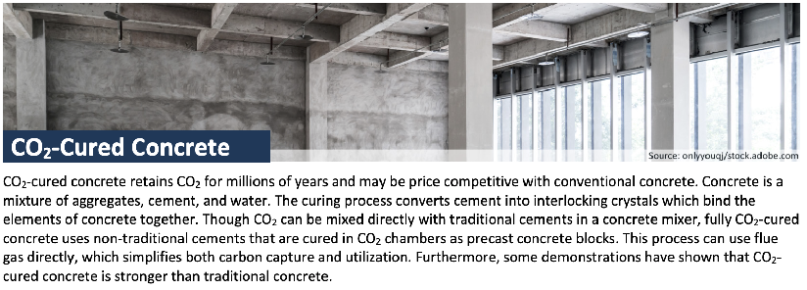
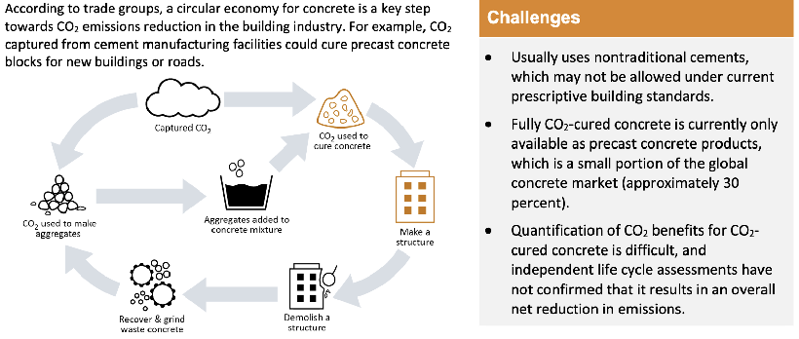
Based on those four questions, the three high-scoring prospects were:
CO2 Cured Concrete - Already satisfying 4 out of 4 criteria
Synthetic Mineral Aggregates & Polymers - Maybe satisfying 3 of 4 (and eventually 4 of 4?) For those three leading prospects, the GAO summarized their analyses of each as follows:
CO2-Cured Concrete (4 out of 4):
Reading as if liquid concrete is just foamed
via injection of GHG gases, which are then trapped as the concrete solidifies into shapes such as blocks, bricks, pavers . . .
But other sources clarify that the key process feature is carefully controlling both pressure
and temperature during solidification ("curing") which then leads to the injected CO2's carbon being incorporated into thermodynamically stable solid calcium carbonate compounds *
* See for instance: https://theconstructor.org/concrete/curing-concrete-carbon-dioxide/39587/

Slide 52
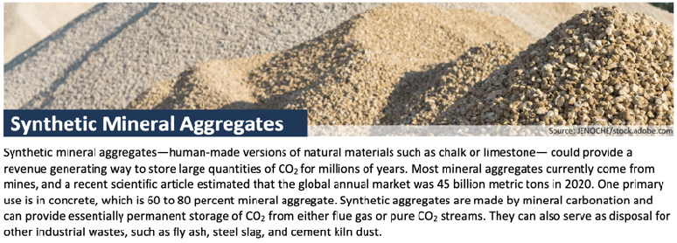
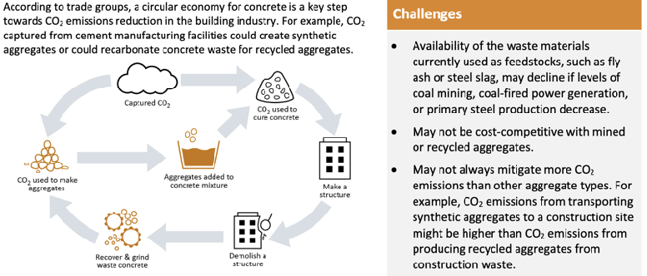
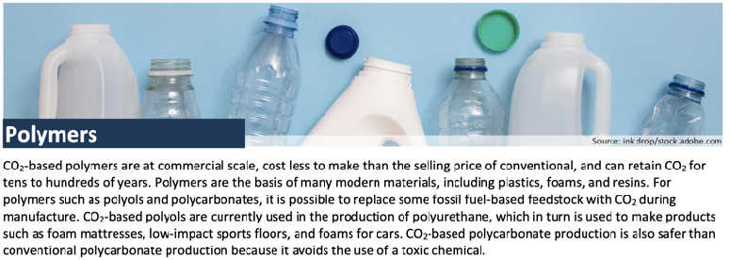
Continuing:
Synthetic Mineral Aggregates (3 out of 4):
Here, instead of driving carbon to bind with solidifying concrete, it is driven to react with already solid "aggregates" (i.e., small stones) of either natural rocks or waste solids.
Desirably, those waste solids could include
fly ash (from coal burning), slag (from steel making) & dust (from cement making) which could then be used as the aggregates that must be added to cement to make concrete
or tars to make asphalt
Polymers (3 out of 4) - a.k.a. plastic & rubber
Problematic in that, while they can incorporate GHG carbon, their natural deterioration could re-release it too quickly ( < 100 years) thereby ALSO contributing to our growing problems with micro-plastic ocean (and land?) pollution

Slide 53
Yielding only three possibly viable Utilization candidates (one with major downsides)
Thus, returning to the first of my two earlier CCUS questions:
"Do proposed CCUS techniques include viable means of stably solidifying carbon?"
The answer appears to be "Yes, but only for 2-3 out of dozens of suggested technologies"
As seen above in my added GAO scoring of the earlier IEA figure about Utilization technologies
So the citizen editors of Wikipedia's CCU page got it right - listings such as this actually describe:
Economically relevant Carbon Capture & Utilization (CCU) - But NOT more challenging
Climate relevant Carbon Capture, Utilization and SUSTAINED Sequestration
for which I will now coin and carefully use the distinguishing acronym: CCUSS

Slide 54
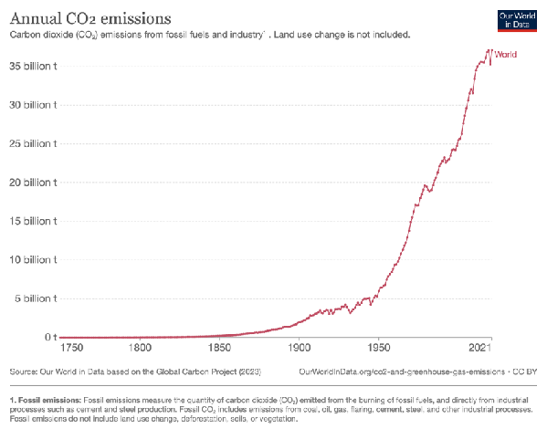
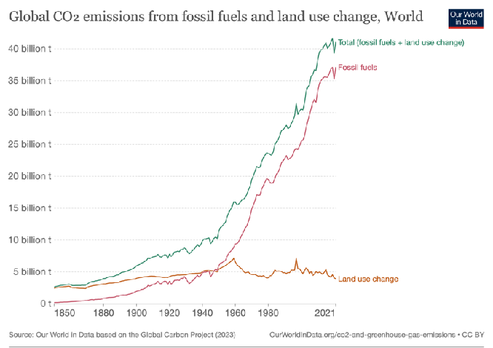
Can use of these CCUSS techs grow fast enough to blunt climate change?
To blunt climate change we must eliminate - or at least slash - human GHG emissions: Which according to multiple sources have followed this historical trend: ^{8. 9}
Direct Human GHG Emissions
Effective Human GHG Emissions
(including human land-use effects such
as elimination of wetlands and deforestation)
Meaning that, barring other dramatic and thus far absent reductions in CO2 emissions,
CCUSS would have to capture (or slash) ~ 40 billion t (40 Giga tonnes) of CO2 per year
8) https://www.iea.org/reports/co2-emissions-in-2022 9) https://ourworldindata.org/co2-emissions

Slide 55
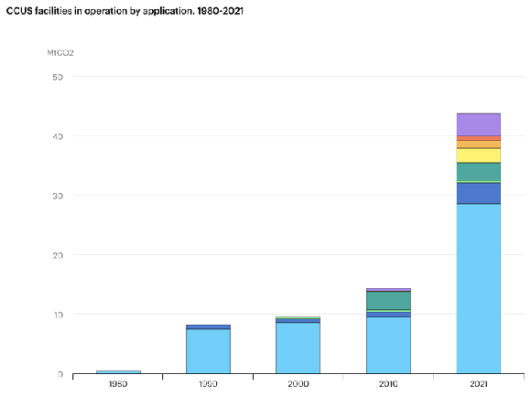
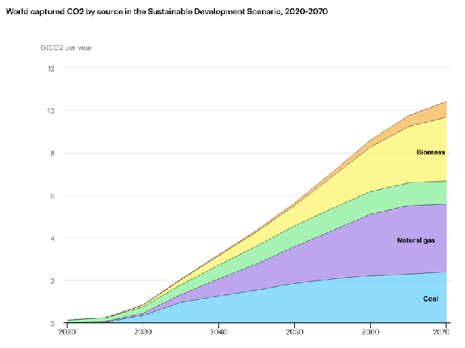
How much CO2 might CCUSS be able to capture?
According to the International Energy Agency study (of what was overwhelmingly ONLY CCU): ⁴
Annual CCU CO2 Capture to 2021: Scenario of Future CCU CO2 Capture:
-- 43 Mega-tons = 0.043 Giga-tonnes --
--------------- 10.5 Giga-tonnes -------------
From color key: ZERO CCUSS
Today's human GHG emissions: 40 Giga tonnes / year = target
2021's actual CCU CO2 capture: 0.043 Giga-tonnes / year 1/930 x target
Versus (hockey stick like) IEA projections of
2030 CCU CO2 capture: 0.7 Giga-tonnes / year 1/57 x target
2040 CCU CO2 capture: 2.9 Giga-tonnes / year 1/15 x target
2050 CCU CO2 capture: 5.7 Giga-tonnes / year 1/7 x target
4) My orange notes added to figures from: https://www.iea.org/reports/about-ccus

Slide 56
But could the IEA be underestimating the true potential of Carbon Capture ?
Have any other credible sources projected the impact of carbon capture on GHG emissions?
I identified one other study, a synopsis of which was released by McKinsey & Company
An organization Wikipedia describes as being far from a green bastion:
"(It is) the oldest and largest of the "Big Three" management consultancies (MBB), the world's most prestigious strategy consulting firms (focusing) on the finances and operations of their clients."
In their report entitled: Scaling the CCUS Industry to Achieve Net Zero Emissions ⁶
McKinsey chose a target for annual carbon capture of 4.2 Giga-tonnes of CO2 by 2050
Which is very close to the preceding slide's IEA projection of 5.3 Giga-tonnes of CO2 by 2050
To achieve that goal, McKinsey concluded (color NOT added):
"CCUS uptake needs to grow 120 times over by 2050
for countries to achieve their net-zero commitments"
Almost identical to IEA's: (2050 projected 5.7 Gt/yr ) / (2021 actual 0.043 Gt/yr) = 133 times
Implying McKinsey was ALSO ignoring the the hugely important distinction between
economically relevant (but mostly climate irrelevant) "CCUS" and climate relevant CCUSS
6) https://www.mckinsey.com/industries/oil-and-gas/our-insights/scaling-the-ccus-industry-to-achieve-net-zero-emissions

Slide 57
Further, is a 2050 goal of capturing only 4.4 - 5.3 Giga-tonnes of CO2 enough?
Effective Human GHG Emissions
Direct Human GHG Emissions
35
billion (giga) tonnes
5
0
Centuries of human CO2 emission have raised its atmospheric concentration to an unprecedented level,
now driving global warming faster than even the more pessimistic model predictions of a decade ago
Now, even if we immediately stopped emitting ANY MORE CO2,
it would take a century or more for already airborne CO2 to naturally fade away
So we'll instead continue our CO2 emissions but, over the next 25 years, trim them by < 15%?
I'll stick with my earlier statement that we'll likely need to slash our existing emissions, meaning that a
"Business as Usual + CCUSS Scenario" requires ~ 7X more CCUSS than IEA & McKinsey target So instead of an already credibility-straining 120X to 133X growth from the 2021 CCUS level,
the net required CCUSS growth would be more like 7 x (120X to 130X) ~ 900X

Slide 58
I opened this section by contrasting Climate vs. Industry driven Visions of a Hydrogen Economy
vs.
The first part of the Industry-driven Vision was that Hydrogen would continue to be supplied by Steam Methane Reforming of Methane (SMR), but via plants migrating from CO2 release to CCUS
Gray Hydrogen
Blue Hydrogen
Which lead me to then ask:
"Do proposed CCUS techniques include viable means of stably solidifying carbon?"
For which the answer appears to be: Yes, but only for 2-3 out of dozens of suggested technologies
"Can use of those CCUS techs grow fast enough to blunt climate change?"
For which the answer from the last few pages appears to be:
If one projects (radical, unprecedented, implausible?) 120-900X growth of CCUSS by 2050
An Introduction to Sustainable Energy Systems: WeCanFigureThisOut.org/ENERGY/Energy_home.htm

Slide 59
Bringing me almost to the second and third parts of Hydrogen Economy Visions:
Part 2) Hydrogen Gas could be shipped via existing Natural Gas infrastructure
including the existing 3 million miles of buried U.S. Natural Gas Pipelines
Part 3) Once delivered, Hydrogen Gas's portability would then accommodate myriad applications
Especially in the U.S.'s largest energy consumption sector of Transportation
Where it might even meet the extreme challenge of GHG-free long-distance flight
Transportation
Industrial
Residential
Commercial
7.88 QW-h
7.59 QW-h
3.39 QW-h
2.67 QW-h
"Bringing me almost" because some extremely important questions must first be addressed:

Slide 60
How much Energy does H2 contain / How much energy can it transport?
And how does H2's stored energy compare to that of other Energy Storage Media?
I've sought out tabulations of Energy Density,¹⁻² and data on single Energy Storage Media ³
Energy / Mass data are fairly easy to find, but effective values depend upon containers
Energy / Volume data can be difficult to find and, for gases, values depend upon pressure
For a particular Medium, a cited energy density value typically spans a range of about 10%
Variation is due in part to many Media not being uniquely defined, for instance:
Fossil-fuel gasoline, diesel, jet fuel & natural gas are in fact complex chemical mixtures
which can vary by source, or by deliberate efforts to tweak their energy content
Similarly, Li ion batteries & Li metal batteries each come in many different formulations
Given my intent of exploring possibilities (and the continuing improvement of new technologies),
in the table that follows I've tended to select higher values reported by responsible sources
Further, in that table, to make comparisons easier, I've also added two columns providing
the ratio of a medium's Energy / Mass and Energy / Volume to those values for Gasoline
1) https://en.wikipedia.org/wiki/Energy_density 2) https://en.wikipedia.org/wiki/Energy_density_Extended_Reference_Table
3) See sources in the "Energetics of Hydrogen & Competing Energy Storage Media " section of my Resources webpage (link)

Slide 61
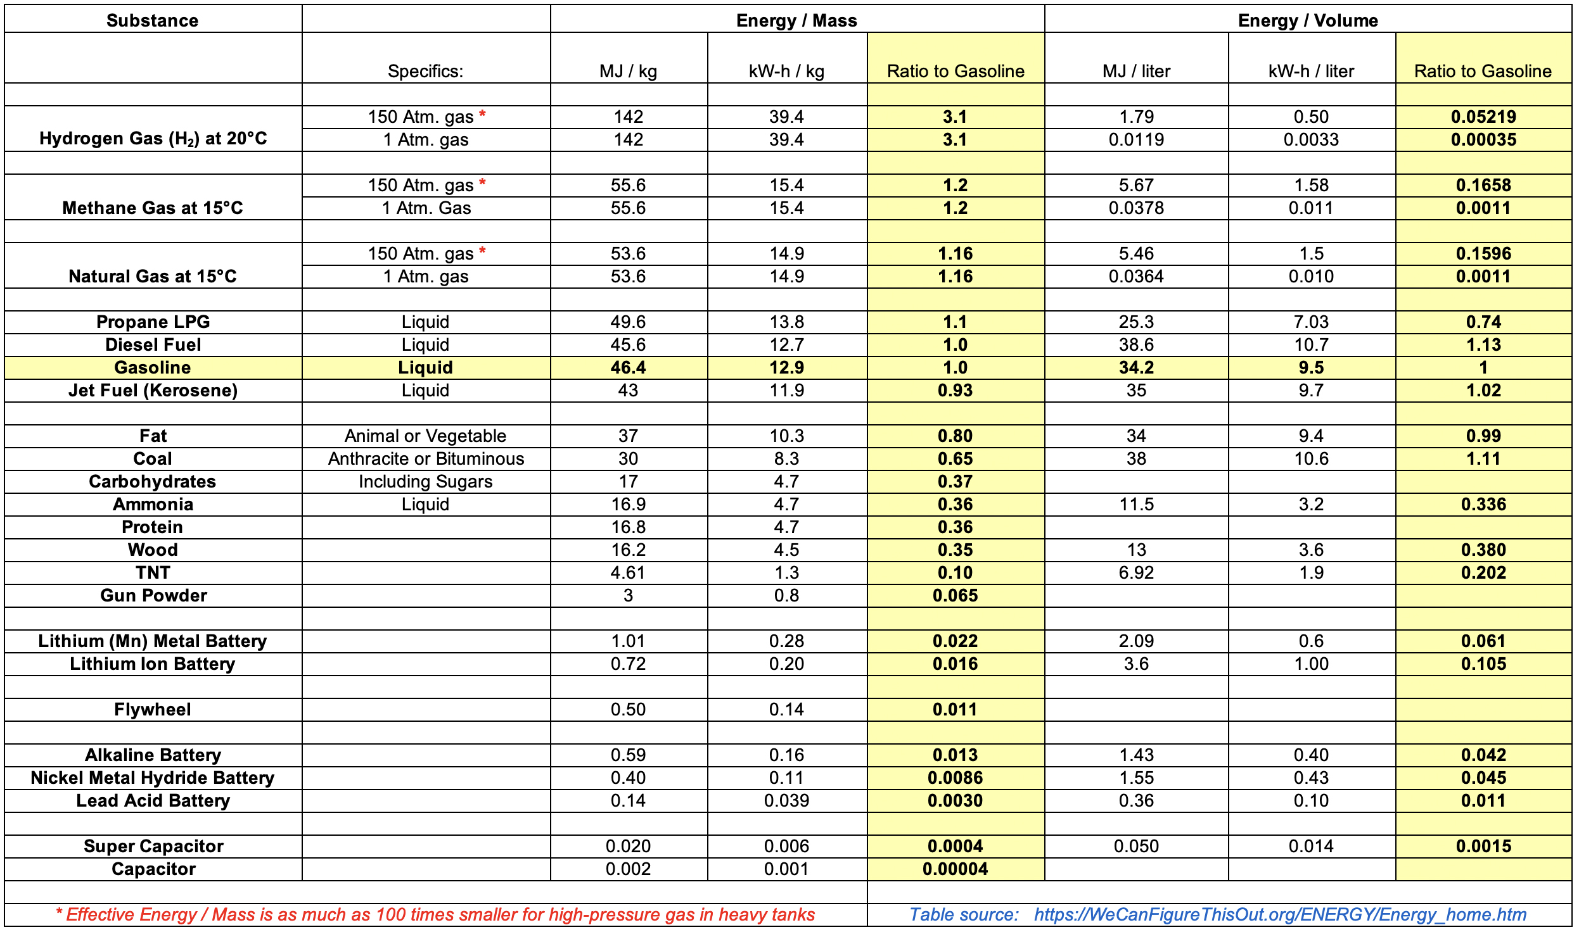
In table form, including my data on many additional Energy Storage Media:
Increasing Energy per Mass →
An Introduction to Sustainable Energy Systems: WeCanFigureThisOut.org/ENERGY/Energy_home.htm

Slide 62
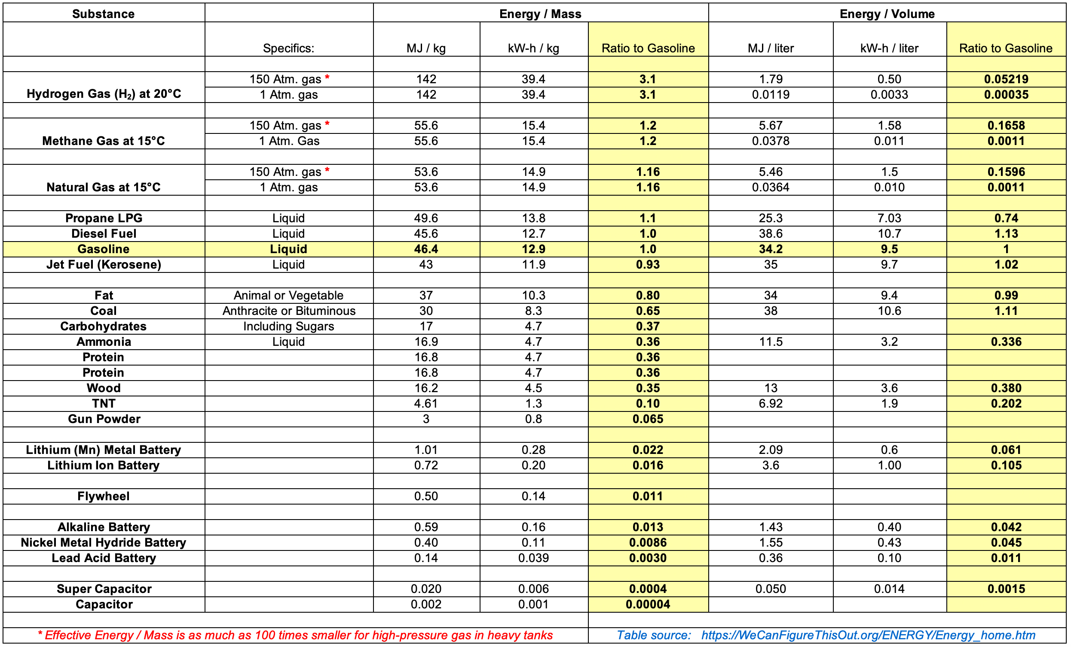
Hydrogen compared to today's most important Energy Storage Media:
Hydrogen:
1/20 th
1/3000 th
Fossil Fuels:
New Batteries:
Old Batteries:
H2 Energy per MASS is ~ 3X that of Gasoline / Diesel / Jet fuel
At 150 Atm. pressure ¹ H2 Energy per VOLUME is ~ 1/20 that of Gasoline / Diesel / Jet fuel
At 100 Atm. pressure ² H2 Energy per VOLUME is ~ 1/30 that of Gasoline / Diesel / Jet fuel
At 1 Atm. pressure H2 Energy per VOLUME is ~ 1/3000 that of Gasoline / Diesel / Jet fuel
At any pressure H2 Energy per VOLUME is ~ 1/3 that of Natural Gas at the same pressure
1) ~ Upper pressure range of common "class 1" compressed-gas cylinders
2) ~ Pressure in NG pipelines: https://homeupward.com/what-is-the-psi-of-natural-gas-in-a-home/ OR https://www.nrel.gov/docs/fy13osti/51995.pdf

Slide 63
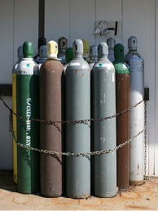
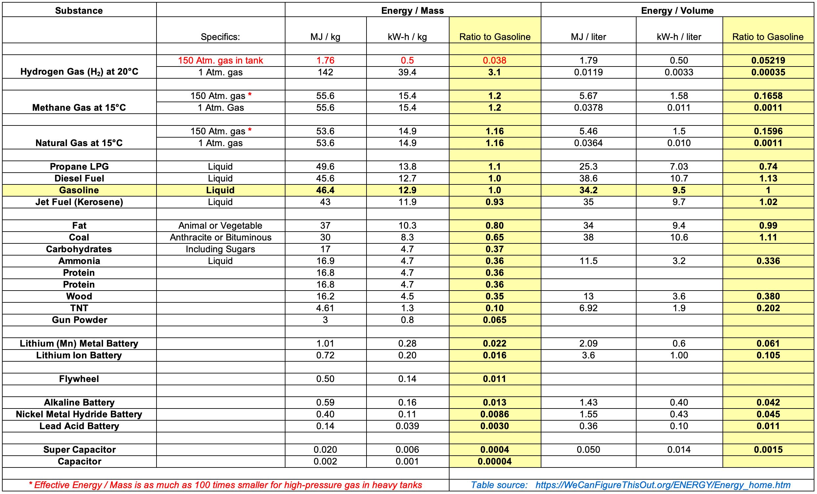
But high pressurization of H2 requires a very strong & heavy container:
The most common high-pressure container is a "Class 1" steel gas cylinder: ¹
Which can contain gases at up to ~ 150 atmospheres of pressure ²
And hold up to ~ 50 liters of that gas within the cylinder's ~ 50-85 kg body
But that reduces pressurized Hydrogen's effective Energy Density per Mass:
From the table: 150 Atm. Hydrogen's intrinsic Energy Density = 39.4 kW-h/kg
But while 50 liters of 150 Atm. H2 weighs = 50 x 0.0126 kg/l = 0.63 kg
the weight of the cylinder needed to contain that H2 = 50-85 kg
Hydrogen's EFFECTIVE Energy Density / Mass when contained in a gas cylinder:
≤ [0.63 / (0.63+50)] x 39.4 kW-h/kg = 1.24% of its intrinsic value: 39.4 kW-h/kg → 0.49 kW-h/kg
For CONTAINED 150 Atm. Hydrogen, the CORRECTED top of the table would instead be:
1) https://en.wikipedia.org/wiki/Gas_cylinder 2) Hence my use of 150 Atm. in the preceding table

Slide 64
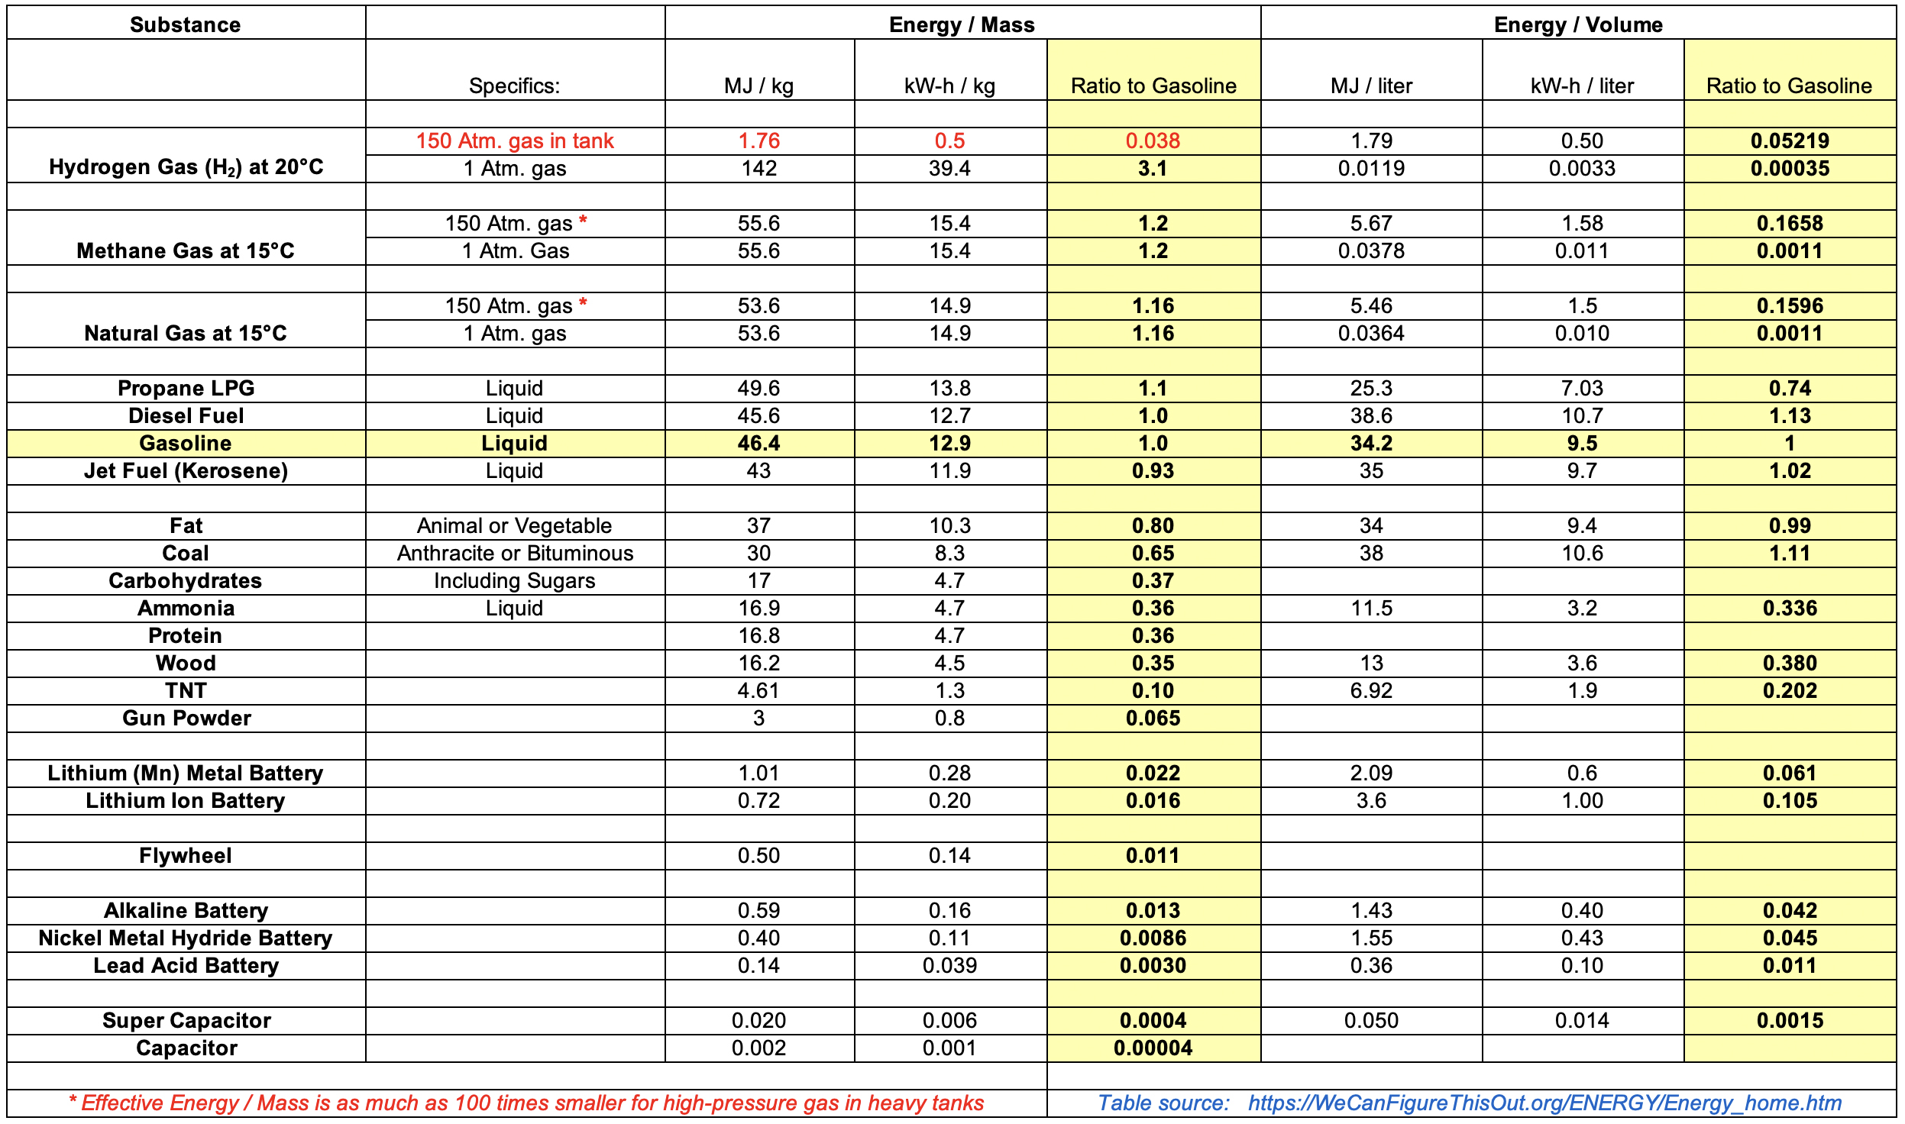
Container weight correction has HUGE downsides for a Hydrogen Economy:
Before: H2 easily surpassed the Energy / Mass of ALL common fossil-fuels,
while maintaining Energy / Volume only ~ 3X smaller than Natural Gas
After: H2 Energy / Mass plummets below fossil-fuels, to almost as low as Lithium Batteries
Placing H2 in direct competition with the already-mature technology of those batteries
(use up & down keys to identify the data linked to each statement)

Slide 65
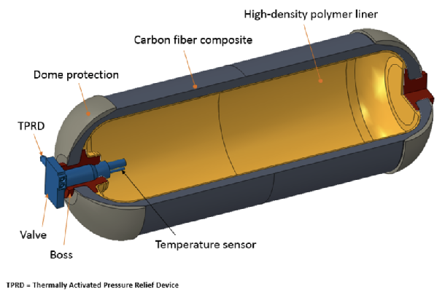
What about using entirely new types of high pressure Hydrogen gas containers?
Above, based on conventional steel gas cylinders, I calculated:
(Mass of stored 150 Atm. H2) / (Mass of that stored H2 + gas cylinder) = 1.24%
But for vehicle applications, the U.S. DOE is funding research into high-tech containers including
350 Atm. & 700 Atm. versions of this: ¹
Their goals for (H2 mass) / ("System mass") ratio are 4.5% for 2020, and 6.5% "eventually"
The DOE reported one lab approaching the 2020 goal having attained a ratio of 4.2%
For that 700 Atm. Argonne National Lab unit, System energy / System mass = 1.4 kW-h / kg
Which IS far better than the value I calculated for 150 Atm. steel cylinders: 0.49 kW-h / kg
But still HUGELY short of H2's (often misleadingly cited) intrinsic value of 39.4 kW-h / kg
1) https://www.energy.gov/eere/fuelcells/physical-hydrogen-storage

Slide 66


Then why not just liquify Hydrogen?
After all, the ease of liquifying Propane vastly increases its energy density and portability,
and liquifying Natural Gas is what makes its huge shipments possible:
When a fuel is driven from gas to liquid, its molecules ABRUPTLY huddle 1000's of times closer,
giving that liquid a very desirable 1000's of times more energy per volume!
How does one force such a transition? Decrease temperature (T) and / or increase pressure (P)
But getting practical, we need to know exactly which combinations of T & P force this transition
And getting really practical, we need to compare these for a variety of candidate fuels
Scientists plot a substance's Temperature & Pressure behavior in:
Left figure: https://www.ferrellgas.com/tank-talk/blog-articles/how-to-paint-a-propane-tank/
Center figure: https://blog.masterappliance.com/discover-these-8-professional-uses-for-a-propane-torch/
Right figure: https://gcaptain.com/new-lng-terminals-get-smaller/

Slide 67
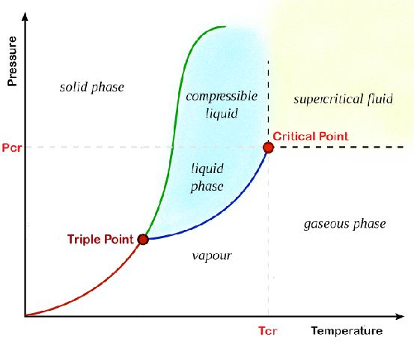
"Phase Diagrams"
Where pressure increases upward, and temperature increases rightward: ¹
Our everyday experience falls in the diagram's center,
where the blue line plots T & P combinations where
vapor and liquid coexist in equilibrium
(= the substance's "Vapor Pressure Curve")
At lesser T's and greater P's everything becomes liquid
At greater T's and lesser P's everything becomes vapor
But at higher Temperatures things get weird:
There is a Critical Point above & right of which a normal dense liquid DOES NOT form
Instead, there is Supercritical Fluid (SF) ² which is described as a strange high temperature state
with properties gradually shifting from gas-like to liquid-like moving up & right in the diagram
By NOT abruptly densifying, SF's offer no abrupt energy storage or transport advantage,
leading us to seek T & P combinations below & left of the Critical Point = (Tcr, Pcr)
1) This is my modified / simplified version of a figure from: https://en.wikipedia.org/wiki/Phase_diagram
2) https://en.wikipedia.org/wiki/Supercritical_fluid

Slide 68
Comparing liquid Hydrogen with other liquid energy fuel contenders:
Drawing from the Phase Diagrams of Ammonia, Propane, Methane and Hydrogen: ¹⁻³ Ammonia Propane Methane Hydrogen
Critical Temperature (Tc) 132.4 ºC 96.7 ºC -82.6 ºC -240 ºC
Critical Pressure (Pc) 111 Atm. 42 Atm. 46 Atm. 13 Atm
Vapor Pressure of 25 ºC liquid 9.9 Atm. 9.9 Atm. (N/A) (N/A)
Temperature for 1 Atm. Vapor Pressure -33 ºC -43 ºC -162 ºC -253 ºC
Critical temperatures for Ammonia (132.4 ºC) & Propane (96.7 ºC) are far above 25 ºC meaning
they are liquid in 25 ºC containers able to withstand their modest 9.9 Atm. vapor pressures
Or to use lighter/cheaper 1 Atm. tanks, they'd be cooled to -33 ºC and -43 ºC respectively
But to liquify the Methane in Natural Gas it MUST be refrigerated below its -82.6 ºC Tc
Or to use lighter/cheaper 1 Atm. pressure tanks, on today's LNG ships it is cooled to -162 ºC ²
Liquifying Hydrogen requires refrigeration below -240 ºC = 33º above Absolute Zero
Or to use 1 Atm. tanks, it must be cooled to -253 ºC = 20º above Absolute Zero ³
1) https://www.engineeringtoolbox.com/gas-critical-temperature-pressure-d_161.html
2) https://en.wikipedia.org/wiki/Liquefied_natural_gas 3) https://lcn.people.uic.edu/classes/che205s17/docs/che205s17_reading_02a.pdf

Slide 69
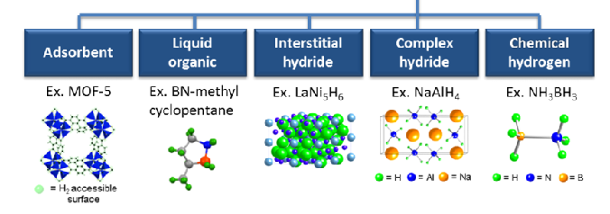
But there might be a final wildcard way to densely store Hydrogen:
REVERSIBLY bond large numbers of H to certain complex molecules,
or drive H into the crevices of especially porous materials,
or into even the small spaces between the bonded atoms of special solids: ¹
Plans & results from a U.S. DOE research initiative on "Materials-based Hydrogen Storage:" ²
H2 Mass / System Mass System Energy / Mass System Energy / Volume
2020 Goal: 4.5% 1.5 kW-h / kg 1.0 kW-h / l
Ultimate Goal: 6.5% 2.2 kW-h / kg 1.7 kW-h / l
NaAlH4 results: 1.2% 0.4 kW-h / kg 0.4 kW-h / l
MOF-5 results: 3.8% 1.3 kW-h / kg 0.7 kW-h / l
Chemical hydrogen results: 4.6% 1.5 kW-h / kg 1.3 kW-h / l
The best per volume energy density achieved is only ~ 3X better than:
H2 in 150 Atm. gas cylinder 1.24% 0.49 kW-h / kg 0.495 kW-h / l
1) Figure from: https://www.energy.gov/eere/fuelcells/hydrogen-storage 2) https://www.energy.gov/eere/fuelcells/materials-based-hydrogen-storage

Slide 70
FINALLY getting to the second and third parts of Hydrogen Economy Visions:
But armed with all of that Energetics Information,
and now using it to analyze the full real-world consequences of:
This Reality MEETING These Visions
Transportation
Industrial
Residential
Commercial
7.88 QW-h
7.59 QW-h
3.39 QW-h
2.67 QW-h
An Introduction to Sustainable Energy Systems: WeCanFigureThisOut.org/ENERGY/Energy_home.htm

Slide 71
The second part of Hydrogen Economy Visions concerned TRANSPORT of H2
For which "Liquifying Hydrogen requires refrigeration below -240 ºC = 33º above Absolute Zero"
and "To use 1 Atm. tanks, it must be cooled to -253 ºC = 20º above Absolute Zero"
very likely rule out practical / economic seaborne transport of liquified H2:
As my "At any pressure H2 Energy per VOLUME is ~ 1/3 that of Natural Gas"
means replacing Natural Gas with H2 would require 3X our present day pipeline capacity
While "At 100 Atm. pressure H2 Energy per VOLUME is 1/30 that of Gasoline / Diesel / Jet fuel"
suggests that for H2 from centralized SMR / CCUS plants to ALSO replace liquid fossil fuels,
(which IS part of Industry's alleged Vision), our huge fossil fuel pipeline network
would also have to be replaced by even HUGER additional H2 pipeline capacity ¹
+ ? ? ?
1) I did not try to estimate HOW MUCH more H2 pipeline capacity would be required to replace the existing U.S. liquid fossil fuel pipeline network because, among other factors, gases at 100 atmospheres almost certainly flow though pipes very differently than liquid fossil fuels
(which if now pumped at much lower pressures would also use pipelines of significantly different design)

Slide 72
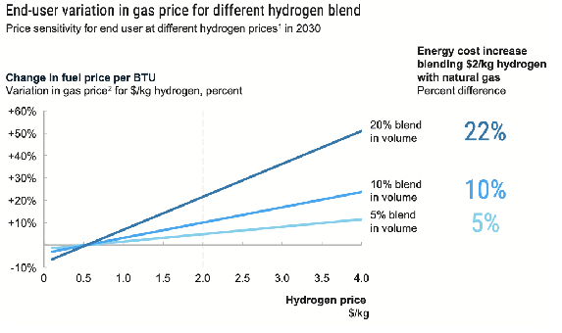
But some industry-backed Visions would only DILUTE pipeline Natural Gas with H2
As in the Fuel Cell & Hydrogen Energy Association: Road Map to a U.S. Hydrogen Economy ¹
"Companies can blend low percentages of hydrogen into existing natural gas networks without the need for major changes in infrastructure or new home appliances. In the US gas network today, blending levels should be safe within a range of 4 to 5 percent . . . Various studies show blending levels limited at 5 to 30 percent by volume without appliance upgrade" ¹
But again recalling my: "At any pressure H2 Energy per VOLUME is ~ 1/3 that of Natural Gas"
if H2 were added to Natural Gas at volume fractions of: 3% 5% 20% 30%
Its energy contribution to the gas mixture would then be: 1% 1.7% 7% 10%
Which, despite reduction in NG's share, would increase mixture's cost in proportion to H2 share: ¹
1) Pages 29-31 in: https://www.fchea.org/us-hydrogen-study Yellow box added to figure

Slide 73
Then why even bother to make such minor changes? A disturbing precedent:
Gasohol (gasoline diluted with ≤ 10% methanol)
Which once seemed like it might be a climate-friendly change, but turned out to yield equivalent
or higher GHG emissions while causing major environmental & worldwide economic damage (associated with the required massive cultivation of water & fertilizer-hungry corn) ¹
But which continues on thanks to political leverage of embedded farming & industry interests
Well aware of that precedent, many now see the proposed use of weakly H2 diluted Natural Gas
as a way of Greenwashing business-almost-as-usual operation of the Natural Gas Industry
Among those criticisms (cited in the introduction of this noteset):
The Sierra Club:
Washington Post:
"The fossil fuel industry is hyping hydrogen of all kinds as a low-carbon
replacement for all sorts of uses of fossil fuels - from powering vehicles
and heavy industry to heating buildings. In reality, many hydrogen projects
will only lock us in to continued fossil fuel use and additional investments
in fossil fuel infrastructure" ²
Clean Energy Superstar or Smokescreen or Fossil Fuel Use? (2022) ⁷
Get Tax Right or Clean Hydrogen Will be a Bigger Boondoggle than Biofuels (2023) ⁸
1) See my noteset: Biomass and Biofuels (pptx / pdf / key) 2) https://www.sierraclub.org/articles/2022/01/hydrogen-future-clean-energy-or-false-solution
7) https://www.washingtonpost.com/climate-solutions/2022/03/17/hydrogen-clean-energy-climate-change/
8) https://www.washingtonpost.com/opinions/2023/04/27/clean-hydrogen-tax-credit-stringent-rules/

Slide 74
The third & final part of Hydrogen Economy Visions concerned Applications of H2
Left of center icons depict Residential, Commercial & Industrial HEATING
which is the major contributor to the red parts of these types of U.S. Energy Consumption:
Industrial
Residential
Commercial
7.59 QW-h
3.39 QW-h
2.67 QW-h
The leftmost 4 icons depict Residential & Commercial HEATING, mostly gas furnaces & ovens
With fairly minor changes furnaces / ovens could indeed be converted to burn Hydrogen fuel
But recalling my "At any pressure H2 Energy per VOLUME is ~ 1/3 that of Natural Gas"
H2 furnaces & ovens would require 3X the gas to heat as well as Natural Gas units
An Introduction to Sustainable Energy Systems: WeCanFigureThisOut.org/ENERGY/Energy_home.htm

Slide 75
But for Residential & Commercial HEATING there's often an immensely a better solution:
HEAT PUMPS which, rather than converting their input electrical energy directly into heat,
instead use that energy to compel a liquid to expand and evaporate (absorbing heat) outside,
and then compel the resulting vapor to compress and condense (releasing heat) inside,
thereby effectively "pumping" heat from outside to inside
Which can actually be 300% energy efficient (delivering 3X the heat energy per energy expended)
and which can be reversed, at the flick of a switch, to pull heat from inside to outside
thereby running as invented by Willis Carrier to produce AIR CONDITIONING ^{1, 2}
Pressurizing
Pump
Pressurizing
Pump
Vaporized Coolant
Liquefied Coolant
Liquefied Coolant
Vaporized Coolant
Indoor
Heat
Exchanger
Outdoor
Heat
Exchanger
Indoor
Heat
Exchanger
Outdoor
Heat
Exchanger
Restricting Valve
or Capillary
Restricting Valve
or Capillary
But Heat Pump efficiency drops as difference between inside & outside temperature increases
making them unsuitable for room air heating or cooling in extreme climates, or for the extreme heating done in other types of commercial non-room-air furnaces & burners
1) https://www.smithsonianmag.com/smithsonian-institution/unexpected-history-air-conditioner-180972108/ 2) https://en.wikipedia.org/wiki/Willis_Carrier
3) Figure and further detail in my noteset: Energy Consumption in Housing (pptx / pdf / key)

Slide 76
The 5th and 6th icons instead depicted Industrial Heating
Most of that heat is now produced with electric heaters or GHG-emitting Natural Gas burners,
because non-air industrial heating is mostly to temperatures beyond the reach of Heat Pumps
Here H2 could be substituted for Natural Gas, but having 1/3 the intrinsic heat energy / volume,
3X the H2 volume of the Natural Gas it supplanted would again be required
If that H2 came from Green Electricity driven Electrolysis, it would eliminate GHG emissions
But going even father back in this noteset:
For Electrolysis: H2 Energy Output / Electrical Energy Input = 64 - 68% ⁶
Meaning 1.5 times more heat would come from heaters powered directly by Green Electricity
While the final alternative of SMR / CCUSS generated GHG-free H2
would work ONLY if CCUSS were fully employed, versus:
industry Visions of partially applying only partially (now minimally) effective "CCUS"

Slide 77
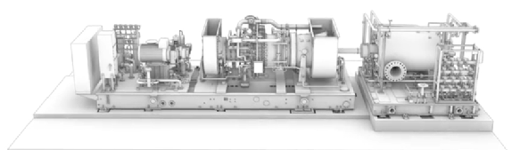
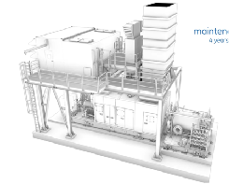
The 7th icon depicted gas-powered generation of electricity
And did a good job of representing a real Open Cycle Gas Turbine (OCGT) power plant (at right) ¹
Which, even with its covers and catwalks fully in place
can still be remarkably simple and compact:
But using GHG-free electricity to Electrolyze water into H2,
and then using that H2 to fuel a turbine to drive a generator to re-generate electricity
would really only make sense in a single, but possibly very important, situation:
As a buffer used to marry the natural cycles of wind & solar electricity generation
with the significantly different human cycles of electricity consumption:
Electricity →
→ H2 →
→ H2 →
→ Electricity
1) For more detail, se my noteset: Fossil Fuels (pptx / pdf / key)
OCGT photos (used in that noteset) were clipped from video at: https://www.youtube.com/watch?v=OkfqUSBdN8M

Slide 78
Bringing us to the final (and largest) category of U.S. Energy consumption: Transportation
The leftmost transportation icon depicts road travel in Cars and Trucks
But I've already discussed calculations of H2 Fuel Cell Vehicle energy efficiencies: 22-33%
which are far inferior to those of Battery Electric Vehicles: 66-77%
But there are recurring claims that Fuel Cell Vehicles might at least offer superior range
Which IS critical in long distance trucking & and some delivery truck applications,
and is at least perceived to be critical in many personal vehicle purchasing decisions
So setting aside efficiencies, let's see if my energy data support claims of superior FCEV range
I'll try to compare the range of my own car (a small "mature" gasoline-fueled crossover-SUV)
with that of its possible Fuel Cell or Battery Electric Vehicle replacements (FCEV / BEV)
My car now has or now gets:
53 liter (14 gal) fuel tank 9.4 highway km / liter (22 mpg) 500 km (310 mile) range

Slide 79
Drawing on my earlier discussion of comparative energetics:
By excerpting its table, including its calculation for pressurized H2 in standard steel cylinders
Hydrogen:
Fossil Fuels:
Batteries:
Then ignoring the likely small weight of my car's thin sheet metal gas tank itself,
its gasoline-filled 53 liter tank must weigh ~ (53 l) (0.001 m³/l)(755 kg/m³) = 39.3 kg
,
Which, from the table, says it contains ~ (39.3 kg)(12.9 kW-h/kg) = 507 kW-h of fuel energy
But having an internal combustion engine + automatic transmission + 4 wheel drivetrain,
no more than 20% of that fuel energy is ultimately transferred to the wheels = 101.4 kW-h
We now need to compare that energy with the energy H2 Fuel Cells or Lithium Batteries might provide
But how will the quantity of Hydrogen Tanks or Batteries likely be constrained?
By matching the 53 liter VOLUME of my gasoline tank OR by matching its ~ 39.3 kg MASS?
It will likely be some subtle vehicle-type-dependent combination of BOTH - So I will calculate BOTH

Slide 80
First calculating ranges as constrained by fuel storage VOLUME:
Hydrogen:
Fossil Fuels:
Batteries:
From earlier, my gasoline internal combustion engine + automatic transmission + 4 wheel drivetrain car
now uses 53 liters of gasoline to deliver to its wheels ~ 101.4 kW-h
Versus 53 liters of Lithium ION Batteries providing ~ (53 l)(1.00 kW-h/l) = 53.0 kW-h
of which, as in all electric vehicles ~ 75% makes it to the wheels: (53.0)(.75) = 39.8 kW-h
Which is 39.2% that of the fossil fueled vehicle
Versus 53 liters of 150 Atm. H2 in steel cylinders containing (53 l)(0.50 kW-h/l) = 26.5 kW-h
of energy input to Fuel Cells which would output about 50% as much electrical energy
of which, as in all electric vehicles ~ 75% makes it to the wheels: (26.5)(0.5)(0.75) = 9.93 kW-h
Which is 9.8% that of the fossil fueled vehicle
Or assuming that research does ultimately produce practical 700 Atm. H2 storage tanks
which would increase H2 storage per volume by ~ 5X, yielding instead (5)(9.84) = 49.2 kW-h
Which is 49.0% that of the fossil fueled vehicle

Slide 81
Then calculating ranges as constrained by fuel storage MASS:
Hydrogen:
Fossil Fuels:
Batteries:
From earlier, my gasoline internal combustion engine + automatic transmission + 4 wheel drivetrain car
now uses 39.9 kg of gasoline to deliver to its wheels ~ 101.4 kW-h
Versus 33.9 kg of Lithium ION Batteries providing ~ (33.9 kg)(0.20 kW-h/kg) = 6.78 kW-h
of which, as in all electric vehicles ~ 75% makes it to the wheels: (6.78) (0.75)= 5.09 kW-h
Which is 5.0% that of the fossil fueled vehicle
Versus 33.9 kg of H2 in steel cylinders containing (33.9)(0.50 kW-h/kg) = 17.0 kW-h
of energy input to Fuel Cells which would output about 50% as much electrical energy
of which, as in all electric vehicles ~ 75% makes it to the wheels: (17.0)(0.5)(0.75) = 6.36 kW-h
Which is 6.27% that of the fossil fueled vehicle
Or assuming that research does ultimately boost (H2 mass) / (Storage System Mass) from 1.24% to 6.5%
that (6.5 / 1.25) = 5.2X improvement would boost H2 energy to wheels from 6.23 kW-h to 32.4 kW-h
Which is 32.6% that of the fossil fueled vehicle

Slide 82
Finally, calculating both for possible future use of Lithium METAL batteries
Hydrogen:
Fossil Fuels:
Batteries:
From earlier, my gasoline internal combustion engine + automatic transmission + 4 wheel drivetrain car
now uses 53 liters of gasoline to deliver to its wheels ~ 101.4 kW-h
VOLUME CONSTRAINED:
53 liters of Lithium METAL Batteries provide ~ (53 l)(0.6 kW-h/l) = 31.8 kW-h
of which, as in all electric vehicles ~ 75% makes it to the wheels: (31.8)(.75) = 23.9 kW-h
Which is 23.5% that of the fossil fueled vehicle
MASS CONSTRAINED:
33.9 kg of Lithium METAL Batteries provide ~ (33.9 kg)(0.28 kW-h/kg) = 9.49 kW-h
of which, as in all electric vehicles ~ 75% makes it to the wheels: (9.49) (0.75)= 7.12 kW-h
Which is 7.0% that of the fossil fueled vehicle

Slide 83
Comparing those possibly confusing arrays of results:
Expressing BEV & FCEV energy-to-wheels as percentage of Fossil Fuel vehicle energy-to-wheels:
Volume Constrained: Mass Constrained:
BEV FCEV BEV FCEV Today's Li Ion Batteries & Today's H2 Tanks: 39.2% 9.8% 5.0% 6.27%
Today's Li Ion Batteries & Tomorrow's H2 Tanks: 39.2% 49.0% 5.0% 32.6%
Tomorrow's Li Metal Battery & Tomorrow's H2 Tanks: 25.3% 49.0% 7.0% 32.6%
When I compare today's BEV with today's FCEV:
VOLUME constrained BEV range is ~ 3X longer than FCEV range
MASS constrained ranges are both much lower, but near identical
The comparison of BEVs using TODAY's Batteries with FCEVs using TOMORROW's H2 Tanks
is instead a very misleading and inappropriate apples-to-oranges comparison
But when I compare tomorrow's BEV using a projected more robust & safer Li Metal Battery with
tomorrow's FCEV using U.S. DOE projected new Hydrogen Storage Tank technology:
Projected VOLUME & MASS constrained FCEVs improve much more strongly than BEVs
  producing FCEV Ranges that (as claimed) would be much longer than BEV ranges
(undoubtedly why the U.S. DOE is pushing its underlying Hydrogen storage research programs)

Slide 84
Repeating a bit to make sure ALL of my EV calculations are put into perspective:
First, do not let those Range calculations obscure my earlier calculation,
and its corroboration by no less than three other respected sources,
that BEVs are at least 2-3X more Energy Efficient than H2 FCEVs
BEVs will thus require substantially less expansion of our Green Electricity Grid
and require us, as individuals, to spend far less on powering them up
Second, contrary to claims, my Range calculations based on current technologies
indicated ~ 4X superior BEV ranges under Volume constraints
  versus near equal BEV and FCEV ranges under Mass constraints
Third, only when I assumed that U.S. DOE Hydrogen storage programs are fully successful
could claims of superior across-the-board FCEV ranges find any validation
Finally, even if research falls short, with current technology unconstrained by Volume or Mass
BEVs could MATCH fossil-fuel vehicle range if batteries were 2.5X larger in volume
FCEVs could MATCH fossil-fuel vehicle range if H2 Tanks were 10X larger in mass

Slide 85
Bringing us to this would-be H2 application:
Regarding efforts to reduce GHG emissions from trains, I found three informative sources:
From the International Rail Journal: "Europe Leads the Charge to Replace Diesel Traction" ¹
From RailNet.com ² - which thoughtfully analyzed a study on:
U.S. rail electrification from the Lawrence Laboratory National Lab, UCLA & UC Berkeley ³
For me, these contained two surprises and one reminder:
The first surprise was that overhead electrification of Europe's trains is not nearly complete
It was instead pointed out that while mainline passenger & freight rail was largely electrified,
low branch line traffic often fails to support the cost of overhead electric line installation
Leading to intense discussion, including about possible Battery or H2 Fuel Cell engines ¹
But, while ongoing, discussion seemed to be leaning toward addition of battery tenders
which are cars packed with batteries trailing existing mainline electric engines
to which those engines can switch when on unelectrified branch lines ²
1) https://www.railjournal.com/opinion/europe-leads-charge-replace-diesel-traction/
2) https://dieselnet.com/news/2021/12berkeley.php 3) https://www.nature.com/articles/s41560-021-00915-5.pdf

Slide 86
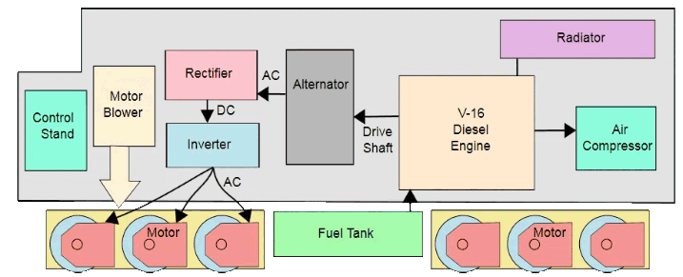
The reminder:
For ~70 years virtually all rail engines - including U.S. engines - have been partially electric
As in the icon image's engine which has wheels driven directly by electric motors,
powered from the main body of the engine by diesel-engine-driven electric generators:
The second surprise:
Despite the much, much longer distances traveled by U.S. freight trains,
not only fully electrical, but even battery electric engines are being seriously discussed
This based on the fact that while a train may travel ~ 700 miles per day, there are stops during that day to replace crews (or even change out engines to deal with different upcoming terrain)
Advocates argue that Battery electric engines could be recharged during these stops OR that
already recharged engines could be swapped in - both using only existing infrastructure ³
U.S. rail operators are still unconvinced but, again, the relative maturity of battery technology
seems to have undercut consideration of less developed options, such as H2 Fuel Cells ²
Figure: https://commons.wikimedia.org/wiki/File:DieselElectricLocomotiveSchematic.svg
2) https://dieselnet.com/news/2021/12berkeley.php 3) https://www.nature.com/articles/s41560-021-00915-5.pdf

Slide 87
And then on to this would-be H2 application:
In my noteset about Energy Consumption in Transportation (pptx / pdf / key)
I spend over forty pages discussing ways of lowering the carbon footprint of Shipping
Summarizing that discussion VERY briefly (emphasizing parts relevant to Hydrogen):
For simpler ideas, the estimated percentage CO2 emission reductions are disappointingly minor
Moving from higher toward lower impact ideas, highlights include:
Speed reduction (8.5%), Hull Cleaning (4.8%), Wind Power (2.4%), Solar Power (0.1%) ¹
I therefore constructed a model of a possible large (Panama Canal limited) Battery Electric Ship,
but while that model showed that such a BES might be technically feasible, matching the Range of Fossil-Fuel counterparts required Li Batteries costing ~ 6.3 billion dollars
Explaining the shipping industry search for extremely high energy density but climate-friendly fuels
Essentially, something with near fossil-fuel energy density, but without the carbon
1) Page 10 : https://theicct.org/sites/default/files/publications/ICCT_GHGfromships_jun2011.pdf

Slide 88
Per my table, pressurized-H2 is NOT the obvious Fossil-Fuel replacement
But lower in the table, Ammonia has Energy/Mass = 4.7 kW-h / kg, Energy/Vol. = 3.2 kW-h / l
Which is more than 1/3 that of fossil-fuels (and 7-10X times better than pressurized H2)
Even more striking is that while liquifying H2 requires temperatures below -240 ºC
Ammonia only requires cooling below -33.3 ºC, and will remain liquid at room temperature
if held in a tank capable of withstanding its 9.9 Atm. room temperature vapor pressure
But paralleling H2:
NH3 is also now generated via energy-intensive, heavily GHG-emitting chemical processes
Which would have to be replaced by Green Electricity powered Electrolytic Synthesis
And continuing that parallel:
While Green NH3 could then cleanly fuel Internal Combustion Engines
The environmentally preferred use would to fuel NH3 Fuel Cells producing Electricity

Slide 89

But due to its much higher energy density AND much higher boiling point . . .
Ammonia Fuel Cell powered test ships ARE under construction:
As funded by the European Union's fourteen nation ShipFC project, ¹
the "Viking Energy" is scheduled for sea trials late in 2023, ² propelled by NH3 Solid Oxide Fuel Cells generating 2 MW of electricity
With a 2020: "Study of Alternative Ship Propulsion System(s) Fueled by Ammonia . . ." ¹
concluding that Ammonia powered alternatives to fossil-fueled diesel ships would:
      Require 1.6 - 2.3 times the volume
      Be 1.4 - 1.6 times heavier
      Have a total life cycle cost 3.5 - 5.2 times larger
      But could reduce GHG emissions by 83.7 - 92.1%
1) https://www.prototech.no/news/2020/01/23/prototech-awarded-contract-to-supply-2mw-zero-emission-ammonia-fuel-cell-module/
2) https://www.prototech.no 3) https://www.mdpi.com/2077-1312/8/3/183/htm

Slide 90
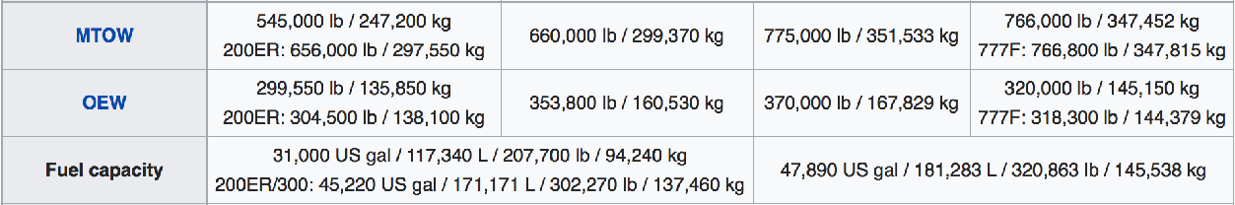
And finally to this would-be H2 application:
In my noteset about Energy Consumption in Transportation (pptx / pdf / key) I also
spend over twenty-four pages discussing ways of lowering the carbon footprint of Aircraft
But its most Hydrogen (and Battery) relevant section is an analysis I made of a typical airliner
In particular, for different Boeing 777 models with maximum ranges of 10,000 to 16,000 km
For which Wikipedia had a webpage that supplied these data: ¹
Max Takeoff Weight
Empty Weight
1) With two expanded acronyms, excerpted from main table at: https://en.wikipedia.org/wiki/Boeing_777

Slide 91
Thus, for a flight approaching the aircraft's full range:
Load weight (Passengers + Cargo) = (Max. Takeoff weight) - (Empty weight) - (Max. Fuel weight):
Aircraft Model's Range:
Max takeoff Wt (=100%):
Aircraft Empty Wt:
Max Full Fuel Load Wt:
→ Passenger + Cargo Wt =
10,000 km
247200 kg
135850 kg ~ 55%
94240 kg ~ 38%
17110 kg ~ 7%
11,000 km
299370 kg
160530 kg ~ 54%
94240 kg ~ 32%
44600 kg ~15%
13600 km
351533 kg
167829 kg ~ 48%
145538 kg ~ 41%
38166 kg ~ 11%
16,000 km
347452 kg
145150 kg ~ 42%
145538 kg ~ 42%
56764 kg ~ 16%
Leading to the conclusion that for a typical, fully loaded, transcontinental or transoceanic flight:
Load Weight is approximately ~ 3/4 Fuel versus 1/4 (Passengers + Cargo) ¹
If Fuel Weight increased by 33%, Passenger + Cargo weight would have to be cut to ZERO
If Fuel Weight increased by only 10%, Passenger + Cargo Weight would have to be cut by 30%
:
But flight income is PAID by and thus proportional to Passenger + Cargo Weight
33% Heavier Fuel → ZERO Income
10% Heavier Fuel → 1/3 drop in Income (likely yielding Negative Profit)
Smaller increases in Fuel Weight could still bankrupt today's low-profit-margin Aircraft Industry
1) Explaining modern air travel's HUGE CARBON FOOTPRINT:
For each 1 kg of body & luggage weight you add to a flight, ~ 3 kg of hydrocarbon fuel must be loaded and then burned into Greenhouse Gases

Slide 92

Returning (for a final time) to my Energetics Table:
Below H2 (with Energy / Mass plummeting in its pressurized and thus necessarily heavy tanks)
Below all of the Fossil-Fuels AND Fat (which, biofuel or not, would surely choke a Jet engine)
EVERYTHING ELSE IN THE TABLE HAS ENERGY / MASS < 1/2 THAT OF JET FUEL
meaning planes would need MORE THAN twice the weight of those other "fuels"
Income-generating Green Flight thus REQUIRES new fossil-fuel-like synthetic fuels,
(achievable only by investing much more energy & money into their chemical synthesis)

Slide 93
Summary & Conclusions
An Introduction to Sustainable Energy Systems: WeCanFigureThisOut.org/ENERGY/Energy_home.htm

Slide 94
Part I: Hydrogen Sources
Climate Driven Choice: Green-electricity-powered water Electrolysis
=
Electricity →
→ Hydrogen Gas
Now accounting for only an almost negligible "~ 0.03% of today's H2 production"
For electrolyzed H₂ to displace U.S. use of
Fossil Fuels (red & pink parts of pie charts),
Total U.S. Green Electricity production would
have to increase by ~ 7 to 12 times
Residential
Commercial
Transportation
Industrial
3.39 QW-h
2.67 QW-h
7.88 QW-h
7.59 QW-h
= THE SAME CHALLENGE CONFRONTING ALL ELECTRIFICATION SCHEMES
(including those dependent upon batteries)

Slide 95
Part I: Hydrogen Sources (cont'd)
Industry Driven Choice: H2 gas synthesized via its separation from Fossil Fuels
Most particularly, by high-energy-investment Steam Reforming of Methane (SMR), with a
claim that the GHG CO2 byproduct of reforming would EVENTUALLY be captured
Contrary to 2019 report that:
"Overall, less than 0.7% of current hydrogen production
is from renewables or from fossil fuel plants equipped with CCUS"
But even more alarming (to me): The accepted meanings of "EVENTUALLY" and "CCUS"
"EVENTUALLY" because the broadly accepted goal is to increase the level of CO2 capture
to <15% of today's level of human CO2 emissions, and doing that only by the year 2050
An apparently weak and likely climate-ineffective goal nevertheless widely
calculated to still require a 120-133X increase of today's level of carbon capture
Versus COMPLETE CO2 capture instead requiring an almost ~ 1000X increase

Slide 96
Then hugely compounded by insights into the use of the acronym "CCUS"
Which, expanded into Carbon Capture, Utilization & Sequestration,
is popularly believed to mean carbon capture capable of blunting Global Warming
Instead, "CCUS" is being broadly applied to describe carbon capture
driven almost entirely by economic exploitation, rather than by suppression of warming
Economic exploitation involves carbon capture for days, months, years or perhaps decades
vs. suppression of global warming which instead requires CO2 capture for a century or longer
Rated by the U.S. GAO: Only a very small subset of today's "CCUS" technologies actually
qualify as climate-relevant Carbon, Capture, Utilization and SUSTAINED Sequestration

Slide 97
Part II: Transportation of Hydrogen
Climate-Driven & Industry-Driven Visions both assume H2 transport
from its point-of-synthesis to its point-of-use via existing or similar infrastructure
But based on simple, direct, and unambiguous energy data and calculations:
H2's 3X lower energy / volume means replacing NG will require 3X more pipeline capacity:
While 30X lower energy / volume of pressurized H2 gas means replacing liquid Fossil Fuels
will require VASTLY more pipeline capacity, as well as very different types of pipelines:
+ ? ? ?
While considerably more complex "Phase Diagram" science indicated that
shipment of liquified H2 would require such extreme low temperatures (-240 to -253º C)
as to almost certainly rule out such transport:

Slide 98
Part III: Applications of H2
Which I will summarize even more quickly because it was topic of the preceding section:
Heating:
H2 combustion could replace Fossil Fuel combustion in high temperature furnaces But rather than using electricity to produce that hydrogen via Electrolysis it would be
~ 1.5X more energy efficient to use that electricity directly in electric heaters
Similar direct use of electricity in heat pumps would produce a further 3X energy efficiency improvement for room air heating, while also allowing for room air cooling
H2 Fueled Electric Power Plants: Make energy sense only if used for
matching the natural cycles of wind and solar electricity production
to the substantially different human cycles of electricity consumption
Electricity →
→ H2 →
→ H2 →
→ Electricity
Highway Transportation: H2 FCEVs will remain 2X to 3X times less energy efficient than BEVs
But if research programs succeed, future FCEVs might indeed offer significantly longer range

Slide 99
Part III: Applications of H2 (cont'd)
Rail Transportation:
Europe's already extensive mainline over-rail electric lines seems to make it more likely that
travel onto now non-electrified branch lines will be provided via added "battery tenders"
Whereas, despite the immensely longer and entirely non-electrified U.S. main and branch lines,
the fact that engines now use diesels to generate electricity powering electric wheel motors,
makes replacing those diesel engines with batteries, or adding "battery tenders"
plausible enough that proponents are beginning to argue for such a change
Ocean Transportation: Battery electric conversion seems to be prohibitively expensive
But while Fuel Cell driven ships are being discussed and test ships are even being built,
the fuel of choice is now Ammonia, chosen because it can be stored onboard
with only modest cooling or pressurization (-33.3 ºC or 9.9 Atm.)
versus the extreme cooling required to liquify H2 (-240 to -253 ºC)
Air Transportation: ONLY Fossil-fuels or their synthetic near equivalents are energetic enough
AND light enough for income-producing (passenger / cargo hauling) long distance flights

Slide 100
My Personal Takeaways?
Climate-driven Visions of a Hydrogen Economy are severely challenged
by their underlying need for a radical expansion of Green electricity capacity,
a challenge shared with other visions such as those relying heavily on Batteries
But this nevertheless severely undercuts claims that a Hydrogen Economy
stands out as a potentially far simpler & far faster way of cutting GHG emissions
While Industry-driven Visions seem to implode when one digs into their claims
that huge amounts of GHG-free Hydrogen could be produced from fossil fuels
based on now grossly underutilized and grossly ineffective carbon capture schemes
The only place where use of Hydrogen seems to offer an unambiguously superior result
is for future research-improved Fuel Cell Electric Vehicles (and possibly trains)
where despite, lower Energy Efficiency, much longer Ranges might be possible
These limited opportunities for Hydrogen seem like they would be better addressed
by much more limited and much more focused additions to our infrastructure,
such as a new national highway network of Hydrogen-fuel offering truck-stops
(with a possibly parallel network of Hydrogen-fuel offering train-stops)

Slide 101
Credits / Acknowledgements
Some materials used in this class were developed under a National Science Foundation "Research Initiation Grant in Engineering Education" (RIGEE).
Other materials, including the WeCanFigureThisOut.org "Virtual Lab" science education website, were developed under even earlier NSF "Course, Curriculum and Laboratory Improvement" (CCLI) and "Nanoscience Undergraduate Education" (NUE) awards.
This set of notes was authored by John C. Bean who also created all figures not explicitly credited above.
Copyright John C. Bean
(However, permission is granted for use by individual instructors & students in non-profit academic institutions)
An Introduction to Sustainable Energy Systems: WeCanFigureThisOut.org/ENERGY/Energy_home.htm

