Slide 1
Magnetic Induction: Motors, Generators & Transformers
John C. Bean
Outline
A review of electric & magnetic fields (drawn from preceding note set)
Magnetic-field-sucking "ferromagnetic materials" => Magnetic field directing "Pole Pieces"
The surprisingly straight-forward inner working of electric motors
DC motors that switch "rotor" magnetization via "split ring" electrical contacts
Even simpler AC motors
Increasing and smoothing out a motor's torque by adding multiple electro-magnet pairs
Nikola Tesla's clever "brushless" induction motor alternative
Which, flattened out, now provides the basis for ultrahigh speed "maglev" trains
How the two adjacent coils of "transformers" allow one to transform AC power
Optimizing Voltage x Current choices for either long distance power transmission
Or for the myriad voltages now required for the most efficient & safe use of power
(Written / Revised: January 2018)

Slide 2
Magnetic Induction: Motors, Generators & Transformers
In the preceding note set about Electric & Magnetic Fields (pptx / pdf / key),
we figured out what they are and how they work
We now want to apply that knowledge to electrical power systems
Specifically, to learning how:
Magnetic induction + electro-magnetism provide the basis of
electrical motors and electrical generators
And how they are used in transformers
Which make electricity immensely more versatile
And facilitate transmission of electrical power over long distances
To get started, let's refresh our memories a bit:

Slide 3
For ELECTRIC FIELDS, we figured out that:
Electric fields are created between charges, which come in two types: + and -
- So named because they can act to cancel one another out
- Each type of charge repels it own kind while being attracted to the other kind
- We now know that most + charge is due to protons locked in atomic nuclei
- While most - charge is due to electrons
Which either surround those nuclei OR flow through many materials
(which are then called "conductors" or "metals")
The repulsive or attractive forces between those + and - charges
extend well beyond the charges themselves, out into space
We call the resulting force field an Electric Field

Slide 4
We represent Electric Fields using diagrams such as this:
+
-
Where:
The arrows give the DIRECTION of electric force upon a + charge
(which is reversed for - charge)
The closeness of the arrows / lines gives the relative intensity of that force
But this is ONLY A SHORTHAND REPRESENTION of that spreading inter-charge force
The force really NOT just along those lines
It is instead distributed throughout the inter-charge space

Slide 5
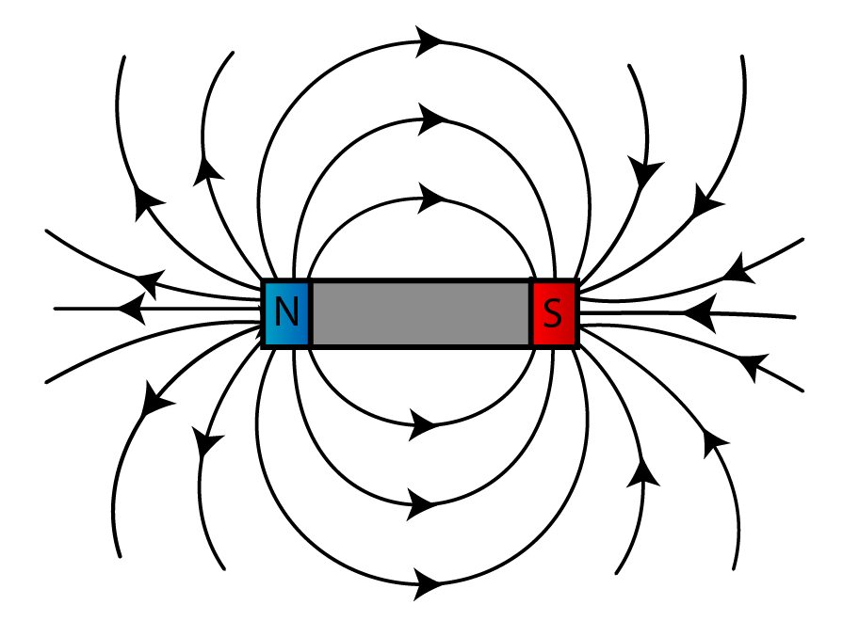
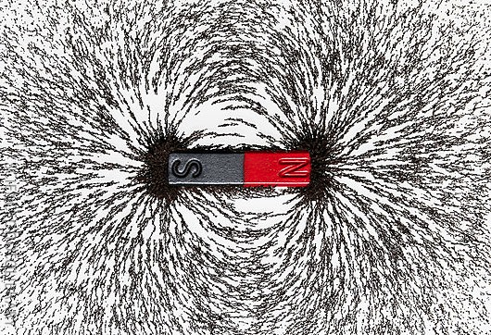
For MAGNETIC FIELDS we instead found that:
They are NOT mere abstractions, they can apparently be seen!
But what we see is NOT a simple map of magnetic force!!
The only thing these maps
directly represent is how iron filings
move when they're near a magnet:
But FROM such maps we CAN figure out how another magnet will move,
by making use of this alternative set of rules:
- Parallel "magnetic field lines" repel each other
- Anti-Parallel "magnetic field lines" attract each other
- The closer the lines are, the stronger these effects
Left figure: http://spmphysics.onlinetuition.com.my/2008/06/introduction-to-magnetism-revision.html
Right figure: http://www.magnetyze.com/page/magnetic-fields.aspx

Slide 6
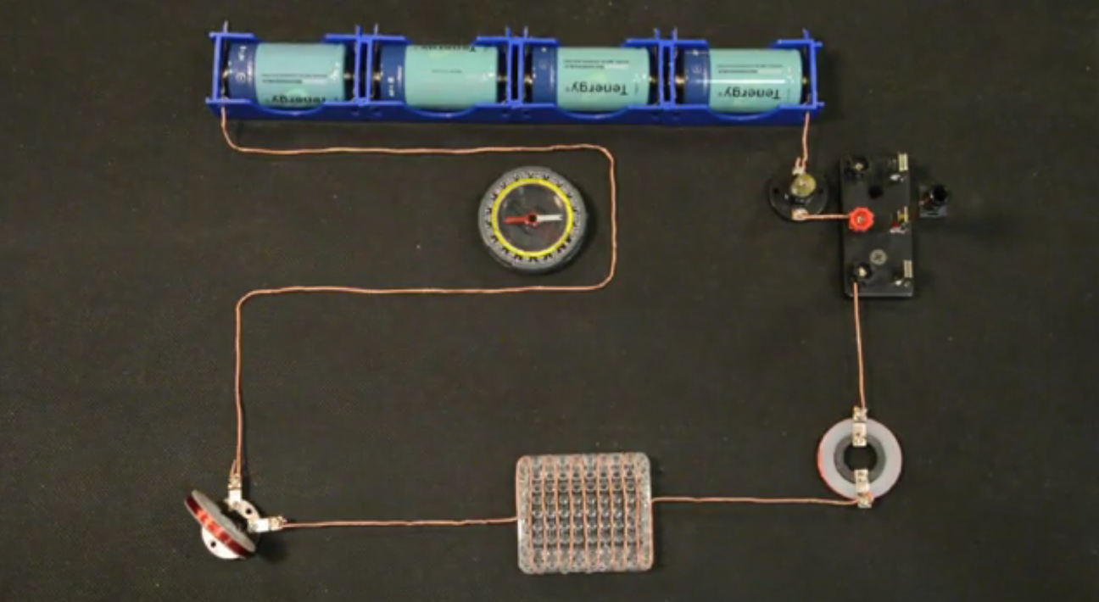
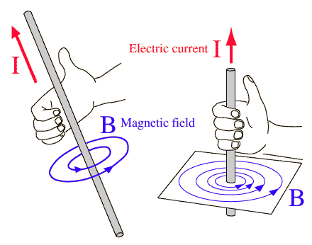
Then, based on experiments such as this:
We figured out that, in addition to permanent magnets,
Flowing Electric Charge produces Magnetism = ELECTRO-MAGNETISM
Which is described by "hand rules" (this set is known as Lenz's Law):
Right Hand Rule for moving + charge
Left Hand Rule for moving – charge
+ Charge Flow
- Charge Flow
B Magnetic Field
B Magnetic Field
Thumb in direction of + charge flow,
Magnetic field is along curled right fingers
Thumb in direction of - charge flow.
Magnetic field is along curled left fingers

Slide 7
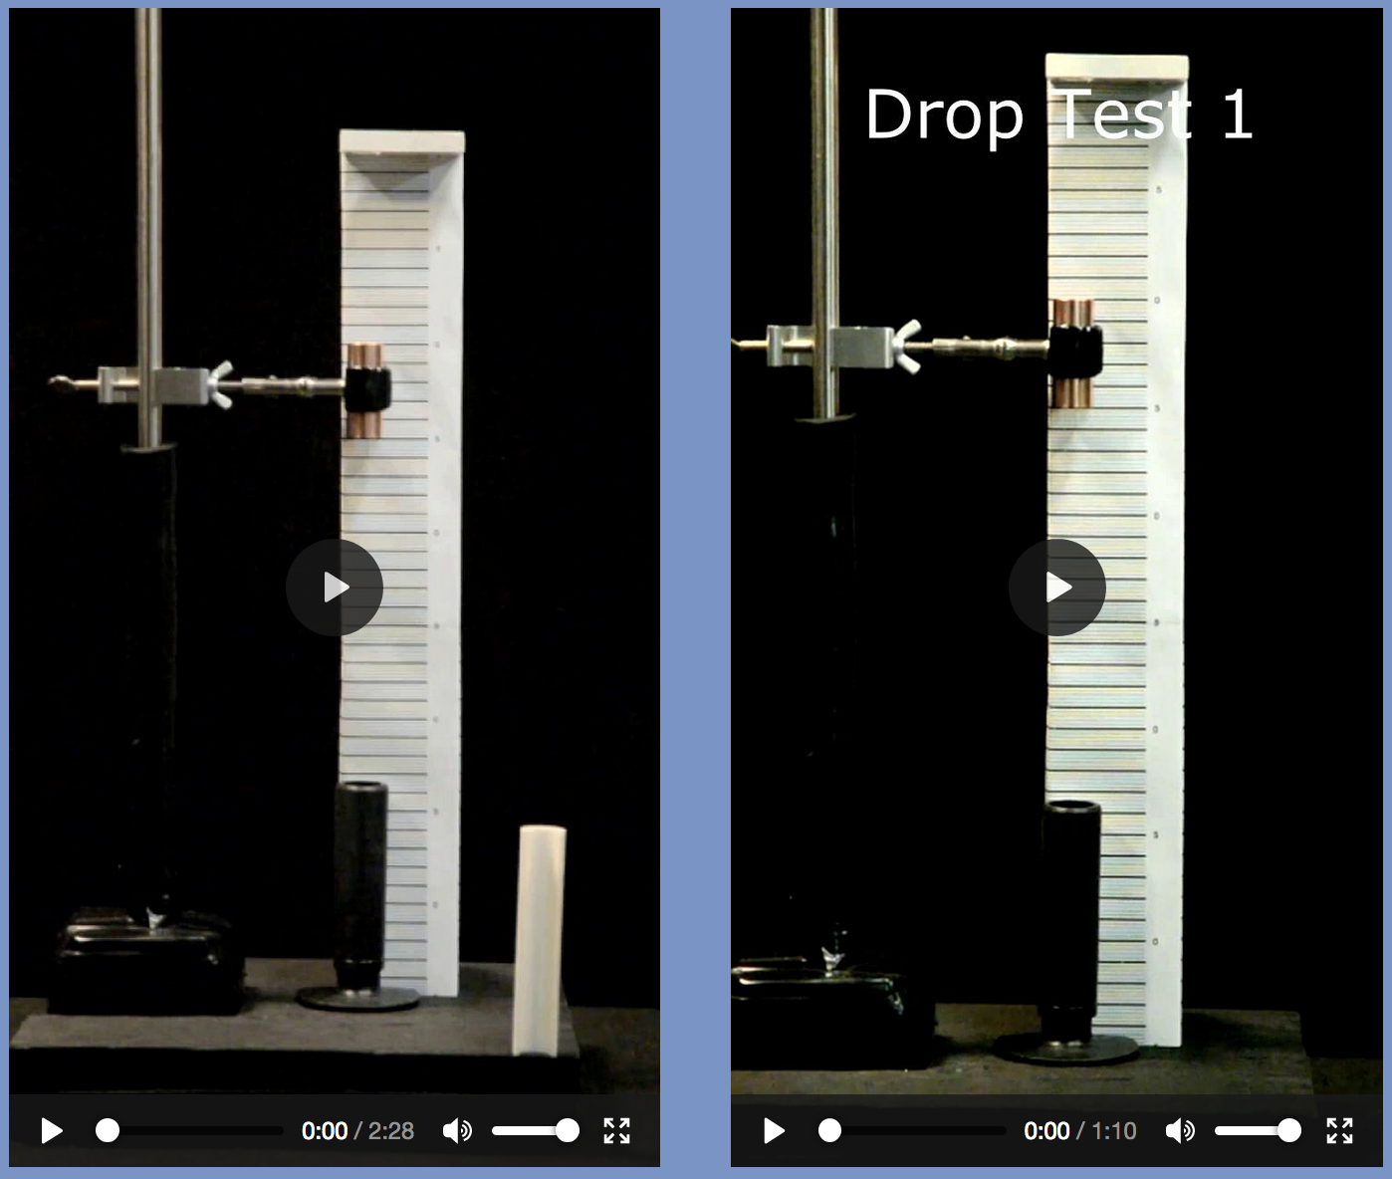
Further experiments taught us that:
MOVING Magnetic Fields apply a force upon charges
This also occurs when charges MOVE THROUGH Magnetic Fields
But this force depends subtly on the directions of the Magnetic Field and the motion
This geometry produces a force:
But this geometry does not:
Electron velocity as seen by magnet
Electron velocity as
seen by magnet
Force on Electron
(back into page)
Electron
NO FORCE ON ELECTRON !
Magnetic field
Electron
Magnetic field

Slide 8
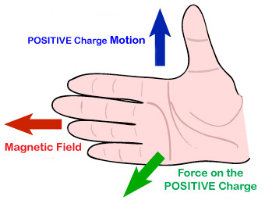
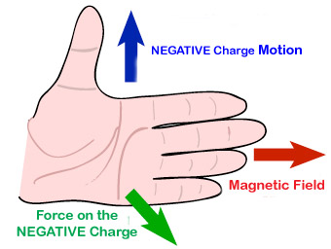
Which can be described by a another set of "hand rules"
Right Hand Rule for positive charges: Left Hand Rule for negative charges:
"MOTION" = Part of electron’s velocity that is perpendicular to the magnetic field
(this velocity being evaluated from the magnet’s perspective)
Because this force is INDUCED by MAGNETIC Field motion relative to charges
This phenomenon is called MAGNETIC INDUCTION
(it is also referred to as the "magnetic part of the Lorentz Force")

Slide 9
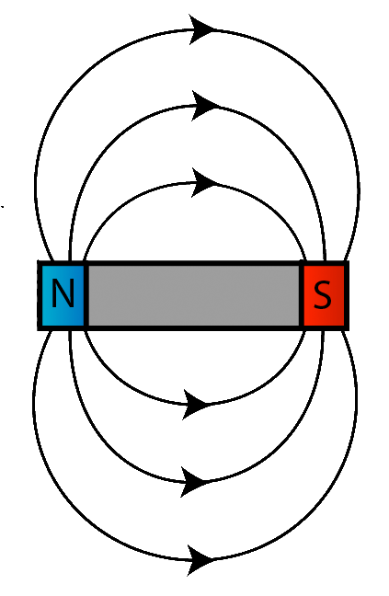
Magnetic Induction drives the formation of electron loops in conductors
These induced electron loops are
often called EDDY CURRENTS
Electro-Magnetism then causes the electron loop to produce its own magnetic field
Its electro-magnetic field lines parallel those of moving magnet (in black)
The two magnets (permanent and electro) thus push against one another
An Introduction to Sustainable Energy Systems: WeCanFigureThisOut.org/ENERGY/Energy_home.htm

Slide 10
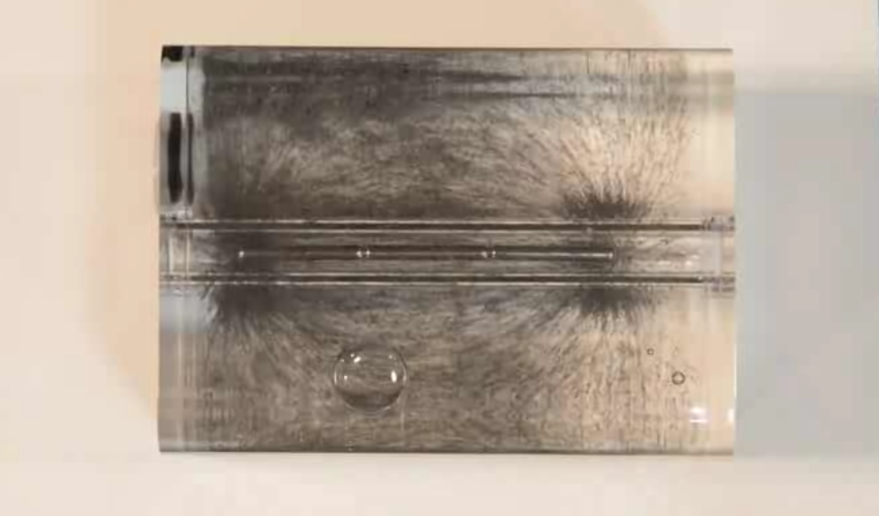
I am now almost ready to explain electric motors & generators!
But we first need to explain one more observation from the last note set:
In the demonstration shown on the left (= Demonstration #2 at this LINK)
We saw iron filings form and then flow along these looping lines
WHY do they to do this?
The somewhat complex explanation:

Slide 11
Electro-magnetism causes looping charge to produce a magnetic field
Well, individual electrons ARE just blobs of charge, what if THEY can spin?
Spinning electron clouds => Tiny loops of current => Tiny magnetic fields
Physicists discovered that electrons DO indeed generate tiny magnetic fields
Which they first attributed to "electron spin"
Later, more sophisticated (and vastly more obscure) Quantum Mechanics
concluded that it wasn't as simple as just spinning clouds of charge
But QM still concluded that individual electrons DO have tiny magnetic fields,
which it still refers to as "electron spin"

Slide 12
What if a material's "spinning electrons" meet an applied magnetic field?
Heat tries to randomize the orientation of the electrons, along with their "spins"
But when a magnetic field is it IS applied, the parts of it penetrating the material
will drive the spins to rotate their magnetic fields in the opposite direction
An Introduction to Sustainable Energy Systems: WeCanFigureThisOut.org/ENERGY/Energy_home.htm

Slide 13
The spin magnetic fields will then blend into a counter magnetic field:
Which will ATTRACT the external magnetic field, drawing more of it inside
This REDUCES the intensity of the MAGNETIC FIELD REMAINING OUTSIDE
Increased spacing of the remaining external field lines => Lowered energy!

Slide 14
If our iron filings are those bits of of material:
They can better suck in field (lowering its energy) by rotating along the field lines:
But they can suck in MUCH MORE field if they also assemble into nose-to-tail chains:
A majority of "external" magnetic field lines can then be sucked in,
leaving a vastly weaker, and thus lower energy, magnetic field outside,
=> Our iron filing patterns of "magnetic field lines"

Slide 15
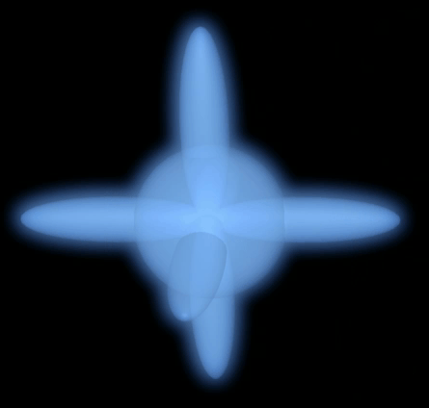
But this does NOT occur for ALL materials
In many materials, spins themselves pair up oppositely (countering charge repulsion)
In some atoms, spin directions are locked by electrons in other atomic orbitals
And in some atomic mixtures (such as steels),
minute quantities of certain impurities can lock up spins
For a material to suck in magnetic fields
(which ALSO means that it will be ATTRACTED BY MAGNETS)
IT MUST HAVE SOME UNPAIRED, UNLOCKED, ELECTRON SPINS
Magnetic fields of paired electrons cancel
=> External magnetic fields then have no effect

Slide 16
But if spins ARE free to align opposite to an applied magnetic field:
Then that material is called a ferromagnetic (= it behaves like iron)
Ferromagnetic materials are attracted to magnets
Ferromagnetic shapes trap & redirect external magnetic fields
And because ferromagnetic materials DO "suck in" magnetic fields:
They can be made into special shapes, called POLE PIECES, which
concentrate and direct magnetic fields where we need them,
as required in both electric motors and electric generators
Which I am NOW FINALLY ready to explain!

Slide 17
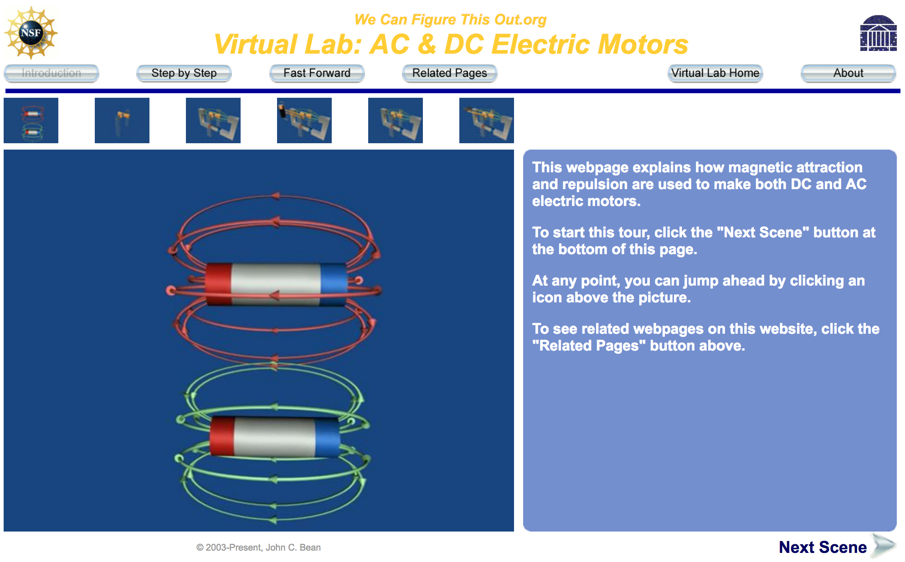

Motors and generators depend upon the motion of magnetic fields
Static images & figures cannot show motion. Nor can Magnetic Fields be videotaped
Hence the computer-animated "Virtual Lab" section of WeCanFigureThisOut.org
Where I've posted my fully animated explanation of motors and generators
Please now view that complete presentation:
(For each scene: View the animation, read the text explanation, then repeat the animation)
Its Link: AC and DC Electric Motors Its explicit URL: https://www.wecanfigurethisout.org/VL/Motors.htm

Slide 18
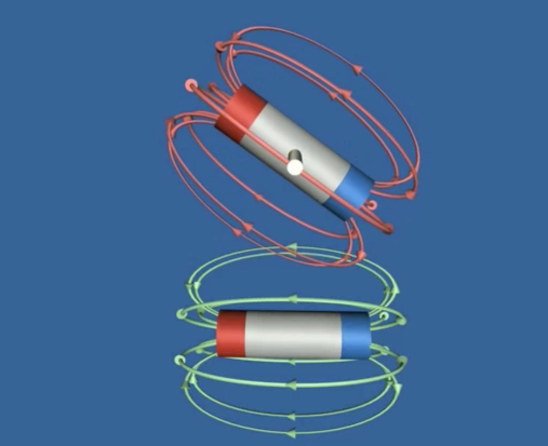
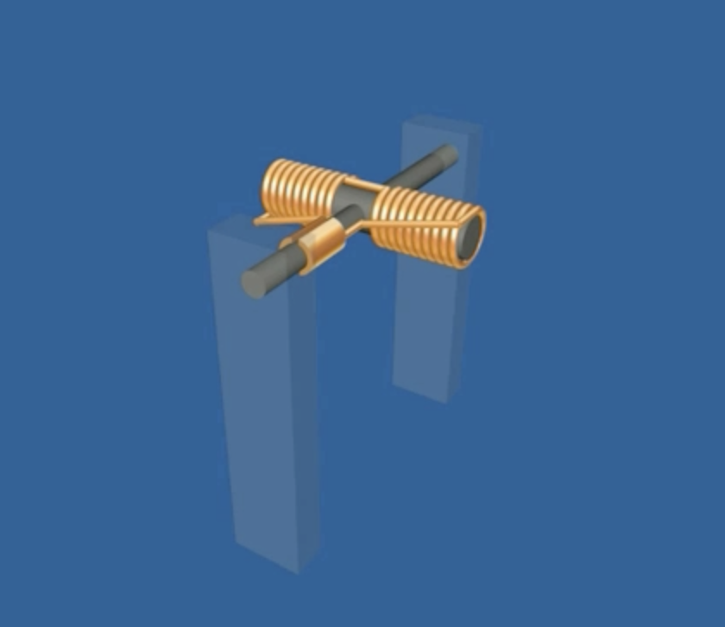
Review of preceding "AC & DC Electric Motor" presentation:
Scenes 1 & 2:
How one magnet can cause another to rotate.
How magical pole switching could sustain rotation.
Scenes 3 & 4:
How the top permanent magnet can be
replaced with a non-magic electro-magnet.
An Introduction to Sustainable Energy Systems: WeCanFigureThisOut.org/ENERGY/Energy_home.htm

Slide 19
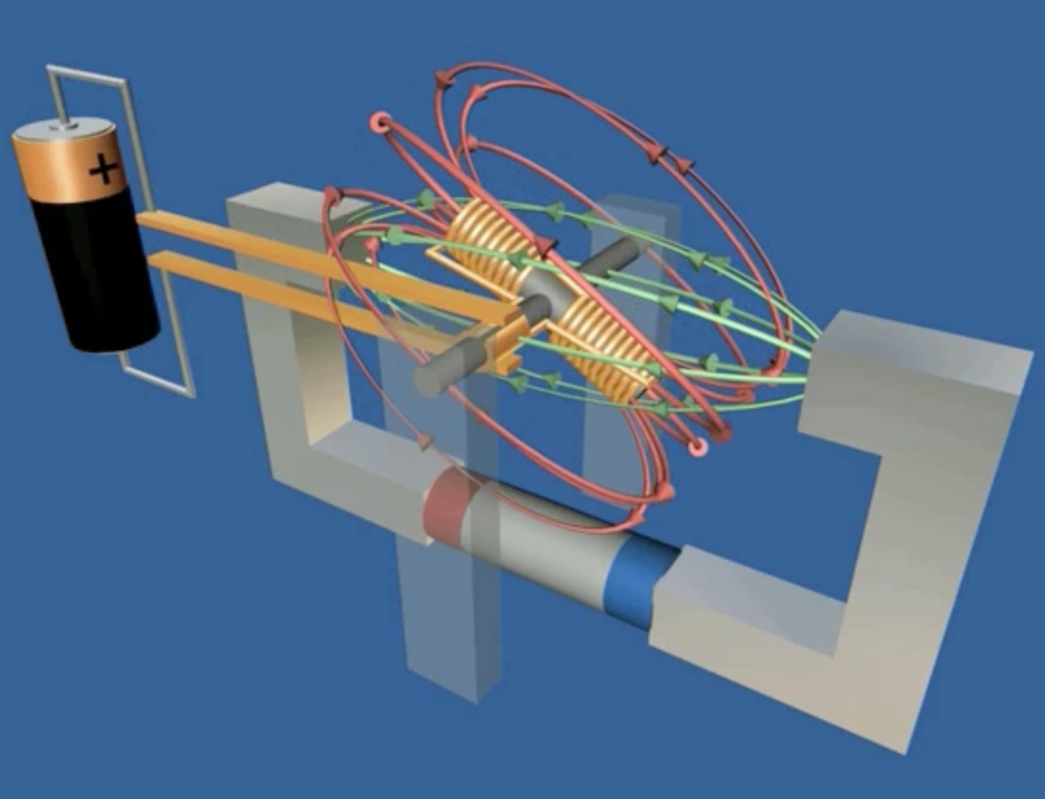
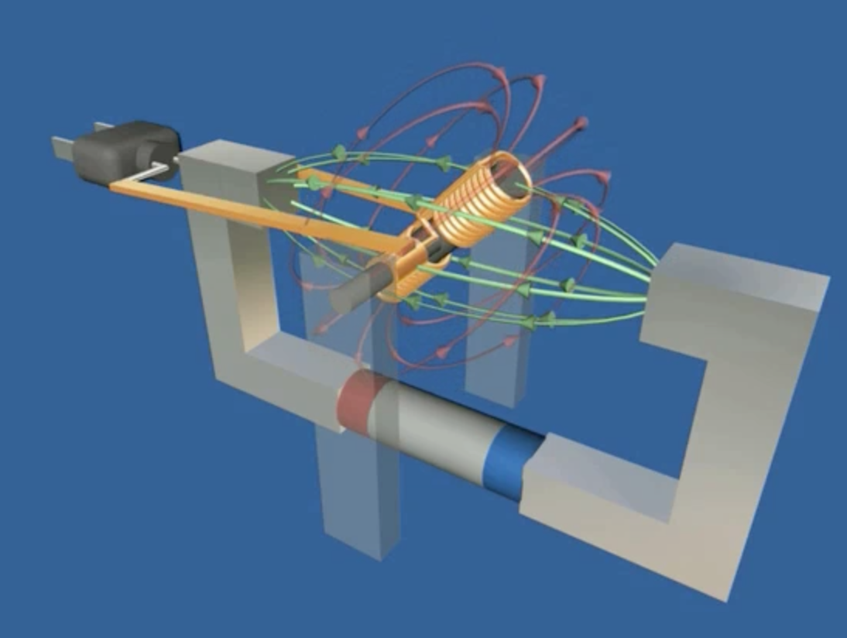
Review of preceding "AC & DC Electric Motor" presentation (continued):
Scenes 5 - 8:
How "split-ring" battery contacts can then switch the electro-magnet's direction of current flow every half turn
Scenes 8 - 11:
How a different (simpler) set of contacts can send naturally switching AC current to the electro-magnet
An Introduction to Sustainable Energy Systems: WeCanFigureThisOut.org/ENERGY/Energy_home.htm

Slide 20
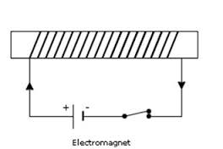
A subtle problem: The Motor's torque is not constant during rotation
Using all permanent magnets, let's run through a half turn of motor rotation:
Start of turn:
Nearly parallel magnetism
LOTS of repulsion
LOTS of torque
¼ turn:
Perpendicular magnetism
MINIMUM repulsion
MINIMUM torque
Nearly ½ turn:
Nearly anti-parallel magnetism
LOTS of attraction
LOTS of torque
Thickness of yellow PowerPoint arrow ends up representing torque vs. rotation!

Slide 21
A solution: Multiple rotor electromagnets
During first 1/4 turn:
YELLOW electromagnet ON
~ Parallel magnetism
Maximum torque
ORANGE electromagnet OFF
No magnetism, NO torque
At ¼ turn:
Turn YELLOW electromagnet OFF
=> No torque
Turn ORANGE electromagnet ON
=> Torque
During second 1/4 turn:
YELLOW electromagnet OFF
No magnetism, NO torque
ORANGE electromagnet ON
~ Parallel magnetism
Maximum torque
Keep turning NEW electromagnets on
WHEN they are oriented to push most strongly!
An Introduction to Sustainable Energy Systems: WeCanFigureThisOut.org/ENERGY/Energy_home.htm

Slide 22
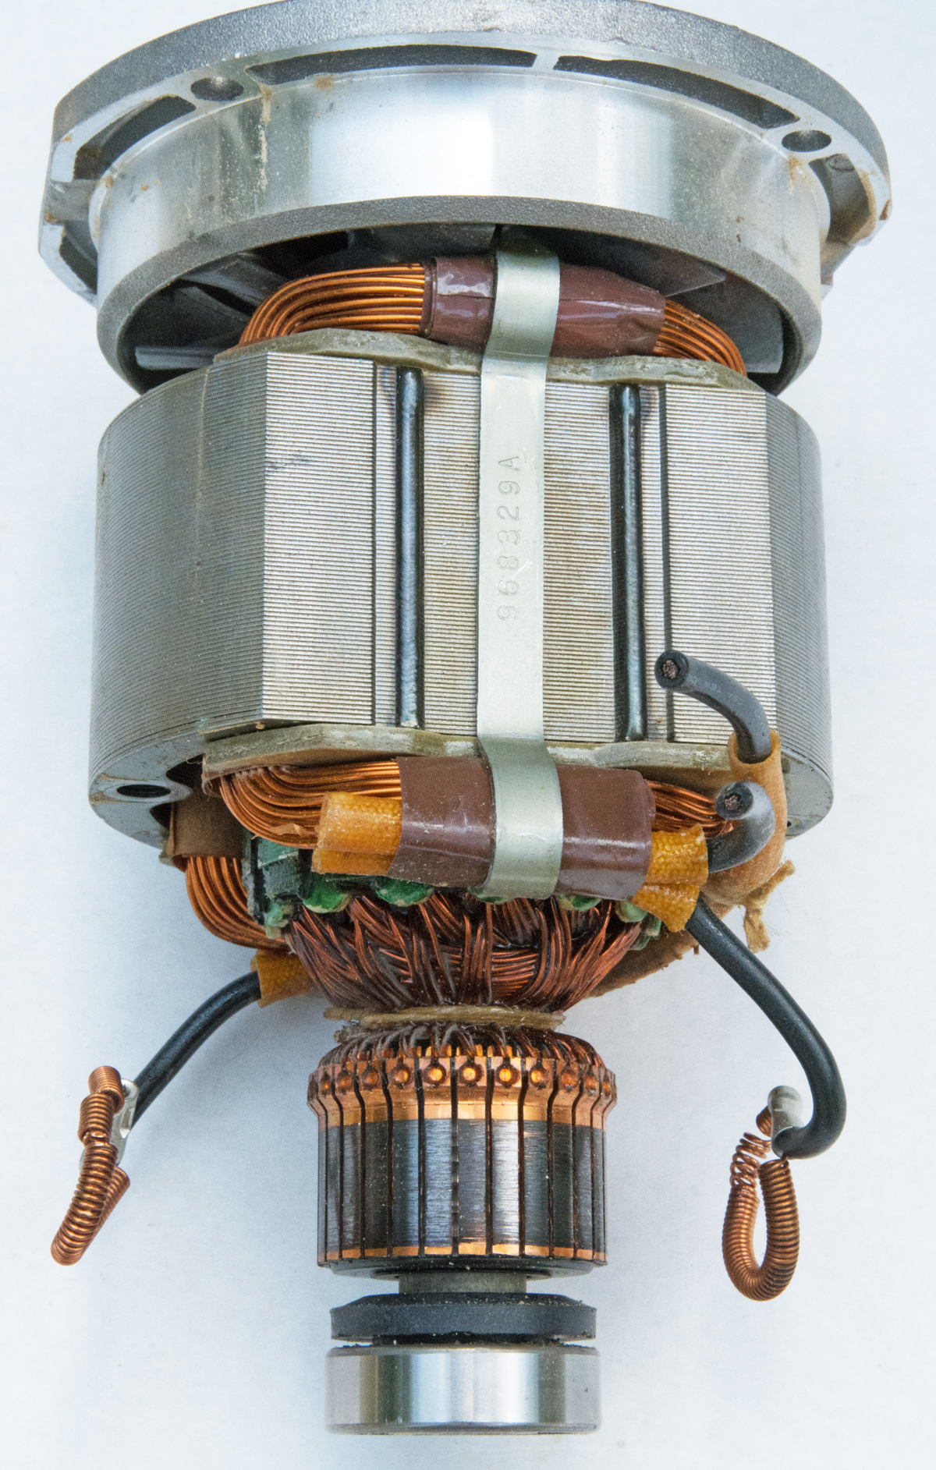
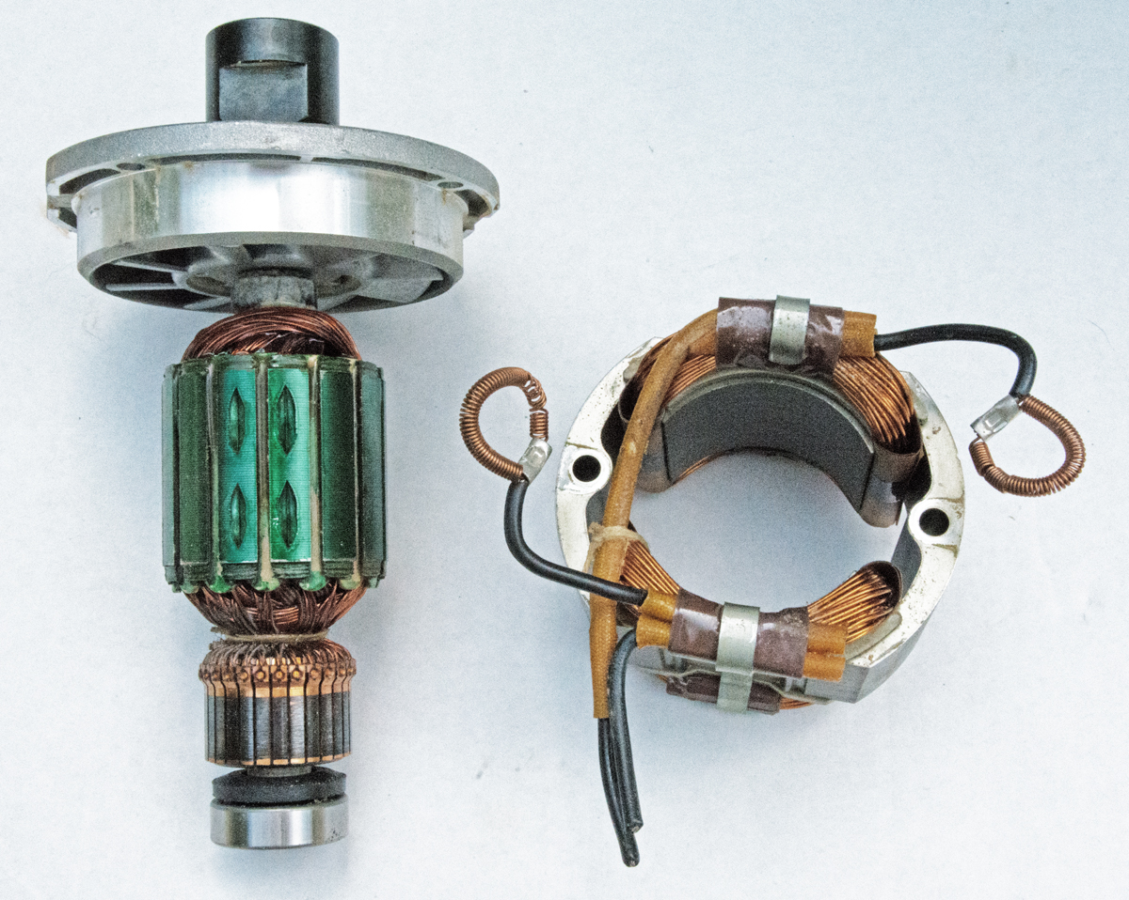
Taking that to an extreme:
Photographs I took of the motor from an old woodworking router tool:
LEFT: "Stator" pair of electromagnet
RIGHT: Rotor with MANY electromagnets
Assembly minus the tool's outer shell (which took with it part of contact assembly):
An Introduction to Sustainable Energy Systems: WeCanFigureThisOut.org/ENERGY/Energy_home.htm

Slide 23
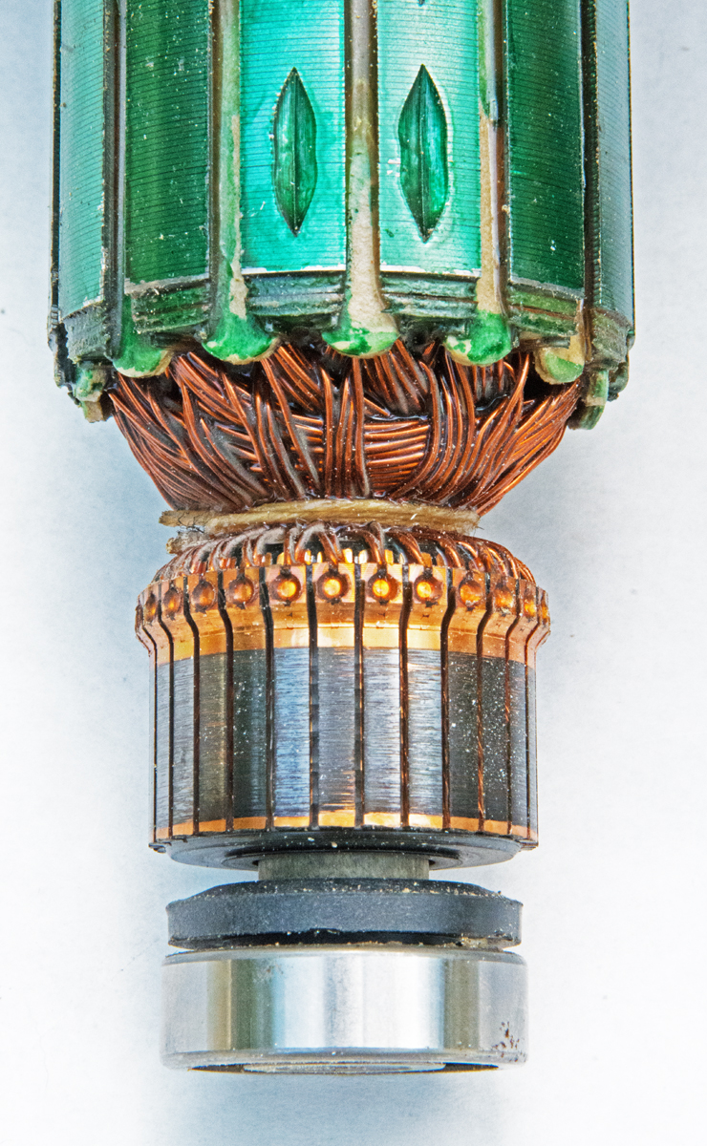
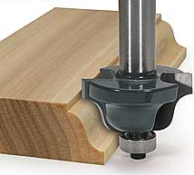
Close-up of rotor:
The electromagnets are wrapped around green-tinted rectangular pole pieces:
Their wires then run down to the sections of split ring near the bottom
But THIS ring has not been split in half
It has been divided in to 28 contacts!
At two contacts per electromagnet
28 contacts => 14 electromagnets
(confirmed by count of the green rectangles)
The manufacturer did this because wood routers
drive HUGE cutting bits into wood
and they thus require LOTS of continuous torque!

Slide 24
So my router motor was actually more like this:
OUTER ("stator") AC electromagnet pair, switching polarity 120 times a second
AC
INNER ("rotor") AC electromagnets (14 rather than the 4 that I fit into drawing)
Only ONE of which receives AC power at any time
That ONE "selected" by its contacts rotating under the fixed "brushes"

Slide 25
BIG ENERGY SYSTEM TAKEAWAY MESSAGE #1:
In ALL of the above: CAUSE & EFFECT ARE INTERCHANGEABLE
Moving currents create magnetic fields (via Lenz's Law)
Switching currents => Switching Magnetic Fields = The basis of Motors
Moving magnetic fields induce currents (via the Lorentz Force)
Rotation of charge-containing wires in a magnetic field =>
Induced current flow in those wires = The basis of Generators
Electric Motors and Electric Generators thus have the SAME structure
One is just the other "being run backwards"
Turn a DC motor => You get DC POWER OUT = DC generator
Turn an AC motor => You get AC POWER OUT = AC generator

Slide 26
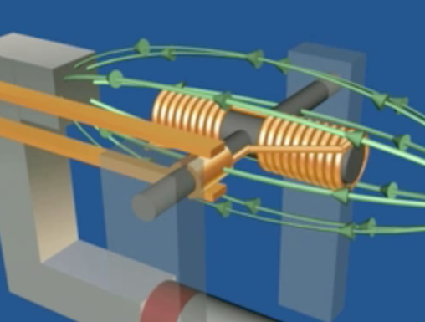
But there are complications in really Good or Big motor/generators
Strong permanent magnets are really large and heavy
Not something you really want to spin at thousands of RPM!
Thus, where possible, spinning electro-magnets are substituted
But spinning electromagnets have their own problem:
Those rubbing contacts ("brushes"), either DC split ring or dual AC ring:
They wear away!
Especially split rings (which can also spark when the contacts slide over gaps)!
An Introduction to Sustainable Energy Systems: WeCanFigureThisOut.org/ENERGY/Energy_home.htm

Slide 27
And there is an additional (embarrassing) problem in Big Generators:
If you build a big generator using ONLY electromagnets
You will NEED SOME INPUT POWER TO PRODUCE OUTPUT POWER
Why? because you have got to START with a magnetic field
Which can then be rotated to induce electrical current in a wire
This magnetic field can be in the rotating "rotor" part of the generator
DC current applied to rotating electromagnet => Rotating B field
OR the rotating magnetic field can be created by stationary "stator" electromagnets
AC current applied/switched between electromagnets => Rotating B field
Either way you need power INTO electromagnets to get power OUT of the generator
THUS: A Hydroelectric Dam w/o Grid or local auxiliary power
may not be able to produce power even when water is spinning its generators!

Slide 28
Reflecting on those motor / generator challenges:
There's no easy solution for the preceding generator complication
That of needing a little incoming power to generate a lot more output power
But there IS a solution to the problem of massive rotating permanent magnets
And there IS a solution to the problem of contact wear in rotating electromagnets
What if you could completely do away with the rotating magnet
And just make the "rotor" out of a dumb unpowered chunk of metal?
HUH?
What would the magnets of the "stator" push against ? (!@$!)
An Introduction to Sustainable Energy Systems: WeCanFigureThisOut.org/ENERGY/Energy_home.htm

Slide 29
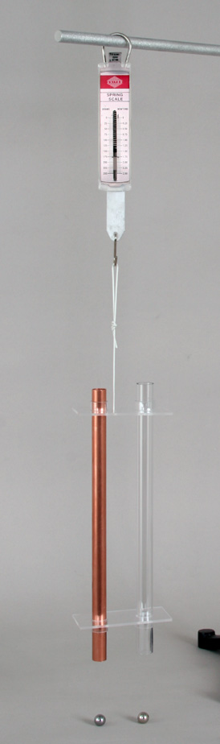
Nikola Tesla figured out the solution!
You saw it in the video demonstrations & explanations of the preceding note set!!
LINK to those video demonstrations / LINK to that note set's explanations
When a magnet fell through a (non-magnetic) copper pipe, its fall was slowed
BECUASE its movement induced loops of current in the pipe
Those loops of current generated their own magnetic field
Which pushed back upon the falling magnet
But via Newton's: "Action = reaction"
The pipe was also pushed downward
And we actually measured the force on the pipe using this apparatus:
"Lenz's Law Apparatus" (#32520) from The Science Source (www.thesciencesource.com)

Slide 30
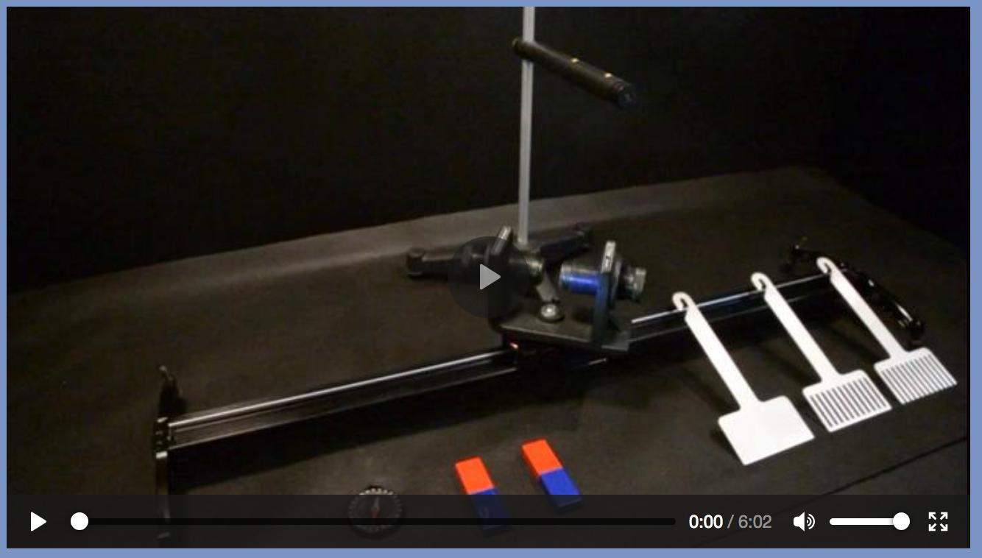

But how would falling magnets + pipes be made into an electric motor?
OK, Nikola Tesla's new motor idea actually followed more naturally from
this OTHER apparatus I demonstrated for that note set
If you have not recently viewed that demonstration, please do so now
It is demonstration #9, near the bottom of this webpage: LINK or QR code:

Slide 31
Exactly HOW the moving magnet pushed upon the aluminum shapes:
Solid aluminum paddle with movable electrons
Electron's motion
as seen by magnet
Magnet's direction
of movement (leftward)
Magnet's field
As magnet enters from right (it's field pointing into page):
its field first encounters right (leading) edge of paddle
Magnet perceives electrons in paddle as moving rightward
Lenz's LH Rule: Thumb right, fingers into page
Electrons at right of paddle pushed out of left palm = DOWN
Electrons at right/far edge of paddle scurry back upward

Slide 32
The arriving magnet thus "induces" loops of electron flow:
Then, via electro-magnetism's LH Rule (curled fingers):
Green loop of electrons generates blue magnetic field loops
Which, where they meet the red incoming magnetic field, are PARALLEL
So magnet & induced fields repel one another
Magnetic
field movement
Which works the same way, almost as
well, with this second aluminum shape

Slide 33
But in the "comb" shape an induced electron loop cannot form:
Shape #1 Shape #2 Shape #3
Magnetic
field movement
By blocking the induced electron current loops in the final comb shape
a parallel magnetic field is NOT set up in the COMB
and there is NO resistance to passing a magnet field through it!

Slide 34
From this, Nikola Tesla proposed the "induction motor"
Which as its rotating core ("rotor") did NOT use ANY magnets
It was instead a simple metal shape, with absolutely no electrical connections
(Mimicking our aluminum shapes above)
It was propelled by electro-magnets effectively rotating in a circle around it
"Effectively rotating" because there was actually a circle of electro-magnets
That were all, in fact, stationary
The trick? Energizing pairs of electro-magnets in a rotating sequence
How? By connecting them up to three "out-of-phase" AC power lines
An Introduction to Sustainable Energy Systems: WeCanFigureThisOut.org/ENERGY/Energy_home.htm

Slide 35
Diagrams of the required three AC power line voltages:
Three "out of phase" AC (alternating current / voltage) signals:
Signal 1)
Signal 2)
Signal 3)
Arrows mark when each reaches a positive or negative peak
Time / Degrees
Time / Degrees
Time / Degrees

Slide 36
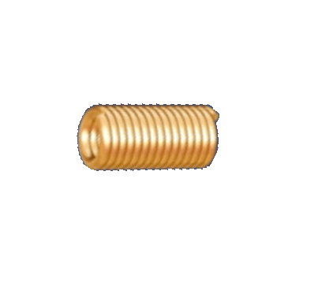
Apply each of those signals to a PAIR of stator electromagnets:
One electromagnet:
Pair of electromagnets, wired together "in series:"
Which (including AC power source), I will represent this, OR just this:
AC
AC

Slide 37
Three such electromagnet pairs, each powered by its own AC:
Each of those pairs rotated 1/3 of a circle from each other:
AC current/voltage #1 to blue electromagnets
AC current/voltage #2 to pink electromagnets
AC current/voltage #3 to green electromagnets
AC2
AC3
AC1

Slide 38
Looking more closely at the timing of the three AC power signals:
Noting exactly when each AC signal reaches its highest and lowest point:
Signal 1)
Signal 2)
Signal 3)
Arrows mark when each AC power signal reached an up or down peak
Time / Degrees
Time / Degrees
Time / Degrees
0
90
180
270
360

Slide 39
AC peaks => Max fields from the connected electromagnet
Combining the timing of AC "up" and "down" peaks
with the orientations of the three connected electro-magnets:
Timing & orientation of "up" peaks Timing and orientation of "down" peaks
Resulting, at those times, in these magnetic field directions within the motor:
0
60
120
180
240
300
180
Net Result:
Magnetic Field,
rotating in circles!
240
120
300
60
0

Slide 40
Now, between those electromagnet pairs, put a plain metal ring
Then apply the LH Rule of Magnetic Induction:
Using this to figure out electron flow in metal ring:
Red: Rotating magnetic field
Blue: Motion of charge, relative to field
Green: Force on electrons => movement
An Introduction to Sustainable Energy Systems: WeCanFigureThisOut.org/ENERGY/Energy_home.htm

Slide 41
Next apply Lenz's LH Rule of Electro-Magnetism:
To figure out the magnetic field created by those now moving electrons
- Charge Flow
B Magnetic Field
The edges of the ring's induced magnetic field
PARALLEL those of the rotating field
So these two fields REPEL one another
Rotating field will thus drive rotation of ring
An Introduction to Sustainable Energy Systems: WeCanFigureThisOut.org/ENERGY/Energy_home.htm

Slide 42
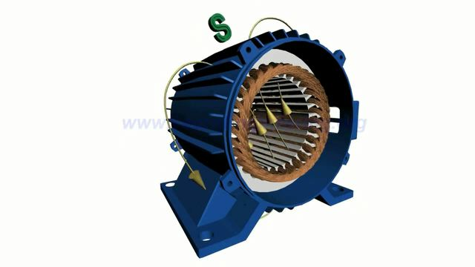
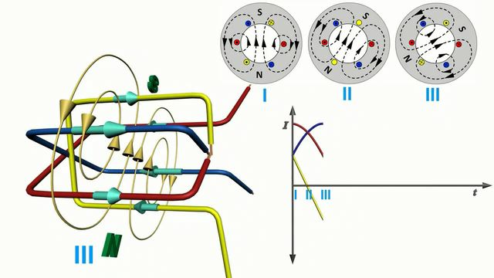
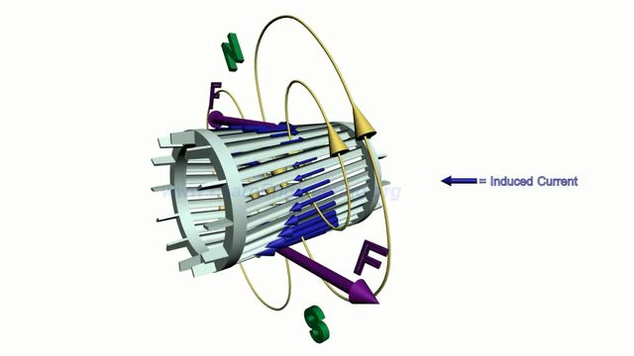
As depicted in this "www.LearnEngineering.org" animation
Screenshots from the almost five minute long animated tutorial:
One of MANY excellent teaching animations on this website
Link to original: www.learnengineering.org/2013/08/three-phase-induction-motor-working-squirrel-cage.html
YouTube posting: www.youtube.com/watch?v=LtJoJBUSe28&feature=kp

Slide 43
"Slip?"
Did you catch that animation's reference to slip?
The idea that rotor had to rotate more slowly than rotating magnetic field?
Slip did NOT OCCUR in our earlier permanent magnet or electro-magnet motors
But it MUST OCCUR in induction motors because
to have an effect on charges (rather than on other magnets)
the applied magnetic field must be MOVING relative to those charges
If the rotor kept pace with rotating field, there would be no relative motion!
Instead, the rotor HAS to rotate more slowly than the magnetic field
so that the rotating magnetic field is always moving towards it,
which THEN induces current in rings => Induced magnetic field,
which pushes back against rotating applied field

Slide 44
Time Out!
But this induction/brushless motor requires THREE DIFFERENT AC INPUTS!
Is it really worth all of that trouble?!
It's actually no trouble because the most efficient power station generators
naturally incorporate multiple pairs of stator coils
which naturally send three different phases of AC power into the Grid!

Slide 45
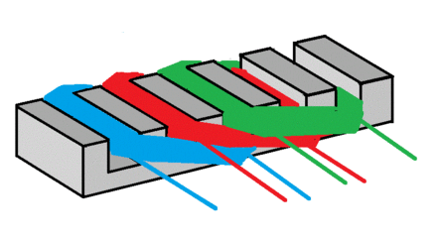
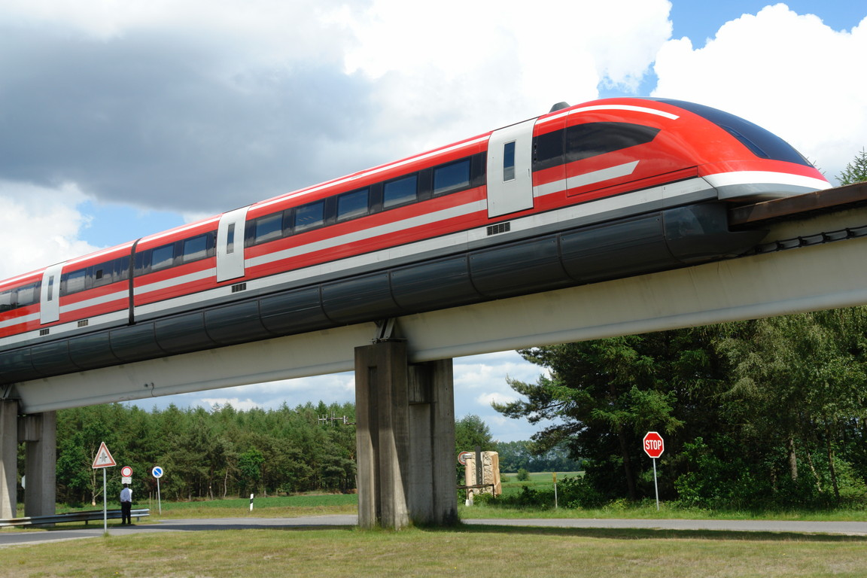
Flattening out this motor yields a Linear Induction Motor
Which can propel metal shapes in a line by passing moving magnets below them:
But in lieu of moving permanent magnets, a linear induction motor makes use of
long rows of electromagnets, which are turned on and off in sequence
=> Levitation & propulsion of MAGLEV TRAINS
As evident in this demonstration
https://en.wikipedia.org/wiki/Linear_induction_motor https://en.wikipedia.org/wiki/Maglev

Slide 46
On to this note set's final topic: TRANSFORMERS
What exactly IS electrical power? It involves flowing electrical charge
Which delivers power in a way that is analogous to water power
Imagine two pipes supplying water:
A Fat Pipe supplies lots of water flow, but at miniscule pressure
A Skinny Pipe supplies miniscule flow, but at at high pressure
NEITHER could supply very much water power, because to do much work:
You need BOTH flow AND pressure
In fact: Water Power = Flow x Pressure
The Electrical Power equivalent = Current x Voltage
An Introduction to Sustainable Energy Systems: WeCanFigureThisOut.org/ENERGY/Energy_home.htm

Slide 47
But what are the best choices of current and voltage?
Shortcomings of LARGE CURRENT:
Current = electron flow through a material
But flowing electrons bump into atoms, loosing kinetic energy
(=> vibration of those atoms = "heat")
So current flow => LOSS of electrical energy / power
Shortcomings of LARGE VOLTAGE:
Voltage is the analog to water pressure:
High pressure water requires thicker pipes
High voltage electricity requires thicker/better insulation
Insulation adds cost / takes up more volume
But too little insulation => chance of failure => electrocution!

Slide 48
The optimum choice thus depends upon the application:
When TRANSMITTING electrical power, we want to minimize losses
So there is a strong incentive to REDUCE CURRENT
But power is then maintained by using INCREASED VOLTAGE
When USING electrical power (especially in homes and/or appliances):
We often want to minimize bulk by minimizing the thickness of insulation
But to keep the chance of insulation failure to a minimum
We then need to DECREASE VOLTAGE
Maintaining power by by then using INCREASED CURRENT
And modern IC-based electronics insists on ESPECIALLY LOW VOLTAGES
But how can you move from one VOLTAGE to another?

Slide 49
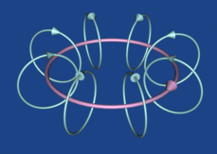
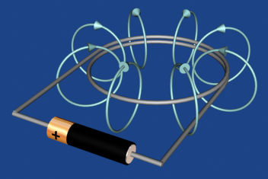
You need a transformer
We've seen how current loops produce magnetic fields (via electro-magnetism):
You can drive a (steady) loop of current by connecting a coil of wire to a battery

Slide 50
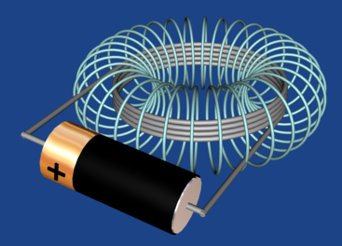
More turns of wire => More intense magnetic field:
One full circle: Versus four full circles:
But more loops => More resistance to current flow ("a longer pipe")
So you'll also need higher applied voltage ("pressure") to get the same flow
Which will require a larger (higher voltage) battery

Slide 51
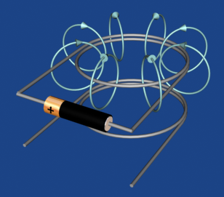
Place two such wire coils side by side
Close enough that the magnetic field from the 1st coil can impinge upon the 2nd coil
There is CHARGE in the lower 2nd wire coil
Constant current through upper 1st coil is making a constant MAGNETIC FIELD
That magnetic field impinges upon the charge in the 2nd coil
But it does not grow or contract, and thus does not MOVE by that charge
So NOTHING will happen in that 2nd coil!

Slide 52
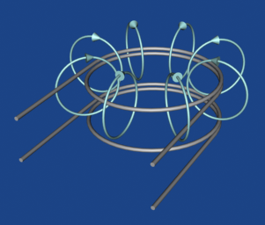
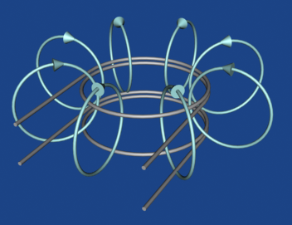
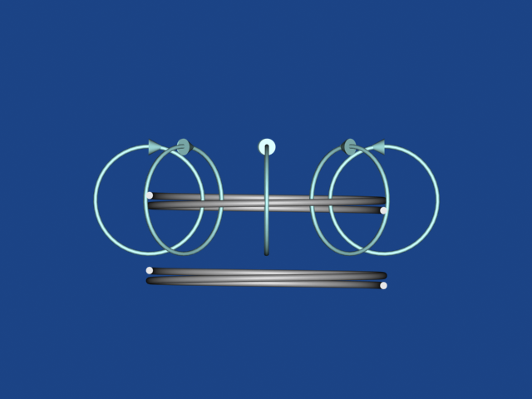
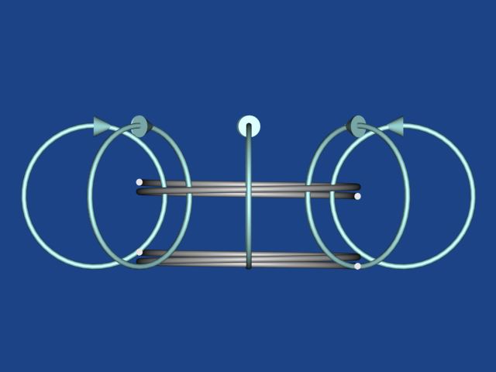
Instead, apply a CHANGING (AC) voltage/current to the top coil:
Time 1: Time 2 (increased voltage/current):
Side view: See how growing field from top coil sweeps thru the lower coil!
An Introduction to Sustainable Energy Systems: WeCanFigureThisOut.org/ENERGY/Energy_home.htm

Slide 53
But due to magnetic induction:
The sweep of top coil's growing magnetic thru the bottom coil
will try to induce a current flow out of that bottom coil
So AC electrical power can actually be transmitted between the coils!
Is this the current/voltage transformer that we are looking for?
Not yet, at least not with these ~ identical coils
We instead need mismatched coils:
An Introduction to Sustainable Energy Systems: WeCanFigureThisOut.org/ENERGY/Energy_home.htm

Slide 54
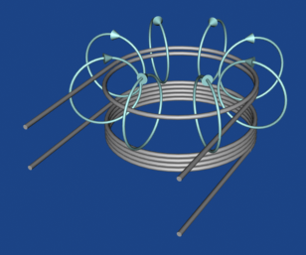
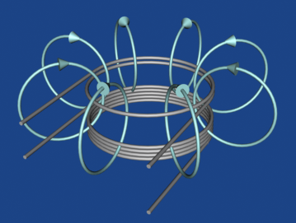
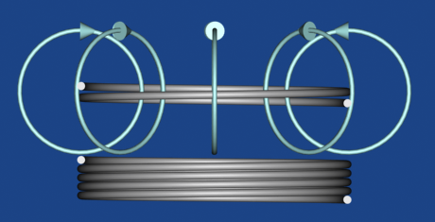
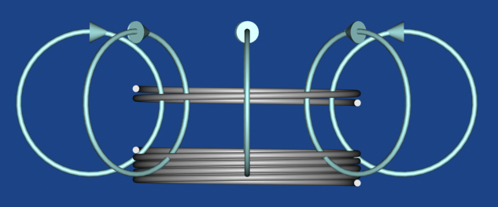
Coils with different numbers of turns:
Again apply AC (changing) voltage/current to the top coil:
Time 1: Time 2 (greater voltage/current):
Side views:
More turns intercepted at bottom => We expect MORE (something) coming out!

Slide 55
But more WHAT coming out?
We can't get more POWER out of the bottom coil than was put into the top coil
That would be creating power (and thus not conserving energy)!
But we CAN change the form of that constant power = Current x Voltage
But which goes up, which goes down?
Hint: The longer wire in the 2nd coil more strongly resists flow of current
With coils above we'd get higher voltage but lower current out of the bottom coil
An Introduction to Sustainable Energy Systems: WeCanFigureThisOut.org/ENERGY/Energy_home.htm

Slide 56
More generally:
For a TRANSFORMER (which IS two such closely spaced coils), with
N _{in} = number of input turns N _{out} = number of output turns
Apply an AC SIGNAL to the "input" coil
Because unchanging DC signals produce no magnetic induction!
Between the coils, voltages and currents will then be "transformed" as:
Voltage _{out} / Voltage _{in} = N _{out} / N _{in}
Which, for Power _{in} = Power _{out} (i.e., V_{in} x I_{in} = V_{out} x I_{out}) requires that:
Current _{out} / Current _{in} = N _{in} / N _{out}

Slide 57
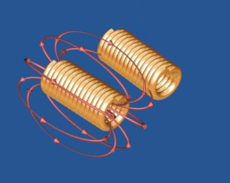
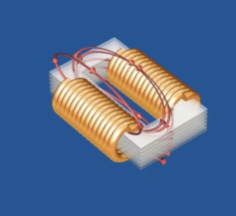
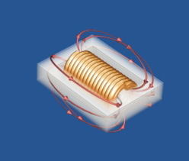
But that is for IDEALLY EFFICIENT magnetic induction!
It's the part of the magnetic field sweeping through the 2nd coil that does the work
But in our simple "transformers" above, most magnetic field is way out in space
Doing very little to couple the input and output coils together!
So an efficient transformer must redirect/concentrate magnetic fields
Which (as we did with motors) can be done by adding "pole pieces"
Consisting of materials that, like iron, tend to "suck in magnetic fields"
(Remember? Due to reorientation of "electron spins")

Slide 58
For anyone interested in the details:
Those more efficient transformer designs are fully explained in my
virtual reality animations on this note set's Resources Webpage (link)
But rather than further risk brain freeze, I think it's more important that I now
wrap up with a summary of this note set's most important points:

Slide 59
Magnetic Induction provides the basis of:
DC electric motors which, if we drive their rotation, become DC generators
AC electric motors which, if we drive their rotation, become AC generators
Including Nikola Tesla's clever AC induction / "brushless" motor
Which requires nothing other than a piece of metal for the rotor
(for which there is a similar - but not identical - generator design)
MOTORS (along with heaters) are our #1 consumers of electrical power
GENERATORS now provide 99% of that U.S. electrical power
(With the remaining 1% is instead provided by photovoltaic solar cells)

Slide 60
Magnetic Induction also provides the basis for:
AC transformers which allow us to alter AC voltages and currents
And to do this cheaply, compactly, and very efficiently
For motors, AC power is more versatile & more controllable:
DC motors change speed any time the voltage wanders or the load changes
But AC motor speed is pretty much locked into the AC power frequency
And ONLY AC power can be "transformed" via transformers
Allowing for separately optimized power transmission AND power consumption
Thus, while some early power systems were built with DC and others with AC,
for instance in the US: Thomas Edison's ruthlessly promoted DC systems
versus Nikola Tesla & George Westinghouse's AC systems
By more effectively exploiting Magnetic Induction
AC power systems won out . . . EVERYWHERE!

Slide 61
Credits / Acknowledgements
Some materials used in this class were developed under a National Science Foundation "Research Initiation Grant in Engineering Education" (RIGEE).
Other materials, including the WeCanFigureThisOut.org "Virtual Lab" science education website, were developed under even earlier NSF "Course, Curriculum and Laboratory Improvement" (CCLI) and "Nanoscience Undergraduate Education" (NUE) awards.
This set of notes was authored by John C. Bean who also created all figures not explicitly credited above.
Copyright John C. Bean
(However, permission is granted for use by individual instructors in non-profit academic institutions)
An Introduction to Sustainable Energy Systems: WeCanFigureThisOut.org/ENERGY/Energy_home.htm

