Slide 1
Electric and Magnetic Fields
John C. Bean
Outline
Teaching "E & M" by memorizing equations vs. watching things happen
Our personal experiences with electric fields / The experiences of one British schoolmaster
Electric charge: Two canceling types, attractive to each other, repulsive to themselves
Electric Fields: An abstract way of mapping out the forces between electric charges
Magnetic Fields: Metal filing trails that are NOT force maps
How such non-force-maps can nevertheless explain the forces between magnets
Electro-Magnetism: How charges (driven by Electric Fields) can generate Magnetic Fields
The gravity-defying fall of magnets through non-magnetic metal pipes
Explained by Magnetic Induction = Propulsion of electrons by passing Magnetic Fields
=> Causing their Electro-Magnetism to create an opposing Magnetic Field
Explaining (eventually) metal recycling, maglev trains, electric generators, electric motors . . .
(Written / Revised: July 2019)

Slide 2
Electric and Magnetic Fields
In my introductory note sets, I raised two points:
1) To affect energy, you must study whole Energy SYSTEMS
Why? Because stand-alone technologies can have surprisingly little impact
The prime example? Solar Cells
Which still struggle to provide even 2% of U.S. power!
2) Study of Energy Systems requires a feel for Electricity & Magnetism
Why? Because electricity & magnetism often act in unexpectedly weird ways
Which can make seemingly simple things very not simple
Such as the efficient long distance transmission of electrical power
Which impedes adoption of many sustainable energy alternatives!

Slide 3
But what do I mean by "a feel" for electricity & magnetism?
Well, it will be useful to have basic answers to questions such as these:
What ARE Electric and Magnetic Fields?
How are they different (or similar)?
How and when they are created?
What sort of things does each act upon (or not act upon)?
Can they interact with one another?
What constitutes a basic answer? An intuitive sense for how these things work
Which is very different from a complete mathematical answer
(which is instead required to finally engineer an Energy System)
An Introduction to Sustainable Energy Systems: WeCanFigureThisOut.org/ENERGY/Energy_home.htm

Slide 4
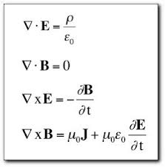

But electricity & magnetism lessons are normally built upon mathematics
Especially in physics classes
Further, those lessons generally START at the END of a very long story
Encapsulating more than a century of investigation in 4 + 1 (cryptic) equations:
Maxwell's Equations:
The Lorentz Force Law:
Where: E = The Electric Field
B = The Magnetic Field
    ρ = Electrical charge / volume
J = The flow of that charge
Where: q = The charge on an object
v = That charge's velocity
(relative to the magnetic field)

Slide 5
WHY do physics teachers teach "E & M" this way?!
As an applied physics major, I came to suspect that the real reason might be:
TO MAKE US FEEL DUMB!
Because, not only were those equations anything but obvious,
but even after learning them, they could still be devilishly difficult to apply!
Further, I couldn't imagine how even the physics gods came to derive them!
But eventually (on my own), I learned that it took a LOT of physics gods
and a LOT of time (centuries!) to reach such a complete understanding ¹
Which made me feel less dumb but which also left me
feeling decidedly put out with some of my former professors!
1) A somewhat technical account of that history can be found HERE in Resources Webpage for this note set

Slide 6
WE NOW NEED INTUITION - Which is born from personal observation
As, in fact, Maxwell himself depended on a whole LOT of observation
done by a whole LOT of physicists (then called "natural philosophers")
taking whole LOT of time (mid 1700's to early 1900's for full understanding)
The early observations led to a confusingly disconnected set of "laws" & "theorems"
. . .
Which, only after long analysis, were finally condensed into Maxwell's Equations
Gauss's Law
Faraday's Law
Lenz's Law
Ampere's Law
Kirchhoff's Law
Snell's Law
Joules's Law
Biot-Savart Law
Lorentz Force Law
Curie's Law
Superposition Theorem
Reciprocity Theorem
Coulomb's Theorem
Norton's Theorem
Thevenin's Theorem

Slide 7
Leading to my novel (downright heretical) plan for this note set:
Let's forget about the final Maxwell Equations
Let's avoid the formality of the Lorentz Force Law
Let's slide by most of those subsidiary "laws" and "theorems"
Let's instead look at the behavior of electric and magnetic fields
Drawing on our personal experiences
Drawing upon videos I've found showing electric field behavior
Drawing upon videos I've now created showing magnet field behavior
Those observations alone can give us the intuition we now need
Further, our attempts at explaining observed behavior will take us along
the same path that led scientists to invent all of those weird laws!
An Introduction to Sustainable Energy Systems: WeCanFigureThisOut.org/ENERGY/Energy_home.htm

Slide 8
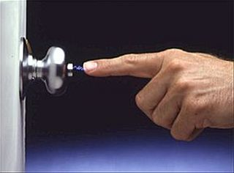
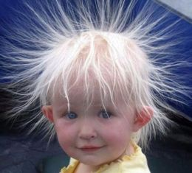
THUS: What were our earliest personal experiences of electricity?
I recall these:
A shocking winter experience:
Toddlers gone wild:
The latter generally seen only for a toddler with freshly cleaned hair
because, somehow, clean fine (and thus light) hair seemed to be essential,
suggesting that something was just barely overcoming gravity!
http://www.nachi.org/static-electricity.htm
http://joyerickson.wordpress.com/
2012/08/05/pull-up-something-cool/

Slide 9
These were much more likely if a lot of winter shuffling was involved
Suggesting that the act of shuffling was somehow transforming us
"Magic carpet spirits?" "Ancient Aliens?" ¹
However, if you watched REALLY closely, you occasionally saw something more:
One toddler started with wildly dancing hair
He/she touched a second toddler with normal hair
Resulting in two toddlers both now with mildly dancing hair
Suggesting that the first toddler had acquired something from the carpet
Which was then shared (and diluted) between the two toddlers
To figure out that something, there was a great historical tool: Pith Balls
1) To their everlasting shame (I hope!), "Ancient Aliens" is probably a "History Channel" trademark

Slide 10
What the heck are "Pith Balls?"
"Pith" was the name given to the dried stems of vascular plants
Which, due to both the drying and those veins, were exceptionally light
(The modern "pith ball" equivalent: Styrofoam covered by aluminum foil)
"Pith" was cut up into balls ~ 1 cm diameter
Which were hung from fine threads
Then, mirroring our carpet-shuffling experience:
If those balls were touched by glass rods rubbed on various types of fur,
the balls would suddenly dance around (as with the toddler's hair)
But going beyond the behavior of hair:
Individual balls could be touched with rods rubbed on different furs,
And they could be guided to touch one another,
And their resulting movement could be measured

Slide 11
Those "experiments" were first done in 1754:
By a British schoolmaster named John Canton
His "apparatus" (which we now call a Pith Ball Electroscope)
had two pith balls hanging side-by-side from threads
The basic experiment consisted of touching both balls with a glass rod rubbed on fur
BEFORE the pith balls were touched: AFTER they'd been touched::
An Introduction to Sustainable Energy Systems: WeCanFigureThisOut.org/ENERGY/Energy_home.htm

Slide 12
Which, as with our toddlers, suggested that:
The fur-rubbed glass rod gave SOMETHING to the pith balls
Which then caused them to repel one another
Canton then set about dissecting this "electric" behavior
By touching electrified balls with un-electrified balls
Or by electrifying balls differently via different rod/fur combinations
And then quantifing results by measuring the Pith Ball's swing
I'd hoped to now replicate Canton's Pith Ball experiments
But it turns out that they work well in only very dry cold conditions
Conditions that are exceedingly hard to replicate in a lecture hall
(Or produce at all . . . at least here in central Virginia!)
In wetter conditions that SOMETHING almost immediately leaks away!

Slide 13
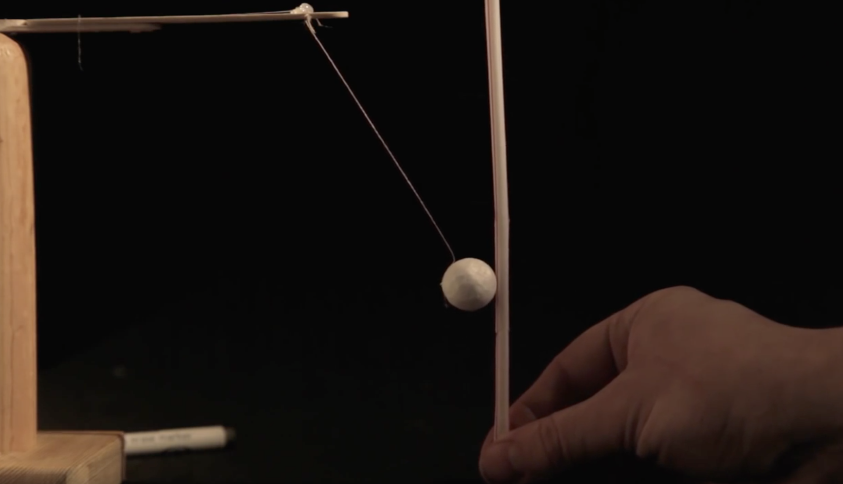
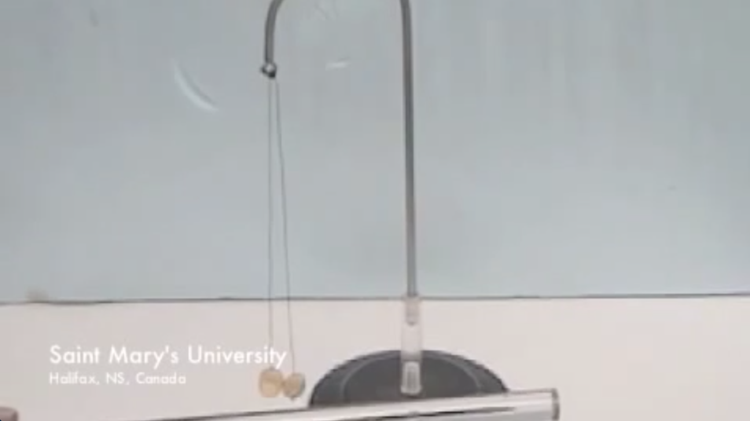
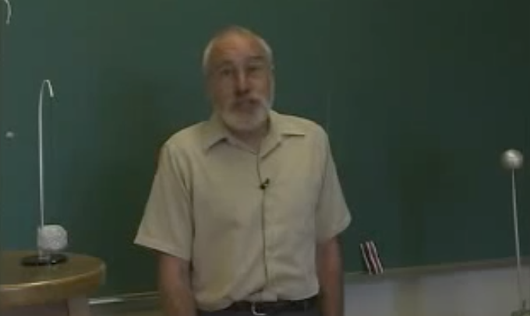
But to prove that it CAN be done, I offer you these YouTube videos:
From the Kahn Academy: Or from Saint Mary's University:
Or from this gentleman (who notes the difficulty of performing such experiments!):
These YouTube videos can be found HERE on the Resources Webpage for this note set

Slide 14
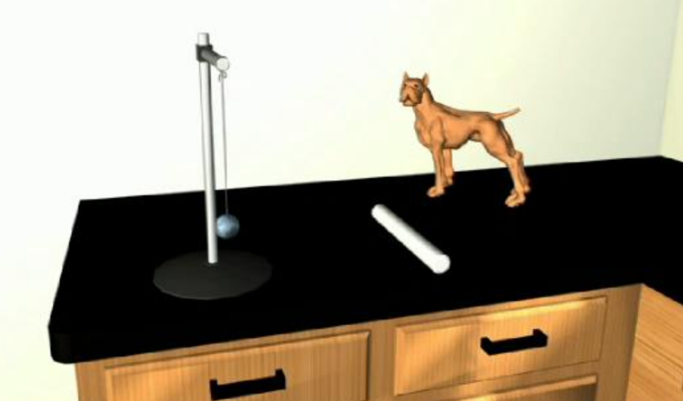
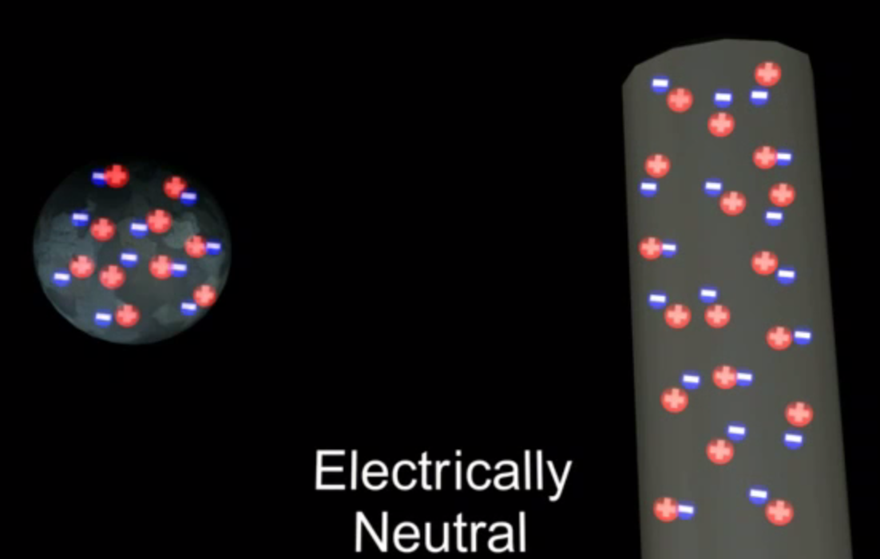
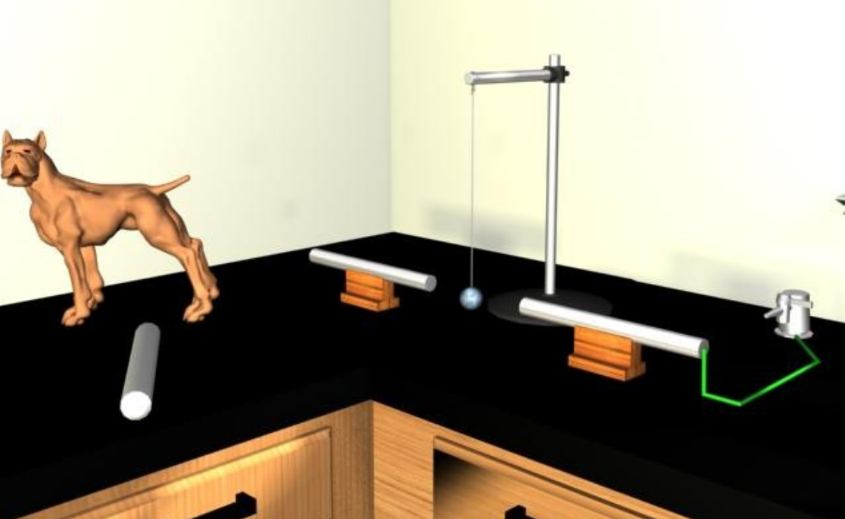
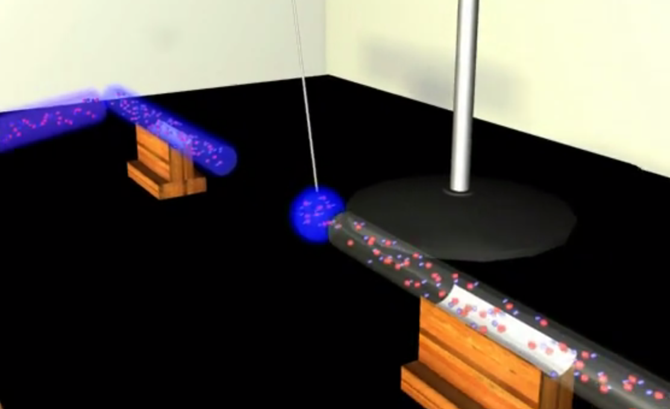
Or a pair of our X-ray vision / virtual reality animations:
Explaining the subtle INNER WORKINGS of Pith Ball experiments we once witnessed:
Snapshots from "Pith Ball Basics" (LINK to full X-ray vision animation):
Reality vs. Virtual Reality
Snapshots from "Pith Ball Ping Pong" (LINK to full X-ray vision animation):
Reality vs. Virtual Reality

Slide 15
I'm sorry that I couldn't film a full set of real "Pith Ball" experiments
But I will make it up to you when we turn to the topic of magnetic fields
Which turn out to be a whole lot easier to generate and manipulate
Which allowed me to create nine of my own experiments
And to post videos of them on this note set's Resources Webpage
For now:
With credibility added by those YouTube Pith Ball videos, in figures and words,
let me describe Pith Ball experiments that John Canton and his contemporaries
did (or might have done) to develop an understanding of electric fields
An Introduction to Sustainable Energy Systems: WeCanFigureThisOut.org/ENERGY/Energy_home.htm

Slide 16
Proceeding (for now) in virtual reality:
Schoolmaster John Canton's basic experiment confirmed our "shuffling" experience:
Rubbing feet (or glass rods) on rugs (or fur)
captured something which, when shared between light hairs (or Pith Balls),
caused those hairs (or Pith Balls) to repel one another
But what was that SOMETHING? And was it in fact only ONE THING?
Canton certainly had different types of furs and cloth readily available
And it's very likely that he next tried using them *
* Note that I am not particularly concerned with Canton's exact experiments
I'm instead trying to put myself (and you) into his shoes
and imagine what we (as scientists) might have done to FigureThisOut
An Introduction to Sustainable Energy Systems: WeCanFigureThisOut.org/ENERGY/Energy_home.htm

Slide 17
Repeating the experiment but rubbing the rod on different fur or cloth:
Start: After touching
the right ball:
Momentarily Then remove rod
push balls together
(e.g. w/ glass rod): Result:
This SEEMS to be the SAME result:
The rod delivered Something that can be shared & repels parts of itself
But is it the SAME thing or a NEW thing that acts similarly?

Slide 18
To test, treat each ball differently:
Touch each separated ball, with a DIFFERENT rod, rubbed on a DIFFERENT thing:
Touch ball 1 with rod 2: Then touch ball 2 with rod 1:
  Nothing! Attraction!
But if they actually touch: The attraction is lost:
An Introduction to Sustainable Energy Systems: WeCanFigureThisOut.org/ENERGY/Energy_home.htm

Slide 19
Whoops: We now seem to have TWO THINGS!
1) These two things ATTRACT each other
As opposed to the repulsion exhibited by parts of the same thing!
2) But if allowed to combine, they NEUTRALIZE / CANCEL one another
After considerable analysis and debate, "natural philosophers" concluded:
THING = "ELECTRICAL CHARGE"
TWO VARIETIES = "+" and "-" charge (so labeled because +'s cancel –'s)
"+ Charge" repels itself AND "- Charge" repels itself
BUT "+ Charge" attracts "- Charge"
An Introduction to Sustainable Energy Systems: WeCanFigureThisOut.org/ENERGY/Energy_home.htm

Slide 20
But what about the observed forces?
This WAS in same time period when Newton was formulating his Law of Gravity
So scientists of this era would have wanted to quantify/codify this new electric force:
Its direction AND magnitude AND dependence on + / - charges
They could have used two large fixed pith balls + 1 small hanging probe ball
Side view of two large balls mounted above a table PLUS a hanging probe ball:
Then charge up the balls:
Probe Ball: + OR –
Left Large Ball: +
Right Large Ball: -
+
-
An Introduction to Sustainable Energy Systems: WeCanFigureThisOut.org/ENERGY/Energy_home.htm

Slide 21
Looking from above, recording the probe ball's deflection:
Here with a probe ball having the same plus charge as the left fixed ball
Length of arrow = Amount of deflection/swing (proportional to force)
of the hanging probe ball, when it is at that position
+
-
An Introduction to Sustainable Energy Systems: WeCanFigureThisOut.org/ENERGY/Energy_home.htm

Slide 22
But it's MUCH easier to merge all of those arrows together:
This was as good as I could do with PowerPoint's clumsy built-in graphics:
(Toggle back an forth to preceding slide to see what I've done)
+
-

Slide 23
THIS, finally, is recognizable as the common map of an electric field:
+
-
The Direction of Force on a + Charge = The Direction of the arrows
But by merging arrows, I have lost information on the STRENGTH of the Force!
I can reclaim it by noticing that now: Strength of Force α Spacing of arrows

Slide 24
Stepping Back
We have observed that:
There is something called charge
Also now known as "static electricity" or "electrostatic charge"
Which comes in two flavors
Which we've named "plus" and "minus"
because, if they are allowed to combine, they cancel one another
Each type of charge repels charge of the same type
But attracts charge of the opposite type
An Introduction to Sustainable Energy Systems: WeCanFigureThisOut.org/ENERGY/Energy_home.htm

Slide 25
Electric Fields = How forces spread out BETWEEN charges
For which we now use this shorthand representation:
Arrows give the DIRECTION of that force upon a + charge
Closeness of the lines gives the relative intensity of that force
But this is ONLY a way of REPRESENTING that spreading inter-charge force!
That force is not really concentrated into lines
Nor does it fall to zero between those lines
+
-
An Introduction to Sustainable Energy Systems: WeCanFigureThisOut.org/ENERGY/Energy_home.htm

Slide 26
The line spacing does not even (directly) give the strength of the force
In fact, these two diagrams could represent the exact same situation:
Or the easier / lazier version:
ONLY the arrow direction,
and the relative spacing of the arrows (across a single diagram) are significant!
+
-
+
-

Slide 27
Recapping our "basic answers" about Electric Fields:
What ARE Electric Fields?
Spreading force fields
How and when they are created?
By "plus" and "minus" charges
What sort of things do they act upon (and what is that action)?
The force repels charges of the same type
And attracts charges of the opposite type
With the direction of repulsion or attraction parallel to the lines in a field map
And the intensity of repulsion or attraction varying inversely as the line spacing
An Introduction to Sustainable Energy Systems: WeCanFigureThisOut.org/ENERGY/Energy_home.htm

Slide 28
But to clear up some possible confusion, let's now board a time machine and come forward a century or so:
In 1897 J.J. Thompson discovers the Electron
which is identified as the primary source of – charge
In 1911 Ernest Rutherford discovers the Proton
which is identified as the primary source of + charge
Over the first third of the 1900's nuclear physics evolves, figuring out that:
Protons are almost always locked up in the nuclei of atoms
While Electrons (as "quantum mechanical" clouds) are outside the nuclei
and (for many atoms) they can be easily separated from those nuclei
=> Electrons are almost always the only movable "electric charge"
So it took TWO CENTURIES to fully figure out "simple" electric fields!!

Slide 29
Moving on to:
Magnetic Fields
The BAD NEWS: It's about to get decidedly weirder
The GOOD NEWS: I've created magnetic field demonstrations that DO work
A whole lot of them (nine!)
Which we can now use to FigureThisOut
An Introduction to Sustainable Energy Systems: WeCanFigureThisOut.org/ENERGY/Energy_home.htm

Slide 30
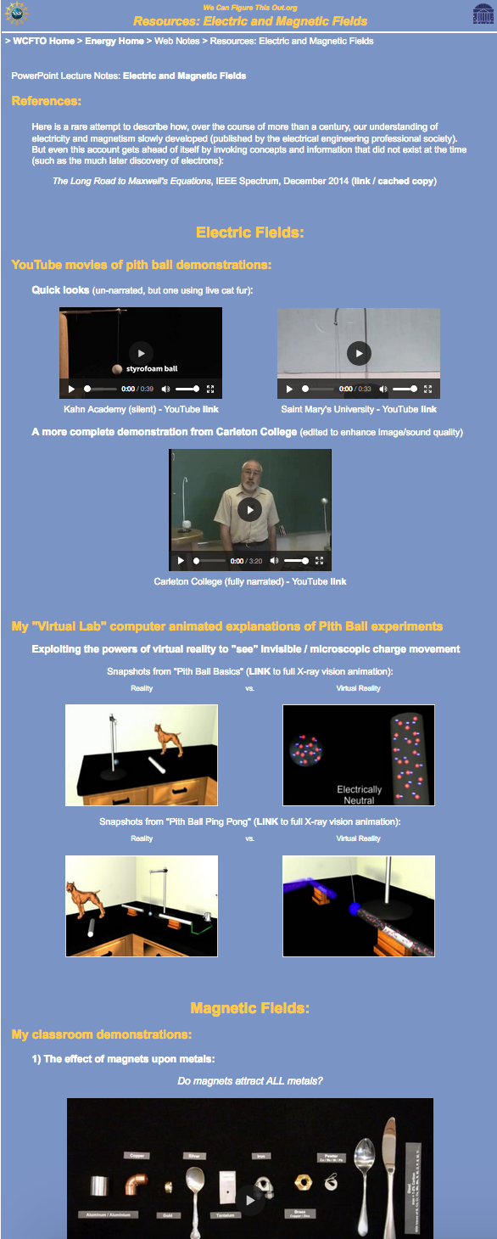

A necessary logistical digression:
Videos CAN be embedded within PowerPoint files. They can also be
called by PowerPoint files if they are at a known/fixed location on the same PC
But in my (painful) experience, both are great ways to lock up a personal computer
And even when things DO work, video files still require long prior downloading
I thus leave videos on my server where they can be streamed from html webpages
The nine video demonstrations
we will now use to "figure out"
magnetic fields are streamable
from this note set's
Resources Webpage:
That webpage is accessible via
this LINK OR this QR code:
OR via this explicit URL:
https://wecanfigurethisout.org/ENERGY/Web_notes/Electricity/Electricity%20and%20Magnetism%20-%20Supporting.htm

Slide 31
Starting at the beginning: What IS a magnet?
A classic magnet consists of:
Iron, or alloys (mixtures) of iron, cobalt, nickel and "rare earth" elements
Which have been exposed to another, intense, already-existing magnet
But then where did our FIRST magnet come from?
Answer: The earth
But that answer only raises other questions, such as:
How did the earth become magnetic?
And, as a rather weak magnet, how could the earth
ultimately produce today's much stronger magnets?
The answer to both of those questions lies with the topic of electro-magnetism
Which we'll come to a bit later in this note set
An Introduction to Sustainable Energy Systems: WeCanFigureThisOut.org/ENERGY/Energy_home.htm

Slide 32
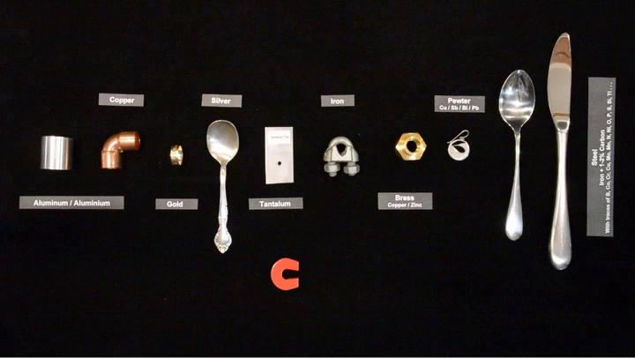
For now, a simpler question: "What do magnets do?"
My students' response: "They attract metals"
My second question: "Which metals?" Typical response: "Um . . . ALL metals"
Let's test that via my first video demonstration / experiment
For which I scrounged different types of metals around my home and lab
Please now view demonstration #1 on the Resource Webpage:

Slide 33
Results of that experiment:
MY MAGNET ATTRACTED: Iron
and a piece of ~ 98% Iron + ~ 2% carbon + trace impurities (a "steel")
MY MAGNET DID NOT ATTRACT the elemental metals:
- Copper, aluminum, gold, silver, or tantalum
MY MAGNET DID NOT ATTRACT mixtures (alloys) of:
Copper and zinc (= brass),
Copper + Antimony + Bismuth (= pewter)
~ 98% Iron + ~ 2% carbon + DIFFERENT trace impurities (other "steels")
In fact, MAGNETS ATTRACT VERY FEW METALS, generally only:
- Iron and some iron mixtures (which is decidedly weird!)
- Nickel, cobalt, a few "rare earths," along with some mixtures of these
~ The same raw materials used for MAKING magnets!

Slide 34
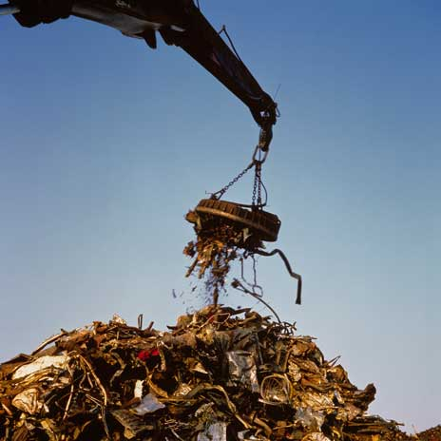
"Houston, we have a problem!"
You know that recyclers use (electro) magnets to pull metal out of garbage:
But, I've just shown you that magnets attract only iron and some steels
Plus a few rare combinations of other metals
So how DO we recycle, for instance, aluminum?
Which we DO recycle, and very efficiently: 80-90%
Because recycling takes ~ 1/20 the energy of extracting new aluminum
(I promise to explain how this is done by the end of this note set)
Photo: http://www.bbc.co.uk/schools/gcsebitesize/science/triple_aqa/keeping_things_moving/the_motor_effect/revision/2/

Slide 35
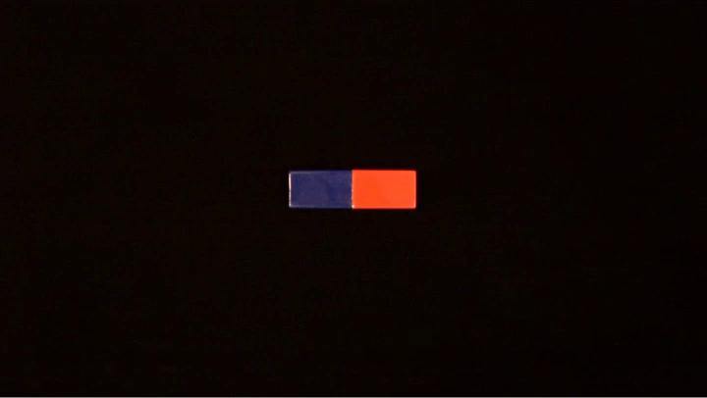
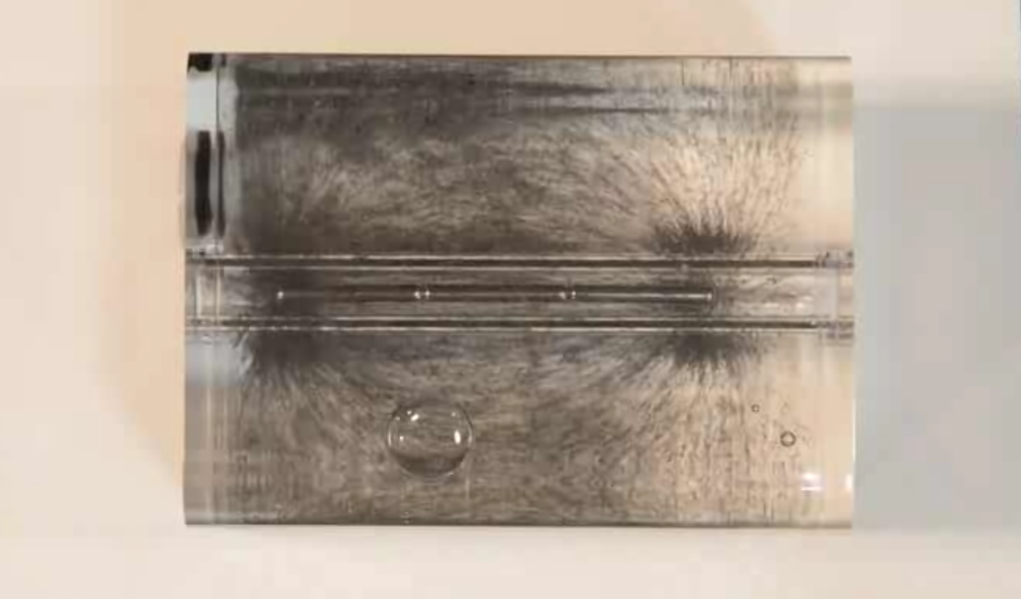
Proceeding to some other "basic questions"
How do magnets act upon one another?
And from either that action
Or our knowledge of how magnets affect the metals they DO affect
Can we figure out:
What are Magnetic Fields?
Please now view demonstration #2 on the Resource Webpage:
An Introduction to Sustainable Energy Systems: WeCanFigureThisOut.org/ENERGY/Energy_home.htm

Slide 36
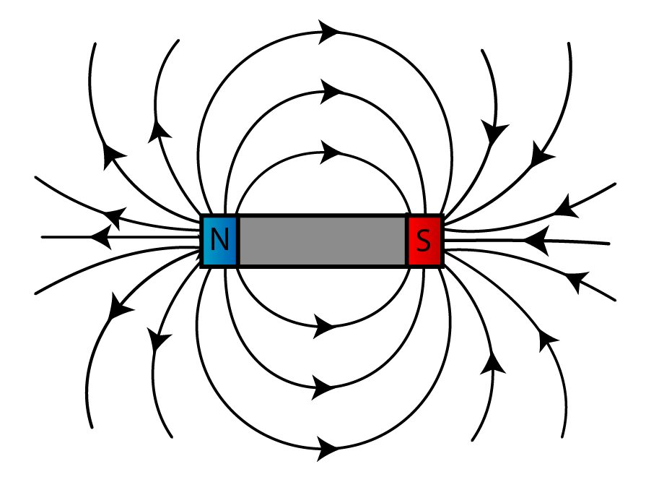
From experiment / demonstration #2:
The compass arrow and floating iron shavings suggested this pattern:
Our earlier Electric Field pattern mapped out the Electric Force upon charges
So this new pattern might map out the Magnetic Force upon something
But while the iron shavings condensed along such lines
They then flowed both directions along the lines!
(toward whichever magnet end that was closest to them)
http://spmphysics.onlinetuition.com.my/2008/06/
introduction-to-magnetism-revision.html

Slide 37
Could the arrows instead map Magnetic Force upon other magnets?
No, that wasn't what we saw when we played with the pair of magnets
The second magnet instead twirled around and/or danced off to right or left
AND / OR:

Slide 38
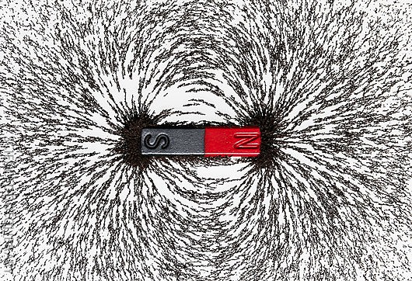
So whatever this was trying to show us:
http://www.magnetyze.com/page/magnetic-fields.aspx
It was NOT a simple force field map, such as that for Electric Fields
Where arrows gave the force's direction, and spacing gave the force's intensity
But an alternative set of rules CAN account for MAGNET MOVEMENT:
- Parallel "magnetic field lines" repel each other
- Anti-Parallel "magnetic field lines" attract each other
- The closer the lines are, the stronger the above effects
An Introduction to Sustainable Energy Systems: WeCanFigureThisOut.org/ENERGY/Energy_home.htm

Slide 39
Showing how those rules explain the magnets' movements:
Pushing parallel magnets together: Pushing anti-parallel magnets together:
Parallel lines => Repulsion Anti-parallel lines => Attraction

Slide 40
Or if pushed together while not perfectly aligned
Lower Magnetic Lines are being pushed together more tightly => Stronger repulsion
Producing (if released simultaneously), two magnets spinning away from each other:

Slide 41
But this is a class/website about Sustainable Energy Systems
The "electricity" of such Energy Systems
consists of charge being pushed along by the force of an Electric Field
Which makes our earlier observations of electric fields EXTREMELY RELEVANT
But Energy Systems make no comparable use of magnetism
Because we know of no practical way of transporting energy
by pushing magnets along under the force of Magnetic Fields
Which makes our observation of magnet movement ABSOLUTELY IRRELEVANT!
However, "natural scientists" observed two more strange phenomena
That not only restored magnetism's RELEVANCE to electrical power systems,
they made magnetism the absolute BASIS of electrical power systems!

Slide 42
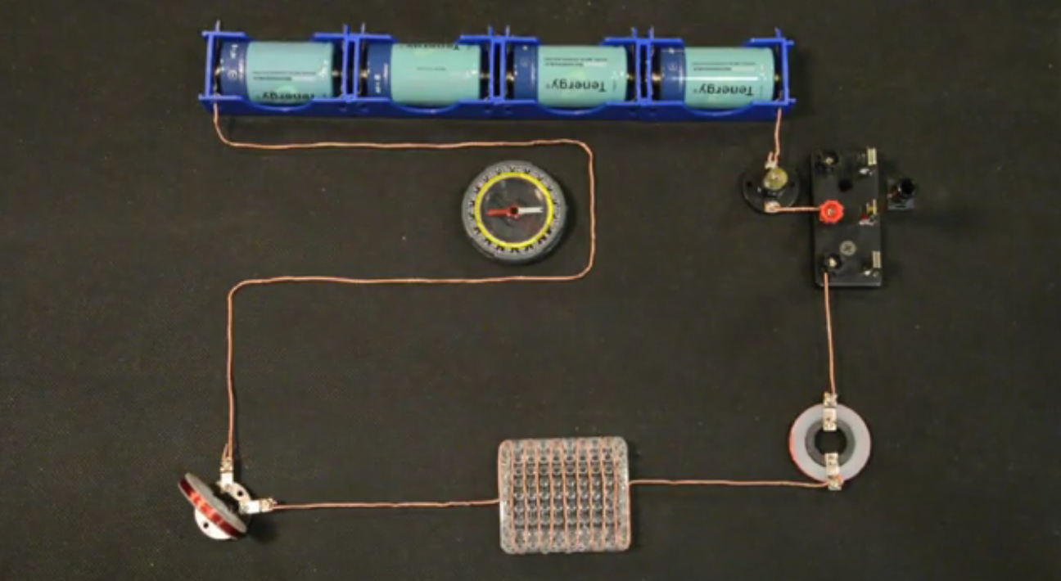
The first was discovered by Danish professor Hans Christian Ørsted
Who, on 21 April 1820, was preparing a classroom lecture demonstration about
Allessandro Volta's then recent invention of the "galvanic battery"
When he connected that battery to a long wire,
by shear chance he happened to notice the deflection a of a nearby compass
His report of this caught the attention of French scientist André-Marie Ampère,
who ultimately explained what we now call electro-magnetism
Please now view demonstration #3 on the Resource Webpage:

Slide 43
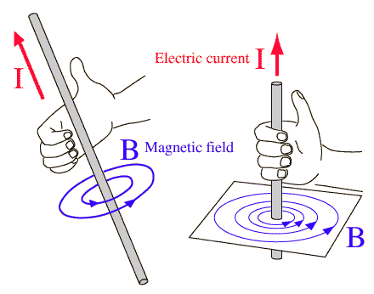
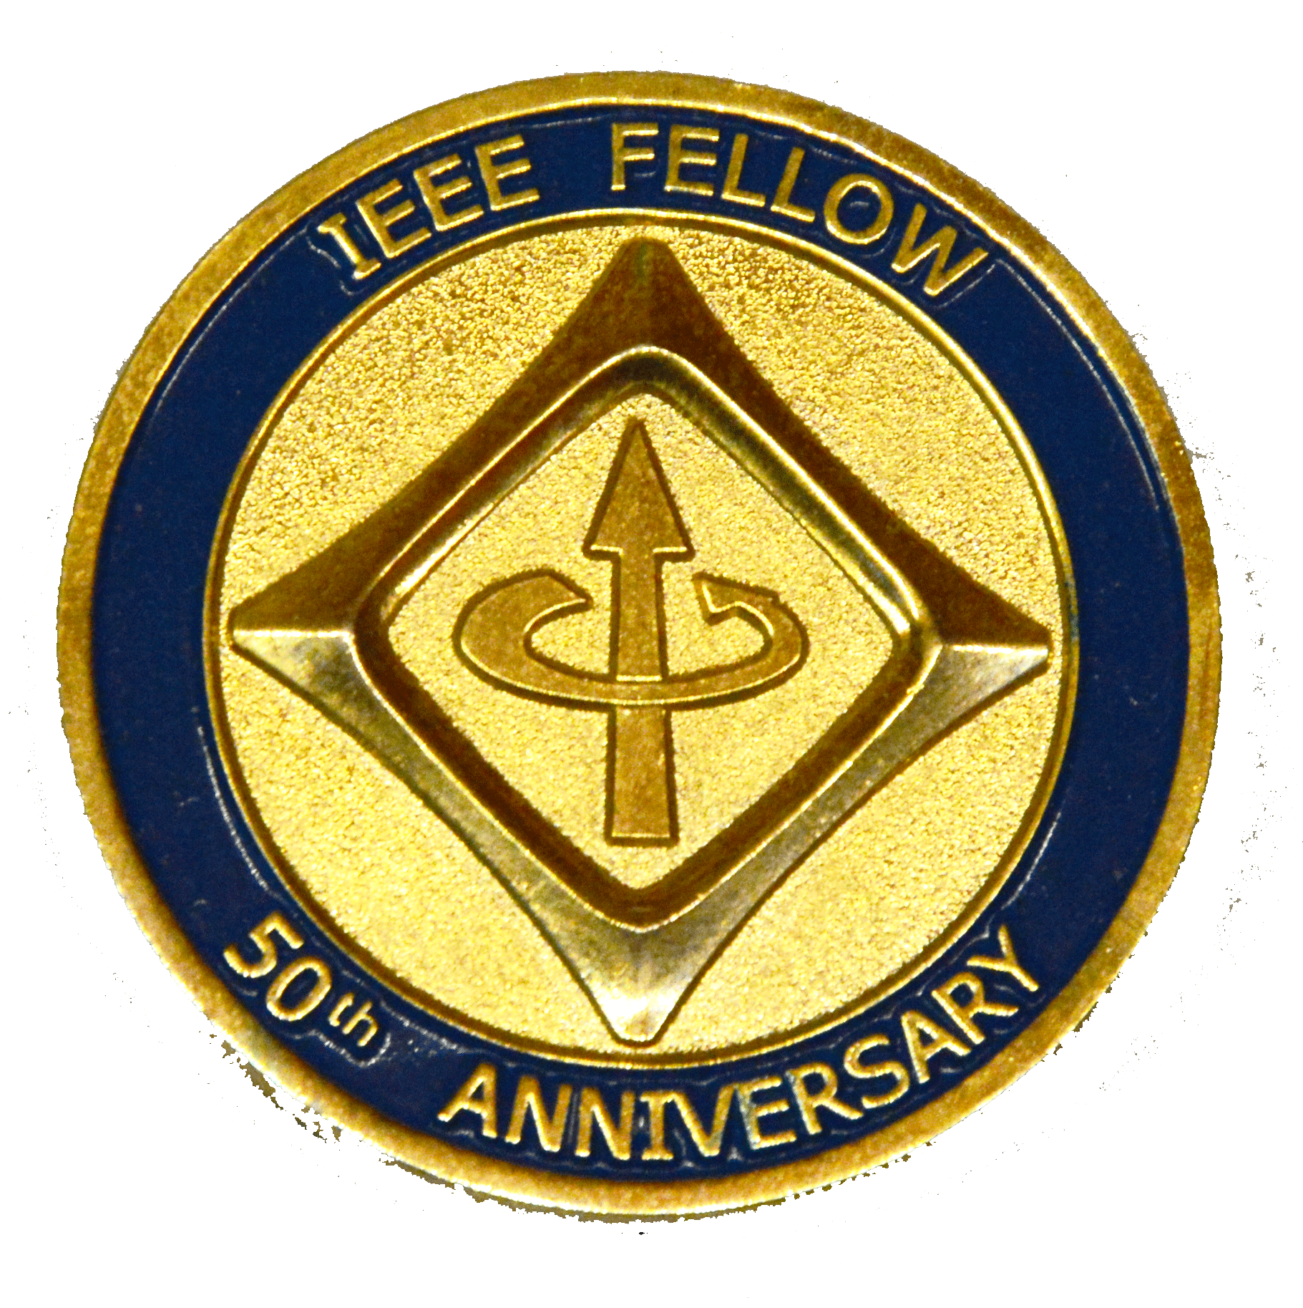
Did some of those names sound a bit familiar?
They should because (ultimately):
The unit of electrical energy, the Volt, was named for Allessandro Volta
The unit of charge flow, the Ampere, was named for André-Marie Ampère
A unit of Magnetic Field, the Oersted, was named for Hans Christian Ørsted
Their combined discoveries uncovered the phenomenon of ELECTRO-MAGNETISM
= Charge flow in a wire producing magnetic field loops around that wire
Generally now depicted via a Right Hand Rule:
Also represented in my membership pin from the international
Institute of Electrical and Electronic Engineers (IEEE):
+ Charge Flow
B Magnetic Field

Slide 44
But this was all done in the early/mid 1800's
Well before the discovery of negative movable electrons and positive nuclear protons
Ampere didn't know what the charges were, and assumed both types could move
And he thus chose to state his rule in terms of moving positive charge
The magnetic field of moving negative charge loops in the opposite direction
But I find it easier to think of this as two separate rules:
Right Hand Rule for moving + charge
(which, in fact, almost never moves!):
Left Hand Rule for moving – charge
(which we now call "electricity"):
+ Charge Flow
- Charge Flow
B Magnetic Field
B Magnetic Field
Thumb in direction of + charge flow,
Magnetic field is along curled right fingers
Thumb in direction of - charge flow.
Magnetic field is along curled left fingers

Slide 45
In the end, you can often actually ignore the charge's sign:
Because, while + and – moving charges produce reversed magnetic loops:
Moving minus charge: Moving positive charge:
Electric fields push + and – charges in the opposite direction:
Electric field (e.g., along a wire)
Resulting force on charges:
Thus in a wire (if both types of charges could move), the net result would be:
Magnetic loops are in the SAME direction + net charge flow is in the SAME direction
=> Continued sloppy discussion of "electrical current" as "positive charge flow"

Slide 46
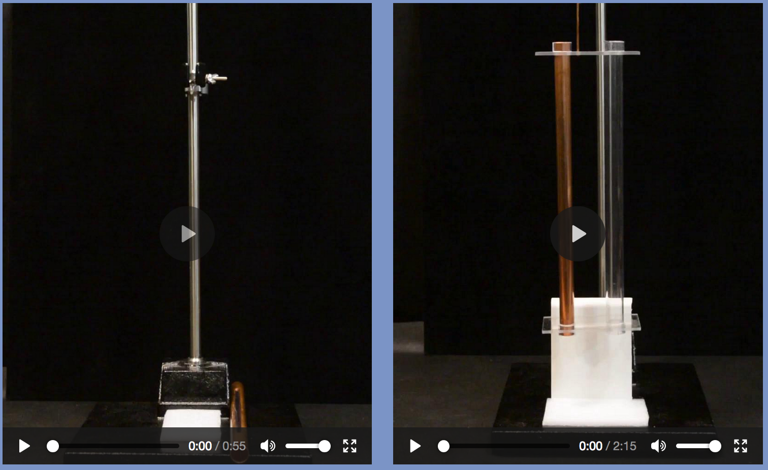
Electro-magnetism provides a second way of creating magnetic fields
It also provides the source of nearly all of our permanent magnets because:
Permanent magnets induced by Earth's magnetic field are ~ uselessly weak
But electro-magnets can be powered up to be immensely stronger
Allowing us to lock much strong magnetic fields into things like iron
But didn't we conclude that magnets (of any type / strength)
were IRRELEVANT to Electrical Power Systems?
Yes. We need one more discovery: Magnetic Induction
Please now view demonstrations #3 & #5 on the Resource Webpage:

Slide 47
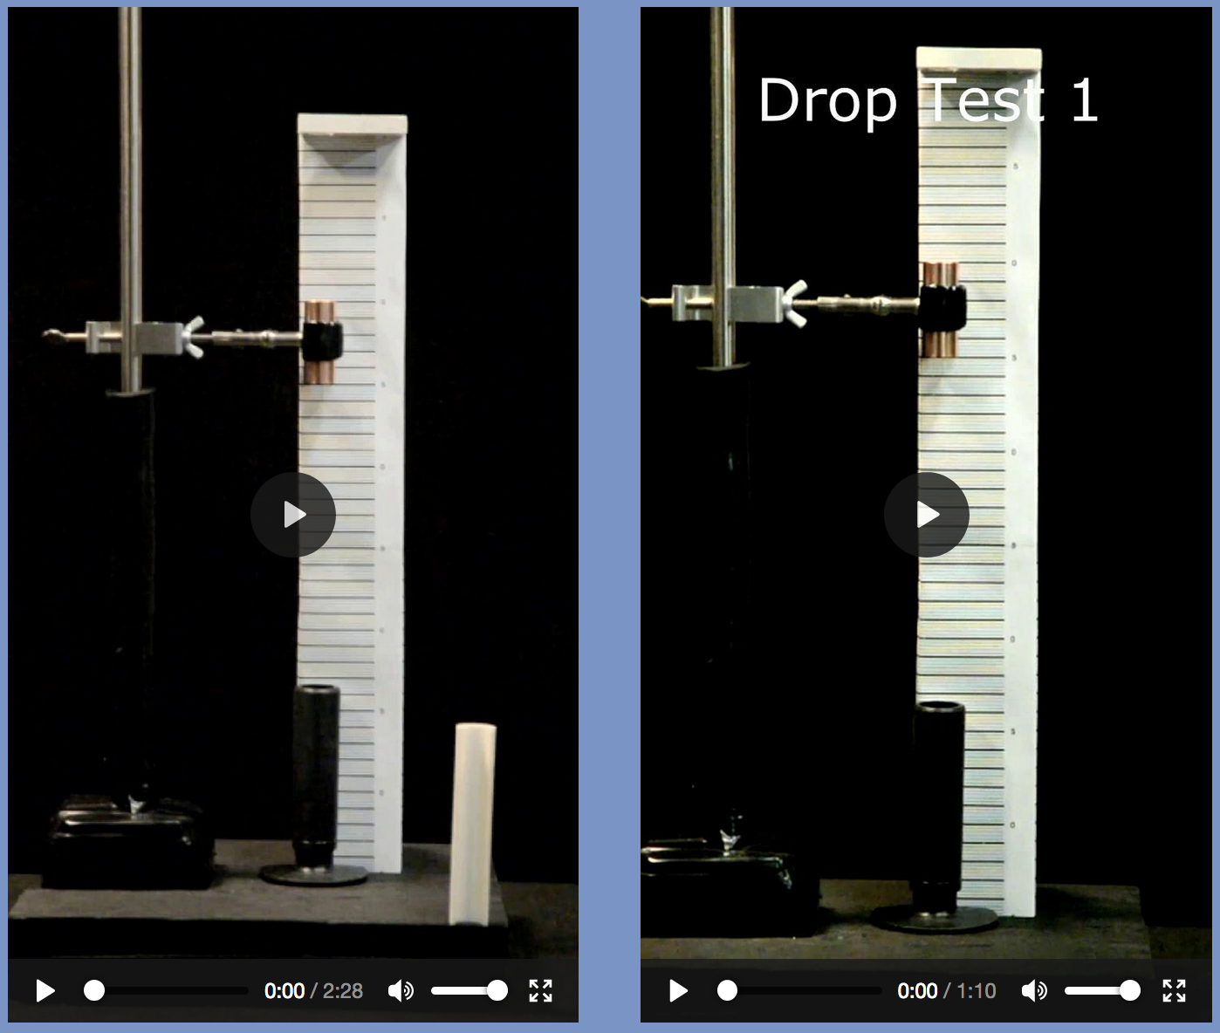
OK, but how does this defiance of gravity make magnetism relevant?
For that, we have to figure out what is CAUSING magnetic induction
Which will also explain why it's even called "magnetic induction"
But we have now gotten to the extreme weirdness I promised for magnetism
And this explanation is going to require some rather subtle new observations!
Please now view demonstrations #6 & #7 on the Resource Webpage:

Slide 48
Those magnets (partially) resisted the force of gravity
But it now looks like magnet ENDS resist most strongly!
However, the entire fall occurs in a very short (~ 2 second) time span
Could our eyes be fooling with us? To Check:
Those movies were shot in 60 frame (picture) per second QuickTime video format
(The original QT format videos are downloadable from the Resources Webpage)
Right-clicking time in QuickTime player displays the frame number
That frame number, along with the ruler I'd mounted behind the magnet,
allowed me record the magnet's frame-by-frame fall distance
Which converted to distance vs. time using the frame time spacing of 1/60 sec
For each test, I entered fall distance vs. frame and time into an Excel spreadsheet
(Also downloadable from this note set's Resource Webpage)

Slide 49
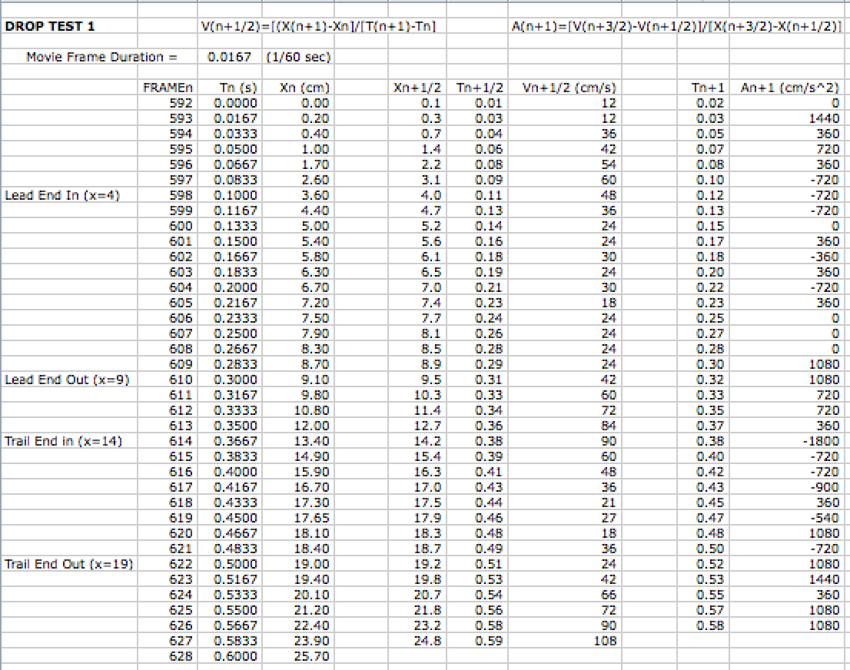
The "Drop Test #1" part of that spreadsheet:
Drop data
Velocity vs. Time
Acceleration vs. time
Where velocity & acceleration came from Newton's: v = dx/dt, a = dv/dt
by means of "finite difference" differentiation: dY/dx ~ ΔY/Δx
(see the formulae at the top and/or check the cell definitions)

Slide 50
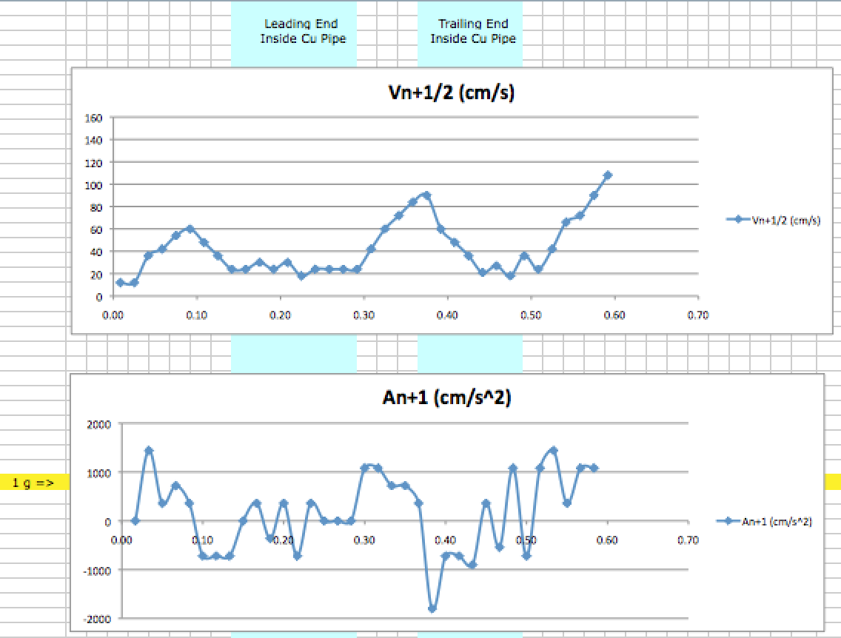
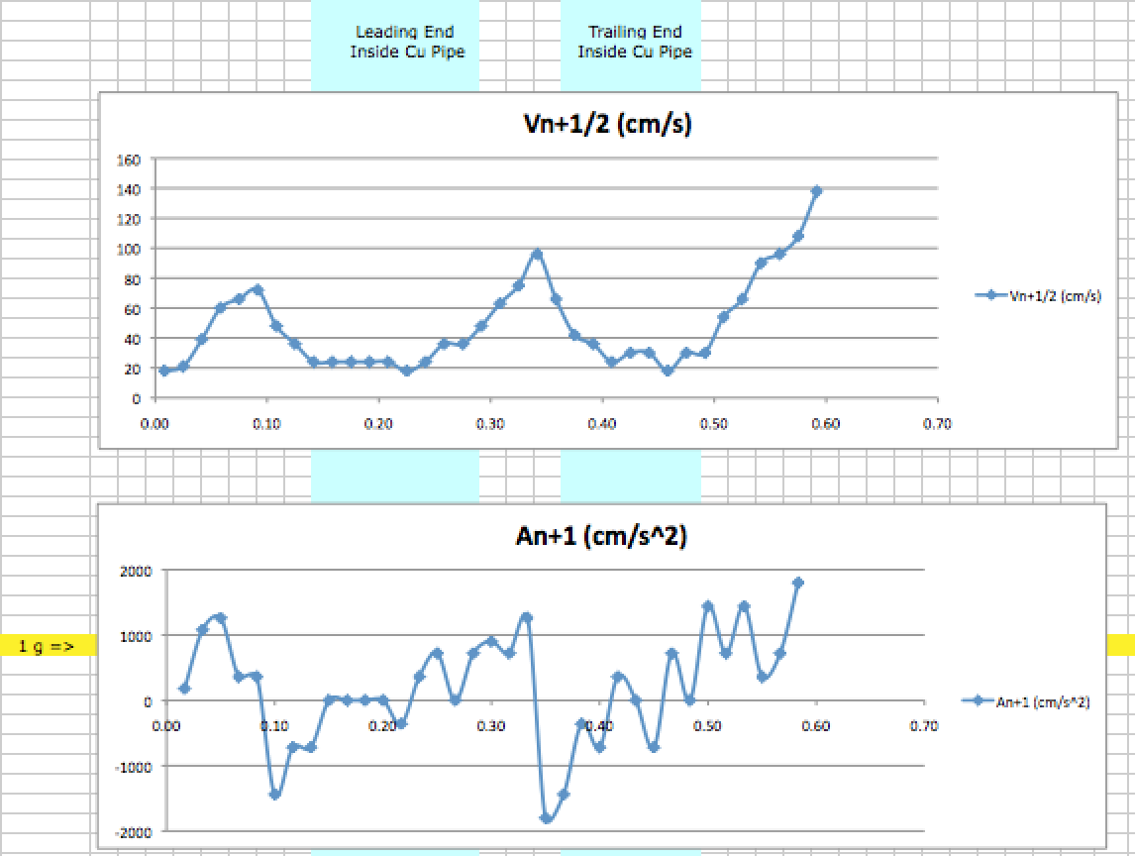
Spreadsheet plots of Drop Test #1 (left) and Drop Test #2 (right):
Left blue band = Only leading edge of the magnet is inside the short copper pipe
Right blue band = Only trailing edge of the magnet is inside the short copper pipe
VELOCITY rises steadily UNTIL an end of the magnet enters/approaches the pipe
ACCELERATION rises back to ~ 1000 cm/s² (1 g) when NEITHER end is inside pipe
The magnet's fall IS inhibited by its ENDS sweeping through the pipe!

Slide 51
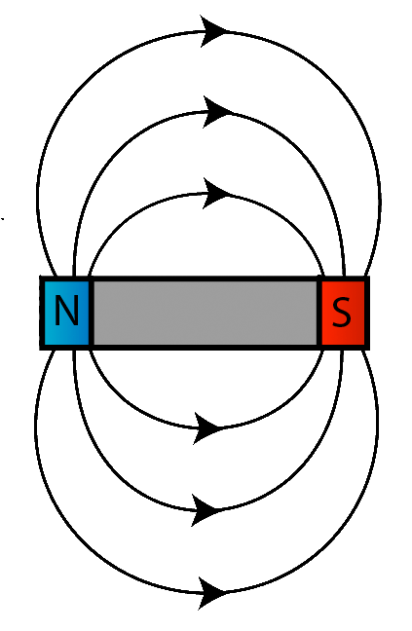
That sequence shown in diagrams:
Freefall:
Braking:
Freefall:
Braking:
Freefall:
An Introduction to Sustainable Energy Systems: WeCanFigureThisOut.org/ENERGY/Energy_home.htm

Slide 52
Why do only configurations at left slow the magnet's fall?
With ends inside pipe:
What if the pipe mimicked a flipped magnet?
With parallel Magnetic Lines compressing together
THIS would CERTAINLY slow the top magnet's fall!

Slide 53
But how could a non-magnetic pipe suddenly behave like a magnet?!
If it suddenly became an ELECTRO-MAGNET!
That is, if the metallic copper atoms' movable valence electrons
suddenly decided to run around in circles which,
based on my earlier right hand (actually left for electrons) rule,
those circles would be surrounded by loops of magnetic field:
Which would mimic the magnetic field of this:
An Introduction to Sustainable Energy Systems: WeCanFigureThisOut.org/ENERGY/Energy_home.htm

Slide 54
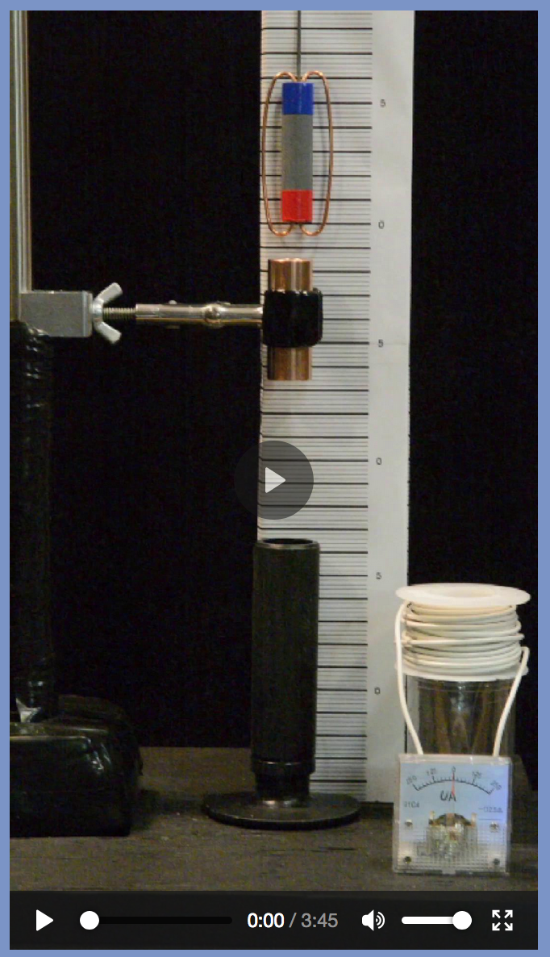
Evidence for such an implausible occurrence?
Replace the copper pipe by a spiral of copper wire
The induced flow of charge within that wire can then be measured
Please now view demonstration #8 on the Resource Webpage:

Slide 55
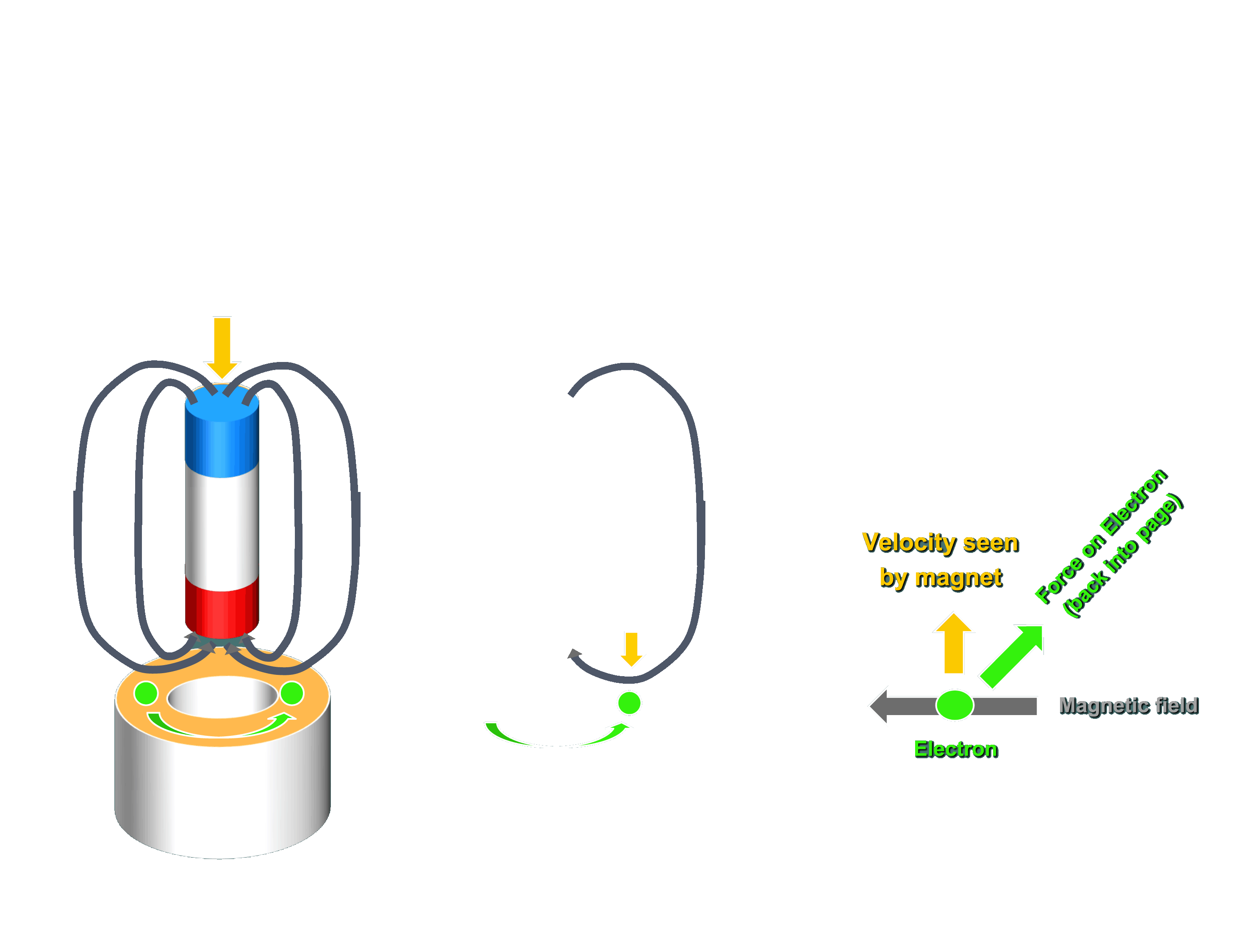
So we really do get dueling magnets! But from our Drop Tests:
This must occur only as the ends of the magnet interact with the pipe
Such as here, as the leading magnetic field enters the pipe:
Big Picture:
Action at right:
Close-up of apparent action:

Slide 56
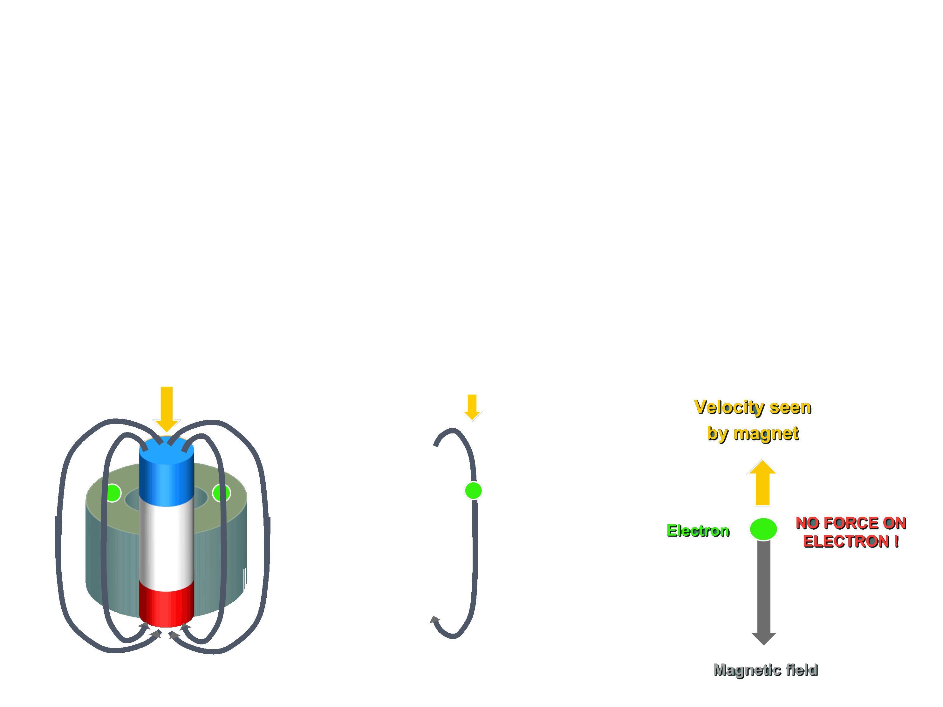
But also from those Drop Tests:
It must cease when the ends of the magnet are well beyond the pipe
Such as here, a few tenths of a second later:
Big Picture:
Action at right:
Close-up of apparent action:

Slide 57
It depends on HOW the magnetic field passes by the electron!
This geometry produces a force:
But this geometry does not:
Velocity seen
by magnet
Velocity seen
by magnet
Force on Electron
(back into page)
Electron
NO FORCE ON ELECTRON !
Magnetic field
Electron
Magnetic field
There IS a force when the magnetic field passes the electron EDGE ON
There IS NOT a force when the magnetic field passes the electron END ON
= Force scales with electron’s velocity PERPENDICULAR to magnetic field!

Slide 58
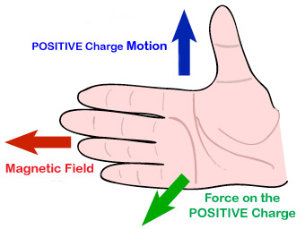
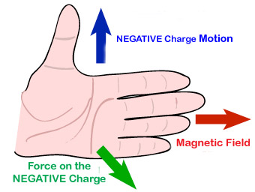
Putting this together yields what we now call the Lorentz Force
Which is the force INDUCED on a charge by movement through a MAGNETIC field
Giving this phenomenon the name: MAGNETIC INDUCTION
It is described by another RIGHT HAND RULE (for moving positive charges)
Which I'll again translate into a left hand rule (for moving negative charges)
Right Hand Rule for positive charges: Left Hand Rule for negative charges:
MOTION = Part of electron’s velocity that is perpendicular to the magnetic field
(this velocity being evaluated from the magnet’s perspective)

Slide 59
Reviewing this magnetic induction + electro-magnetism conspiracy:
A generalized / simplified diagram of all our falling magnet experiments:
Gravity tries to push permanent magnet down through pipe
Copper Pipe = A non-magnetic metal / conductor
Which contains moveable electrons
Thru which a magnetic field is MOVING downwards
An Introduction to Sustainable Energy Systems: WeCanFigureThisOut.org/ENERGY/Energy_home.htm

Slide 60
Applying our new Left Hand Rule:
Moving magnetic field applies a force on the pipe's electrons
The magnet is really what is moving DOWN
But IT sees electrons as moving UP towards it
Near the leading (lower) edge of the falling magnet:
Bottom Left Wall of Pipe:
Magnetic field lines point RIGHT
Magnet sees electrons moving UP
Force on electrons is out of page
Bottom Right Wall of Pipe:
Magnetic field lines point LEFT
Magnet sees electrons moving UP
Force on electrons is into page

Slide 61
Those forces of magnetic induction drive an electron loop
Electro-magnetism causes electron loop to produce its own magnetic field
With this electro-magnet's field lines parallel to those of falling magnet (black)
The two magnets (permanent and electro) thus push against one another
Transferring momentum from permanent magnet to electrons of the pipe
An Introduction to Sustainable Energy Systems: WeCanFigureThisOut.org/ENERGY/Energy_home.htm

Slide 62
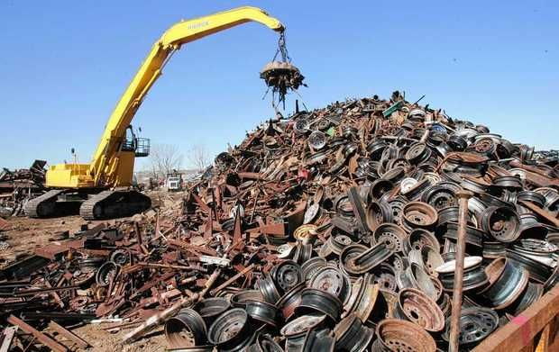
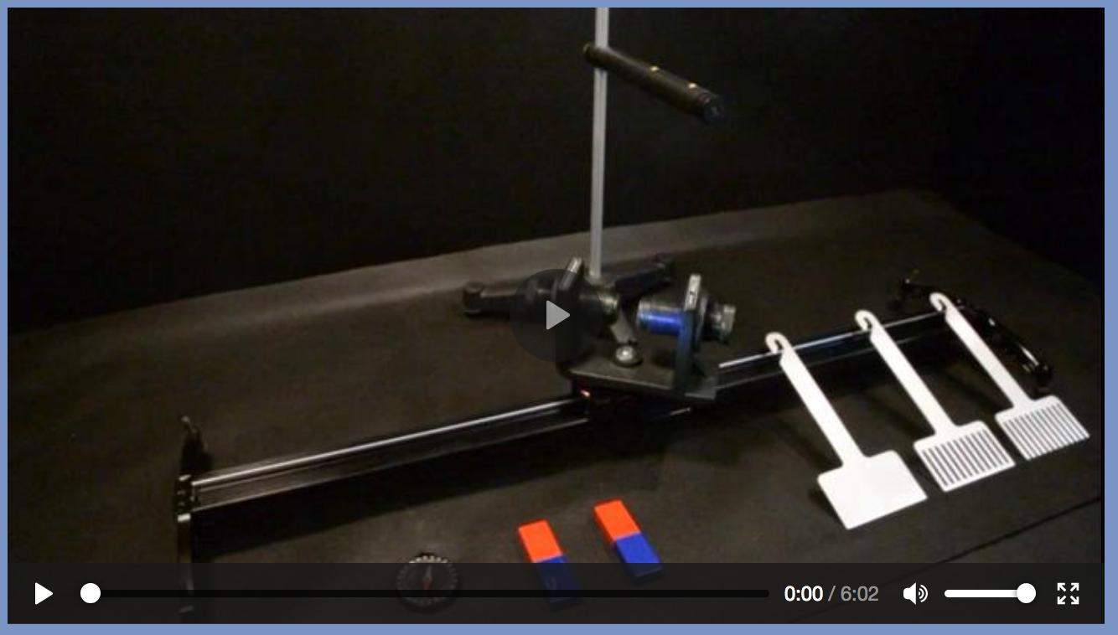
I'm going to guess "brain-freeze" may be now be setting in!
But many slides ago I promised that by the end of this note set
I'd explain how we recycle non-magnetic metals (e.g., Al & Cu)
To do that, we need one FINAL demonstration:
Please now view demonstration #9 on the Resource Webpage:

Slide 63
Based on that demonstration:
Just embed magnets in the roller at the end of a trash conveyer belt!!
As that roller rapidly rotates, magnets are whipping up toward the top of belt
Slinging their magnetic fields upward and to the left
When that block of metal approaches the end of the belt
Its electrons are going to be pummeled by those moving magnetic fields
=> Forces that will push those electrons (and the block) up off the belt!

Slide 64
So while the trash falls off the end of the belt:
Nonmagnetic metals (such as Al & Cu) missed by the earlier electromagnet
Are now going to be slung upward
Allowing them to jump over a barrier
Onto a second conveyor now carrying away ONLY metals
Or flicking them into a separate "metals only" bin:
An Introduction to Sustainable Energy Systems: WeCanFigureThisOut.org/ENERGY/Energy_home.htm

Slide 65
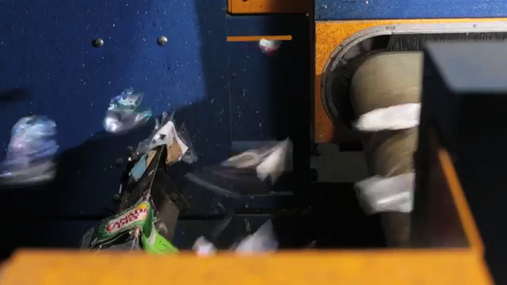
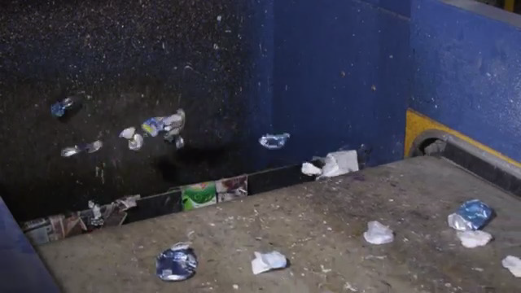
From the bottom of this note set's Resources Webpage:
A video from the "American Recycling Center" of such an operating conveyor
Using magnetic induction to sort out non-magnetic aluminum & copper:
https://www.youtube.com/channel/UCurq7PjCvPBx4zZ6v0i0wGw

Slide 66
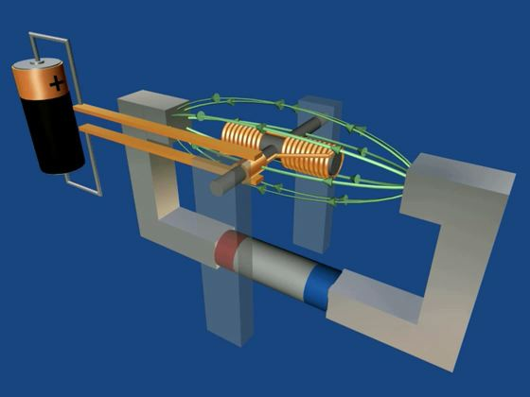
The energy savings of recycling make magnetism MILDLY relevant
But in the note set Magnetic Induction (pptx / pdf / key) I’ll show you how:
Magnetic Induction + Electro-Magnetism
yield electric motors, electric generators & transformers
= THE KEY ELEMENTS OF ALL ENERGY SYSTEMS
An Introduction to Sustainable Energy Systems: WeCanFigureThisOut.org/ENERGY/Energy_home.htm

Slide 67
Credits / Acknowledgements
Some materials used in this class were developed under a National Science Foundation "Research Initiation Grant in Engineering Education" (RIGEE).
Other materials, including the WeCanFigureThisOut.org "Virtual Lab" science education website, were developed under even earlier NSF "Course, Curriculum and Laboratory Improvement" (CCLI) and "Nanoscience Undergraduate Education" (NUE) awards.
This set of notes was authored by John C. Bean who also created all figures not explicitly credited above.
Copyright John C. Bean
(However, permission is granted for use by individual instructors in non-profit academic institutions)
An Introduction to Sustainable Energy Systems: WeCanFigureThisOut.org/ENERGY/Energy_home.htm

