Slide 1
Biomass and Biofuels
John C. Bean
Outline
Biomass vs. Biofuels – The difference between them / Their modification of the Carbon Cycle
Biomass and its sustainability:
The leading energy contributors: Sawdust, agricultural waste & manure
The up-and-coming contributors: Municipal solid waste to energy & landfill gas to energy
The synthesis of Biofuels via: Predigestion + Fermentation + Distillation
Analysis of five key issues confronting biofuel growth, synthesis and use:
- Lifetime energy return on energy invested (EROI)
- Net greenhouse gas impact
- Land use and fertilizer pollution
- Consumption of fresh water
- Effect upon U.S. and world food prices
(Written / Revised: September 2018)

Slide 2
Biomass and Biofuels
These terms are used in two very different ways
To some people they describe parts of a single process:
"Biomass" is just the input or feedstock used to create a "biofuel"
E.G.: Corn is a typical "biomass" feedstock for making alcohol "biofuel"
To others, these terms describe two different processes:
Biomass is a fuel using byproducts of things we are already doing, whereas
Biofuel uses something specifically grown for the purpose of making fuel
Put another way: If, in the fairly recent past it was considered waste or garbage,
but we now burn it for heat and/or power, it is biomass
I've believe the latter definition captures some very important practical distinctions
And I will thus use that latter definition throughout this note set

Slide 3
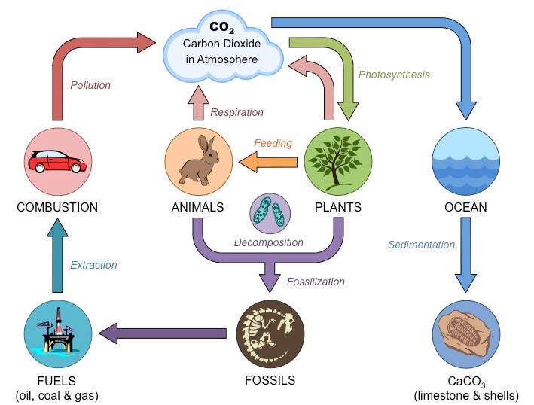
The Carbon Cycle of fossil fuels:
CO₂ is captured by plants => It's fossilized => Burnt by us => Emitted back as CO₂
That does indeed complete a cycle, but it is a hugely unsustainable cycle:
Because the early steps (capture + fossilization) took tens of millions of years
But our burning of the resulting fossil fuel may be completed in ~ 200 years
(20,000,000 / 200 = 1 million to one mismatch = A VERY BIG OOPS!)
http://ib.bioninja.com.au/standard-level/topic-4-ecology/43-carbon-cycling/carbon-cycle.html

Slide 4
Biomass & Biofuels = Our attempt to bypass the fossilization step:
For biomass, we may tap directly into the arrows leaving "plants" or "animals"
For instance, by finding ways to turn their semi-raw waste into power
For biofuels, we'd substitute our own chemical synthesis for natural "fossilization"
However, by eliminating the organic accumulation that went into fossilization,
we'd need: 1) A lot more plants or 2) Super-efficient plant surrogates
My modified version of: http://ib.bioninja.com.au/standard-level/topic-4-ecology/43-carbon-cycling/carbon-cycle.html

Slide 5
But we need more than just a slightly altered cycle:
We need what scientists & engineers call a steady state
Which means that all of the flows must continuously balance such that
CO₂ neither accumulates nor depletes at any point in such a diagram
Which means that our alterations must be strictly carbon neutral
But given our underlying goal of maintaining heat transfer through our atmosphere,
we must bear in mind that CO₂ is not the only important greenhouse gas
Water vapor is even more important, and its concentration is strongly affected by
plants, their types, their presence or absence
Methane is also a wicked greenhouse gas, and it's produced by animals & bacteria
An Introduction to Sustainable Energy Systems: WeCanFigureThisOut.org/ENERGY/Energy_home.htm

Slide 6
Biomass:
Which accidental-byproducts / recently-considered-garbage does this encompass?
The leading players are: Sawdust produced by lumber mills
Agricultural waste (e.g., end-of-season plant husks)
But use is also made of: Manure
Municipal Solid Waste
Sawing up logs produces a LOT of sawdust, which for many years had few uses
Then Henry Ford, seeking some profit from his Model T factory's waste sawdust,
partnered with Edward Kingsford to invent the charcoal briquette
(thereby giving birth to an American backyard tradition) ¹
And when adhesives improved sufficiently, someone glued sawdust back together
to invent our lowest grade of present day lumber: Particleboard
1) https://www.nytimes.com/2014/09/28/magazine/who-made-that-charcoal-briquette.html

Slide 7
But that hardly put a dent in the accumulating piles of sawdust
And it was thus inevitable that someone would cart it off to a power plant
and try burning it as a replacement for coal or oil in the production of steam
It worked, but not as well as coal or oil, which are both dense carbon-rich materials
Ripped from fibrous wood, sawdust is instead light, moist, highly irregular particles
These light and irregular particles pack very, very loosely
producing sawdust that can be 1/3 - 1/2 air (which does not combust!)
Further, when fresh, the remaining non-air part can be more than half water:
When that wet sawdust is burned, vaporization of its water will consume
a good portion of the carbon fiber's combustion energy
Agricultural waste tends to share these shortcomings of low density + wetness
An Introduction to Sustainable Energy Systems: WeCanFigureThisOut.org/ENERGY/Energy_home.htm

Slide 8
The result: Typical biomass produces far less energy than fossil fuels
Combustion energy per kilogram of fuel: ¹
Natural Gas: 54.4 MJ / kg
Fuel Oil: 45 MJ / kg
Coal: 29 MJ / kg
Biomass: 10-15 MJ / kg
A 5:1 reduction over today's
favorite U.S. fossil fuel!
To which one might respond: "Who cares? If it's carbon neutral, just burn more!"
But producing far less energy per mass and per volume has consequences:
A lot of trucks or rail cars must be hired to get enough of it to the power plant!
Biomass power plants thus require a nearby biomass source (within 100 miles or so)
Which is rare enough that the number of biomass power plants is very small
As is the capacity of such plants, which typically produce only ~ 140 MW ¹
1) Sources: A variety of energy system textbooks, particularly: Introduction to Energy & the Environment by Edward S. Rubin

Slide 9
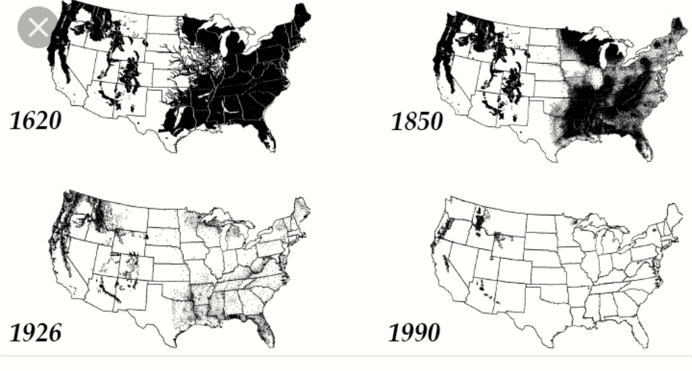
And then there is the question of such biomass's sustainability:
That sawdust came from cutting down and then cutting up trees
But to be part of a sustainable steady-state carbon-neutral cycle
those trees must be replaced at the same rate they are now being cut down
Are those trees being replaced? That has certainly not been our historical trend
U.S. Forest Cover:
Figure: https://jacquithurlowlippisch.com/tag/long-leaf-pine/

Slide 10
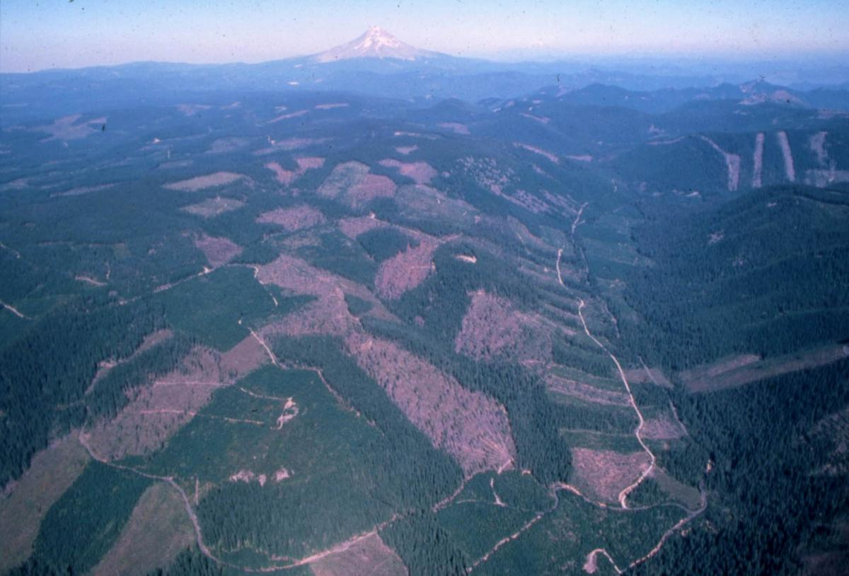
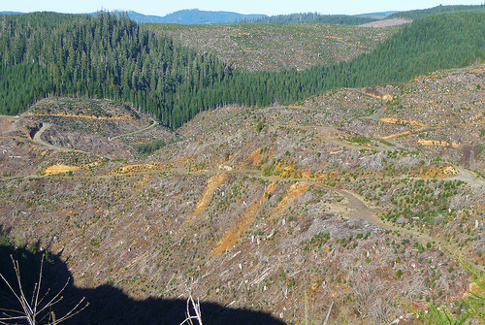
Which is seen in the ongoing "clear cut" logging of our Pacific Northwest:
http://www.oregonwild.org/forests/private-forests-profile
http://forestlegacy.org/clearcutting-70-of-state-forests-not-a-great-idea/

Slide 11
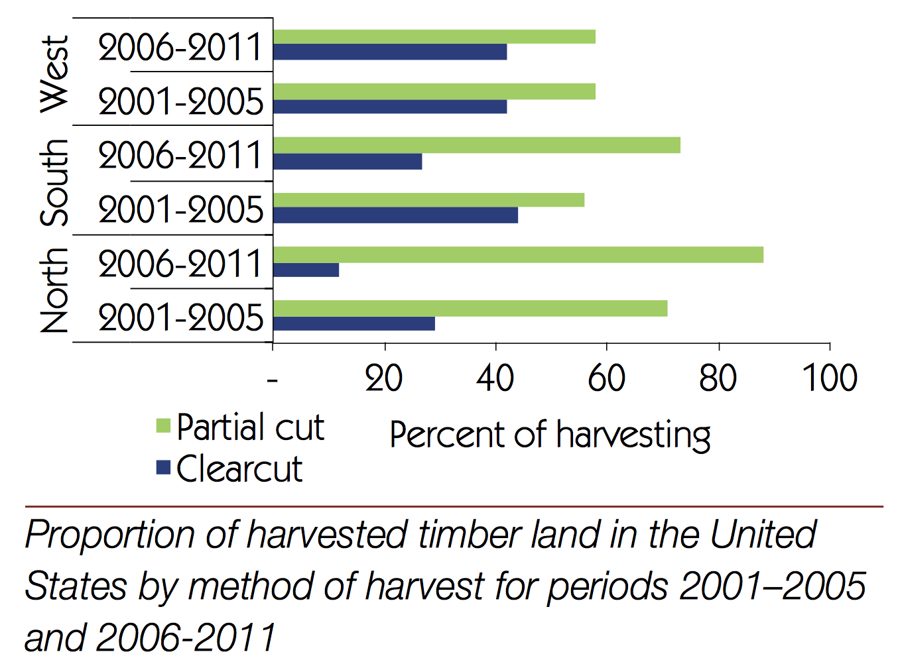
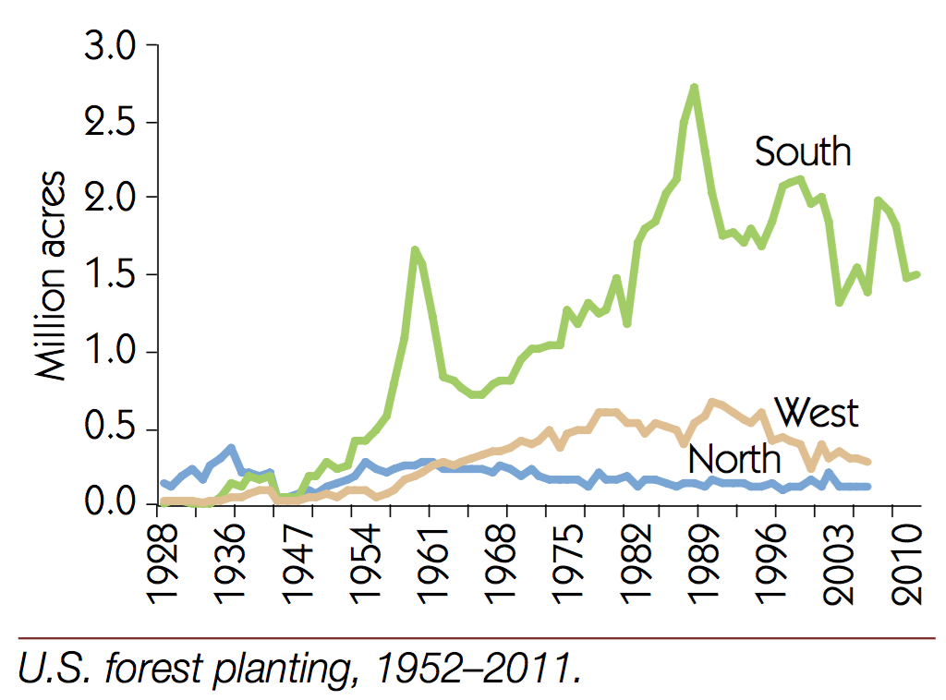
But have we perhaps learned something . . . somewhere? Possibly:
From the USDA's report: U.S. Forest Resource Facts and Historical Trends" (2014) ¹
U.S. Clear cut vs. Partial Cut Logging: U.S. Forest Planting:
Indicating: A significant net downward trend in U.S. clear cut logging
A significant upward trend in Southern U.S. tree planting/replanting
1) https://www.fia.fs.fed.us/library/brochures/docs/2012/ForestFacts_1952-2012_English.pdf

Slide 12
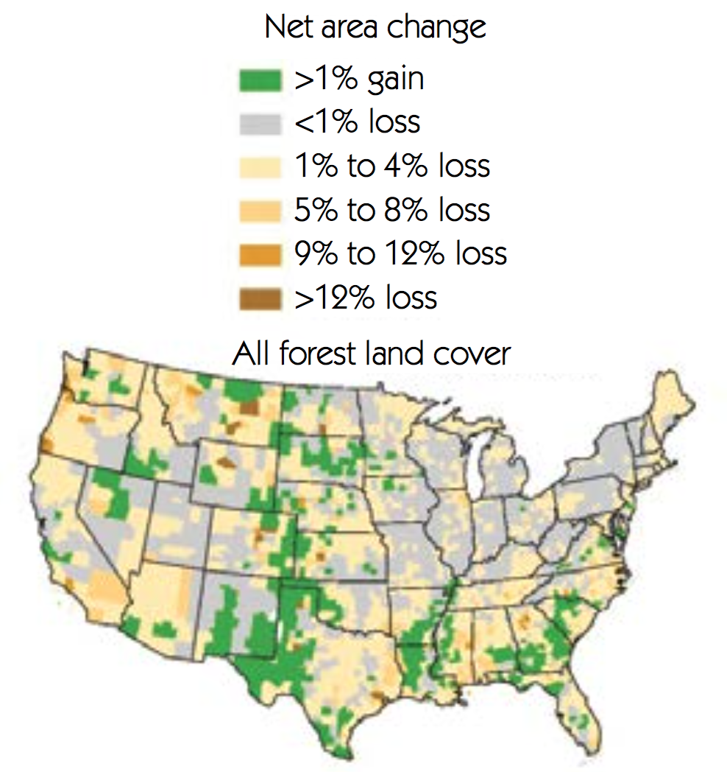
And while this map still shows a net downward trend in forest area:
It adds significant reforestation efforts in the Midwest to those noted in the South ¹
But it also indicates that "worst practices" are still employed in the far West
Where, for instance, I found recent industry proposals to clear cut 70% of
the available land in Oregon's state owned Tillamook & Clatsop forests ²
1) https://www.fia.fs.fed.us/library/brochures/docs/2012/ForestFacts_1952-2012_English.pdf
2) http://forestlegacy.org/clearcutting-70-of-state-forests-not-a-great-idea/

Slide 13
Biomass power from at least Southern forests might now be sustainable
But what about the second major biomass player: Agricultural waste?
Its energy density (per mass or volume) are similar enough to sawdust
that most of my sources fail to distinguish between them
But use of agricultural waste raises a different set of sustainability concerns:
It is mostly the post-harvest remains of corn or other plants
These would likely be 100% replaced by new plants seeded the next year
But farmers learned long ago that to sustain soil fertility the last season's
plant remains should (at least ultimately) be plowed back into the same soil
That soil's fertility cannot be maintained if these remains are instead
carted away, year after year, to be burned in a biomass-fueled power plant
An Introduction to Sustainable Energy Systems: WeCanFigureThisOut.org/ENERGY/Energy_home.htm

Slide 14
The stopgap solution: Pour on even more fertilizer ¹
But corn has unusually shallow roots, which means that in many locations
it requires not only water irrigation
but also unusually intense & continued fertilization
Runoff of such fertilizers is already blamed for major river & Gulf of Mexico pollution
As discussed in this note set's later section on corn-based biofuels
Further, most of that fertilizer is synthesized in vast chemical processing plants
which have their own very large environmental footprints
And while that fertilizer may replace certain depleted chemicals & minerals
it is doubtful that it can fully offset the year-after-year removal of plant "waste"
Making sustainability & carbon neutrality of corn biomass (and biofuel) very doubtful
1) http://www.scientificamerican.com/article/nitrogen-fertilizer-anniversary/

Slide 15
Nevertheless, those biomasses produce most of today's U.S. biomass power
About which these conclusions can be drawn:
Based on the limited availability of cheap local biomass (which is likely to continue):
Biomass power plants tend to be small (typically ~ 140 MW) ¹
The number of such biomass plants is also small (~ 300 nationally) ²
Nevertheless, these biomass power plants:
Generated 1.6% of U.S. power in 2016 ( ~ twice that of all solar plants!) ³
According to the U.S. Energy Information Administration that power was:
Cheaper than coal power & CCGT gas, more expensive than OCGT gas ⁴
But, per the discussion above:
Sustainability & carbon neutrality of biomass remains questionable
1) Introduction to Energy & the Environment by Edward S. Rubin
2) http://renewableenergydev.com/biomass-power-plants-in-the-united-states/
3) See EIA data in my U.S. Energy Production & Consumption note set
4) See EIA data in my Power Plant Economics note set

Slide 16
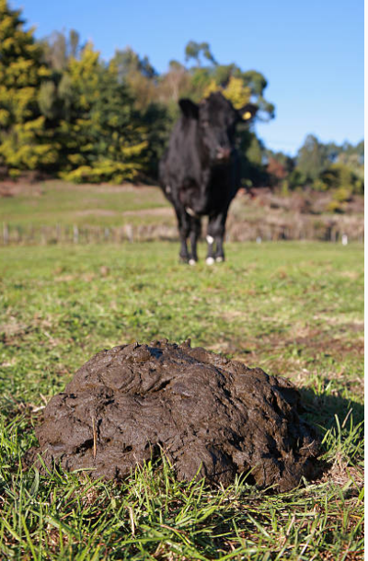
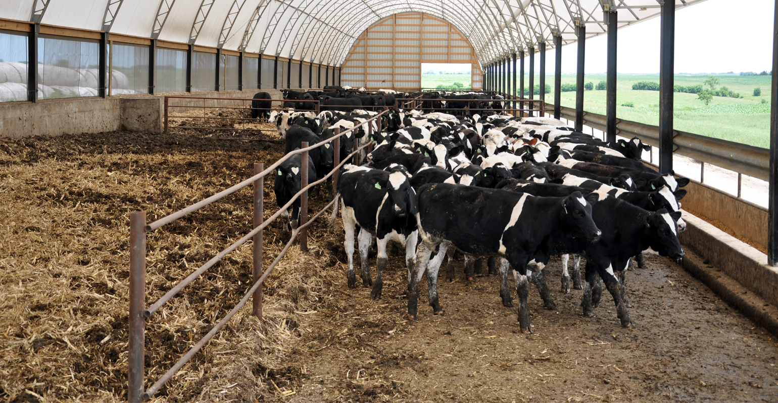
That leaves two less used sources of biomass power:
The first is animal manure
Collected not from here: But instead from here:
Because the vast majority of U.S. beef, pork and poultry is NOT "free range"
Animals are instead concentrated into factory farms or feed lots for fattening
Where they naturally produce massive amounts of manure
(Which made my childhood visit to a chicken factory farm TRULY UNFORGETABLE!)
Left: https://www.gettyimages.com/photos/cow-dung?sort=mostpopular&mediatype=photography&phrase=cow%20dung
Right: http://www.wallacesfarmer.com/livestock/consider-options-livestock-buildings

Slide 17
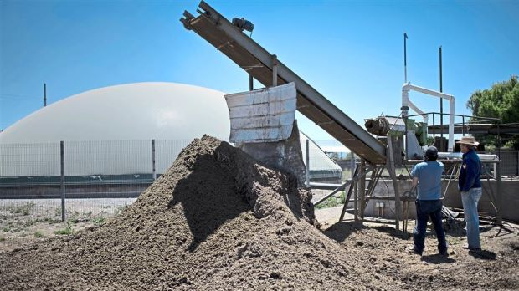
That manure can be easily gathered into air-tight buildings:
Including simple inflatable domes, such at that seen in this picture's background:
Inside such enclosures, located right at the factory farm or feed lot,
without extensive machinery, added chemicals, or any external energy input,
METHANE will be liberated via bacteria's ANAEROBIC DIGESTION
The EPA said that in 2010 manure was used to generate 1.67 GW of U.S. power ¹
With incentives, another study said it could grow to 5.5% of U.S. power by 2025 ²
Which, if accomplished, would put biomass power at today's wind power level!
http://www.thestar.com.my/Lifestyle/Features/2014/11/24/Biogas-a-lowtech-fuel-with-a-big-payoff/
1) As cited in: Energy Systems Engineering by Vanek, Albright & Angenent (McGraw Hill 2012), p. 470
2) https://pubs.acs.org/doi/abs/10.1021/es104227y

Slide 18
IMPORTANTLY: That methane is going to be liberated anyway!
If we don't harvest it, the bacteria will still digest the manure, liberating methane
as it rots in putrid piles (quite possibly also contaminating our water sources)
But here my early comment about "wicked" methane comes into play
As detailed in my Greenhouse Effect (pptx / pdf / key) note set:
Methane closes one of our atmosphere's very few "heat windows"
giving it a greenhouse gas impact estimated to be 30X worse than CO₂
So by capturing the methane from rotting manure, and then burning it into CO₂
we can not only produce electrical power
we can also radically reduce that manure's ultimate greenhouse gas impact
Which, if not literally, would still effectively make that methane's capture and use:
CARBON NEGATIVE!
An Introduction to Sustainable Energy Systems: WeCanFigureThisOut.org/ENERGY/Energy_home.htm

Slide 19
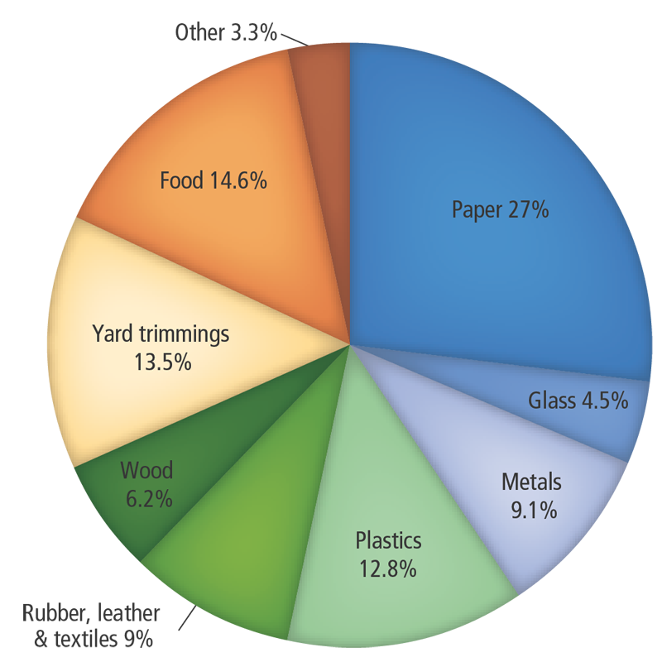
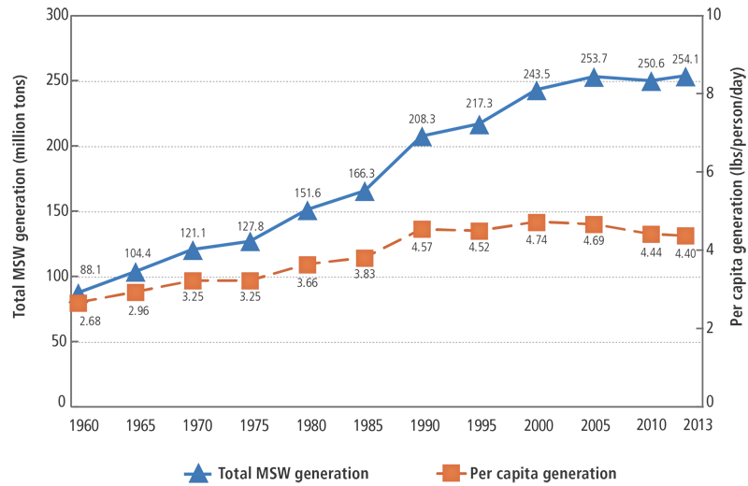
Which brings us to Municipal Solid Waste (MSW) biomass:
In the U.S. each one of us produces 4.40 pounds (2 kg) of waste per day ¹
Yielding a national total of 250 million tons of waste per year:
That is: Close to a ton of garbage per person per year
As shown at the right, a very large fraction of this waste (~75%) is organic
and is thus potentially burnable as a fuel:
1) https://archive.epa.gov/epawaste/nonhaz/municipal/web/html/

Slide 20
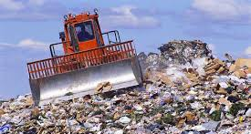
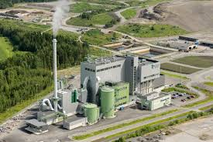
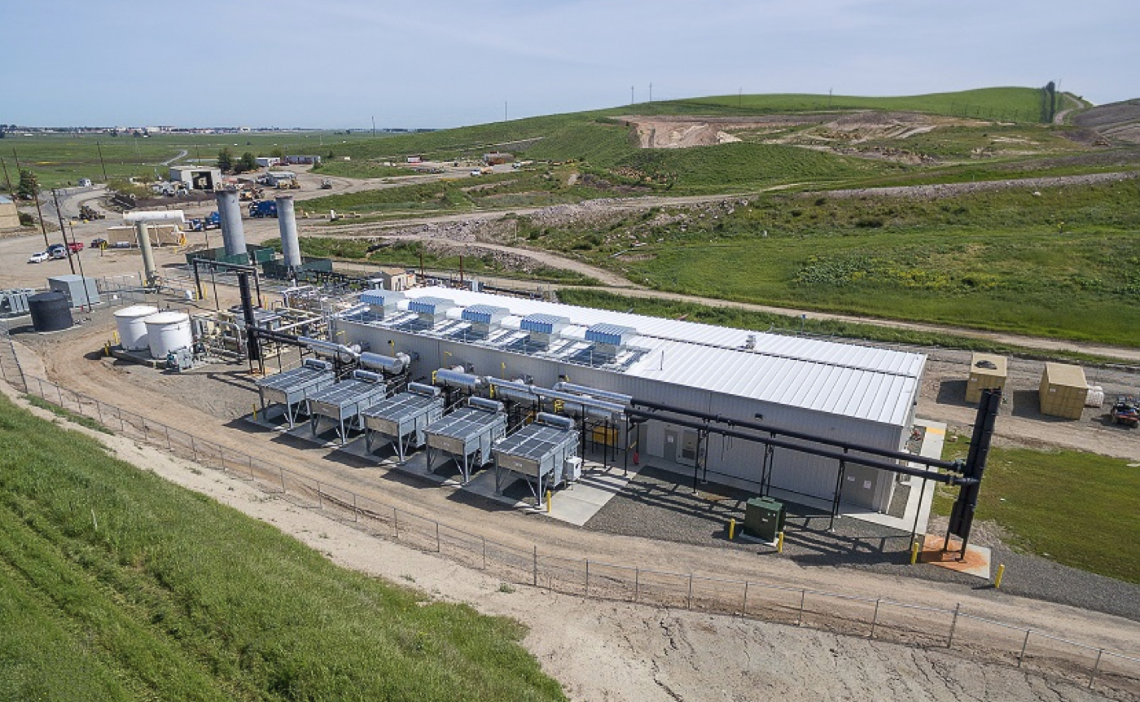
By default that garbage ends up in ever-growing piles outside our cities
But cities are now exploring its use for power generation via either:
"Waste to Energy" (WTE) OR "Landfill Gas to Energy" (LFGTE)
Top: http://greenbeston.com/what-is-municipal-solid-waste/
Left: http://www.afconsult.com/en/do-business/references/international/thermal-heat-and-power/tarastenjarvi-waste-to-energychp-plant/
Right: http://www.pennenergy.com/articles/pennenergy/2016/05/solano-county-landfill-gas-to-energy-project-providing-clean-power-to-homes.html

Slide 21
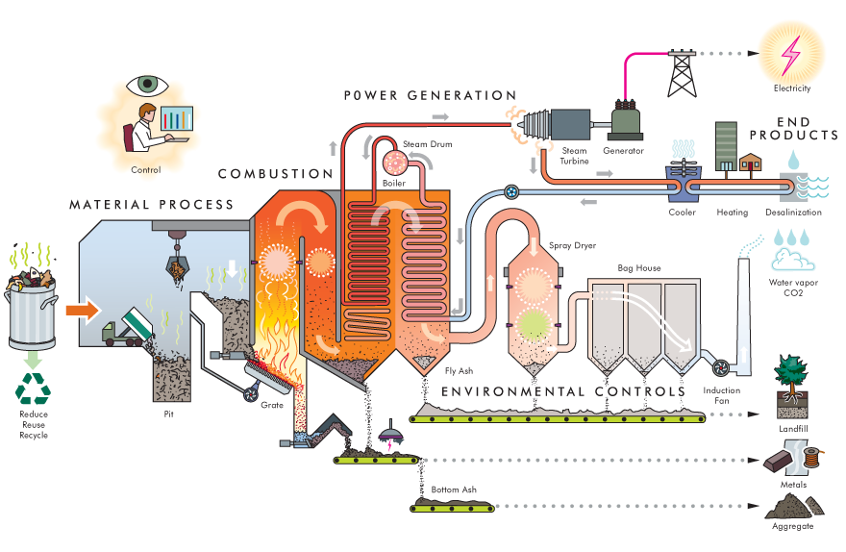
Waste to Energy burns the waste, producing steam:
That steam can then be used to do two things, in a process called Cogeneration
- The steam first drives the turbine generators of a conventional power plant
- It is then piped out to heat nearby factories, businesses and/or residences
Electrical Power =>
Heating =>
Landfill =>
Metals =>
Aggregate =>
Interactive webpage: http://www.deltawayenergy.com/wte-tools/wte-anatomy/

Slide 22
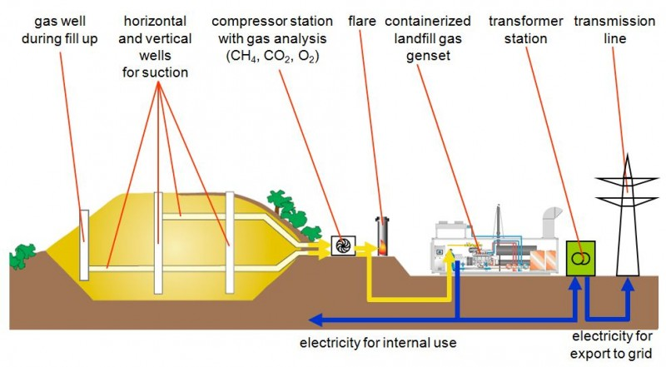
Landfill Gas to Energy instead mines garbage landfills for methane:
Anaerobic bacteria again try to convert the garbage's ~75% of organics to methane
If not captured, that potent greenhouse gas leaks out into the atmosphere
But piping can instead capture and direct it to a simple gas power plant:
http://www.westernbranchdiesel.com/continuous-gas-power/landfill-gas/

Slide 23
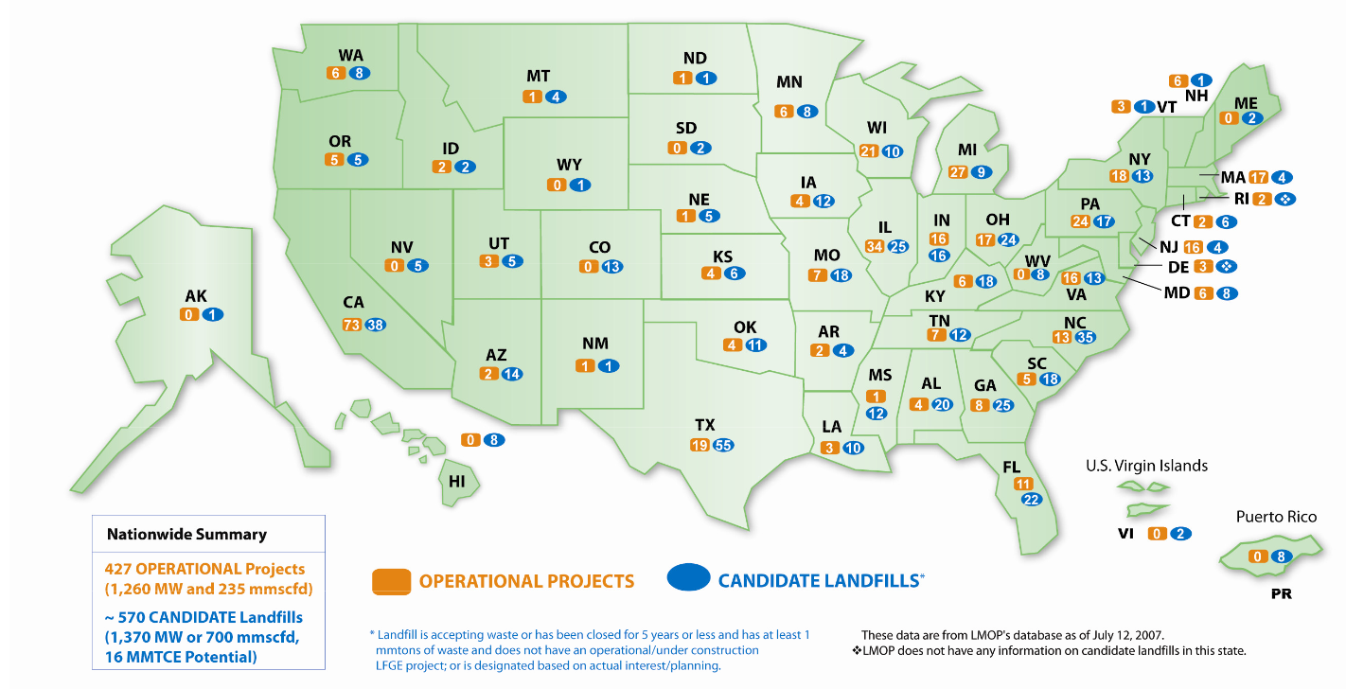
According to the EPA, there are 86 such facilities, located in 25 states: ¹
As mapped here: ²
However: ¹
"No new plants have been built in the US since 1995, but some plants have expanded"
"The 86 facilities have the capacity to produce 2,720 megawatts of power per year by processing more than 28 million tons of waste per year"
"In 2011 we combusted about 29 million tons of MSW (about 12 percent)"
Thus: ~12% of MSW produced ~ 0.5% of U.S. power (2.7 GW / 500 GW)
1) https://archive.epa.gov/epawaste/nonhaz/municipal/web/html/index-11.html
2) https://www.epa.gov/sites/production/files/2015-07/documents/biomass_combined_heat_and_power_catalog_of_technologies_3._biomass_resources.pdf

Slide 24
But what about the remaining ~ 88% of that garbage?
According to the University of Michigan's Center for Sustainability: ¹
"In 2014, 52.6% of MSW generated in the U.S. was disposed of in 1,908 landfills"
"While the total number of landfills in the U.S. has steadily declined, total capacity has increased."
"Environmental impacts of landfill disposal include loss of land area, emissions of methane (CH₄, a greenhouse gas) to the atmosphere"
"Landfills were the third largest source of U.S. anthropogenic CH₄ emissions in 2015"
"58% of landfill-produced CH₄ is recovered and combusted into CO₂ through flaring or electricity generation"
But are waste or landfill gas combustion TRULY environmentally friendly?
http://css.umich.edu/factsheets/municipal-solid-waste-factsheet

Slide 25
PoweScoreCard.org's take on Waste to Energy incineration:
"Burning MSW can generate energy while reducing the volume of waste by up to 90
percent, an environmental benefit . . . "
"MSW contains a diverse mix of waste materials, some benign and some very toxic.
Effective environmental management of MSW plants aims to exclude toxics from the
MSW-fuel and to control air pollution emissions from the WTE plants . . . "
"Burning MSW in WTE plants produces comparatively high carbon dioxide emissions,
contributor to global climate change."
"The net climate change impact of these emissions is lessened because a major component of trash is wood, paper and food wastes that would decompose if not burned.
If left to decompose in a solid waste landfill, the material produces methane - a potent
greenhouse gas."
http://www.powerscorecard.org/tech_detail.cfm?resource_id=10

Slide 26
Vs. the Natural Resources Defense Council's take on landfill gas combustion:
"Combustion of raw LFG in a flare, an engine, or a turbine dramatically reduces the overall toxicity."
"Collection and combustion dramatically reduces global warming impacts and toxicity."
"Using LFG to generate electricity further reduces the greenhouse gas impacts and also reduces emissions of nitrogen oxides, sulfur dioxide and mercury."
"Burying garbage in landfills results in the release of more heat-trapping gases than any other waste-management option."
"Because LFG is a by-product of landfills, and landfills are such a poor way to manage our waste, LFG can not be considered renewable"
As detailed elsewhere in their report, they believe a BETTER SOLUTION is:
Massively cutting our waste generation + Increasing our recycling
https://www.nrdc.org/sites/default/files/lfg.pdf

Slide 27
Neither organization is ready call WTE or LFGWTE environmentally friendly
But they DO seem to be saying they're better than what we are doing now:
Which is letting our U.S. garbage rot away in massive landfills,
emitting methane and possibly leaking toxins into our soil and water
But is one of those two technologies MORE environmentally friendly?
Or as a recent academic study put it:
"Is It Better to Burn or Bury Waste for Clean Electricity Generation?" – Concluding:
"Although various aspects of LFGTE and WTE have been analyzed in the literature, this paper is the first to present a comprehensive set of life-cycle emission factors per unit of electricity generated for these energy recovery options.
"The greenhouse gas emissions for WTE ranges from 0.4 to 1.5 MTCO2e/MWh, whereas the most aggressive LFGTE scenario results in 2.3 MTCO2e/MWh.
"WTE also produces lower NO_{x} emissions than LFGTE, whereas SO_{x} emissions depend on the specific configurations of WTE and LFGTE."
1) https://pubs.acs.org/doi/abs/10.1021/es802395e

Slide 28
But from today's 0.5%, how might waste's power contribution grow?
In a 2014 industry-funded / non-peer-reviewed study from
Columbia University's "Earth Engineering Center" concluded that: ¹
"If all the MSW that was landfilled in 2011 were to be diverted to WTE power plants, it could generate enough electricity to supply 13.8 million households,
i.e., 12% of the U.S. total. "
"In addition, if the steam turbine exhaust of the WTE plants were to be used for district heating . . . (it) could provide district heating for 9.8 million homes."
"Diversion of all MSW from landfills to WTE plants could also result in reducing the
greenhouse gas (GHG) emissions of managing the U.S. waste by at least 123 million tons of carbon dioxide equivalent (2.1 % of U.S. total greenhouse gas emissions), comparable to the annual emissions of over 23 million cars."
1) https://www.americanchemistry.com/Policy/Energy/Energy-Recovery/2014-Update-of-Potential-for-Energy-Recovery-from-Municipal-Solid-Waste-and-Non-Recycled-Plastics.pdf

Slide 29
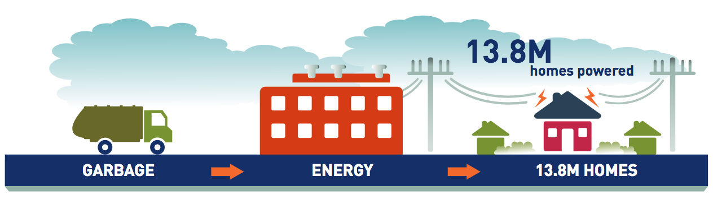
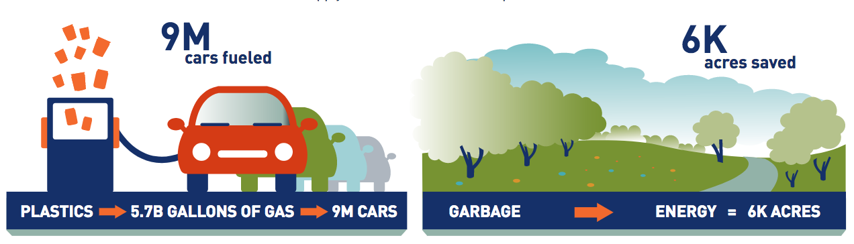
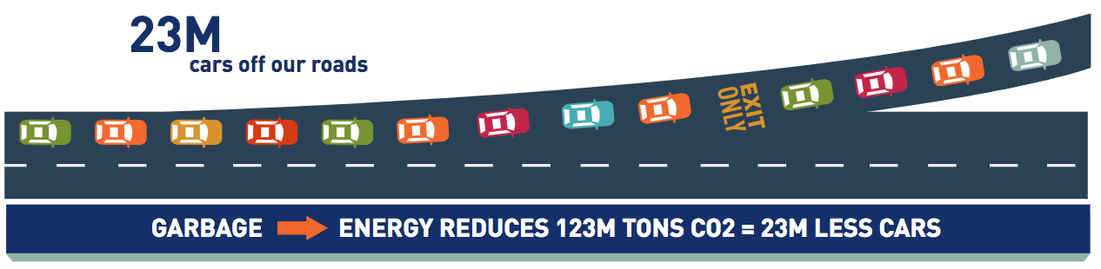
The benefits of such a 100% diversion, as translated into "infographics"
by the industry association AmericanChemistry.com:
https://www.americanchemistry.com/Policy/Energy/Energy-Recovery/The-Power-of-Waste.pdf

Slide 30
Moving on to the alternative of: Biofuels
An Introduction to Sustainable Energy Systems: WeCanFigureThisOut.org/ENERGY/Energy_home.htm

Slide 31
Biofuels are a form of Solar Energy
So we need to review some key solar energy facts:
The sun delivers the most energy when it shines vertically down thru clear skies
In which case the energy flow (= power) is ~ 1 kW / m² of earth surface
But this occurs only near noon on a summer day
Only in locations near the earth's equator
Only in perfect weather
Averaging over time, location and weather each cut the power by ~ ½
Giving a fully averaged solar power of about 125 W / m² of earth surface
That is a very small amount of power per earth area!
Fossil fuels cheated this by stockpiling solar energy over tens of millions of years
Which we are now doing or best to use up in about 200 years!
An Introduction to Sustainable Energy Systems: WeCanFigureThisOut.org/ENERGY/Energy_home.htm

Slide 32
For sustainability we must now balance power collection with power use
But existing forms of solar power collection / conversion are very inefficient
For photovoltaic solar cells: ¹
Complex research designs achieve collection/conversion efficiencies pushing 50%
Widely commercialized cells achieve collection/conversion efficiencies of 10-25%
Use of novel (potentially much cheaper) materials achieve efficiencies of 1-10%
Whereas:
Plant photosynthesis has a collection/conversion efficiency of ~ 1% ²⁻⁵
Algae (including saltwater tolerant species) can achieve ~ 10% ⁶
POWER OUT = (Averaged Solar Power) x (Collection/Conversion Efficiency)
= (~125 W / m²) x (One of the numbers above)
1) See my note set entitled "Today's Solar Cells" including its U.S. National Renewable Energy Lab data
2) "Energy Systems Engineering – Evaluation and Implementation" by Vanek, Albright & Angenent, page 453
3) "Sustainable Energy – Choosing Among Options" by Tester, Drake, Driscoll, Golay & Peters, page 506
4) "Sustainable Energy Without the Hot Air" by D.J.C. Mackay, page 49 (and references therein)
5) "Principles of Sustainable Energy Systems" by F. Krieth, 2nd Edition, pages 206-208
6) "Energy Systems Engineering – Evaluation and Implementation" by Vanek, Albright & Angenent, page 456

Slide 33
As calculated in Power Plant Land & Water Requirements (pptx / pdf / key) notes:
U.S. reliance on PHOTOVOLTAIC SOLAR CELLS would require HUGE tracks of land:
20,000 to 40,000 km² (0.2 – 0.4% of the total fifty state area)
Reliance on ALGAE-BASED BIOFUELS would require ENORMOUS tracks of land:
~ 200,000 km² (2% of the total fifty state area)
Reliance on PLANT-BASED BIOFUELS would require HUMONGOUS tracks of land:
~ 2,000,000 km² (20% of the total fifty state area)
Building & maintaining such operations inevitably requires large ENERGY INPUT
And that input inevitably translates into GREENHOUSE GAS OUTPUT
MAKING THIS THE MOST IMPORTANT SLIDE IN THIS WHOLE NOTE SET
AS IT EXPLAINS WHY BIOFUELS NEED REVOLUTIONARY IMPROVEMENT
An Introduction to Sustainable Energy Systems: WeCanFigureThisOut.org/ENERGY/Energy_home.htm

Slide 34
The basics of biofuel synthesis: ¹
Most biofuels are alcohols produced by the fermentation of sugars
Which makes sugar cane an excellent biofuel feedstock (as used in Brazil)
But sugar cane is a tropical water-guzzling plant, so we need alternatives
Fortunately: All plants contain sugar compounds
Including corn, U.S.'s favorite biofuel feedstock
Plant fiber (a 'ligno cellusosic matrix") typically consists of:
Outer (tough/dense) lignin shell surrounding
Linear cellulose fibers strands
Interwoven with wandering hemicellusose fibers
Cellulose = polymer of sugar molecules, with hemicellulose easier to break down
Lignin, on the other hand, is tough non-soluble material very hard to break down
1Here I draw heavily from then BEST textbook coverage of biofuels I have found:
Chapter 14 – Energy Systems Engineering, Evaluation & Implementation by Vanek, Albright and Angenent

Slide 35
Predigestion is thus used to free the feedstock's sugars
The first step is to break down the plant structures, better exposing the cellulose
This can be done by mechanical, chemical and/or biological processes:
- Most popular: Brute force "dry milling" (i.e. grinding) OR
- Addition of sulfuric acid (but the byproducts can be toxic to yeasts!) OR
- Simple hot* water treatment
Which also dissolves starches, the source of much of corn's sugar
Then, exposed cellulose is broken into component sugars by the enzyme "cellulase"
Which WOULD then prepare feedstock for fermentation if not for one more thing:
You must first kill off yeast-interfering bacteria which is native to the feedstock
Which is generally done by another heat* treatment
HEAT = Big chunks of energy you must put INTO biofuel

Slide 36
The liberated sugars are now ready for fermentation:
Wherein microorganisms convert the sugars into combustible alcohols
This can be done by bacteria: Multicellular prokaryotic organisms
Or by yeasts: Single cell eukaryotic organisms
Fermentation = Predigested feedstock ("mash") + bacteria / yeast + heat
But there is a Catch 22: Concentrated alcohol is toxic to bacteria / yeast, thus:
Bacterial / "domesticated" yeast fermentation tops out at ~ 5% alcohol
While some "wild yeasts" achieve ~ 15% alcohol
From your barroom experience you probably know that neither would burn
Combustion requires "distilled spirits" = ~ 10X higher alcohol percentages
Thus, when the bacteria or yeasts die off due to their own alcohol production,
one then needs a way of concentrating the alcohol they produced

Slide 37
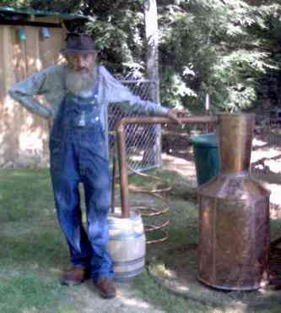
Bringing us to the next step of distillation
Which, as suggested by this picture, CAN also be fairly simple:
Heat the now fermented "mash"
This vaporizes the alcohol, but also some water
Pass these vapors through a long, progressively cooler, pipe
High boiling point water condenses in the early still-hot section of pipe
And is diverted away into drains
Lower boiling point alcohol only condenses in the later, cooler sections of pipe
Where, as a liquid, it can then be collected
But to get GOOD separation, distillation must be done slowly, requiring
Long periods of HEATING => Another BIG chunk of energy put INTO this biofuel
Figure: http://www.apptrav.com/howto.html

Slide 38
But U.S. biofuel use was driven by neither science nor economics
Instead, we now grow 40% of U.S. corn for biofuels because of politics:
- 1973 CAFE (Corporate Average Fuel Economy) standards (i.e., a government act)
Mandating average fuel economy levels for automobile manufacturers
- 1988 AMFA (Alternative Motor Fuel Act)
- 2007 Energy Independence and Security Act
Together, these laws strongly "incentivized" use of alternate fuels
Stimulating, for instance, use of "E10" = 90% gasoline + 10% ethanol
But this was done far AHEAD of the science really needed to judge it
And was instead the product of good intentions + agri-business / farm state politics
An Introduction to Sustainable Energy Systems: WeCanFigureThisOut.org/ENERGY/Energy_home.htm

Slide 39
Leading to a list of intensely controversial questions such as:
1) Does ethanol production CONSUME more energy than the fuel releases?
2) Does ethanol (from any source) really diminish greenhouse gas impact?
3) Could its growing production entail unacceptable land use or fertilizer pollution?
4) Could possible reliance on biofuels require implausible amounts of water?
5) Has corn's fuel use already inflated corn's food price here and abroad?
Let's consider those questions one by one:
An Introduction to Sustainable Energy Systems: WeCanFigureThisOut.org/ENERGY/Energy_home.htm

Slide 40
1) Does ethanol production CONSUME more energy than the fuel releases?
In my note set:
Lifetime Energy Output vs. Lifetime Energy Investment: EROI (pptx / pdf / key)
I ask the same question of ALL energy technologies
To put the alternatives into perspective, you should ultimately study that note set
But for your present use I'll excerpt that note set's minimally edited biofuel section:

Slide 41
Before making a financial investment, you'd want to know its likely ratio of:
Income Produced / Monetary Investment ~ Return on Investment (ROI)
A similar energy measure would be the ratio of:
Lifetime Energy Produced / Lifetime Energy Invested
For years researchers gave this (or its reciprocal) different names, including:
Energy Intensity
Energy Intensity Ratio
Energy Return on Invested
Energy Return on Investment
Energy Return on (energy) Invested
Energy Return on Invested Energy

Slide 42
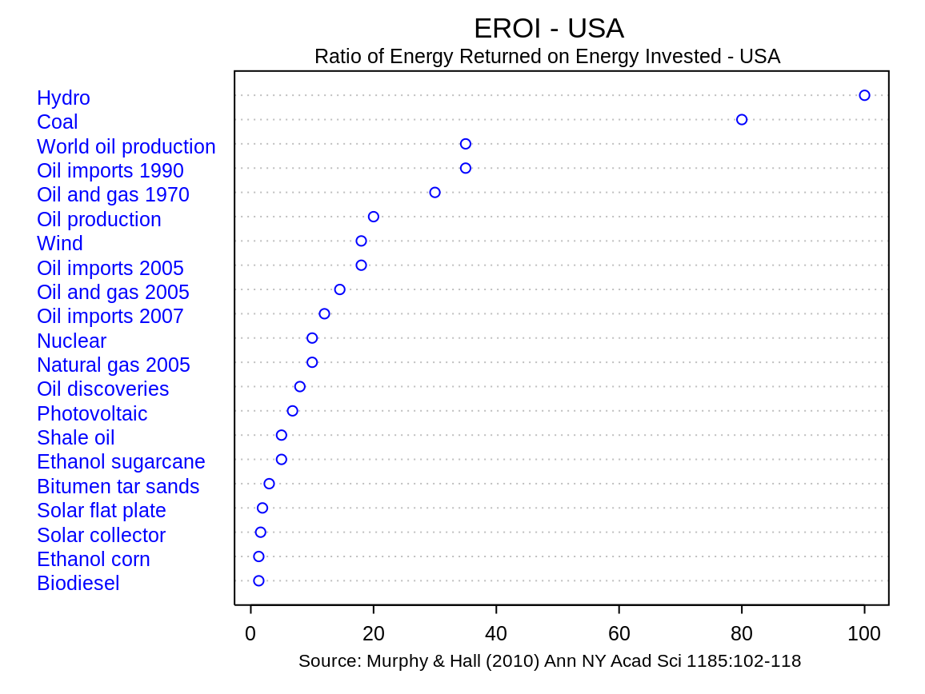
But thankfully, they've now converged on the simple abbreviation: EROI
Largely stimulated by the 2010 paper of D.J. Murphy & C.A.S. Hall entitled:
Year in Review: EROI or energy return on (energy) invested ¹
Wikipedia's plot of data from that seminal paper: ²
1) Or as I will denote it: Murphy 2010 - Year in review: EROI or energy return on (energy) invested
2) Energy Return on Energy Invested, Wikipedia, https://en.wikipedia.org/wiki/Energy_returned_on_energy_invested

Slide 43
The EROIs of biofuels are driven down by excessive energy inputs:
As discussed above, ethanol production from corn requires energy to:
- Synthesize the exceptionally large quantities of fertilizer required by corn
- Break down the 'ligno cellusosic matrix" of that corn to expose its cellulose
- Rid the resulting "mash" of bacteria that could interfere with yeast growth
- Provide the sustained warmth that yeast requires to ferment sugars into alcohol
- Provide the sustained heat that distillation requires to separate out that alcohol
The exact steps may change if sugar cane is the feedstock
or if biodiesel is to be the output
But multiple biological and/or chemical synthesis steps
combined with final fuel separation steps
inevitably => exceptionally large energy inputs
Figure: http://www.apptrav.com/howto.html

Slide 44
And there is also the issue of not very well hidden research agendas
EROI was defined as: Lifetime Energy Output / Lifetime Energy Input
Thus, if harvesting sugar for ethanol involves burning off its fields,
that heat is considered an energy input because it could have been used
instead to homes, to create the steam in an electricity plant . . .
But many biofuel studies choose to redefine EROI as instead:
Lifetime Energy Output / Lifetime Fossil Fuel Energy Input
Some even consider only the inputs of a single specific fossil fuel
Why the sudden redefinitions? Because these studies are primarily focused on
eliminating the atmospheric carbon footprint of today's fossil fuels
And from such a climate-change-driven perspective,
YES, a biofuel requiring less fossil fuel to create is more desirable!
An Introduction to Sustainable Energy Systems: WeCanFigureThisOut.org/ENERGY/Energy_home.htm

Slide 45
But EROI's were meant to clarify our energy decisions
Whereas mobile EROI definitions seem to only cloud those decisions. For example:
Airlines may soon be compelled to adopt supposedly carbon-neutral biofuels
But if we force such a change, it will not be because it makes energy sense
It will be because it makes unavoidable climate change sense
Why? Because jet travel can account for 1/3 of your personal carbon footprint
Its elimination may thus be so important that we switch to carbon-neutral fuels
even if those aircraft biofuels end up being net energy sinks!
Or to instead call upon Murphy & Hall's words from their seminal EROI publication: ¹
"In the case of corn ethanol, at least three different methods of net energy
analysis had been employed in the literature, resulting in three different
estimates of EROI that were mutually incommensurable"
1) Murphy 2010 - Year in Review: EROI or Energy Return on (Energy) Invested

Slide 46
Specific sources of dispute?
- Omitted energy inputs (e.g., for fertilizers or for farm machinery & infrastructure)
- Inflated claims about possible secondary use of energy
As in the possible use of waste heat for local heating of buildings
or for steam production in adjacent electrical power stations
- Inflated claims of byproduct ("co-product") energy value (output)
As in claims that used corn mash could largely replace corn livestock feed
despite fermentation having depleted it of much of its nutritional value
- Counter claims that co-product energies were omitted in specific papers
Despite clear evidence I found of their being included in those exact papers
(They might have been undervalued, but they weren't omitted!)
For further details, see the many biofuel papers I cite on this Biomass and Biofuel notes set's
Resources Webpage

Slide 47
Hall and Lambert looked back on all of this in a joint 2014 review:
In that review they considered biofuel EROI research:
From no less than 31 different studies
Considering feedstocks of wood, corn, sugar cane, molasses . . .
Which they rolled into a composite statement that Biofuel EROI ~ 5
But I've found that lumping EROI data together can be a very poor idea
Which almost compelled me to dig up each of those 31 studies
Separating EROI's for each feedstock, sorting data by date of study, etc.
Which I might have done had I not come to share their conclusion about biofuels:
"We believe that outside certain conditions in the tropics
most ethanol EROI values are at or below the 3:1 minimum extended EROI
value required for a fuel to be minimally useful to society"
Hall, Lambert & Balogh 2014 - EROI of Different Fuels and the Implications for Society

Slide 48
My bottom line reevaluation of ALL energy EROI's (from my EROI note set): ¹
Technology EROI
Heat from:
Conventional oil 16
Ethanol from sugarcane 9
Biodiesel from soy 5.5
Tar Sands 5
Heavy oil from California 4
Ethanol from corn 1.4
Electricity from:
Hydroelectric Dams 40+
Wind ~ 40
Coal (CC) 2.5-5
Natural Gas (CCGT) 3.5-5
  Solar PV 9, 12, 15, 35
Nuclear 35-40
1) Lifetime Energy Output vs. Lifetime Energy Investment: EROI (pptx / pdf / key)
Likely now lower for fossil fuels
and/or overstated for biofuels.
But insufficient new data
to support strong revisions
poly-Si
xtal-Si
α-Si
CdTe

Slide 49
2) Does ethanol (from any source) really diminish greenhouse gas impact?
The most authoritative response I found was a National Academies report entitled: ¹
Renewable Fuel Standard:
Potential Economic and Environmental Effects of U.S. Biofuel Policy
Page 4: The U.S. RFS / EISA gasohol program "may be an ineffective policy for reducing global GHG emissions"
Page 4: "if the expanded" (gasohol) "production involves removing perennial vegetation on a piece of land and replacing it with an annual commodity crop" (such as corn) "then the land-use change would incur a one-time GHG emission from biomass and soil that could be large enough to offset GHG benefits gained by displacing petroleum-based fuels with biofuels over subsequent years. Furthermore, such land conversion may disrupt any future potential for storing carbon in biomass and soil."
Page 5: "In contrast, planting perennial bioenergy crops in place of annual crops could potentially enhance carbon storage in that site.
Page 10: "Air quality modeling suggests that production and use of ethanol as fuel to displace gasoline is likely to increase such air pollutants as particulate matter, ozone, and sulfur oxides. Published studies projected that overall production and use of ethanol will result in higher pollutant concentration for ozone and particulate matter than their gasoline counterparts on a national average."
1) https://www.nap.edu/catalog/13105/renewable-fuel-standard-potential-economic-and-environmental-effects-of-us

Slide 50
University & government labs have reached differing conclusions:
From a Washington State University study:
"Ethanol as Fuel: Energy, Carbon Dioxide Balances, and Ecological Footprint" ¹
"The use of ethanol as a substitute for gasoline proved to be neither a sustainable nor an environmentally friendly option, considering ecological footprint values, and both net energy and CO₂ offset considerations seemed relatively unimportant compared to the ecological footprint. As revealed by the ecological footprint approach, the direct and indirect environmental impacts of growing, harvesting, and converting biomass to ethanol far exceed any value in developing this alternative energy resource on a large scale."
"In the US case, the use of ethanol would require enormous areas of corn agriculture, and the accompanying environmental impacts outweigh its benefits. Ethanol cannot alleviate the United States’ dependence on petroleum."
"However, the ethanol option probably should not be wholly disregarded. The use of a fuel that emits lower levels of pollutants when burned can be important in regions or cities with critical pollution problems."
1) https://academic.oup.com/bioscience/article/55/7/593/306765

Slide 51
As opposed to this Argonne National Lab study:
"Well-to-Wheels Energy Use and Greenhouse Gas Emissions of Ethanol from Corn, Sugarcane and Cellulosic Biomass for U.S. Use" ¹
Which states that:
"We quantitatively address the impacts of a few critical factors that affect life-cycle GHG emissions from bioethanol."
"Even when the highly debated land use change GHG emissions are included, changing from corn to sugarcane and then to cellulosic biomass helps to significantly increase the reductions in energy use and GHG emissions from using bioethanol."
Paraphrasing a later sentence (to add both clarity and emphasis):
Relative to petroleum gasoline:
Ethanol from corn can reduce life-cycle GHG emissions by 19–48%
Ethanol from sugarcane can reduce life-cycle GHG emissions by 40–62%
Ethanol from corn stover can reduce life-cycle GHG emissions by 90–103%
Ethanol from switchgrass can reduce life-cycle GHG emissions 77–97%
Ethanol from miscanthus can reduce life-cycle GHG emissions by 101–115%
1) http://iopscience.iop.org/article/10.1088/1748-9326/7/4/045905/meta

Slide 52
Perhaps confused, many environmental organizations seem to be fence sitting:
In that while they state their concerns about biofuels' possible environmental impacts,
they fail to take a clear stand for or against corn ethanol programs
The Sierra Club, however, is more outspoken: ^{1, 2}
"The Club opposes further deployment of corn-based ethanol based on its extremely dubious net carbon benefits and its unresolved direct and indirect environmental impacts. The Club also opposes proposals to use agricultural waste and residue products (e.g , corn stover) without rigorous evidence that the material being used is surplus to the needs of soil health and fertility"
In 2015 biofuels production in the US is still primarily based on corn-based ethanol, an industry that receives enormous federal subsidies and preferences. The corn ethanol industry has not only failed to prove its sustainability, but if anything, concerns about corn ethanol’s impacts have grown.
"Those concerns don’t apply equally to all biofuels."
1) https://content.sierraclub.org/grassrootsnetwork/team-news/2015/02/sierra-club-guidance-biofuels
2) https://www.sierraclub.org/press-releases/2017/11/epa-turns-blind-eye-ethanol-s-environmental-impacts

Slide 53
My (also somewhat tentative) overall conclusions:
I saw a huge range of claims about gasoline vs. gasohol carbon footprint
Easily spanning: "Gasohol's GHG impact is 20% better" to "20% worse"
But, absent a consensus, there was still a strong trend toward the conclusion that:
E10 Gasohol has the same carbon footprint as pure gasoline +/- 2%
For instance in "Intro to Environmental Engineering & Science" by Masters and Ela:
Page 416: "With careful accounting, greenhouse gas emissions of corn-based ethanol are similar to
gasoline, sugarcane is a better source, and cellulosic ethanol promises to be far better that either
corn or ethanol"
NOTE (!): This discussion was NOT about whether gasohol is "carbon neutral."
It was about if gasohol's creation and use liberates MORE carbon than gasoline!
Which seems to make those closely-matched / ambiguous evaluations rather damning:
Is gasohol green? No, at best it's Gasohol / At worst it's Gasohol

Slide 54
3) Could gasohol require unacceptable land use or fertilizer pollution?
I've already estimated implausible land use. Here's the world press's take on fertilizer pollution:
Forbes Magazine: (www.forbes.com/sites/christopherhelman/2013/11/11/attention-fracktivists-corn-ethanol-is-the-real-environmental-culprit/)
"The evidence of water pollution caused by ethanol is obvious: nitrogren fertilizer applied in the corn fields has ruined wells under farmland and has seeped into rivers that millions of people rely on for drinking water. Eventually the chemicals drift down the Mississippi, resulting in a 5,800 square-mile dead zone in the Gulf of Mexico."
Associated Press: (http://bigstory.ap.org/article/secret-dirty-cost-obamas-green-power-push-1)
"As farmers rushed to find new places to plant corn, they wiped out millions of acres of conservation land, destroyed habitat and polluted water supplies, an Associated Press investigation found."
Scientific American: (www.scientificamerican.com/article/nitrogen-fertilizer-anniversary/)
"The production of ethanol from corn in the U.S. is a disaster in terms of fertilizer flowing down the Mississippi River," says Cornell University environmental biologist Robert Howarth, chair of the International SCOPE Biofuels Project"
New York Times: (www.nytimes.com/2010/06/25/business/energy-environment/25iht-rbogeth.html?pagewanted=all&_r=0)
"Fertilizer and pesticide runoffs from the U.S. Corn Belt are key contributors to “dead zones” in the Gulf of Mexico and along the Atlantic Coast. . . . increasing corn production to meet the 2007 renewable fuels target would add to nitrogen pollution in the Gulf of Mexico by 10 to 34 percent. "

Slide 55
Which is supported by sources such as these:
From page 10 of the previously cited National Academies report: ¹
"The increase in corn production has contributed to environmental effects on surface and ground water, including hypoxia, harmful algal blooms, and eutrophication."
From the White House's: "Scientific Assessment of Hypoxia in U.S. Coastal Waters" ²
"Although coastal hypoxia can be caused by natural processes, a dramatic increase in the number of U.S. waters developing hypoxia is linked to eu􏰉troph􏰈ication due to nutrient (nitrogen and phosphorus) and organic matter enrichment resulting from human sources."
'The incidence of hypoxia has increased ten-fold globally in the past fifty years, and almost thirty-fold in the United States since 1960."
"Despite the use of improved production methods in recent years, agriculture is still the leading source of nutrient pollution in many watersheds due, in part, to a high demand for nitrogen-intensive crops, such as corn."
From the Union of Concerned Scientists' "Corn Ethanol's Threat to Water Resources" ³
Pollution from corn farming is a leading cause of water quality problems in the Upper Mississippi River watershed, polluting drinking water in agricultural areas and degrading rivers and lakes, while also expanding the Gulf of Mexico’s “dead zone” (a large area deprived of oxygen). These problems ... are exacerbated by government policies that increase demand for corn ethanol.
1) https://www.nap.edu/catalog/13105/renewable-fuel-standard-potential-economic-and-environmental-effects-of-us
2) https://obamawhitehouse.archives.gov/sites/default/files/microsites/ostp/hypoxia-report.pdf
3) https://s3.amazonaws.com/ucs-documents/clean-vehicles/corn-ethanol-and-water-quality.pdf

Slide 56
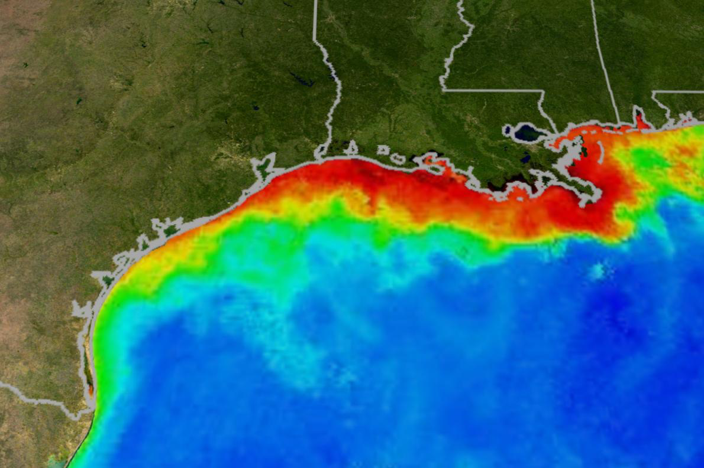
The Gulf of Mexico "Dead Zone" – Summer of 2017 ¹
1) https://news.nationalgeographic.com/2017/08/gulf-mexico-hypoxia-water-quality-dead-zone/
National Geographic Magazine – 2 August 2017:
"The National Oceanic and Atmospheric Administration (NOAA) announced today that this summer’s dead zone is the largest ever recorded, measuring 8,776 miles."
"The Gulf of Mexico hypoxic or low-oxygen zone, also called a dead zone, is an area of low to no oxygen that can kill fish and other marine life. It’s primarily caused by an excess of agricultural nutrients that flow downstream and into surface waters, stimulating harmful algae."
"Preliminary reports from the United States Geological Survey (USGS) align with the observation, estimating that 165,000 metric tons of nitrate–about 2,800 train cars of fertilizer—and 22,600 metric tons of phosphorus flowed down the Mississippi and Atchafalaya rivers into the Gulf of Mexico in May."

Slide 57
4) Could reliance on biofuels require implausible amounts of water?
According to the technical press:
IEEE Spectrum (June 2010) – "Biofuel's Water Problem:" ¹
"Irrigating biofuels on a grand scale would be disastrous"
"At present, less than 20 percent of the corn grown in the Midwestern corn belt of the United States is irrigated. But the increases in corn production appears to be in areas where irrigation is common. That’s a problem, because irrigation already accounts for 37 percent of the water withdrawn from aquifers, lakes, and rivers in the United States"
IEEE Spectrum (November 2009) – "Organic But Not Green" ²
"Our simple model, developed at the school of electrical and computer engineering at Georgia Tech, is designed to evaluate alternative energy scenarios. It simulates the consumption of energy, land, water, and carbon both globally and on regional scales; it projects emissions of carbon and waste heat; and it takes all obvious interdependencies into account."
"To our own surprise, the model we constructed showed that there is simply notenough land and water to support a prosperous biofueled world."
1) https://spectrum.ieee.org/green-tech/conservation/biofuels-water-problem
2) http://ieeexplore.ieee.org/document/5292048/

Slide 58
Which is fully substantiated by the National Academies:
Paraphrasing from page 10 from their previously cited report: ¹
Estimates of life cycle water consumption for alternate biofuels:
Corn-grain ethanol = 15-1,500 gallons per gallon of gasoline equivalent
Cellulosic biofuels = 2.9-1,300 gallons per gallon of gasoline equivalent
Petroleum-based fuels = 1.9-6.6 gallons per gallon of gasoline equivalent
For perspective: The U.S. EIA says we used 143 billion gallons of gasoline in 2016 ²
From above, if corn-grain ethanol were substituted, it might require:
143 billion gal. x 1500 = 215 trillion gal. H₂O for biofuels (2.15 x 10¹⁴)
But 326 million individual Americans now use ~ 33,000 gallons of water per year ³
326 million x 33,000 gal. = 10.8 trillion gal. H₂O for citizens (1.08 x 10¹³)
Yes! As claimed in the preceding slide, biofuels would precipitate a water crisis!
1) https://www.nap.edu/catalog/13105/renewable-fuel-standard-potential-economic-and-environmental-effects-of-us
2) https://www.eia.gov/tools/faqs/faq.php?id=23&t=10 3) https://water.usgs.gov/edu/qa-home-percapita.html

Slide 59
5) Has corn's fuel use inflated corn's food price here and abroad?
According to the world press:
Washington Post: (www.washingtonpost.com/blogs/wonkblog/wp/2012/08/21/study-u-s-could-put-a-big-dent-in-food-prices-by-relaxing-ethanol-rules/)
"One top U.N. food official, José Graziano da Silva, has already called for an "immediate, temporary suspension" of the U.S. ethanol mandate in order to ease the pressure on world food prices . . . (a paper from) three agricultural economists at Purdue University finds that even a partial relaxation of the mandate could reduce corn prices by up to 20 percent next year"
Aljazeera: (www.aljazeera.com/indepth/opinion/2012/10/201210993632838545.html)
"US corn ethanol fuels food crisis in developing countries" LEAD: "The US ethanol programme pushed up corn prices by up to 21 per cent as it expanded to consume 40 per cent of the harvest"
National Public Radio: (www.npr.org/2010/12/22/132082743/if-your-meat-prices-rise-you-can-blame-ethanol)
"Ethanol demand has helped send corn prices soaring."
Forbes Magazine: (www.forbes.com/sites/williampentland/2012/07/28/the-coming-food-crisis-blame-ethanol/)
"A series of spikes in global food prices resulted in riots in 2008 and contributed to violent uprisings in North Africa and the Middle East in 2011. The culprit is a matter of considerable and frequently heated debate, but the most commonly cited candidates include market speculators, global warming and aggressive government renewable fuel mandates."
Wall Street Journal: (http://online.wsj.com/news/articles/SB10001424127887323713104578133571463805826)
"The cause of higher grocery bills isn’t the drought. It’s the failed federal ethanol policy"

Slide 60
Which is strongly supported by prominent studies such as these:
Biofuels Impact on Crop and Food Prices: Using an Interactive Spreadsheet
(A report to the U.S. Federal Reserve's Board of Governors): ¹
"Over the past two years (ending June 2008), we estimate that the increase in worldwide biofuels production pushed up corn, soybean and sugar prices by 27, 21 and 12 percentage points respectively. The countries that account for most of the upward pressure on these prices are the United States and Brazil."
Accurate market price formation model with both supply-demand and trend-following for global food prices providing policy recommendations
(from the Proceedings of the National Academy of Science) ²
Recent increases in basic food prices are severely affecting vulnerable populations worldwide. Proposed causes such as shortages of grain due to adverse weather, increasing meat consumption in China and India, conversion of corn to ethanol in the United States, and investor speculation on commodity markets lead to widely differing implications for policy . . . The results show that the dominant causes of price increases are investor speculation and ethanol conversion.
1) https://www.federalreserve.gov/pubs/ifdp/2009/967/ifdp967.pdf
2) http://www.pnas.org/content/112/45/E6119

Slide 61
Counter arguments in FAVOR of biofuels?
The negatives, above, mostly concerned farmed (= irrigated + fertilized) crops
Non-farmed (non-irrigated + non-fertilized) crops eliminate many problems:
For instance, sugar cane (in Brazil) or (possibly?) switchgrass in U.S.
New lignum processing might radically enhance biofuel yield / energy balance
For instance, via use of genetically engineered bacteria
Even more promising: Algae are much better at capturing solar energy
And some grow in hugely more available brackish water
Finally, for airplanes, lightweight energy dense fuels will always be essential
Batteries are, and will probably remain, too heavy
And hydrogen requires heavy pressure tanks or absorbing medium
Suggesting that biofuels could become the key to "clean" aviation

Slide 62

AP (30 June 2015): United Airlines investing $30 million in biofuels producer
AP (30 June 2015): Why airlines keep pushing biofuels: They have no choice
"Airlines are turning to a technology very few can make work on a large scale: converting trash into fuel . . .
"It's about retaining, as an industry, our license to grow,' says Julie Felgar, managing director for environmental strategy at plane maker Boeing . . .
"Unlike the ground transport sector, they don't have a lot of alternatives, says Debbie Hammel, a bioenergy policy expert . . .
Making biofuels at large, commercial scale is difficult and dozens of companies have gone belly up trying . . .
(But) if any industry is going to crack fuel from waste on a big scale, the airline industry might be the best bet. Instead of having to build the infrastructure to distribute and sell these fuels at hundreds of thousands of gas stations, jet fuel only has to be delivered to a small number of major airports."

Slide 63
Credits / Acknowledgements
Some materials used in this class were developed under a National Science Foundation "Research Initiation Grant in Engineering Education" (RIGEE).
Other materials, including the WeCanFigureThisOut.org "Virtual Lab" science education website, were developed under even earlier NSF "Course, Curriculum and Laboratory Improvement" (CCLI) and "Nanoscience Undergraduate Education" (NUE) awards.
This set of notes was authored by John C. Bean who also created all figures not explicitly credited above.
Copyright John C. Bean
(However, permission is granted for use by individual instructors in non-profit academic institutions)
An Introduction to Sustainable Energy Systems: WeCanFigureThisOut.org/ENERGY/Energy_home.htm

