Slide 1
Where Do We Go from Here?
John C. Bean
Outline
Searching for an effective, politician & lobbyist-proof, way of mitigating climate change
Cap & Trade: Affecting industry directly / but me only indirectly
Its success with acid rain vs. the complexities of applying it to climate change
Carbon Tax: Affecting ALL directly
What tax rate would be required to produce the desired changes?
A prediction based on present day energy economics
What is my personal carbon footprint? => How much tax would I likely pay?
Household cost as a function of carbon tax rate and your local energy sources
Would this be justified by what economists call the Social Cost of Carbon?
Their last two decades of research & debate about this cost
My analysis of their data, incorporating more recent climate modeling
(Written / Revised: November 2019)

Slide 2

A former student recently sent me this card:
She noted the strong resonance with this class
Which leads me to now pose a final question:

Slide 3

Where Do We Go from Here?
I've described my own early error of fixating upon a single energy technology
Which, driven by my research interests, turned out to be solar photovoltaics
But David McKay then taught me the need to consider entire energy systems
And that energy systems were now hugely complex and rapidly changing puzzles
David and I have now taught YOU a lot about those energy system pieces
Hopefully, that now suggests many ways in which they might be fit together

Slide 4
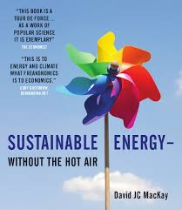
But how do we ensure that anything is now actually DONE?
In his book's final brief chapter, David's closing admonitions were:
1) "Stop saying NO and start saying YES" (to specific energy alternatives)
2) Craft your chosen alternatives into "A plan that adds up"
3) And then "Tell all your political representatives"
I echo David's sentiment, but am increasing troubled with his 3rd recommendation

Slide 5
Sadly, today's politicians are almost always someone who:
1) DID manage to eek out some sort of law degree . . . from somewhere
2) Has NOW mastered the ability to parrot a set of talking points
3) But is totally preoccupied with funding his/her FUTURE re-election campaign
≠ People qualified or inclined to study our carefully crafted energy plans
Instead, in their hands our complex plans can easily disappear behind closed doors
Through which only well-moneyed lobbyists have access
And emerge as endlessly complex, carefully loophole-infested bills
That only a pack of lawyers can really understand (or exploit)

Slide 6
And I already see rich evidence of highly politicized energy policy:
In MacKay's Britain, where politicians have not only gutted support for sustainables
but even deleted public service webpages about improving household efficiency
Or in power companies successfully lobbying against U.S. sustainability programs
such as the Clean Power Plan, Net Metering and/or Feed-in Tariffs
And here in Virginia where Dominion Power (the state's largest single political donor!)
"convinced" the legislature to adopt a renewables plan that
makes it exceedingly unattractive for homeowners to sell power to the grid
So sorry David, before I toss the responsibility "over the fence" to the politicians
I want a plan that is REALLY simple to understand, implement and monitor

Slide 7
I'm not alone in seeking a simple, clean, efficient, transparent solution
The left & the right, businessmen & environmentalists, have all felt a similar need
And this has led to a LOT of recent talk about two closely related ideas:
Carbon Cap and Trade A Carbon Tax
Evidence for such a meeting of the minds?
Merril Lynch investment brokers: "Those who advocate only command-and-control regulation seem to ignore all of the published data, from the experiences of academics, governments and the private sector, that highlight precisely why emissions trading is a more cost-effective approach to reducing emissions than blunt regulation. Put simply, it is better to reduce emissions in a way that results in lowest costs to society." ¹
The Environmental Defense Fund: "Cap and trade is the most environmentally and economically sensible approach to controlling greenhouse gas emissions, the primary driver of global warming." ²
1) http://www.fern.org/book/trading-carbon/cap-and-trade-most-cost-effective-way-reduce-emissions
2) https://www.edf.org/climate/how-cap-and-trade-works

Slide 8
Cap and Trade has a longer history, so let's examine it first
It is a governmental approach to decreasing the emission of a certain pollutant
But here the government does not legislate how this will be done
It just demands that it will be done:
By setting the allowable amount of pollutant emission = The Cap
The process starts by surveying ALL present day sources of emission
Then, a company's present day emission of that pollutant => It's year #1 Cap
And it is issued a permit for that amount of pollutant emission
But in year #2, quantities in ALL Caps/Permits are ratcheted downward by x%
Following a publically announced, multi-year, decreasing schedule
This, alone, would apply equal pressure on all of the pollutant producers
An Introduction to Sustainable Energy Systems: WeCanFigureThisOut.org/ENERGY/Energy_home.htm

Slide 9

But different companies likely face very different challenges:
Company A, may have only one possible production process
From which the pollutant is an inevitable byproduct
The decreasing Cap would thus drive Company A right out of business
For Company B, there might be another possible production process
And investment in that alternative might result in less pollutant emission
So Company B could survive the decreasing Cap
Thus caps alone would drive a rapid corporate survival of the fittest
Which could then easily produce massive economic and societal disruption

Slide 10
That is where The Trade comes in:
Companies are allowed to sell their pollutant emission permits to one another
So Company A can offer to buy permits from Company B
Those permits (as all permits) still decrease according to The Schedule
And buying these permits is going to add to Company A's expenses
Which will increase the cost of its product
But if Company A's product is essential, we'll accept that now-increasing price
But we'll sure as heck try to find ways of using less of that product!
Meanwhile, the income Company B got by selling its permits to Company A
could help finance its development of that new less polluting process,
allowing it to convert itself into a new green Company B!
An Introduction to Sustainable Energy Systems: WeCanFigureThisOut.org/ENERGY/Energy_home.htm

Slide 11
The winners?
The Environment: Pollutant emission has decreased according to The Schedule
Company B: Which has recast itself into an new greener form
Company A: Which survived because it has an essential product
But which is still being squeezed by its permits' decreasing emission limits
And by consumers trying to avoid use of its ever more expensive product
All of which has supposedly been accomplished by:
Replacing massive governmental micromanagement / regulation with
The Invisible Hand of a (quasi) free market economic system
= Adam Smith's "unintended social benefits resulting from individual actions" ¹
1) https://en.wikipedia.org/wiki/Invisible_hand

Slide 12
Does Cap and Trade really work?
It was first tested by economists in computer models at the precursor of the EPA: ¹
"These studies used mathematical models of several cities and their emission sources in order to compare the cost and effectiveness of various control strategies. Each abatement strategy was compared with the "least cost solution" produced by a computer optimization program to identify the least costly combination of source reductions in order to achieve a given abatement goal. In each case it was found that the least cost solution was dramatically less costly than the same amount of pollution reduction produced by any conventional abatement strategy" ¹
The Bush I administration then worked with the Environmental Defense Fund
Writing a version of C&T into the 1990 Clean Air Act, targeting SO₂ emissions
SO₂ + H₂O => Sulfuric acid => Acid rain => Dead northeastern lakes
The result? A rapid and dramatic reduction in U.S. SO₂ emissions
Leading U.S. & international agencies to label SO₂ C&T a resounding success!
1) https://en.wikipedia.org/wiki/Emissions_trading

Slide 13
Why not just apply Cap and Trade to ALL greenhouse gases?
Well, as cited above, that IS exactly what many suggest
Including many economists, investment houses, and the EDF
However, as applied to all greenhouse gases, Cap and Trade gets very complicated:
1) There are a LOT of different greenhouse gases
2) Cap and Trade depends on precise initial answers to the questions of:
What is each gas's current emission? By whom, in exactly what amounts?
But consider my Fossil Fuels (pptx / pdf / key) note set where:
Recent studies suggested that EPA's bottom-up assessment of CH₄ emission:
- Massively understates that greenhouse gas's total emission
- And completely misses "accidental" / "off the books" emissions
from rogue operators within the natural gas industry

Slide 14
So while Cap & Trade minimizes later governmental micromanagement It depends on up front governmental micromanagement:
First, to acquire accurate information on which to base the overall capping schedule
Second, to determine size of a massive number of company-by-company permits
=> Hugely complex computations and negotiations
Almost certainly occurring behind closed doors in marathon processes
Which, I fear, reopens possibility of massive well-funded corporate lobbying efforts
Aimed at special corporate dispensations, blunting and/or corrupting results
It's claimed this is exactly what's happening to EU's greenhouse gas C&T program
E.G., a Carnegie Mellon study "Cap and Trade is Not Enough" which concluded:
Facing economic stagnation, the EU has backed off their C&T targets
Effectively undercutting the whole program
1) http://www.cmu.edu/gdi/docs/cap-and-trade.pdf

Slide 15

Further, Cap and Trade lets "us" get off rather easily
As discussed in my lectures on power consumption in transportation and housing:
"Our" personal transportation and housing choices
account for nearly half of the U.S.'s
(spectacularly) high energy consumption
Thus, as the majority of that energy production relied on greenhouse gas emissions,
"our" personal choices drive almost half of the total U.S. greenhouse emissions
Nevertheless, Cap and Trade has almost no directly perceivable effect upon us:
Above, we got hit only via the increasing cost of Company A's product
Wouldn't a program confronting us with the consequences of our choices
produce dramatically quicker and larger reduction in greenhouse gas emissions?
Pogo, by Walt Kelly, Post Hall Syndicate

Slide 16
Leading to idea of a more even-handed and visible Carbon Tax
It's ~ a negative value added tax where, for any step in a product's production
that (at least eventually) produces greenhouses gases,
a tax is added proportional to the amount of greenhouse gas released
If CO₂ is released, add a tax in proportion to that CO₂ weight
If another gas is released, scale the tax up or down
Based on the ratio of that gas's greenhouse impact relative to CO₂
Economists (vague on combustion?) talk of tax per equivalent tonne of C burned
Scientists talk of tax per equivalent tonne of CO₂ emitted
One tonne of Carbon burned => (44/12) tonnes of CO₂ emitted
Based on the relative atomic masses of C (= 12) and CO₂ (= 44)
(1 tonne = 1000 kg ~ 1.1 "tons" - an antiquated, now virtually abandoned, primitive unit)

Slide 17
So the idea's simple - But I had trouble putting it into perspective!
Because it seemed to raise all of these hard-to-answer questions:
1) How big would the tax have to be in order to drive down greenhouse emissions?
Heck! MacKay discusses tax rates from $7 to $900 per CO₂ tonne!!! ¹
2) How would a certain level of tax affect ME personally?
Requiring ME to figure out: How much greenhouse gas am I responsible for?
3) What would be the larger/longer-term impacts of the tax upon our economy?
Which leads economists to ask: What is the true "Social Cost of Carbon?"
= Idea that if the true/complete cost were actually charged,
free market's Invisible Hand could then find the optimum solution
I'll now try to figure out the answers to those questions
1) David J.C. MacKay, Sustainable Energy without the Hot Air, page 224 / Figure 29.2

Slide 18
What size tax is required to drive down greenhouse gas emissions?
Throughout this class we've noted that onshore wind energy is thriving:
Now 5% of U.S. power, and our preferred target for new energy investment
While in contrast, solar energy is struggling:
Less than 1% of U.S. power
With even that number dependent on government subsidies/programs
In present day ~ free-market energy system, difference must be due to economics:
Levelized cost of energy (LCOE) from wind IS competitive
Levelized cost of energy from unsubsidized solar IS NOT competitive
LCOE difference, added to fossil fuels, should make THEM non-competitive!
= Plausible target value for an effective carbon tax

Slide 19
Recent LCOE data from Power Plant Economics (pptx / pdf / key) notes:
EIA Lazard
Sequestered IGCC Coal 119.1 143 ¹
Natural Gas CC (CCGT) 50.1 42-78
Natural Gas Peaking (OCGT) 85.1 156-210
Hydroelectric 61.7
Nuclear 92.6 112-183
Biomass - no subsidy (subsidized) 95.3 55-114 (40-112)
Geothermal - no subsidy (subsidized) 44.6 (41.6) 77-117 (64-116)
Wind Onshore- no subsidy (subsidized) 59.1 (48) 30-60 (14-52)
Wind Offshore - no subsidy (subsidized) 138.0 (117.1) 113
Solar PV 63.2 (49.9)
Si crystalline PV – utility - no subsidy (subsidized) 46-53 (37-42)
Thin Film PV – utility - no subsidy (subsidized) 43-48 (35-48)
Solar Thermal w/o Storage - no subsidy (subsidized) 237
Solar Thermal w/ Storage - no subsidy (subsidized) 165.1? (126.6)? 98-181 (79-140)
1) Lazard gives sequestered IGCC coal as being at the top of their bar = 143 (footnote 11)

Slide 20
Comparing solar LCOE vs. wind LCOE :
2017 value of difference: (LCOE for solar) – (LCOE for onshore wind) =
EIA 2017: ~ 25 $/MW-hour
Lazard 2016: ~ 25 $/MW-hour
Whereas, in preceding years, the EIA reported a difference of more like $50
Difference over whole time span contributed to Solar's lower present day use
Thus, lumping these together:
25-50 $/MW-hour difference made solar markedly less competitive
So a carbon tax that forced fossil-fuel power plants to charge that much more
should also make those fossil-fuel power plants markedly less competitive
Or, to accelerate the transition away from fossil fuels,
we might want to set the Carbon Tax rate to twice that value

Slide 21
But we still have to figure out each power plant's carbon production:
We can do this by answering a sequence of science/technology questions:
1) What fraction of each fossil fuel is carbon (by weight)?
2) How much combustion heat energy is produced per mass of fuel (in kJ/kg)?
3) What electrical energy is produced (by power plant) per fuel's heat energy?
NG OCGT = Natural Gas using Open Cycle (single) Gas Turbine
NG CCGT = Natural Gas using Combined Cycle Gas Turbines
Coal = 0.67 ¹
Natural Gas = 0.74 ¹
Oil = 0.87 ¹
Coal = 28,400 ¹
Natural Gas = 54,400 ¹
Oil = 45,300 ¹
Coal = 0.37 ²
NG OCGT = 0.37 ³
NG CCGT = 0.61 ³
Oil = ~ 0.4 ⁴
1) Rubin, Introduction to Engineering & the Environment, Table 5.1 page 165
2) Example 5.1, Rubin, Introduction to Engineering & the Environment, page 166
3) http://www.powermag.com/pushing-the-60-efficiency-gas-turbine-barrier/
4) "Efficiency in Electricity Generation" - EURELECTRIC (impossibly long web link)

Slide 22
Combining these factors for each fuel:
Throwing in factor of 44/12 to convert from mass C burned to CO₂ emitted:
CO₂ Mass / Electrical Energy = [(44/12) (Fuel C Fraction)] ÷
[(Heat Energy / Fuel Mass) (Electrical Energy / Heat Energy)]
In units of grams CO₂ produced per kW-h of electrical energy produced:
Versus final number alone, as found on various websites (in g CO₂/kW-h):
Coal = 865
NG OCGT = 486
NG CCGT = 295
Oil = 620
Coal = 989
NG = 803
Oil = 1020
(1)
Coal = 1029
NG = 515
Oil = 758
(2)
Coal = 1039
NG CCGT = 375
(3)
Coal = 840-1200
NG OCGT = 700
NG CCGT = 450
Oil = 780
(4)
1) Rubin, Introduction to Engineering & the Environment, Table 5.2 page 168
2) https://en.wikipedia.org/wiki/Fossil-fuel_power_station
3) https://www.netl.doe.gov/publications/proceedings/01/carbon_seq/1b2.pdf
4) http://bravenewclimate.com/2010/01/09/emission-cuts-realities/

Slide 23
Then extracting a sort of consensus value for each fuel:
Also inserting data on IGCC coal ¹ power that I did not have space for above
And converting from kW-h to MW-h (as used in LCOE's)
I conclude that for these fossil fuels, using the indicated power plant technology:
Conventional Coal => 1.0 tonne CO₂ produced / MW-hour of electricity
IGCC Coal => 0.7 tonnes CO₂ produced / MW-hour of electricity
NG OCGT => 0.7 tonnes CO₂ produced / MW-hour of electricity
NG CCGT => 0.45 tonnes CO₂ produced / MW-hour of electricity
Oil => 0.78 tonnes CO₂ produced / MW-hour of electricity
1) From Carbon Fuels lecture: IGCC = Integrated Gasification (of coal) with Combined Cycle (dual turbines)

Slide 24
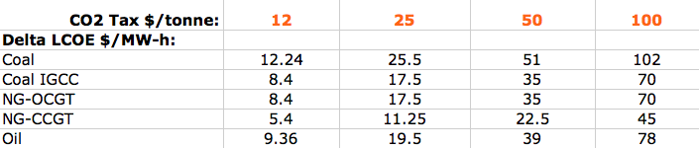
Then, to make each of these fossil fuels non-competitive:
Wind vs. Solar analysis suggested LCOE's must rise ~ 25-50 $/MW-hour
Most of the above fuels produced roughly 1 tonne CO₂ per MW-hour electricity
Suggesting a Carbon Tax => 25-50 $/tonne CO₂
NG CCGT produced half the CO₂, but to pressure it as hard we could double its tax:
Carbon Tax => 50-100 $/tonne CO₂
Or, to speed shift away from fossil fuels, we might just tax all fuels at:
Carbon Tax => 100 $/tonne CO₂
My spreadsheet with a range of possible values for tax per CO₂ tonne emitted:

Slide 25
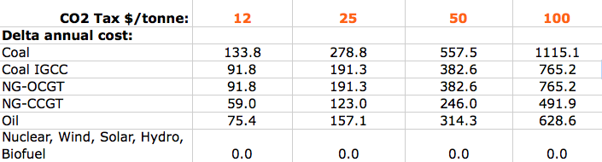
So how will those possible Carbon Tax rates affect ME?
The EIA says average U.S. household uses 911 kW-h of electrical power per month
Which yields an annual household electricity consumption of 10.932 MW-h
Multiplying the table on the previous slide by that number, we then get:
ADDED household cost per year, for a CO₂ Tax per tonne at rate in red:
(for that electrical energy produced via alternate fuels / technologies)
An Introduction to Sustainable Energy Systems: WeCanFigureThisOut.org/ENERGY/Energy_home.htm

Slide 26
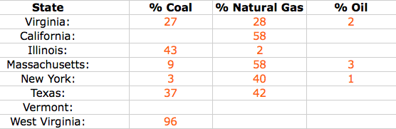
But MY power is generated by a mix of power plant types / fuels
Further, I know that the mix of power technologies and fuels changes state by state
From NPR data¹ in U.S. Energy Consumption & Production (pptx / pdf / key) notes:
NPR did not break down if natural gas power was OCGT or CCGT
So let me assume it is 50% of each
Then, combine the weighting of this table with the preceding table to get:
1) http://www.npr.org/2015/09/10/319535020/coal-gas-nuclear-hydro-how-your-state-generates-power?utm_source=facebook.com&utm_medium=social&utm_campaign=npr&utm_term=nprnews&utm_content=20150910

Slide 27
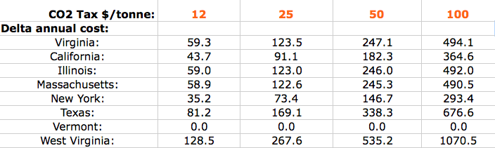
Added cost of electrical power per average household per year:
For CO₂ tax per tonne in red, and each state's 2014 methods of power generation:
Vermont: CO₂ tax has 0$ impact - because their power is 0% fossil fueled
Most other states (with mixes of fossil-fueled and non-fossil fueled electricity):
Added cost / household / year ~ 5 times the CO₂ tax / tonne
West Virginia (with 96% coal fossil-fueled electricity):
Added cost / household / year ~ 10 times the CO₂ tax / tonne

Slide 28

What about the impact on MY annual transportation costs?
From website advocating carbon trading to support 3rd world forestry & farming: ¹
Gasoline liberates ~ 0.0088 tonnes CO₂ per gallon burned
Assuming MY car gets 20 MPG
And that I drive (alone) 12,000 miles by car each year
(meaning that I burn 600 gallons of gasoline per year)
Out and back 5500 mi jet trip emits 2 tonnes CO₂ per passenger
And assuming that I travel 12,000 miles by jet each year
=> MY added annual transportation costs for the CO₂ tax rates per tonne in red:
1) COTAP = "Carbon Offsets to Alleviate Poverty" organization
http://cotap.org/carbon-emissions-calculator/

Slide 29
Recapping my answers to this point:
Carbon Tax necessary to NUDGE power production away from fossil fuels:
~ 25-50 $ / equivalent tonne of CO₂ emitted
Carbon Tax necessary to SHOVE power production away from fossil fuels:
~ 50-100 $ / equivalent tonne of CO₂ emitted
Impact on typical American's annual household power bill:
States using totally greenish energy: 0$
States using ~ 50% greenish energy: ~ 5X the CO₂ Carbon Tax Rate above
States using ~ 0% greenish energy: ~ 10X the CO₂ Carbon Tax Rate above
Impact on individual American's annual transportation bill:
For 12,000 automobile miles: ~ 5X the CO₂ Carbon Tax Rate above
For 12,000 jet miles: ~ 2X the CO₂ Carbon Tax Rate above
Total, for resident of 50% state: ~ 12X the CO₂ Carbon Tax Rate

Slide 30
So we seem to be talking ~ $600-1200 per person per year
PLUS the rise in prices of purchased goods/services that also emitted carbon
For which the ultimate payback would be reducing the
presumably much LARGER cost of continued fossil fuel use
Including health and environmental costs from its pollution,
as well as possibly huge costs predicted to accompany global warming
To which some might respond:
But payoff is decades/generations in the future, humans don't think that far ahead!
Sticky-fingered politicians would just use this as an excuse to add more taxes!
What's the evidence that fossil fuel use or global warming will be so expensive?
Reacting to those objections:

Slide 31
James Hansen's modest Carbon Tax proposal:
James Hansen is an environmental scientist who used to work for NASA
At NASA he and his colleagues studied the atmosphere
Which got them into the subject of global warming
Which then got them into big trouble with the Bush II administration
Bush II officials (with high-level NASA cooperation?) tried to gag these scientists
Preventing any contact with the press and censoring their presentations
Which is an eye-opening history I urge you to further investigate ¹⁻³
But today's relevance is that Hansen now advocates a unique Carbon Tax
countering both human short-sightedness AND government's sticky fingers
1) New York Times: http://www.nytimes.com/2006/01/29/science/earth/29climate.html?_r=2&pagewanted=print&
2) Scientific American: http://www.scientificamerican.com/article/nasa-climate-scientist-james-hansen-quits-to-fight-global-warming/
3) Union of Concerned Scientists: http://www.ucsusa.org/our-work/center-science-and-democracy/promoting-scientific-integrity/james-hansen.html#.VroQGTZx6_U Page 1 of 4

Slide 32
Hansen's "Carbon Tax and 100% Dividend" proposal: ¹
Hansen suggests an immediate carbon tax on the order of $100 / tonne CO₂
Which he estimates might cost the typical American $1200 per year
Which is dead on my preceding estimates for a level
that should SHOVE us toward diminished fossil fuel use
But he would guarantee that we get all that tax back, almost immediately
Specifically: We would each be sent a $100 refund check each month
Actually, he suggests a direct bank deposit
I doubt practicality of that, especially for many poorer citizens
But while we'd all get the same FIXED MONTHLY REFUND,
we could reduce our personal Carbon Tax PAYMENT
by choosing goods & services NOT subject to the Carbon Tax
1) http://www.columbia.edu/~jeh1/mailings/2008/20080604_TaxAndDividend.pdf

Slide 33
=> Revenue & tax neutral behavior-modification tool only!
But by raising U.S. costs, wouldn't we just INVITE foreign imports?
At least from countries that do NOT also impose a Carbon Tax?
Well, China has also become extremely concerned with air pollution
But yes, countries like India now seem unable to deal with this challenge
So let me modify Hansen's proposal - Apply his tax to ONLY:
- Fossil Fuels - Electrical Power
And apply this "Hansen/Bean" tax regardless of the fuel/power country-of-origin:
At U.S. Carbon Tax rate, minus Carbon Tax rate applied in country-of-origin
This would be easy, transparent and fair (to all of the countries involved) AND
This would still affect our two biggest sources of greenhouse gases!
An Introduction to Sustainable Energy Systems: WeCanFigureThisOut.org/ENERGY/Energy_home.htm

Slide 34
OK, that's a climate activist's proposed solution
But climate activism is controversial, at least in the United States
So let's go back, instead, to the type of questions economists ask, such as:
1) What would continued use of fossil fuels really cost?
2) What level of carbon tax would accurately recover those costs?
Economists try to answer such questions through the concept of an Externality:
“An externality is an effect of some activity on an entity (such as a person) that is not party to a market transaction related to that activity.” ¹
“In economics, an externality is the cost or benefit that affects a party who did not choose to incur that cost or benefit.” ¹
I.E.: The full cost of an action may NOT be represented by its market price
1) https://en.wikipedia.org/wiki/Externality

Slide 35
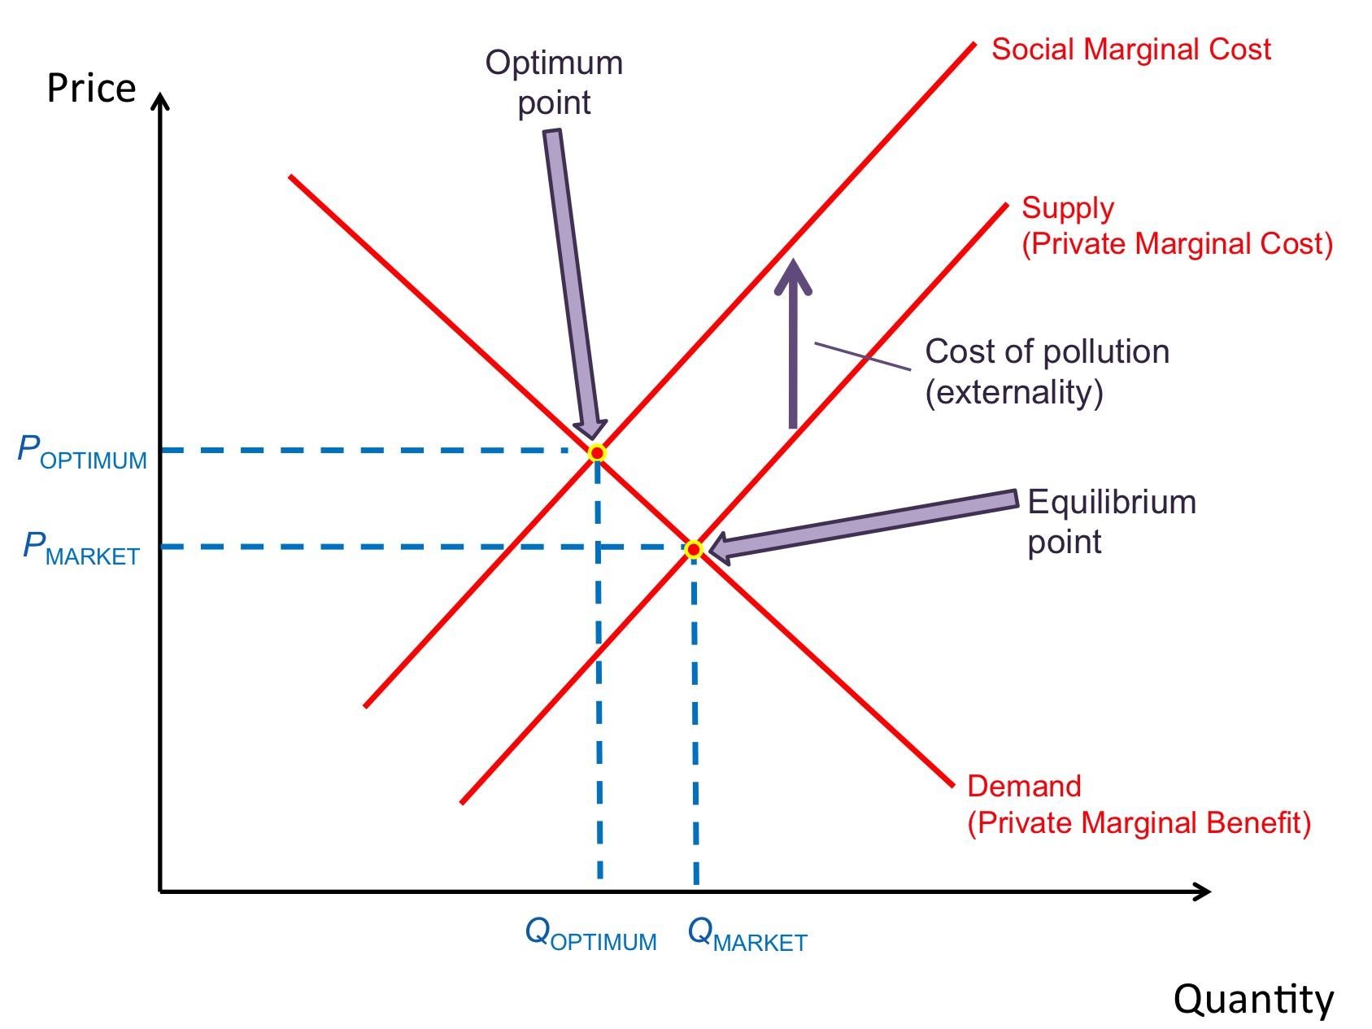
An externality as defined via classic Supply and Demand curves:
Red = Supply line of quantity vs. price
Intersection => Market Cost
Green = Demand line of quantity vs. price
But Yellow = Social Marginal Cost = Complete cost to society vs. quantity
Intersection of social marginal cost line and the supply line
=> More economically accurate value for true Social Cost of the product
Market Cost – Social Cost = Externality
(here there is a "negative externality")

Slide 36
Products with negative externalities are considered to be subsidized
Merriam-Webster defines subsidy as:
“Money that is paid, usually by a government, to keep the price of a product or service low or to help a business or organization to continue to function (or) a grant by a government to a private person or company to assist an enterprise deemed advantageous to the public”
The energy industry is ABSOLUTELY RIDDLED with subsidies!
Some of which are well known, such as subsides for solar energy
Some of which are hidden, such as huge tax breaks for fossil fuel production
And then there are a raft of ongoing, non-governmental, subsides
Such as allowing industries to pollute the air
without paying for that pollution's health and environmental costs
And lurking subsidies, such as not charging them for future costs of sea level rise

Slide 37
Economists believe that subsidies effectively subvert the economic system
Leading them to take the lead in trying identify all such energy industry subsidies
An example of which was the 2015 International Monetary Fund publication:
"IMF Working Paper: How Large Are Global Subsidies?" ¹
Which concluded that, worldwide:
Fossil fuels receive a $5.3 trillion annual subsidy = 6.5% of global GDP
But of that, only $500 billion came via explicit government spending & tax-breaks
Which economist's refer to as being: Pre-tax subsidies
The much, much larger, but hidden, balance came from:
Post-tax subsidies = "failure to internalize negative externalities"
= Not taking product's full impacts (and thus true costs) into account
1) https://www.imf.org/external/pubs/ft/wp/2015/wp15105.pdf

Slide 38
Economists argue that all such "Externalities should be Internalized!"
Which, translating into English, seems to mean that they should be eliminated
Green "Supply – Private Marginal Cost" line would then RISE to overlay
Yellow "Social Marginal Cost" line
=> A simple, but now accurate, Supply vs. Demand problem
Or, falling into geek-speak, we would do away with G I G O:
"Garbage in" (misinformation) => "garbage out" (inefficient economic solutions)

Slide 39
What does IMF identify as (largely invisible) "post-tax" externalities?
It's tally of negative externalities due to fossil fuels:
Global Warming = $219.19 billion
Local Air Pollution = $206.56 billion
Congestion = $147.10 billion
Accidents = $58.26 billion
Road Damage = $9.48 billion
Forgone Consumption Tax Revenue = $45.32 billion
Or, for the U.S. alone (per year):
(Visible) Pre-Tax U.S. Fossil-Fuel Subsidies = $13.29 billion
(Largely invisible) Post-Tax U.S. Fossil Fuel Subsidies = $699.18 billion

Slide 40
But critical IMF data was drawn from an almost inaccessible OECD report We wanted to see the source data!
Luckily, it turns out that economists are really bugged by "negative externalities"
Because they subvert the "invisible hand's" generation of economic solutions!
Economists have thus studied energy's negative externalities for ~ two decades
And they have generated a large and accessible body of (pre-IMF) research
about both past AND future hidden costs of fossil fuels
Further, they used this research to compute the Social Cost of Carbon (SCC),
which, ideally, should now be added to the cost of fossil fuels
= Which we could now do by imposing a carbon tax!
But what is this social cost of carbon (as estimated by economists)?
Wikipedia cites it as $48 / tonne C (=> $12 / tonne CO₂)
MUCH less than the behavior-modifying tax we discussed earlier!

Slide 41
So would our earlier "effective" carbon tax = An economic travesty?
We found that a 50-100 $/tonne CO₂ tax would strongly curtail carbon emissions
But if true societal cost of those carbon emissions is 12 $/tonne CO₂
We'd be grossly distorting the operation of the economic system
=> Inefficiencies, waste, unnecessary pain & suffering, etc.
So let's look at how economists came up with 12$/tonne CO₂ figure:
Wikipedia cites key publication with first author identified as "Yoh"
Who turns out to be head of the IPCC committee that compiled the study
Key work cited in that study is by German economist R.S.J. Tol who:
1) FIRST did his own research on Social Cost of Carbon (~ 1995-2005)
2) THEN reviewed the SCC work of dozens of other economists
Both roles AND their timing turn out to be very important!

Slide 42
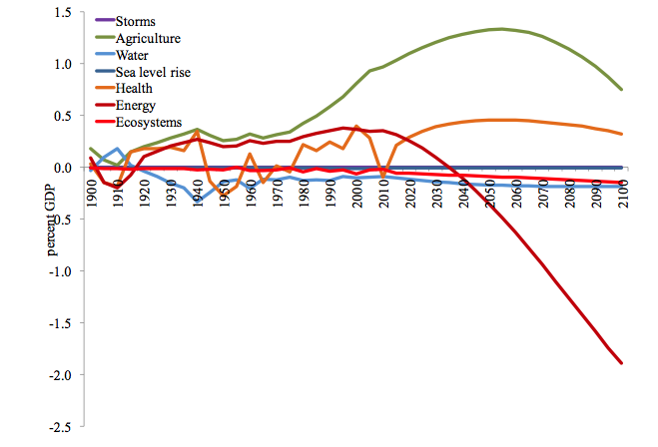
Tol's summary of a SCC computations by all economists
Components of SCC, expressed as percentages of Gross Domestic Product:
http://www.copenhagenconsensus.com/sites/default/files/climate_change.pdf
Percent of Gross Domestic Product
Versus year (1900 – 2100)
Things economists think could benefit from climate change:
Agriculture (1900-2100), Energy (< 2025), Health (most of 1900-2100)
Things economists think could be hurt by climate change:
Energy (> 2025), Ecosystems (post ~ 2000), Sea Level Rise (1900-2000)

Slide 43
The economists' reasoning: ¹
Agriculture benefits because plants grow better with more CO₂ to consume
Until late this century when heating + drought knock back their growth
Energy consumption initially drops because of its decreased use for heating
Until ~2025 when warming massively increases air-conditioning energy
Health benefits from decreased impact of tropical diseases such as
Malaria, Dengue Fever . . . as jungles and wetlands dry out
Ecosystems are damaged from ~2000 onward,
But financial impact is miniscule compared to benefits above
Sea Level Rise costs are similarly minimal
Actually thought to be smaller in 21st century then in mid 20th century!
1) Estimates of the Damage Costs of Climate Change, Environmental and Resource Economics 21, pp. 135-160 (2002)

Slide 44
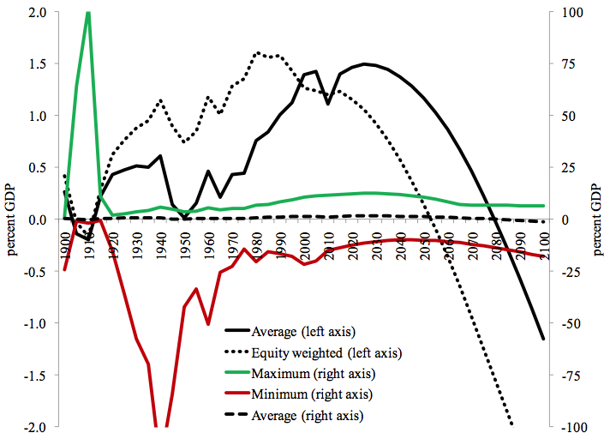
Do you have problems with any of that?
You are in good company: Economists massively disagree with each other
As revealed by study's alternate plots of TOTAL SCC cost, 1900-2100:
<= Equity Weighted
<= Average
Maximum =>
Average =>
Percent of Gross Domestic Product
Percent of Gross Domestic Product
Minimum =>
http://www.copenhagenconsensus.com/sites/default/files/climate_change.pdf

Slide 45
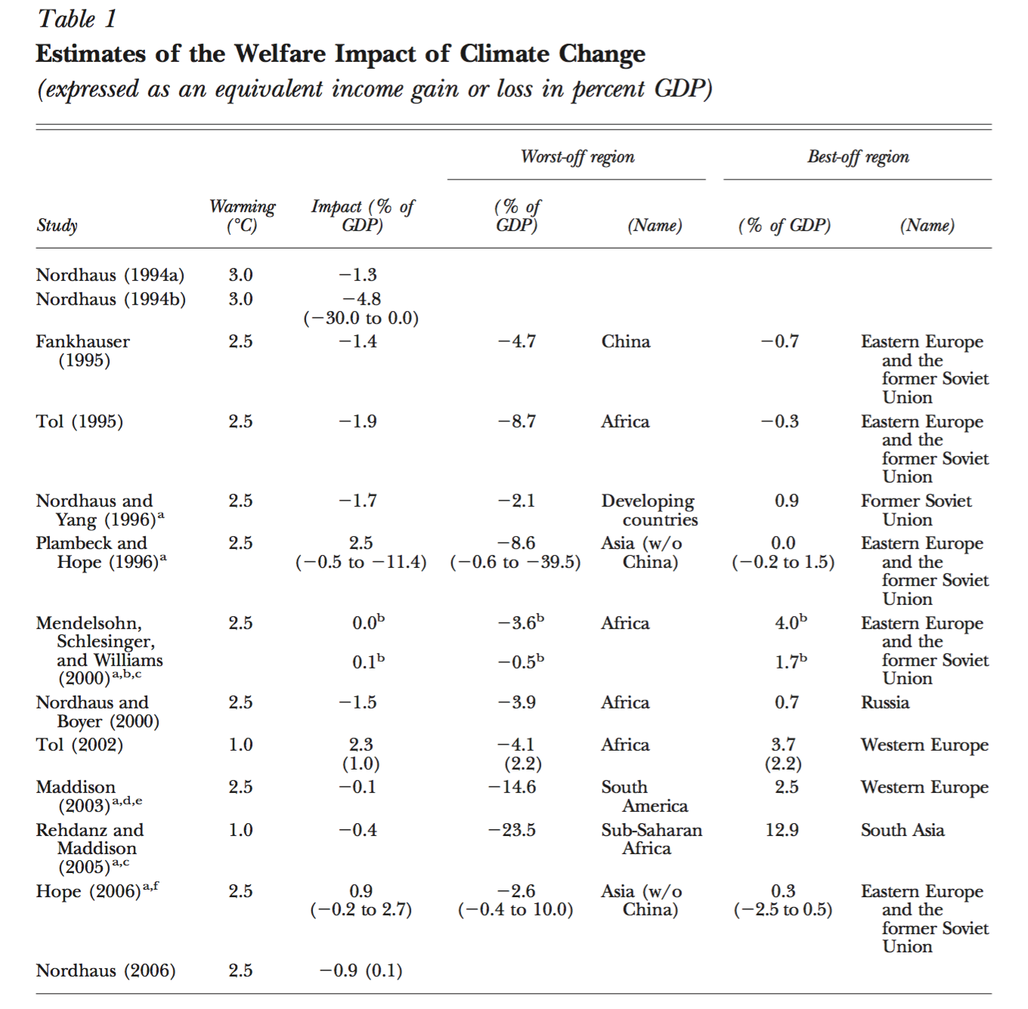
Disagreement is also apparent in this table from one of Tol's reviews
Different table lines = SCC results calculated by different economists
Note not only differences in cost numbers but even difference in signs!
http://www.ssc.wisc.edu/~walker/wp/wp-content/uploads/2012/09/Tol2009.pdf

Slide 46
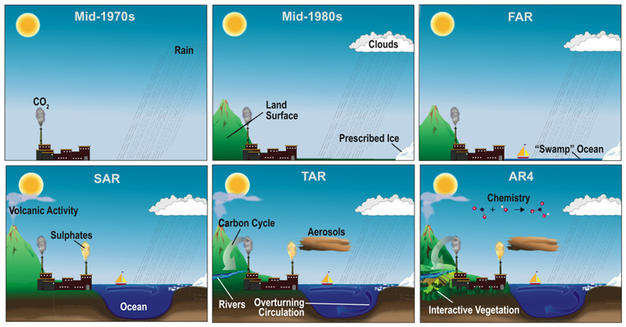
But "elephant in the room" may actually be the DATE of those studies:
Key cross-field review article (giving SCC, component by component) was:
Estimates of the Damage Costs of Climate Change,
Journal of Environmental and Resource Economics 21, pp. 135-160 (2002)
But that was well before the maturation of our climate change models!
(1996)
(2001)
(2007)
(For discussion of those models see my lecture on Climatology and Climate Change)

Slide 47
The economists WERE aware of the this problem:
As Tol, himself pointedly acknowledged in his 2009 SCC review paper: ¹
"In a survey article I co-authored more than a decade ago on the social costs of climate change, we suggested that all aspects of the problem were roughly known, and that research would be complete within a few years.
This view turned out to be so overoptimistic
as to be entirely mistaken."
1) Tol 2009: J. Economic Perspectives 23(2), pp. 29-51(2009)

Slide 48
He also acknowledged that they'd NOT considered catastrophic change:
"Examples of extreme climate scenarios include an alteration of ocean circulation patterns . . . (which) could lead to a sharp drop in temperature in and around the North Atlantic . . .
(Or) collapse of the West Antarctic Ice Sheet . . . which would lead to a sea level rise of 5 - 6 meters in a matter of centuries.
(Or) the massive release of methane from melting permafrost . . . which would lead to rapid warming worldwide.
(These) have the potential to happen relatively quickly, and if they did, the costs could be substantial . . .
Effects of sea level rise would increase ten-fold should the West Antarctic Ice Sheet collapse.
But the work of Olsthoorn, van der Werff, Bouwer, and Huitema
suggests that this may be too optimistic." ¹
1) Tol 2009: J. Economic Perspectives 23(2), pp. 29-51(2009)

Slide 49
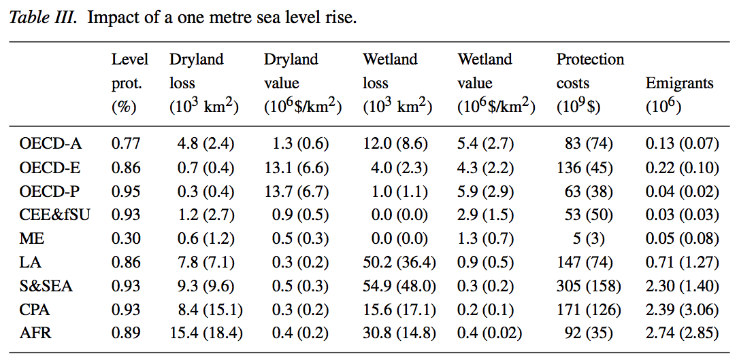
Let me look at just his sea-level-rise cost estimates:
In 2002 he generated this table for impact of century long 1 meter rise in sea level
He noted that this was a higher rise than the IPCC then predicted:
"OECD A" and "OECD E" refer to North America and Europe respectively:
North America: 1 meter sea level rise => 130,000 displaced persons
Europe: 1 meter sea level rise => 220,000 displaced persons

Slide 50
This was then folded into the economists' SCC estimate of 12$/ tonne CO₂
This result was based on most elaborate climatological studies available in 2002
But a decade later more (& more sophisticated) studies have now been published
Including one published in March 2016 issue of Nature Climate change entitled:
Millions projected to be at risk from sea-level rise
in the continental United States
From that research paper's abstract:
"We find that a 2100 SLR (Sea Level Rise) of 0.9 meter places a land area projected to house 4.2 million people at risk of inundation,
whereas 1.8 meters affects 13.1 million people"
Take a look at that paper's state-by-state predictions:
An Introduction to Sustainable Energy Systems: WeCanFigureThisOut.org/ENERGY/Energy_home.htm

Slide 51
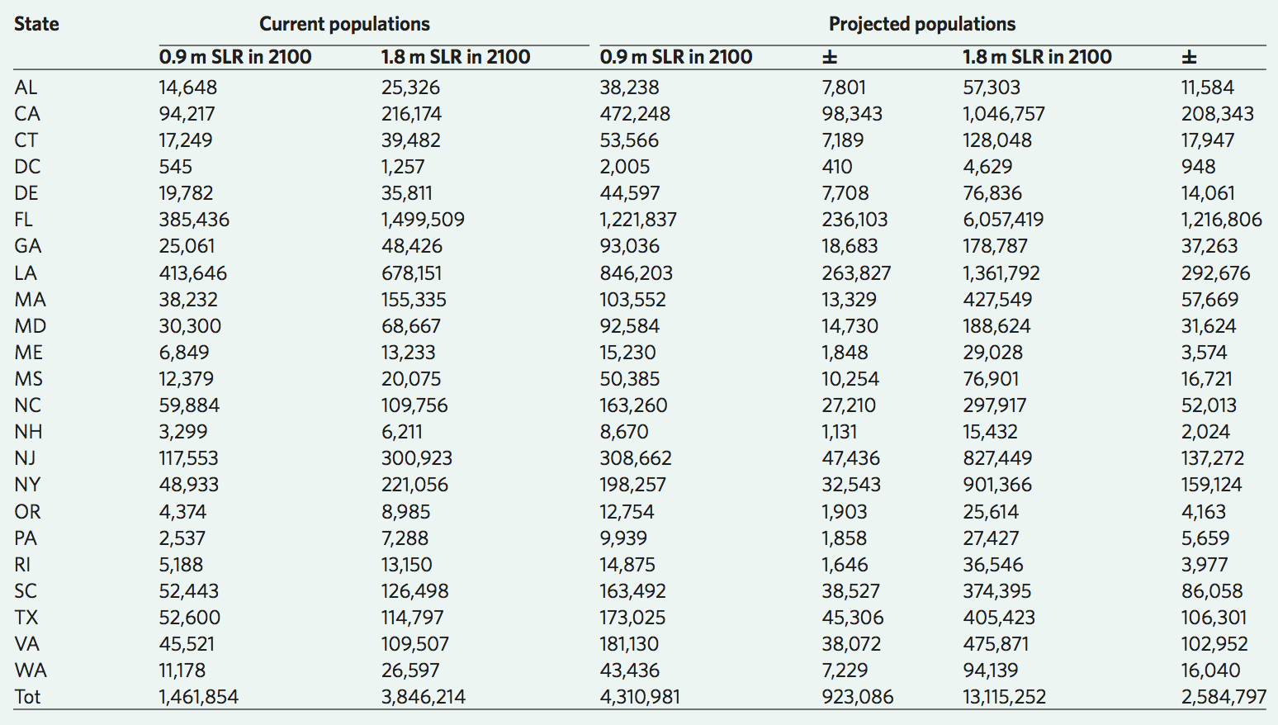
State-by-state predictions of population affected by sea level rise:
Or the same data shown on a U.S. coastal map:
An Introduction to Sustainable Energy Systems: WeCanFigureThisOut.org/ENERGY/Energy_home.htm

Slide 52

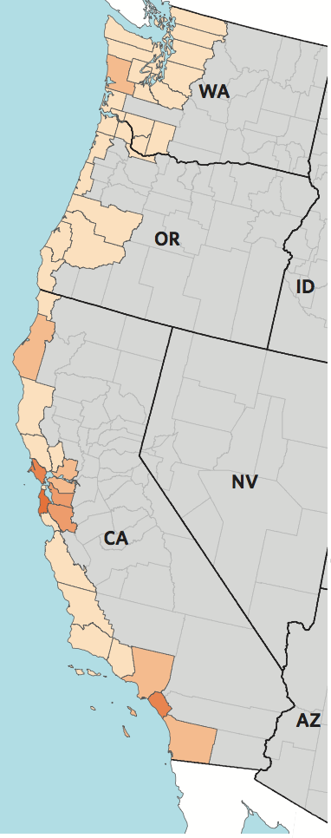
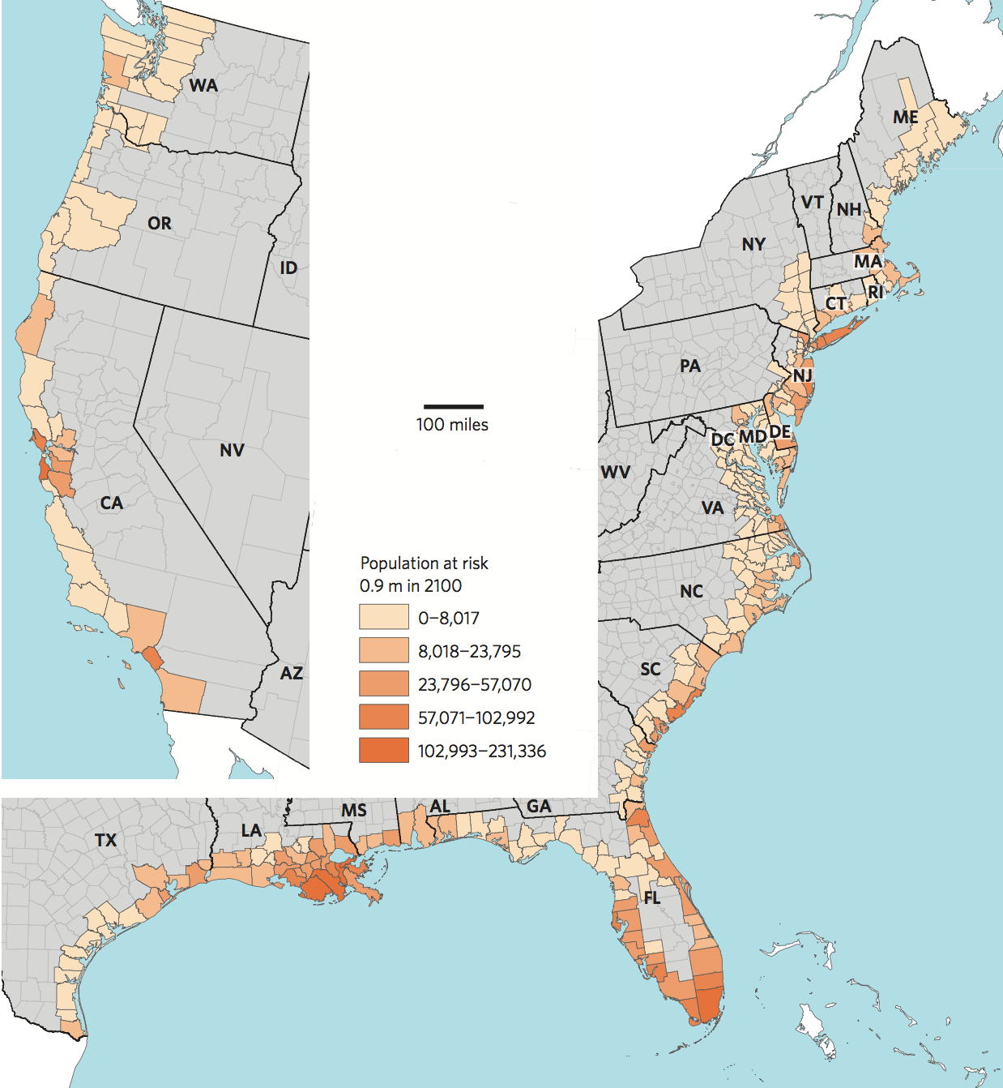
Note that this shows counties affected rather than actual flooding boundaries

Slide 53
TWO things have changed from the time of the economist's work:
1) In 2002, IPCC had been estimating sea level rises of less than 1 meter,
Whereas sea level rises of up to 1.8 meters are now seriously discussed
2) For even a 1 meter rise, vastly greater impact is now predicted
Tol 2002: 1 meter rise impacts 130,000 people over whole of North America
New Study: 0.9 meter rise impacts 4,310,981 in the U.S. alone
How could 1 meter rise now threaten ~ 50 TIMES more people?
The answer comes one sentence later in Tol's earlier musings:
"Effects of sea level rise would increase ten-fold should the West Antarctic Ice Sheet collapse. But the work of Olsthoorn, van der Werff, Bouwer, and Huitema ² suggests that this may be too optimistic: that we may have overestimated the speed with which coastal protection can be built up"
2) http://link.springer.com/article/10.1007%2Fs10584-008-9423-z

Slide 54
So discrepancy is not in HOW MANY would be affected by a 1 meter rise
Discrepancy is in HOW those people would be affected!
Economists had assumed ocean barriers could prevent ~ all encroachment
Cutting number having to relocate from millions to hundreds of thousands
Was that really EVER plausible
given the length of U.S. coastline?
Further, those economists assumed COST of such construction would be so palatable
that the total Social Cost of Carbon would still be only 12$ / tonne CO₂
Instead, economists Olsthoorn, van der Werff, Bouwer, and Huitema
(from the the world's premiere dike-building country of the Netherlands)
had warned from the start about the difficulty of holding back the sea!

Slide 55
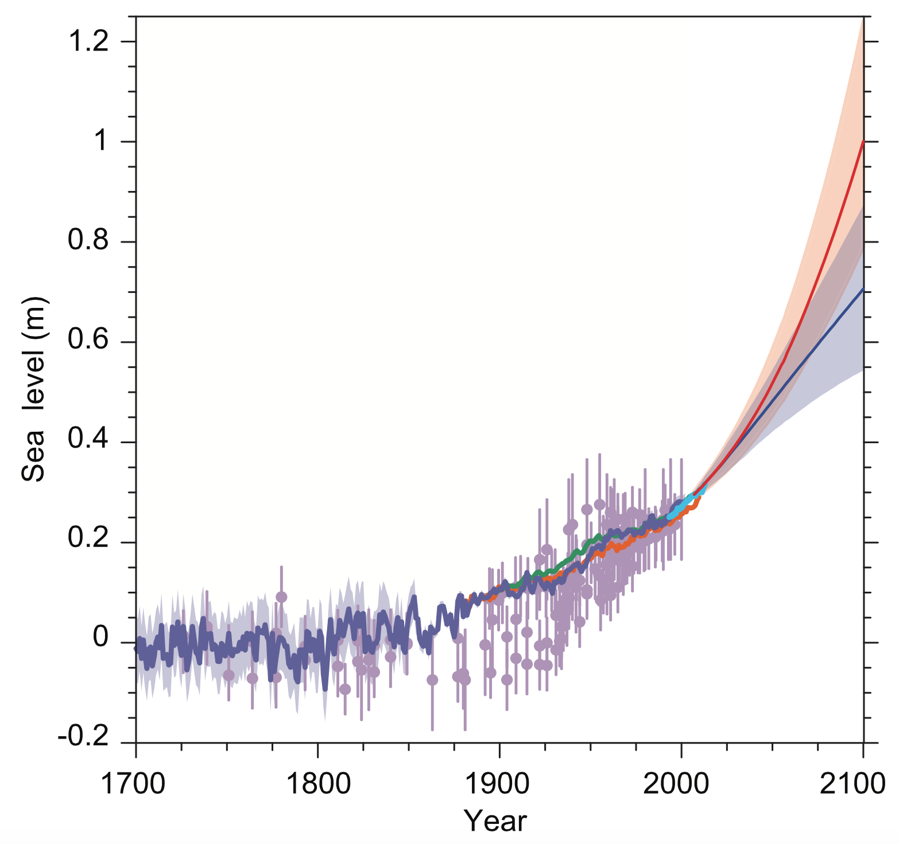
And it is not just one report:
The IPCC's 5th Assessment (2013) has also upped predictions of sea level rise: ⁶
Violet ("RCP2.6") = With strong international efforts to curb greenhouse gases
Orange ("RCP8.5") = Without such efforts
1 Meter
6) https://www.ipcc.ch/pdf/assessment-report/ar5/wg1/WG1AR5_Chapter13_FINAL.pdf

Slide 56

(Relevant news articles I've not yet fully researched and/or verified)
New Elevation Data Triple Estimates of Global Vulnerability to Sea-Level Rise and Coastal Flooding
Princeton University (Nature Communications, October 2019) ^{1, 2}
Based on new airborne LIDAR mapping data & modeling: "Here we show . . . that 190 million people currently occupy global land below projected high tide lines for 2100 under low carbon emissions, up from 110 million today, for a median increase of 80 million.
Under high emissions (our data/modeling) indicates up to 630 million people live on land below projected annual flood levels for 2100, and up to 340 million for mid-century, versus roughly 250 million at present.
We estimate one billion people now occupy land less than 10 meter above current high tide lines, including 250 million below 1 meter."
1) Source Nature Communications report: https://www.nature.com/articles/s41467-019-12808-z
2) Climate Central Org analysis: https://climatecentral.org/pdfs/2019CoastalDEMReport.pdf
3) BBC Article: https://www.bbc.com/news/science-environment-50236882
4) Guardian Article: https://www.theguardian.com/environment/2019/oct/29/rising-sea-levels-pose-threat-to-homes-of-300m-people-study?CMP=Share_iOSApp_Other

Slide 57
(Relevant news articles I've not yet fully researched and/or verified)
Missing Economic Risks in Assessments of Climate Change Impacts
Grantham Research Institute, Columbia University - September 2019 ^{1, 2}
"Economic assessments of the potential future risks of climate change have been omitting or grossly underestimating many of the most serious consequences for lives and livelihoods because these risks are difficult to quantify precisely and lie outside of human experience."
"Some of these impacts involve thresholds in the climate system beyond which major impacts accelerate, or become irreversible and unstoppable."
"Many of these impacts could exceed the capacity of human populations to adapt, and would significantly affect and disrupt the lives and livelihoods of hundreds of millions, if not billions, of people worldwide."
1) Source report: http://www.lse.ac.uk/GranthamInstitute/wp-content/uploads/2019/09/The-missing-economic-risks-in-assessments-of-climate-change-impacts-2.pdf
2) New York Times article: https://www.nytimes.com/2019/10/23/opinion/climate-change-costs.html?smid=nytcore-ios-share

Slide 58
The Paris Summit thus leaves the door open to catastrophic change:
That fall 2015 meeting declared a goal of no more than 2°C warming by 2100
A goal that is supported by (at best) weak commitments & enforcement
But climatologist Hansen and his colleagues have now predicted that
1.5°C might be enough to trigger collapse of Arctic or Greenland ice sheets ⁷
Which would make STRONG corrective measures imperative!
But we have now see that while:
Early economic studies suggested Social Cost of Carbon of ~ 12$ / tonne CO₂
Which is far less than 50-100$ / tonne CO₂ value that I estimated
would be adequate to SHOVE power production away from fossil fuels
Newer studies, consistent with the economists' own earlier doubts,
suggest that revised Social Cost of Carbon MAY be ~ 50-100$ / tonne CO₂
7) http://www.atmos-chem-phys-discuss.net/15/20059/2015/acpd-15-20059-2015-print.pdf

Slide 59
Putting this all together:
A carbon tax of about $100 per tonne of CO₂ (equivalent) emitted:
WOULD offset current cost disadvantages of emerging energy alternatives
DOES apparently represent the true hidden costs of fossil fuel emissions
Which means that Carbon Taxes DO meet David McKay's closing call for:
An idea that DOES add up!
Leaving us with David's remaining calls to:
"Stop staying no and start saying yes!" (to this, or alternatives)
And to start working toward implementation of such ideas
Bringing me to end of this class, with just one more thing to add:

Slide 60
THANK YOU DAVID
IN MEMORIAM – APRIL 2016
Obituary (The Guardian)

Slide 61
Credits / Acknowledgements
Some materials used in this class were developed under a National Science Foundation "Research Initiation Grant in Engineering Education" (RIGEE).
Other materials, including the WeCanFigureThisOut.org "Virtual Lab" science education website, were developed under even earlier NSF "Course, Curriculum and Laboratory Improvement" (CCLI) and "Nanoscience Undergraduate Education" (NUE) awards.
This set of notes was authored by John C. Bean who also created all figures not explicitly credited above.
Copyright John C. Bean
(However, permission is granted for use by individual instructors in non-profit academic institutions)
An Introduction to Sustainable Energy Systems: WeCanFigureThisOut.org/ENERGY/Energy_home.htm

