Slide 1
Greenhouse Effect, Carbon Footprints and Sequestration
John C. Bean
Outline
Building a simple "do-it-yourself" model of the Greenhouse Effect based on:
1 color of sunlight + 1 color of earthlight + 1 greenhouse gas
Which ultimately collapses because: It's all about different colors
Colors where gas A absorbs & emits vs. colors where gas B absorbs & emits
Critical colors = Those where earth might radiate away heat (particular infrared colors)
But is now being thwarted by the addition of new atmospheric gases
Data on gases now accumulating in the atmosphere
Including now-censored "EPA Inventory of U.S. Greenhouse Gas Emissions & Sinks"
Discussion of atmospheric gas sources, especially energy industry sources
Possibilities of reducing such emissions
Or of at least "sequestering" those emissions
(Written / Revised: February 2021)

Slide 2
Greenhouse Effect, Carbon Footprints and Sequestration
This lecture continues our discussion of climate change
Last time I discussed how acquire long-term climate data
And provided an overview of how climate models have evolved
Today I'll dig deeper into the Greenhouse Gas Effect
Which sounds simple - and indeed the basics are
But with a realistic variety of gases, it becomes extremely complicated!
As suggested by conflicting "expert" statements, such as:
"CH₄ is 5X worse than CO₂" versus "CH₄ is 30X worse than CO₂"
And as will be seen in the "simplified" greenhouse model I'll try to develop
I'll then close by discussing Carbon Footprints and Carbon Sequestration
An Introduction to Sustainable Energy Systems: WeCanFigureThisOut.org/ENERGY/Energy_home.htm

Slide 3
Common explanations of the greenhouse effect can be very incomplete
To demonstrate this, let's try to develop our own model
That model should include:
- Incoming sunlight partly absorbed/scattered by atmosphere, partly passing to earth
- Outgoing heat (IR radiation) emitted by the warm earth,
partly absorbed/scattered by atmosphere, partly passing to out to space
Sunlight
IR Radiation from Earth
Earth

Slide 4
To clarify our model, simplify our model:
Do this by temporarily assuming that:
- Sunlight is all one color = color_{sunlight}
- IR radiation emitted by earth is all one color = color_{earthlight}
- There is only one really important greenhouse gas = gas
We then need to know:
- Gas's light absorbance (per molecule or mass) at color_{sunlight} = Absorb_{sunlight}
- Gas's light absorbance (per molecule or mass) at color_{earthlight} = Absorb_{earthlight}
- Plus the concentration of that gas in the atmosphere
Which ought to be proportional to:
(Rate of gas introduction) x (Average gas lifetime in atmosphere)
That is: Concentration_{gas} = C1 x Rate_{added} x Lifetime

Slide 5
We would also need to know:
- Intensity of arriving sunlight (power / area) = P_{sunlight}
- Intensity of earth's IR thermal emission (power / area) = P_{earthlight}
The other stuff might be fixed, but this quantity will not be!
Because it will intensify if earth's surface heats up (and reverse)
So output of our model will be resulting value of P_{earthlight} as a function of time
=> Temperature of earth's surface as a function of time
So let's now see how far we can get with this simplified model:
To come up with quantitative results we'd also have to figure out a lot of constants
Taking into account things like geometries
But we just want trends now, so I'll just stick in constants as C's

Slide 6
Sun power flow downward through the atmosphere:
Power arriving at TOP of atmosphere = P_{sunlight}
In the atmosphere some fraction of this power will be absorbed or scattered:
= C2 x Concentration_{gas} x Absorb_{sunlight}
= C2 (C1 x Rate_{added} x Lifetime) (Absorb_{sunlight})
= C3 x Rate_{added} x Lifetime x Absorb_{sunlight}
So sunlight power passing downward through the atmosphere directly would be
= P_{sunlight} (1 – C3 x Rate_{added} x Lifetime x Absorb_{sunlight})
However, sunlight power absorbed by greenhouse gas eventually has to exit
It should radiate out randomly in all directions, thus
Half re-radiates upward out into space, half re-radiates downward to earth
Sun power to earth = P_{sunlight} (1 – ½ C3 x Rate_{added} x Lifetime x Absorb_{sunlight})

Slide 7
Earth IR power radiated upward into outer space:
By just turning all of the arguments above on their heads, and we should have:
Earth power to space = P_{earth} (1 – ½ C4 x Rate_{added} x Lifetime x Absorb_{earthlight})
Which, eventually, should balance last page's sun energy coming down to earth:
Sun power to earth = P_{sunlight} (1 – ½ C3 x Rate_{added} x Lifetime x Absorb_{sunlight})
So equate, solve for P_{earth}, figure out what temperature would produce that power
What's so hard about this? To expand our model we only seem to need:
- Conversion of earth's surface temperature to power emitted
- Absorbance data for real greenhouse gases
- Concentration of real greenhouse gases
OR their rate of addition to and lifetime in the atmosphere
An Introduction to Sustainable Energy Systems: WeCanFigureThisOut.org/ENERGY/Energy_home.htm

Slide 8
Conversion of surface temperature to power emitted:
Radiation from any heated object can be approximated by a "blackbody"
Which assumes that objects have all sorts of oscillators (e.g., oscillating electrons)
Some oscillate slowly, some oscillate more quickly
Oscillation of electrons => emission of electromagnetic radiation ("light")
Slow oscillators => Low frequency (long wavelength) light
Fast oscillators => High frequency (short wavelength) light
But these same oscillators can also absorb light, including each other's light
So heat energy is shared around between these oscillators
Sharing => Final balance of light from slow vs. faster oscillators
Analysis of sharing + dose of quantum mechanics => "Blackbody Curve"
An Introduction to Sustainable Energy Systems: WeCanFigureThisOut.org/ENERGY/Energy_home.htm

Slide 9

Blackbody Curves:
Planck's Blackbody Law:
Light Intensity (W/m²-μm)= A / λ⁵ [e^{B / λT}-1)
Where λ = Wavelength, T is temperature of the object (in °K)
A = 3.742 x 10⁸ W-μm⁴/m² B = 1.44 x 10⁴ μm-K
Which generates curves like this for objects of different temperatures:
6000°K
Note: A light bulb's color temperature refers to the shape of one such curve
Light
Power
5000°K
4000°K
3000°K
100
500
1000
1500
2000
2500
Visible
Wavelength (nm)

Slide 10
Characteristics of which:
Roughly match our personal experiences:
As object gets hotter, it emits MORE total heat energy
As object gets hotter, its color changes from red => orange => yellow . . .
From blackbody curves, those observations can be quantified in the:
Stefan-Boltzman Law = Total blackbody energy = Total heat emitted = σT⁴
σ = 5.670 x 10⁻⁸ W/m²/(°K)⁴
Wien Displacement Law = Peak blackbody wavelength = 2896 μm / T (in °K)
6000°K
Light
Power
5000°K
4000°K
3000°K
100
500
1000
1500
2000
2500
Visible
Wavelength (nm)

Slide 11
Implications for our model:
- We approximated sunlight's true spectrum as a single color
- We also approximated earth's (mostly IR heat) spectrum as a single color
We could still use the new laws by lumping each spectrum into one color. That is:
Sunlight spectrum ~ 6000°K Black body curve, so using Stefan-Boltzman and Wein:
P_{sunlight} = σ (6000°K)⁴ ~ 70 million W/m² (at sun's surface)
Color_{sunlight} ~ Peak_wavelength_{sun} = 2896 μm / 6000 ~ 0.5 μm
Earth spectrum, keeping earth's surface temperature as variable to be solved for:
P_{earth} = σ (Temperature_{earth})⁴
Color_{earth} ~ Peak_wavelength_{earth} = 2896 μm / Temperature_{earth}

Slide 12
To see how we could solve for T_{earth} , really simplify:
For instance, by eliminating the atmosphere
And assuming flat sun right next to flat earth:
But cooler "Earth" receives more heat than it emits!
So, it would heat up until incoming and outgoing heat flows balanced
Stefan-Boltzman Law, in this geometry, would require equal temperatures:
=> Extreme case of global planar warming
Sun ~ 5778 °K
Earth
Sun ~ 5778 °K
Earth ~ 5778 °K
An Introduction to Sustainable Energy Systems: WeCanFigureThisOut.org/ENERGY/Energy_home.htm

Slide 13

Or we could use a more realistic geometry:
Sun
~ 5778 °K
With its light spreading out, sun delivers far less power/area to earth's atmosphere
Earth then re-emits that energy in all directions (not just side receiving sunlight)
So balance of heat flow to and from earth' surface is achieved with
earth surface temperature far less than sun's 5778 °K surface temperature
And we all know balance comes with earth surface temperature of about 300 °K
But that "about" is all important to those of us living on the earth!
An Introduction to Sustainable Energy Systems: WeCanFigureThisOut.org/ENERGY/Energy_home.htm

Slide 14
But that's getting ahead of ourselves, we still need more input data:
One of the things still needed is the concentrations of real greenhouse gases
A naturally occurring but extremely important greenhouse gas is water vapor
For which I could use measured concentrations + temperature trends
Hoping it does not complicate things by converting to IR reflecting clouds!
Other current atmospheric greenhouse gas concentrations:
Gas: CO₂ CH₄ N₂O CFC-11 HCFC-22 CF₄
Parts/million by volume (1994)¹: 358 1.72 0.312 0.00027 0.0001 0.00007
Parts/million by volume (2014)²: 395 1.89 0.326 0.00024 0.0002
But these are only recent concentrations, and we want to model possible changes
1Source: Introduction to Engineering and the Environment - Rubin (p. 471)
2Source: http://cdiac.ornl.gov/pns/current_ghg.html

Slide 15
To model possibly changing greenhouse gas concentrations:
We'd do better by using relationships like: Concentration α Rate_{added} x Lifetime
So we'd first work up estimates on current and future rates of gas introduction
This is where we'd put in the effect of our industrial civilization
Then we'd need each gas's typical (average) lifetime in the atmosphere
For which I found data from various sources (ACS / Rubin textbook / ORNL):
Average greenhouse gas lifetimes in atmosphere (in years):
Gas: CO₂ CH₄ N₂O CFC-11 CFC-12 HCFC-22 HFC-23 SF₆ CF₄
Life¹: 50 12 114 100 270 3200
Life²: 50-200 12 120 50 12 50000
Life³: 100-300 12 121 45 100 11.9 3200
1Source: www.acs.org/content/acs/en/climatescience/greenhousegases/properties.html
2Source: Introduction to Engineering and the Environment - Rubin (p. 471)
3Source: http://cdiac.ornl.gov/pns/current_ghg.html

Slide 16
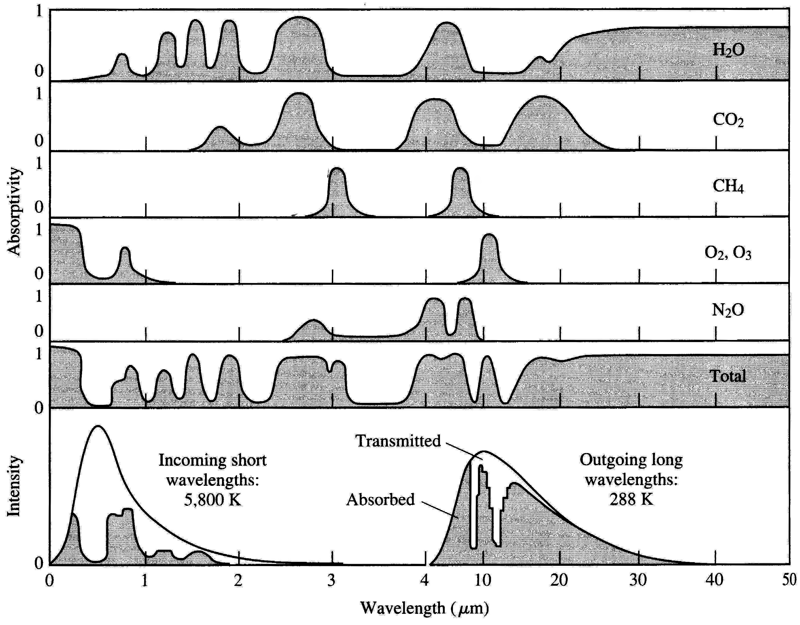
Bringing me to data on real greenhouse gas absorbances
Where our simplified model runs into a non-simple wall:
Greenhouse gases absorb at all sorts of wavelengths, with huge overlaps!
Source: Introduction to Engineering and the Environment - Rubin (p. 482)
Taken from: Introduction to Environmental Engineering & Science - Masters
Sun's radiation
Earth's radiation

Slide 17
Implying:
Our model's single wavelength approximations are going to be very inaccurate
We can't just approximate sun and earth light by single wavelengths
Because gas absorption is all across their blackbody spectra
Effect of each greenhouse gas is also no longer independent of other gases
For one, through their absorbance overlaps, gases can exchange energy
But even more important is HOW the gas absorbance bands overlap:
Where more concentrated gas already blocks sunlight, new gas has small effect
But if new/dilute gas blocks open wavelengths, it can have a HUGE EFFECT
Because it closes a previously open greenhouse window!

Slide 18
CUMULATIVE blocking effect:
Order of chart is most concentrated gases (top) => most dilute gases (bottom)
PageDn to add red bands showing blocking due to successively more dilute gases
Green = Window for Earthlight heat loss left open by water vapor

Slide 19
Cumulative effect of added gases on earth's heat loss window:
Heat loss window is now mostly shut by CO₂ , CH₄ , O₂ , O₃ and N₂O

Slide 20
This explains the difficulty in predicting the impact of a given gas
For instance: Why I have heard methane is "5X worse" or "30X worse than CO₂"
Because it is NOT about methane's entire absorption spectrum
It's about where methane absorbs IR colors that no other gas has already absorbed
And that depends on the absorption spectra of ALL the other gases
And on the concentrations of ALL those other gases
Making this an extremely complex and tightly interwoven calculation!

Slide 21
Another way of looking at this is "Global Warming Potential"
For which American Chemical Society has a nice webpage, which I'll just quote:
"GWP is a measure of how much energy a greenhouse gas would add to
atmospheric warming in a given time compared to CO₂.
A molecule’s GWP depends on three factors:
1) The wavelengths where the molecule absorbs.
The absorption needs to be in the thermal IR range where the Earth emits and will be more effective if it absorbs where water vapor and CO₂ do not.
2) The strength of the relevant absorptions.
The more energy the molecule absorbs, the more effective it will be in warming.
3) The atmospheric lifetime of the molecule.
The longer the gas persists, the more warming it can produce."
http://www.acs.org/content/acs/en/climatescience/greenhousegases/properties.html

Slide 22
Yielding assessments of relative greenhouse impact
CUMULATIVE impact on global warming:
Gas Lifetime (yrs) 20 yrs out 100 yrs out 500 yrs out
CO₂ (= STANDARD) (50-300) 1 1 1
CH₄ 12 72 25 7.6
N₂O 114 289 298 153
CFC-12 (CCl₂F₂) 100 11000 10900 5200
HFC-23 (CHF₃) 270 12000 14800 12200
HFC-134a (CH₂FCF₃) 14 3830 1430 435
Sulfur Hexafluoride 3200 16300 22800 32600
Remember that lifetimes are not absolute (gas doesn't then suddenly disappear)
It's more like radioactive half lives, where ~ 50% will be gone in this time
http://www.acs.org/content/acs/en/climatescience/greenhousegases/properties.html

Slide 23
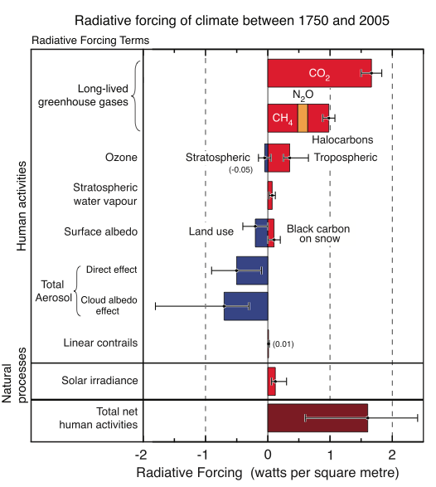
FULL effect of each gas is tabulated in IPCC's "radiative forcings"
Which go beyond GWP's by adding in relative concentrations of gases
Here showing only manmade forcings (i.e. above and beyond natural occurrences)
CO₂
CH₄ | N₂O | CFCs
O₃
H₂O (added by human activity)
IPCC Fourth Assessment Report - Working Group 1
2007 (p. 136)

Slide 24
So we now understand need for hugely complex computer models:
Which must deal with full spectra of solar and earth light/power emission
AND deal with full spectrum of a given greenhouse gas's absorption
Including possible absorption at one wavelength / re-emission at another
And deal with overlaps in absorption/emission spectra between multiple gases
Including possible blockages by more concentrated gases
And deal with complexities such as:
Water as vapor absorbs IR radiation => strong greenhouse gas => heating
But if subtle factors convert it to clouds => Reflects sunlight => cooling
Explaining uncertainties about a specific greenhouse gas's impact
Which is due to only small segments of its absorption bands
that peek out from behind the absorption bands of other gases

Slide 25
To alter projected trends We will have to reduce greenhouse effects Which will require reduction in following carbon footprints:
An Introduction to Sustainable Energy Systems: WeCanFigureThisOut.org/ENERGY/Energy_home.htm

Slide 26
Worldwide annual greenhouse gas emissions in 1990's (in M-ton):
Source World US
CO₂: Commercial Energy 22,900 5,250 (US = ¼ world!)
Cement manufacturing and gas flaring 1,000 50
Tropical deforestation 5,900 -
Total 29,800 5,300
CH₄: Fossil fuel production 100
Enteric fermentation 85
Rice paddies 60
Landfills 40
Animal waste 25
Sewage 25
Total 375 11
N₂O: Cultivated soils 3.5
Industrial 1.3
Biomass burning 0.5
Cattle and feed lots 0.4
Total 5.7 0.5
Other: CPC-11, -12, -13 0.7 0.1
HCFC-22 0.2 0.1
HFCs, PFCs, SF6 0.34
Source: Intro to Energy and the Environment – Edward S. Rubin (p. 40), citing IPCC and others

Slide 27
EPA Inventory of US Greenhouse Gas Emissions and Sinks (1990-2012) (in million metric tons CO₂ equivalent)
Source 1990 2012
CO₂: Fossil Fuel Combustion 4745 5072
Electricity Generation 1820 2023
Transportation 1494 1740
Industrial 845 774
Residential 338 288
Commercial 219 197
Non-energy use of Fuels 121 110
Steel Production / Mining 100 54
Natural Gas Systems 38 35
Cement Production 33 35
Lime Production 11 13
Ammonia Production 13 9
From table ES-2 of: http://www.epa.gov/climatechange/Downloads/ghgemissions/US-GHG-Inventory-2014-Main-Text.pdf
See note that follows

Slide 28
(continuing on to methane and nitrous oxide data)
Source 1990 2012
CH₄: Enteric fermentations (a.k.a. flatulence) 138 141
Natural Gas Systems 156 130
Landfills 148 102
Coal Mining 81 56
Manure Management 32 53
Petroleum Systems 36 32
N₂O: Agriculture soil management 282 306
Stationary Combustion 12 22
Manure Management 14 18
Mobile Construction 44 17
Nitric Acid Production 18 15
From table ES-2 of: http://www.epa.gov/climatechange/Downloads/ghgemissions/US-GHG-Inventory-2014-Main-Text.pdf
See note that follows

Slide 29

A note/digression about disappearing EPA Data
In researching this lecture note set, on 3 October 2014 I first accessed the preceding:
"EPA Inventory of U.S. Greenhouse Gas Emission & Sinks: 1990-2014"
At: http://www.epa.gov/climatechange/Downloads/ghgemissions/US-GHG-Inventory-2014-Main-Text.pdf
Re-accessing that link on 28 April 2017, the EPA server gave me a "file not found" error
The next day the same link returned this message:

Slide 30

Accessing that EPA Public Affairs Office link:
Should you now encounter similar difficulty in accessing the original report,
note that I have posted my 2014 download on this lecture's "Resources" webpage: LINK

Slide 31
At the top of both preceding lists: Carbon footprint of power plants
So let's look more closely at power plants (including info from previous lectures):
Fuels that can boil water to drive power plant steam turbine generators:
Energy Source Carbon % Heating Value Carbon Intensity
Biomass 45% 10-15 kJ/g 30-45 g C / MJ
Coal 59% 24.2 kJ/g 24.4 g C / MJ
Crude Oil 85% 44.3 kJ/g 19.2 g C / MJ
Natural Gas 74% 54.4 kJ/g 13.7 g C / MJ
Lowest carbon output per heat energy output (by far) is for natural gas
Suggesting use of natural gas should drastically reduce power's carbon footprint
By factor of two compared to coal-fired energy!
Sources: Intro to Energy and the Environment – Edward S. Rubin (p. 214 / p. 519)
and: http://www.omafra.gov.on.ca/english/engineer/facts/11-033.htm

Slide 32
But US power plant emissions (gm/kW-h of electricity produced) =
Type CO₂ SO₂ NO_{x} Particulates
Coal fired plants 989 6.38 3.69 0.35
Oil fired plants 1,020 8.96 2.01 0.15
Natural gas fired plants 803 0.00 2.87 0.005
Hold it!
Preceding table: Natural gas's "carbon intensity" (a.k.a. footprint) ~ 50% of coal
This table: Natural gas's CO₂ output per unit of power produced = 81% of coal
Which is it? What's the difference?
Answer comes from Fossil Fuels (pptx / pdf / key) note set:
Source: Intro to Energy and the Environment – Edward S. Rubin (p. 168)

Slide 33
Depends on how much of that heat is converted into electrical energy:
Normal COAL power plant just boils water => drives turbine => drives generator
Sending a lot of the heat energy up the smoke stack
Normal Gas power plant burns that gas in simple gas turbine generator (OCGT)
Sending some of the heat energy out its exhaust / up the smoke stack
But more recently, in the U.S. we are beginning to use our cheap gas
in more expensive & efficient combined cycle gas turbine (CCGT) plants
Boosting cost of NG power, but driving carbon footprint to ~ 50% of coal
However, in Europe, natural gas from Russia is 3-5 times more expensive
So Europeans are now shutting down more expensive CCGT plants
Reverting to less efficient simple gas turbines (used for only peak power)
With less efficient OCGT's, in Europe NG carbon footprint => ~ 81% of coal

Slide 34
Next biggest carbon production footprint = Cement production
Net CO₂ release is ~ 4-8% of man's carbon footprint
Which is certainly a problem to be addressed!
But are the quantities of cement used in power plants an energy system problem?
It sounds plausible:
Reactors & Dams ARE among our very largest concrete structures!
Leading many bloggers/activists to ask:
Could the carbon footprint of the concrete used in Reactors & Dams
negate their claim of having almost no carbon footprint?
To answer that question let me now revisit (and merge)
material from my Hydroelectric, Nuclear, and Fossil Fuel note sets:

Slide 35
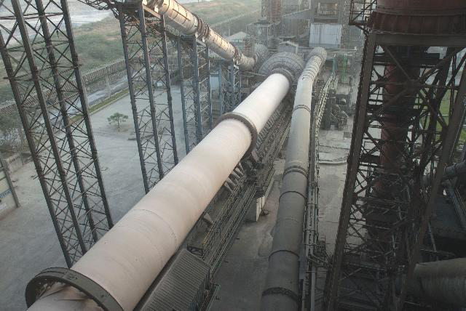
What is concrete?
Concrete consists of gravel ("aggregate") glued together with a cement
Portland cement is the most commonly used modern glue
It contains calcium silicates (e.g., Ca₃SiO₅ and Ca₂SiO₄) which,
when exposed to water, form hydrates that bind the gravel together ¹
The source of that Ca is naturally occurring limestone (CaCO₃)
Ca is liberated by heating the limestone at 1400-1600°C in HUGE rotating kilns: ²
1) Portland cement science:
http://matse1.matse.illinois.edu/concrete/prin.html
2) Photo: https://www.cemnet.com/Articles/story/39950/acc-s-mega-kiln-line-project.html

Slide 36
Concrete's Carbon Footprint:
The above process has a huge carbon footprint due to:
- Burning of carbon fossil fuels to produce the 1400-1600°C kiln temperatures
- The need to constantly heat those massive kilns, even when not in production
- The release of CO₂ that occurs as Ca is liberated from the limestone (CaCO₃)
The now censored EPA Inventory of US Greenhouse Gas Emissions & Sinks reported ¹
that 2012 U.S. Portland cement production produced a carbon footprint of:
35 million metric tonnes CO₂ equivalent = 38.5 million tons CO₂ equivalent
Annual U.S. Portland cement production is ~ 86 million tons ² and thus:
1 ton of Portland cement => 0.45 tons of CO₂ equivalent released
Concrete (aggregate + Portland cement) is ~ 11% Portland cement by weight ³ =>
1 ton of Concrete => 0.05 tons of CO₂ equivalent released
1) Deleted from the EPA website in April of 2017 "under the leadership of President Trump and Administrator Pruitt."
(but my copy can still be viewed/downloaded at THIS LINK)
2) www.cement.org 3) www.cement.org/cement-concrete-basics/concrete-materials

Slide 37
Putting concrete's carbon footprint into an energy perspective:
What fraction of U.S. concrete production is used to produce energy?
A "typical" nuclear plant requires "up to 350,000 cubic yards" of concrete ¹
Which, given concrete's density ² of 1.9 tons/yd³ => 665,000 tons Concrete
Which is 11% Portland cement => 73,000 tons Portland cement
That typical nuclear plant produces ~ 1.5 GW of electrical power
Ratio of nuclear plant Portland cement use to power produced:
= 73 kilo-tons cement /1.5 GW => 0.049 tons Portland cement / kW
And given that Nuclear plants operate for at least 40 years, this translates into:
= 0.0012 tons Portland cement / kW-yr for a nuclear plant
1) www.concreteconstruction.net/construction/construction-of-nuclear-power-stations.aspx
2) http://hypertextbook.com/facts/1999/KatrinaJones.shtml

Slide 38
Repeating that calculation for hydroelectric dams:
There really isn't a "typical" dam – designs vary too much by location
But we can use data from two large U.S. hydroelectric dams:
Hoover Dam: 3.25 million yd³ concrete / 2.8 GW power capacity ¹
(3.25x10⁶ yd³ Concrete)(1.9 tons/yd³)(11%) => 679,000 tons Portland cement
=> 0.24 tons Portland cement / kW
Bonneville Dam: 750,000 yd³ concrete / 1.189 GW power capacity ^{2, 3}
(7.5x10⁵ yd³ Concrete)(1.9 tons/yd³)(11%) => 157,000 tons Portland cement
=> 0.13 tons Portland cement / kW
Average is 0.185 tons Portland cement / kW
And given hydroelectric dam lifetimes of ~ 100 years, this translates into:
= 0.0013 tons Portland cement / kW-yr for a hydroelectric plant
1) http://en.wikipedia.org/wiki/Hoover_Dam 2) http://en.wikipedia.org/wiki/Bonneville_Dam
3) www.asce.org/People-and-Projects/Projects/Landmarks/Bonneville-Dam,-Columbia-River-System/

Slide 39
Finally, using those ratios to calculate carbon footprints:
From my note set on U.S. Power Production & Consumption (pptx / pdf / key)
Average total U.S. power is ~ ½ Tera-Watt
In 2016, nuclear plants produced 19.7% of that power => 9.8 x 10⁷ kW
with 0.0012 tons Portland cement / kW-yr for a nuclear plant
that translates into 117,600 tons Portland cement / yr, and thus:
Total U.S. nuclear footprint = 52,920 tons of CO₂ equivalent
In 2016 hydroelectric dams produced 6.3% of that power => 3.1 x 10⁷ kW
with 0.0013 tons Portland cement / kW-yr for a hydroelectric plant
that translates into 40,300 tons Portland cement / yr, and thus:
Total U.S. hydro footprint = 18,135 tons of CO₂ equivalent
An Introduction to Sustainable Energy Systems: WeCanFigureThisOut.org/ENERGY/Energy_home.htm

Slide 40
Comparing carbon footprint of different types of existing U.S. power plants:
In Where Do We Go from Here? (pptx / pdf / key) analysis of carbon tax impact, I found:
Conventional Coal => 0.001 metric tonne CO₂ eq. / kW-hr => 9.6 ton CO₂ eq. / kW-yr
OCGT Natural Gas => 0.0007 metric tonne CO₂ eq. / kW-hr => 6.7 ton CO₂ eq. / kW-yr
CCGT Natural Gas => 0.00045 metric tonne CO₂ eq. / kW-hr => 4.3 ton CO₂ eq. / kW-yr
In 2016 COAL provided 30.4% of U.S. power => 1.52 x 10⁸ kW
Carbon footprint = (1.52 x10⁸ kW)(9.6 ton/kW-yr) = 1.5 x 10⁹ tons CO₂ / yr
= 28,300 times Nuclear's current carbon footprint
= 82,700 times Hydro's current carbon footprint
In 2016 NATURAL GAS provided 33.8% of U.S. power => 1.69 x 10⁸ kW
Which, if it were produced using half OCGT and half CCGT, would represent
Carbon footprint = (1.69 x10⁸ kW)(5.5 ton/kW-yr) = 9.3 x 10⁸ tons CO₂ / yr
= 17,600 times Nuclear's current carbon footprint
= 51,300 times Hydro's current carbon footprint

Slide 41
Comparing carbon footprint for each kW-hour of power you consume:
From top of preceding page, converting kW-yr to kW-h, and ton to kg:
Conventional Coal Power: 9.6 ton CO₂ eq. / kW-yr=> 0.99 kg CO₂ eq. / kW-hr
OCGT Natural Gas Power: 6.7 ton CO₂ eq. / kW-yr => 0.69 kg CO₂ eq. / kW-hr
CCGT Natural Gas Power: 4.3 ton CO₂ eq. / kW-yr => 0.44 kg CO₂ eq. / kW-hr
From two pages ago, converting GW-yr to kW-h, and ton to kg:
Nuclear Power: 52,920 ton CO₂ eq. / 98 GW-yr => 0.000055 kg CO₂ eq. / kW-hr
Hydro Power: 18,135 ton CO₂ eq. / 31 GW-yr => 0.000061 kg CO₂ eq. / kW-hr
Nuclear's carbon footprint / kW-hr is ~ 10,000 lower than for fossil fuels
Hydro's carbon footprint / kW-hr is ~ 10,000 lower than for fossil fuels
An Introduction to Sustainable Energy Systems: WeCanFigureThisOut.org/ENERGY/Energy_home.htm

Slide 42
How can this be, given nuclear and hydro's "heavy" use of concrete?
Their concrete keeps them producing power for a VERY LONG time (40 yrs / 100 yrs)
And they use only a VERY SMALL fraction of our total 86 million tons of cement / yr
A nuclear plant requires 0.0012 tons Portland cement / kW-yr
Now producing 19.7% of the U.S.'s ½ Tera-watt, nuclear thus requires:
=> (0.0012 cement/kw-yr)(19.7%)(0.5x10⁹kW) = 118,200 tons cement / yr
= 0.14% of total U.S. Portland cement production
=> Only 0.71% if we produced ALL OF OUR POWER via nuclear!
A hydroelectric dam requires 0.0013 tons Portland cement / kW-yr
Now producing 6.3% of the U.S.'s ½ Tera-watt, hydro thus requires:
=> (0.0013 cement/kw-yr)(6.3%)(0.5x10⁹kW) = 40,950 tons cement / yr
= 0.047% of total U.S. Portland cement production
=> Only 0.76% if we produced ALL OF OUR POWER via hydro!

Slide 43
Preceding was an example of life cycle analysis (LCA)
Which sometimes reveals big differences between:
Ongoing (operational) carbon footprint vs. life-cycle carbon footprint
Life cycle analyses (LCA's) integrate in effects of all materials and processes used
to manufacture and operate and decommission/dispose of that technology
Here it was suggested that zero carbon footprint of nuclear and hydro power
would, with full LCA, instead yield significant non-zero carbon footprint
But in this case I could rebut that suggestion based on only a little web browsing
Proving (once again) that for energy you can't believe all that you hear!
But principle is valid and lifecycle analyses CAN make a big difference!
An Introduction to Sustainable Energy Systems: WeCanFigureThisOut.org/ENERGY/Energy_home.htm

Slide 44

LCA’s also raise doubts about another green technology: Electric Cars
First LCA criticism: Their source of power
An electric car gets ITS power from a power plant
In the U.S. most of THAT power now comes from fossil fuel combustion
Coal plant power is actually dirtier than power from gasoline auto engines
Because we’ve been reducing auto emissions for half a century!
Result: Carbon footprint of gasoline burning cars can actually
be LOWER than the carbon footprint of an electric car
“Won’t that change as we clean up our electric power system?”
Yes, for same reasons Si PV’s carbon footprint will also decrease!
An Introduction to Sustainable Energy Systems: WeCanFigureThisOut.org/ENERGY/Energy_home.htm

Slide 45
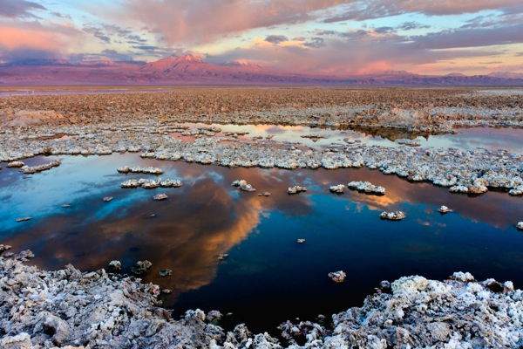
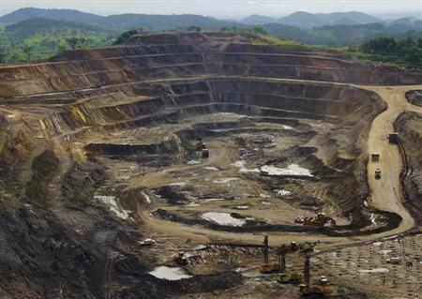
Second LCA criticism of electric cars:
Their batteries require huge masses of exotic metals
- Mined at great energy and pollution costs
- Refined at great energy and pollution costs
- Transported from worldwide sources (=> more energy / carbon pollution)
World's largest source of lithium, World's largest source of cobalt
deep in Chile's remote Altacama desert: (main component of Li battery electrodes):
Salar de Altacama (dry lake) Katanga, Democratic Republic of the Congo
Left photo: http://en.wikipedia.org/wiki/Salar_de_Atacama
Right photo: http://in.reuters.com/article/2013/02/19/drcongo-mining-idINDEE91I03520130219

Slide 46
With combined LCA issues leading to reports such as these:
In the press:
How environmentally friendly are electric cars?
(BBC News, 11 April 2013)
Buyer beware: There are shades of greenness
(New York Times, 26 January 2007)
From half million member international Institute of Electrical & Electronic Engineers:
How green is my plug-in?
(IEEE Spectrum - March 2009)
Speed bumps ahead for electric vehicle charging
(IEEE Spectrum Magazine - January 2010)
Unclean at any speed:
Electric cars don’t solve the automobile's environmental problems
(IEEE Spectrum Magazine - July 2013)
An Introduction to Sustainable Energy Systems: WeCanFigureThisOut.org/ENERGY/Energy_home.htm

Slide 47
The most credible major study of electric cars I’ve found:
Prepared by the U.S. National Academies of Science and Engineering:
Transitions to Alternative Transportation Technologies:
Plug-in Hybrid Electric Vehicles (2010)
They studied alternative hybrid electric car designs
Which, to minimize carbon emissions, would use ONLY batteries for early miles
Thus more numerous short auto trips would use zero gasoline
Alternate designs were designated:
PHEV-10 = Plug-in Hybrid Electric Vehicle – 10 initial miles on battery
PHEV-40 = Plug-in Hybrid Electric Vehicle – 40 initial miles on battery
With other acronyms:
HEV = Hybrid Electric Vehicle (non plug-in)
GHG = Green House Gas

Slide 48
Conclusions of this national academies report:
From "Results and Conclusions" chapter (page 33):
PHEV-10s will emit less carbon dioxide than non-hybrid vehicles, but save little relative to HEVs after accounting for emissions at the generating stations that supply the electric power.
PHEV-40s are more effective than PHEV-10s, but the GHG benefits are small unless the grid is decarbonized with renewable energy, nuclear plants, or fossil fuel fired plants equipped with carbon capture and storage systems
THAT IS: Compared to gasoline cars, plug-in electric cars will make little difference
As long as they are still charged from carbon-fueled electrical grid
Further, this report paid little attention to carbon footprint of materials
It's thus possible that greenhouse impact of electric cars is now negative
As has been suggested by a number of critics!
An Introduction to Sustainable Energy Systems: WeCanFigureThisOut.org/ENERGY/Energy_home.htm

Slide 49
Leading, finally, to the topic of carbon sequestration
Which is the idea that, at the carbon-burning power plants, we trap carbon gases
And somehow prevent them from entering the atmosphere
Making this easier: Coal power plant use of IG (integrated gasification)
Which (from carbon fuels lecture) uses heat + steam to drive these conversions:
3C (coal) + O₂ + H₂O => H₂ + 3 CO followed by:
CO + H₂O => H₂ + CO₂
This is done before the power plant's combustion/steam production step
With only the hydrogen ("syngas") then used for that combustion!
Opening the possibility of trapping that then diverted CO₂
An Introduction to Sustainable Energy Systems: WeCanFigureThisOut.org/ENERGY/Energy_home.htm

Slide 50
But sequestration will be made a lot HARDER by:
(From earlier slide in this lecture)
Average greenhouse gas lifetimes in atmosphere (in years):
Gas: CO₂ CH₄ N₂O CFC-11 CFC-12 HCFC-22 HFC-23 SF₆ CF₄
Life¹: 50 12 114 100 270 3200
Life²: 50-200 12 120 50 12 50000
Life³: 100-300 12 121 45 100 11.9 3200
That is, majority of studies / more recent studies now say that
CO₂ now in the atmosphere, will stay in atmosphere for hundreds of years
So to make a difference, we will have to sequester new CO₂ for CENTURIES
To give atmosphere time to purge CO₂ already present
1Source: www.acs.org/content/acs/en/climatescience/greenhousegases/properties.html
2Source: Introduction to Engineering and the Environment - Rubin (p. 471)
3Source: http://cdiac.ornl.gov/pns/current_ghg.html

Slide 51
But aren't they already successfully sequestering CO₂?
That's certainly what the advertising campaign about "clean coal" suggested!
Versus a 2008 Congressional Research Service Report to Congress:
Page 9:
"Coal-fired IGCC experience in the United States is limited to a handful of research and prototype plants, none of which is designed for carbon capture.
A commercial IGCC plant is being constructed by Duke energy . . . and other projects have been proposed. However, some other power plant developers will not build IGCC plants because of concerns over cost and the reliability of the technology"
Page 30:
"The estimates of the cost and performance effects of installing carbon controls are uncertain because
no power plants have been built with full-scale carbon capture"
Page 31:
"Amine scrubbing (of CO₂) is estimated to cut a coal plant's electricity output by 30% to 40%
. . . cost for building a coal plant with amine scrubbing is an estimated 61% higher"
Thus while not QUITE a fantasy, "clean coal" is certainly NOT a reality!
Source: CRS Report to Congress – "Power Plants: Characteristics and Costs" (November 13, 2008) - Order Code RL34746

Slide 52
Suggested CO₂ sequestration techniques:
Helping natural sequestration along:
1) Create new peat bogs: Which are very efficient at capturing carbon
2) Reforestation: Another of nature's prime ways of capturing carbon
3) Wetland restoration:
Wikipedia reports that they store 14.5% of world's soil carbon
While occupying only 6% of land surface area
Or manmade sequestration:
4) Iron or Urea fertilization of seas
To induce phytoplankton growth which would then metabolize CO₂
There've been Fe trials but are strong doubts about quantities required
As well as concerns about such wholesale tinkering with seas

Slide 53
5) High pressure injection into cavities created by fossil fuel removal
Shoot CO₂ down pipes used earlier to remove oil or gas, then cap them off
Or plug up entrances to depleted coal mines, and fill with CO₂
Hold it!
I grew up atop the San Andreas Fault - I know how active the earth can be!
What would a big earthquake do to a CO₂ storage site?
A related idea that would use un-mineable coal seams
5b) Enhanced Coal Bed Methane Extraction (ECBM):
Inject CO₂ into coal seam, driving out methane absorbed to the coal
Producing methane (for use), and subsidizing cost of pumping in the CO₂
But if methane is then burned, it will then release more CO₂
So would there really be any net sequestration?

Slide 54
The estimates on ECBM carbon sequestration:
Net carbon sequestration (presumably = CO₂ in, minus methane out)¹
For major international coal fields in designated regions:
Region Country Carbon Sequestration Potential
San Juan U.S. 1.4 giga-tonne
Kuznetsk Russia 1 giga-tonne
Bowen Australia 0.87 giga-tonne
Ordos China 0.66 giga-tonne
Sumatra Indonesia 0.37 giga-tonne
Canbay India 0.07 giga-tonne Total ~ 4.4 Gt
From earlier in this lecture, man's annual production of CO₂ = 29.8 Gt
ECBM potential sounds interesting – But it would encourage coal/gas use
And are we really ready to accept the coal + gas industry's numbers?
1Source: Energy System Engineering – Evaluation and Implementation – Vanek et al. (p. 215)

Slide 55

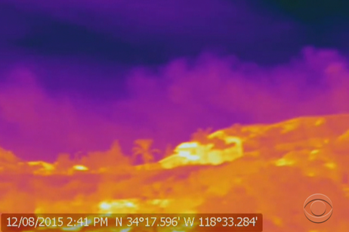
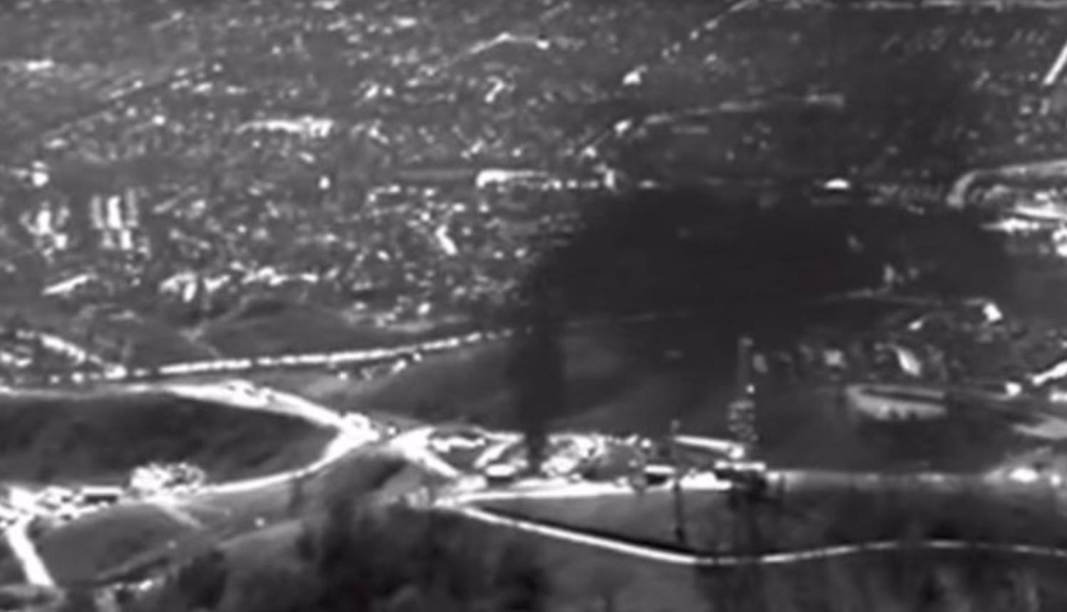
(revisited)
And regarding ALL "Pump a gas into the ground and forget" schemes:
Remember the 2015-16 Porter Ranch fiasco?
from my Fossil Fuels (pptx / pdf / key) note set:
= The same fossil fuel operators
= The same idea of pumping gas into abandoned wells
But at Porter Ranch they only tried storing the gas for a few months
And we're to believe they could keep gases buried for centuries?
(This didn't even require the San Andreas Fault breaking loose!!!)

Slide 56
6) High pressure injection into saline aquifers
Which are common but, because of salinity, not used for drinking or farming
It's claimed that in the US, majority of power plants are located over such aquifers
We'd then pump CO₂ down into aquifer water flowing (slowly) by
SOME of that CO₂ might eventually precipitate out as solid carbonate
Rather than capacities, test projects instead target storage rates²:
Project: Country: Sequestration Rate:
Brindisi Italy 8 x 10⁻⁶ giga-tonnes/year
Porto Tolie Italy < 10⁻³ giga-tonnes/year
Belchatow Poland 10⁻⁴ giga-tonnes/year
Vattenfall Germany < 6 x 10⁻⁴ giga-tonnes/year
Luzhou China 6 x 10⁻⁵ giga-tonnes/year
Versus man's production of CO₂ = 29.8 giga-tonnes / year
2Source: Energy System Engineering – Evaluation and Implementation – Vanek et al. (p. 217)

Slide 57
7) Conversion of CO₂ into inert materials
Finally! Something more plausible than, over the span of centuries:
- Pressurized CO₂ gas STAYING in abandoned oil/gas well or coal mine!
- Carbonated salt water NOT LOOSING its fizz!
Here, instead, CO₂ would be converted to carbonate minerals
Which are common, and are known to be stable over millennia
However: HOW will it be converted, and at what energy cost?
Converted at power plants via reactions with minerals such as Ca or Mg
Reactions don't require energy input, they release energy (albeit slowly)
So would still use heat, but get more heat back => power production
But required quantities of Ca / Mg => Major energy / environmental challenges
An Introduction to Sustainable Energy Systems: WeCanFigureThisOut.org/ENERGY/Energy_home.htm

Slide 58
A more acceptable alternative?
8) Injection into ocean bottom basalt formations
As recently described in the New Scientist (22 July 2014) - Rock Solid Solution:
"CarbFix³" process pumped CO₂ into wastewater from Icelandic geothermal plant
Re-injected water into rock formations,
Where it reacted with magnesium silicates
Article claimed process could work in basalt as well as "mantle peridotite"
Basalt is what makes up most of earth's ocean bottoms
Practicality? Scalability? Hard to tell as was only interview with project leader
But to me, the idea of mimicking geological processes to solidify CO₂ makes sense
I'd also look toward possible sequestration via cultivated bacteria / algae
3Website: https://www.or.is/en/projects/carbfix

Slide 59
My bottom line take on current carbon sequestration ideas?
Plans to simply pump gaseous CO₂ into holes just do not seem plausible
I cannot believe that a pressurized gas will stay in place for centuries
Even if this is THE STRATEGY backed by the major fossil fuel producers
Given that time span, I believe CO₂ will have to be chemically converted/bound
There are a huge number of such ideas floating around
Several times more ideas than I described above!
But these ideas are immature, untested, and potentially unscalable
Leading me back to the one sure way I know of controlling atmospheric CO₂:
Radically diminishing its production . . . as soon as possible
An Introduction to Sustainable Energy Systems: WeCanFigureThisOut.org/ENERGY/Energy_home.htm

Slide 60
Credits / Acknowledgements
Some materials used in this class were developed under a National Science Foundation "Research Initiation Grant in Engineering Education" (RIGEE).
Other materials, including the WeCanFigureThisOut.org "Virtual Lab" science education website, were developed under even earlier NSF "Course, Curriculum and Laboratory Improvement" (CCLI) and "Nanoscience Undergraduate Education" (NUE) awards.
This set of notes was authored by John C. Bean who also created all figures not explicitly credited above.
Copyright John C. Bean
(However, permission is granted for use by individual instructors in non-profit academic institutions)
An Introduction to Sustainable Energy Systems: WeCanFigureThisOut.org/ENERGY/Energy_home.htm

