Slide 1
Climatology and Climate Change
John C. Bean
Outline
Inconvenient truths about An Inconvenient Truth?
Paleoclimatology: Gathering climate data spanning millions of years
Ten thousand years: Dendrochronology (tree rings), radiocarbon dating . . .
Hundred thousand years: Glacial ice cores . . .
Million years: Geology, fossils and their isotopic ratios . . .
The recent stark increases in atmospheric gases such as CO2
vs. a less stark upward trend in temperature
Climate Models: The long, long list of effects & mechanisms that must be included
Their surprisingly slow incorporation during the 1970's to 1990's
The 2000's: Supercomputers finally allow for high-resolution worldwide modeling
The ongoing transition from fitting past data toward accurately predicting future data
(Written / Revised: February 2021)

Slide 2
Climatology and Climate Change
At least in the US, climate change is extremely controversial
So rather than just adding to the high ambient noise level
I am going to share my own personal exploration of this subject
Which began by learning how NOT to judge climate change
And then progressed to "Paleoclimatology" & its tools
Which yield more complete data on atmospheric gases and temperature
To the elements (and difficulties) of climate forecasting
Which took me (as described in the following note set) to the topics of:
The "carbon footprints" of alternative energy technologies
And to the possibly wishful proposals for "carbon sequestration"
An Introduction to Sustainable Energy Systems: WeCanFigureThisOut.org/ENERGY/Energy_home.htm

Slide 3
I am in no way involved in climate research – But I am a scientist!
As a scientist I know that the ultimate test of any theory is successful prediction
So I'd noted poor forecasting of upcoming winters or hurricane seasons
Which certainly suggested that climate modeling was still in its infancy
I thus sought 3rd party (~uninvolved) scientific sources and came across the book:
"Physics for Future Presidents" by U.C. Berkeley's Richard Muller
As in our textbook, Muller reduces important technical topics to basic science
With the goal of estimating basic limits and/or ultimate possibilities
And also as in our textbook, Muller brings with him a scientist's skepticism
Not in the "denier's" sense, but in the sense of "Show me the evidence!"
(Which ultimately pushed him to center stage in the climate change controversy)
An Introduction to Sustainable Energy Systems: WeCanFigureThisOut.org/ENERGY/Energy_home.htm

Slide 4
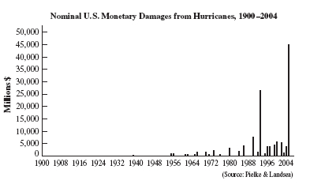
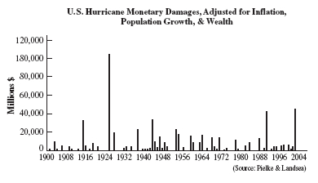
So, as a skeptical scientist, what is the evidence?
Well, on climate, Muller first taught me not to jump to premature conclusions
Such as those he identified in Al Gore's movie "An Inconvenient Truth”
Example #1) U.S. Monetary Damage from Hurricanes, 1900-2004
But when a century of inflation is taken into account, the figure becomes:
Wow!
Damage costs have skyrocketed indicating hurricanes have gotten much worse
Except for a few problems
And what first looked
like a strong trend
becomes NO trend!
Black and white figures here and to follow are from Richard Muller's "Physics for Future Presidents"

Slide 5
And it's actually a bit worse than that:
Because, in that century, we have built hugely more homes/cities on the coast
So similar storms should have produced more (adjusted dollar) damage
The lack of rise in the corrected figure thus suggests lowered damage per building
Which could be taken as evidence of weakening hurricanes
But what about the increase in Category 4/5 hurricanes in last 20 years?
Indeed: 2005 set a record with five such storms recorded
Well, here the key word is “recorded” because:
In the past we only noticed intense hurricanes when they hit us onshore
Or when they crossed heavily trafficked ocean shipping lanes
But we then began sending hurricane-spotting planes out over the ocean
And now weather satellites continuously photograph the entire ocean

Slide 6
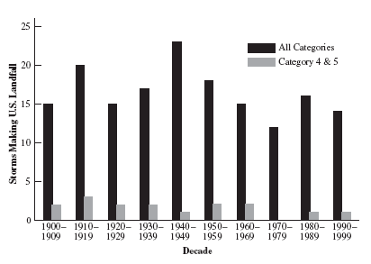
So you have to carefully avoid apple and orange comparisons
Our old data were almost entirely for hurricanes when they came ashore
So, for true historical trends, we must filter our much richer modern data
Taking from it only data for hurricanes AT LANDFALL
A century of tropical storm landfall data:
Thus earlier numbers ignored the fact that we now spot more hurricanes!
And thus, including mid-ocean data, also spot more Cat 4/5 hurricanes

Slide 7
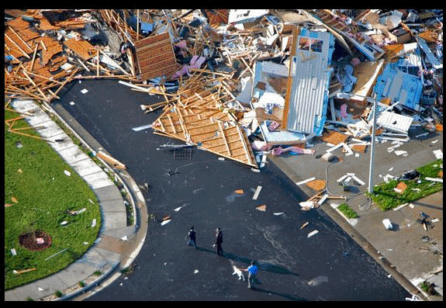
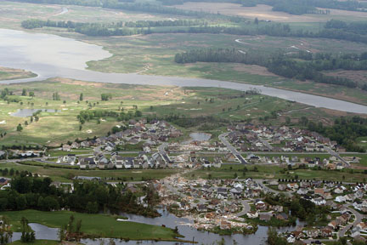
We can also identify increased tornado damage:
At left, a newspaper photo of my daughter's home:
Many saw a tie between this "freak" Suffolk Virginia tornado and global warming
But are we sure of that? Take a look at the larger area photograph on the right
That photo reveals that her neighborhood was built in a grassy tidal marsh
And I know the neighborhood was built in only ~ the last decade
So if an identical storm touched down in the same place two decades ago
We might not have even noticed (with only a tree or two knocked down)!

Slide 8
This reveals a fundamental flaw in weather reporting:
We don't monitor weather with the goal of compiling scientific data
We instead search for anomalous weather that might harm us or our property
And we now search harder and harder, with ever improving technology
Making special use of recent, widespread, deployment of Doppler radars
For which I now carry near-instant monitoring apps on my phone!
With this goal, weather data has a built-in bias toward finding irregularities
So weather data must be very carefully filtered to eliminate biases
Here I'm not just talking about human bias. It can be more subtle, for instance:
We (logically) keep building more Doppler radars in tornado-prone areas
And (surprise!), as a result, we detect more tornados!

Slide 9
So consider a non-weather reporting phenomenon: Ice sheet thickness
There is very strong data, worldwide, on the recent (alarming) retreat of glaciers
And because glaciers do incorporate the snowfall of decades and centuries
They would seem to offer an excellent way of spotting long term trends
In the mountains of the middle latitudes (e.g. the Alps and Rockies)
Summer temperatures can rise above 0°C, thus:
Glacial retreat is an indication of warmer summers => melting
Given its vastness, we are particularly alarmed by the thinning of the Antarctic Ice
However, Antarctica remains well below freezing all year round
But warming of adjacent seas should enhance water evaporation,
Which should increase snowfall => Increase in Antarctic ice thickness
So present thinning of Antarctic ice sheet contradicts some warming models!

Slide 10
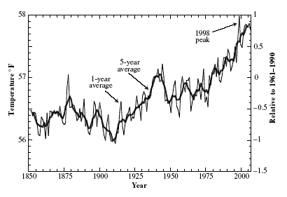
OK, then what about simple, direct, temperature data?
The type of data we had
in the 80's and 90's:
Recorded temperature does seem to be trending upward. However:
- It is awfully noisy (with the upward trend only about twice the variation)
- We KNOW that the earth's climate has regular (non-global warming) variations
For example, mega ice ages (and even mini ice ages)
- Historical data come primarily from a handful of big cities (e.g., London)
But we know that cities are WARMER than the surrounding countryside
And we know these cities GREW hugely during this same period
So we'd expect their (local only) temperatures to have increased!

Slide 11
So even for simple, direct, temperature data:
To accurately evaluate global climate trends, we really need to:
Acquire a much larger data set
Acquire a much more geographically diverse/representative data set
Including, for balance, much more data from the southern hemisphere
Which could be different based on lower land to sea ratio
Rely much less heavily on data from large growing cities
And/or develop models that can reliably separate the effects of localized
urban heat bubbles from underlying large area temperature changes
Acquire temperature data covering 10X, 100X, or 1000X longer time spans

Slide 12
Where am I going with this?
Am I a closet “denier?”
NO, to me a denier is someone who refuses to listen to any evidence
But in the preceding I do see misuse of evidence on the other side of the table
As, at least in the political/popular arena and in news reporting,
advocates have grabbed at selective seemingly supportive data
that could not withstand more careful examination
Whether deliberate or non-deliberate, such selective use of data can mislead
And Gore and others do seem to have succumbed to such “Cherry Picking”
My conclusions from all of the above?
On climate, it can be extremely hard to find unambiguous evidence
So better data are absolutely essential, bringing me to the topic of:

Slide 13
“Paleoclimatology”
Where, as the strange name sort of suggests, this is:
The study of the earth's climate over the earth's whole history
Covering ~ 4.5 billion years, including periods in which earth's surface was:
Largely/entirely molten lava
Or 100% frozen
Or enveloped by suffocating (Venus-like?) atmosphere
For our purposes, more relevant is the last ~ half billion years
When the biosphere (as we know it and need it) came into existence
Data on climate over THAT time span would make it much easier to decide
if something truly strange (and possibly man-made) is now altering climate!
An Introduction to Sustainable Energy Systems: WeCanFigureThisOut.org/ENERGY/Energy_home.htm

Slide 14
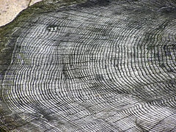
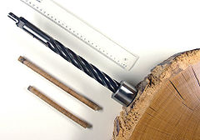
Source of data for last ten thousand years: Dendrochronology
Known more commonly as tree ring dating:
Trees grow more vigorously in certain seasons => thicker accumulations of tissue
Leading to growth rings in trunk and branches
Sections of which can be easily extracted using core drills:
Better growth conditions => Thicker annual rings
Sequence of ring thickness + knowledge of tree's preferences => Climate history
Albeit a history that combines effects of both temperature and rainfall
http://en.wikipedia.org/wiki/Dendrochronology

Slide 15
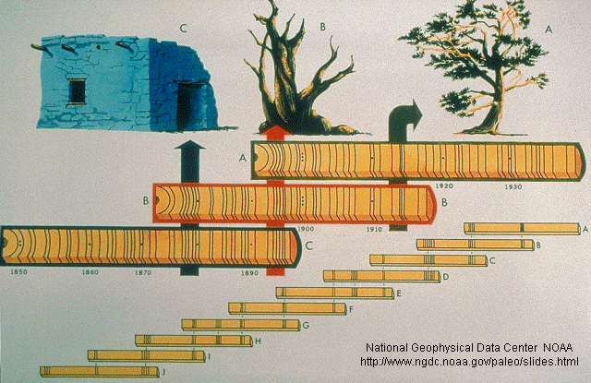
But the oldest trees are only about 2000 years old!
We can extend climate history by using cores from multiple trees (dead or alive):
Trees of different ages that experienced the same climate patterns
Corresponding parts of tree ring pattern allow alignment of cores to one another:
Line up older core with a still older core, and so on and so on:
In certain locations, histories have thus been compiled going back ~ 10,000 years
An Introduction to Sustainable Energy Systems: WeCanFigureThisOut.org/ENERGY/Energy_home.htm

Slide 16
What if we can't find wood from some periods?
We can date disconnected tree ring samples via radiocarbon dating
Which we've all heard of – but probably never had completely explained:
The atmosphere contains both: ¹²C (=stable) & radioactive ¹⁴C (half-life 5730 years)
But, despite ¹⁴C decay, the ¹²C / ¹⁴C ratio remains constant because (KEY POINT!):
Cosmic rays striking the upper atmosphere continuously create new ¹⁴C:
1n (neutron as a cosmic ray) + 14N => 14C + 1p (proton)
This new (replacement) ¹⁴C then diffuses through the entire atmosphere
Thus maintaining an atmospheric ¹²C / ¹⁴C ratio of about 10¹² to 1.5
However, most cosmic rays don't reach the ground, so C inside plants is not altered
But their incorporated ¹⁴C does continue to radioactively decay away
Thus: Changing ¹²C / ¹⁴C ratio inside a plant => Age of that plant

Slide 17
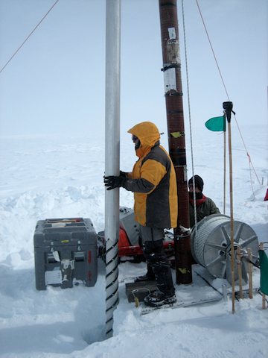
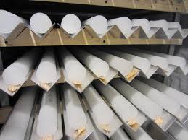
Source of data for last hundred thousand years: Glacial Cores
Water vapor freezes => Snow flakes => Which are compressed into ice
Some glaciers, such as those on Greenland, are over 100,000 years old
And cores can be (relatively) easily drilled from such ancient glaciers:
www.colorado.edu/news/releases/2013/01/23/deep-ice-cores-show-past-greenland-warm-period-may-be-%E2%80%98road-map%E2%80%99-continued
www.washington.edu/news/2014/04/11/greenland-ice-cores-show-industrial-record-of-acid-rain-success-of-u-s-clean-air-act/

Slide 18
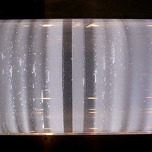
Information extractable from such glacial cores:
Snowfall has annual variations including cycles in snowflake size and compaction
Which can sometimes be seen in the detailed structure of ice cores:
Thicker / broader annual bands
indicate higher annual snow fall
Suggesting colder surface temperatures
(OR more moisture from warmer local seas?)
Whiter bands also (correctly) suggest that gas has been trapped in the cores
I.E., not all of the air between snowflakes escaped as it compacted into ice
By cutting out thin slices and melting in vacuum (or under controlled inert gas)
These trapped bubbles of ancient atmospheres can be reclaimed
www.methanenet.org/news/clathrate-gun-shot-down

Slide 19
More subtly:
Plant pollens can blow over long distances
To eventually fall upon the surfaces of such glaciers
Where they can not only provide another seasonal marker
But, by identifying the plant responsible and its preferred habitat,
they can also indicate climates in surrounding regions
Volcanic dust can circle the world – and then get similarly trapped in glaciers
Offering opportunity to correlate atmospheric opacity with climate
Oxygen has two atomic isotopes, ¹⁶O and ¹⁸O, so seawater has two masses
Relative evaporation of lighter vs. heavier water changes with temperature
So ratio in glacier hints at the nearby ocean surface temperature
"Hints" because factors such as salinity also affect evaporation

Slide 20
Sources of data spanning millions of years:
Morphology/Shape of Sedimentary Deposits:
E.G., Sand dunes, lake shores, glacial scars . . . => indications of climate
Content of Sediment Deposits:
Remnants of animals, plants, pollens => indications of climate
Chemical Analysis of Fossils:
18O to 16O ratio in foraminifera fossils (~ amoeba like water dwellers)
Different heavy/light water evaporation rates =>
Different 18O / 16O ratio in water dwellers =>
Temperature of body from which water evaporated
(as with glaciers)
Mg/Ca ratio in shells varies with temperature at which shell was formed
Sr/Ca ratio in corals varies with temperature at which coral grew

Slide 21
(continuing)
Organic Residues in marine sediments reflect ambient temperature
Leaf shape ("physiognomy") is different for leaves from different climates
Tropical Rain forests: Larger leaves or many "drip tips"
Cooler climates: Smaller leaves, toothed edges more common
Heavy Isotope Bonds (e.g. ¹³C to ¹⁸O) more probable at low temps
Plus quite a few additional techniques
Most of which are also indirect and do require subtle/complex analysis
But which, together, can be used to build up an extremely long climate record
An Introduction to Sustainable Energy Systems: WeCanFigureThisOut.org/ENERGY/Energy_home.htm

Slide 22
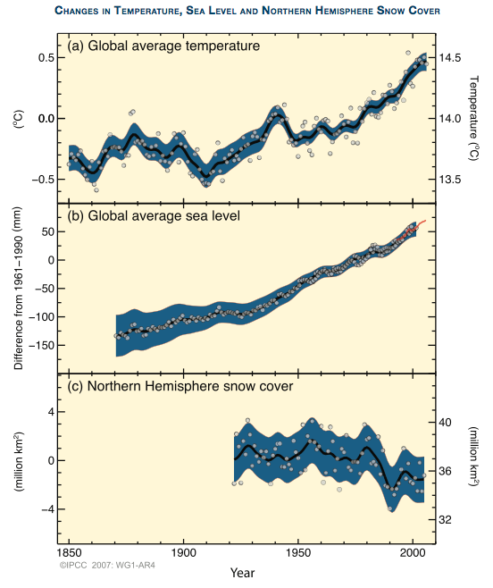
What does resulting much more extensive data set look like?
Above, first call was for more globally representative recent data:
Data from the IPCC (Intergovernmental Panel on Climate Change)
- Chartered by United Nations in 1988
- Goal: Collect/analyze all available data
- 2007 => Nobel Peace Prize (w/ Al Gore)
More data => Higher confidence level
Less scatter
Clearer recent trends
IPCC Fourth Assessment Report – Working Group 1 – 2007 (p. 6):

Slide 23
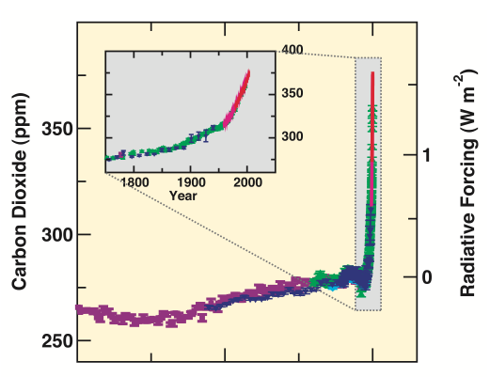
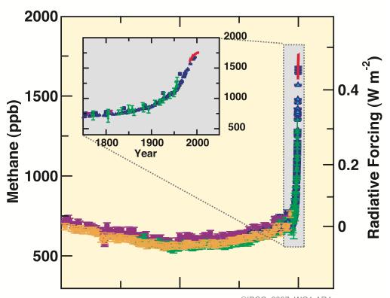
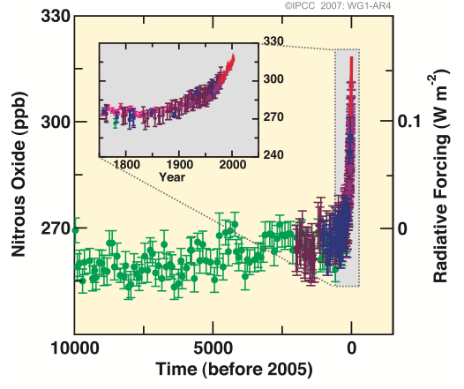
Long term data on three atmospheric greenhouse gases:
Main figures: 8000 BC to 2005 AD Inset figures: 1750-2005 AD
CO₂: CH₄: NO₂:
Note recurring pattern:
- 10,000 BC
- Now
- 1800
Source: IPCC Fourth Assessment Report – Working Group 1 – 2007 (p. 3)

Slide 24
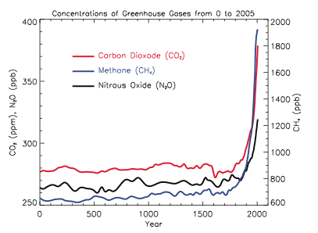
Or, expanding greenhouse gas data for last two millennia:
From the IPCC Fourth Assessment Report (2007):
Source: IPCC Fourth Assessment Report – Working Group 1 – 2007 (p. 135)

Slide 25
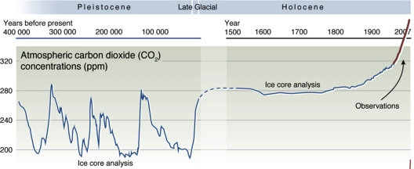
Or CO₂ back to a half million years ago:
From the United Nations Environmental Project / GRID Arendal:
Clearly indicating (at least to me) that:
Although atmospheric CO₂ concentration has indeed varied a lot
Especially during ice age cycles at left
Rise in last ~100 years is unprecedented
New level as of May 2013
http://www.grida.no/graphicslib/detail/historical-trends-in-carbon-dioxide-concentrations-and-temperature-on-a-geological-and-recent-time-scale_a210

Slide 26
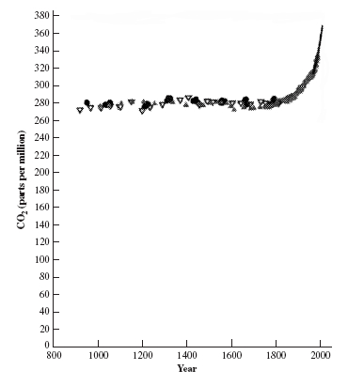
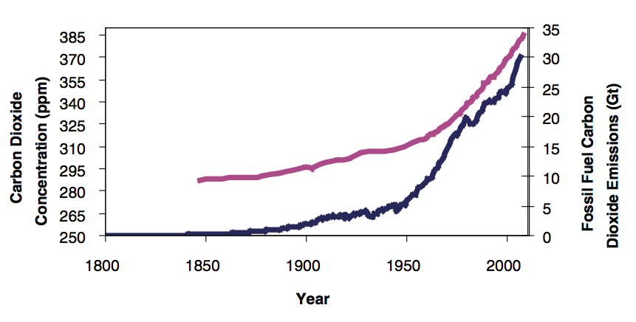
CO₂ data's "signal to noise ratio" and causality:
Raw CO₂ data for last 1200 years:
Upward trend is huge and >> data variation
(much less ambiguous than temperature data)
Sharp modern rise has no historical precedent
But possible correlation with industrial revolution (and fossil fuels) is clear
"Physics for Future Presidents"
US National Research Council
(National Academy of Science &
National Academy of Engineering)
"America's Climate Choices" – Figure 2.2 - National Academies Press (2011)

Slide 27
CO₂ bottom lines:
Data above are so clear and so unprecedented
that I know of no group of reputable scientists
who, however skeptical, do not now accept:
- Reality of recent CO₂ atmospheric gas spike
- Uniqueness of this CO₂ atmospheric gas spike
- Human role in driving CO₂ atmospheric gas spike
HOWEVER don't confuse this CO₂ data with (noisier) temperature data
Also, while we know that greenhouse CO₂ should have a warming effect
Above (alone) does not prove CO₂ drives global warming
(We need still more evidence!)
An Introduction to Sustainable Energy Systems: WeCanFigureThisOut.org/ENERGY/Energy_home.htm

Slide 28
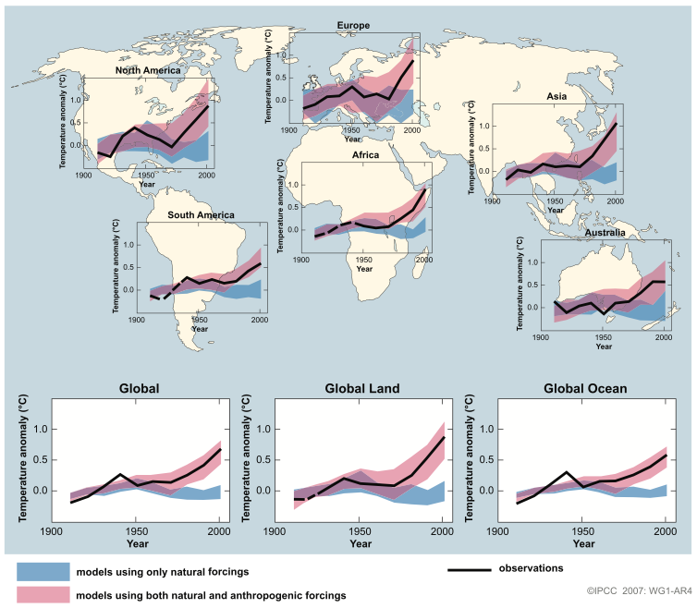
But now returning to more ambiguous temperature data:
2007 IPCC data for last 200 years = Black lines
(for the moment, disregard colored bands = models)
Now documented worldwide: Strong upward trends over the last 200 years
IPCC Fourth Assessment Report – WG1 – 2007 (p. 11)

Slide 29
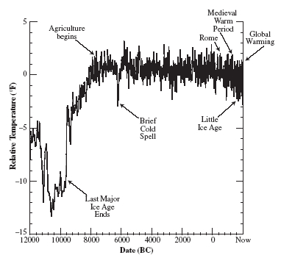
Or, temperature data looking back 12,000 years:
From Muller's "Physics for Future Presidents:"
Last full ice age at left, mini-ice ages / oscillations later

Slide 30
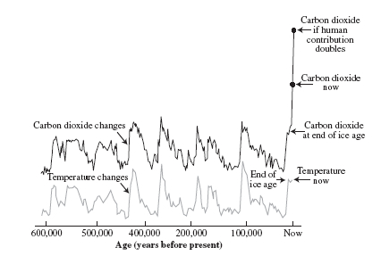
Or, temperature data looking back 600,000 years:
This plot, from Muller's book and Gore's movie, adds in CO₂ data:
Gore and others point out this correlation of CO₂ with temperature
But Muller reminds us that correlation does NOT tell which one causes which
Or if something else could be causing both of these to change
Wait a second! CO₂ is a greenhouse gas
Doesn't that, by definition, mean that it causes warming?
Source: Richard Muller's "Physics for Future Presidents"

Slide 31
CO2 as a cause AND effect of warming:
Yes, CO2 is a strongly infrared-radiation-absorbing gas
Which means that it will absorb incoming IR light from the sun
AND absorb heat that earth would have re-released to space
So atmospheric CO2 is a CAUSE of warming
But microbial activity also releases CO2 from earth surface soils
and warming of soils increases their activity:
  "Soils store about four times as much carbon as plant biomass, and soil microbial respiration releases about 60 petagrams of carbon per year to the atmosphere as carbon dioxide. Short-term experiments have shown that soil microbial respiration increases exponentially with temperature¹"
So atmospheric CO2 is an EFFECT of warming
¹Source: Temperature sensitivity of soil respiration rates enhanced by microbial community response,
Karhu et al., Nature 513, pp. 81-84 (September 2014)

Slide 32
Raising a very scary possibility:
Warming and CO2 each cause the other = Positive feedback
That is, scenarios like this are then fed:
  little more CO2 => little warmer => lot more CO2 => lot warmer . . .
  Action => Reaction => Stronger Action => Stronger reaction . . .
This leads to fears about a possible "TIPPING POINT"
Where, at some point, this feedback loop might become so self-reinforcing
  That, even if we drastically cut OUR CO2 emissions,
    its growth might become unstoppable
Suggesting we'd better learn more about this phenomenon NOW!
An Introduction to Sustainable Energy Systems: WeCanFigureThisOut.org/ENERGY/Energy_home.htm

Slide 33
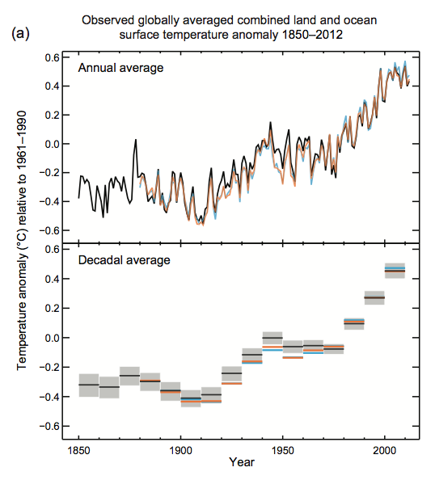
So here is IPCC's much more careful look at a possible correlation
200 years of worldwide TEMPERATURE data:
IPCC Fifth Assessment Report – WG1 – 2013 (p. 6)

Slide 34
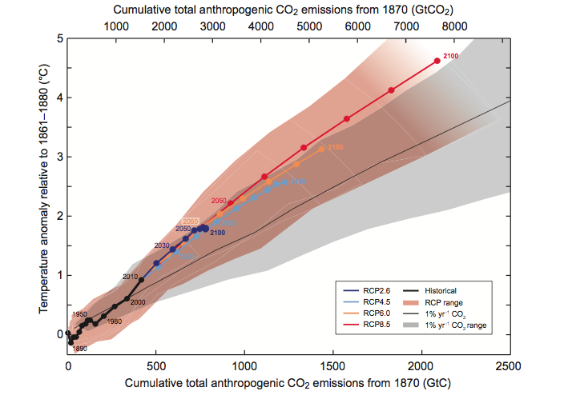
Correlation of that temperature "anomaly" with man-made CO₂
IPCC Fifth Assessment Report – WG1 - 2013 (p. 128)
Note that this is a plot of ΔT vs ΔCO₂ (and not, as earlier, one or other vs. time)
But the data set does include values 1870 to present
More thorough correlation, here with only man-made CO₂, looks excellent
"OK, what if temperature and CO₂ DO track? Are things really getting out of hand?
For instance, I've read about a recent (unexpected) PAUSE in global warming"

Slide 35
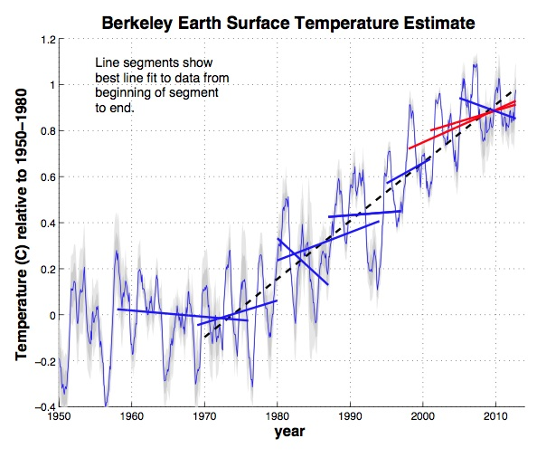
"Global Warming Pause"
Below, expanded, is earth surface temperature data from last 65 years
"BerkeleyEarth.org" has fitted this, over 10-15 years spans, by straight lines
Six segments show increases, three segments show decrease
Much touted "Pause" refers to final short segment
Is this significant? No, at least not yet
Not given the large overall variations
Not unless pause continues a lot longer
At this point "pause" = statistical variation
And when data are averaged enough to quiet variation, trend is clearly upward
Source: BerkeleyEarth.org
An Introduction to Sustainable Energy Systems: WeCanFigureThisOut.org/ENERGY/Energy_home.htm

Slide 36
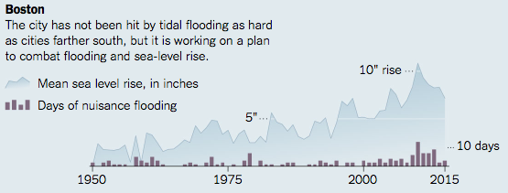
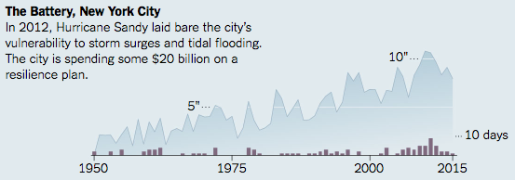
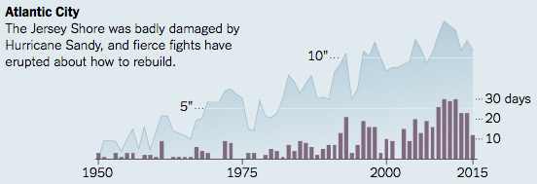
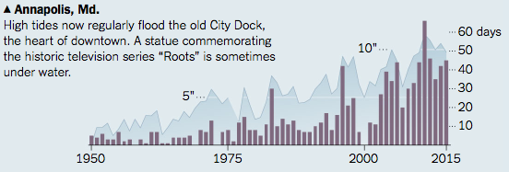
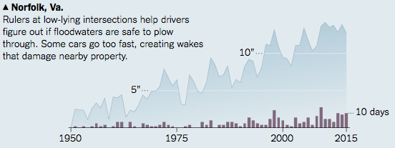
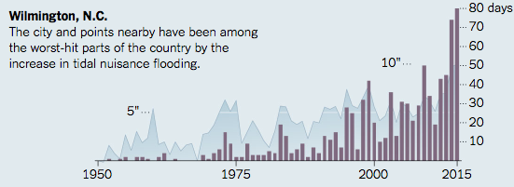
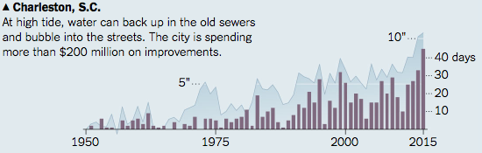
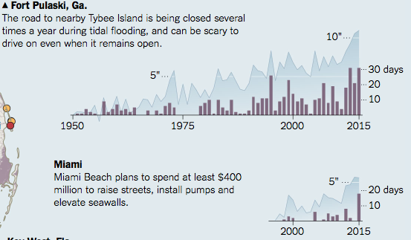
NEW Correlations: NYT (9/2016) - “Sharp Increase in ‘Sunny Day’ Flooding:”
FIGURE: http://www.nytimes.com/interactive/2016/09/04/science/global-warming-increases-nuisance-flooding.html
ARTICLE: http://www.nytimes.com/2016/09/04/science/flooding-of-coast-caused-by-global-warming-has-already-begun.html?_r=0
“Mean sea level rise is relative to 1950, or 1996 for Virginia Key, Miami.
Sources: National Oceanic and Atmospheric Administration; National Ocean Service; William Sweet et al., “Sea Level Rise and Nuisance Flood Frequency Changes Around the United States”

Slide 37
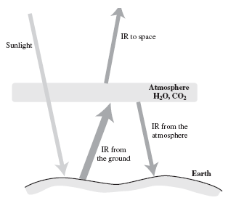
But predicting climate changes would be a lot more convincing!
And so on to the topic of: Building Climatological Models
A very basic representation of the effect of greenhouse gases:
Sunlight in => Heats Ground => IR radiation upward => Some bounced back
From Richard Muller's "Physics for Future Presidents"

Slide 38
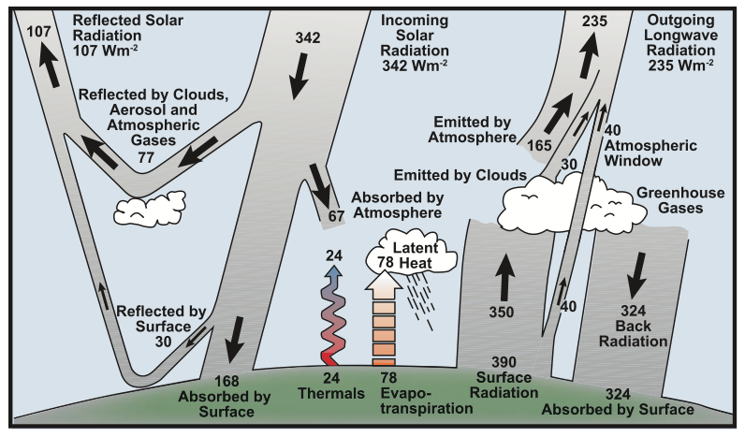
But there is a whole lot more going on in the atmosphere:
And one of the hardest things to model is the effect of water vapor
As a vapor it is the strongest greenhouse gas => heat trapping => Warming
But as clouds it reflects back incoming sunlight => Cooling
AND all sorts of things influence its conversion vapor ⬄ clouds
IPCC Fourth Assessment Report – Working Group 1 – 2007 (p. 96)

Slide 39
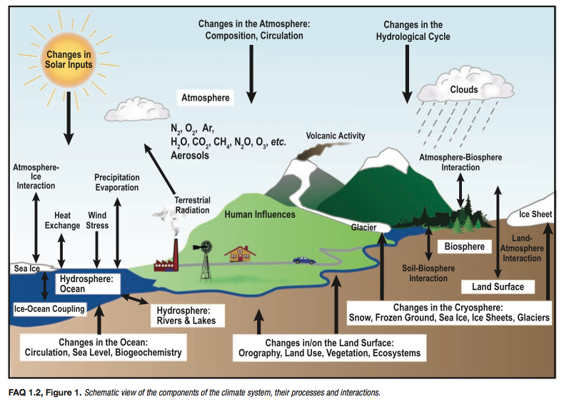
Here are some of those other "things" that must be taken into account:
IPCC Fourth Assessment Report – Working Group 1 – 2007 (p. 104)

Slide 40
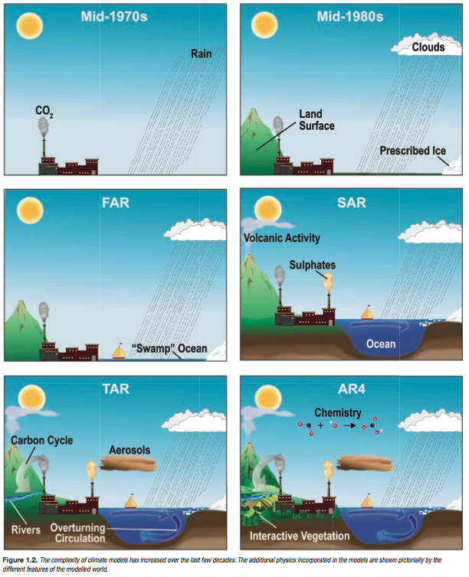
Taking climate model development in smaller steps:
Acronyms do not refer to science involved:
FAR: First Assessment Report (1990)
SAR: Second Assessment Report (1996)
TAR: Third Assessment Report (2001)
AR4: Fourth Assessment Report (2007)
For a Nobel Prize winning UN chartered body, IPCC could sure TRY a lot harder to be understood!
Confirmed: Nature Climate Change, March 2016 ¹
Linguistic Analysis of IPCC Summaries for Policymakers and Associated Coverage
"IPCC (reports) clearly stand out in terms of low readability, which has remained relatively constant despite the IPCC’s efforts to consolidate and readjust its communications policy. In contrast, scientific and quality newspaper coverage has become increasingly readable and emotive."
Figure: IPCC Fourth Assessment Report – Working Group 1 – 2007 (p. 99)
1) http://www.nature.com/nclimate/journal/v6/n3/full/nclimate2824.html

Slide 41

(Relevant news articles I've not yet fully researched and/or verified)
The Real Reason Scientists Downplay the Risks of Climate Change
Author's preview of their new book:
"Discerning Experts: The Practices of Scientific Assessment"
(as published in The Guardian, October 2019) ¹
"While climate skeptics and deniers often accuse scientists of exaggerating the threats associated with the climate crisis, the available evidence suggests the opposite."
"Consider a case in which most scientists think that the correct answer to a question is in the range one to 10, but some believe that it could be as high as 100. In this case, everyone will agree that it is at least one to 10, but not everyone will agree that it could be as high as 100. Therefore, the area of agreement is one to 10, and this will be reported as the consensus view."
"To scientists, we suggest that you should not view consensus as a goal. Consensus is an emergent property, something that may come forth as the result of scientific work, discussion and debate. When that occurs, it is important to articulate the consensus as clearly and specifically as possible. But where there are substantive differences of opinion, they should be acknowledged and the reasons for them explained."
1) https://www.theguardian.com/commentisfree/2019/oct/25/the-real-reason-some-scientists-downplay-the-risks-of-climate-change?CMP=Share_iOSApp_Other

Slide 42
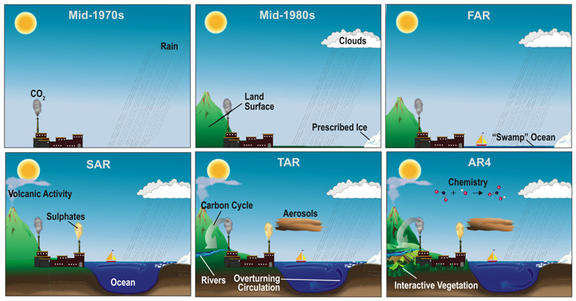
Ignoring acronyms and instead focusing on dates:
Models of 1970's and 1980's were REALLY crude!
Initial focus was almost entirely on the atmosphere
Starting with ONLY the effect of CO₂ (and not even clouds!)
Which WAS sort of natural given question of greenhouse effects
1980's: Atmosphere + clouds + simple land topography and ice masses
~1990: Oceans finally introduced but as shallow uniform "swamp" seas

Slide 43
Moving to developments 1990 to 2007:
1996 (SAR): Addition of volcanoes, other gases, and deep oceans!
2001 (TAR): More gases, deep ocean currents and flows
2007 (AR4): Vegetation as something more than green ground
That is, as something that actually absorbed CO₂ and emitted O₂
Plus atmospheric photochemical reactions / conversions (e.g., "smog")
I.E., finally accounting for most things we knew would be important!

Slide 44
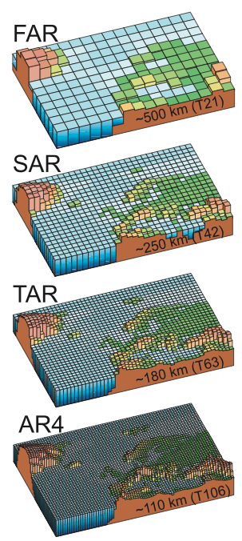
In same period there was HUGE improvement in spatial resolution
Early spatial resolution was awful!
Can you even recognize 1st model's location?
Averaging can obliterate localized effects
Averaged Mtn. + plain ≠ net effect of each!
Only in TAR (2001) is Europe easily recognized!
Only in AR4 (2007) is its diversity well represented!
IPCC Fourth Assessment Report – Working Group 1 – 2007 (p. 113)

Slide 45
Why was development so slow? It's a huge problem!
Accounting for all these atmospheric effects: And all these ground effects:
And doing so, with at least this resolution, over the entire world
Scientific challenges were HUGE! Computational challenges were huge!

Slide 46
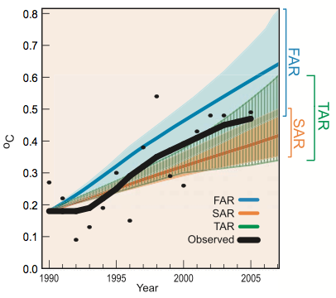
OK, so the models now seem ~ complete, what do they say?
Looking backwards, modeling temperature evolution 1990 to present:
Models track observed temperature trend
With later TAR perhaps most accurate
IPCC Fourth Assessment Report – Working Group 1 – 2007 (p .98):

Slide 47
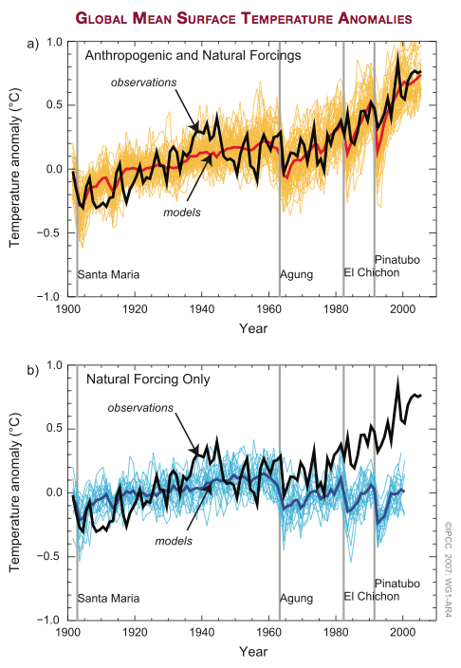
OR modeling recent temperature with or without manmade effects
Natural effects only: Adding in manmade effects:
Above modeling seems to substantiate man's role
But all such models contain a HUGE number of "adjustable parameters"
And any scientist knows that fitting data to an adjustable model is easy
Even if you do your damndest to avoid tweaking results into agreement
IPCC Fourth Assessment Report – Working Group 1 – 2007 (p .62)

Slide 48
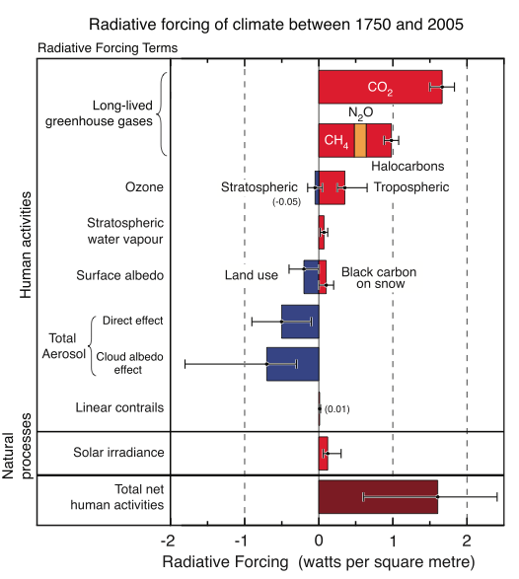
The true scientific test is PREDICTION!
Further, in this case, we very much want to predict effects of OUR actions
In this field those are called "forcings"
As in "driven by man-made forces"
vs. "driven by natural forces"
Here is a chart of possible "forcings"
Divided into manmade (top)
And "natural" (low-middle band)
Some of which drive warming (red)
Some of which drive cooling (blue)
Bars = PREDICTIONS of the magnitudes of each forcing
Which are given in units of Δ Heat absorbed by earth / meter² / time
IPCC Fourth Assessment Report – Working Group 1 – 2007 (p. 136)

Slide 49
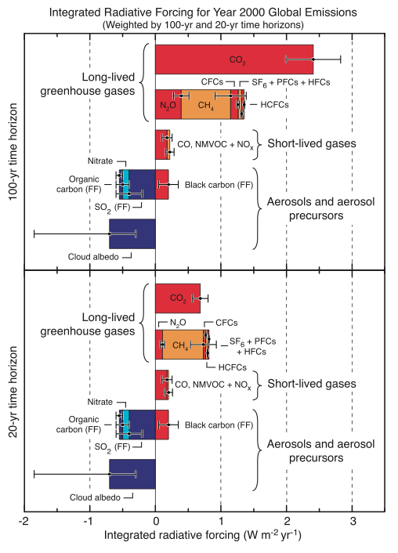
Here are time-integrated forcings (with sub-divisions):
Biggest "warmers" are:
- LONG LIVED greenhouse gases
i.e., CO₂, N₂O, CH₄
Biggest "coolers" are:
- Cloud cover
Why modeling H₂O vapor ⬄ Clouds
is so CRITICAL for correct results!
- SO₂, nitrates . . .
IPCC Fourth Assessment Report – Working Group 1 – 2007 (p. 206):

Slide 50
Putting this all together – NOW look at the colored bands!
Black lines = Measured temperatures
Blue bands = Models incorporating only natural forcings
Pink bands = Models adding in man-made forcings
According to these models,
man's actions make the
critical difference!
IPCC Fourth Assessment Report - WG1 – 2007 (p. 11)

Slide 51
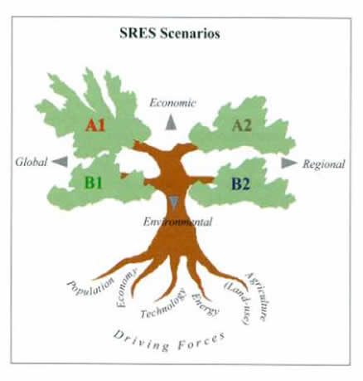
Or looking forward but with different things driving human actions
What IPCC labels "SRES scenarios" (special report on emissions scenarios)
A1
Economic
A2
Global
Regional
B1
B2
Environmental
Center: IPCC's http://sedac.ipcc-data.org/ddc/sres/ Surrounding: My attempt at clarification

Slide 52
Further translating out of IPCC Speak:
A1 = Coordinated global actions
driven by economic development
A2 = Uncoordinated regional actions
driven by economic development
B1 = Coordinated global actions
driven by environmental concerns
B2 = Uncoordinated regional actions
driven by environmental concerns
A1
Economic
A2
Global
Regional
B1
B2
Environmental
http://sedac.ipcc-data.org/ddc/sres/

Slide 53
Or if you want the details:
A1: The A1 scenarios are of a more integrated world. The A1 family of scenarios is characterized by:
Rapid economic growth.
A global population that reaches 9 billion in 2050 and then gradually declines.
The quick spread of new and efficient technologies.
A convergent world - income and way of life converge between regions. Extensive social and cultural interactions worldwide.
There are subsets to the A1 family based on their technological emphasis:
A1FI - An emphasis on fossil-fuels (Fossil Intensive).
A1B - A balanced emphasis on all energy sources.
A1T - Emphasis on non-fossil energy sources.
A2: The A2 scenarios are of a more divided world. The A2 family of scenarios is characterized by:
A world of independently operating, self-reliant nations.
Continuously increasing population.
Regionally oriented economic development.
B1: The B1 scenarios are of a world more integrated, and more ecologically friendly. The B1 scenarios are characterized by:
Rapid economic growth as in A1, but with rapid changes towards a service and information economy.
Population rising to 9 billion in 2050 and then declining as in A1.
Reductions in material intensity and the introduction of clean and resource efficient technologies.
An emphasis on global solutions to economic, social and environmental stability.
B2: The B2 scenarios are of a world more divided, but more ecologically friendly. The B2 scenarios are characterized by:
Continuously increasing population, but at a slower rate than in A2.
Emphasis on local rather than global solutions to economic, social and environmental stability.
Intermediate levels of economic development.
Less rapid and more fragmented technological change than in A1 and B1.
http://en.wikipedia.org/wiki/Special_Report_on_Emissions_Scenarios

Slide 54
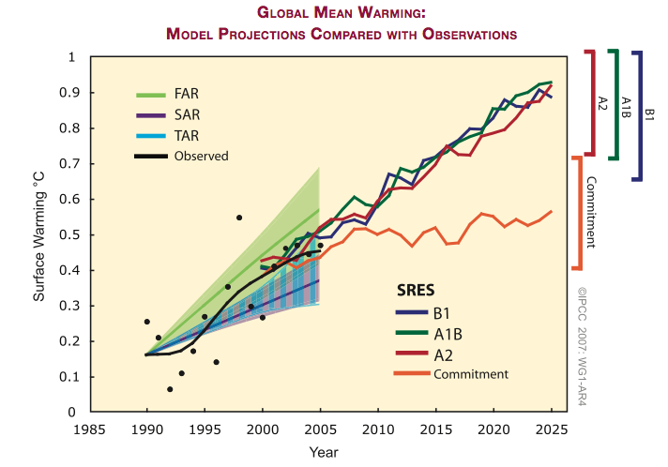
Which then yield these alternate predicted trends
IPCC Fourth Assessment Report – Working Group 1 – 2007 (p .69):

Slide 55
Some explanations and observations:
“Commitment” = If we now halt any further change in atmosphere
That is, we have already committed (made) atmospheric changes
What will those alone (via a sort of momentum) now inevitably produce?
Apparent answer: Stabilization of temperature
Different economic/globalization scenarios?
- Worst case extremes are very similar
- Best cases diverge
Best results are (naturally) for B and A/B drivers
(Environment or Environment & Economics)
ONLY BEST B1 case => ~ Stabilization
(i.e. STRONG coordinated global action focusing on environment impact)
IPCC Fourth Assessment Report – Working Group 1 – 2007 (p. 69):

Slide 56
Bottom lines?
True, classic, scientific test of a theory is its ability to predict the unknown
In this context, that means the future
So wearing only the scientist's hat, we'd just wait to see what happens
But we are also guinea pigs IN this experiment
With our survival (or at least our civilization's survival) at stake
So how might we come to a quicker judgment?
An Introduction to Sustainable Energy Systems: WeCanFigureThisOut.org/ENERGY/Energy_home.htm

Slide 57
As a scientist I'd ask:
1) Are the models now realistic and complete?
Answer (finally) seems to be yes
2) Are the various models converging?
Which I ask because (contrary to conspiracy theorists):
I know that we scientists are intensely competitive
And that we can fight like cats and dogs
ESPECIALLY ABOUT NEW THEORIES!
Indeed, the best way to build a worldwide scientific reputation
is to not follow the crowd, but to stand out from it!

Slide 58
Thus:
Given scientist's drive to stand out, if the model results are CONVERGING,
it would suggest to me that model details HAVE been worked out
That is, increased accuracy of models should drive a convergence
that would counter scientists' natural tendency to disagree
Young field: Mature field:
Model 1
Model 1
Model Results
Model Results
Model 2
Model 2
Year
Year
Preliminary models =>
Moderate/poor agreement =>
Low confidence level
Refined models =>
Good agreement =>
High confidence level

Slide 59
My personal response?
Rather than focusing on only averaged model results
As distilled into the reports of organizations such at the IPCC
I pay particular attention to how model results now DIFFER
That comparison allowing me to better judge the maturity of the field
Where do I now identify issues / inadequate understanding?
1) Water in the atmosphere: Dispersed IR transparent vapor vs. Clouds
2) Incomplete data on deep ocean temperatures
3) Incomplete understanding of ocean currents
Why are these important?
Why is our understanding of them still inadequate?

Slide 60
1) Water's conversion from vapor to clouds:
Water vapor is our atmosphere's most concentrated heat-absorbing gas
But condensed into clouds, it scatters solar energy back out into space
But how important is vapor <=> cloud conversion in climate modeling?
Climate models often calculate the "equilibrium climate sensitivity" (ECS)
= The predicted ΔTemperature if CO₂ rose to twice pre-industrial levels
Embarrassingly, with the same input parameters, different models yield
a ~ 2:1 range of temperature change predictions. Further:
scatter has "changed little over the past several decades" ¹
Recent studies have tried to pin down the source of this persistent scatter
1) http://science.sciencemag.org/content/338/6108/792

Slide 61
These studies build upon the fact that:
Satellites have already accumulated substantial data on world cloud cover
So the authors tested models' "predictions" of past (known) cloud cover
Some models did much better. For example, models putting more effort
into calculating humidity transfer between locations and altitudes
The authors then compared the same models' predictions of future ECS ΔT
They found that models that better accounted for past cloud cover
also produced strongly reduced scatter in ECS predictions
They also noted that those better models predicted significantly larger
temperature changes then found in the IPCC averaging of all models ^{1, 2}
1) http://science.sciencemag.org/content/338/6108/792
2) https://www.nature.com/articles/nature24672

Slide 62
2) Deep ocean water temperature
Why is DEEP ocean temperature so important?
First, while it takes little energy to change the temperature of a gas
it takes immensely more energy to change the temperature of a liquid
Thus, as one NASA article put it, the deep ocean is
"Earth's Big Heat Bucket . . . Where Greenhouse Heat Hides" ^{1, 2}
Second, liquids absorb gases, particularly cold liquids ³
The ocean depths thus store huge amounts of dissolved CO₂
Third, in cold deep water, dissolved methane converts to a solid "clathrate" ⁴
This solid sequesters vast amounts of super greenhouse gas methane,
which could be liberated if the surrounding water warmed enough
1) https://earthobservatory.nasa.gov/Features/HeatBucket/
2) https://www.ncei.noaa.gov/news/ocean-heat-reveals-more-about-climate
3) https://www.usgs.gov/news/ocean-absorption-carbon-dioxide-more-makes-methane-emissions-seafloor-methane-seeps
4) https://en.wikipedia.org/wiki/Methane_clathrate

Slide 63
But we know surprisingly little about ocean temperatures:
North Atlantic shipping has collected centuries of surface temperature data
But we have much poorer data on the much larger South Pacific ^{1,2}
Further, via buoys, we've only recently begun to acquire deepwater data
Some climate models do not account for this shift in measurement technique,
to the point of even lumping together shallow and deepwater data
This has contributed major discrepancies ^{3, 4} to the point of even producing
now discredited reports of an hiatus in ocean warming ^{5, 6}
Given the oceans' huge role in both heat and gas storage
how can we accept this absence of data (=> absence of understanding)?
1) https://oceanbites.org/is-the-deep-ocean-warming-too/
2) https://earthobservatory.nasa.gov/Features/HeatBucket/
3) http://advances.sciencemag.org/content/3/3/e1601545
4) http://advances.sciencemag.org/content/3/1/e1601207
5) https://phys.org/news/2017-01-steady-oceans-years.html
6) https://science.nasa.gov/science-news/science-at-nasa/2014/06oct_abyss

Slide 64
3) Ocean Currents
Our understanding of ocean CURRENTS is similarly limited
These ocean-circling "thermohaline" currents (such as the Gulf Stream)
transfer huge amounts of heat between equatorial and polar seas
This affects ocean and air temperatures as well as
major global weather patterns (e.g., hurricanes, typhoons, El Nino . . . )
These currents are now largely driven by the convection occurring as
colder (denser) polar water slips beneath warmer equatorial water
Climate change will alter these pole to equator temperature gradients
Finally, fresh water from melting polar glaciers will lighten polar seawater,
diminishing the density-driven convection that produces these currents

Slide 65
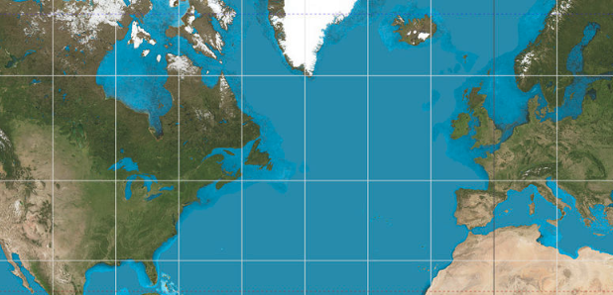
Which could alter or even shut down some of these currents
Reducing North-South heat transfer, hugely compounding climate change
For instance, if the Gulf Stream ceased driving warm waters toward Europe,
temperatures near the Atlantic would tend to equalize by latitude
Driving the temperatures of London toward those of Labrador
and the temperatures of Paris toward those of Newfoundland
(burrr!)

Slide 66
As with deep ocean temperature, the challenge is again to:
Gather much better/complete data on our less well known oceans
And use those data to refine our ocean temperature and flow models
To learn more about the importance of ocean currents see:
Yale's excellent tutorial on worldwide ocean currents:
"How Climate Change Could Jam the World’s Ocean Circulation" ¹
Physics Today's discussion of a particular southern hemisphere current:
"Ocean Currents Respond to Climate Change in Unexpected Ways" ²
MIT's technical (but somewhat cryptic) explanation of ocean behavior:
"The Role of Oceans in Climate Change" ³
1) https://e360.yale.edu/features/will_climate_change_jam_the_global_ocean_conveyor_belt
2) http://physicstoday.scitation.org/doi/pdf/10.1063/PT.3.3415
3) http://web.mit.edu/fnl/volume/215/rizzoli_stone.html

Slide 67
(Relevant news articles I've not yet fully researched and/or verified)
The oceans’ circulation hasn’t been this sluggish in 1,000 years. That’s bad News Washington Post - April 2018 ¹
Reporting on:
Observed Fingerprint of a Weakening Atlantic Ocean Overturning Circulation
Nature Magazine - April 2018 ²
"Our findings show that in recent years the AMOC (Atlantic meridional overturning circulation) appears to have reached a new record low . . . an unprecedented event in the past millennium . . . decline since the 1950s is very likely to be largely anthropogenic" ²
"Weakening may already have an impact on weather in Europe. Cold weather in the subpolar Atlantic correlates with high summer temperatures over Europe, and the 2015 European heat wave" ²
"Continued global warming is likely to further weaken the AMOC in the long term, via changes to the hydrological cycle, sea-ice loss and accelerated melting of the Greenland Ice Sheet, causing further freshening of the northern Atlantic . . . AMOC is one of the well documented ‘tipping elements’ of the climate system" ²
1) https://www.washingtonpost.com/news/energy-environment/wp/2018/04/11/the-oceans-circulation-hasnt-been-this-sluggish-in-1000-years-thats-bad-news/
2) https://www.nature.com/articles/s41586-018-0006-5

Slide 68
So I will be keeping a close watch on the three topics above
As I try to expand my knowledge about climate change modeling
and evaluate the maturity (and thus likely accuracy) of such modeling
But as a citizen, a father, and a grandfather
While I'll continue to try and sort such details out
I'm acting on evidence that models are already accurate enough!

Slide 69
Credits / Acknowledgements
Some materials used in this class were developed under a National Science Foundation "Research Initiation Grant in Engineering Education" (RIGEE).
Other materials, including the WeCanFigureThisOut.org "Virtual Lab" science education website, were developed under even earlier NSF "Course, Curriculum and Laboratory Improvement" (CCLI) and "Nanoscience Undergraduate Education" (NUE) awards.
This set of notes was authored by John C. Bean who also created all figures not explicitly credited above.
Copyright John C. Bean
(However, permission is granted for use by individual instructors in non-profit academic institutions)
An Introduction to Sustainable Energy Systems: WeCanFigureThisOut.org/ENERGY/Energy_home.htm

